Slide 1
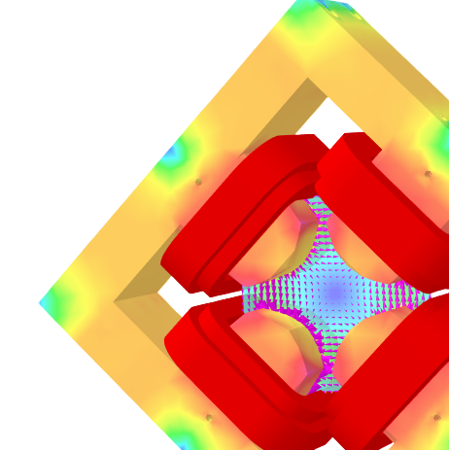



COILS AND ELECTROMAGNETS FOR PARTICLE ACCELERATORS
Established 1981
Vincent Vuatelet
www.sef-technologies.com

Slide 2
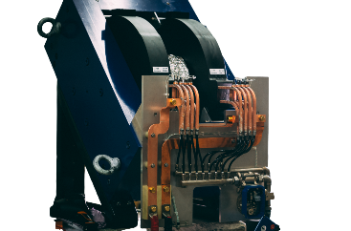
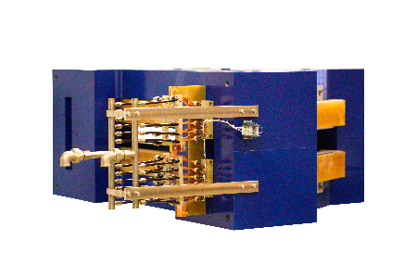
ABOUT US
Agile team, highly experienced professionals including operators, technicians and engineers
SEF Technologies: Leading Innovators in Particle Accelerator Components.
Established in 1981 with 40+ years of expertise in electromagnets for particle accelerators.
Located in Toulouse, France, SEF boasts an agile team of skilled professionals: engineers, technicians, and operators.
Specializing in custom solutions for synchrotrons, linear accelerators, and cutting-edge medical applications.
Based in Toulouse, 1h direct flight from Paris.

Slide 3
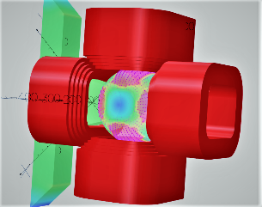
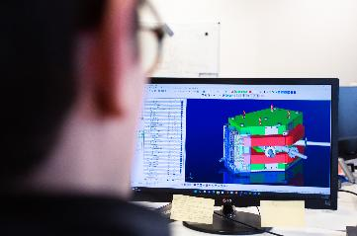

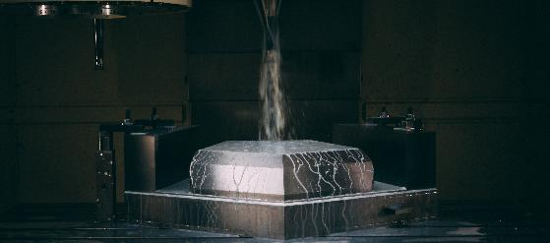
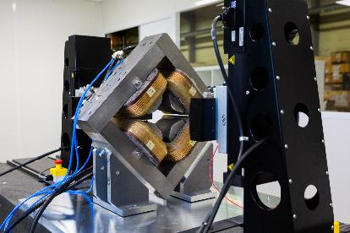
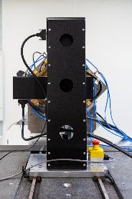
CORE COMPETENCE
ENGINEERING
Comprehensive Expertise Across the Production Lifecycle:
Engineering: Advanced magnetic simulations and mechanical designs using state-of-the-art tools (Opera/3DS).
Production of Coils: Custom manufacturing tailored to specifications.
Machining: High-precision fabrication using advanced equipment.
Assembly, Testing & Control: Rigorous quality assurance ensuring compliance with international standards.
PRODUCTION
OF COILS
MACHINING
ASSEMBLY, CONTROL
AND TESTING
3

Slide 4
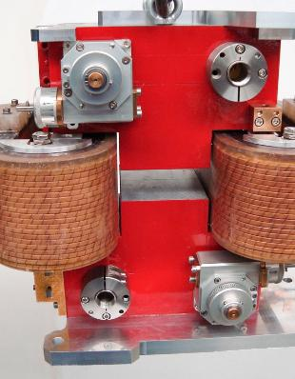
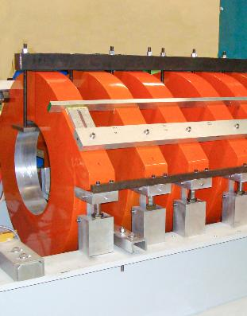
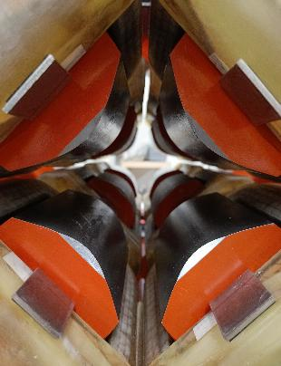
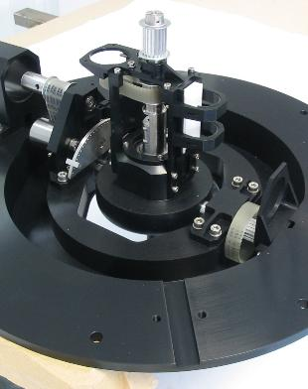

PRODUCTS
Permanent and resistive dipoles SOLEIL
Helmholtz coils CEA
Quadrupôles TITAN CEA
PERMANENT MAGNETS
Dipoles, quadrupoles, inverters
Mechanical equipment ONERA
INTEGRATION
INSTALLATION
Installation on customer premises
Equipment
integration (ex .: routing device )
RESISTIVE MAGNETS
Dipoles, quadrupoles, sextupoles, solenoids, cyclotron main coils, cyclotron correction coils, focusers, inverters, special shaped coils
MECHANICAL ASSEMBLY
Prototypes of electric motors for aeronautics, automotive, and drone sectors
Venturi injectors
Radar antennas
SEF expertise includes the manufacture of the following products:

Slide 5
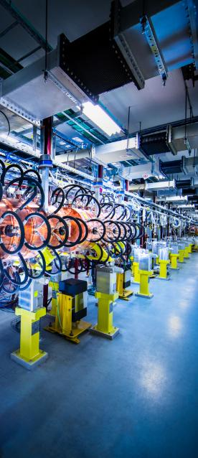
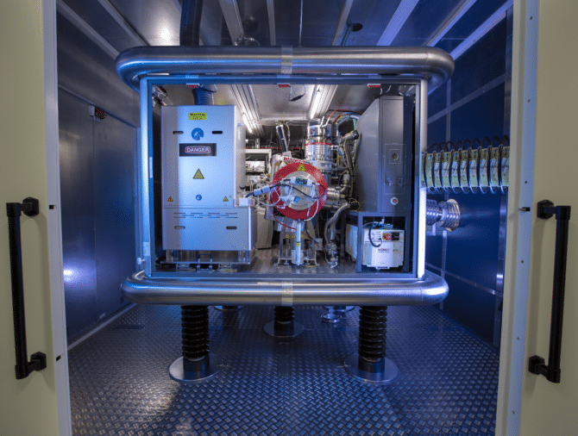
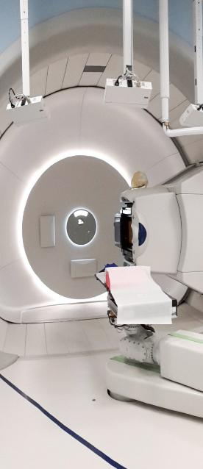















MARKET & APPLICATIONS
SEF has specialised in large-scale particle accelerators, applied medical magnets and ion implantation facilities.
SEF has acquired the experience and customer references to be considered for inclusion on fourth generation projects.
Synchrotrons
Ion implantation for
semiconductors
Synchrotron SOLEIL
Medical market
v
v
5
5

Slide 6
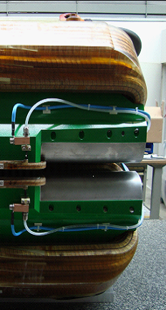
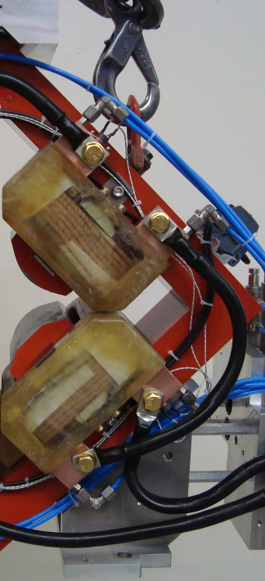
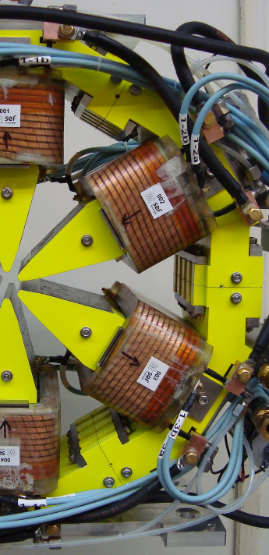
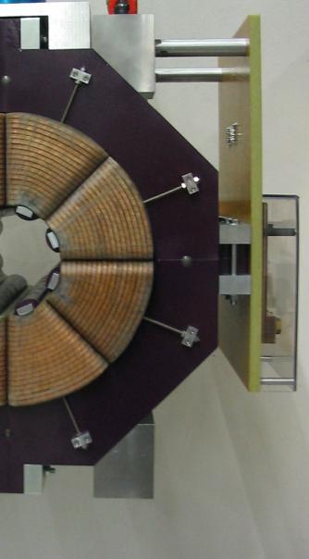
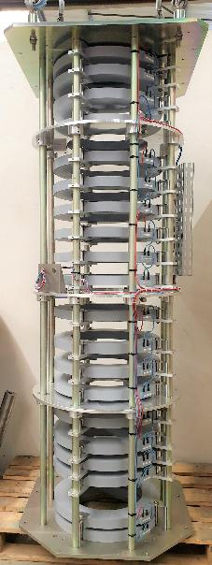
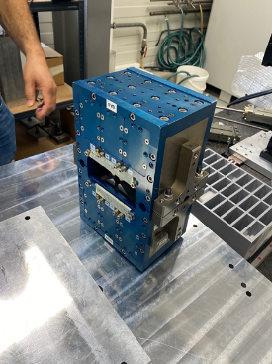
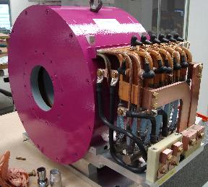
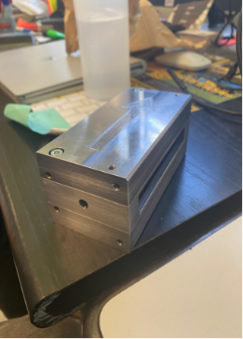
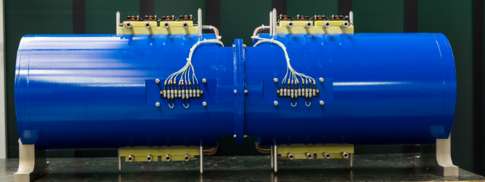
DIPOLES
QUADRUPOLES
SEXTUPOLES
OCTUPOLES
FOCALIZERS
DIPOLES
PRODUCT PORTOFOLIO
SOLENOIDS
PERM. MAG.
!!NEW!!
BUNCHERS
!!NEW!!
!!NEW!!

Slide 7


Your Partner in Innovation and Excellence:
  SEF Technologies delivers industry-leading solutions for particle accelerators, medical applications, and beyond.
  Contact us to explore custom solutions tailored to your unique needs:
    Eric Fanio | CEO
    Email: eric.fanio@sef-technologies.com | Phone: +33 6 52 61 19 16
    Visit us at www.sef-technologies.com
Photos : S. DENIS | Illustrations : Freepik - Eucalyp / freepik.com
THANK YOU FOR YOUR ATTENTION
www.sef-technologies.com

