Slide 1
Pfeiffer Vacuum: Your vacuum partner
Cole Frantz- September 21st, 2026

Slide 2




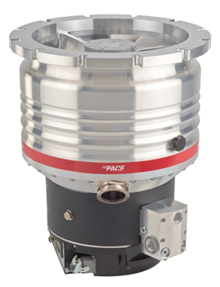

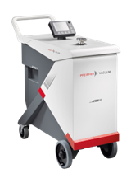
The standard in rough and medium vacuum technology for a wide range of industries, like food packaging, chemical, plastics. Since 1963.
More than 130 years of experience for best-in-class high vacuum, leak detection, and gas abatement. For semicon, analytics, research, etc.
Your reliable partner for all vacuum needs.
Fast, flexible and always near you.

Slide 3


Vacuum keeps fresh
Feeding the world is one of the biggest challenges of our time.
With vacuum, food can be preserved longer and stays fresh and nutritious.
We contribute to providing healthier food to more people, fighting malnutrition and hunger in the world.

Slide 4
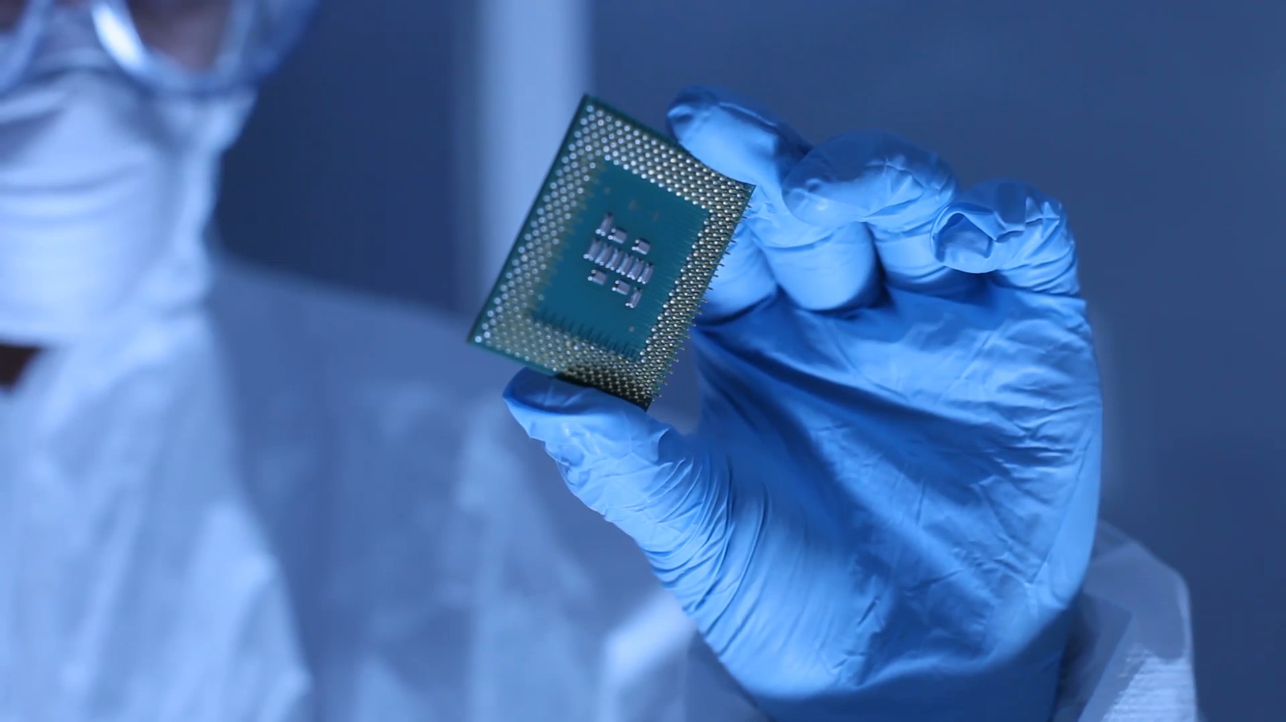
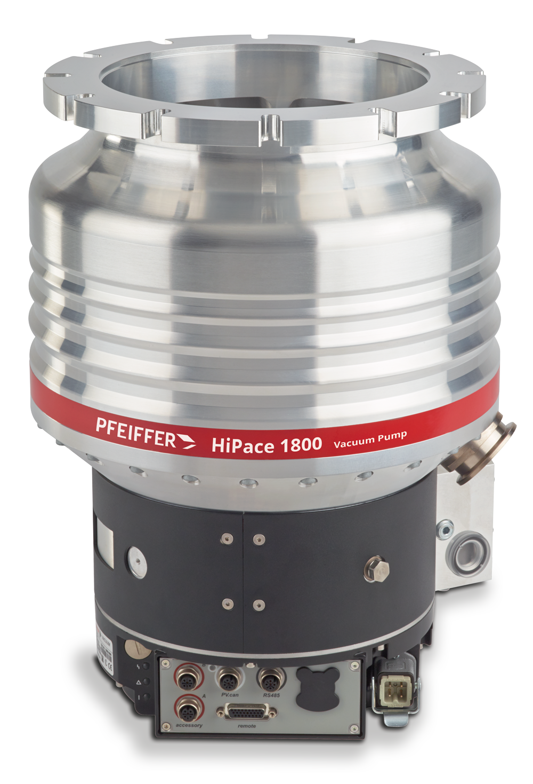
VACUUM DRIVES PROGRESS
Digitalization shapes the develop-ment of our globalized world.
The semiconductor industry provides the components with which our modern electronic devices work.
Their production requires vacuum, which is generated with the aid of turbomolecular vacuum pumps - invented by Pfeiffer Vacuum.

Slide 5
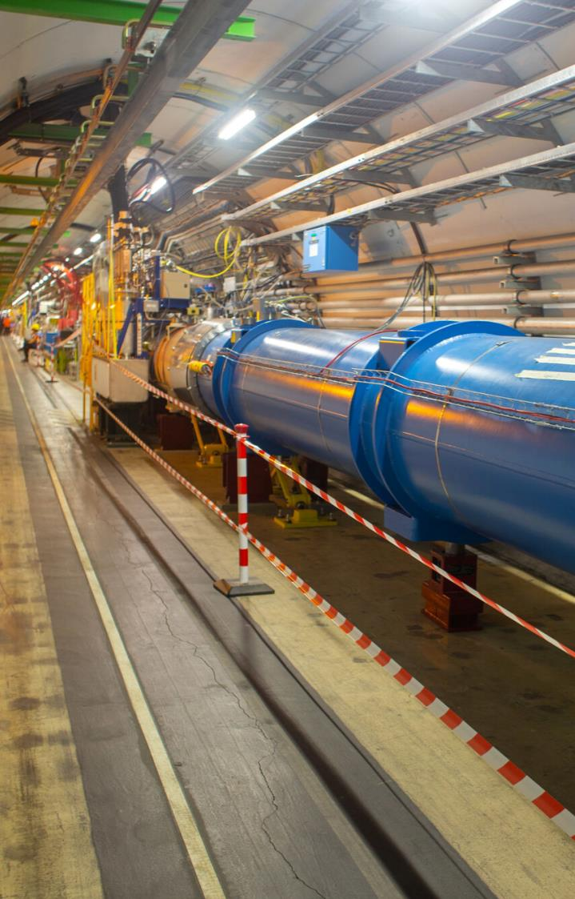
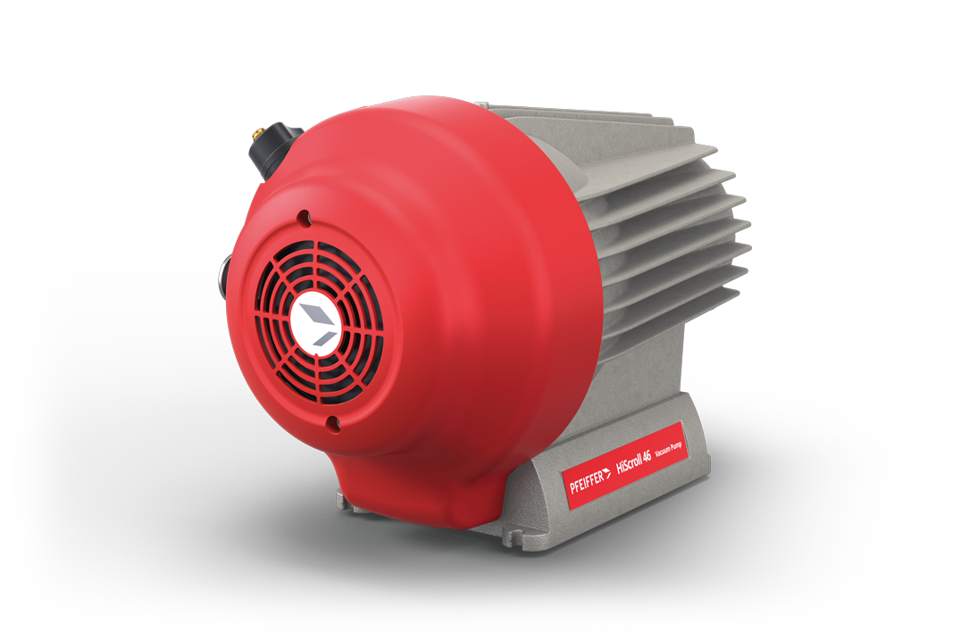
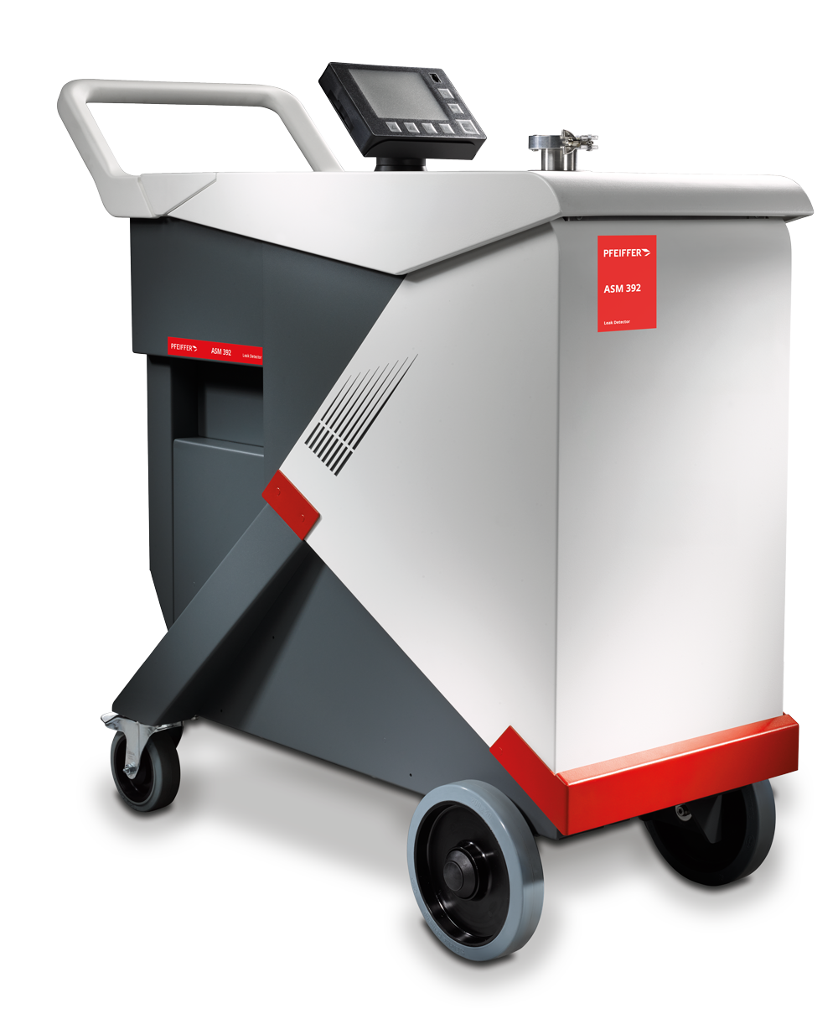
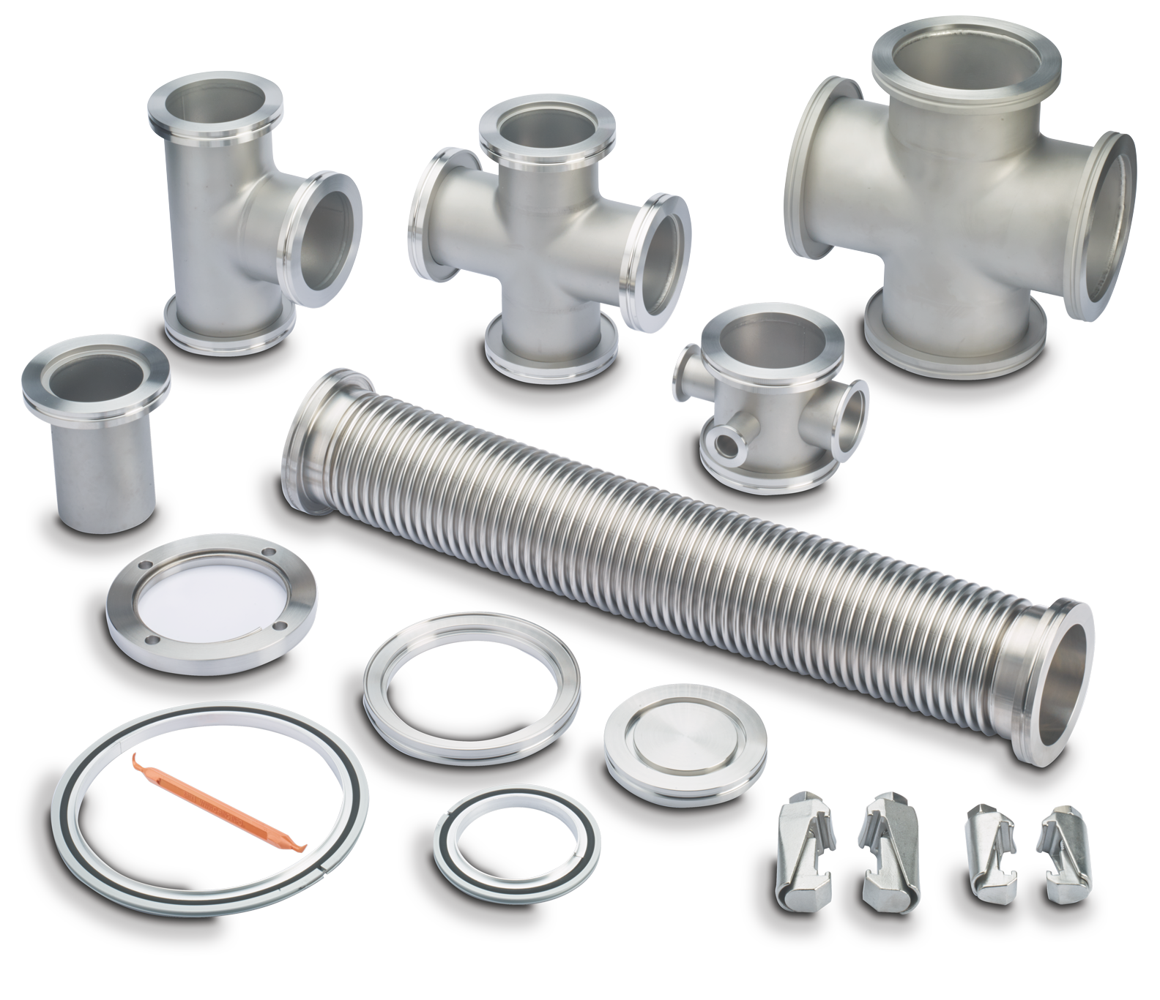
Accelerator Vacuum
Turbopumps
Roughing
Gauging
Hardware
Controllers
Diversified
Project driven
Customized design
Radiation resistance
New technologies

Slide 6
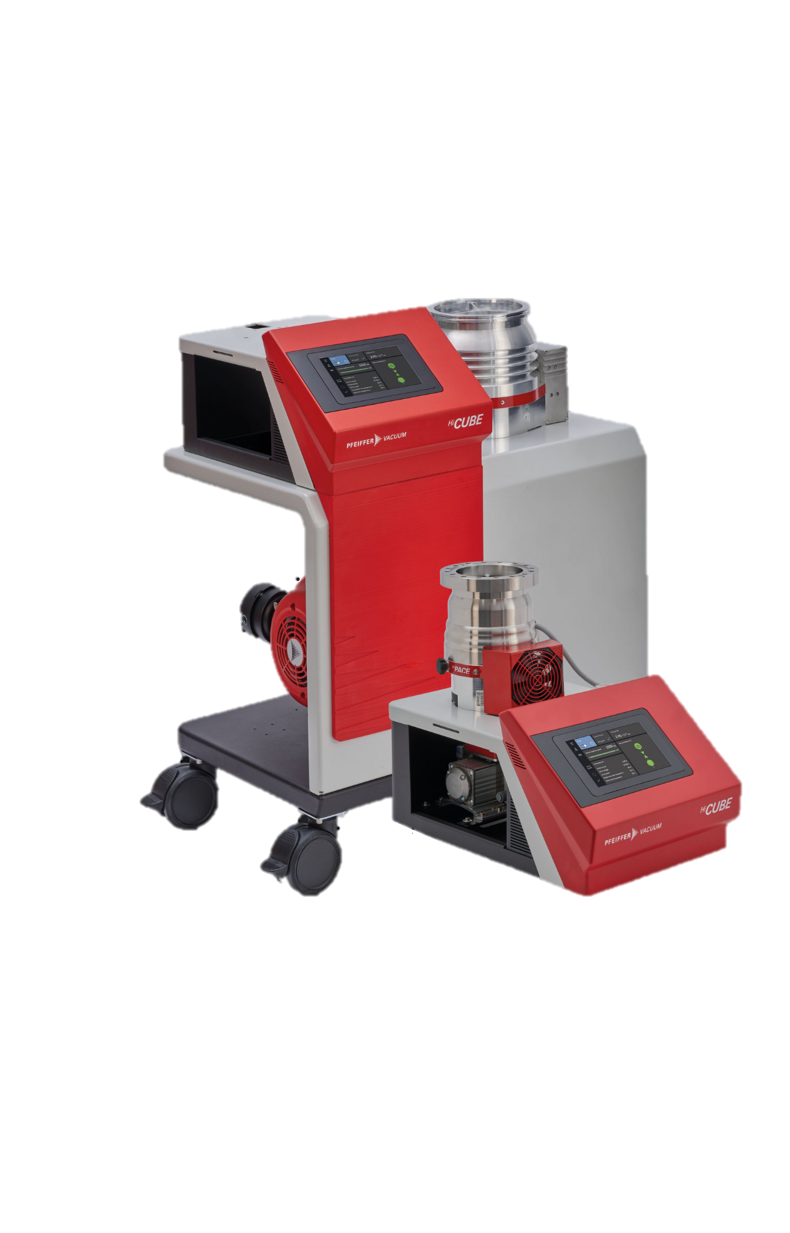
Pfeiffer Canada
Expertise
Canadian organization with 80+ employees dedicated to vacuum technical support and service
The Future of High-Performance Vacuum Systems
Training
Vacuum training provided to graduate students and technicians across Canada at no cost
Dedication
Academic packages for turbo, scroll, and pumping stations with CFI in-kind available
Customized OEM support
Notes:
HiCube is logical solution for Turbos in comb9nation with backing pumps

Slide 7
Your Global One-Stop Supplier
For all vacuum needs
Whatever your process, whatever your requirements, we have the right vacuum solution for you.

Slide 8

Contact me
Cole Frantz
Technical Sales Representative - Pfeiffer
Mobile: 587-583-1023
cole.frantz@pfeiffer-vacuum.com

