Slide 2
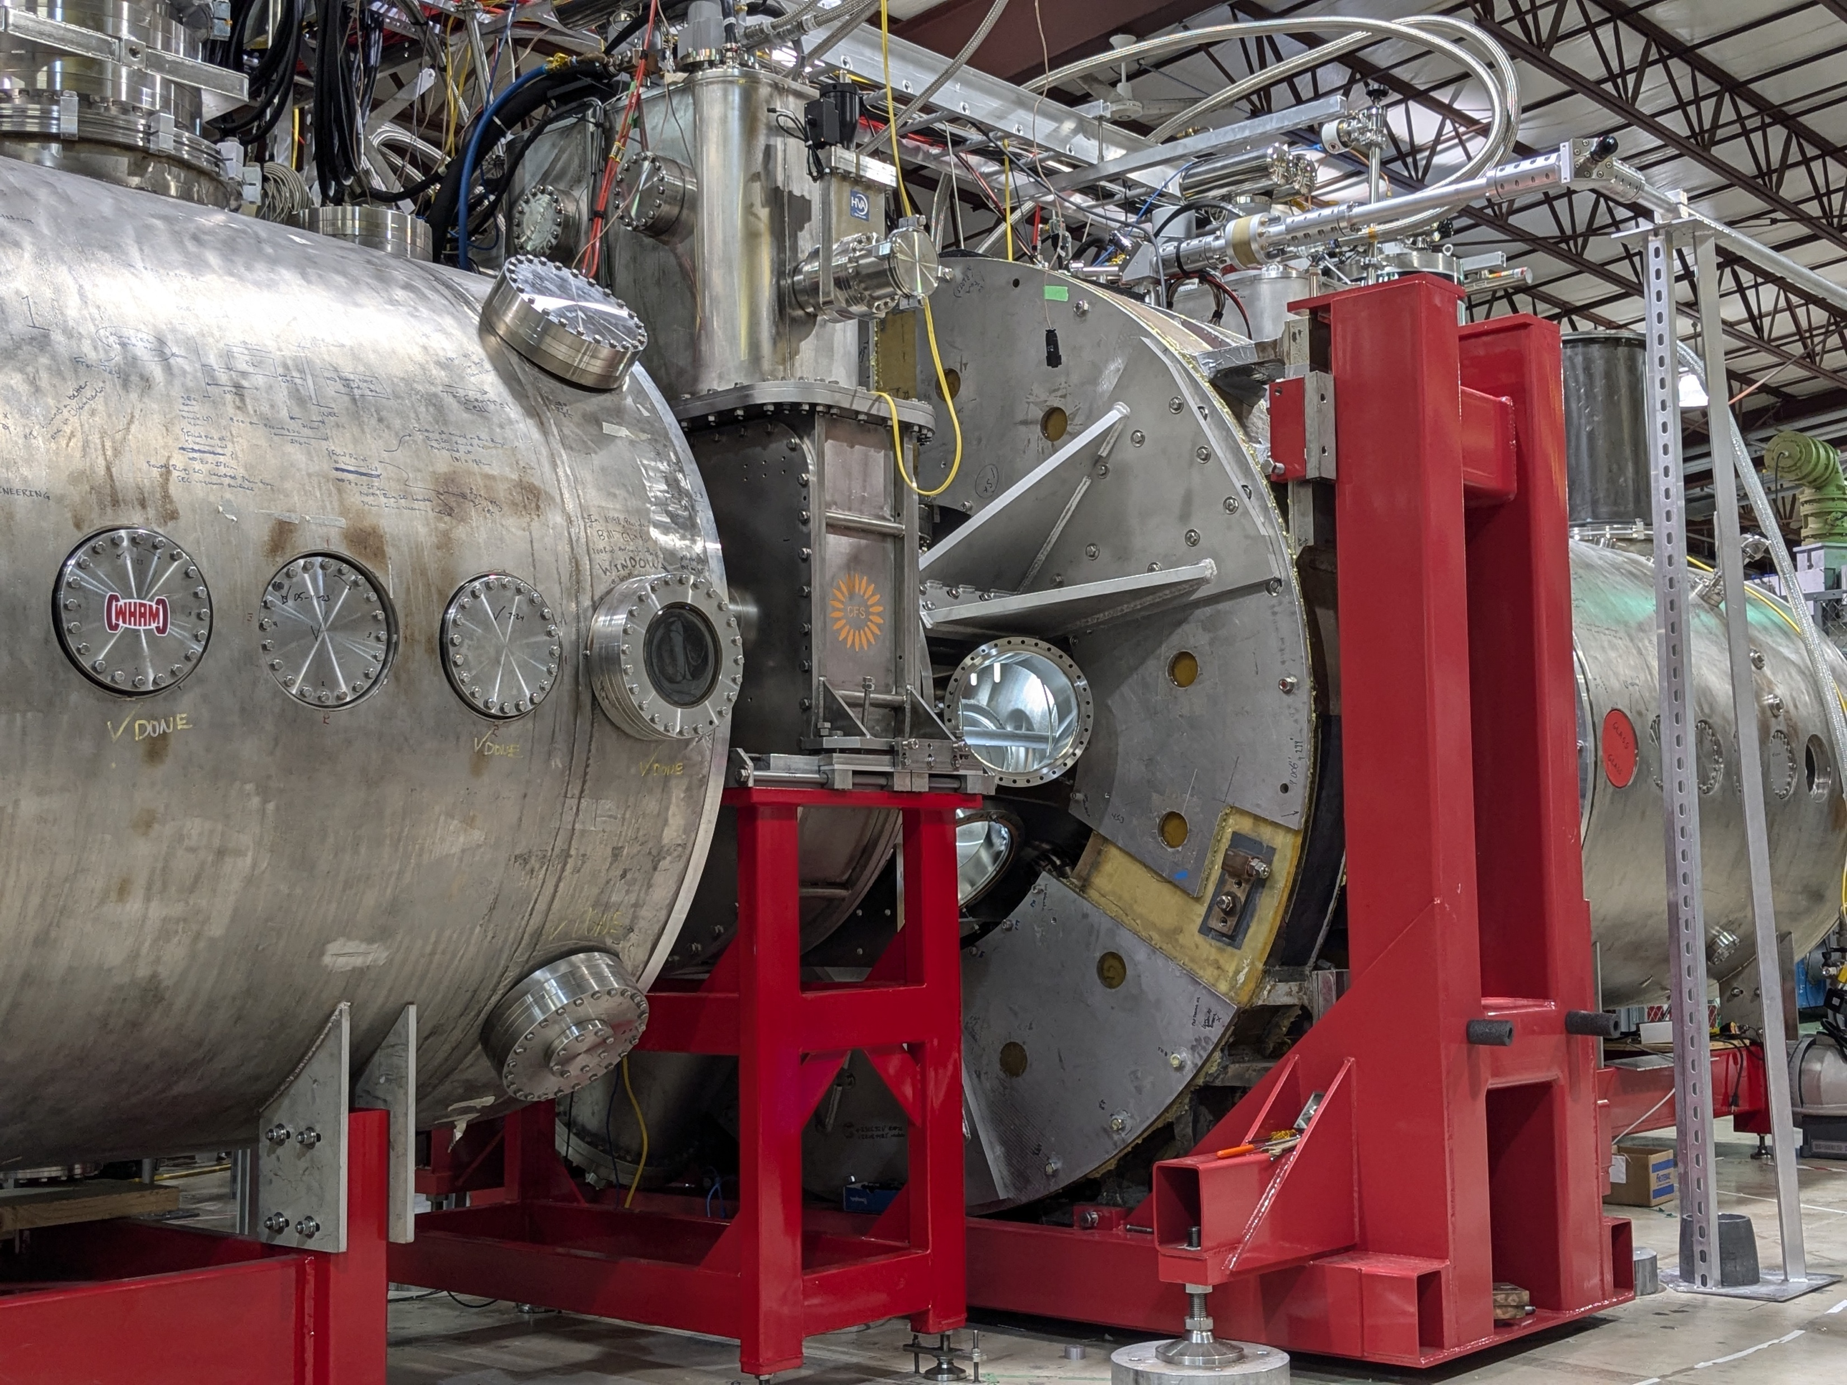
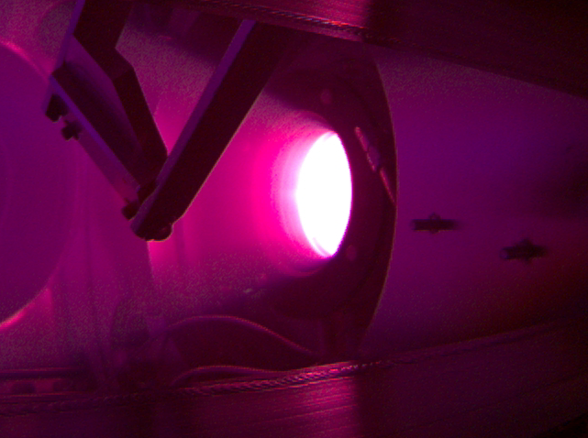
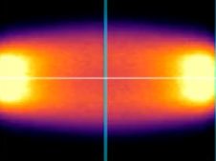
Realta is making fusion real
Real hardware:
Active fusion experiment
Real plasma:
Hotter than the center of the sun
Real data:
Matching theory with performance

Slide 3
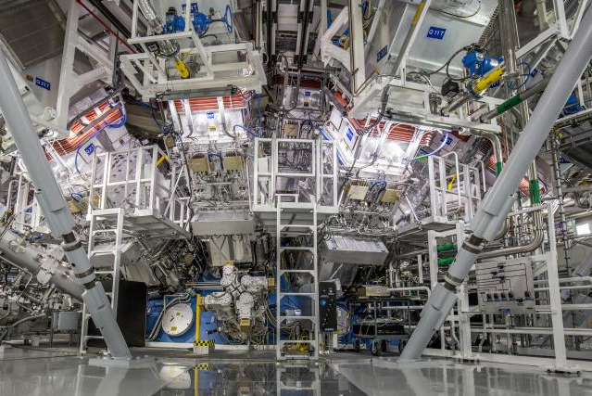
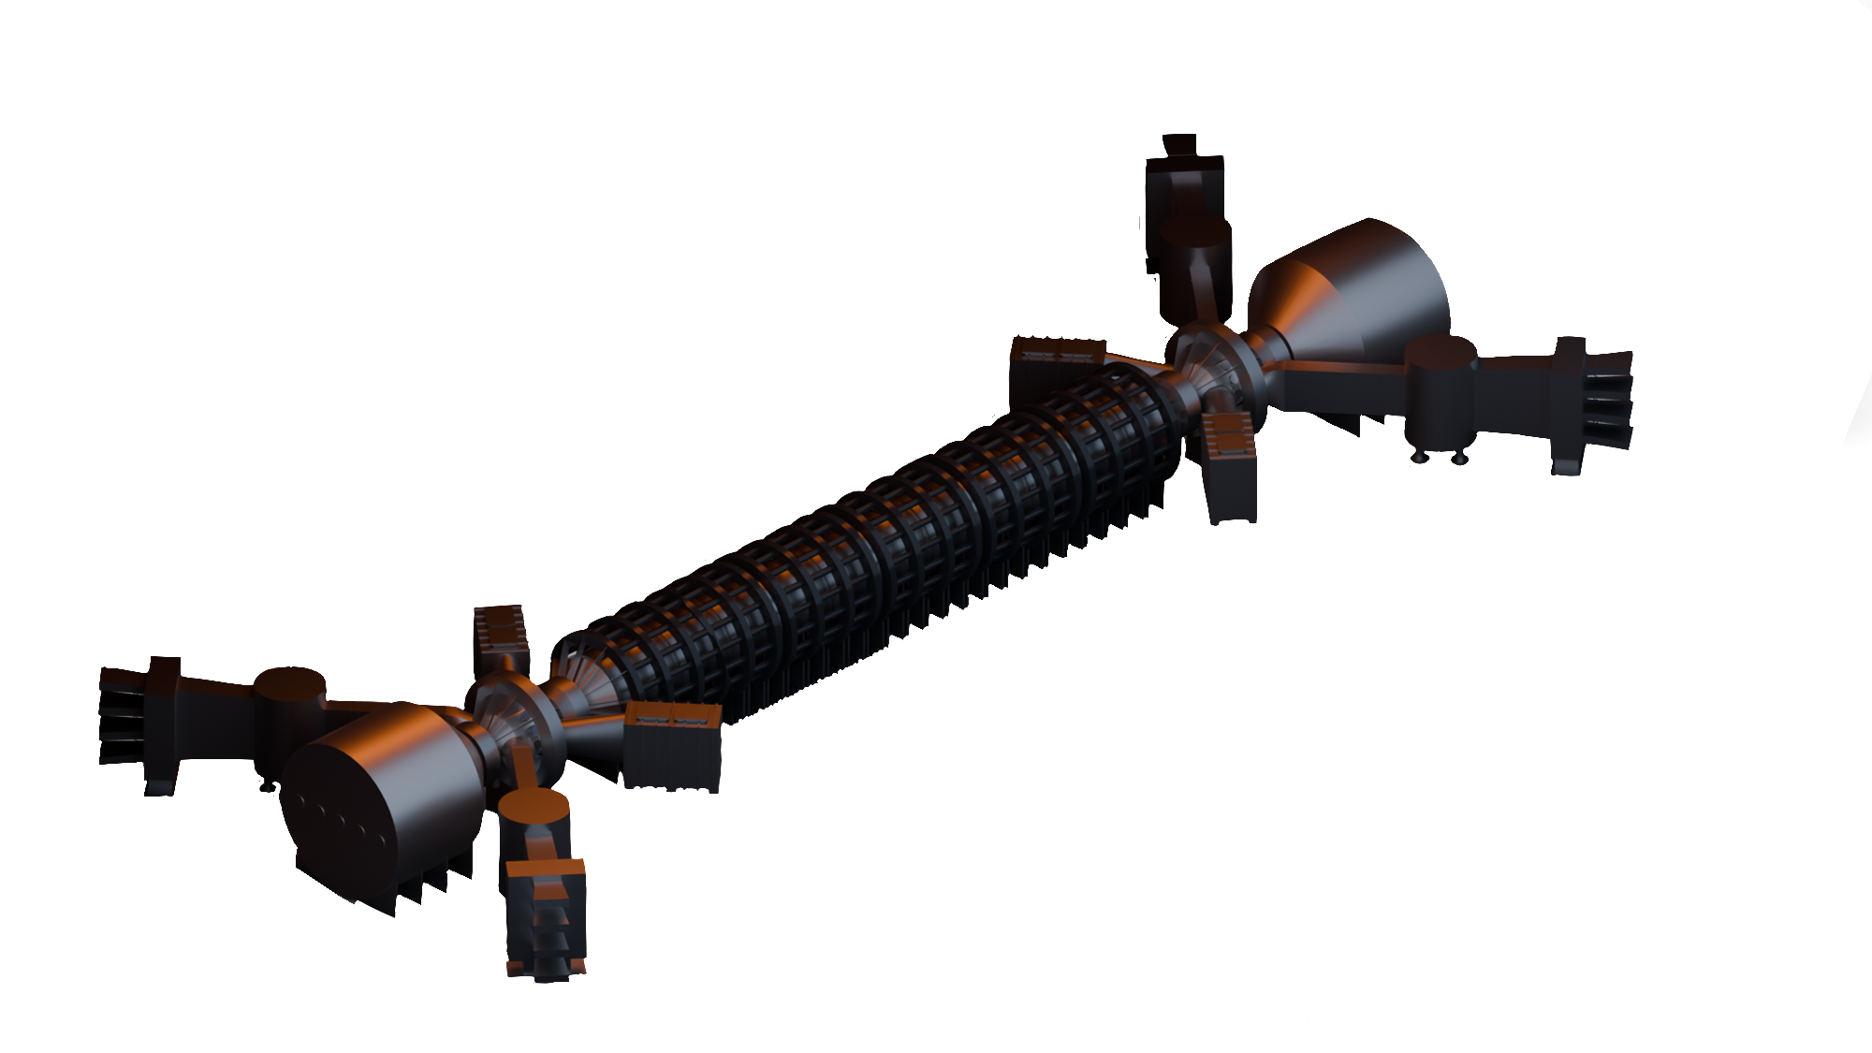
First we make it work, then we make it cheap
Commercially viable fusion
Mid 2030s
Reliability
Availability
NIF achieves fusion ignition
DECEMBER 2022
Maintainability
Inspectability

Slide 4
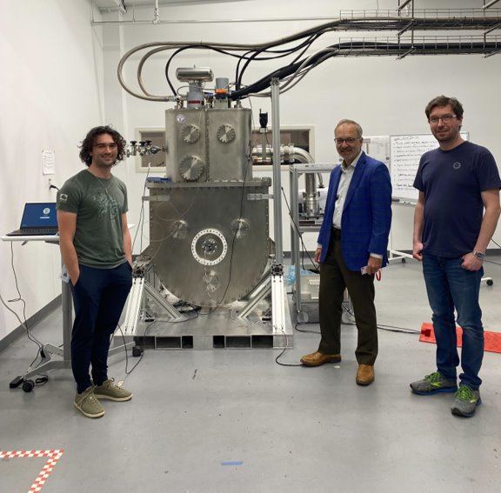
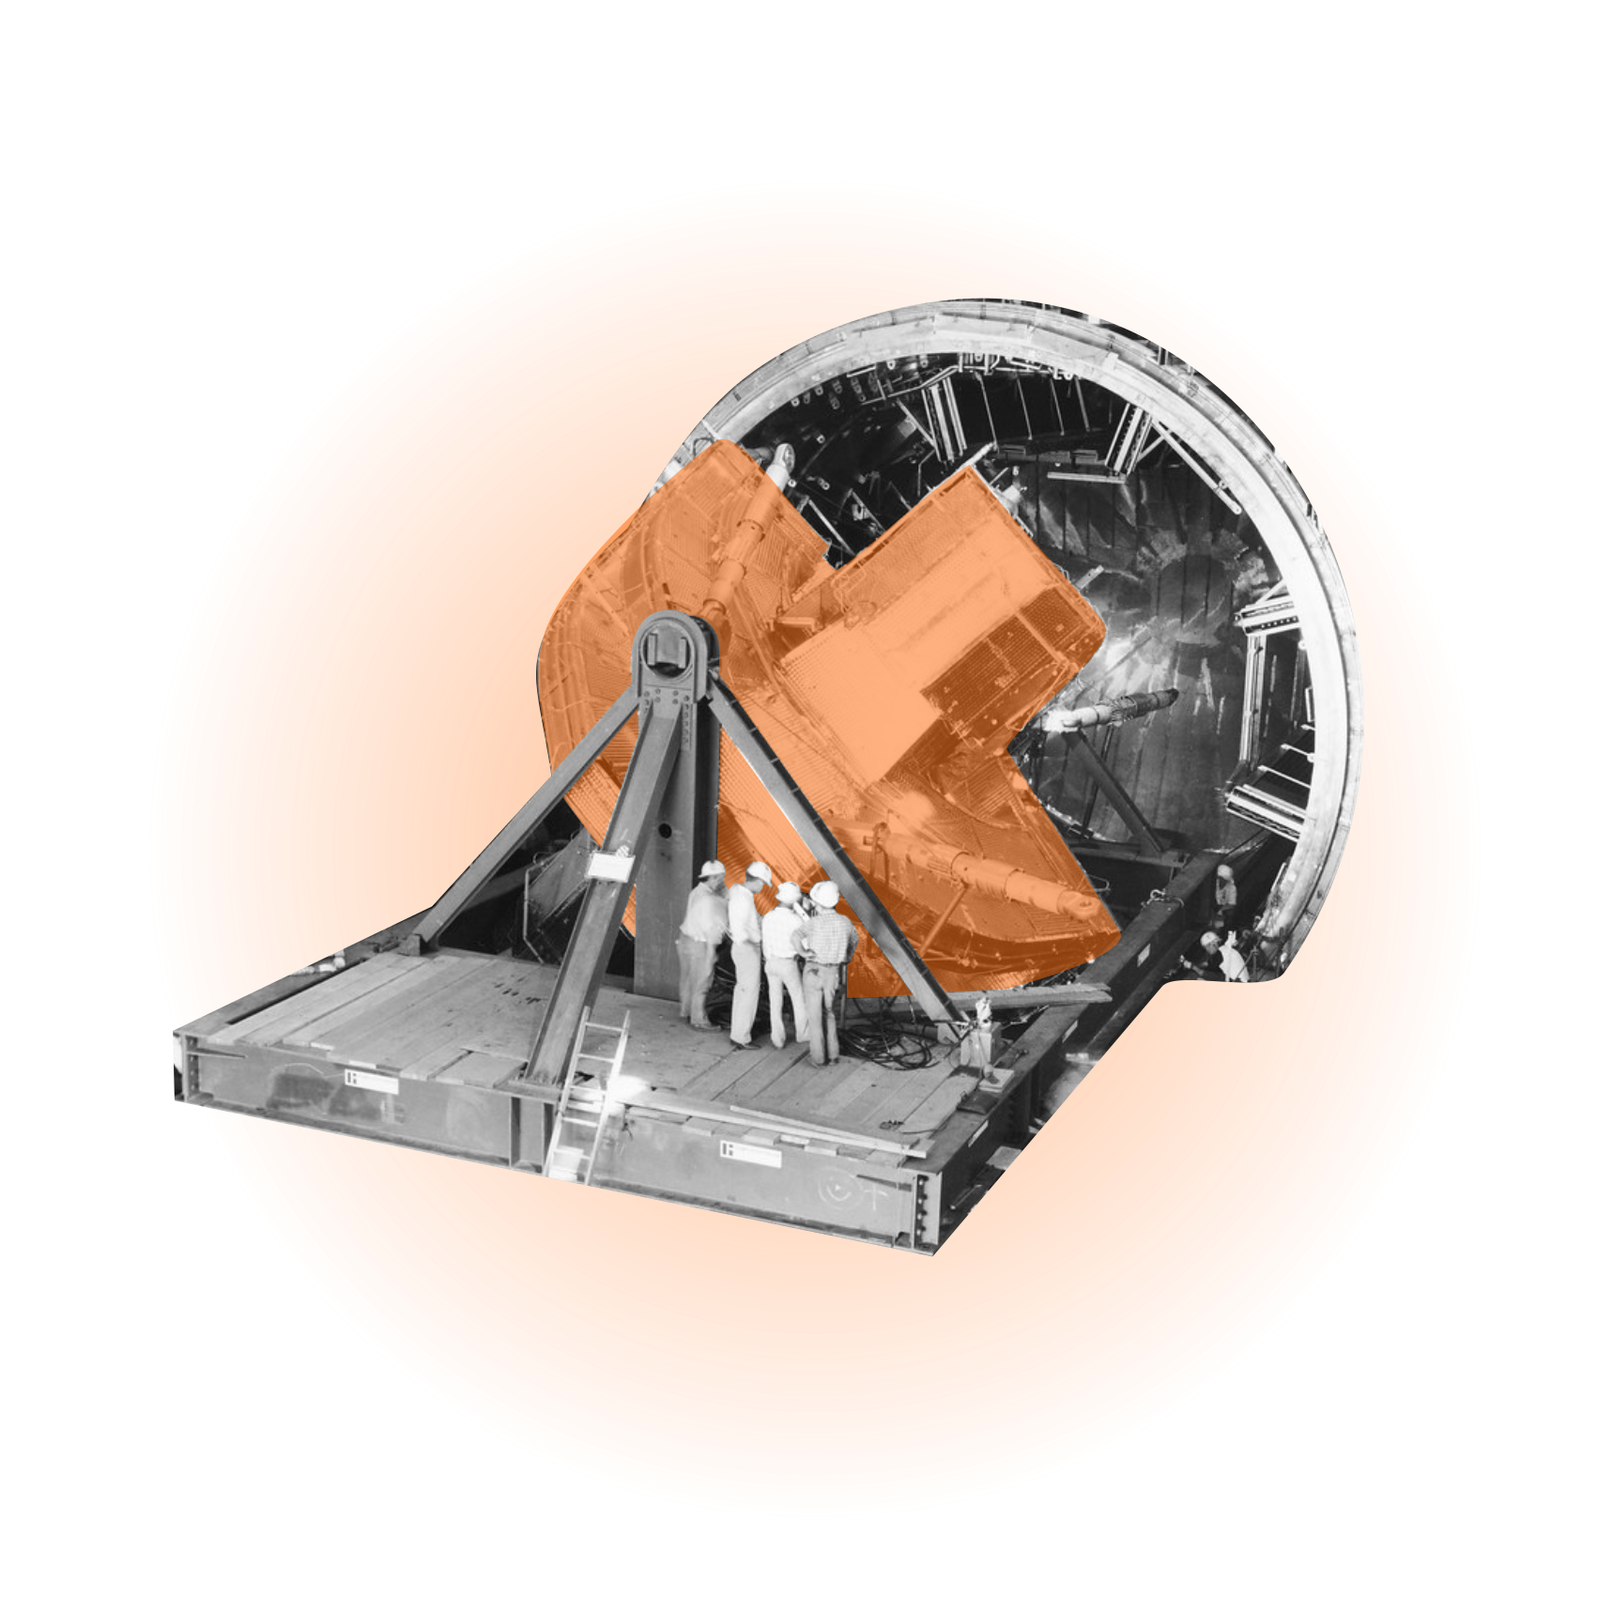
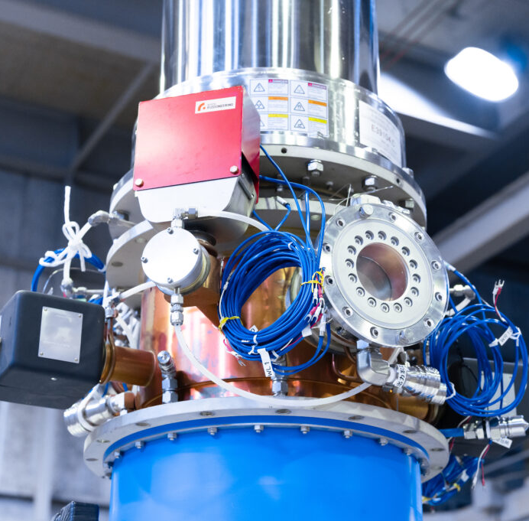
The magnetic mirror, a concept whose time has finally come
1985
Today
Nascent superconductor industry |  | Multiple HTS magnet suppliers, robust fusion ecosystem
Plasma stabilization issues required complex magnet design |  | Axisymmetric magnetic mirror stability demonstrated
Very limited, expensive computer simulations |  | HPC capable of simulating trillions of particle interactions
Lack of commercial-grade plasma heating solutions |  | Commercial plasma heating available, RF NNBI demonstrated
WHAM HTS magnets at Commonwealth Fusion Systems (2023)
Mirror Fusion Test Facility at Lawrence Livermore National Lab (~1985)
Kyoto Fusioneering gyrotron system (2023)

Slide 5

Isotopes of Hydrogen are trapped and heated
H₂
© Realta Fusion
4

Slide 6
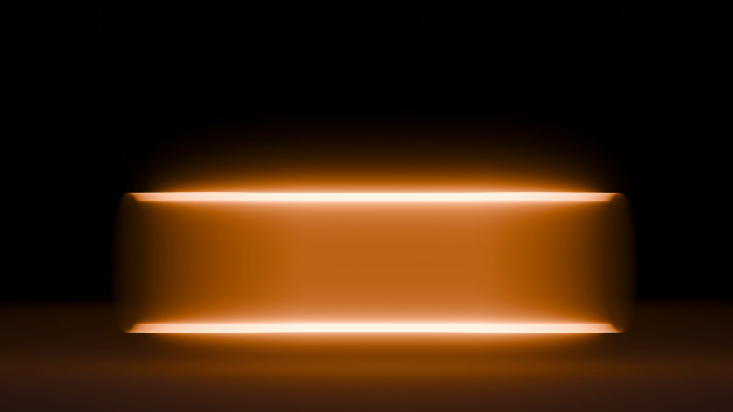

Magnetic “mirrors” cause particles to reflect between their fields
HTS Magnets
Create a simple mirror effect
© Realta Fusion
5

Slide 7
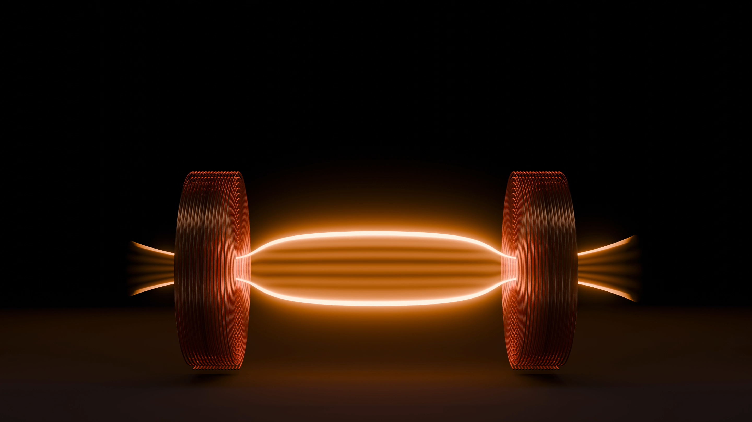
Radically simple geometry
Tandem mirror for energy generation
Low field MRI-grade magnets
© Realta Fusion
6

Slide 8
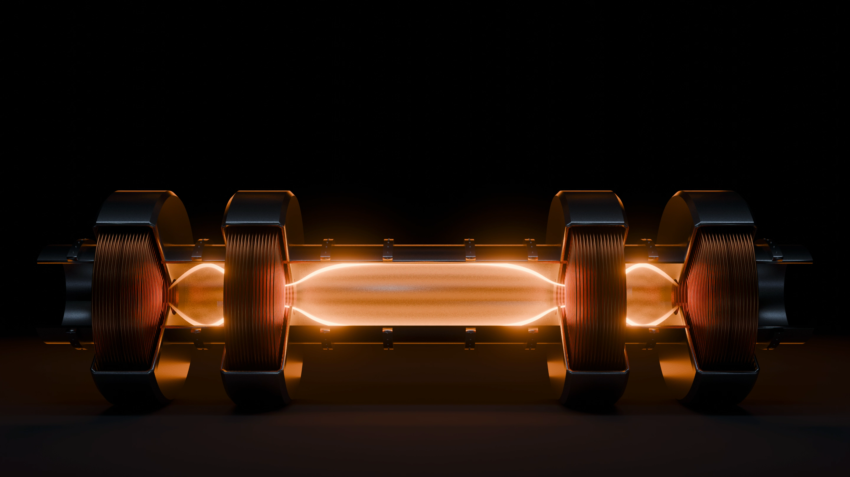
Linear scaling by adding central cell modules
up to 500MW
+50MW
+50MW
+50MW
© Realta Fusion
7

Slide 9
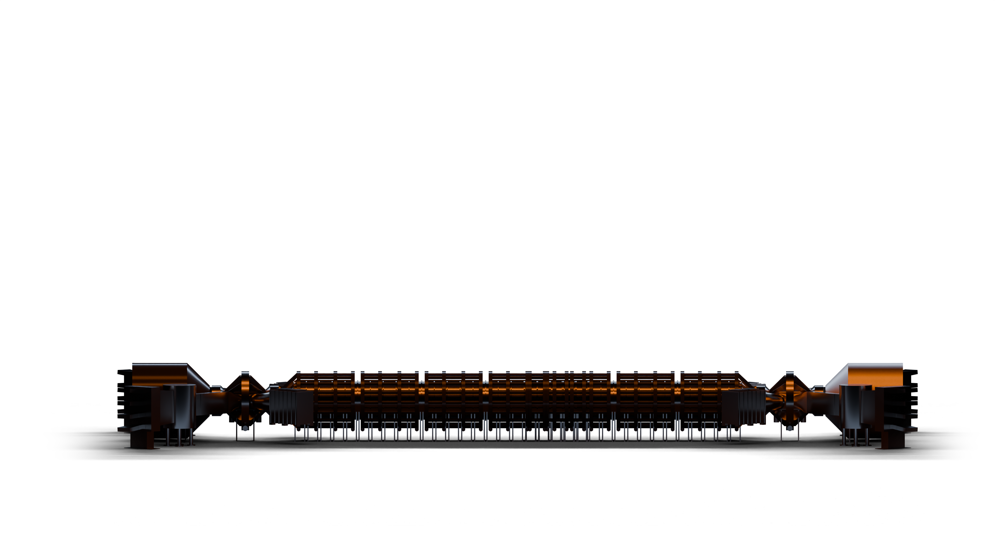
We get further, faster, with less
COMMERCIAL DEPLOYMENTS
HAMMIR-DT
Industrial-scale fusion device unlocks power plant financing
HAMMIR-DD
Q>1 conditions, operate at commercial scale
2026
2029
2033

Slide 10
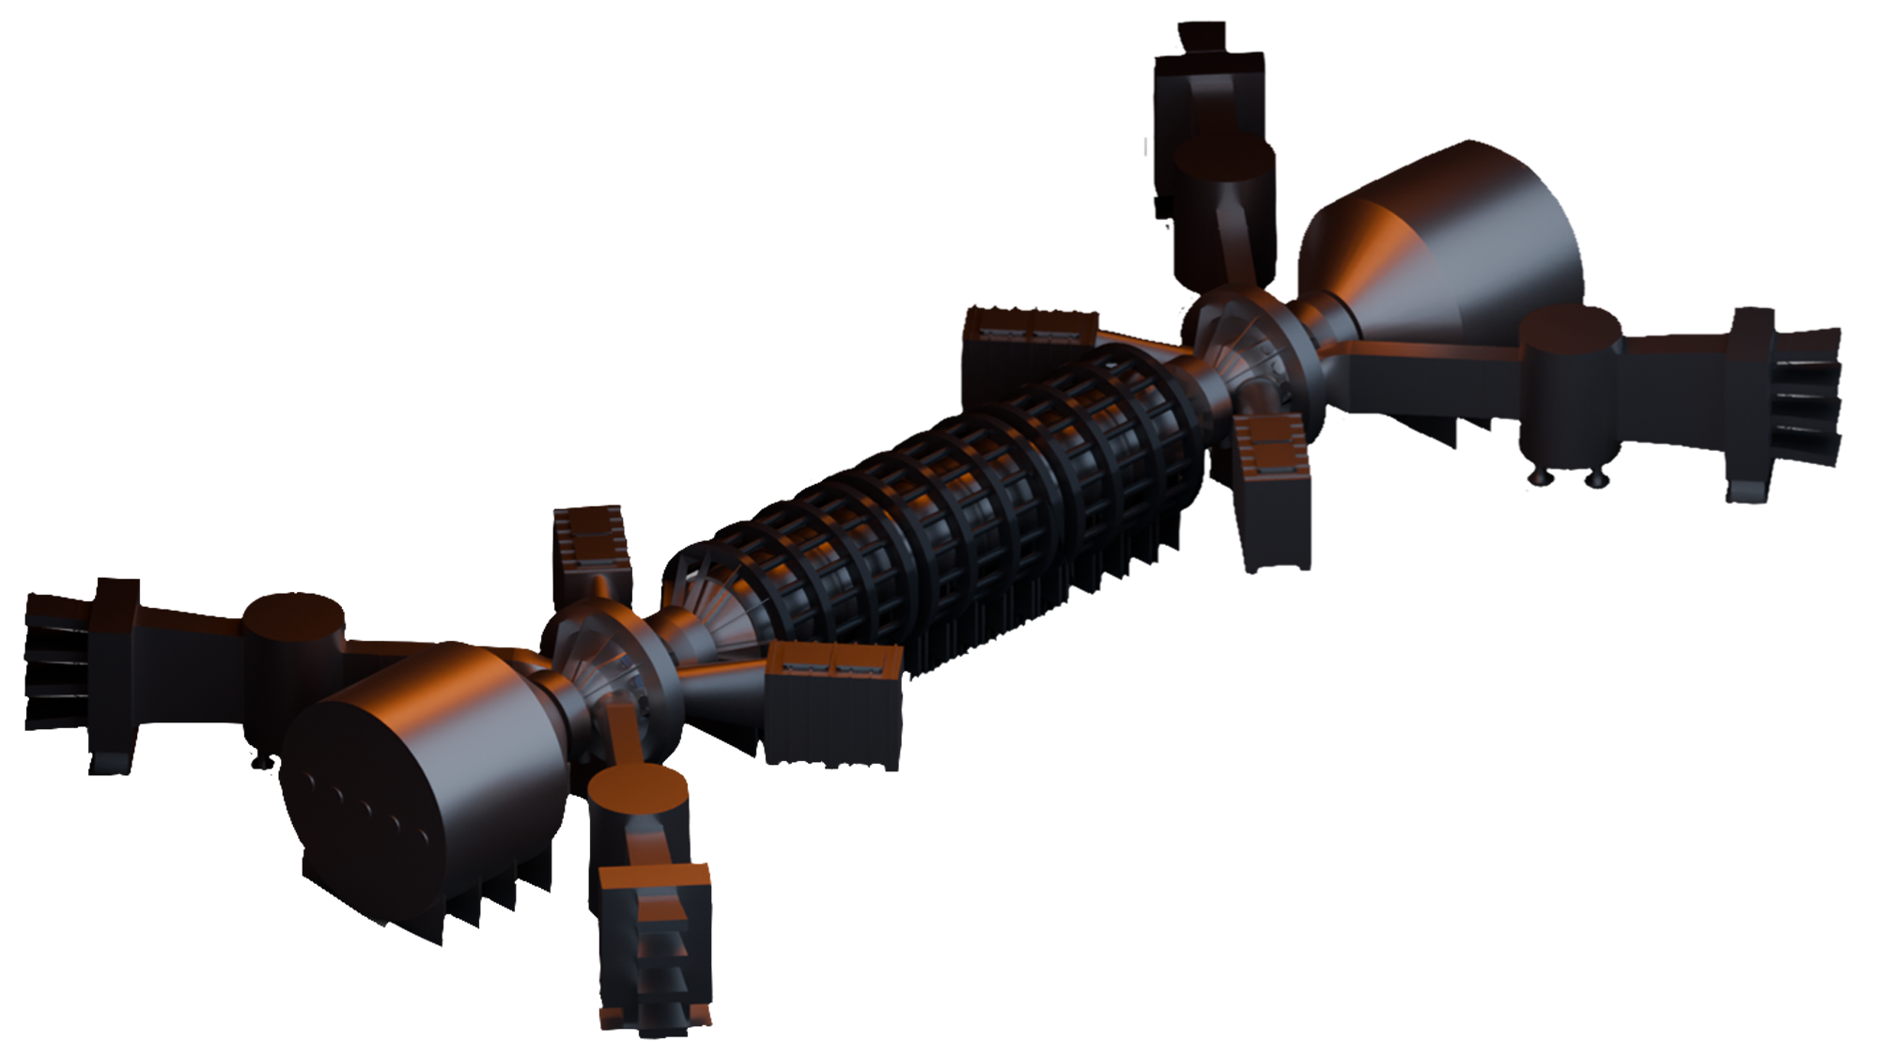
Hammir-DT: Realta’s first-of-a-kind fusion power plant and volumetric neutron source
Deuterium-Tritium
Q >1
Full-commercial scale operations
Generates Revenue
Industrial neutron irradiation services
Materials testing and research
Isotope production
Power generation

Slide 11
Dominick Bindl
Chief Operating Officer
dbindl@realtafusion.com

