Slide 1
High-Performing Neutral-Beam Injection Systems and Their Development at TAE Technologies
James Titus
TAE Technologies, Inc.
10th International Symposium on Negative Ions, Beams, and Sources – NIBS’26
Nelson, BC Canada | September 20-25, 2026

Slide 2

About TAE Technologies
Mission: To deliver clean and economically viable fusion power and fusion-derived technologies to solve existential human challenges
Founded in beautiful Orange County, CA in 1998
550+ employees globally (US, EU, UK)
National lab-scale fusion device
Technology spin-offs
Collaboration with academia and industry to accelerate progress: PPPL, ORNL, LBNL, LLNL, UCI, UCLA, UCSD, Univ. of Wisconsin, Univ. of Washington, U. of Pisa, Nihon U., Google, and more

Slide 3
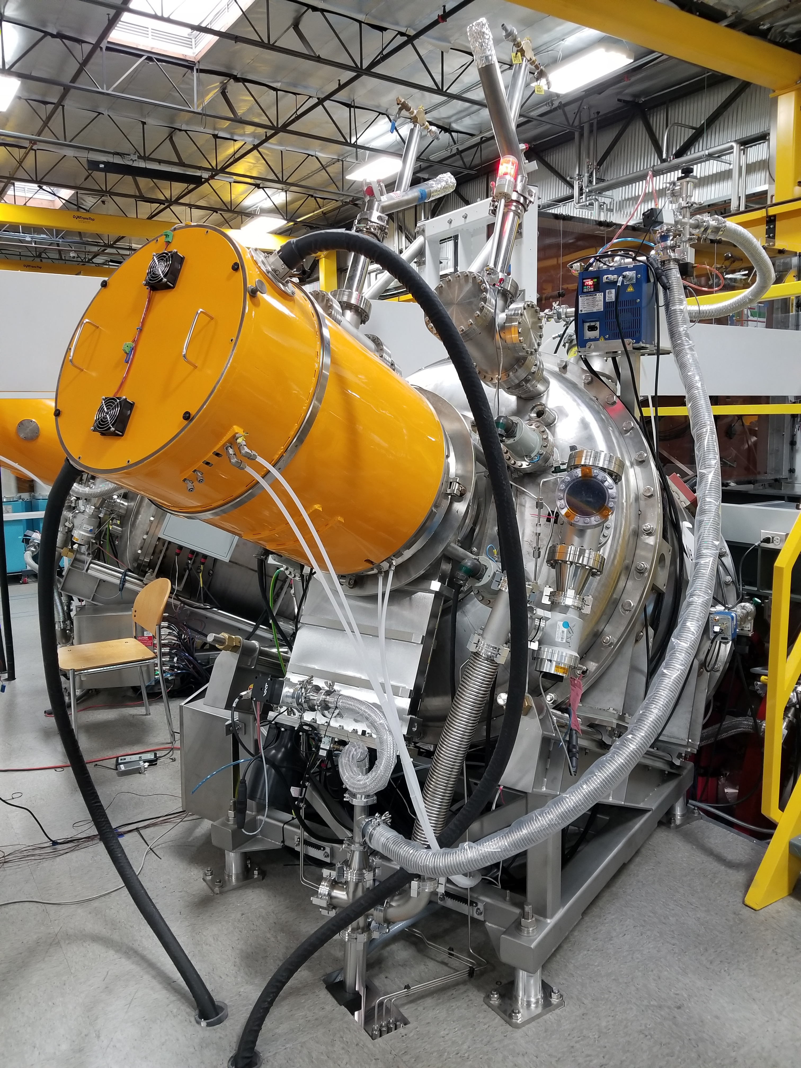
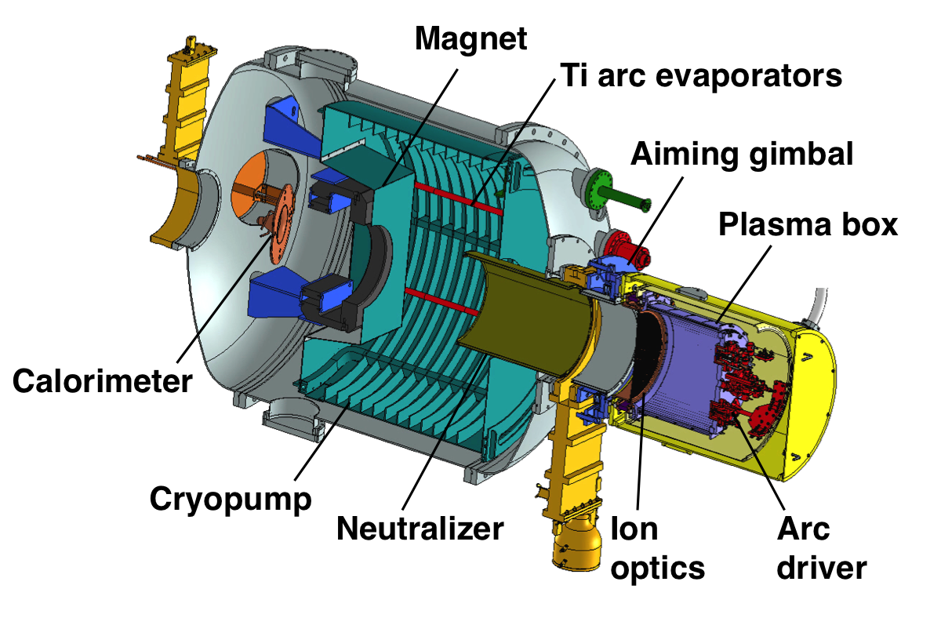
TAE has developed proprietary NBs with unparalleled accuracy and precision
TAE has led the world in short-pulsed NB R&D for over a decade
TAE spent 15+ years on-shoring this technology, the R&D and supply chain
NB team comprised of world-leading experts in the field with decades of NB R&D experience
NBs feature centrally into a number of fusion configurations, in addition to being core to TAE’s Da Vinci and commercial power plant in guaranteeing superior confinement to enable higher temperatures for p-¹¹B fuel
TAE Beam UK (joint venture with UKAEA) has recently been established for long pulse, positive ion NB R&D and manufacturing

Slide 4
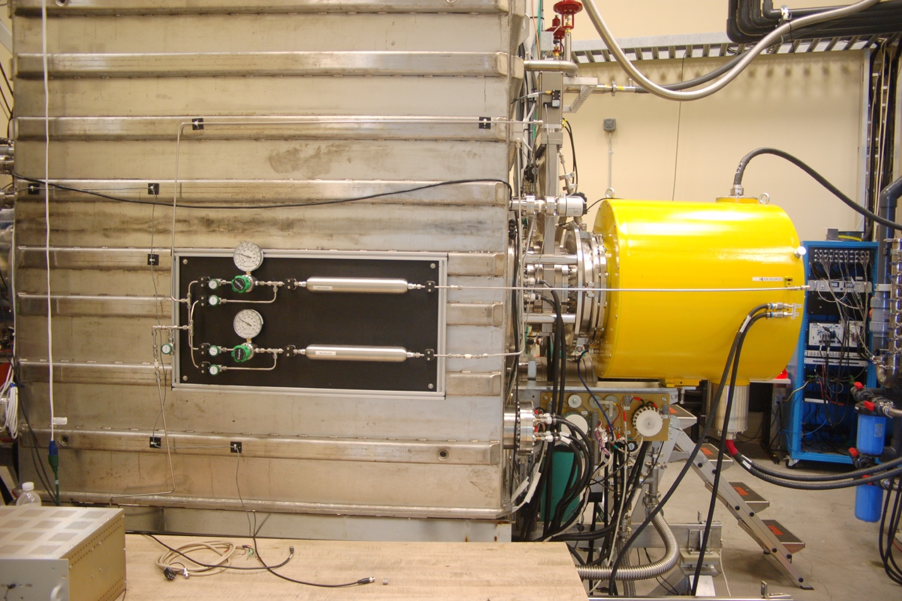
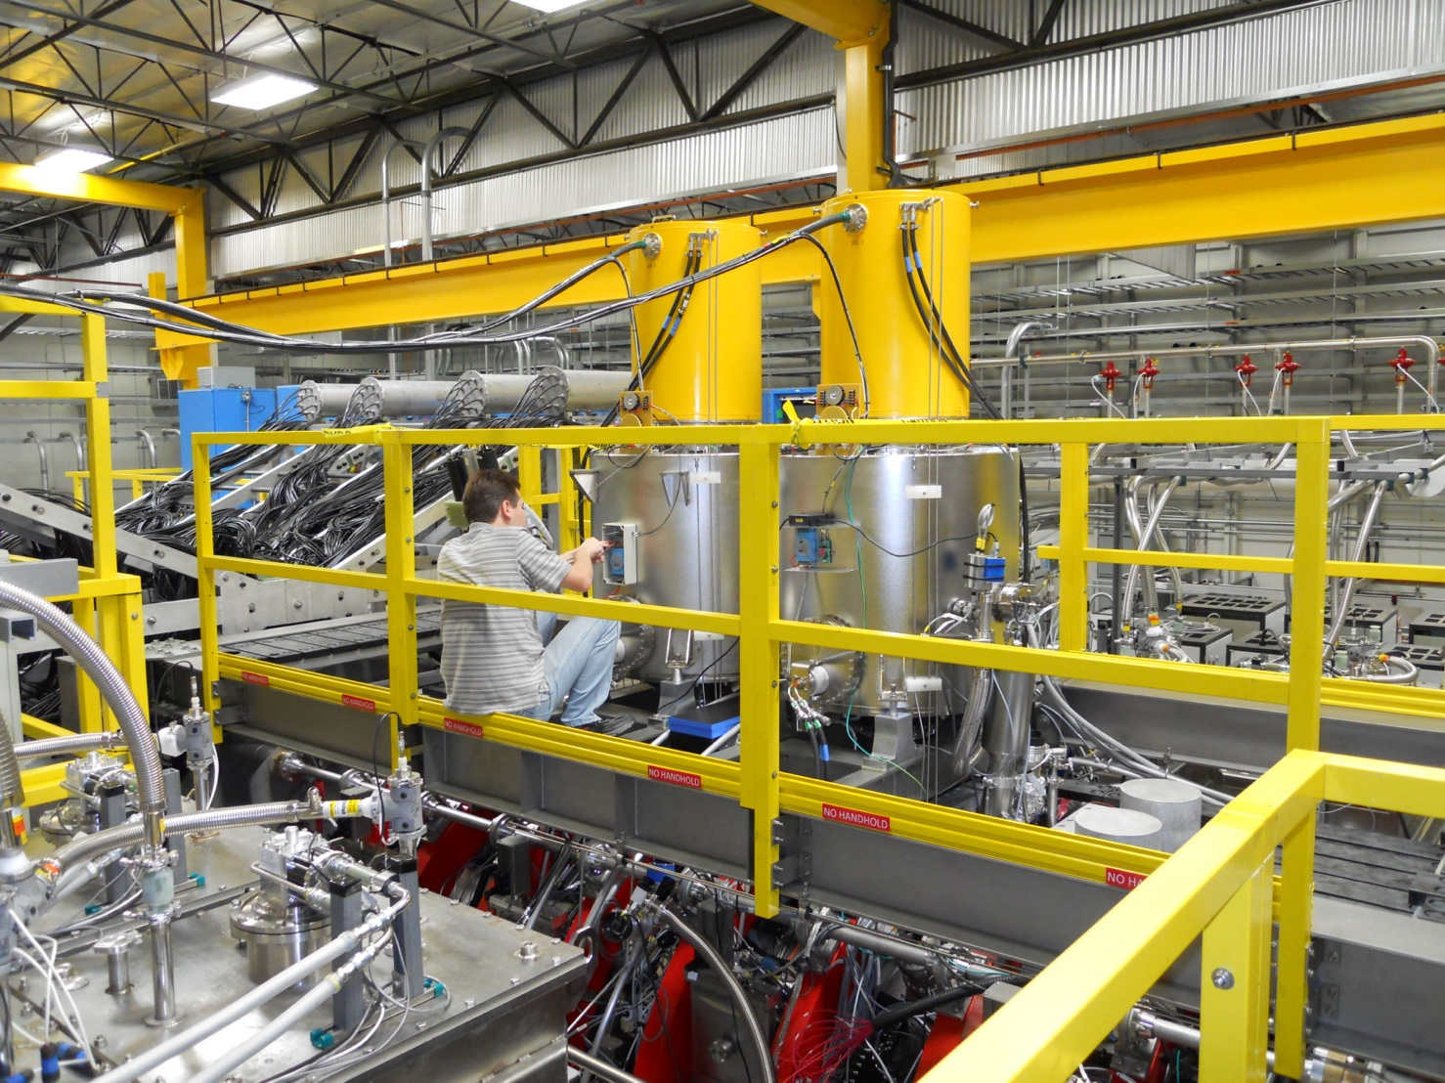
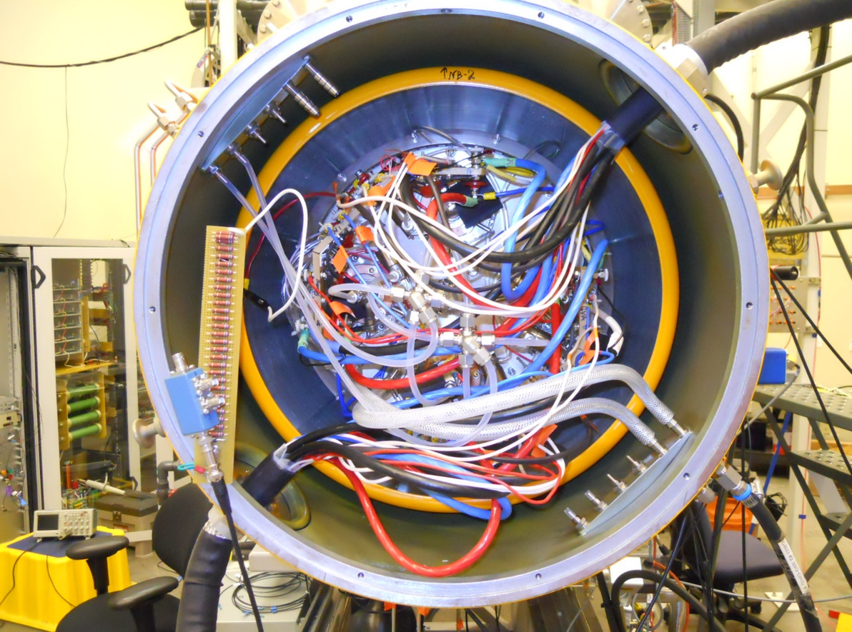
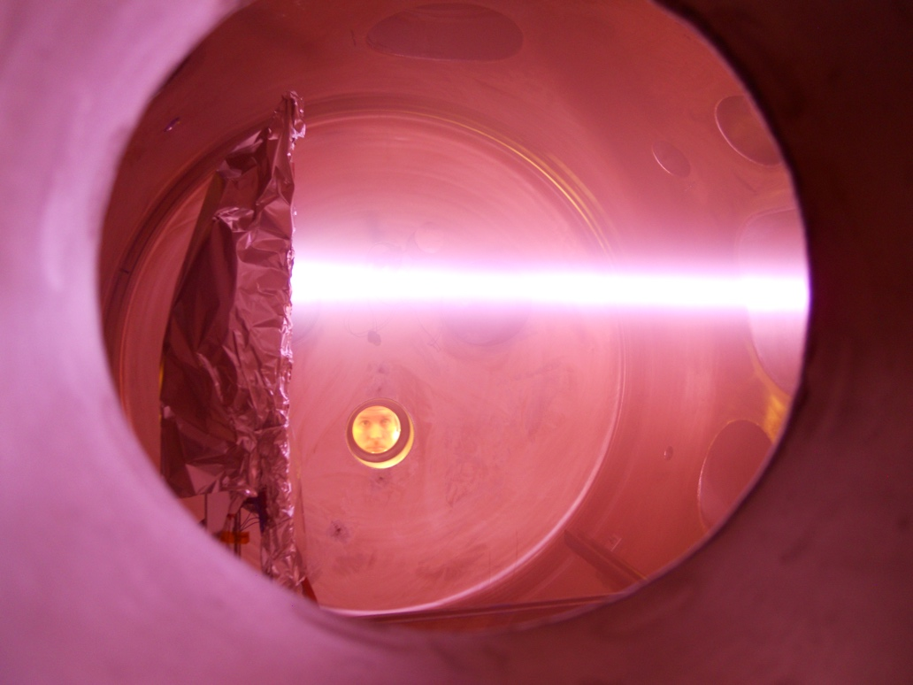
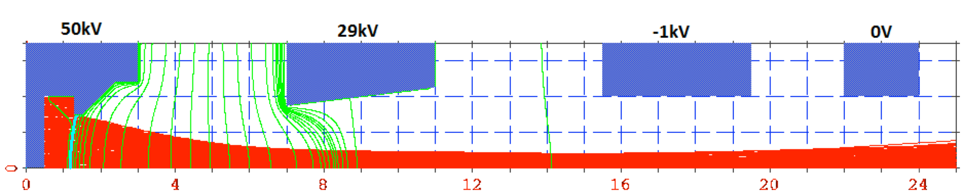
TAE has a long history of NB research and development
Short-pulse and tunable-energy beam technologies
 | C-2 |  | C-2U | C-2W (Norman/Norm*)
Number of NBs | 2 | 6 | 6 | 4 | 4
Plasma source | Arc | RF | Arc | Arc | Arc
Voltage control | Static | Static | Static | Static | Tunable
Accelerating voltage | 20 kV | 40 kV | 15 kV | 15 kV | 15 – 40 kV
Ion current | 40 A | 40 A | 150 A | 150 A | up to 150 A
Pulse duration | 5 ms | 1 s | 8 ms | 40 ms | 40 ms
Beam energy composition (full:half:third) | 84:10:6 | 72:20:8 | 84:10:6 | 84:10:6 | 84:10:6
Power in neutrals (per beam) | 0.6 MW | 1 MW | 1.6 MW | 1.6 MW | 1.6 – 3.5 MW
*Norm NBs to be upgraded in Norm-U (w/ higher energy & longer duration)
C-2 NB (RF Source)
C-2 NB (Arc Source)
C-2U/W Static NBs
C-2W Tunable NB

Slide 5
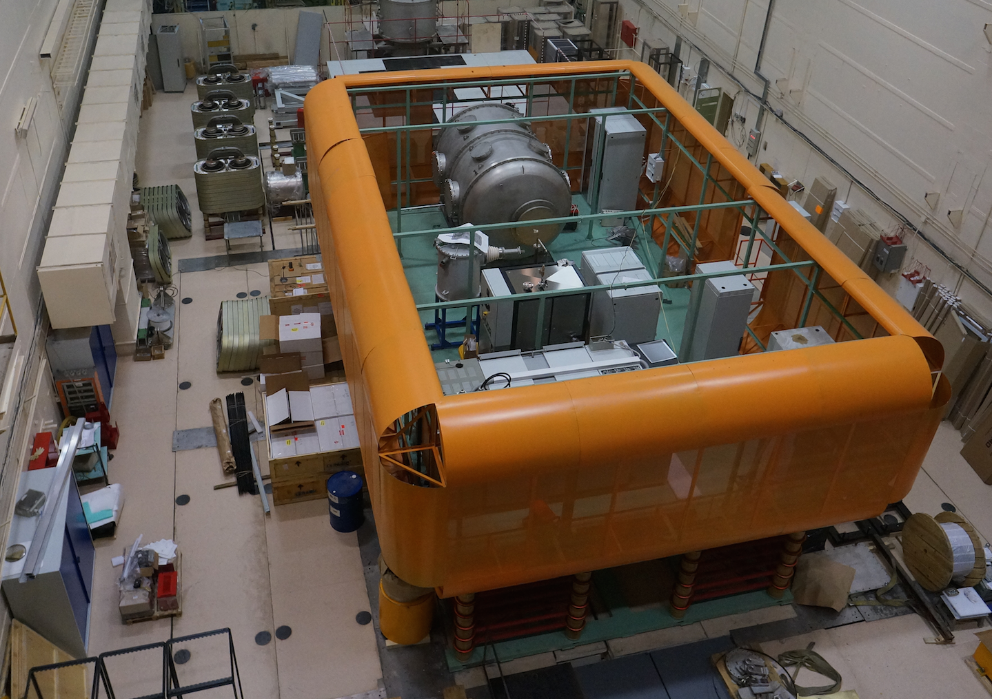
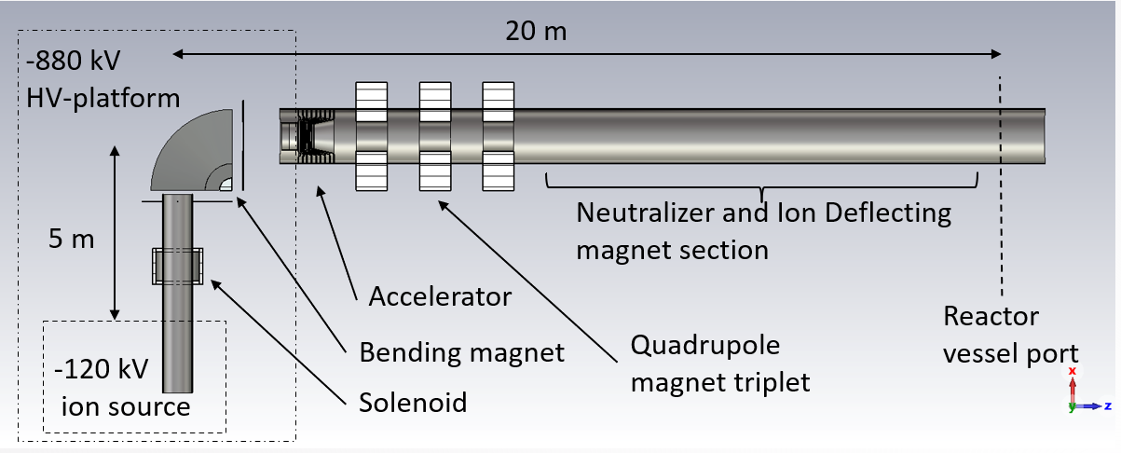
Da Vinci negative-ion-based NB injection system
R&D underway for next generation NBs
Target Specs for Da Vinci:
Accelerating voltage, up to 1 MV
Ion current per source, ~10 A
Continuous operations (>1000 s)
Neutral power, 5 MW per beamline
Distinct Features:
Ion source is separated from accelerator section
Low energy beam transport (LEBT) line includes beam deflecting magnet, pumps and Cs-traps
Single-aperture accelerator is utilized
Plasma or photon neutralizer is employed
High-energy beam prototype
NIBS’26 Presentations:
73. Operation, Performance, and Modeling of a Cesium-Free Negative Hydrogen Ion Source for a BNCT Accelerator (Poster – Session 1)
  Vladislav Vekselman 9/21/26, 5:00 PM
66. Numerical Analysis of the Da Vinci project negative ion-based Neutral Beam Injectors (Poster – Session 2)
  Ken Franzen 9/22/26, 5:00 PM
72. Conceptual design of a negative-ion-based neutral beam module for an FRC reactor prototype (Talk – S1)
  Alexandr Ivanov 9/22/26, 8:55 AM
References:
A.A. Ivanov et al., Rev. Sci. Instrum. 85, 02B102 (2014).
A.A. Ivanov et al., AIP Conf. Proc. 1771, 030012 (2016).

Slide 6
In Conclusion: We are Hiring!
Senior Design Engineer – Neutral Beams
  Focus on designing high-energy ion sources, beamline components, used to heat and sustain plasma.
Accelerator Physicist – Medical Beams
  Focus on developing, commissioning, and operating components, subsystems, and complete particle accelerators for medical and industrial applications.
Sr. Scientist – Neutral Beams
  Participate in development of the long pulse plasma sources (CW), extracting and accelerating systems, beamline components; conduct experiments with the plasma source and beam characterization, along with plasma generation and beam transport simulation.
R&D Engineer – Neutral Beams
  Develop and design NB systems in collaboration with scientists and design engineers. Oversee NB manufacturing.

Slide 7
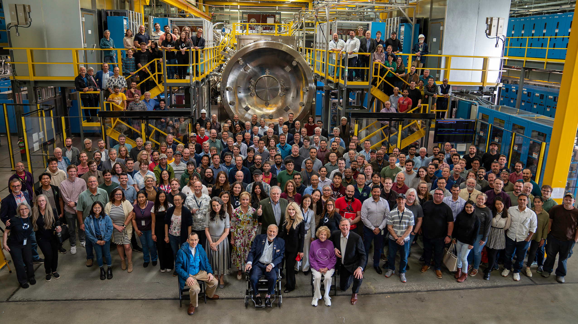
Thank You

