Slide 1
Silvaco Company Overview
Enabling Semiconductor Design and Manufacturing Through AI, Digital Twin Modeling, Software Innovation and Automation
Seth Veitzer
FAE – III
22 September, 2026

Slide 2


Silvaco at a Glance
Enabling semiconductor innovation from atoms to systems
Silvaco Leadership in Semiconductor Software Solutions
Design, Simulate, Analyze, and Verify
from Concept to Complete Product Yield
8 of 10⁽¹⁾
Largest Display Companies Use
Silvaco’s TCAD
4 of 10⁽⁴⁾
Largest SiC, GaN Power Device Providers Use Silvaco TCAD
6 of 10⁽³⁾
Largest Semiconductor Companies Use
Silvaco’s EDA
ATOMS
200+
University Customers
TRANSISTORS
ATOMS
800+ ⁽²⁾
Customers
300+⁽⁵⁾
Employees
SYSTEMS
TCAD
Global Presence
TCAD
EDA
SYSTEMS
TRANSITORS
Headquarters & Development Center
Silicon Valley, USA
SIP
EDA
SIP
Automotive
IoT
5G / 6G
Display
Memory
HPC
Power
Largest in terms of revenue from Q4’2023 to Q3,2024 according to Counterpoint Research
Data as of September 30, 2024
Largest in terms of revenue according to companiesmarketcap.com
2024 Future Market Insight SiC and GaN Semiconductor Market Report
Data as of August 2025

Slide 3
Silvaco’s Technology Portfolio
Leading Technology Computer Aided Design (TCAD) Solution
  Complete 2D/3D process, device, atomistic simulation
  Power, advanced CMOS, Display and Optoelectronics
  AI-Driven Fab Technology Co-Optimization (FTCO™)
Superior Integrated Circuit (IC) Analysis & Verification Tools
  Leading parasitic reduction and analysis
  Advanced modeling utilizing Machine Learning
  Variation analysis
  Sign-off accepted physical verification tools
  Analog/custom IC design
  Complete flow from Schematic to Foundry (GDSII)
Silicon Packaging and Management
  Large portfolio: I3C, AMBA Fabric, MIPI, I/O, Memory, Std. Cell
  Enterprise IP management products
Complete suite of Electronic Design Automation (EDA) tools
  Optimized with Fab Technology Co-Optimization (FTCOTM); Digital Twin and AI processing
Digital Twin and AI
TRANSISTORS
ATOMS
SYSTEMS
TCAD
EDA
Services
SIP
ISO 9001 Certified

Slide 4











Strategic Acquisitions Expanding Solutions Portfolio
Silvaco Has Successfully Integrated 13 Acquisitions
Atomistic TCAD
New
Multi-Physics
TCAD
Enter IP market
Broaden
IP portfolio
Foundation IP creation and characterization
Memory compiler
New
MIPI IP
SIP
New
Variation
aware design
SPICE netlist analysis & reduction
Silicon substrate analysis
Physical verification
OPC*
EDA
Power integrity sign-off
2015
2016
2017
2018
2020
2021
2025
2025
2025
*Acquired from Cadence Design Systems.

Slide 5

Expanding Market Opportunity Using AI Digital Twin Modeling
Fab Technology Co-Optimization™ brings new era of AI-assisted process optimization
Electronic System Design
Digital Twin. Fab Technology Co-Optimization (FTCOTM)
STEP 1 • Design
STEP 2 • Wafer Fab
STEP 3 • Packaging
STEP 4 • Testing
STEP 5 • Final Chip
TechX
Photonics
OPC⁽⁶⁾
Mask Optimization
TechX
Multi-Physics/wafer-scale geometries digital twin models
Design
Fabrication
Packaging
Testing
Final Chip
1

Slide 6
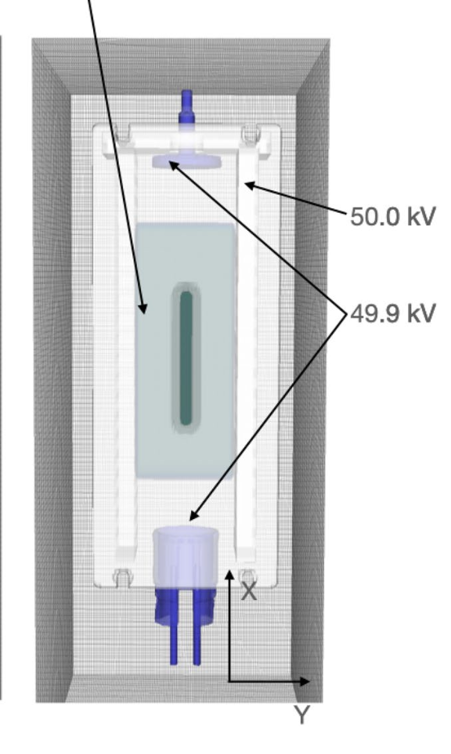
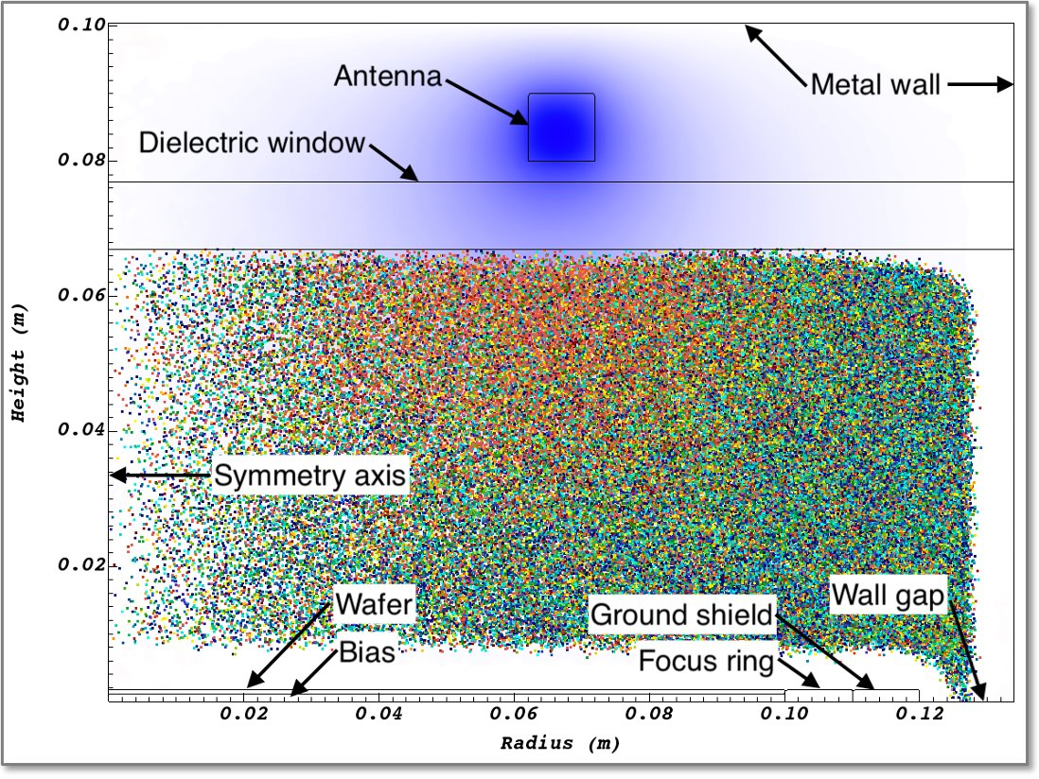
Ion source modeling with VSimPlasma
Plasma chamber modeling is synergistic between CCP/ICP for etch/deposition and ion sources
Similarities
  Kinetic plasma models are required for accuracy
  Self-consistent particle/particle and particle/surface interactions
  Complex plasma chemistry
  Modeling sheath formation is critical
  Plasma chamber dimensions are similar
Differences
  Ion sources typically feature magnetic fields for plasma confinement, requiring 3-D models
  Ion sources are driven by both RF and DC power
  Electrons typically are heated by cathodes or direct injection in ion sources
  Ion source plasmas are typically somewhat lower temperature and pressure
  Ion sources have an aperture instead of a wafer
Ion Source Plasma Chamber
ICP Plasma Chamber

Slide 8




















Why Customers Choose Silvaco
Leading TCAD solution for SiC, GaN Power Devices
AI-Driven Fab Technology Co-Optimization (FTCO™)
Production and market proven design IPs for auto/consumer
Tools for foundation IPs, embedded memories & IO
Best-in-class solution for Display technology development
Unique point tools complementing existing IC design flows
Agility to respond to customers' unmet needs (R&D, Support)
Trademarks
Silvaco and the Silvaco logo are trademarks of Silvaco Group, Inc. All other trademarks and service marks are the property of their respective owners.

Slide 9
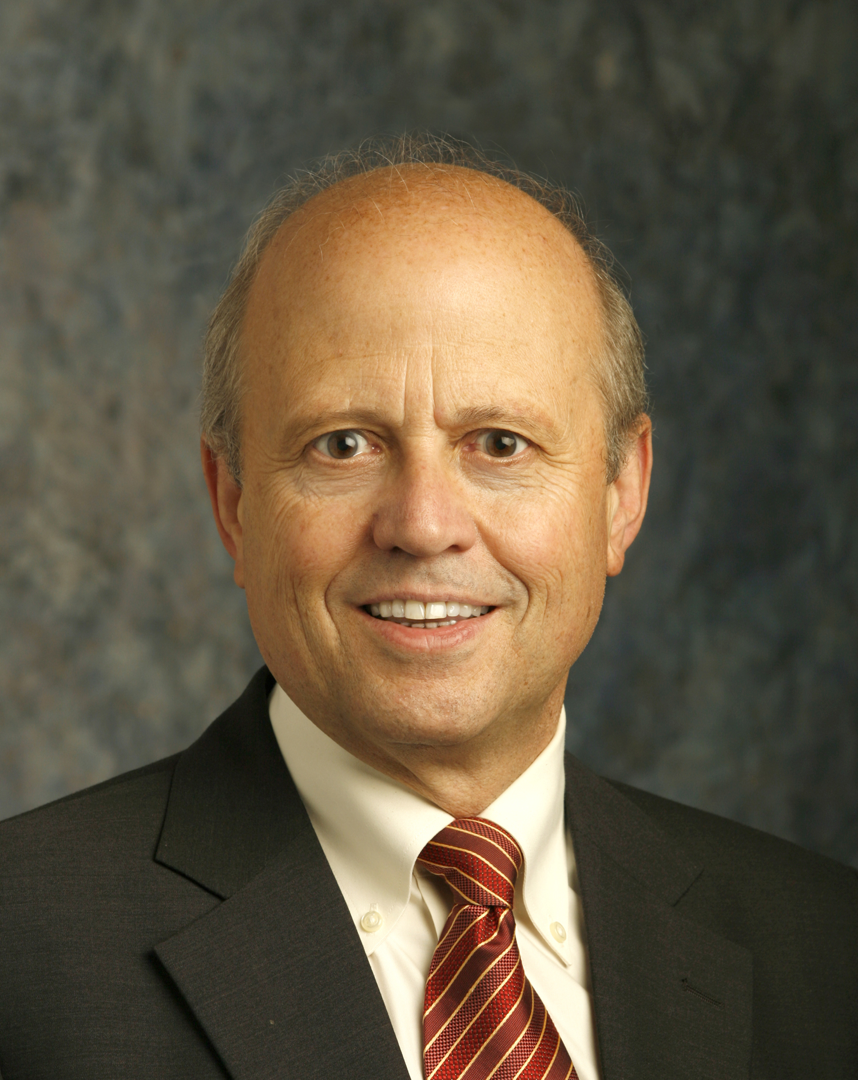
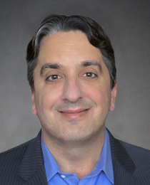
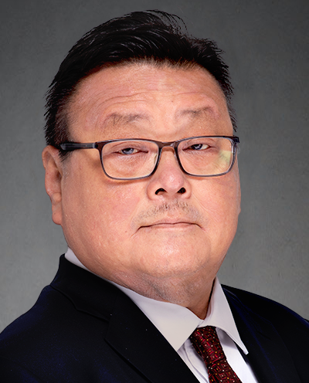
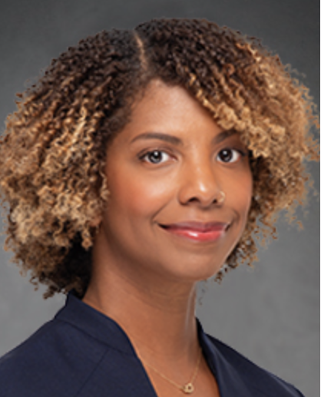
















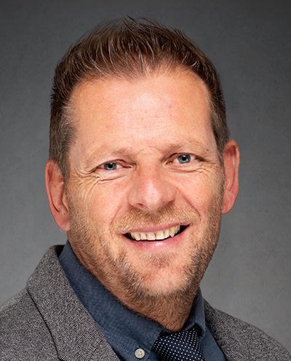

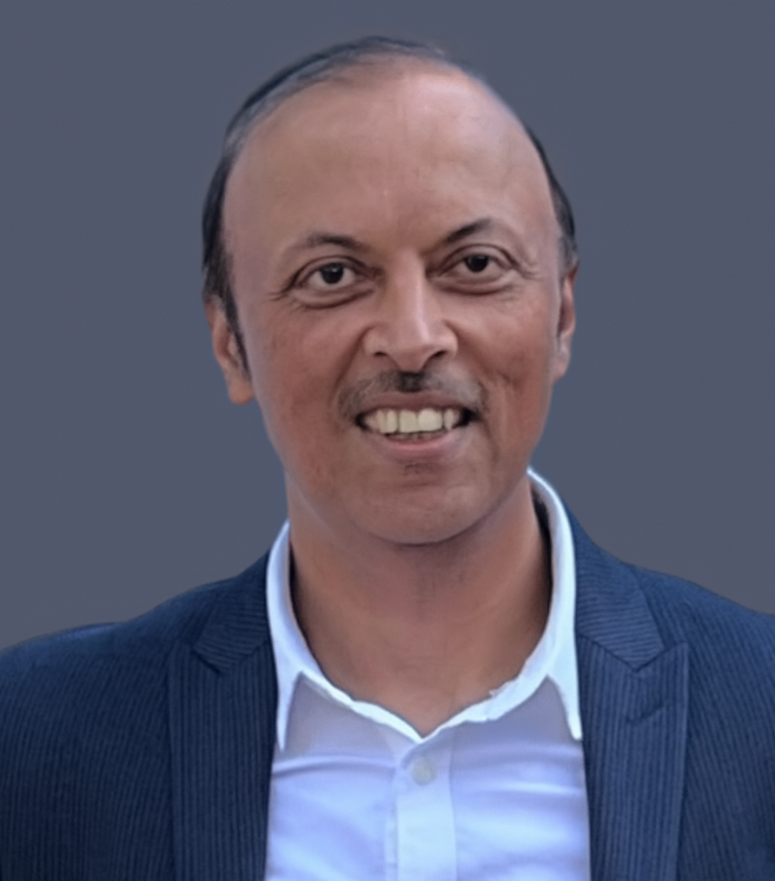




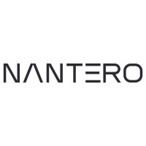






Seasoned Management Team with Deep Industry Expertise
Four New Additions – CFO, SVP/GM IP, SVP/GM EDA, VP Business Development
Wally Rhines
CEO and Board Member
Chris Zegarelli
Chief Financial Officer
Ian Chen
Chief Revenue Officer
Candace Jackson
SVP, General Counsel and Corporate Secretary
  Eric Guichard, Ph.D
  SVP and GM of TCAD
  Andrew Wright
  SVP and GM of IP
  Jasvinder Singh
SVP and GM of EDA
John Berg
VP Business Development

