Slide 1


Fueling the Future with Ion Source Innovation
D-PACE · NIBS’26 KEY SPONSOR · SEPTEMBER 2026
Ion source and related solutions for research, medicine, industry and energy in the accelerator industry.​
Richard McElroy, CEO
richard@d-pace.com
Notes:
Good morning, and thank you for being here. My name is Richard McElroy, and I am the CEO of D-PACE. We are proud to be a key sponsor of NIBS 2026, and it is a pleasure to be hosting you here in Nelson, British Columbia.
D-PACE designs, builds and supports ion sources and related technology for research, medicine, industry and energy.
In the next few minutes I want to give you a quick picture of who we are, what we deliver, and where we are heading.

Slide 2
Three Decades. One Key Focus. ​​​​
D-PACE AT-A-GLANCE
1995
25+
30+
DISC
FOUNDED
SPECIALISTS
PRODUCTS
TEST FACILITY
Decades of focused ion source and accelerator experience
Physicists, engineers, technicians and business leaders
Sources, diagnostics, magnets and beamline solutions
In-house integration, beam testing and validation
PHYSICS, ENGINEERING, INTEGRATION, MANUFACTURING AND TESTING BROUGHT TOGETHER IN NELSON, BC, CANADA.
Notes:
Here is a quick at-a-glance snapshot of us. D-PACE was founded in 1995, so for over three decades we’ve been doing one thing and doing it really well: ion sources and the related systems that enhance their value.
Today we are a team of more than twenty-five specialists - physicists, engineers, technicians and business leaders - working together under one roof. That team supports a catalogue of over thirty products, spanning sources, diagnostics, magnets and complete beamline solutions.
And importantly, we have DISC – the D-Pace Ion Source Centre – our own in-house build, test and research facility, where every system is integrated, beam-tested and validated before it ever ships.
.

Slide 3
Field Proven Across Critical Sectors
PRIMARY MARKETS SERVED
MEDICAL
ENERGY
INDUSTRIAL/OEM
RESEARCH
Isotope production
Diagnostic imaging
Particle therapy & BNCT
Fusion platforms
Fission systems
Lab to deployment
Ion implantation
Surface modification
Materials analysis & NDT
Particle & nuclear physics
Materials science
Accelerator facilities
STABLE, HIGH-PERFORMANCE ION BEAMS AND SUPORTING TECHNOLOGY
ACROSS EVERY SECTOR
Notes:
This focus has taken our ion source solutions into four critical markets.
In medical, our sources support isotope production, diagnostic imaging, and emerging particle therapy and BNCT programs.
In energy, a significant growth area for us, we are working with both established and emerging fusion platforms and fission systems, taking designs from the laboratory through to deployment.
In industrial and OEM applications, we serve ion implantation, surface modification, and materials analysis and testing.
And lastly, in research, our equipment is at work in particle and nuclear physics, materials and discovery science, and accelerator facilities around the world.
So very different sectors, very different applications - but the same requirement every time: a stable, high-performance beam that our customers can count on.

Slide 4
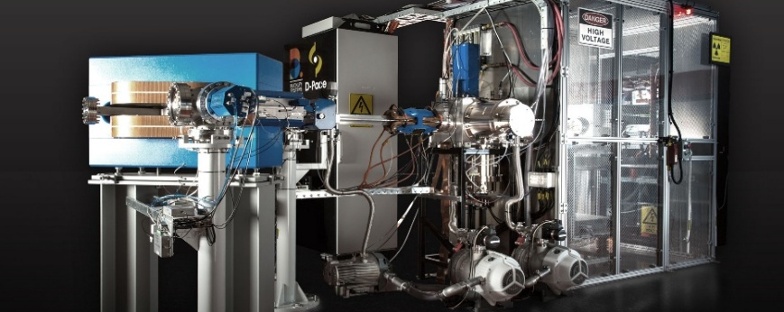
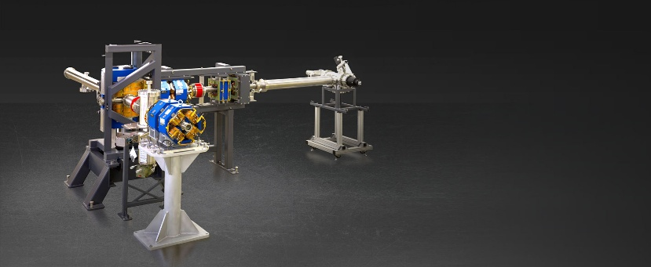
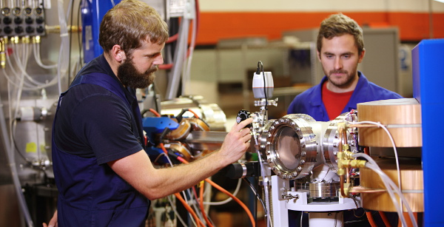
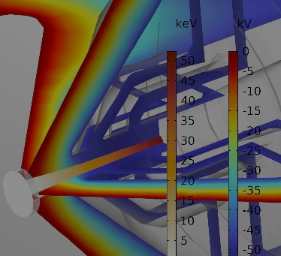
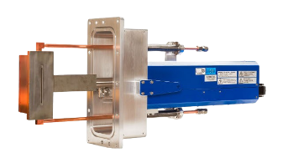
Source. System. Support.
OFFERINGS
ION SOURCES
(Turnkey System or Source Only)
RELATED TECHNOLOGIES
SERVICES
ECR 2.45 GHz
Particles: H⁺, H²⁺, D⁺, He⁺ (>30mA)
Filament-powered Multicusp
Config 1: Negative: H⁻ / D⁻
Config 2: Positive: H⁺, H²⁺, H³⁺
Config 3: Dual: H⁻ D⁻, H⁺, D⁺, He⁺
In Development
Compact 14.5 GHz ECR Alpha Source
Multicusp RF Source (H⁻, D⁻, C₂⁻, C₂H⁻, C₂H₂⁻, O⁻, O₂⁻)
Diagnostics
Emittance Scanners, Beam Profilers, Faraday Cups, Mass Spectrometers
Magnets
Dipoles, Solenoids, Quadropoles
Steering, Mass-Separating, Focussing
Custom Beamlines
Low energy beamlines for ion sources
Application specific beamlines (BNCT, PET)
Ion Source Test Facility
Test Stand 1: 2.54GHz and 14GHz ECR
Test Stand 2: 10kW Filament Multicusp
Modelling & Simulation
Ion source and beamline simulation
Thermal analysis
Simulation Software
Engineering & System Integration
TURNKEY SOLUTIONS DESIGNED, BUILT, INTEGRATED AND BEAM-TESTED
Notes:
Our offering comes in three parts: the source, the complementary technologies around it, and the support and services behind it.
First, ion sources - available as a source alone or as a complete turnkey system. Our ECR 2.45 gigahertz source delivers hydrogen, deuterium and helium species at over thirty milliamps.
Our filament-powered multicusp volume sources come in three configurations: negative, positive, or dual-polarity, covering combinations of hydrogen, deuterium and helium.
And we are also actively developing a compact 14.5 gigahertz ECR alpha source, along with a multicusp RF source for a wider range of negative species that will help us expand and better penetrate medical and industrial markets
Second, a range of related technologies that make the beam more usable and more valuable: diagnostics such as emittance scanners, beam profilers and Faraday cups; specialized magnets including dipoles, solenoids and quadrupoles for steering, mass separation and focussing; and custom low-energy beamlines, including application-specific designs for BNCT and PET.
Third, a range of services rounds out our offerings. Among the most popular and fastest growing are our test stand rentals, combined with our deep modelling and simulation expertise – which customers use to mitigate risk and validate solutions before investing in a full system deployment.

Slide 5
One Platform. Every Source.
TURNKEY SYSTEM ARCHITECTURE STRATEGY
Standardized core, modular by design
Standard, Pre-designed Sources
ECR 2.45 GHz
Multicusp Filament
Future/In Development
Custom / OEM Sources
Microwave driven
Negative/Positive
Magnetic confinement
14.5 GHz Compact ECR
Multicusp 13.56 MHz RF
Application-specific
COMMON PLATFORM BASE
Vacuum & cooling
HV & power distribution
Controls & software
Diagnostics & interfaces
SHORTER LEAD TIME
MAXIMUM FLEXIBILITY
LOWER RISK & EASIER SUPPORT
Proven core subsystems, built and stocked to a standard design
Swap the source modules to match the application
Beam-tested as a full configuration before shipment
Common platform = simpler service and spares
ONE BASE PLATFORM · MANY BEAMS · FASTER TIME TO VALUE
Notes:
Now I want to shift from what we sell to what we are investing in – the work we are doing to make our solutions better and more valuable, and to make us easier to work with and to do business with.
Here is a good example: evolving our turnkey ion source architecture onto a single common platform base, which we expect to bring to market in early 2027. The concept is simple: one platform for every source. Whichever source is needed – a standard ECR or multicusp, a new source still in development, or a custom OEM design – it plugs into the same common base, which houses the vacuum and cooling systems, high-voltage and power distribution, controls and software, and all the diagnostics and interfaces.
The result is three clear benefits for our customers.
Shorter lead times, because the core subsystems are proven, standardized and stocked rather than designed from scratch each time.
Maximum flexibility, because we simply swap the source module to match the application.
And lower risk with easier support, because the complete configuration is beam-tested before shipment, and a common platform means simpler service and spares for years afterward.
In a nutshell - One base platform, many beams, and faster time to value.

Slide 6
Fueling enhanced customer experience and growth
NEAR-TERM STRATEGIC INITIATIVES
5‑year Strategic Plan
Interactive Website
Global Advisory Network
Digital Operations Platform
Quality Management System (QMS)
Deliver more value to customers
Drive focused growth
Elevate customer engagement
Showcase product value
Maximize brand awareness
World‑class advisors to help guide strategy, market expansion, technology.
ERP/CRM to streamline workflows and enhance customer experience.
An ISO 9001–aligned QMS to strengthen consistency and operational excellence.
[ COMPLETE ]
[ PHASE 1 COMPLETE ]
[ ON-GOING ]
[ TARGET: Q2/FY27 ]
[ TARGET : Q2/FY27 ]
Notes:
Staying with that theme of investing in the business to improve the value and experience we deliver, let me close with a quick look at the near-term strategic initiatives we have either completed or have well underway.
First, we have completed and are now executing a five-year strategic plan – focussed on healthy growth to increase the value we deliver to our customers.
Second, we recently launched a new interactive website, making it far easier to explore our products, specifications and capabilities before you ever contact us. Future phases will add a secure customer support portal and e-commerce capabilities to make consumables and spare parts easier to obtain.
Third, we launched our Global Advisory Network, bringing world-class advisors into our strategy, market expansion and technology decisions. Today that includes Morgan, of course, along with Dr. Tom Ruth and Kathryn Hayashi, both formerly of TRIUMF. We expect to expand the network in the coming months with advisors in other key areas.
Fourth, we are about to implement an end-to-end digital operations platform – a new ERP and CRM system that will streamline and automate everything from quoting through order and production management.
And lastly, we are implementing a formal quality management system, with the intent of being ISO certified later in FY27, to ensure consistency and operational excellence
.

Slide 7
Thank you. Enjoy NIBS’26 and your time in Nelson!
CLOSING
info@d-pace.com | +1 250 352 5162 | d-pace.com
VISIT US · EXHIBIT HALL
Be sure to visit the D-Pace booth
to meet the team and learn about us!
Notes:
That is D-PACE in a nutshell: three decades of focus, four critical markets, and one platform built to get the beam our customers need faster.
Thank you for your attention, and thank you for supporting NIBS 2026.
Please come find us at the D-PACE booth in the exhibit hall – the team would be glad to meet you and talk about your application.
Thanks

