Slide 1

PRESENTED BY: DAVID DU AND
MANNY SUBRAMANIAN, PH.D.

Slide 2

TeamBest Global Companies

Slide 3
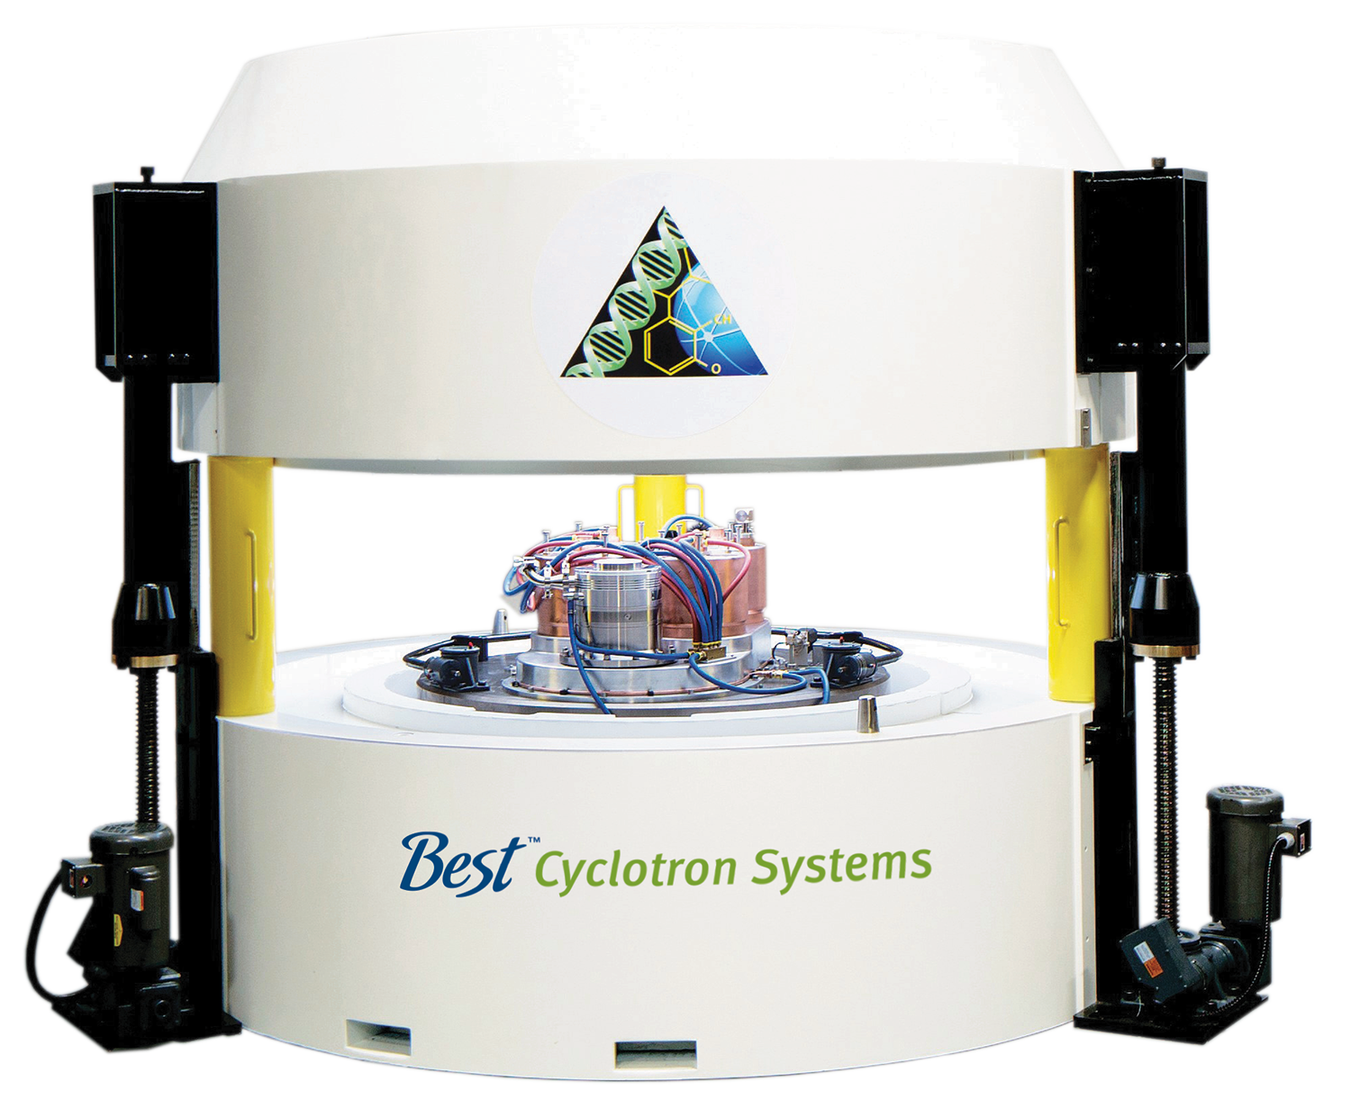
Best™ B100
Self-Shielded Cyclotron
Push button graphic interface
Single or batch dose production
Capable of producing: ¹⁸FDG, Na¹⁸F,
¹⁸F-MISO, ¹⁸FLT, ¹⁸F-Choline, ¹⁸F-DOPA, and ¹⁸F-PSMA
Final dose delivery to syringe or vial
Integrated self-shielded cyclotron and chemistry module
Complete production lab in a 5 x 5 meter area

Slide 4
Best™ BG-95 Sub-Compact Self-Shielded Cyclotron
Low energy compact system, can be placed next to PET/CT
Easy to operate push-button graphic interface
Automated quality control testing
Ideal for Nuclear Cardiology/Oncology and other applications
Capable of producing: ¹⁸FDG, Na¹⁸F,
¹⁸F-MISO, ¹⁸FLT, ¹⁸F-Choline, ¹⁸F-DOPA,
¹⁸F-PSMA, ¹³N and ⁶⁸Ga

Slide 5
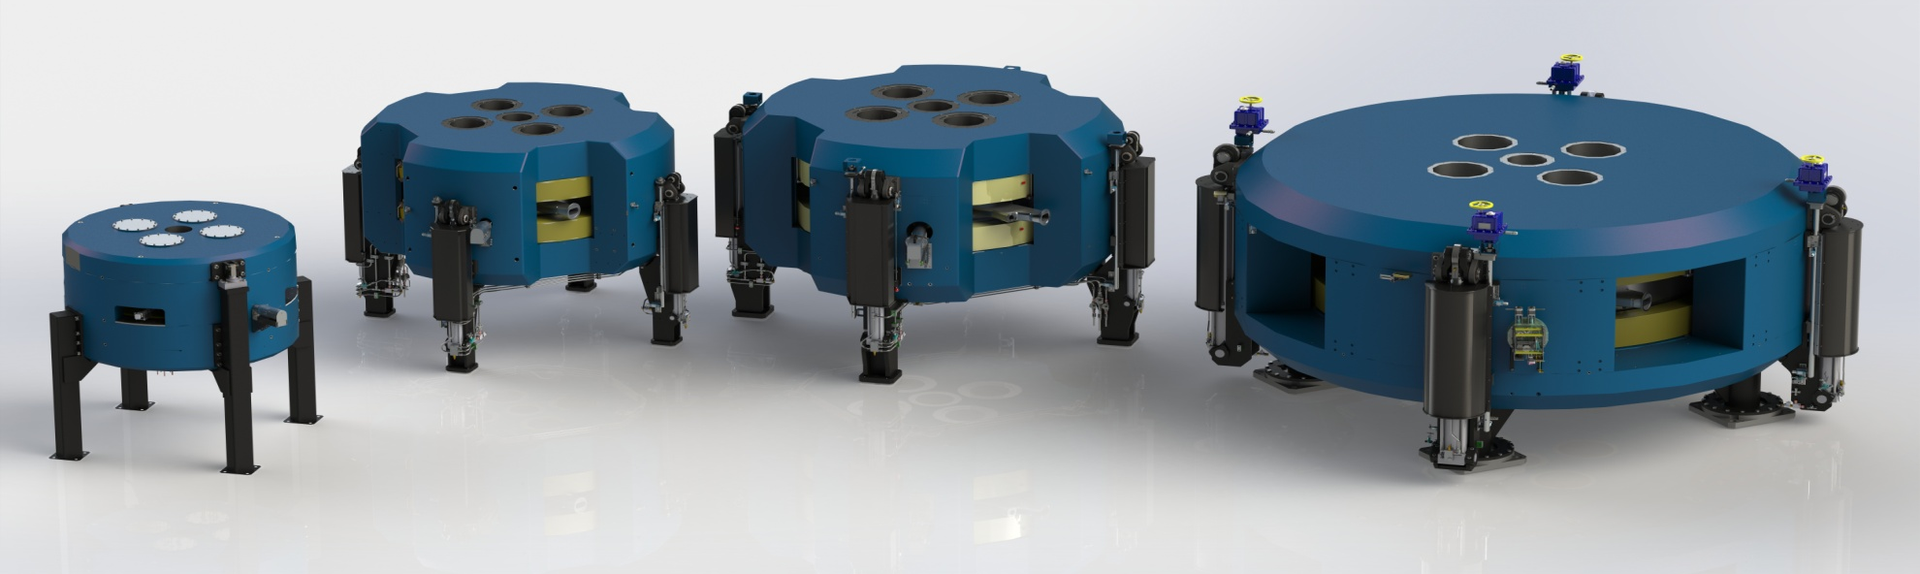
PET and TC^{99m}
SPECT Radioisotopes
Radiotherapeutics and Generators
B15p PET
15 MeV
400 µA +
Targets Radiochemistry
B20u/25p
20/15-25 MeV
400 µA +
Targets Radiochemistry
B30u/35p
30/15-35 MeV
400/1000 µA
Targets Radiochemistry
B70p
35-70 MeV
1000 µA
Targets Radiochemistry
Each cyclotron allows production access to special radioisotopes

Slide 6
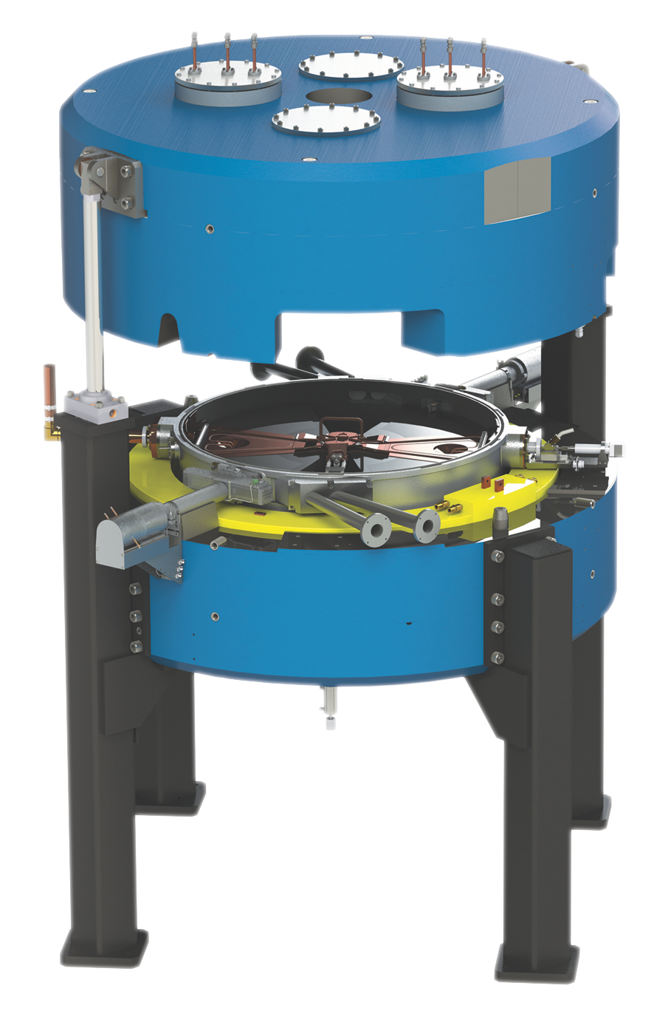
Best™ 6–15 MeV Compact
High Current/Variable Energy Proton Cyclotron
Easy to 1–1000 µA extracted beam current
Capable of producing the following isotopes: ¹⁸F, ⁶⁸Ga, ⁸⁹Zr, ^{99m}Tc, ¹¹C, ¹³N, ¹⁵O, ⁶⁴Cu, ⁶⁷Ga, ¹¹¹In, ¹²⁴I, ²²⁵Ac and ¹⁰³Pd
Up to 5 x 10¹³ neutrons per second from external target
21 stripping foils at each stripping port for
2-minute rapid change

Slide 7
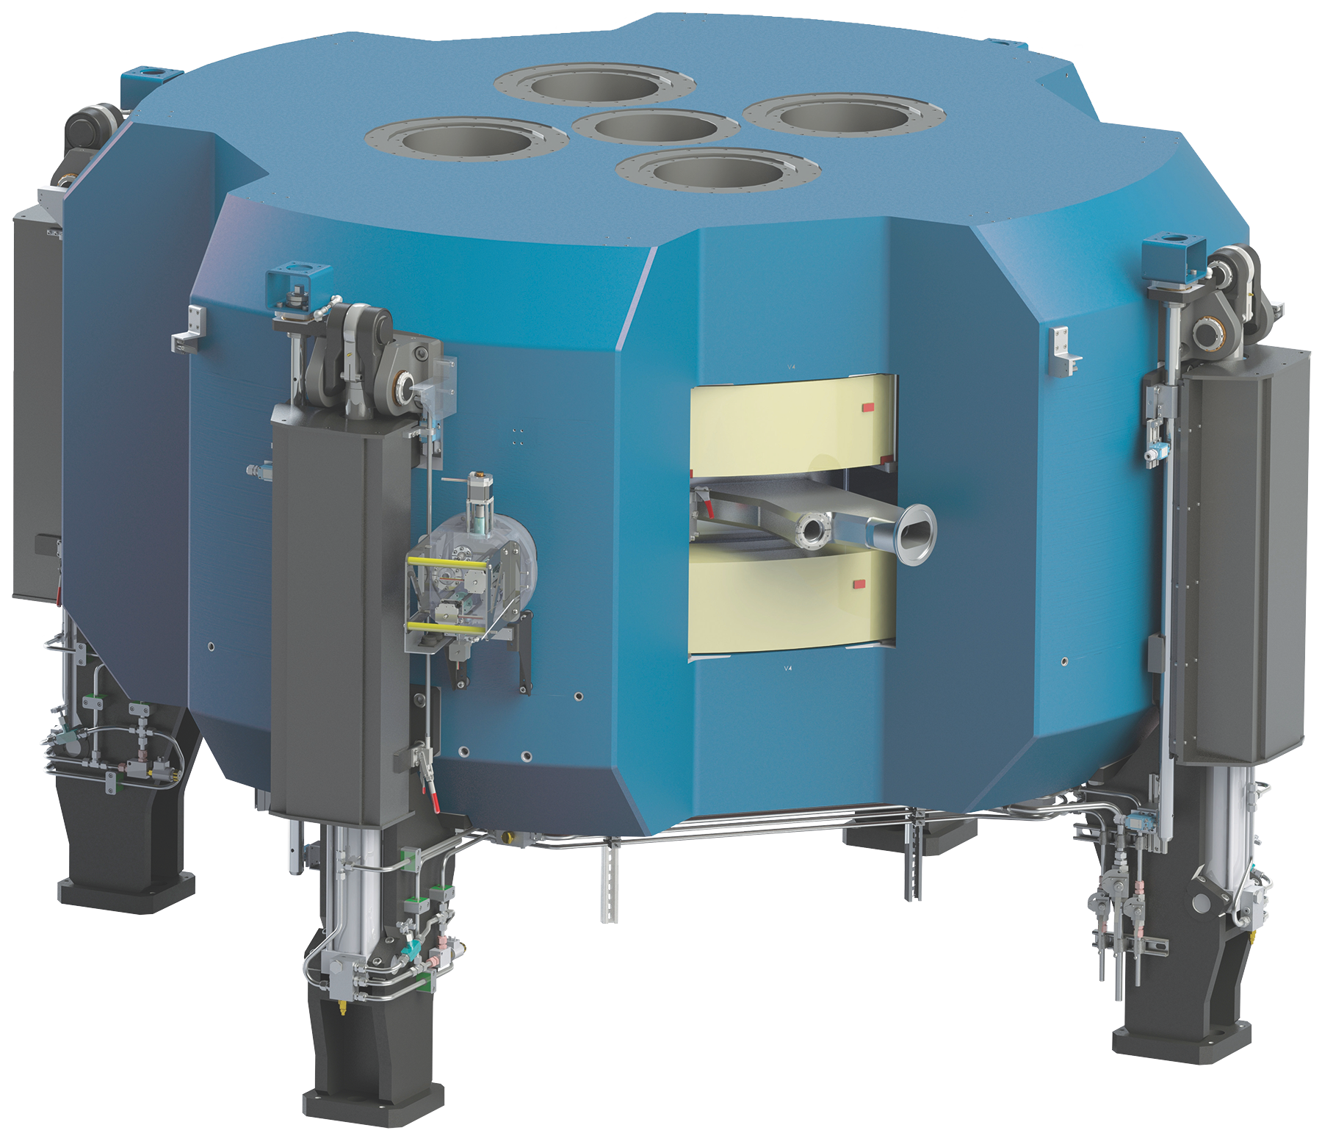
Best™ B25u Upgradeable to
B35adp Cyclotron for Medical Radioisotopes Production
and Other Applications
Proton Particle Beam: 1000 µA Beam Current up to 35 MeV Energy
Deuteron Particle Beam: 500 µA Beam Current up to 15 MeV Energy
Alpha Particle Beam: 200 µA Beam Current up to 35 MeV Energy
www.bestcyclotron.com | 7

Slide 8
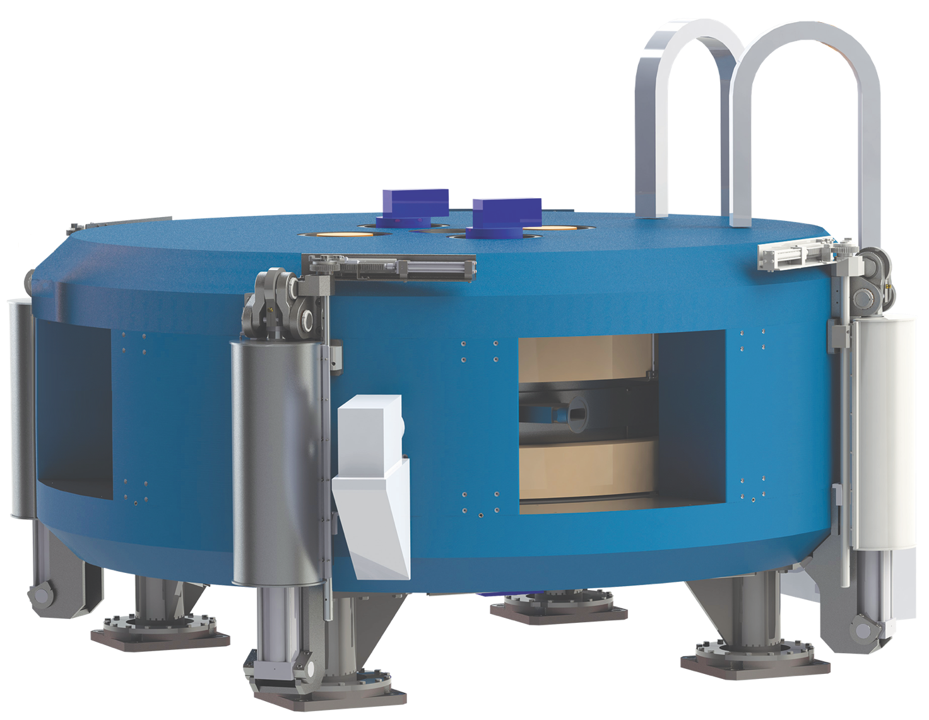
Best™ B-70 MeV Cyclotron
Ideal for Sr-82/Rb-82 Supply
and Research
35-70 MeV variable energy H- cyclotron
700 µA extracted beam current (upgradable to 1000 µA)
2 simultaneous extracted beams
Multiple independent beam lines and target positions
www.bestcyclotron.com | 8

Slide 9
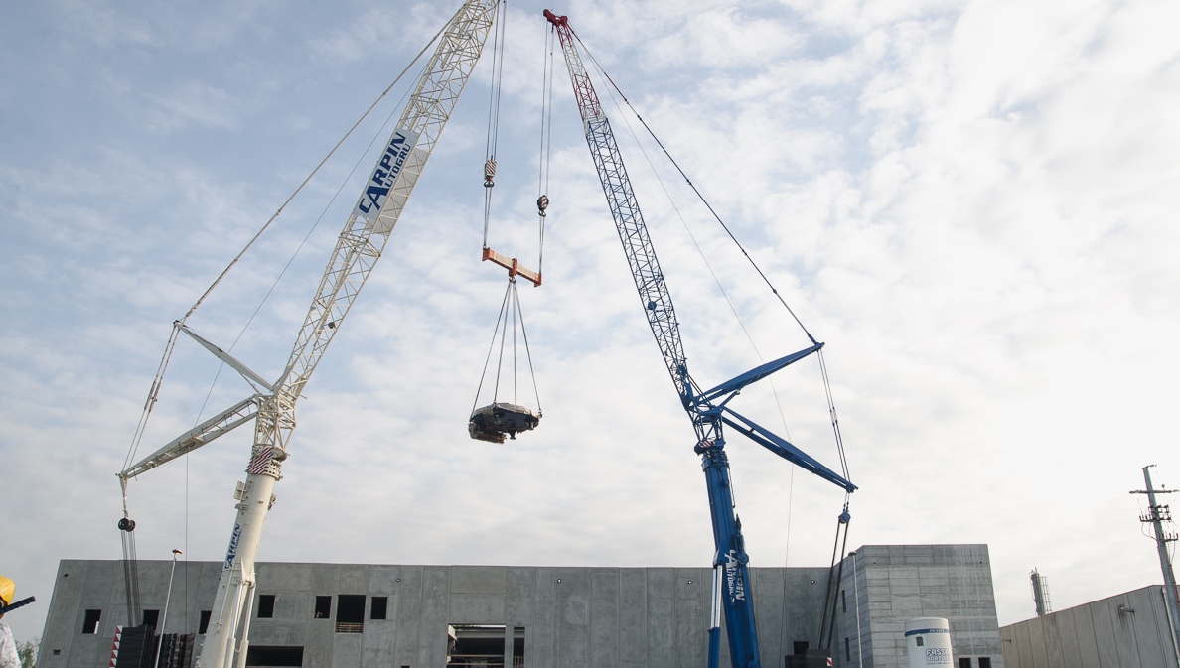
Installation of 70 MeV Cyclotron
May 2015 – Legnaro, Padova, Italy
www.bestcyclotron.com | 9

Slide 10
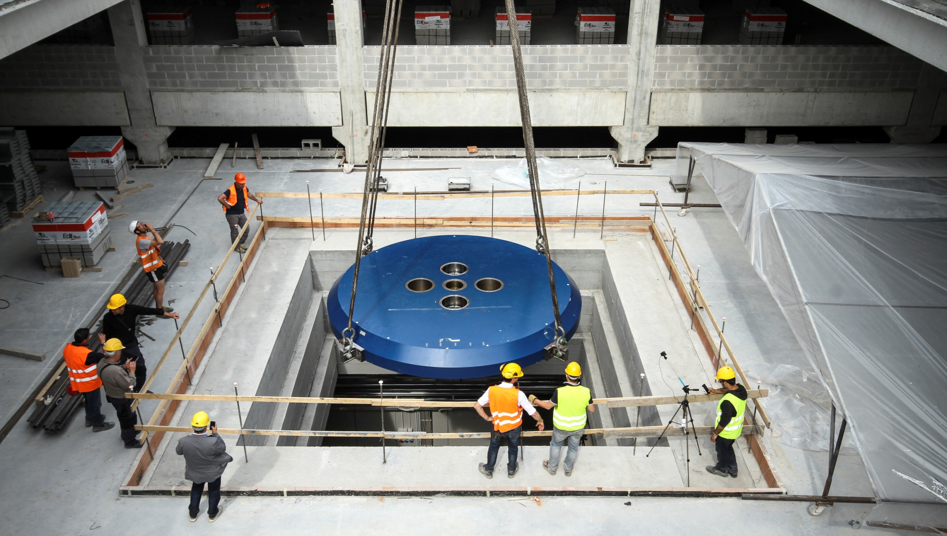
Installation of 70 MeV Cyclotron
May 2015 – Legnaro, Padova, Italy
www.bestcyclotron.com | 10

Slide 11
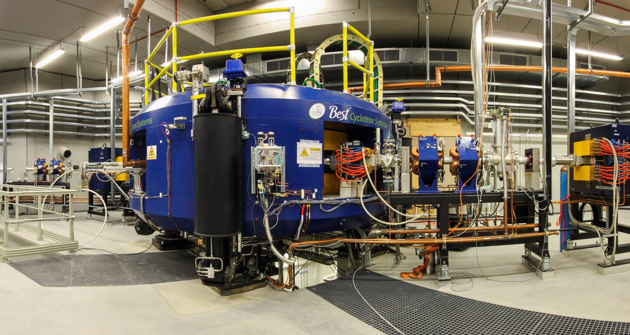
70 MeV Cyclotron
at INFN
www.bestcyclotron.com | 11

Slide 13
Thank You
13

