Slide 1


中国科学院等离子体物理研究所
Chinese Academy of Sciences Institute of Plasma Physics (ASIPP)
Bid to Host NIBS 2028 in Hefei China
Jianglong WEI
on behalf of ASIPP NBI team
10th Negative Ions, Beams and Source, Nelson BC, Canada, Sept 20-25, 2026

Slide 2
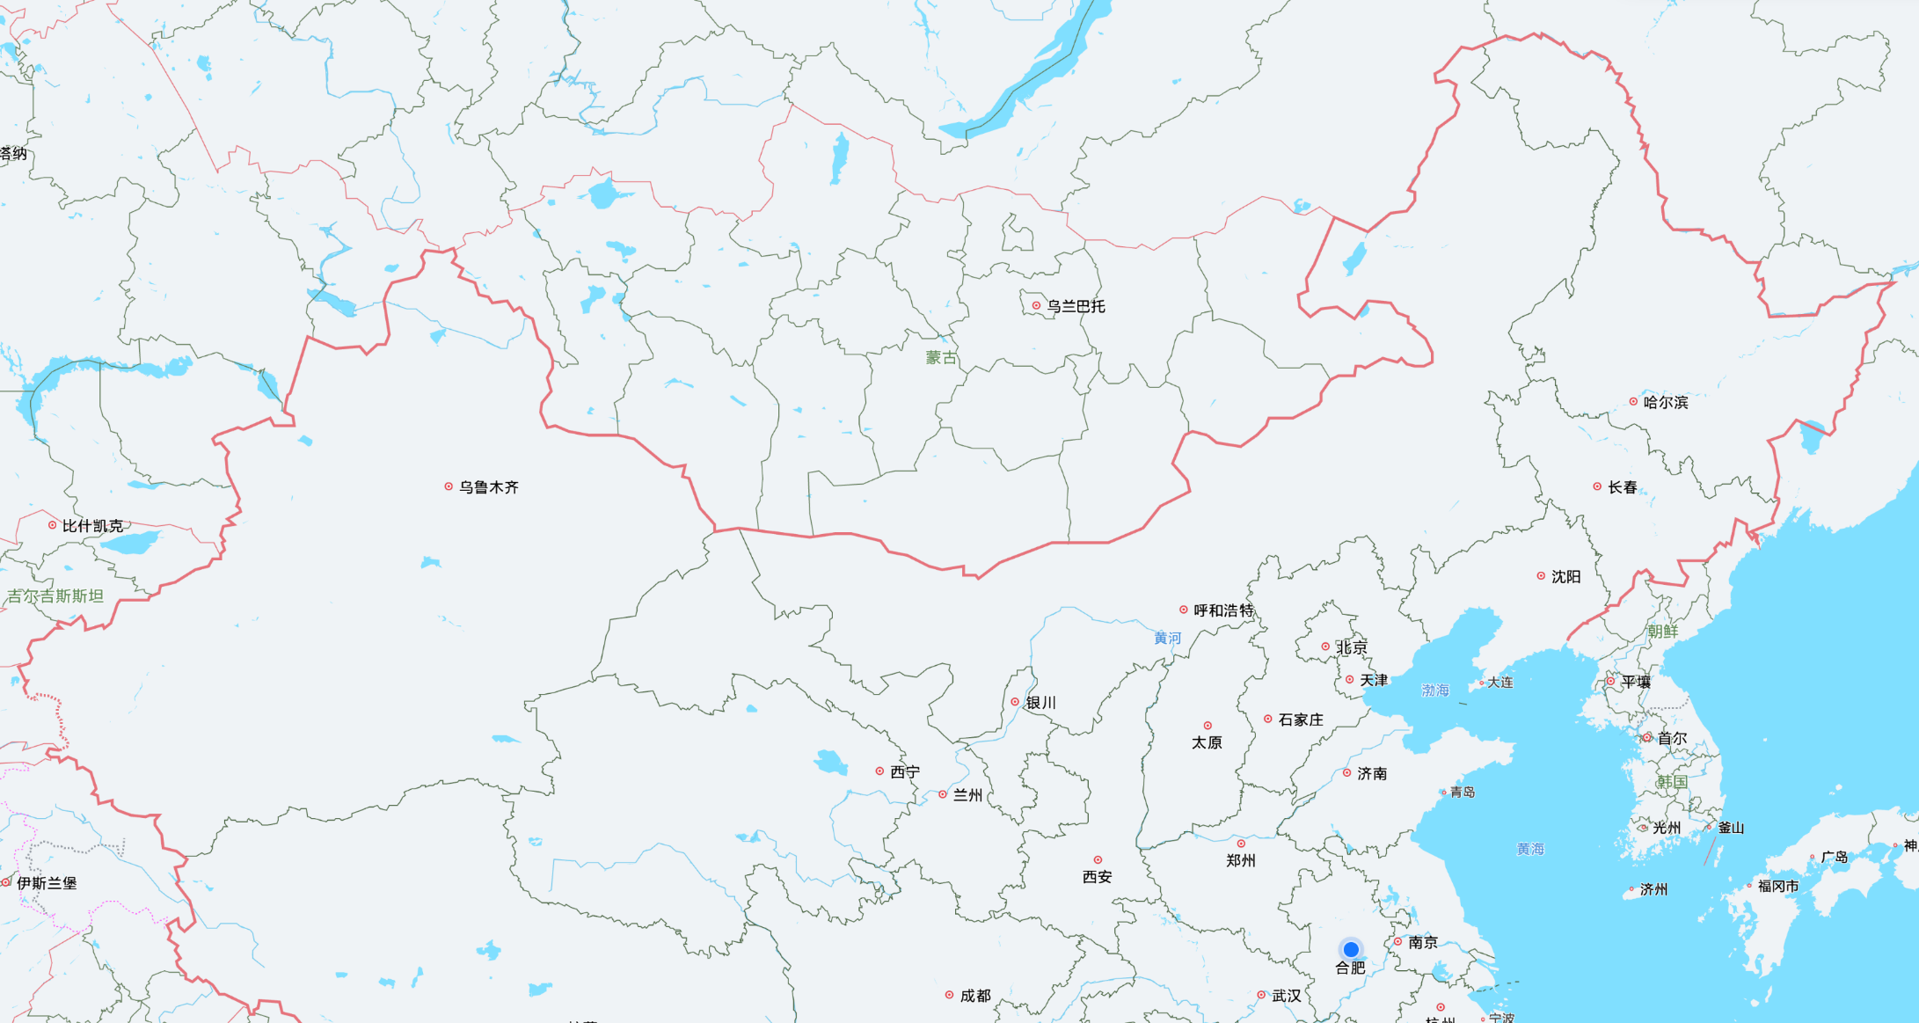
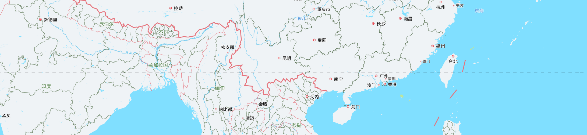
China’s Rapid Growth in Negative Ion Beam Research
Institute | Topic
Institute of Plasma Physics, CAS | Fusion
Institute of High Energy Physics, CAS | Accelerator
Institutes of Modern Physics, CAS | Accelerator
China Institute of Atomic Energy, CNNC | Accelerator
Southwest Institute of Physics, CNNC | Fusion
丨~500 researcher are promoting NIBS development in China
University | Topic
Peking University | Accelerator
Dalian University of Technology | Fusion
Huazhong Univ. of Science & Technology | Fusion
Harbin Engineering University | Accelerator
University of South China | Fusion
Private Company | Topic
ENN Sci. & Technol. Develop. | Fusion
Thor Age | Fusion
SUYAN Fusion | Fusion

Slide 3
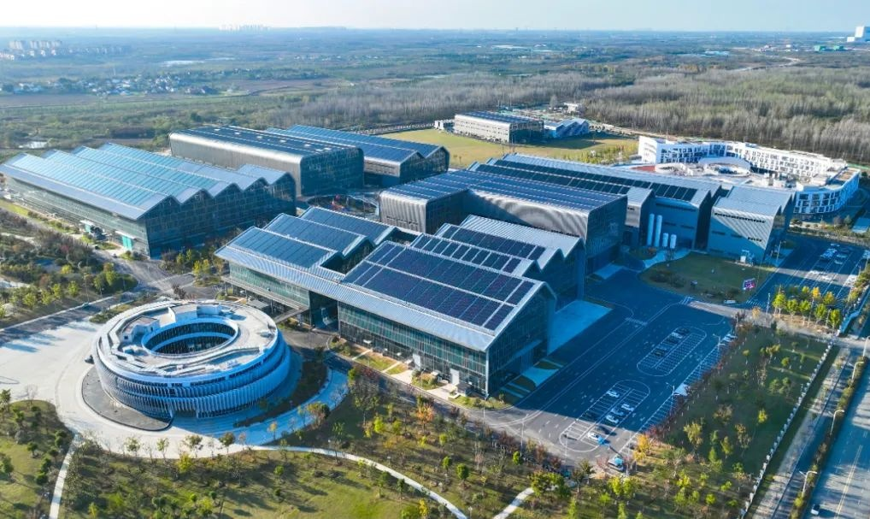
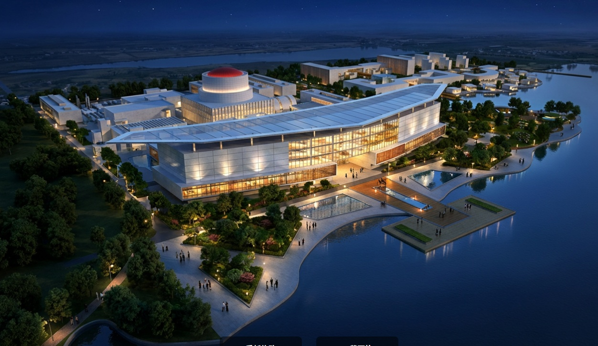
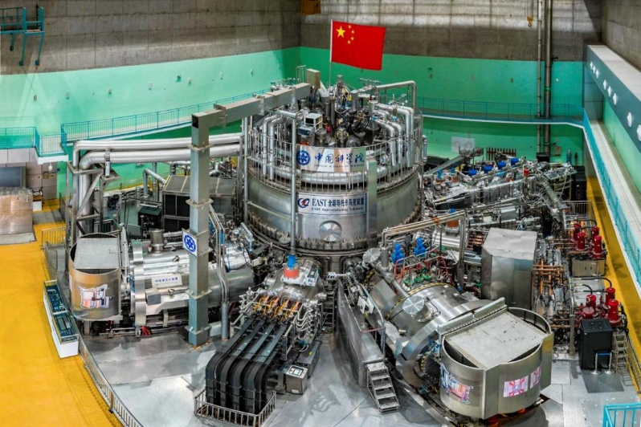
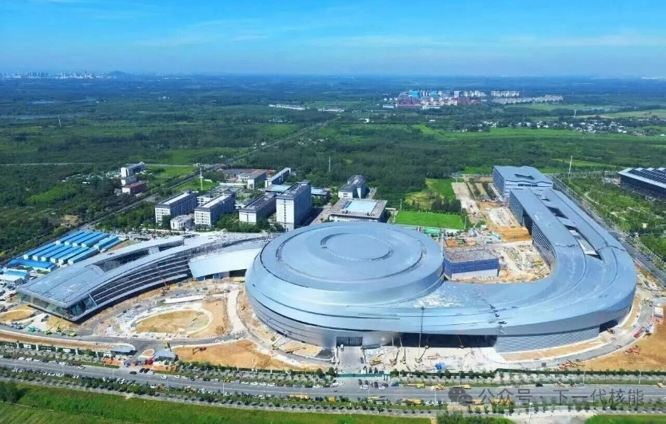
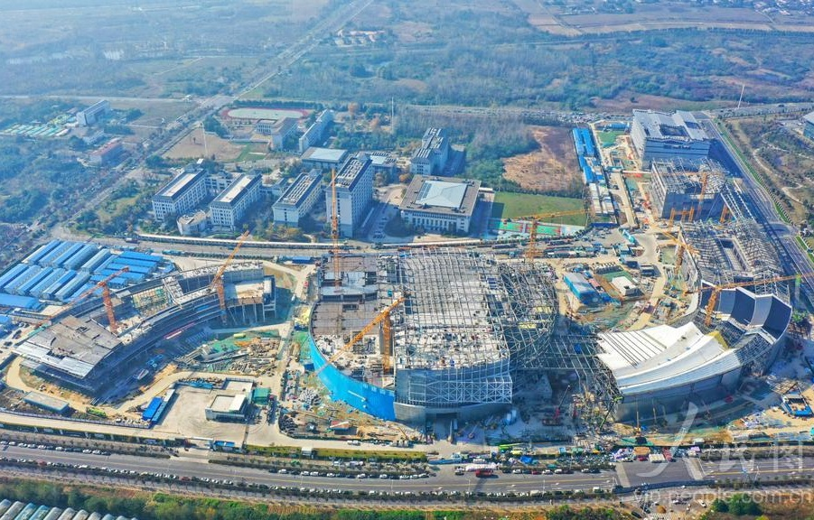
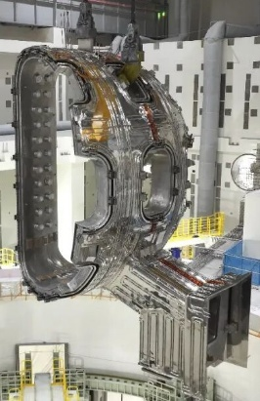
ASIPP Leads Fusion & NNBI Development in China
CRAFT丨First fusion technology R&D cluster
CFEDR丨Chinese fusion DEMO
NNBI test facility: 400keV, 28A,3600s
NNBI: 1000keV, 35MW, 3600s
2019~now
Launch in 2031
EAST丨First full superconducting tokamak
BEST丨First fusion to electricity demonstration
2/8 VV sectors has been installed.
PNBI: 120keV, 15MW, 1000s
NNBI: 500keV, 4MW, 1000s
PNBI: 80keV, 4+4MW, 10-100s
2006~now
First Plasma in 2028

Slide 4
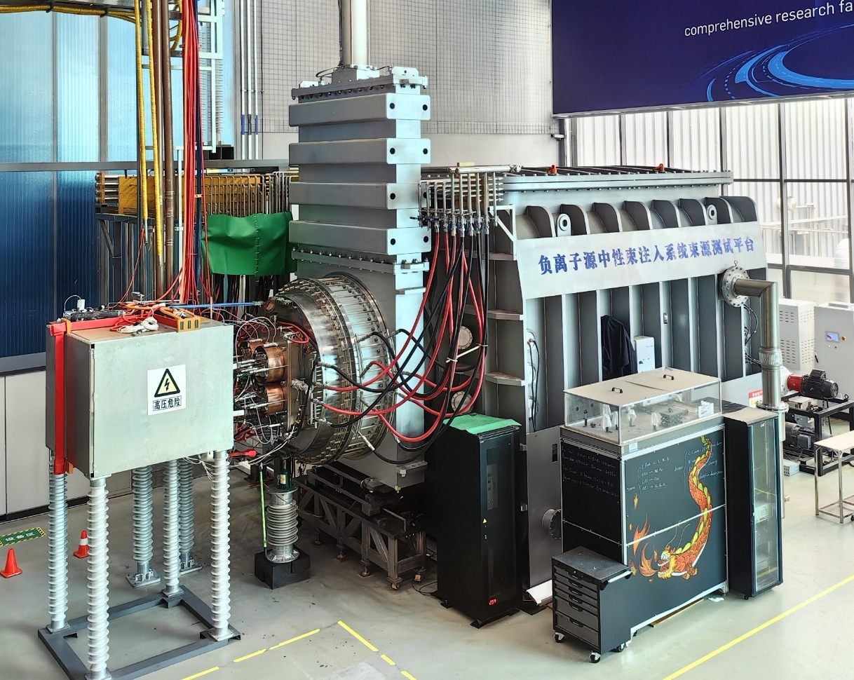
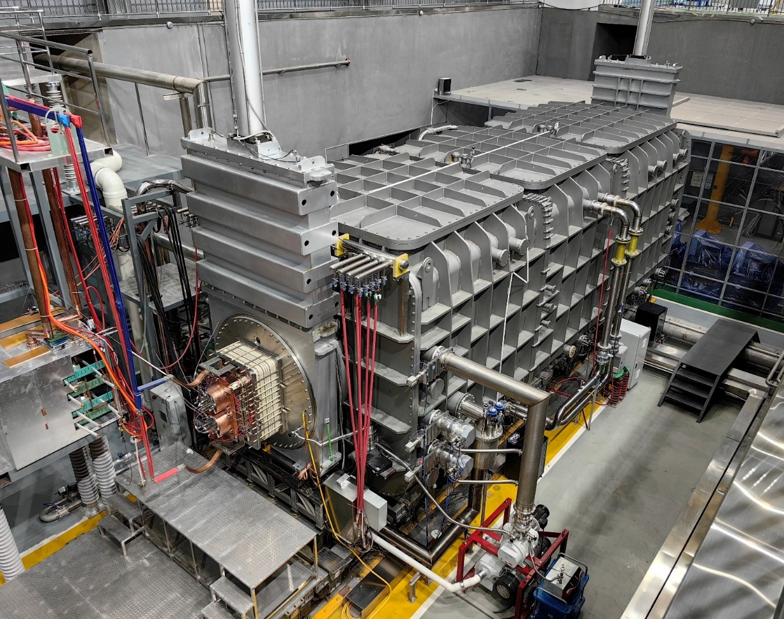
World-Class NNBI R&D Platform at ASIPP
HONOR (Hefei Open-facility for Negative-ion Source Research) → H- production & acceleration
CANBE (CFETR Advance Neutral Beam Equipment) → key NNBI technology (HV, neutralization, beam focus…)
丨HONOR Test Stand (first operation in 2022)
丨CANBE Test Stand (first operation in 2023)
5 m
12 m
4 m
4 m
丨HV Transmission, Negative Ion Beam Source, Gas Neutralizer,
E-RID, Calorimeter, Cryosorption Pumps
丨Equipped with 5 plasma diagnostics + 6 beam diagnostics

Slide 5
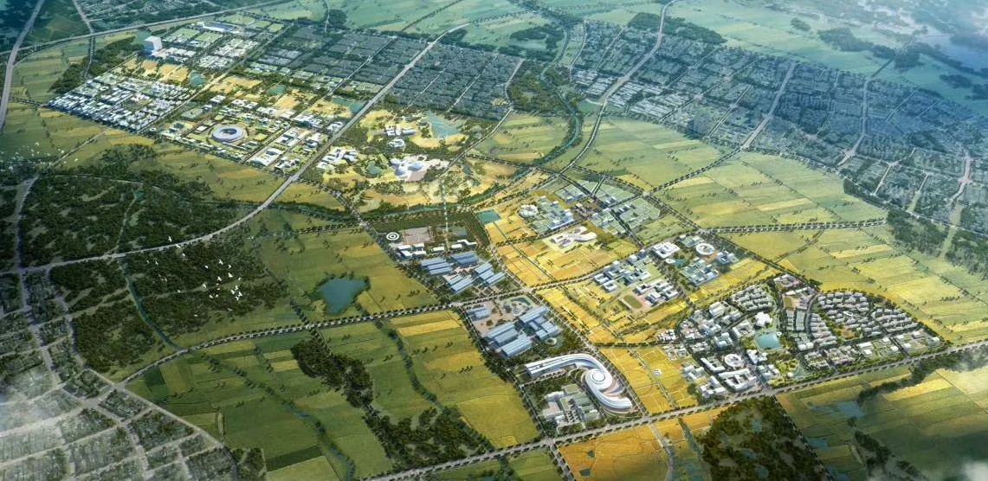
Hefei Hosts 13 Large Scientific Infrastructures
Completed
Being built
Planned
Hangtai Facility
Lighting Protection & Testing
HALF
Synchrotron Radiation
STCF
Electron-Positron Collider
SHMFF II
High Magnetic Field
Tiandu Lab
Deep Space Exploration
Luzhou Tower
Atmospheric Environment
USTC
International Campus
FUTURE
Tritium Blanket
CRAFT
Fusion Technology
Scientist Town
BEST
Fusion Energy
~1.5 km to ASIPP campus
Hefei Future Great Science City: world-class large scientific infrastructures cluster

Slide 6
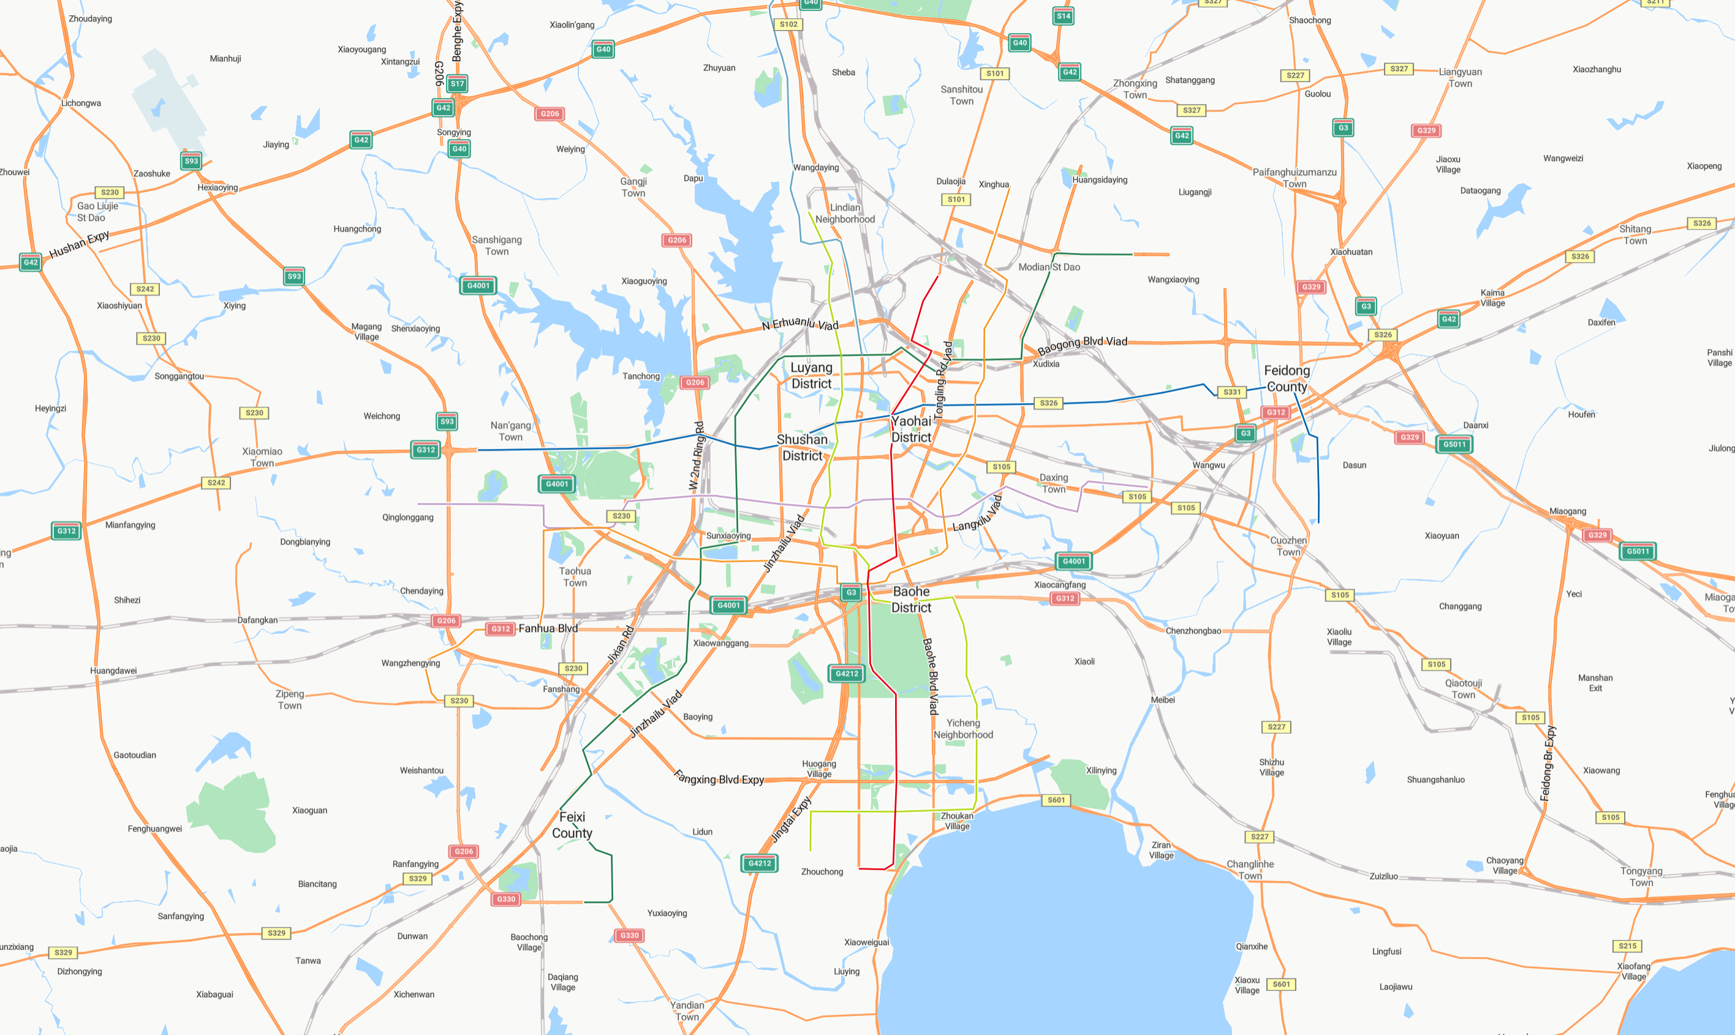
Venue Advantages in Hefei丨Transport
Hefei Airport
1 h to Shanghai, 2 flights each day
1.5 h to Beijing, 6 flights each day
2 h to Guangzhou, 10 flights each day
2 h to Chengdu, 11 flights each day
ASIPP
40 min (Taxi / Bus / Subway)
City Hall
Train Station
20 min
2.5 h to Shanghai, ~every 30 min
4 h to Beijing, ~every 45 min
Chaohu Lake
(4th largest in China)

Slide 7
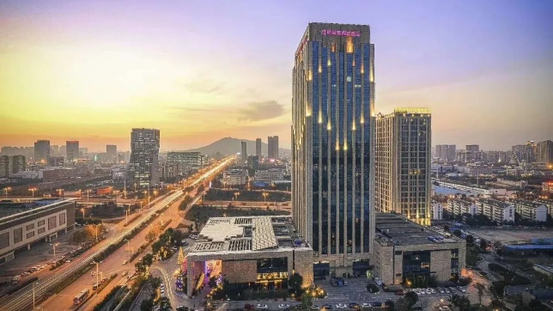
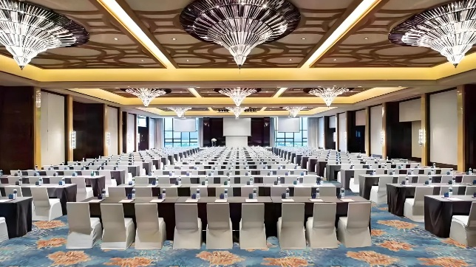


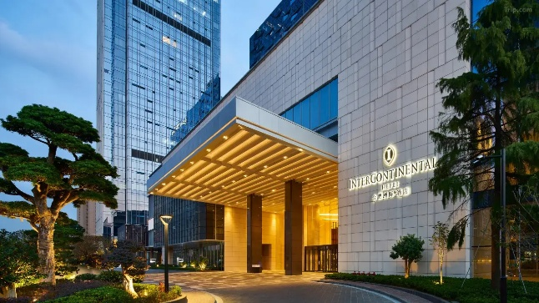
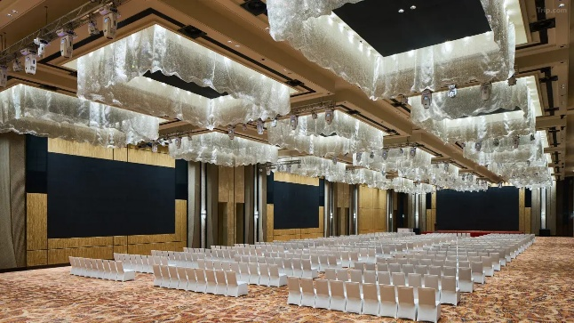



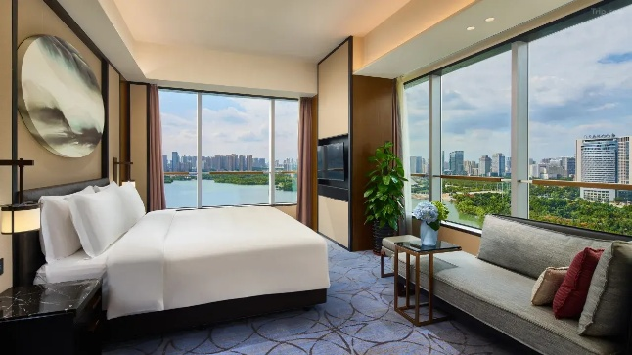

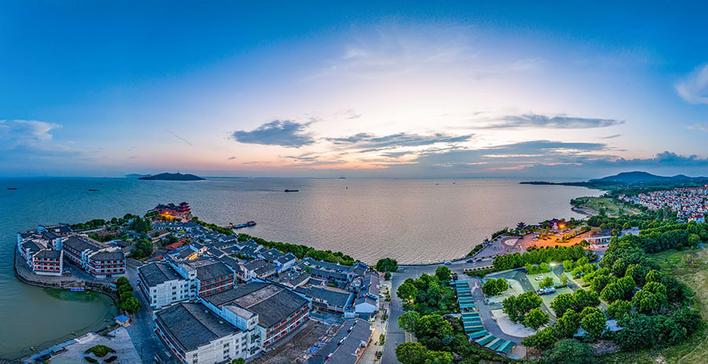
Venue Advantages in Hefei丨Accommodation
Hefei Airport
Option 2丨Crowne Plaza Hotels
ASIPP
40 min (Taxi / Bus / Subway)
>30 hotels in 10 min distance area
City Hall
Train Station
20 min
1.5 h to Huangshan scenic area, every 60 min
Option 1丨InterContinental Hotels
45 min
Chaohu Lake
(4th largest in China)
UNESCO World Heritage Site
(both natural & cultural)

Slide 8
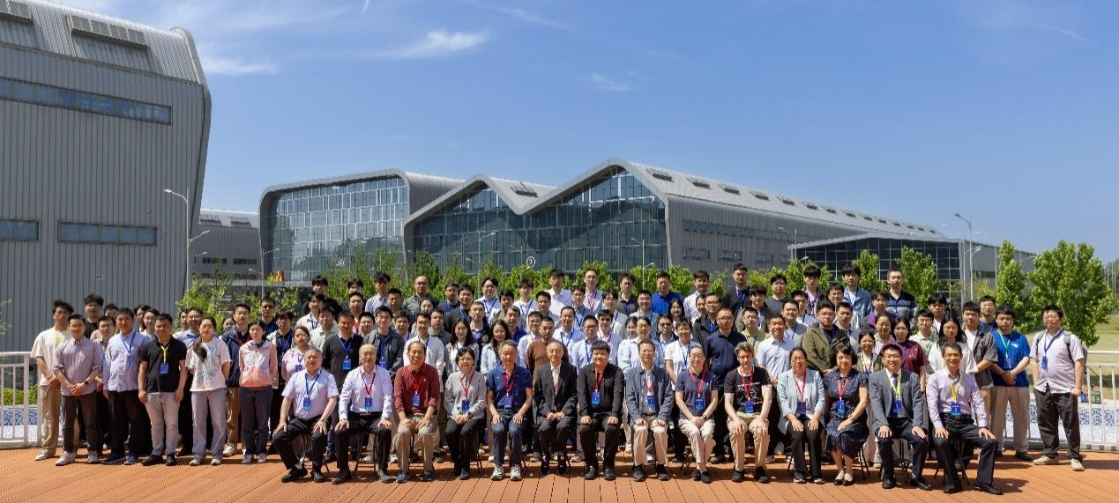
NIBS 2028: Preliminary Conference Plan
Topics
Statue of Facilities
Negative Ion Sources for Accelerator
Negative Ion Sources for Fusion
Beam Neutralization & Transport
Plasma & Beam Diagnostics
Artificial Intelligence
High Voltage PS & Transmission
New & Adavanced Concept
丨Expected Scale
Approximately 150+150 participants, with balanced representation from leading international research groups across Europe, Asia, Americas and Oceania
丨Planned Satellite Workshop
丨Workshop on Neutral Beam Injection in China

Slide 9
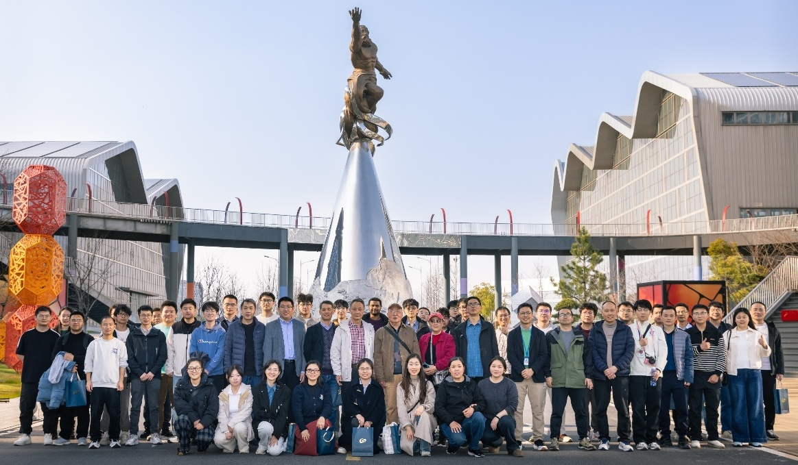
Conference Organization & Guarantee
丨Host Institution: Institute of Plasma Physics, Chinese Academy of Sciences (ASIPP)
丨Co-organizers: Institute of Energy, Hefei Comprehensive National Science Center
丨Conference Committee: International Program Committee, Local Organizing Committee,
and dedicated on-site execution team
ASIPP Team丨Staffs ~35 & Students ~70
丨Full operational guarantees:
Conference funding, visa invitation support, reception logistics, on-site technical support, and participant safety are all fully confirmed

Slide 10
中国科学院等离子体物理研究所
Chinese Academy of Sciences Institute of Plasma Physics (ASIPP)
Thank You
Questions & Discussions
Jianglong WEI (jlwei@ipp.ac.cn)
10th Negative Ions, Beams and Source, Nelson BC, Canada, Sept 20-25, 2026

