Slide 1
Analysis of the plasma meniscus in a negative ion source from the viewpoint of force balance
K. Miyamoto^{a)}, K. Hayashi^{b)}, K. Hoshino^{c)} , and the late A. Hatayama^{c)}
a) Naruto University of Education
b) NIFS
c) Faculty of Science and Technology, Keio University
10th International symposium on Negative Ions, Beams and Sources - NIBS’26
Sept. 20 – 25, 2026, Prestige Lakeside Resort Nelson, Canada

Slide 2
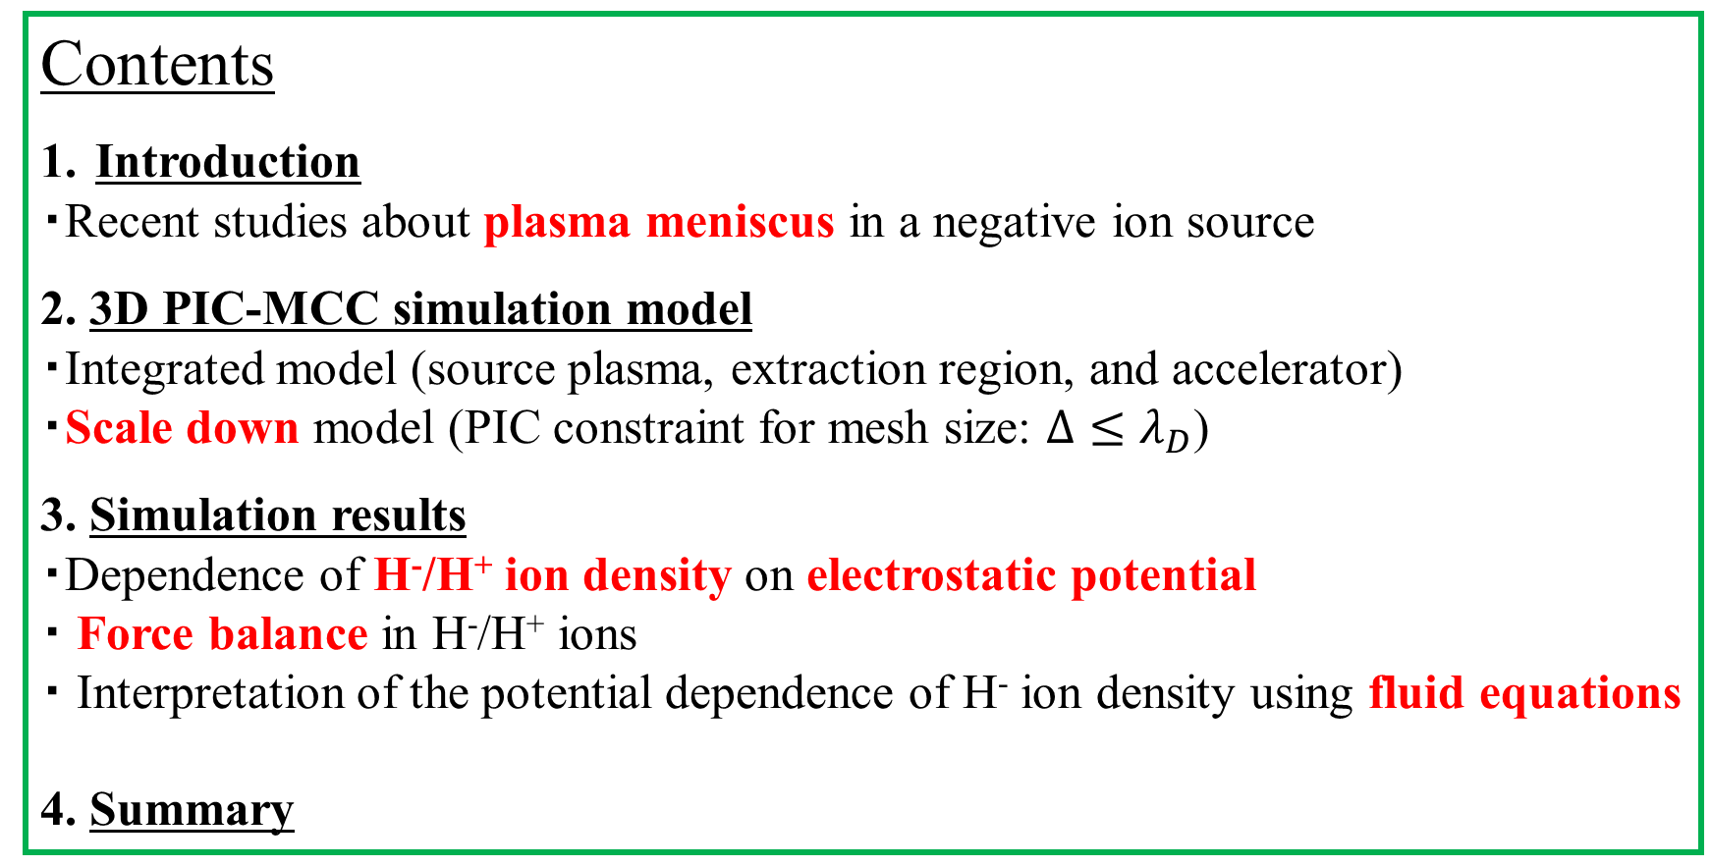
Contents
Introduction
・Recent studies about plasma meniscus in a negative ion source
2. 3D PIC-MCC simulation model
・Integrated model (source plasma, extraction region, and accelerator)
・Scale down model (PIC constraint for mesh size: $Δ≤λ_{D}$)
3. Simulation results
・Dependence of H⁻/H⁺ ion density on electrostatic potential
・ Force balance in H⁻/H⁺ ions
・ Interpretation of the potential dependence of H⁻ ion density using fluid equations
4. Summary

Slide 3
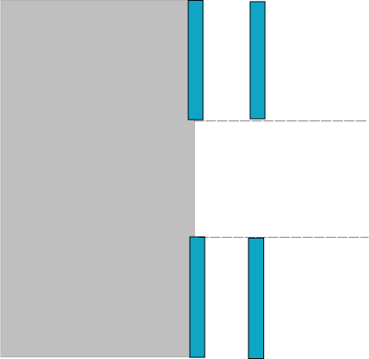
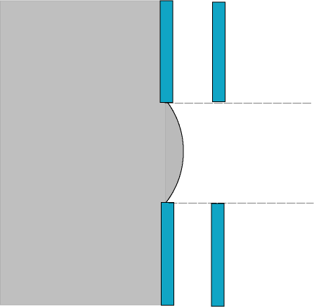
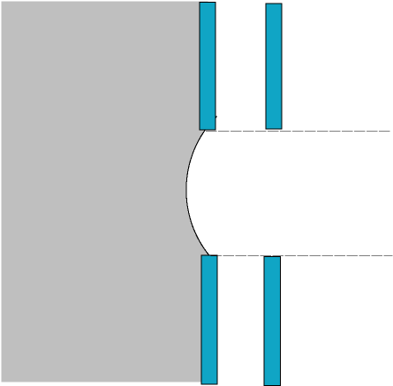


Relation between shape of plasma meniscus and ion beam optics
Control of ion sheath distance d_{eff} between the Plasma Grid (PG) and the Extraction Grid (EG) (or equivalently the position of the plasma meniscus) is very important to obtain good beam quality.
d: geometrical distance between PG and EG
Optimum plasma density
High plasma density
Low plasma density
PG
EG
PG
EG
PG
EG
Source
Plasma
Extraction
aperture
Ion beam trajectory
d_{eff} = d
d_{eff} < d
d_{eff} > d
Plasma meniscus：flat
Extracted ion beam：parallel
Optimum perveance
Plasma meniscus : Convex 凸
comes out towards the EG
Extracted beams : diverged
Plasma meniscus : Concave 凹
penetrates into the source region
Extracted beams : over-focused

Slide 4
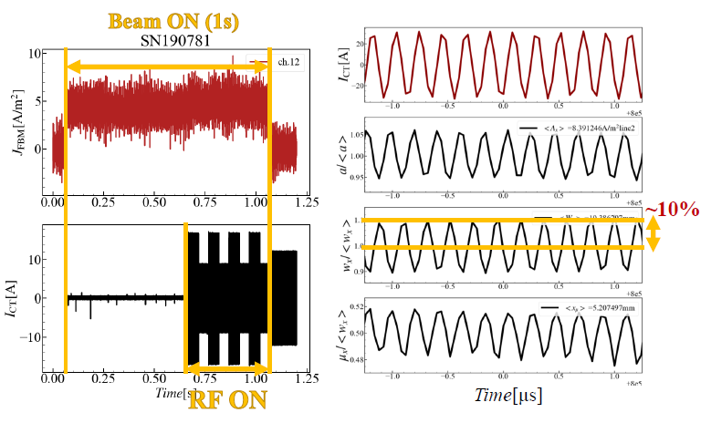
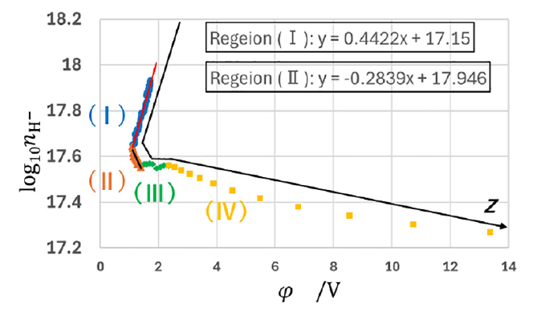
Recent studies about plasma meniscus in a negative ion source
Experiment
Simulation
Oscillations of a negative-ion beamlet width and axis responding to the RF perturbation were observed in the negative ion source [1] while these oscillations were not observed in a core region of the positive ion beamlet in the case of RF positive ion source [2].
(I) H⁻ ion density follows the Boltzmann relation
(II) H⁺ ion density follows the Boltzmann relation
(III) Transition region
Beam accelerating region
The plasma meniscus can be interpreted as the boundary between Region (III) and Region (IV).
[1] K. Nagaoka et al., Scientific reports, 15, 1494 (2025)..
[2] K. Takahashi et al., New J. Phys., 21, 093043 (2019)..
[3] K. Hayashi et al., Plasma and Fusion Res., 21, 14019 (2026).
The plasma meniscus and relevant physical structure in the ion-ion plasma of a hydrogen negative source is investigated with the 3D PIC-MCC simulation from the viewpoint of the force balance of H⁺/H⁻ ions.

Slide 5

3D PIC-MCC simulation model (I)
e
electron
+
H⁺
All the particles
x
40 mm
－
H⁻
x = +8.125 mm
30 mm
+
periodic boundary condition
+
magnetic filter
electron suppression magnetic field
e
×
z
source plasma
e
re-load
e
Surface produced H⁻
・half-Maxwellian
・angular distribution：cosine distribution
・H- is launched uniformly from the PG surface.
delete
－
－
－
－
z = z_{min}
PG
(0 V)
EG
(2.7 kV)
SG
(2.7 kV)
GG
(62.1 kV)
x = -8.125 mm

Slide 6
3D PIC-MCC simulation model (II)
A single aperture of the negative ion source for NIFS is modelled.
Physical parameter | Value
Electron density | 1.8×10¹⁷ m⁻³
Electron temperature | 0.8 eV
H⁺ ion temperature | 0.3 eV
H⁻ ion temperature | 0.1 eV（Volume produced） 1 eV（Surface produced）
H₂ molecular density n_{H2} | 1.88×10¹⁹ m⁻³ （0.3 Pa）
H₂ molecular temperature | 0.1 eV
H atom temperature | 0.3 eV
Ratio of n_{H2} / n_{H} | 0.5

Slide 7
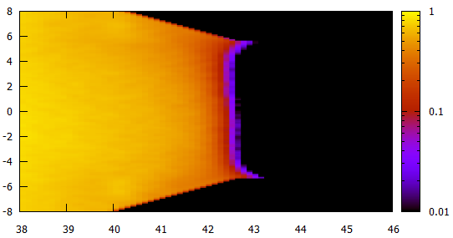
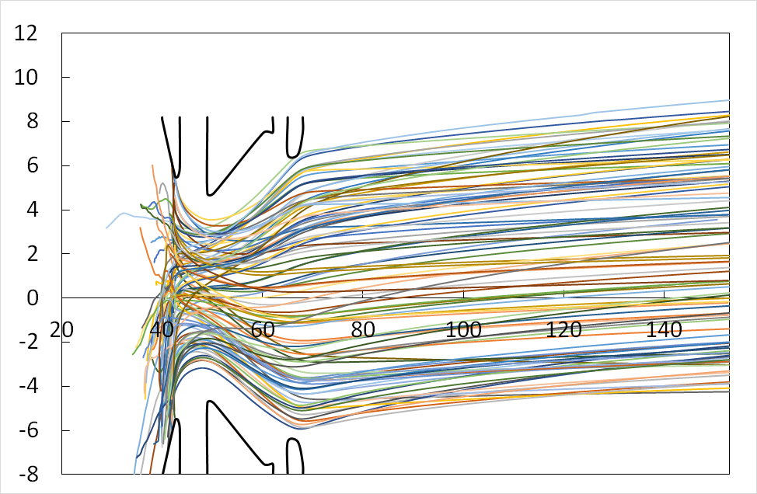
3D PIC-MCC simulation model (III)
Distribution of n_{H+} around the PG
(×n_{e0} m⁻³)
Number of H⁻ particles / time step / process | Surface produced H⁻ ion flux from PG (A/m²)
20 | 39
60 | 146
100 | 255
x (mm)
PG
H⁻ ion beam trajectory
z (mm)
PG
EG
SG
x (mm)
z (mm)
K. Miyamoto et al, JINST, 18, C06014 (2023)

Slide 8
3D PIC-MCC simulation model (IV)
・The following collisions related to the H⁻ ions are taken into account:
Coulomb collision：H⁻－H⁺, H⁻ － H⁻
Charge exchange collision：H⁻ (fast)+ H(slow) → H⁻ (slow)+ H(fast)
Elastic collision：H⁻－H, H⁻ － H₂
Mutual neutralization：H⁺ + H⁻ → H + H
Other simulation conditions
・Initial super-particle numbers：
Electron (8.715×10⁷), H⁺ ion (1.245×10⁸), H⁻ ion (3.735×10⁷)
10 particles per mesh in average
・Neutral particles（H, H₂）are assumed to be the background particles.

Slide 9
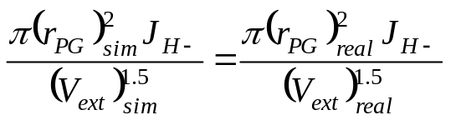

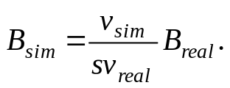
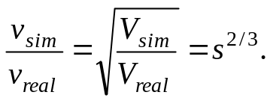


Scaled model
・ The mesh size should be less than the electron Debye length from the PIC constraint. Since the large different size between the electron Debye length and the real negative ion source will cause considerable high computation cost, the simulation model is scaled down.
L_{sim} = s L_{real} (s :scale factor)
・ The strengths of the applied voltages and the magnetic field are modeled followed by the scale down:
Electric field
Magnetic field
(1) Extraction voltage
The magnetic field is scaled down such that the follwing relation for the Larmor radius of electrons r_{L} is satisfied;
The extraction voltage is modeled in order to match the perveance for the real negative ion source.
${\left(r_{L}\right)}_{sim}=s{\left(r_{L}\right)}_{real}$
(2) Acceleration voltages
The applied voltages in the accelerator are modeled to satisfy the law of scaling.
${\left(V_{acc}\right)}_{sim}:{\left(V_{ext}\right)}_{sim}=$ ${\left(V_{acc}\right)}_{real}:{\left(V_{ext}\right)}_{real}$
V_{acc} : acceleration voltage
(6)

Slide 10
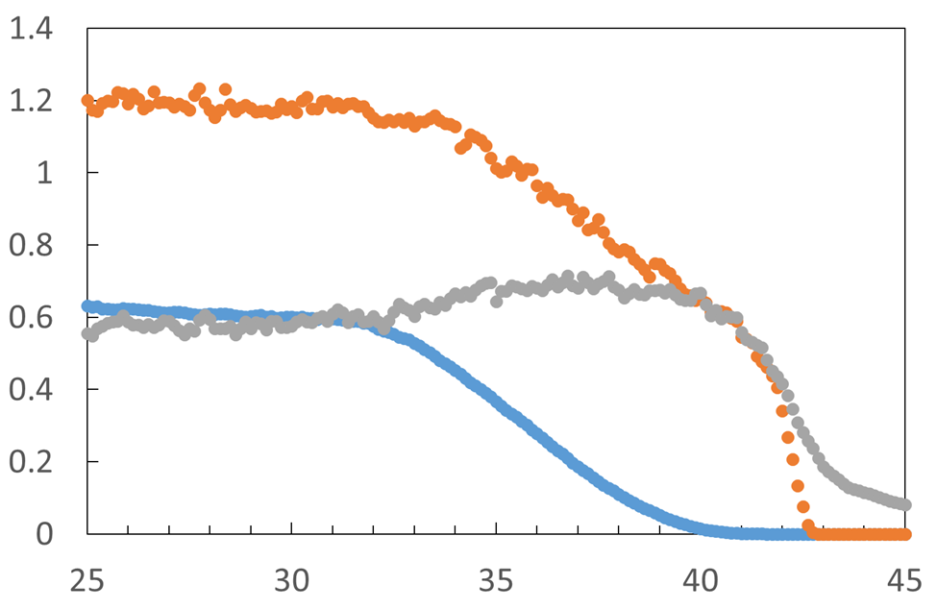
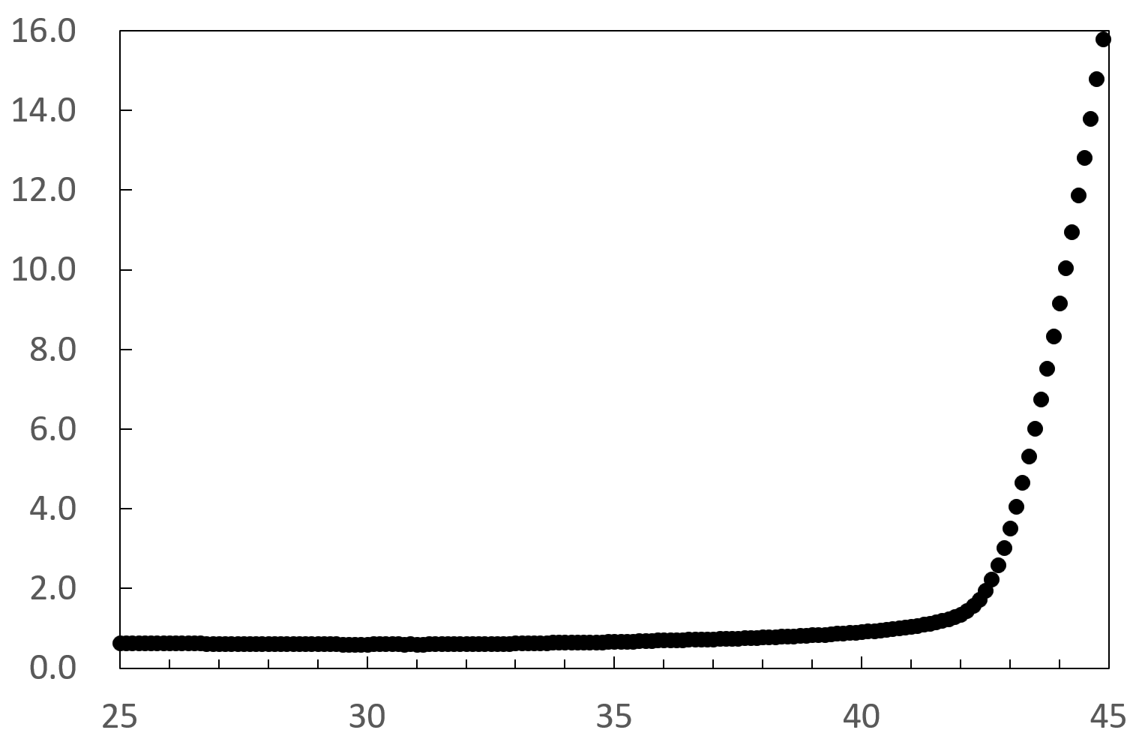

Spatial distribution of plasma density and potential along the z-axis
n_{e0} =1.8×10¹⁷ m⁻³ , λ_{De} = 0.0157 mm
(a) Plasma density
(b) Potential
source plasma
PG
H⁺
PG
source plasma
n_{e}, n_{H+,} n_{H-} (×n_{e0} m⁻³)
H⁻
$$φ_{sim}(V)$$
electron
z_{sim}
×5λ_{De}
z_{sim}
×5λ_{De}
Separation of H⁺/H⁻ ions (z_{sim} = 42×5λ_{De} )

Slide 11
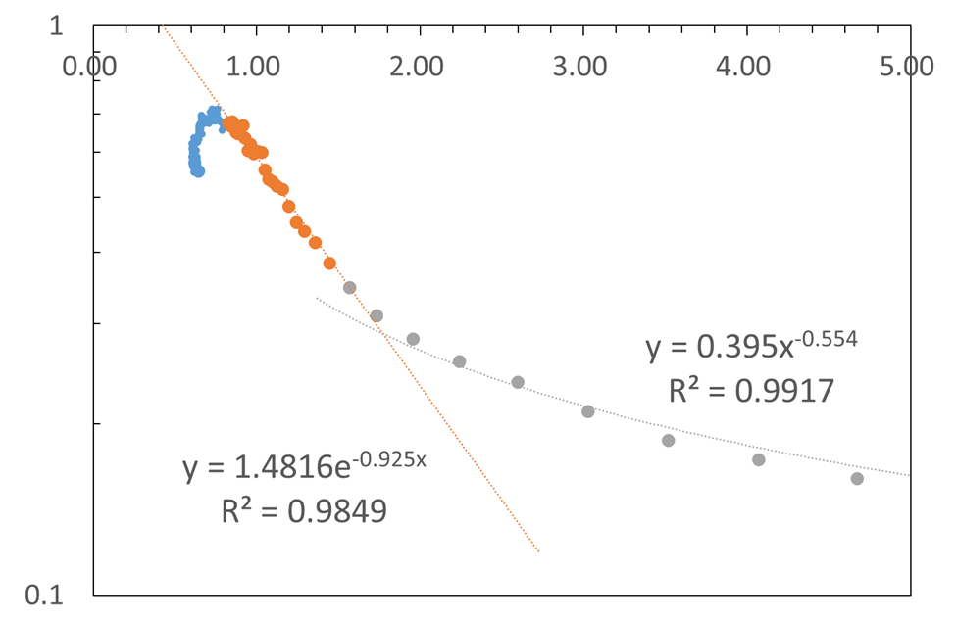

Dependence of H⁻ ion density distribution on the potential
z_{sim} = 42×5λ_{De}
$φ_{sim} (V)$
n_{e0} =1.8×10¹⁷ m⁻³
n_{H-} (×n_{e0} m⁻³)
The negative ion density is approximately inversely proportional to the square root of potential.
The negative ion density varies exponentially with the potential.

Slide 12


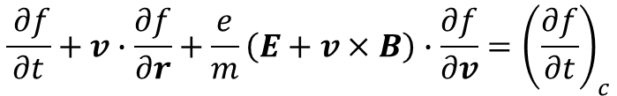

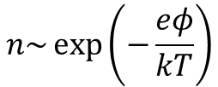


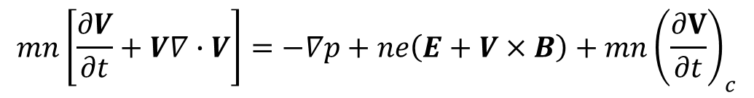


Interpretation of the potential dependence of H⁻ ion density distribution using fluid equations
Boltzmann equation
$$\frac{ ∂f}{∂t}+v∙\frac{∂f}{∂r}+\frac{e}{m}\left(E+v×B\right)∙\frac{∂f}{∂v}={\left(\frac{∂f}{∂t}\right)}_{c}$$
$$\frac{∂}{∂t}\left(n〈A\left(v\right)〉\right)+\frac{∂}{∂r}\left(n∙〈vA\left(v\right)〉\right)−\frac{ne}{m}\sum_{k}{〈\left(E+v×B\right)∙\frac{∂A}{∂v}〉}={\left\{\frac{∂}{∂t}\left(n〈A\left(v\right)〉\right)\right\}}_{c}$$
Moment equation
First-order moment（A = v）
$$mn\left[\frac{∂V}{∂t}+V∇∙V\right]=−∇p+ne\left(E+V×B\right)+mn{\left(\frac{∂V}{∂t}\right)}_{c}$$
Equation for the conservation of momentum
Contribution of V
Contribution of w
$$v=V+w$$
V：Fluid velocity w：Random thermal velocity
In the steady state, if the Lorentz force and collision terms can be neglected, we obtain
Pressure gradient
force
$mnV∇∙V～−∇p+ne$E
Inertial force
$$\left|mnV∇∙V\right|<\left|∇p\right|$$
$$−∇p+neE\sim 0$$
$$n\sim \exp\left(−\frac{eφ}{kT}\right)$$
$$\left|mnV∇∙V\right|>\left|∇p\right|$$
$mnV∇∙V～ ne$E
$$n∝φ^{−1/2}$$

Slide 13
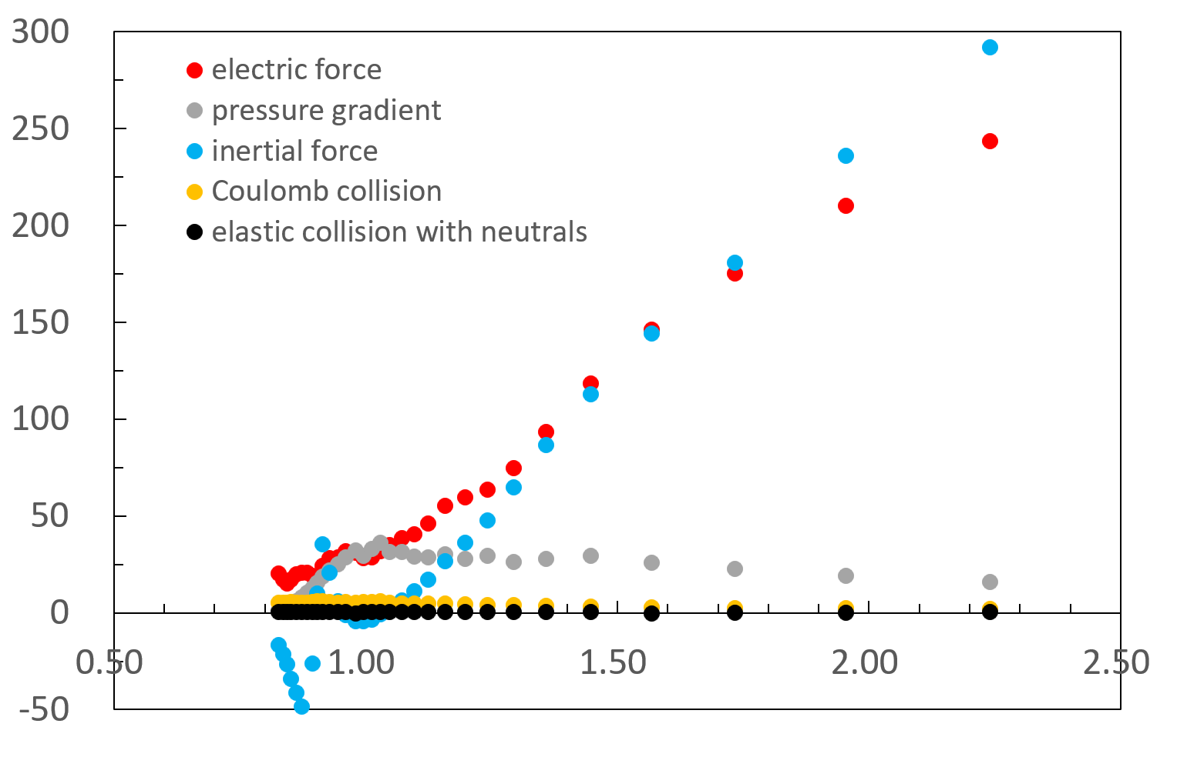

Simulation result for the force balance in H⁻ ions (I)
Electric force： n_{H-}qE_{z} Pressure gradient：γk_{B}T_{H-} $\frac{∂n_{H−}}{∂z}\left(\text{γ}=5/3\right)$ Inertia force： m_{H-} n_{H-} $\frac{dv_{z}}{dt}$Collision terms：$\frac{m_{H−}n_{H−}u_{z}}{τ}$
Forces acting on H⁻ ions F_{sim} (N)
$φ_{sim} (V)$
・The collision terms can be neglected.
・We can classify into (1) the region where the force due to the electric field is comparable to the force due to the pressure gradient, and (2) the regions where the force due to the electric field is comparable to the inertial force.

Slide 14
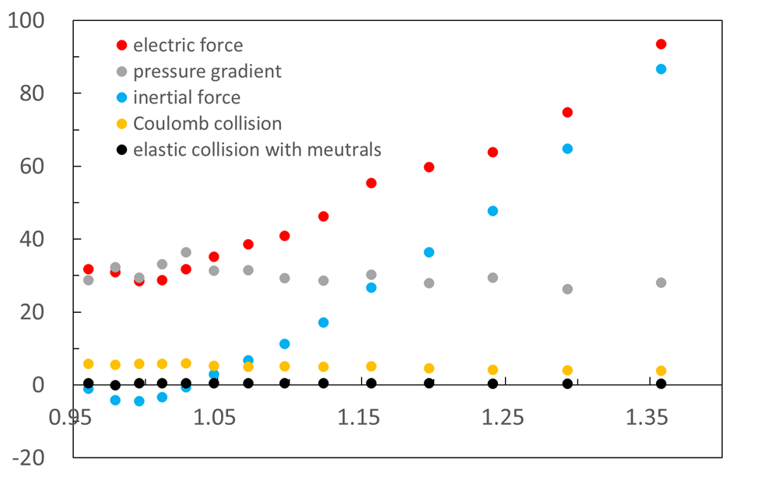






Simulation result for the force balance in H⁻ ions (II)
$φ_{sim} (V)$
n_{H-} (×n_{e0} m⁻³)
Forces acting on H⁻ ions F_{sim} (N)
$φ_{sim} (V)$
$${0.9 V <φ}_{sim}<1.15 V$$
$$\left|mnV∇∙V\right|<\left|∇p\right|$$
It seems that the H⁻ ion density obeys the Boltzmann relation, however, it exhibits a trend opposite to the Boltzmann relation with respect to the potential.
${1.15 V ≤φ}_{sim}$ $≤1.4 V$
$$\left|mnV∇∙V\right|≥\left|∇p\right|$$

Slide 15
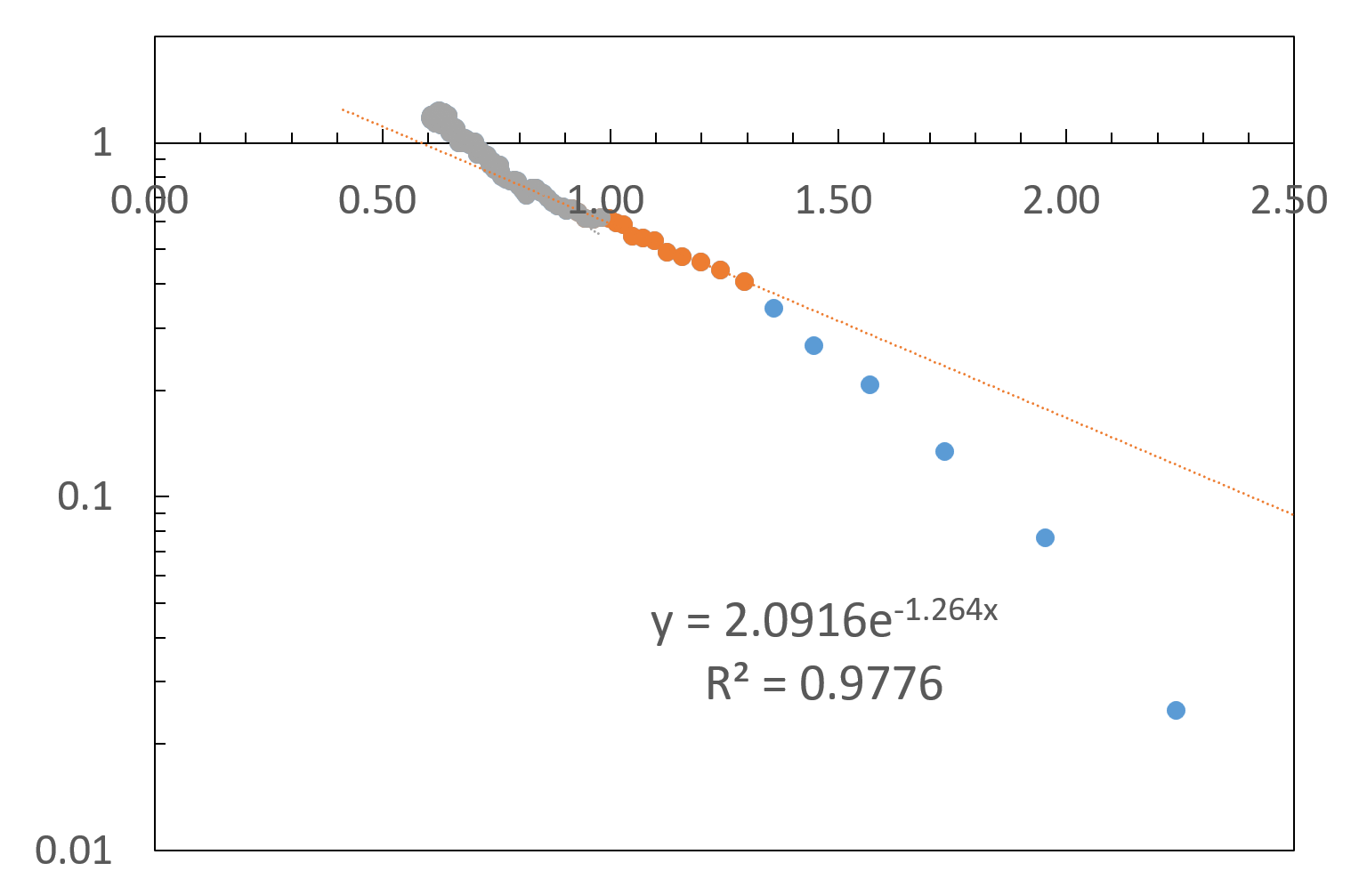

Dependence of H⁺ ion density distribution on the potential
・It is considered that the H⁺ ion density obeys the Boltzmann relation in the range of ${0.9 V <φ}_{sim}<1.4 V.$
・The H⁻ ion density distribution is almost in consistent with that of H⁺ ion density due to the plasma neutrality.
n_{e0} =1.8×10¹⁷ m⁻³
$φ_{sim} (V)$
n_{H+} (×n_{e0} m⁻³)

Slide 16
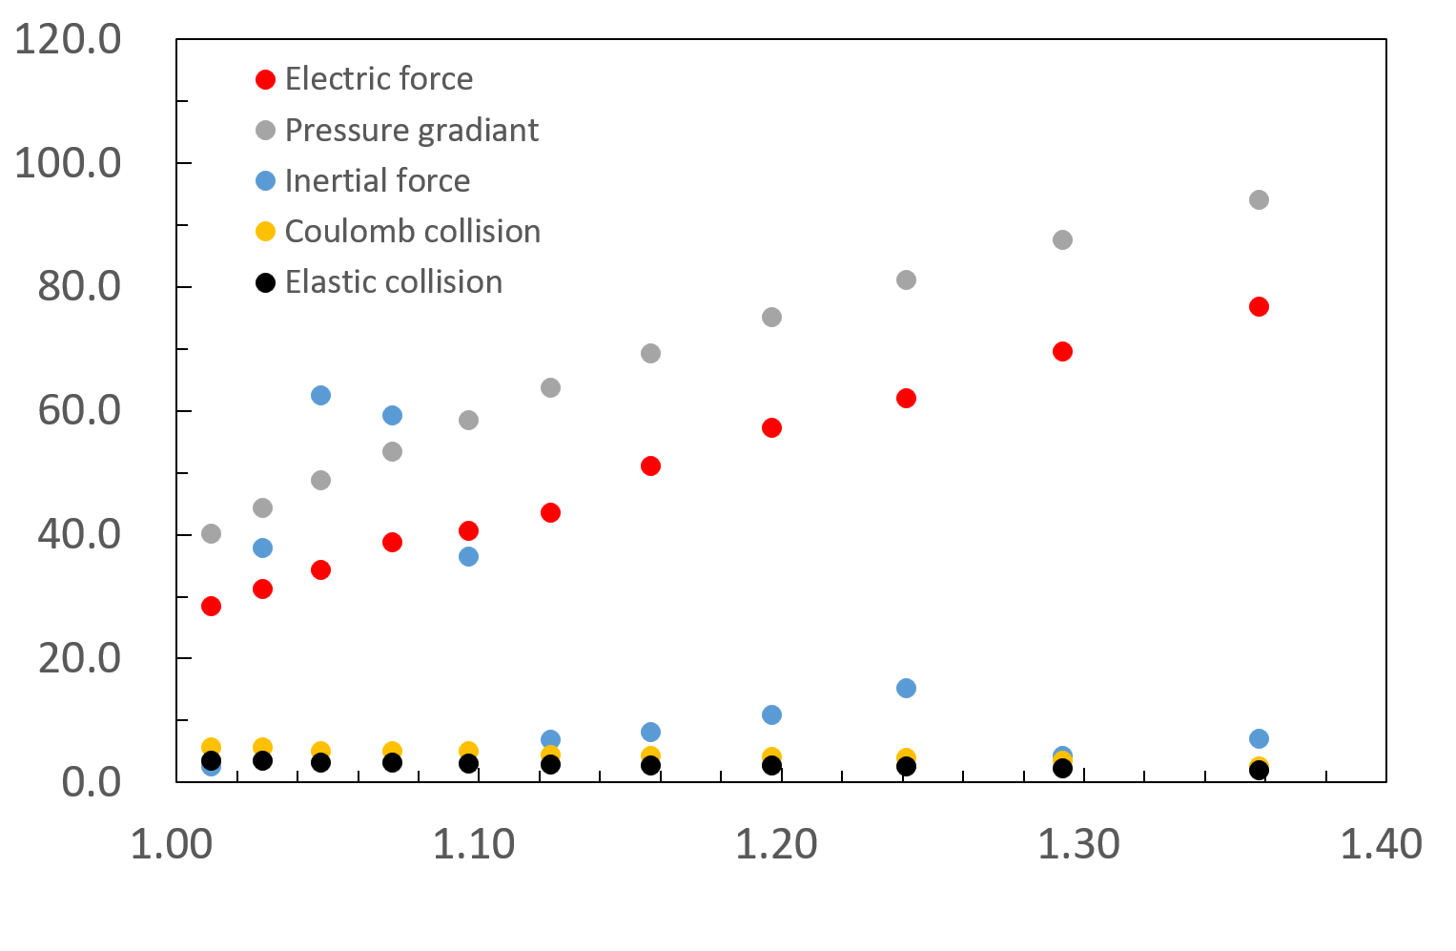
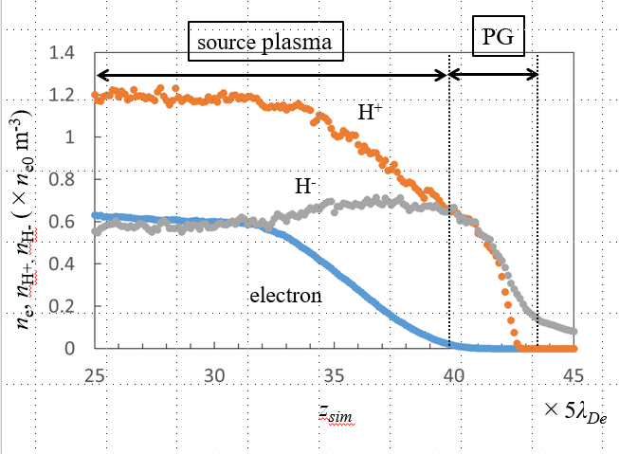





Simulation result for the force balance in H⁺ ions
Forces acting on H⁺ ions F_{sim} (N)
$φ_{sim} (V)$
z_{sim}
40.75×5λ_{De}
41.25×5λ_{De}
41.63×5λ_{De}
41.9×5λ_{De}
42.1×5λ_{De}
$${1.1 V <φ}_{sim}<1.4 V：$$
$$\left|mnV∇∙V\right|<\left|∇p\right|$$
$$neE\sim ∇p$$
Boltzmann relation
$${1.0 V <φ}_{sim}≤1.1 V：$$
A balance of force on the source plasma side is not satisfied. Limitation of the scaled down model??

Slide 17
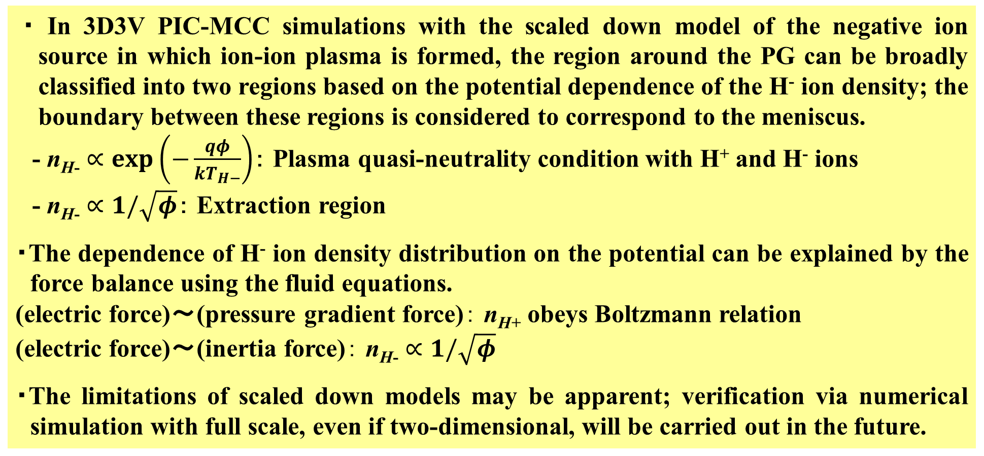
Summary
・ In 3D3V PIC-MCC simulations with the scaled down model of the negative ion source in which ion-ion plasma is formed, the region around the PG can be broadly classified into two regions based on the potential dependence of the H⁻ ion density; the boundary between these regions is considered to correspond to the meniscus.
- n_{H-} $∝exp\left(−\frac{qφ}{kT_{H−}}\right)$： Plasma quasi-neutrality condition with H⁺ and H⁻ ions
- n_{H-} $∝1/\sqrt{φ}$： Extraction region
・The dependence of H⁻ ion density distribution on the potential can be explained by the force balance using the fluid equations.
(electric force)～(pressure gradient force)： n_{H+} obeys Boltzmann relation
(electric force)～(inertia force)： n_{H-} $∝1/\sqrt{φ}$
・The limitations of scaled down models may be apparent; verification via numerical simulation with full scale, even if two-dimensional, will be carried out in the future.

Slide 18
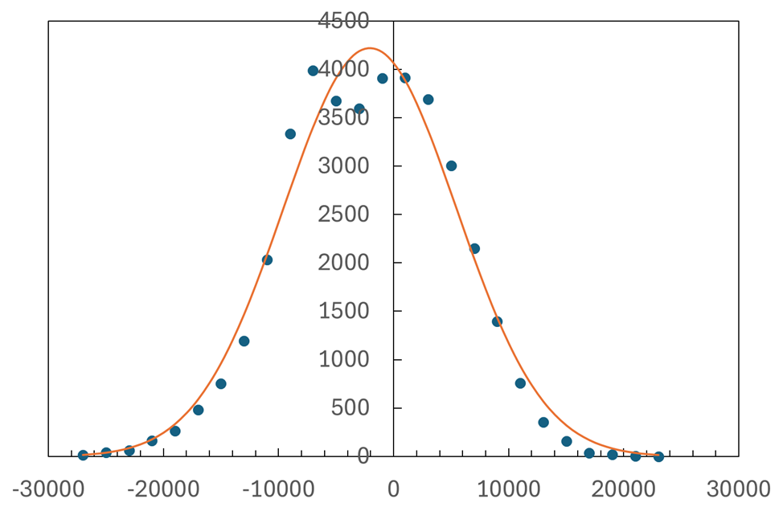
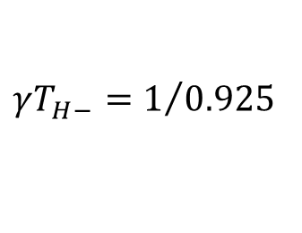



Adiabatic approximation or isothermal approximation? (H⁻ ions)
$φ_{sim} (V)$
The distribution of vz at z_{sim} = 38.9×5λ_{De}
n_{H-} (×n_{e0} m⁻³)
Number of the H⁻ particles
z_{sim} = 38.9×5λ_{De} (mm)
$$γT_{H−}=1/{0.925}$$
$v_{z, sim} (V)$
By substituting T_{H-} = 0.59 eV, we obtain $γ=$1.83.
The distribution of v_{z} is Maxwellian.
T_{H-} = 0.59 eV
$$γ=5/3（Adiabatic approximation for 3D）$$
$$γ=1 (Isothermal approximation)$$

Slide 19
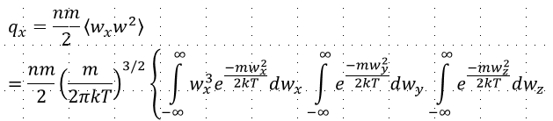


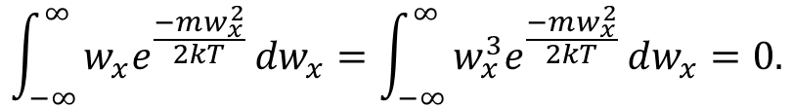
Since the velocity distribution of the negative ions is a Maxwellian distribution, the heat flux q becomes zero, and the adiabatic approximation holds?
Let us consider the x-component:
w：Random thermal velocity
${Since w}_{x}e^{\frac{−mw_{x}^{2}}{2kT} } and w_{x}^{3}e^{\frac{−mw_{x}^{2}}{2kT} }$are odd functions, one obtains
$$\int_{−∞}^{∞}{w_{x}e^{\frac{−mw_{x}^{2}}{2kT} }dw_{x}}=\int_{−∞}^{∞}{w_{x}^{3}e^{\frac{−mw_{x}^{2}}{2kT} }dw_{x}=0.}$$
Therefore, q_{x} is 0. Similarly, q_{y} and q_{z} are 0.

Slide 20
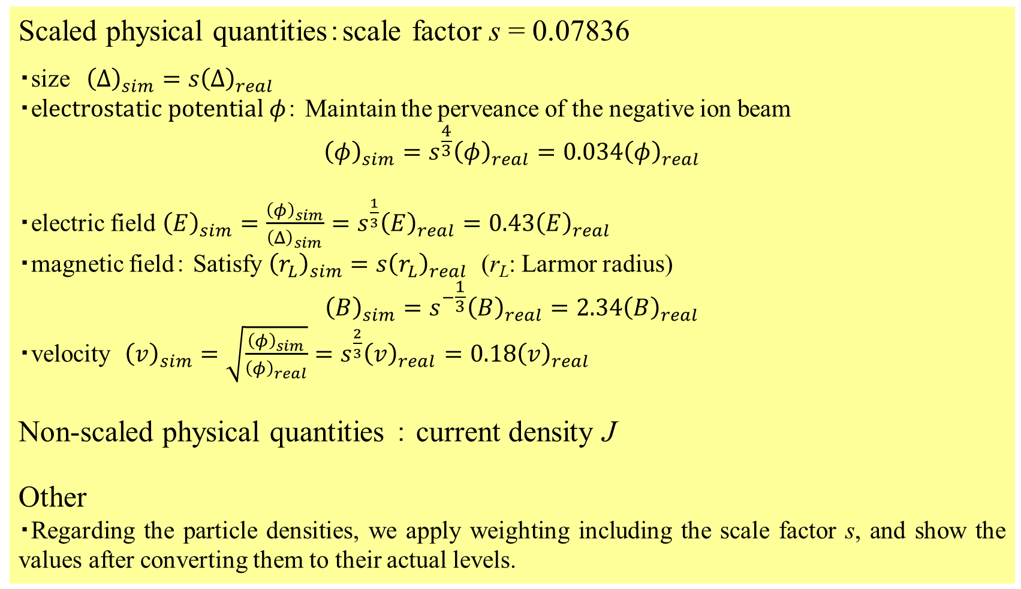
Scaled physical quantities：scale factor s = 0.07836
・size ${\left(Δ\right)}_{sim}=s{\left(Δ\right)}_{real}$
・e$lectrostatic potential φ$： Maintain the perveance of the negative ion beam
$${\left(φ\right)}_{sim}=s^{\frac{4}{3}}{\left(φ\right)}_{real}={0.034\left(φ\right)}_{real}$$
・electric field ${\left(E\right)}_{sim}={\frac{{\left(φ\right)}_{sim}}{{\left(Δ\right)}_{sim}}=s}^{\frac{1}{3}}{\left(E\right)}_{real}={0.43\left(E\right)}_{real}$
・magnetic field： Satisfy ${\left(r_{L}\right)}_{sim}=s{\left(r_{L}\right)}_{real}$ (r_{L}: Larmor radius)
$${\left(B\right)}_{sim}=s^{−\frac{1}{3}}{\left(B\right)}_{real}=2.34{\left(B\right)}_{real}$$
・velocity ${\left(v\right)}_{sim}=\sqrt{\frac{{\left(φ\right)}_{sim}}{{\left(φ\right)}_{real}}}=s^{\frac{2}{3}}{\left(v\right)}_{real}={0.18\left(v\right)}_{real}$
Non-scaled physical quantities ： current density J
Other
・Regarding the particle densities, we apply weighting including the scale factor s, and show the values ​​after converting them to their actual levels.

Slide 21
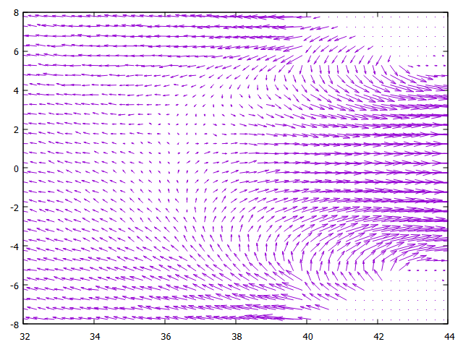
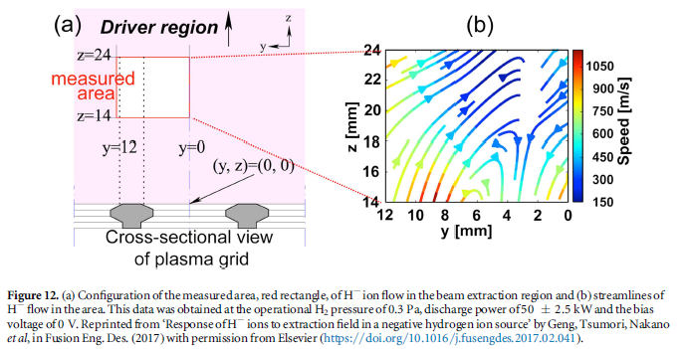
Two-dimensional distribution of H⁻ ion flux J_{H-} around the PG
Negative ions generated on the surface are emitted from the PG, then reverse their direction within the bulk plasma and are extracted.
Simulation result of J_{H-}
Experimental result of H⁻ flow using a Mach probe
PG
×5λ_{De}
x_{sim}
S. Geng et al., Fusion Eng. Des., 123, 481-484 (2017).
z_{sim}
×5λ_{De}

Slide 22
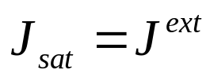
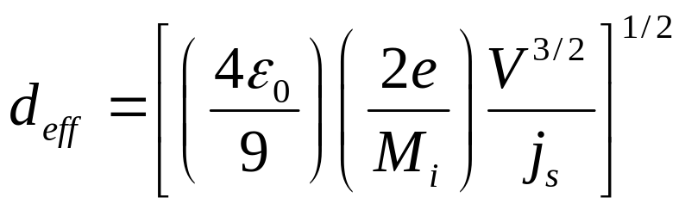
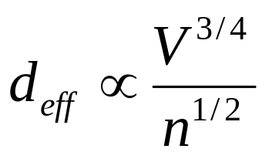
Method for deriving the ion sheath distance (for plasma composed of electrons and positive ions)
Inside the source plasma
=> Current through the sheath J_{sat}
(Saturation current)
Outside the source plasma
(between PG and EG)
=> Extracted current J^{ext} (Child-Langmuir current)
At a wall, the following condition should be satisfied in order to form the sheath:
（ion saturation current）＝
（electron saturation current）
Current continuity
PG
EG
Ion sheath distance d_{eff}
Source
Plasma
M_{i}：Mass of H⁺ ion
j_{s}: Ion saturation current
V：Extraction voltage
Extraction
aperture
or

Slide 23
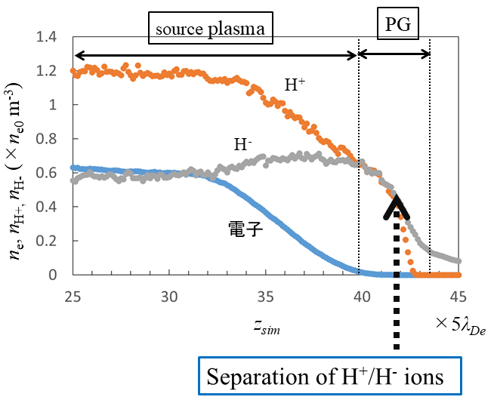

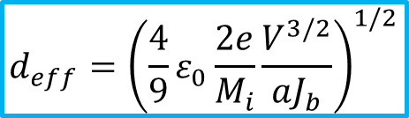
For the surface-produced negative ions, an ion saturation current cannot be defined as it is for positive ions !?
After being emitted from the PG, surface-produced negative ions reverse their direction within the bulk plasma and are extracted.
↓
The ion sheath distance d_{eff} can be evaluated using the negative ion current density J_{b} emitted from the PG surface, instead of the ion saturation current ?
aJ_{b} = J^{ext} (0 < a ≦1)
$$d_{eff}={\left(\frac{4}{9}ε_{0}\frac{2e}{M_{i}}\frac{V^{3/2}}{aJ_{b}}\right)}^{1/2}$$
Substituting J_{b} = 146 A/m², a = 1, V_{sim} = 90.5 V, one obtains
d_{eff, sim} = 0.657 mm = 7.23× 5λ_{De} ( λ_{De} = 0.0157 mm )
z_{sim} = 49 − 7.23 = 41.77×5λ_{De}
z_{sim}
z_{real} (mm)
λ_{De} = 0.0157 mm
41.77
41.77
PG
43.5
43.5
d_{eff}
49
49
EG
×5λ_{De}

