Slide 1

10th International symposium on Negative Ions, Beams and Sources
Latest Developments of Liquid Spray Neutralization for Neutral Beam Injection
Sargis Ter-Avetisyan
Extreme Light Infrastructure-Nuclear Physics (ELI-NP) Bucharest-Magurele, Romania
sargis.ter-avetisyan@eli-np.ro
20–25 Sept 2026
Prestige Lakeside Resort Nelson

Slide 2


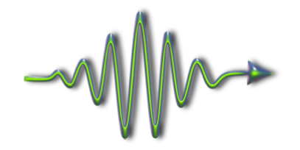
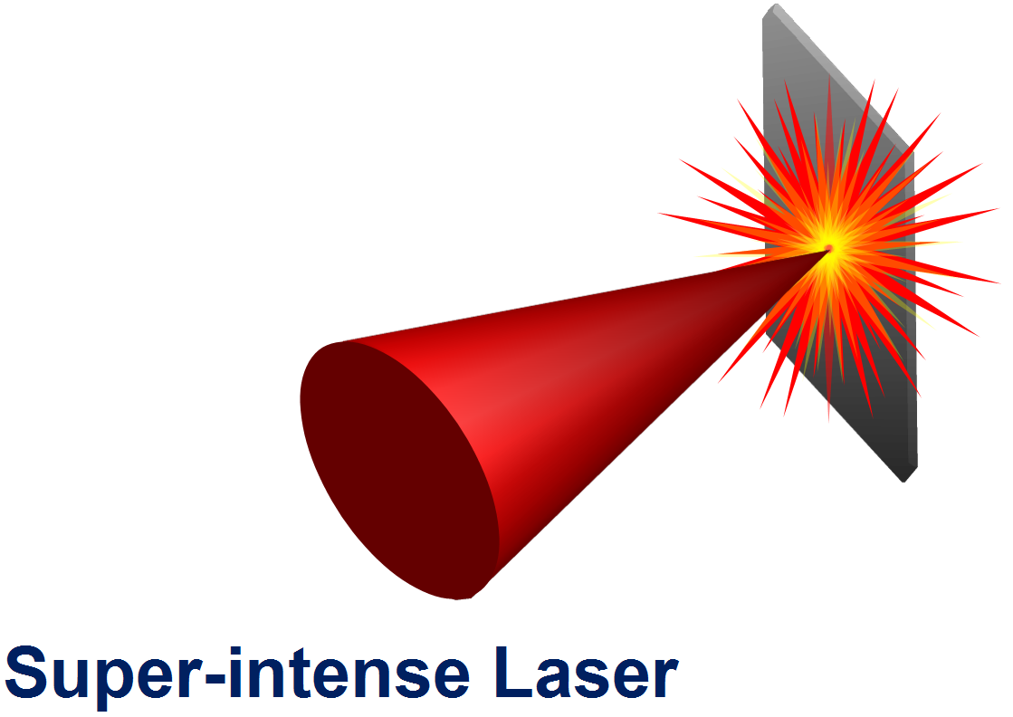




currently, the frontier of maximum intensity is pushed above 10²² W/cm²
(e.g. 10 PW laser at ELI-NP)
exploration of Relativistic Laser-Matter Interactions
Atto/Zeptosecond
Science
Relativistic Laser-Plasma
Lab. Astrophysics
High Energy Protons
Relativistic Electrons
Laser Nuclear Physics
γ-rays,
QED phenomena
Novel Applications
aim:
to develop laser-driven sources of energetic ions (gammas) as a reliable, generic technology for applications

Slide 3
This work highlights another important aspect of ion acceleration research:
namely the ability to generate high-energy beams of
Negative ions and Neutral atoms

Slide 4
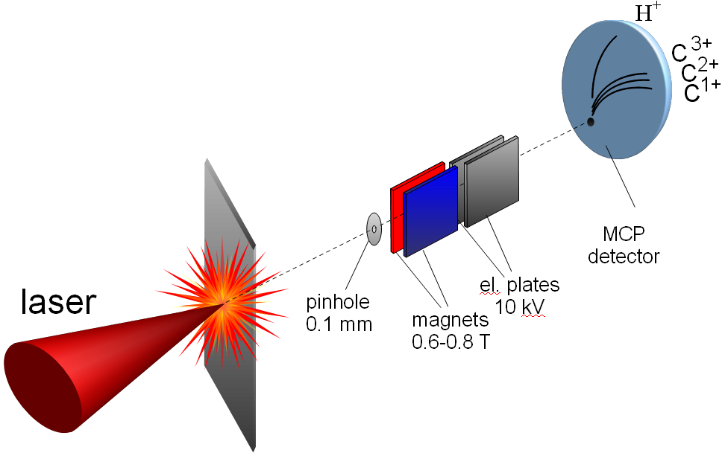
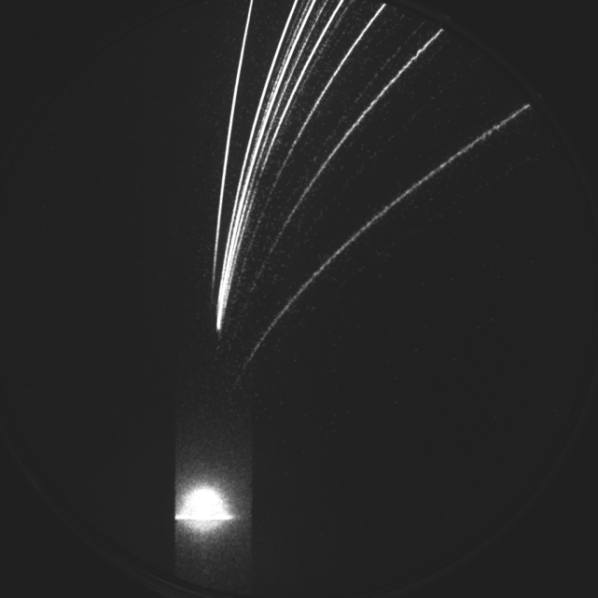
measurement of laser accelerated ion spectra
(Thomson spectrometer)
Absolute calibrated MCP detector
10 nm C, 10 J
I ∼ 5×10²⁰ W/cm²
C6+
P
C2+
7
3
10
5
C1+
magnetic deflection
20
10
30
15
50
C6+(MeV)
Protons (MeV)
I > 10²⁰ W/cm²
electric deflection
Ion spectra (Thomson spectrometer)
“Zero” point

Slide 5
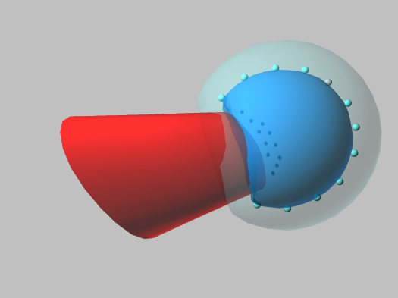
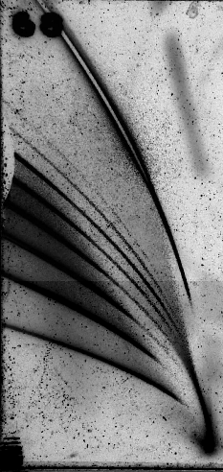
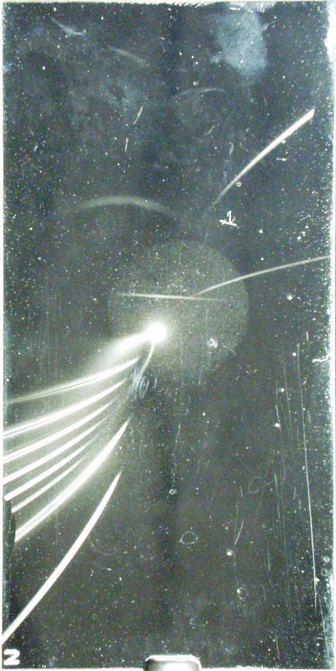
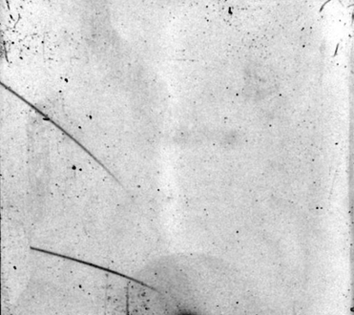
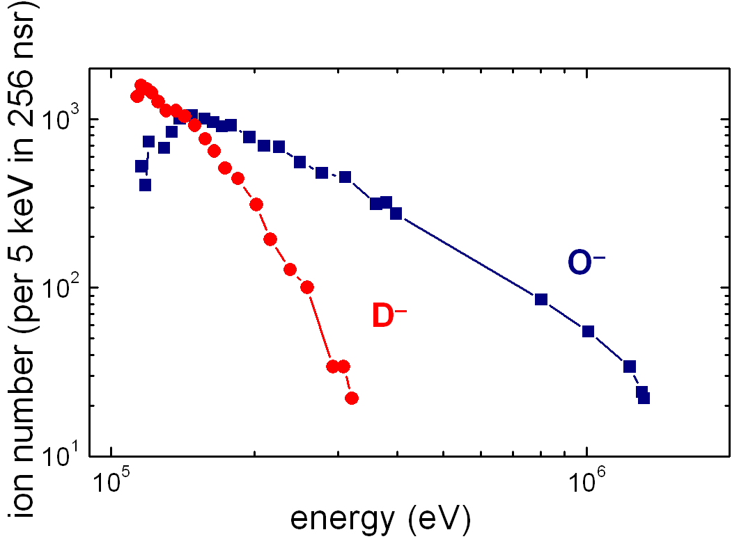
negative ion emission from droplet target
ion spectra from H₂O and D₂O exploded droples
I ~ 5×10¹⁹ W/cm²
p
-
-
O⁸⁺
-
-
-
+
+
+
-
D⁻
+
+
-
Laser
Laser
+
+
-
-
+
-
O¹⁺
-
O¹⁻
droplet size 20 µm
O¹⁺
O⁷⁺
D⁺
p
up to 10⁴ shot accumulation
S. Ter-Avetisyan et.al., J. Phys. B: 37, 3633 (2004),
Notes:
Direct acceleration of pre-existing negative ions in the same electrostatic field that accelerated the positive ions is excluded, as the strong field would immediately strip them of their extra electrons.

Slide 6
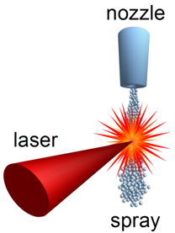
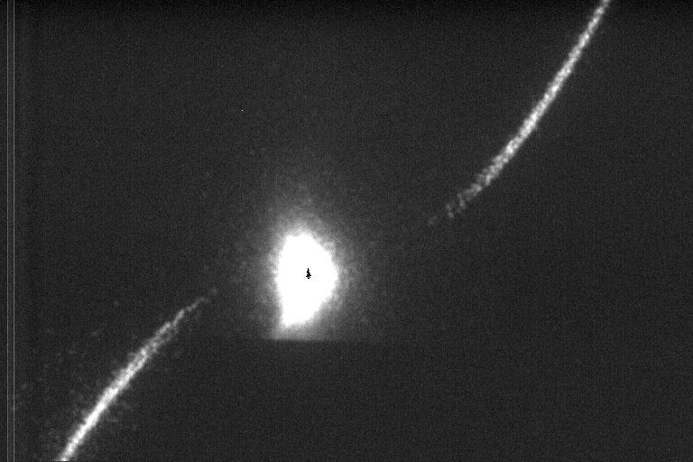
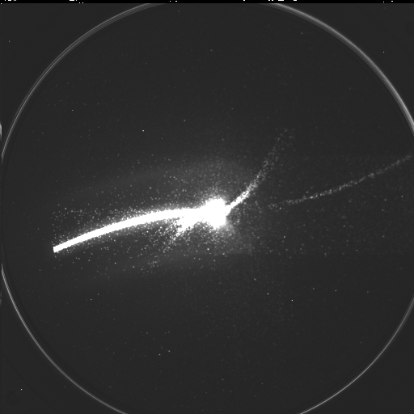
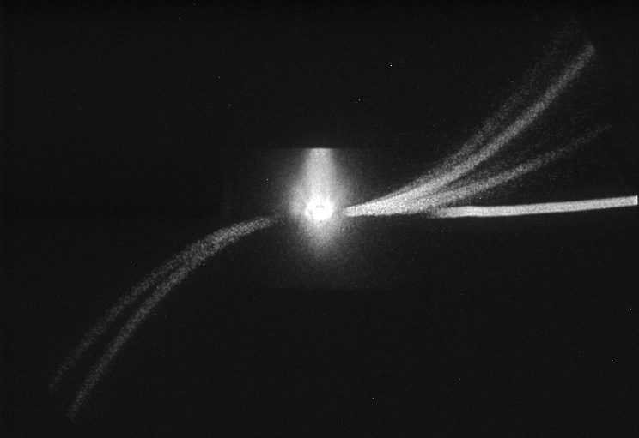
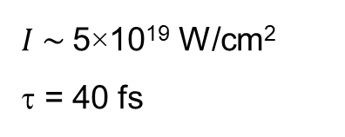
first observation of negative ion generated from liquid spray
measurements in single laser shot
water spray
O⁻
$I \sim$5×10¹⁹ W/cm²
τ = 40 fs
H ⁻ ∼ 150 keV
electric deflection
O⁺
magnetic deflection
H⁺
H⁻
ethanol spray
O¹⁺
C¹⁺
O²⁺
d_{droplet} ~150 nm
C²⁺
droplet density ∼10¹¹ cm⁻³
electric deflection
p
average density 10¹⁸ - 10¹⁹ cm⁻³
C¹⁻
O¹⁻
magnetic deflection
Patent 20060054238 “Device and method for the creation of droplet targets”. Inventors: Ter-Avetisyan, et al.,

Slide 7
water spray and negative ion formation in charge-exchange
interaction geometry
2 mm
possible scenario
positive ions are accelerated in Coulomb explosion
laser
spray
ion propagation through the spray is collisional
high-intensity region
electron capture and loss by fast projectile
4 μm
O^{n+} ↔ O^{(n-1)+}
single droplet
-
-
-
-
-
-
+
+
+
-
+
+
-
-
+
-
-
-
+
-
+
-
+
+
-
-
-

Slide 8
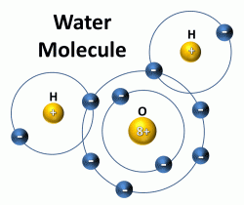


Artist's conception of electron capture by proton
H
H
-
→
A⁻
A⁺ → A⁰
→
A⁺
charge – exchange becomes resonant process if velocities:
$vfast ion$ ≈ $vbound electron$ (Massey criterion )
elastic interaction, no energy exchange
ions’ propagation direction and their energy remain unchanged after the collision
the angular spread is ∼ 1°

Slide 9
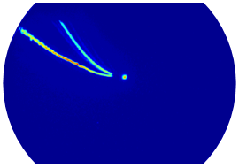
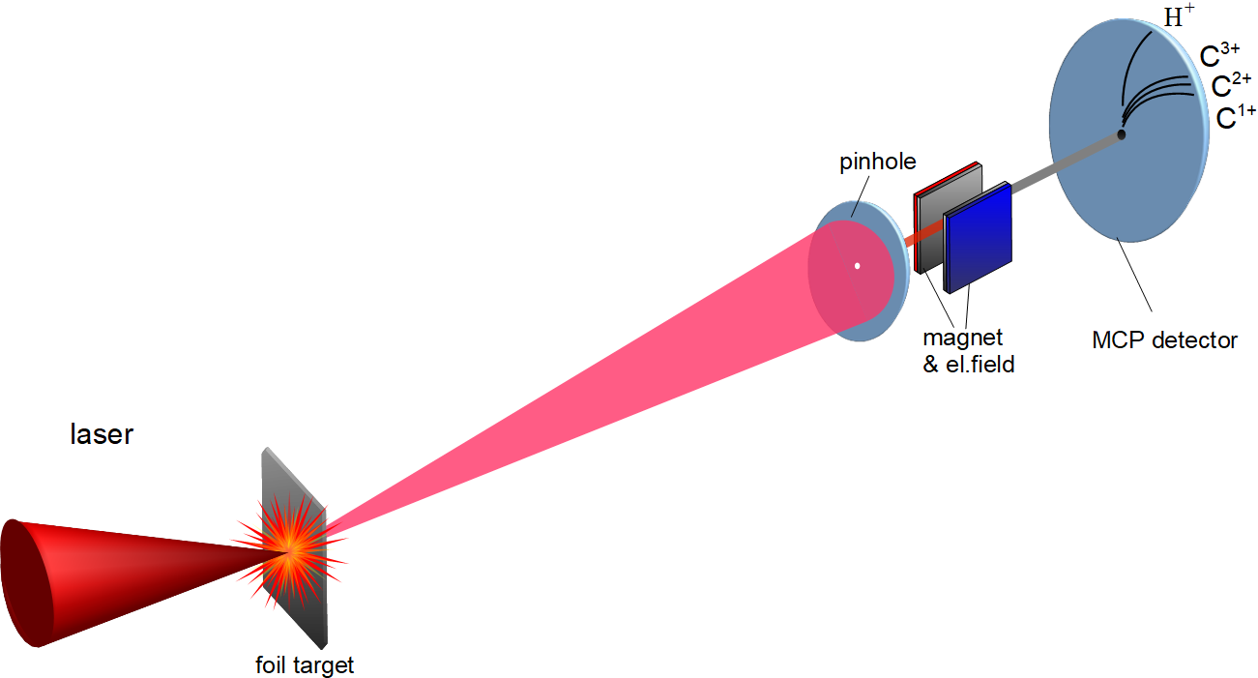
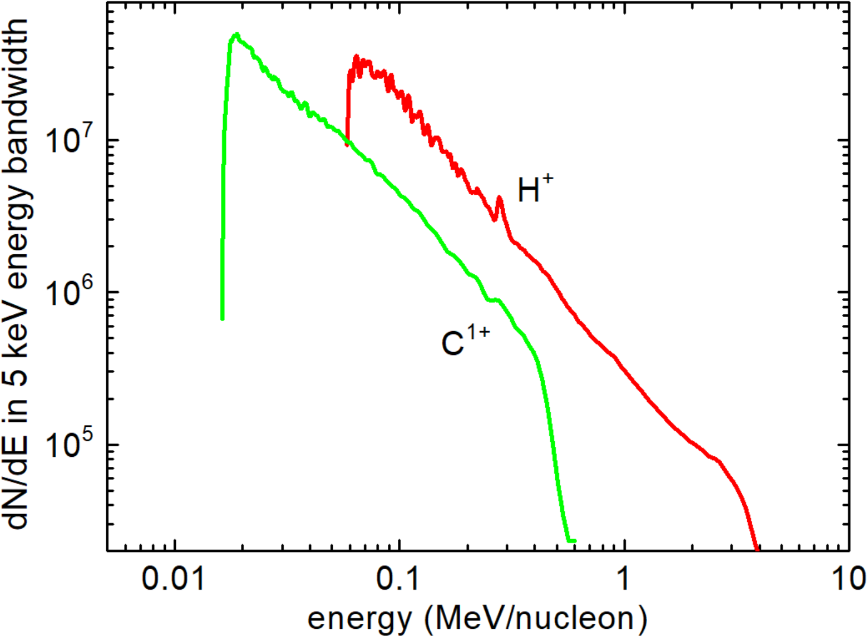


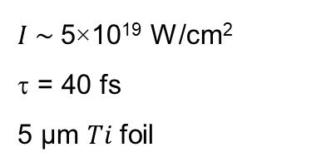



ion acceleration from Ti foil target
$$C^{4+}$$
a')
$$H^{+}$$
$$H^{+}$$
$$C^{4+}$$
Thomson spectrometer
$$H^{+}$$
electric deflection
$I \sim$5×10¹⁹ W/cm²
τ = 40 fs
5 µm $Ti$foil
magnetic deflection
ion spectra

Slide 10
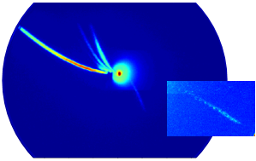
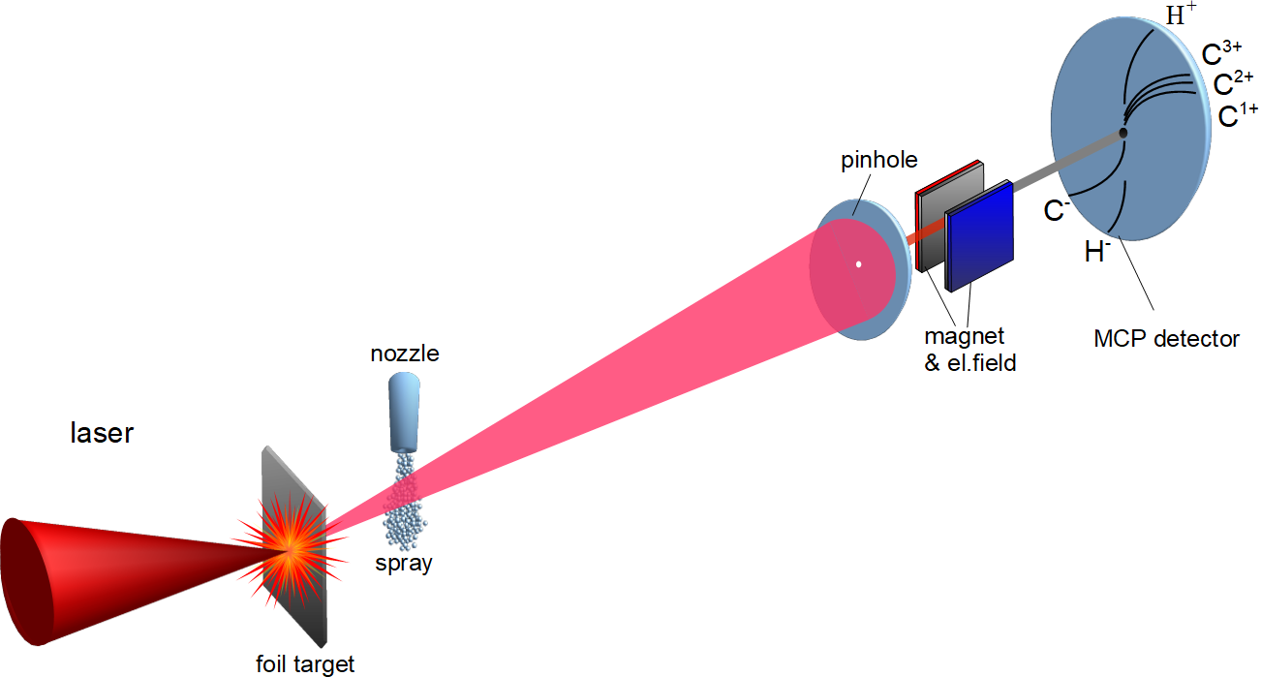
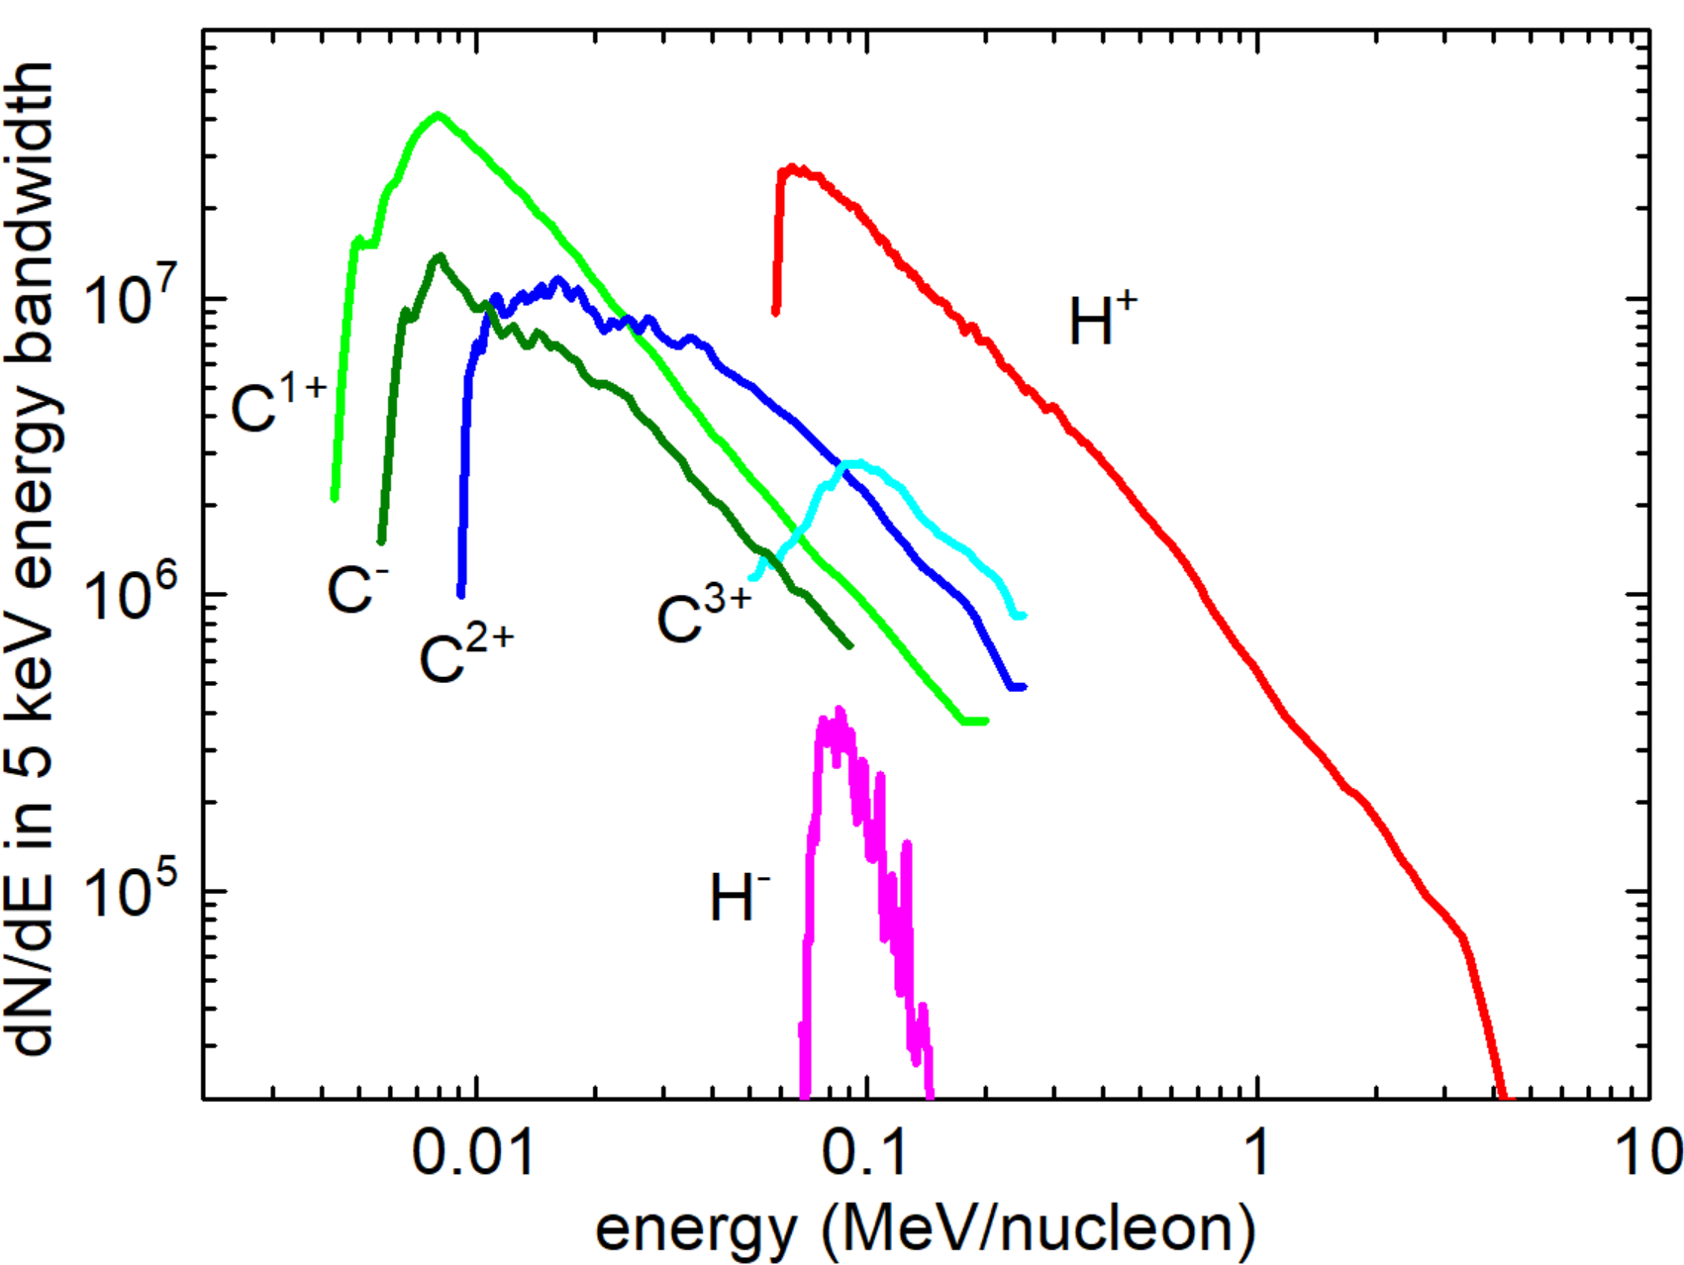





water spray was introduced in the path of positive ion beam
spray as secondary target
$$C^{2+}$$
$$C^{+}$$
$$H^{+}$$
$$H^{−}$$
inserted spray
$$C^{−}$$
ion spectra
A⁻
→
A⁺ → A⁰
→
A^{+n}
implication of the model - existence of neutrals
C⁻_{max} ∼ 1 MeV
H⁻_{max} ∼ 150 keV

Slide 11
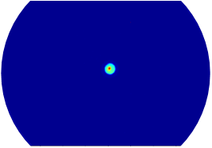
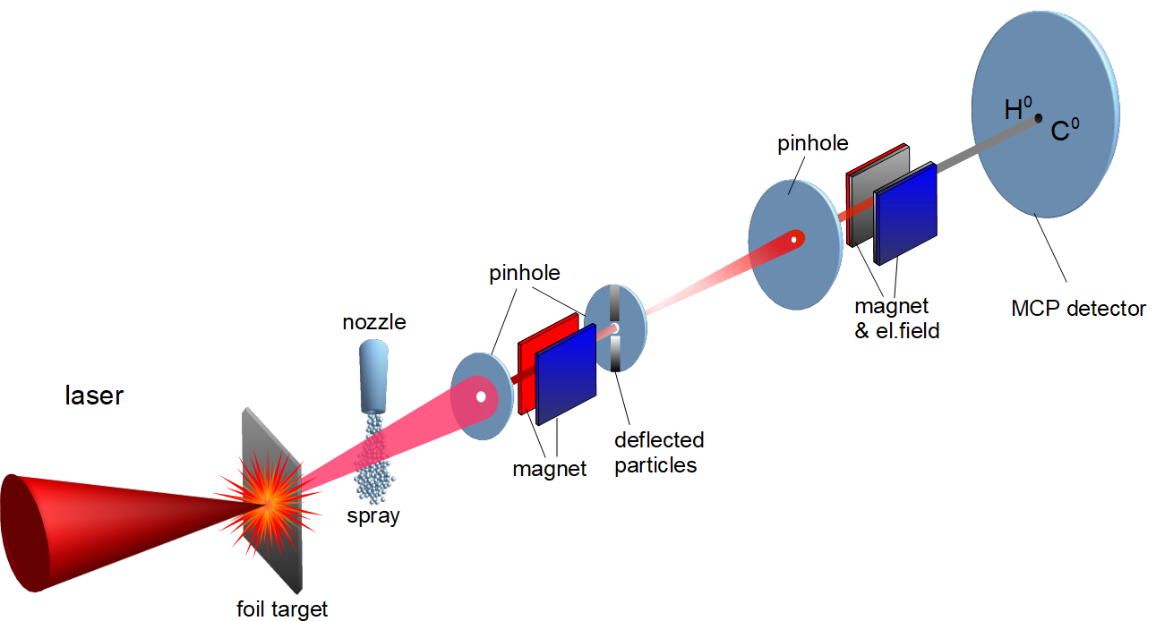


cleaning of the beam from charged particles
inserted magnet
$$C^{0}$$
$$H^{0}$$
c")

Slide 12
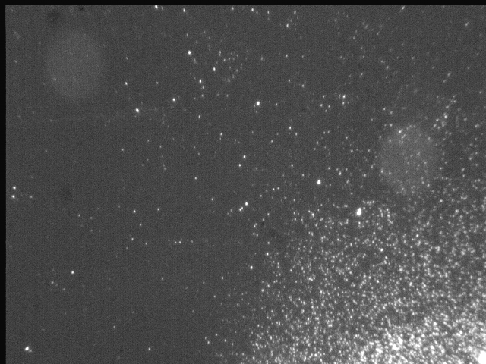
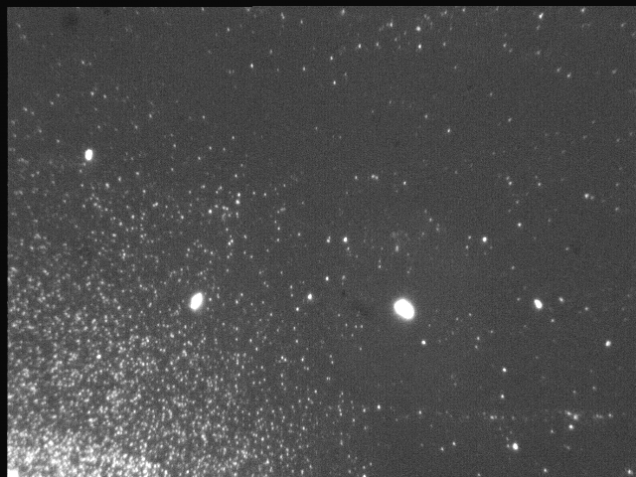
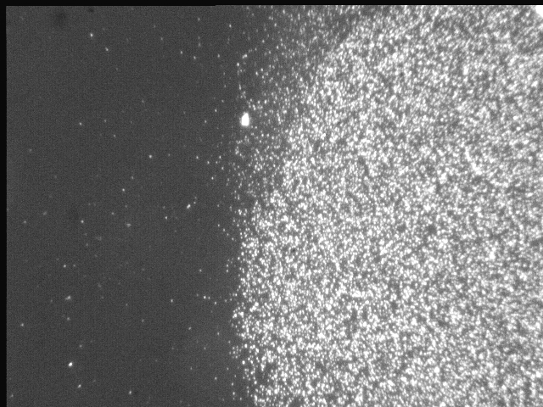
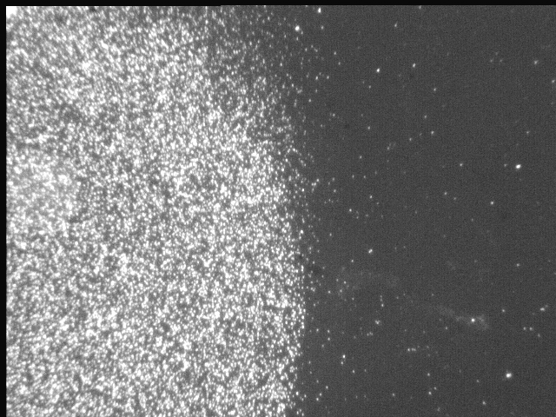
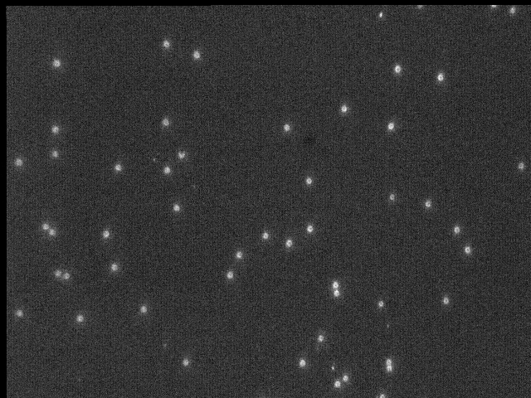
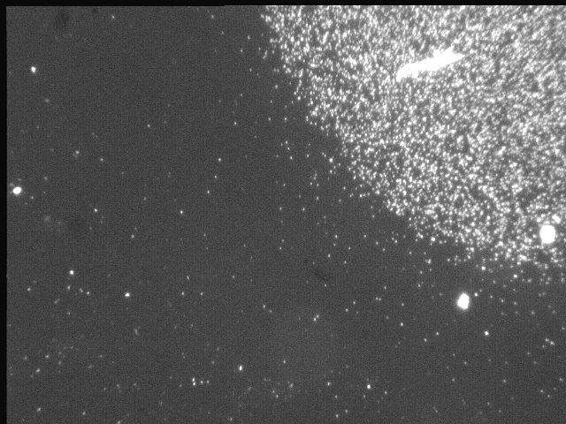
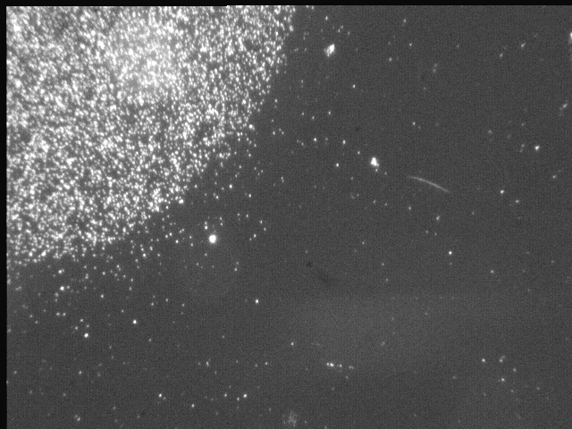
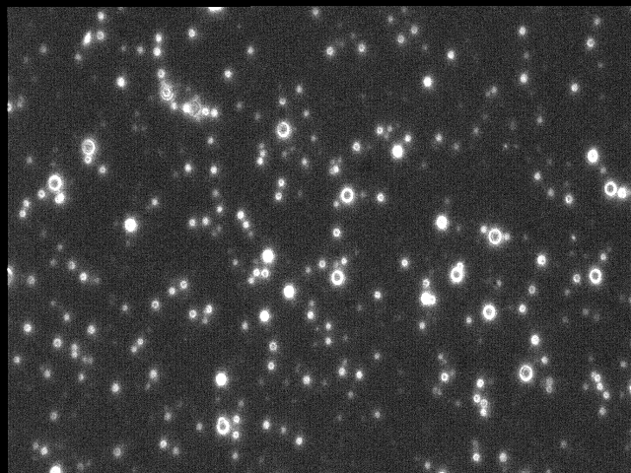
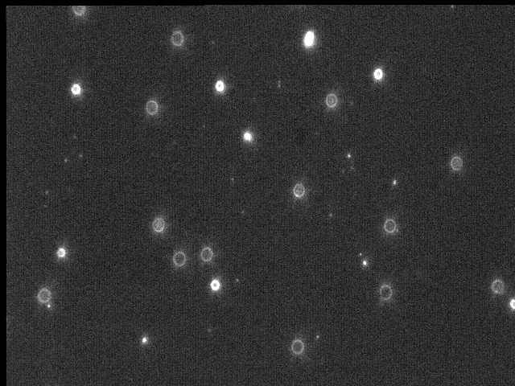
pits on CR39 crated by neutrals impact
“zero” point on CR-39 (1mm pinhole)
hydrogen pits
TOF of neutrals: H and O
O
H
carbon pits

Slide 13
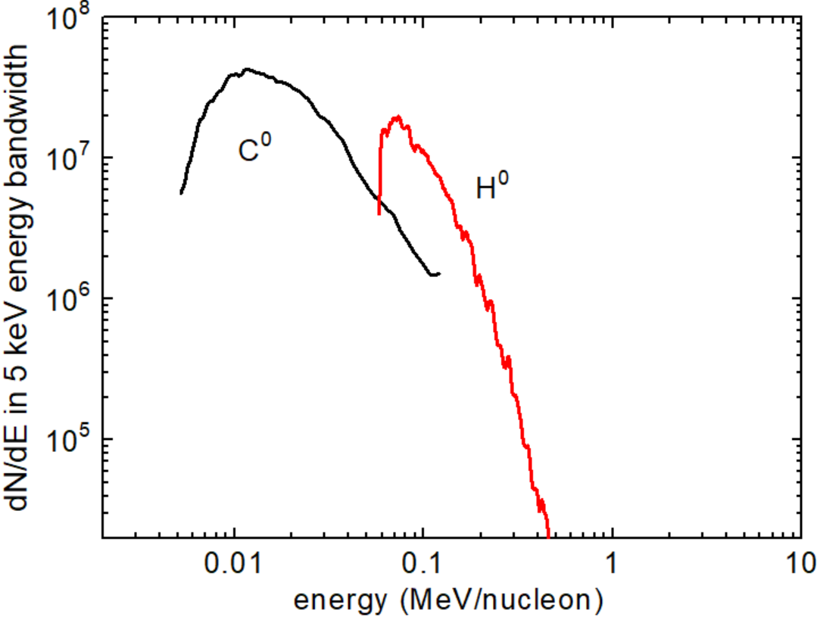
spectra of neutral atoms
Rev. Sci. Instrum. 88, 083303 (2017).
inserted magnet
$$C^{0}$$
$$H^{0}$$
c")
by time-and-space (TaS) mass analyser
C⁰ and H⁰ spectra
A⁻
→
A⁺ → A⁰
→
A⁺
first observation of neutral atom beams with such high energies

Slide 14
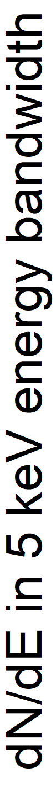
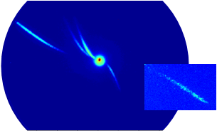
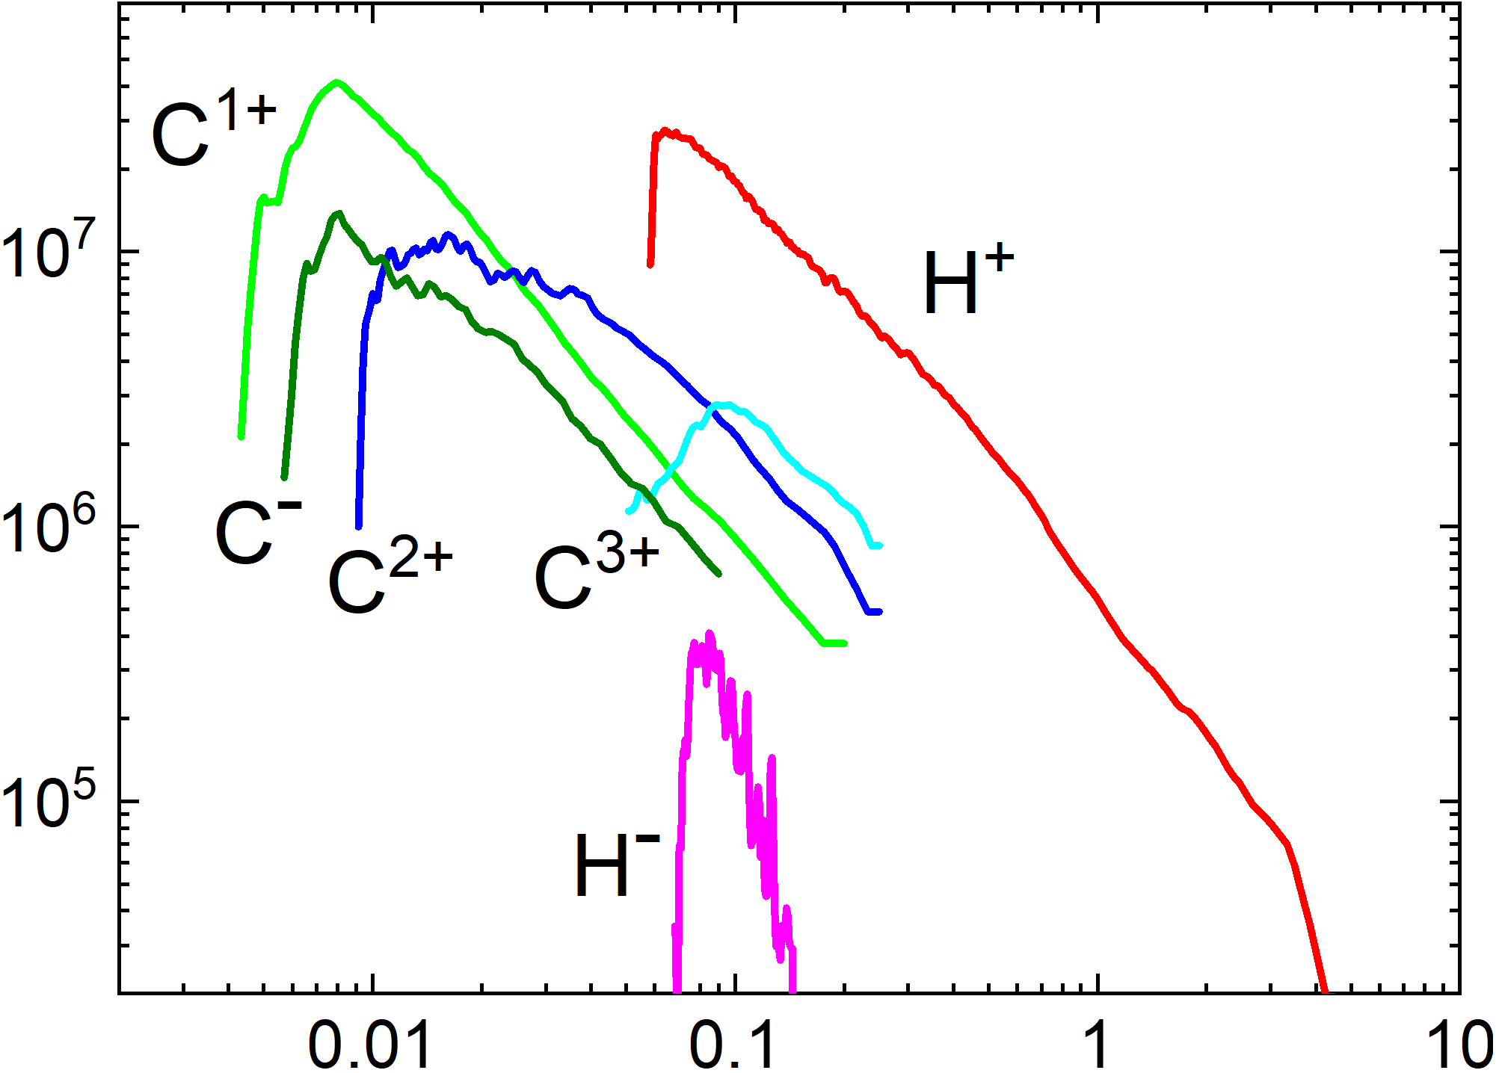
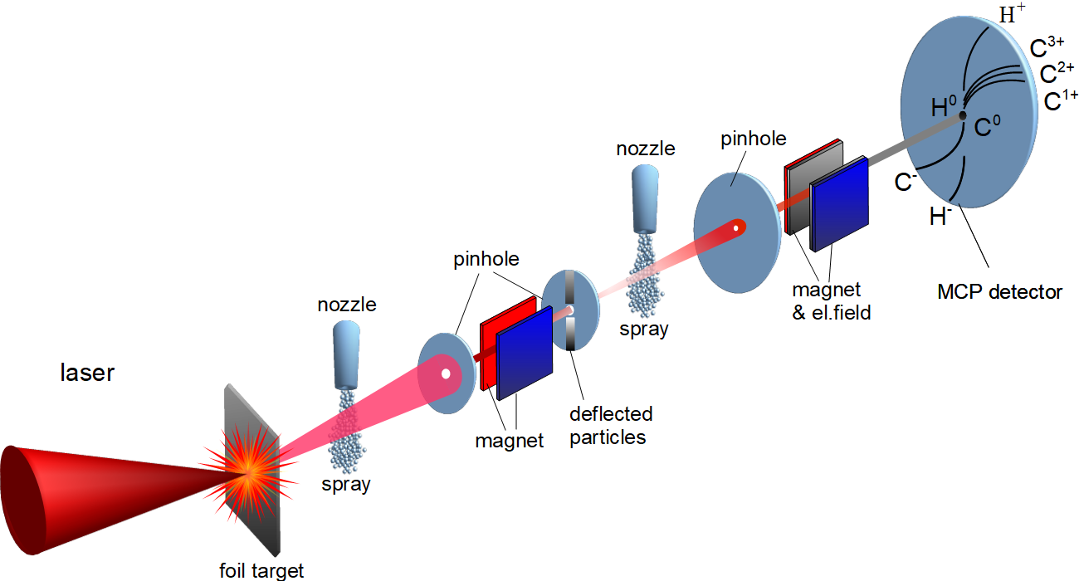

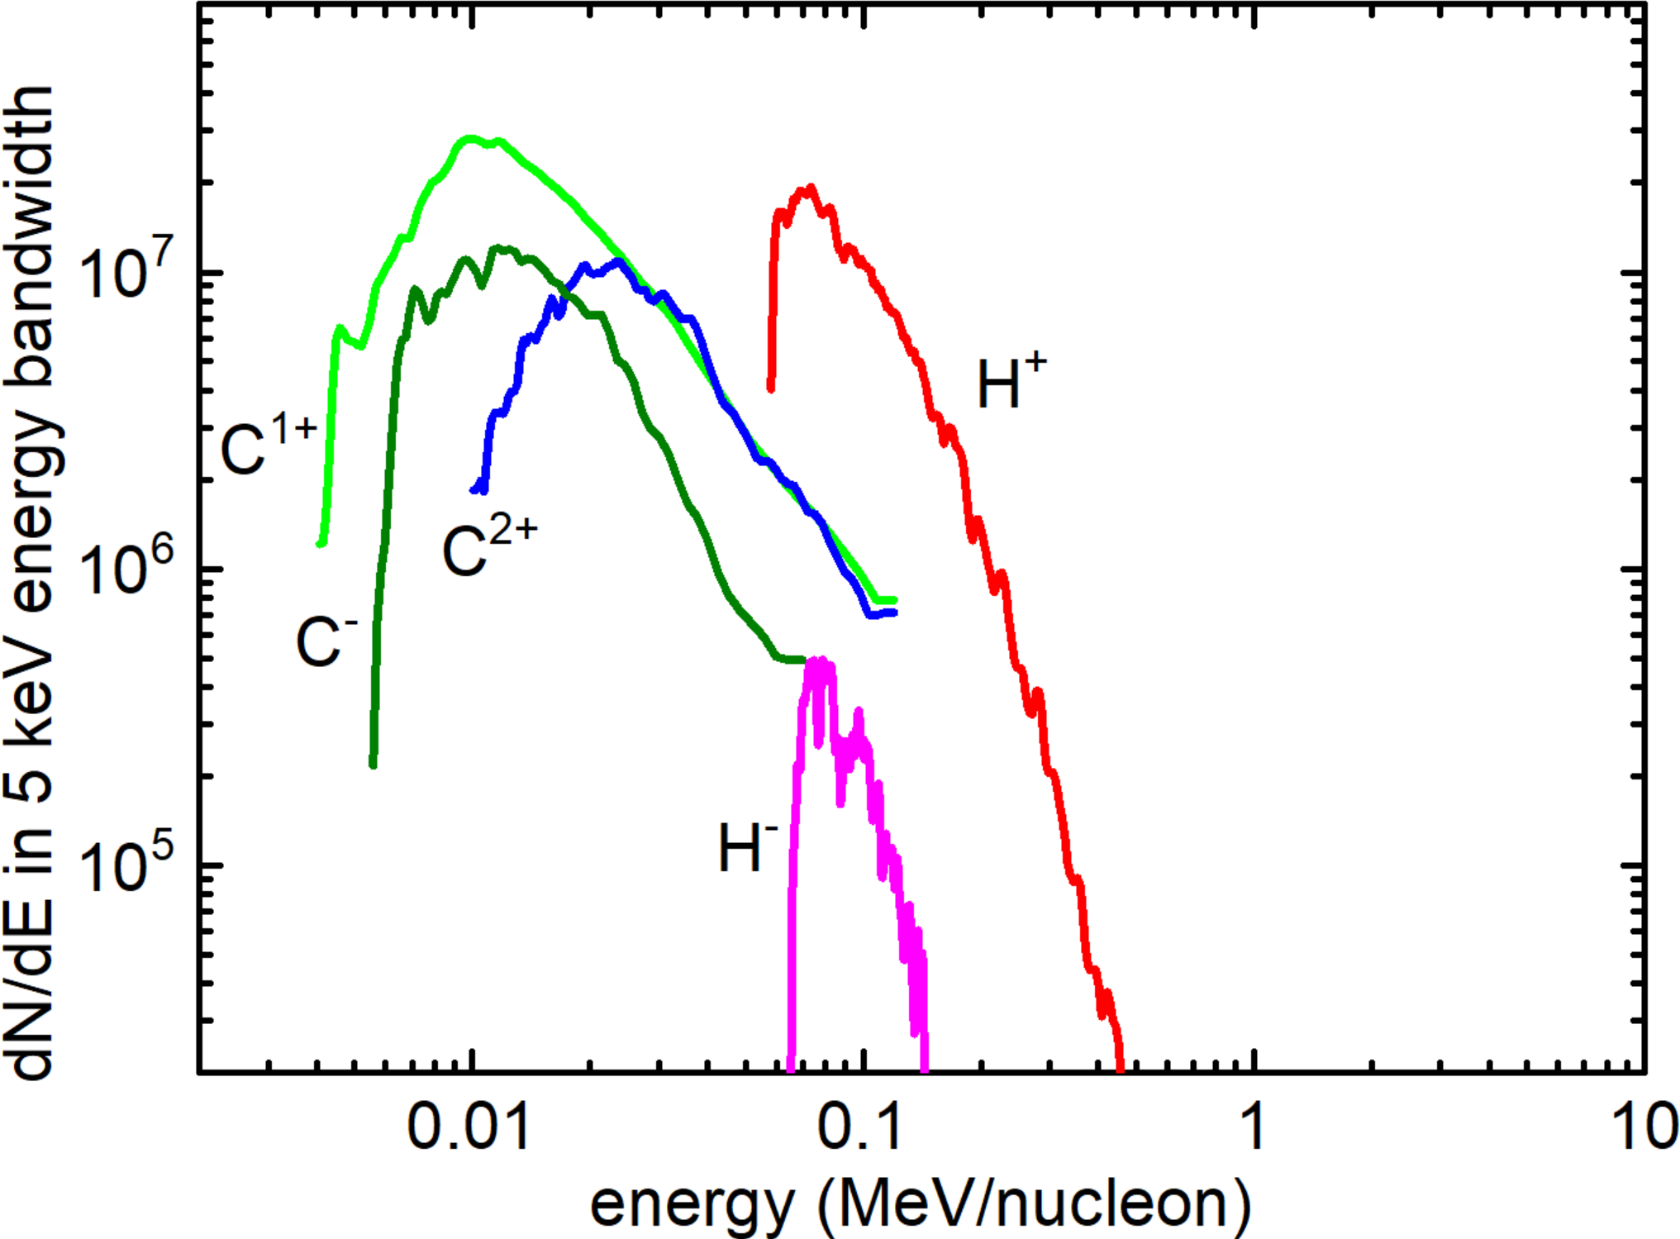







water spray was introduced in the path of neutral atoms
inserted spray
$$C^{2+}$$
$$C^{+}$$
$$H^{+}$$
$$C^{0}$$
$$H^{−}$$
$$H^{0}$$
$$C^{−}$$
C⁻_{max} ∼ 1 MeV
H⁻_{max} ∼ 150 keV
ion spectra
A⁻
→
A⁺ → A⁰
→
A⁺
charge state distribution is in equilibrium
it is independent on charge state distribution in the input beam

Slide 15
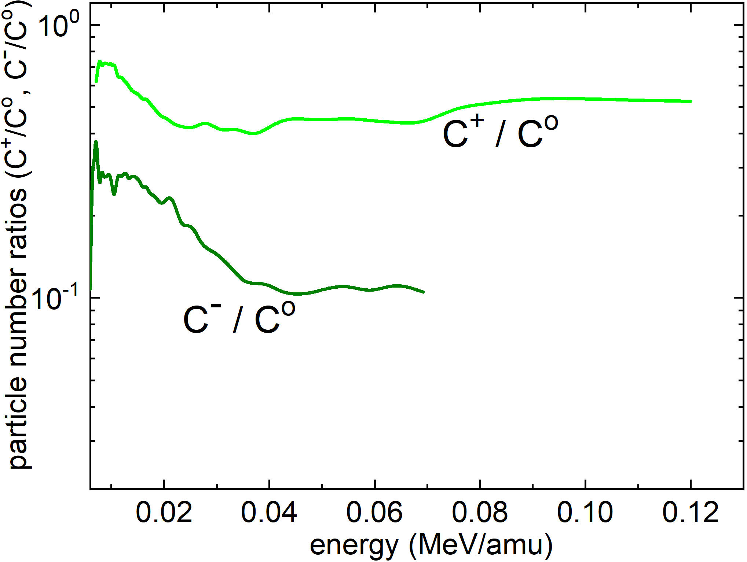
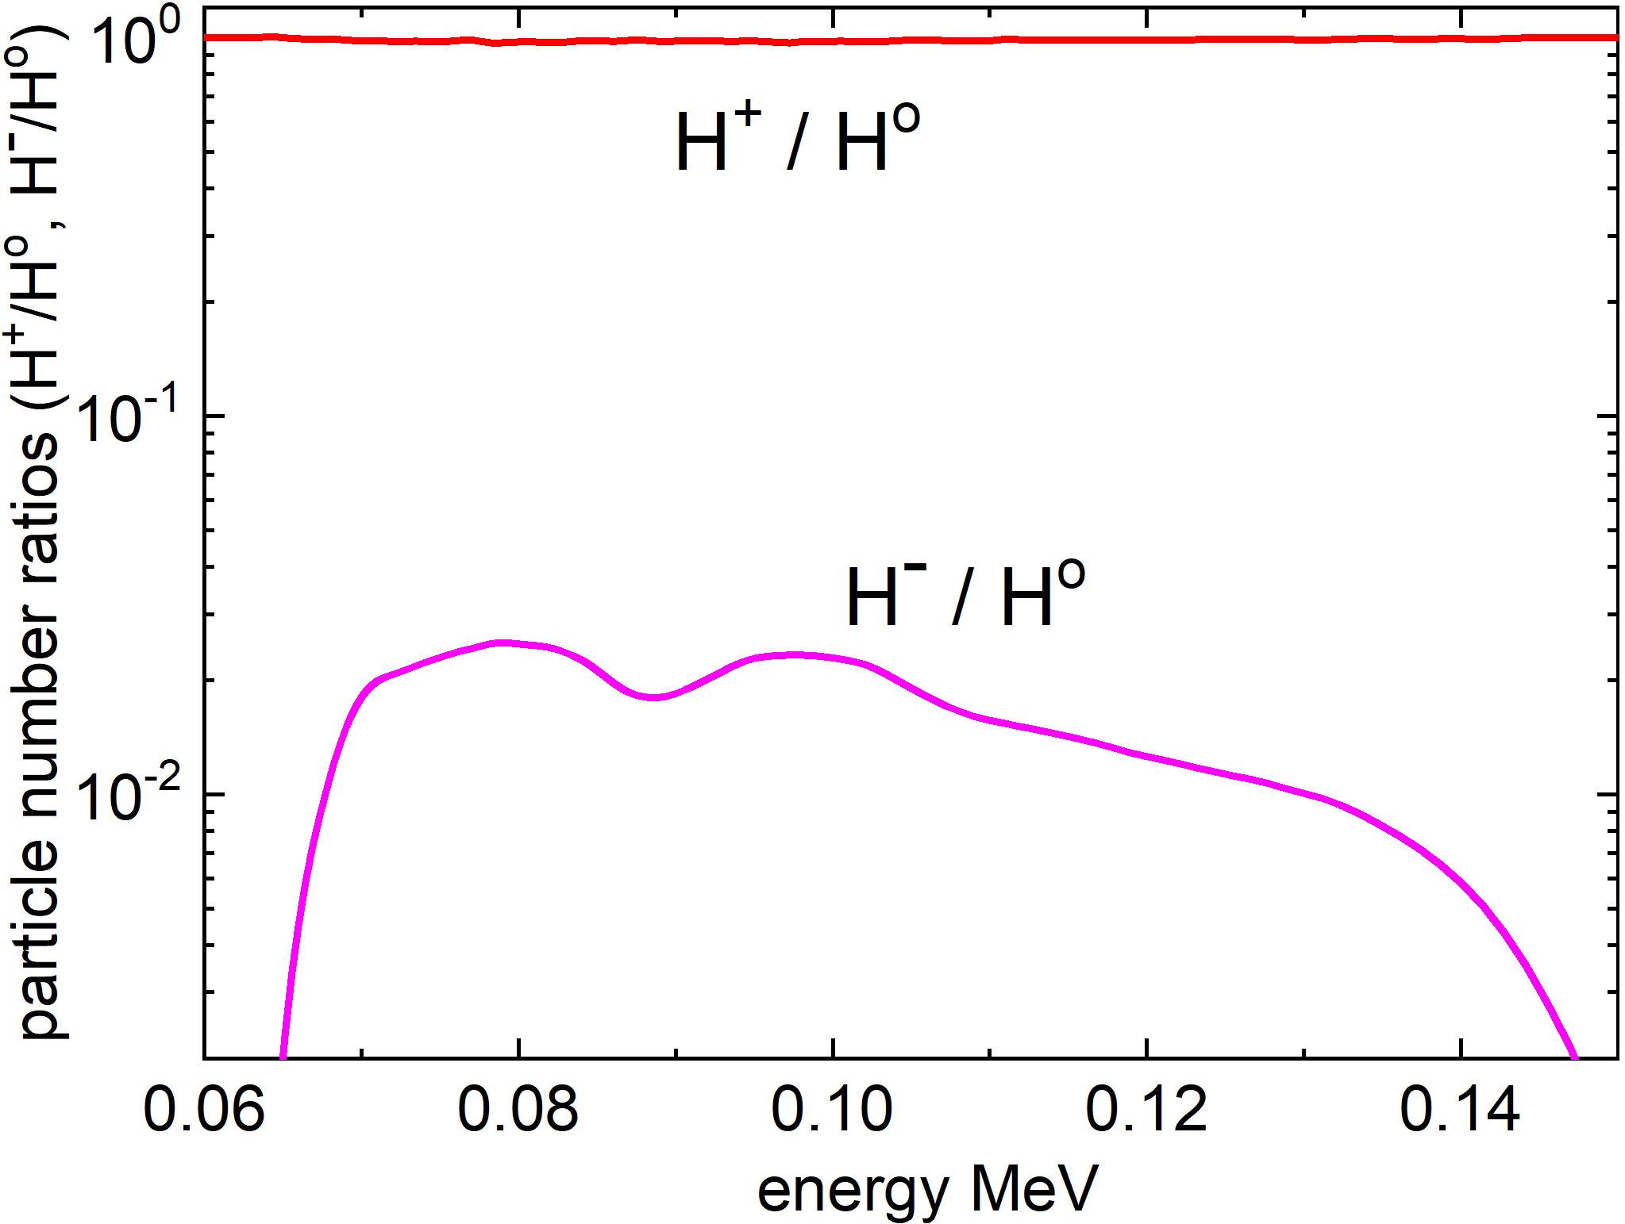




fractions in equilibrium charge-state distributions
almost equal presence of positive ions and neutral atoms in the beam
$H^{+}/H^{0} 1$
$C^{+}/C^{0} 0.5$
$H^{−}$/$H^{0}≈{10}^{−2}$
$$C^{−}/C^{0}≈{10}^{−1}$$
fractions of the equilibrium charge state can provide values for the ratios of the cross sections
In contrast: known cross sections for gaseous targets suggest $σ(C^{+})/{σ(C}^{0}$) and $σ(H^{+})/{σ(H}^{0}$) $≤ {10}^{−1}$
H ⁻ ∼ 150 keV :
known electron attachment cross section above 30 keV becomes excessively low

Slide 16
proposed hypothesis
“spray electrification”
The spray consists of 150 nm water droplets
formed when the supersaturated vapor pressure expands through a supersonic nozzle in vacuum
This can be compared with droplets formation in thunderstorms, or a waterfall effect where droplets electrically charged:
called spray electrification,
The degree of electrification depends on droplet temperature and speed, and a contact with foreign surface
The droplet potential can be several volts, or the electric field at surface ∼ (1 − 10) MV/cm.
Two processes can account for an enhancement production of negative ions:
the electron capture takes place at the charged droplet surface, or
it interacts with the vapor in a strong field.
R. Prasad, et al., Rev. Sci. Instrum. 84, 053302 (2013).

Slide 17
apart from the fundamental interest,
there can be also a practical interest in negative ions and neutral atoms

Slide 18
beams energy content in the measured solid angle of 3.6 × 10⁻⁷ sr
beams energy : after 1st spray
beam energy from the spray
integrated conversion efficiency
H⁻ (70 – 150) keV – 0.24 µJ
H⁺ → H⁻ 0.857 %
C⁻ (75 – 1000) keV – 10.8 µJ
C⁴⁺ → C⁻ 15%
H⁰(50 – 500) keV – 23 µJ
H⁺ → H⁰ 38%
C⁰(60 – 1440) keV ∼ 47.4 µJ
C⁴⁺ → C⁰ 50%
used spray area: ∼3.8×10⁻⁷ cm², whereas the whole spray area: ∼3×10⁻² cm²,
hence, the spray converting ∼10⁵ times more particles
Possible application?

Slide 19
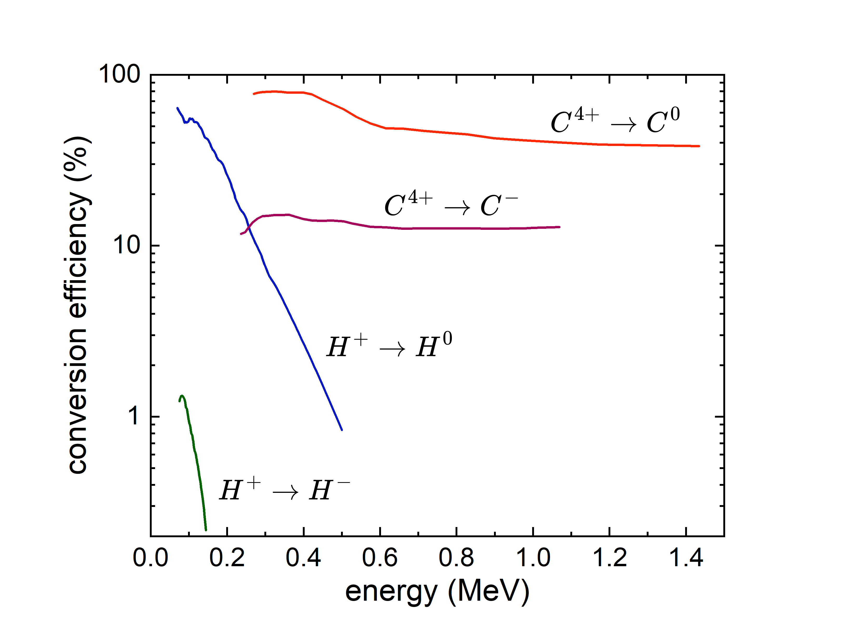
conversion efficiency as a function of energy
integrated efficiency is highly weighted at the energy range where the efficiency is high
600 keV
saturation
40 %
13 %
from 100 keV to 300 keV drops from 60 % to ∼ 6%
decreases more rapidly

Slide 20
Further work – optimisation
Spray size can be changed applying the concept of “corresponding jets”:
    yield will be the same, because the charge state distribution is in equilibrium
spray operation in a long pulse mode: this is also subject to the scaling laws and similarity relations.
The range of energies can be extended (Massey criterion), e.g.:
  by adding an appropriate contaminant, or choosing a different liquids
    using a spray with atoms or molecules excited to the Rydberg state
Role of the droplets in the spay?
the above reasonings can only be qualitative unless confirmed experimentally
negative ions and neutral atoms have the same emittance and energy as the positive ions
It might be interesting for Neutral Beam Injection (NBI) system

Slide 21
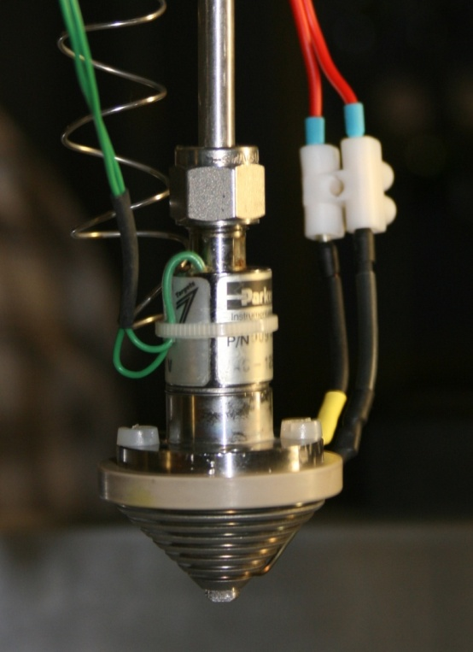








summary
we observed:
$$O^{−}$$
$$C^{−}$$
$$H^{−}$$
$$D^{−}$$
and
$$O^{0}$$
$$C^{0}$$
$$H^{0}$$
$$D^{0}$$
CE : 38% for $H^{+}→H^{0}$ up to 500 keV and 50% for $C^{4+}→C^{0}$up to 1.5 MeV
These estimates are conservative, and the beam-target interaction conditions not optimized
the method is general:
different species of neutral atoms and negative ions can be created
beams inherit the characteristics of positive ions
the brightness of negative ion source is extremely high: >10⁸ A·cm⁻²sr⁻¹
(mainly due to the ultrashort duration)
open questions
the measured trends are quite different from the data available in the literature
there is no clear explanation for the difference between the known data and our measurements.
the physics of charge exchange at high ion energies is not well understood

