Slide 1
Implicit PIC Simulations of Hydrogen Plasmas with Intense Negative Ion Production
Denis Eremin

Slide 2
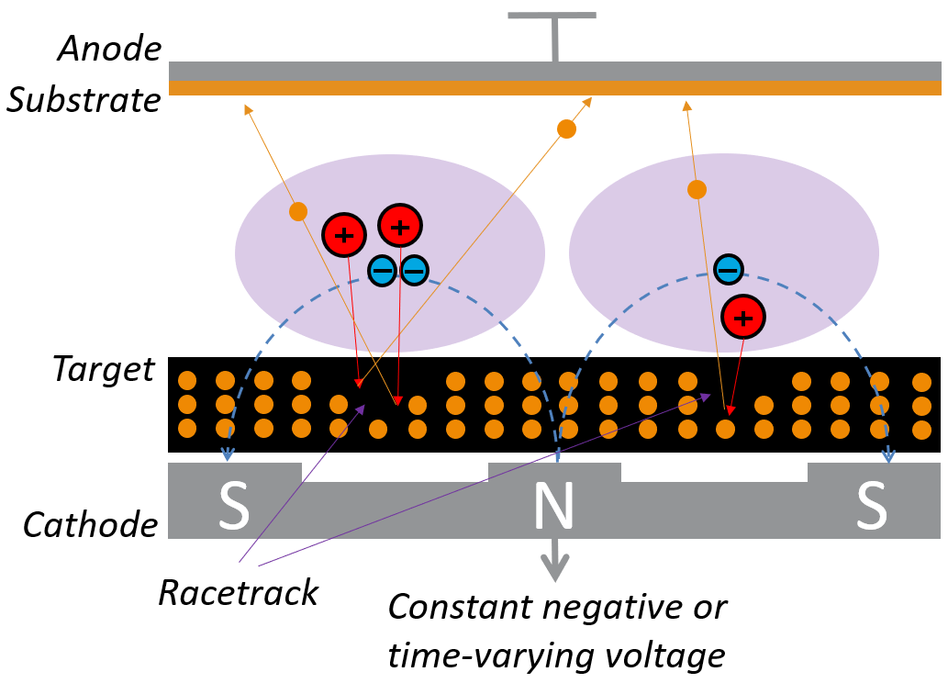
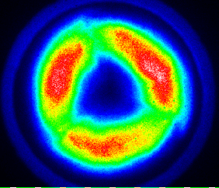
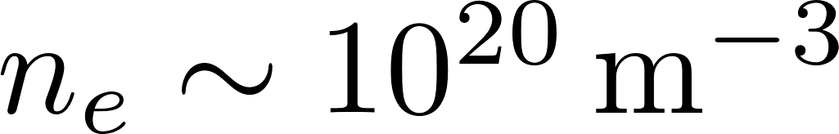

Historical Retrospective: Modeling of HiPIMS
spokes
Challenges:
Large plasma densities ( up to )
Low neutral gas pressure ( )
Multiscale problem ( )

Slide 3
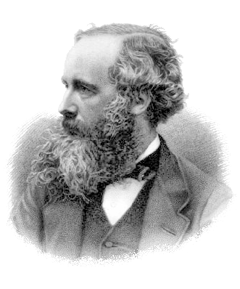
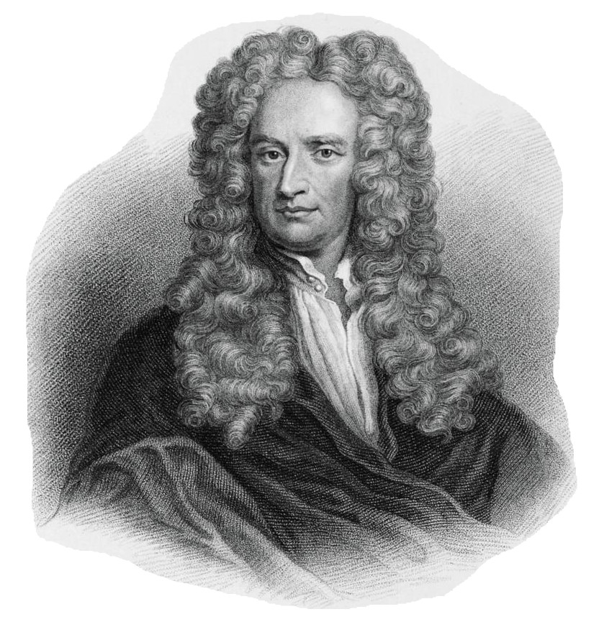
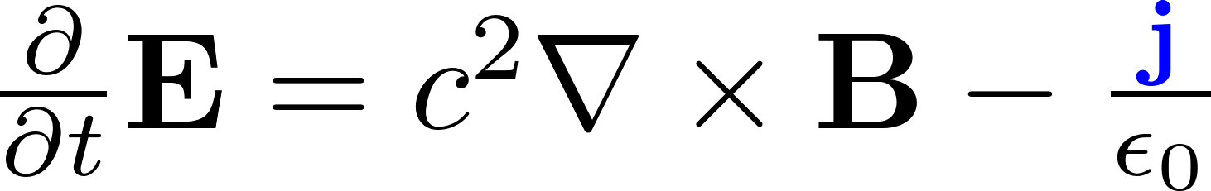
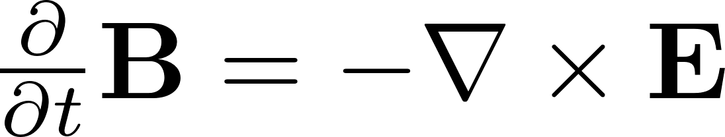

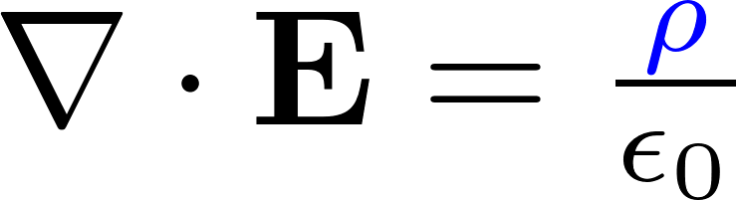
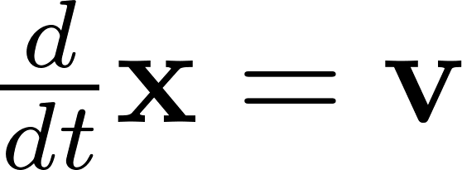

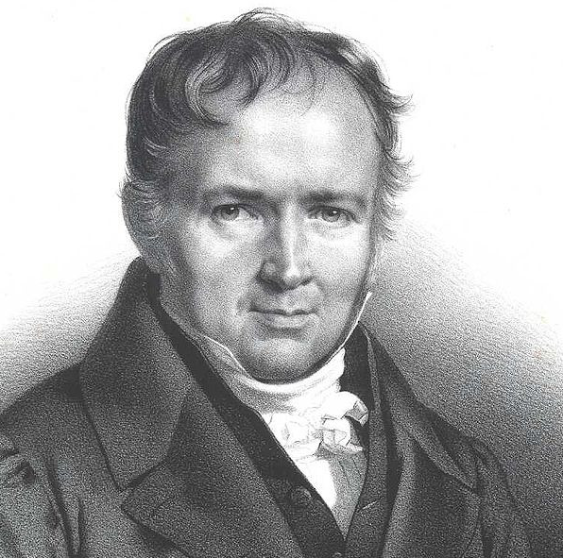
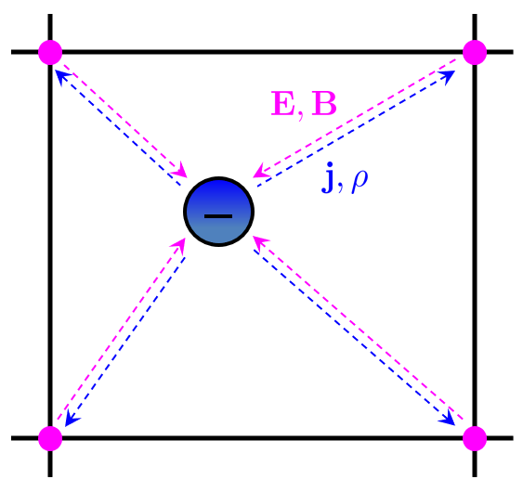
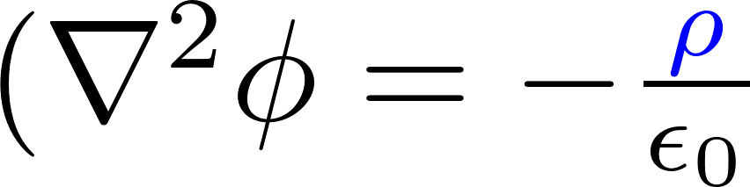

Particle-in-cell (PIC) method
(Super)particles
Grid
electromagnetic field model
electrostatic field model

Slide 4


Particle-in-cell (PIC) method
(Super)particles
Grid
electromagnetic field model
electrostatic field model
Momentum-conserving:
Same interpolation for
Energy-conserving:
Same interpolation for

Slide 5

Particle-in-cell (PIC) method
(Super)particles
decoupled over
(explicit)
Grid
electromagnetic field model
coupled over
(implicit)
electrostatic field model
Momentum-conserving:
Same interpolation for
Energy-conserving:
Same interpolation for

Slide 6

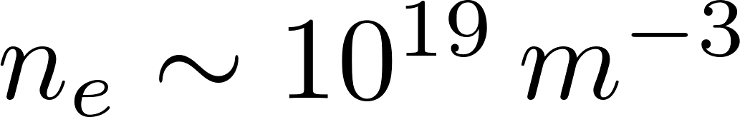

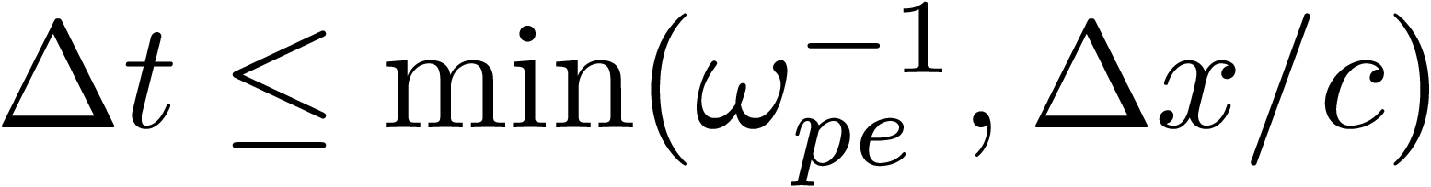

PIC Limitations
Explicit momentum-conserving PIC:
(numerical heating, Finite Grid Instability (FGI))
this results in approx. 5000 x 5000 2D grids
for discharges with
and
(numerical stability)
Implicit energy-conserving PIC:

Slide 7
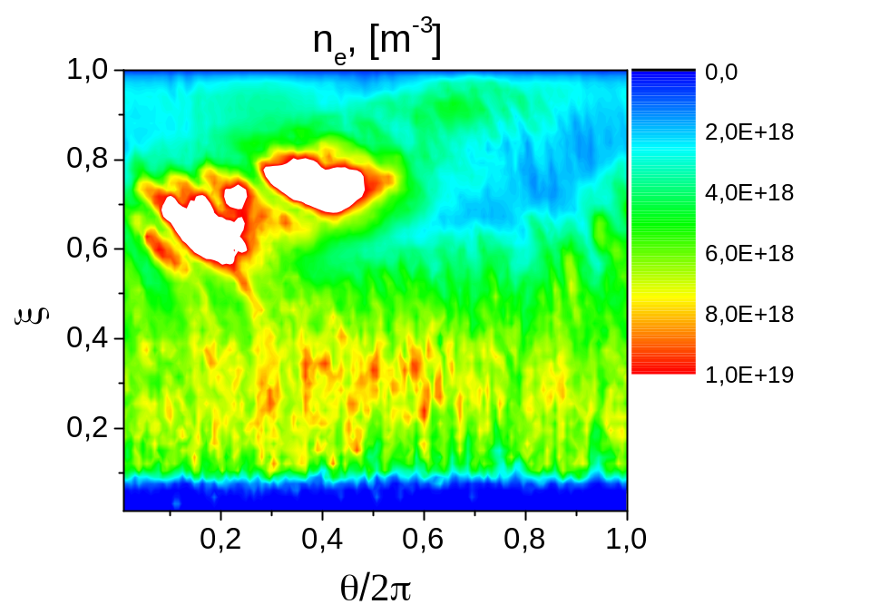
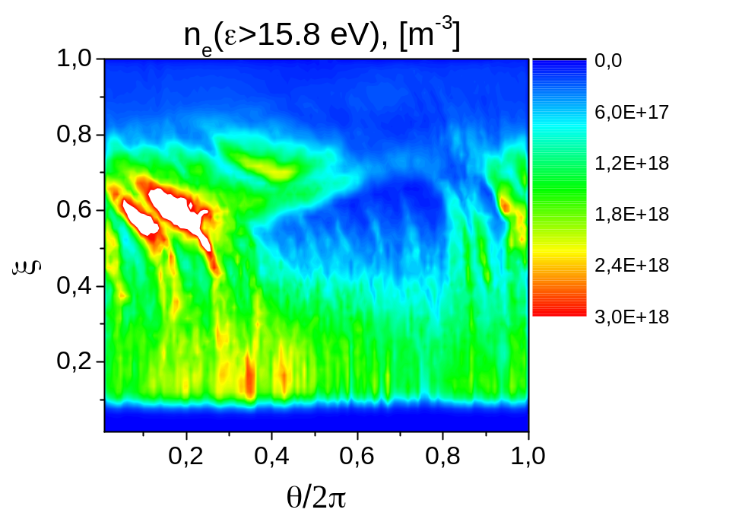
A PIC Simulation of Spokes in Self-Sputtering Regime

Slide 8
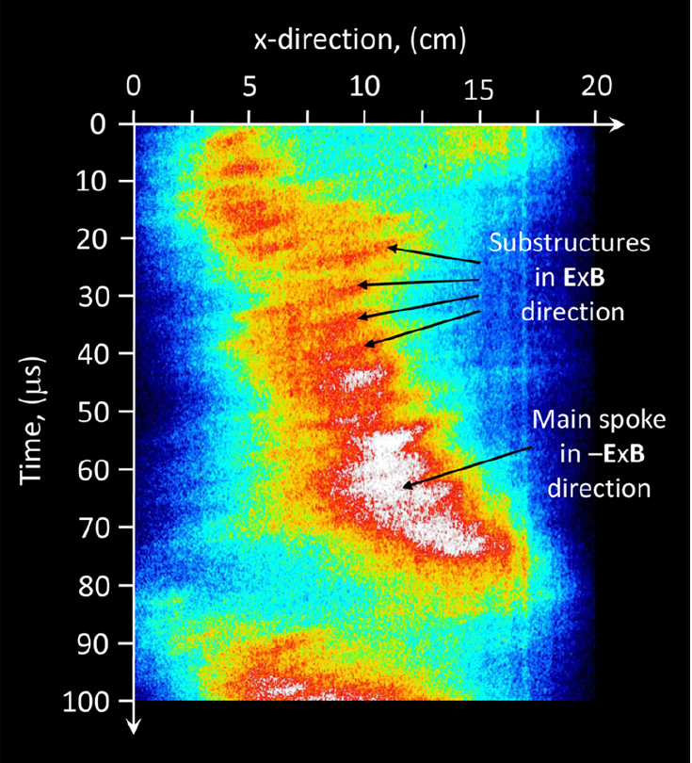
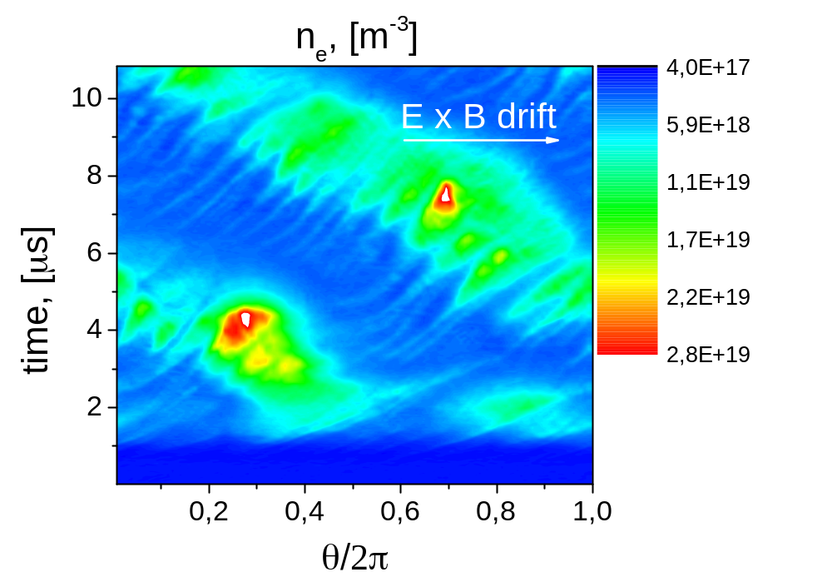
PIC Simulations vs Experiment
streak camera experiment
simulation
A. Anders and Y. Yang,
Appl. Phys. Lett. 111, 064103 (2017)

Slide 9
Energy-conserving implicit PIC (ECCOPIC) code family
Advanced implementation: ECCOPIC
Implicit (or explicit), adapted for multi-GPU environments
Electromagnetic, electrostatic, or Darwin
Modeling complex chemistry is possible
Verified in several international benchmarks for magnetized plasmas
Validated with various experimental data

Slide 10
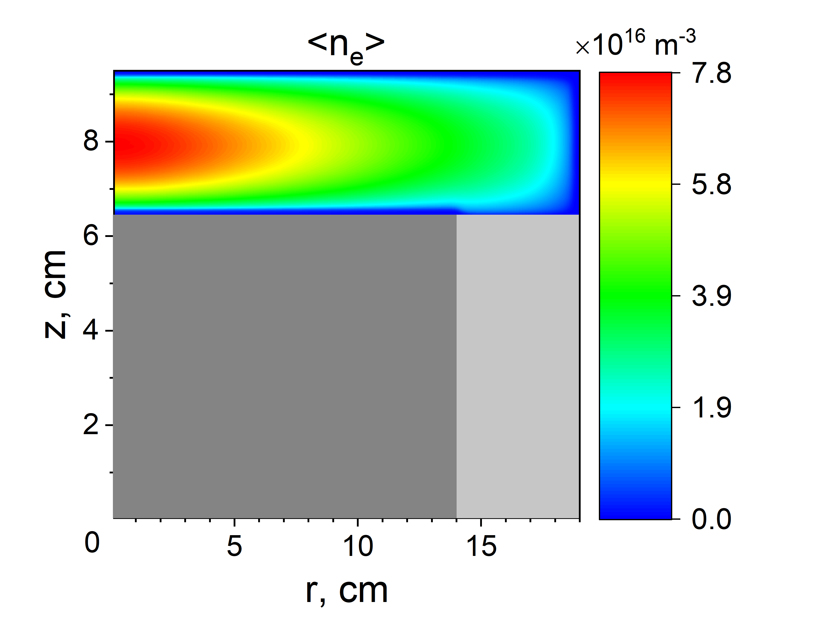
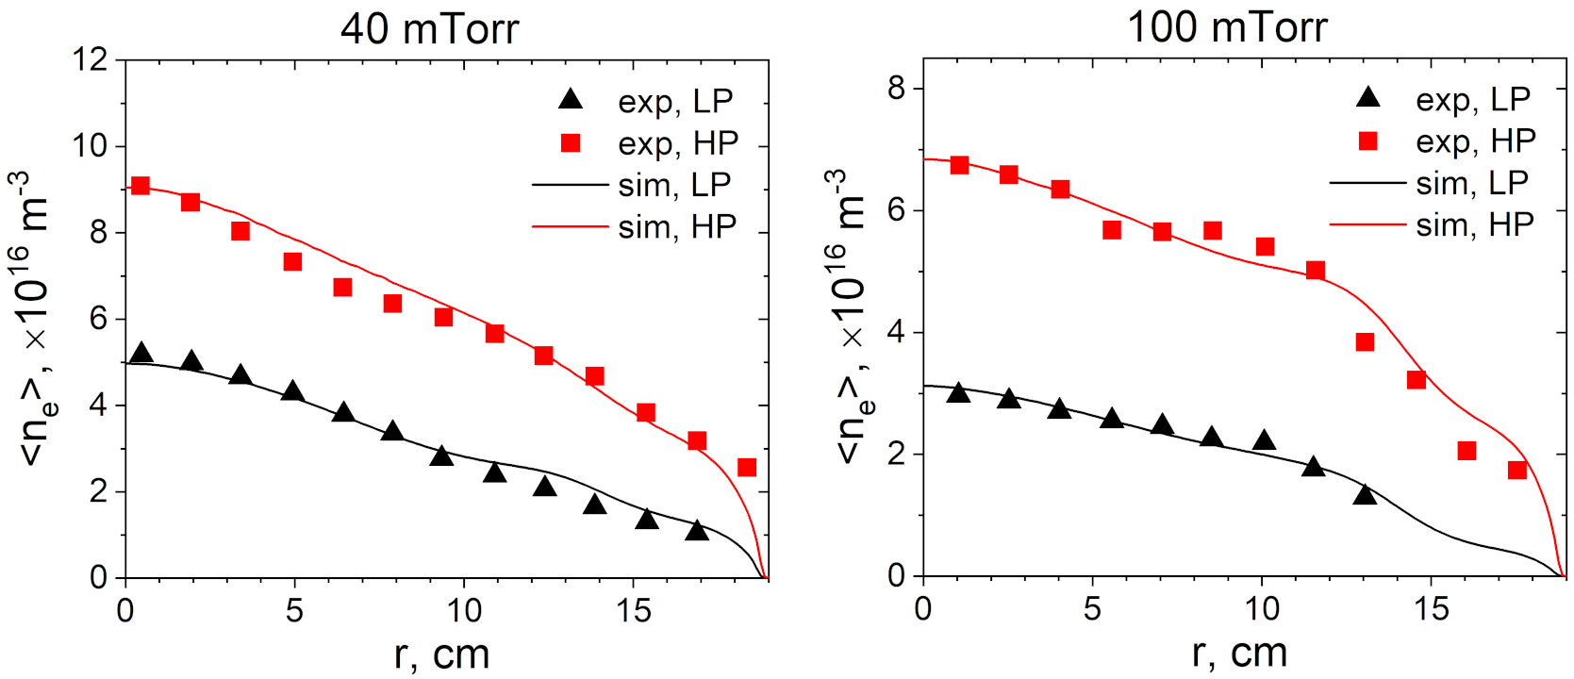
Validation 1: VHF CCP (Ar)
[I. Sawada et al., Jpn. J. Appl. Phys. 53, 03DB01 (2014)]
[D. Eremin et al., Plasma Sources Sci. Technol. 32, 044007 (2023)]

Slide 11
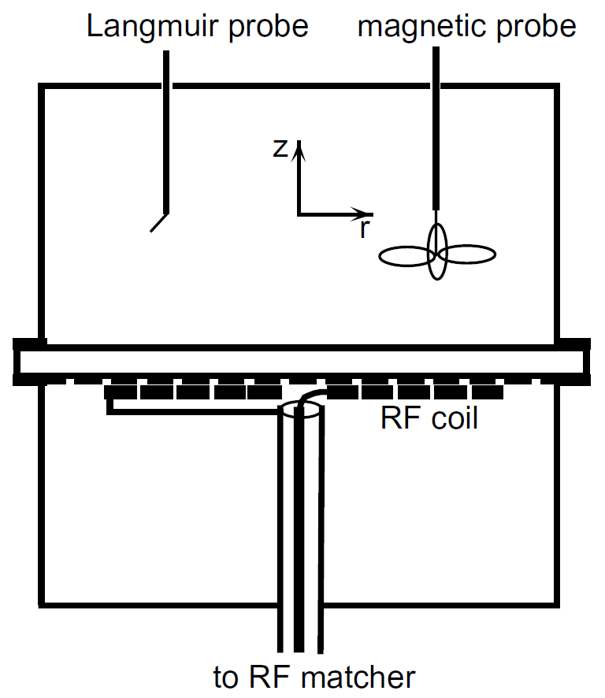
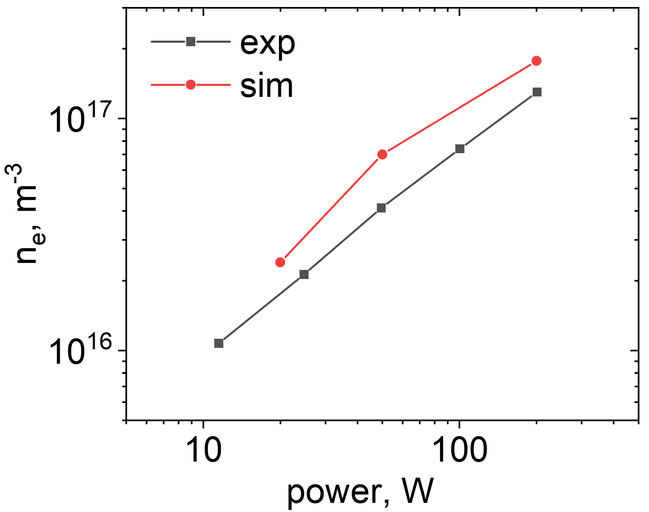
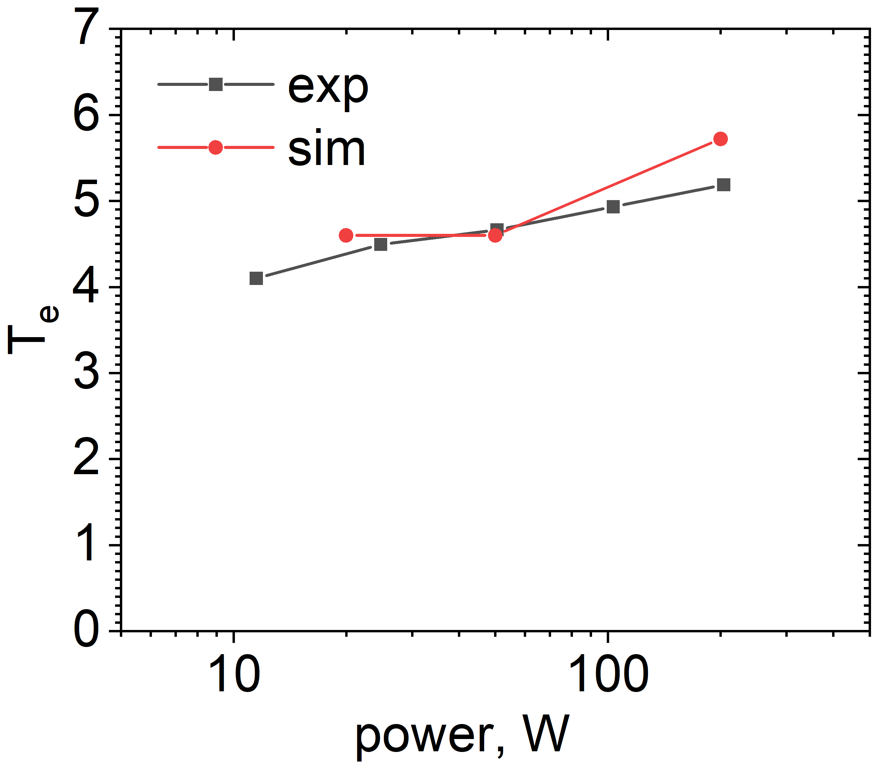
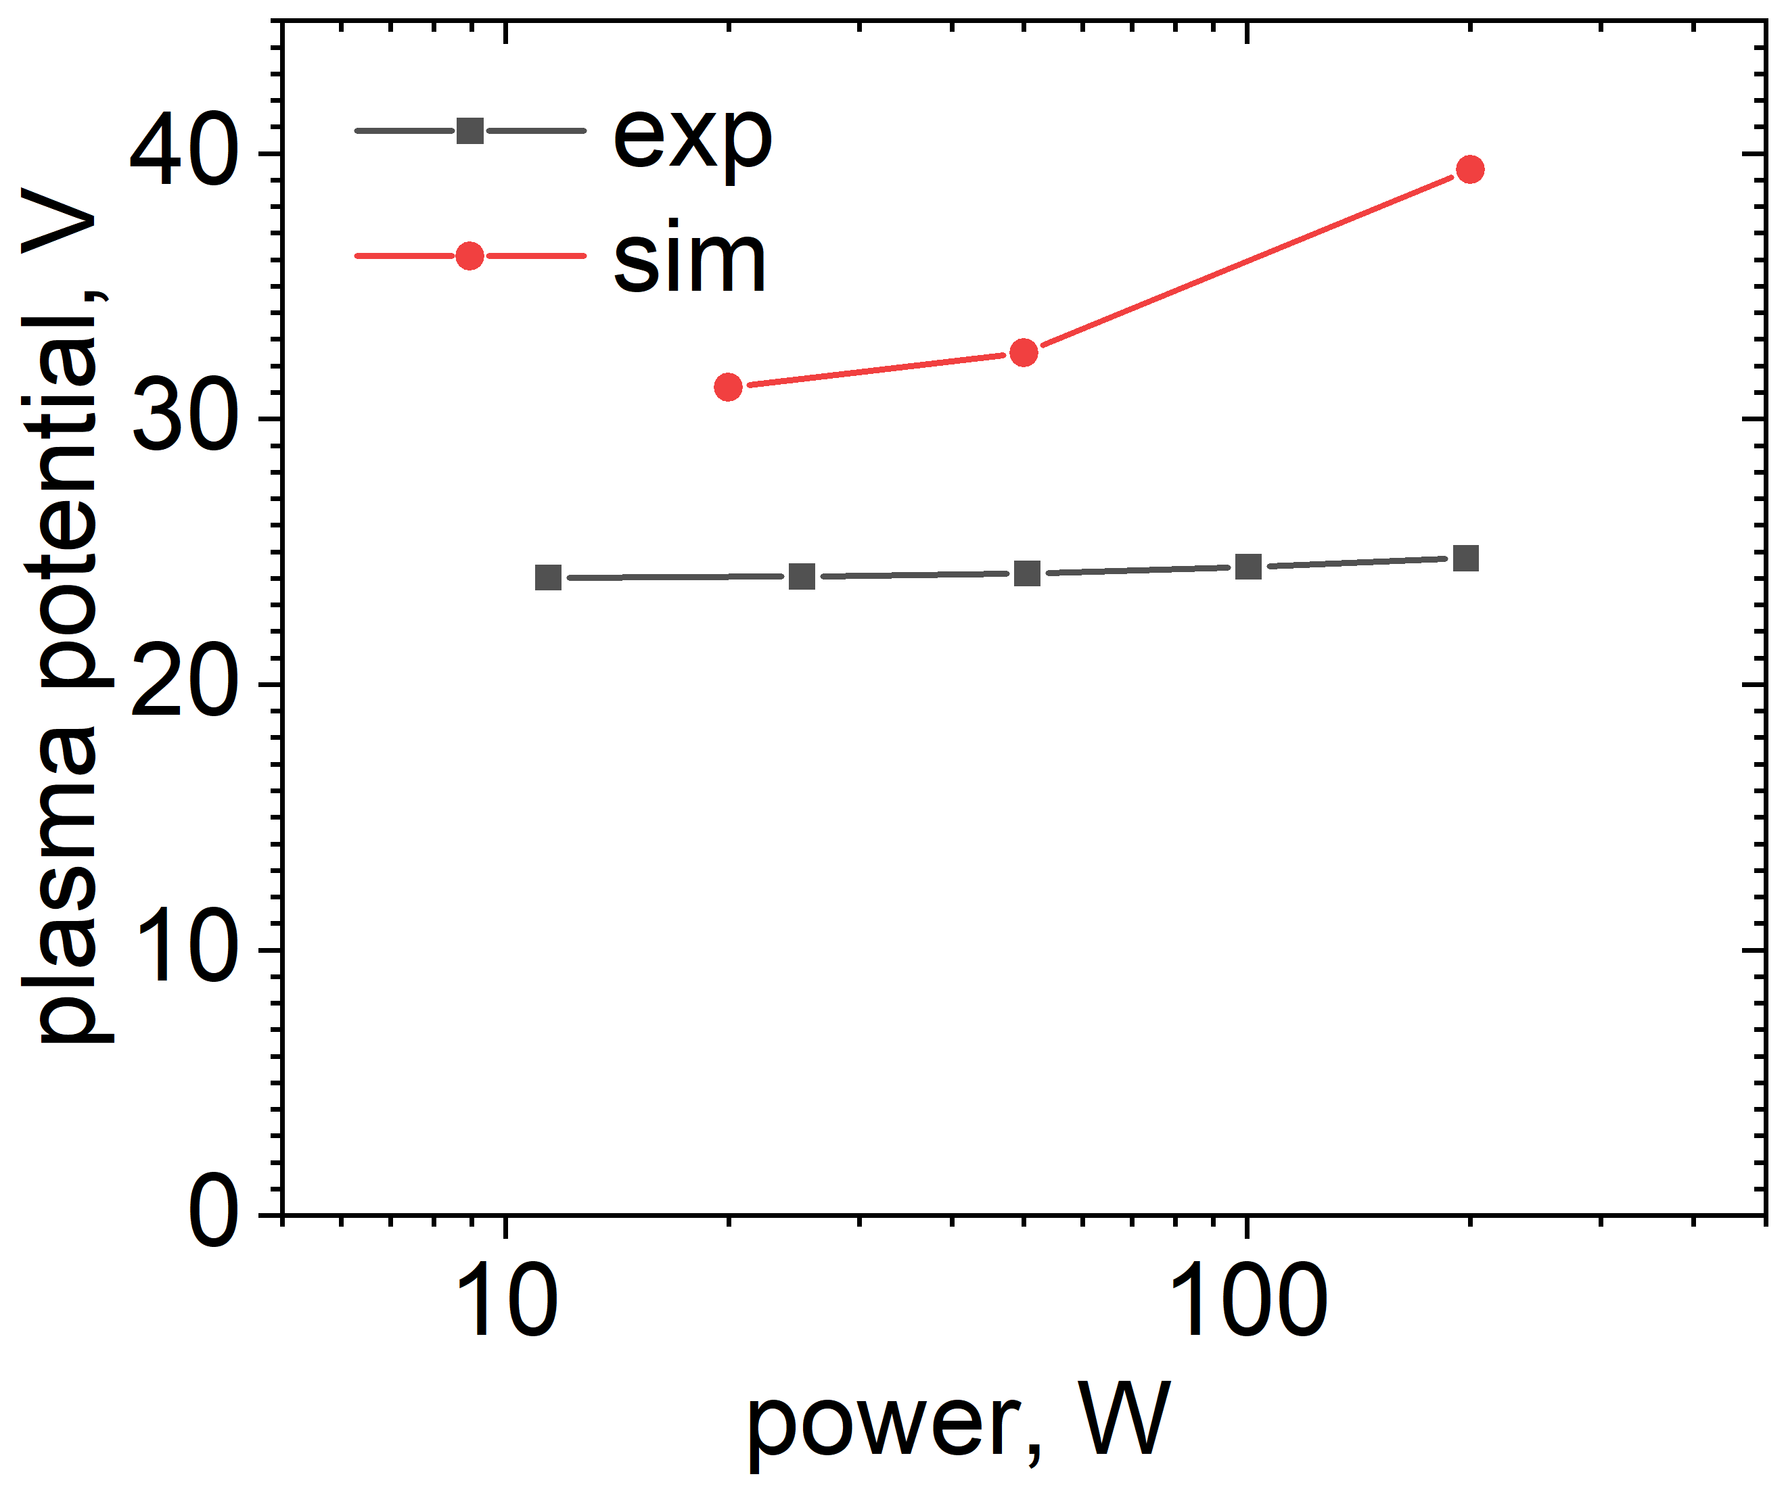
Validation 2: ICP (Ar)
[V.A. Godyak et al., Plasma Sources Sci. Technol. 11, 525 (2002)]

Slide 12
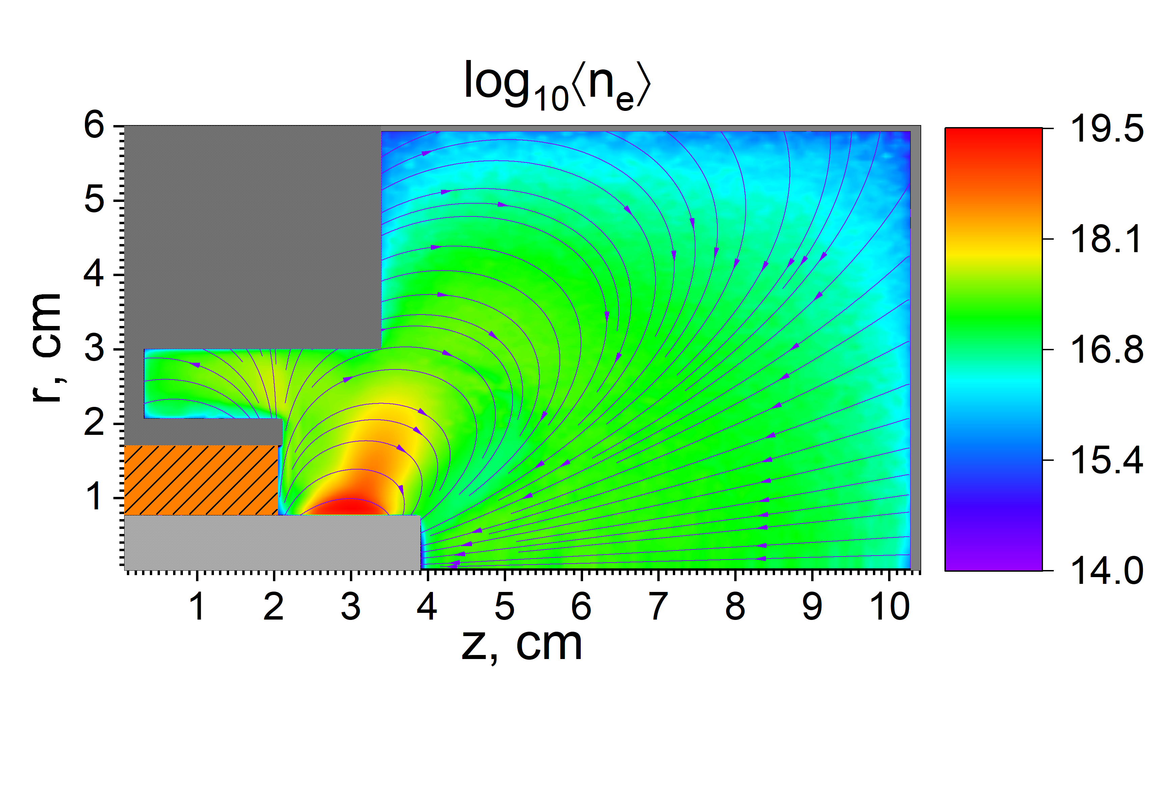
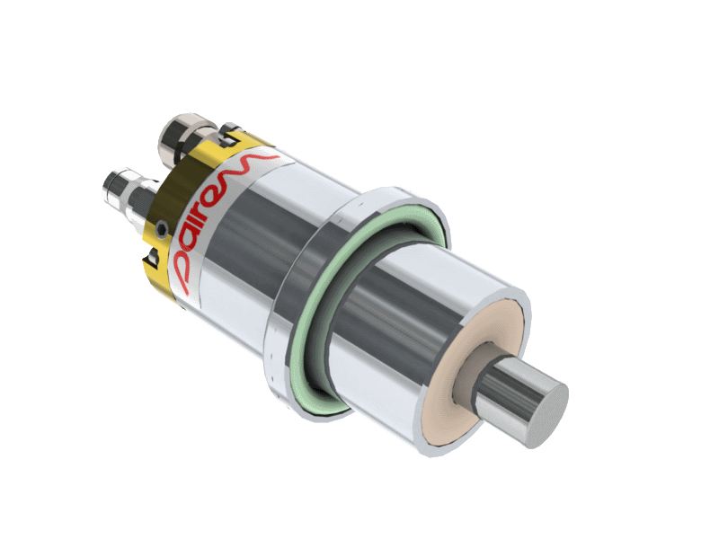

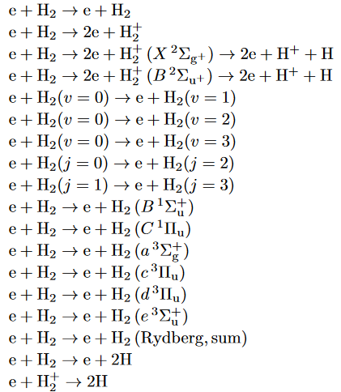
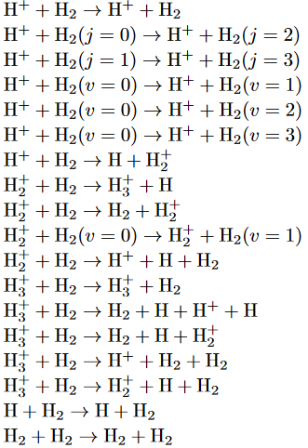
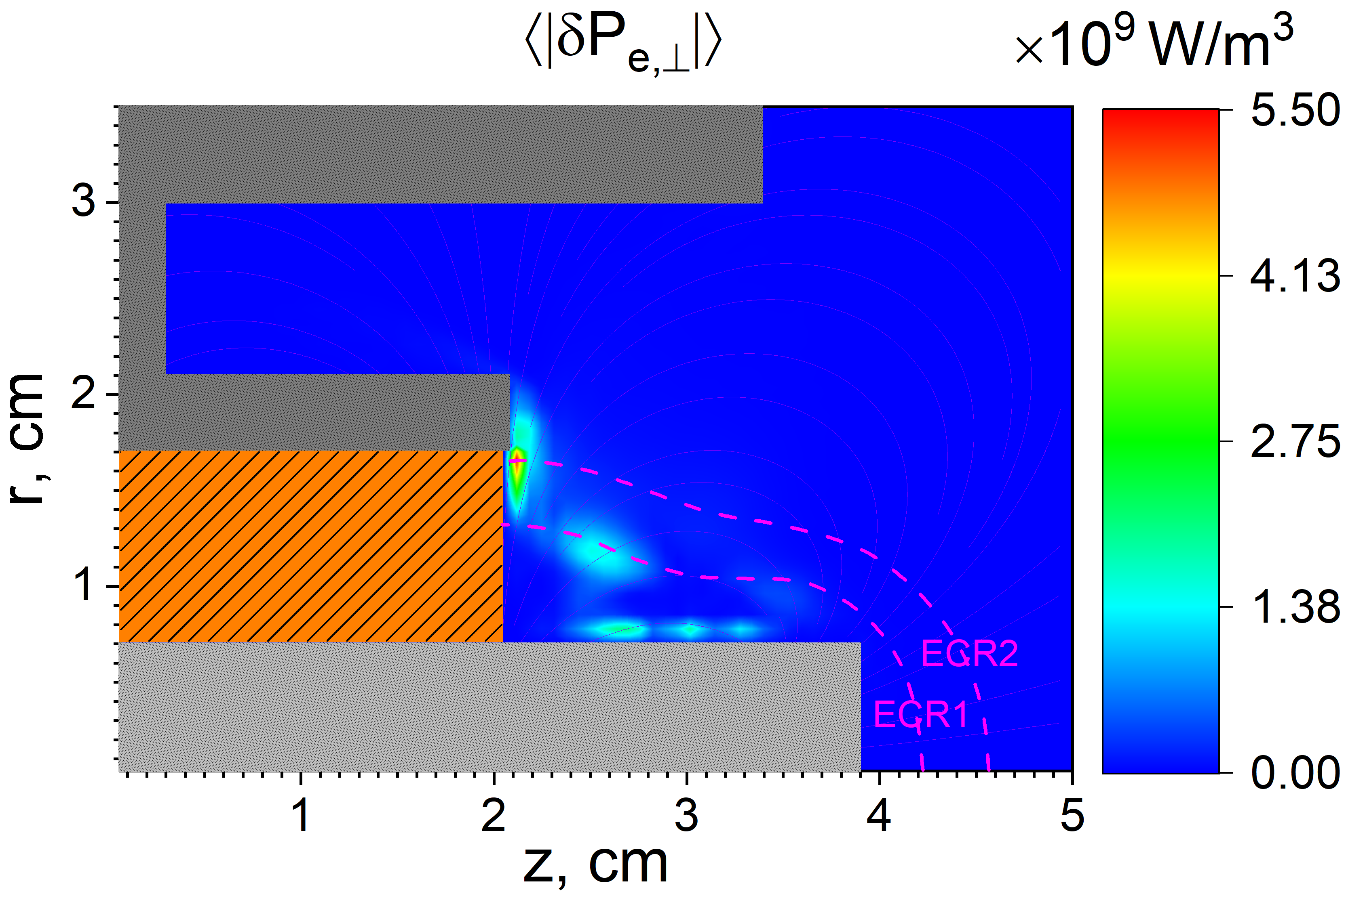
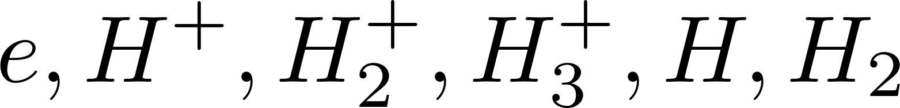
Validation 3: ECR (H )
2
Self-consistent PIC modeling of an ECR plasma in

Slide 13
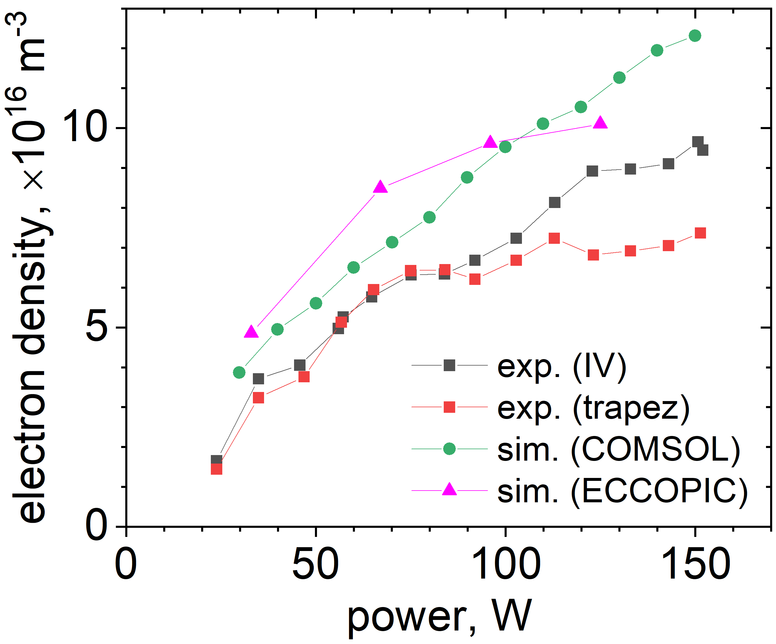
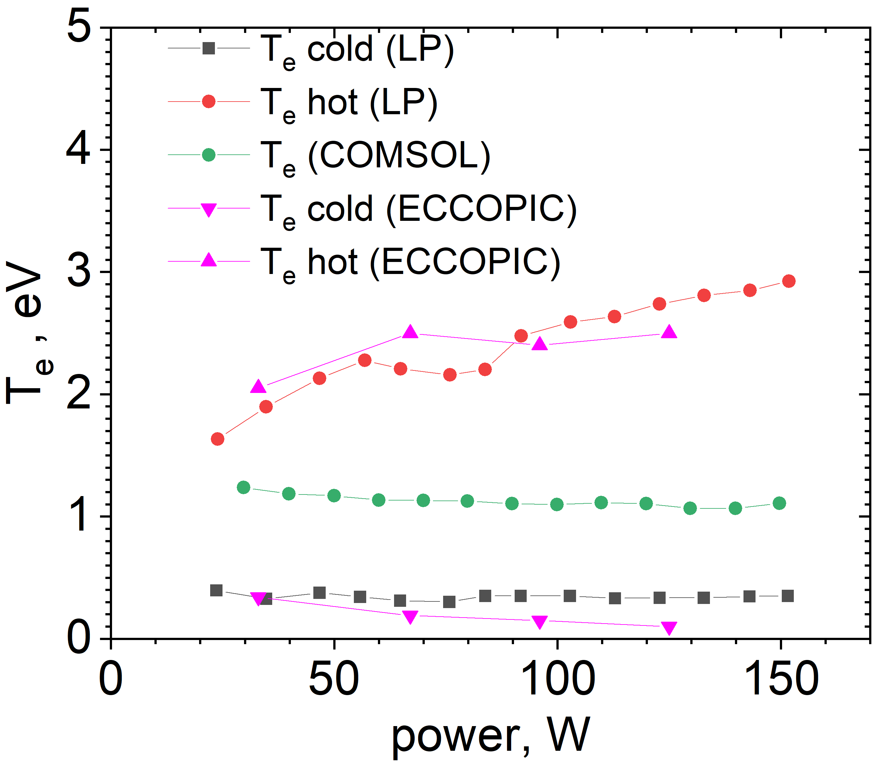
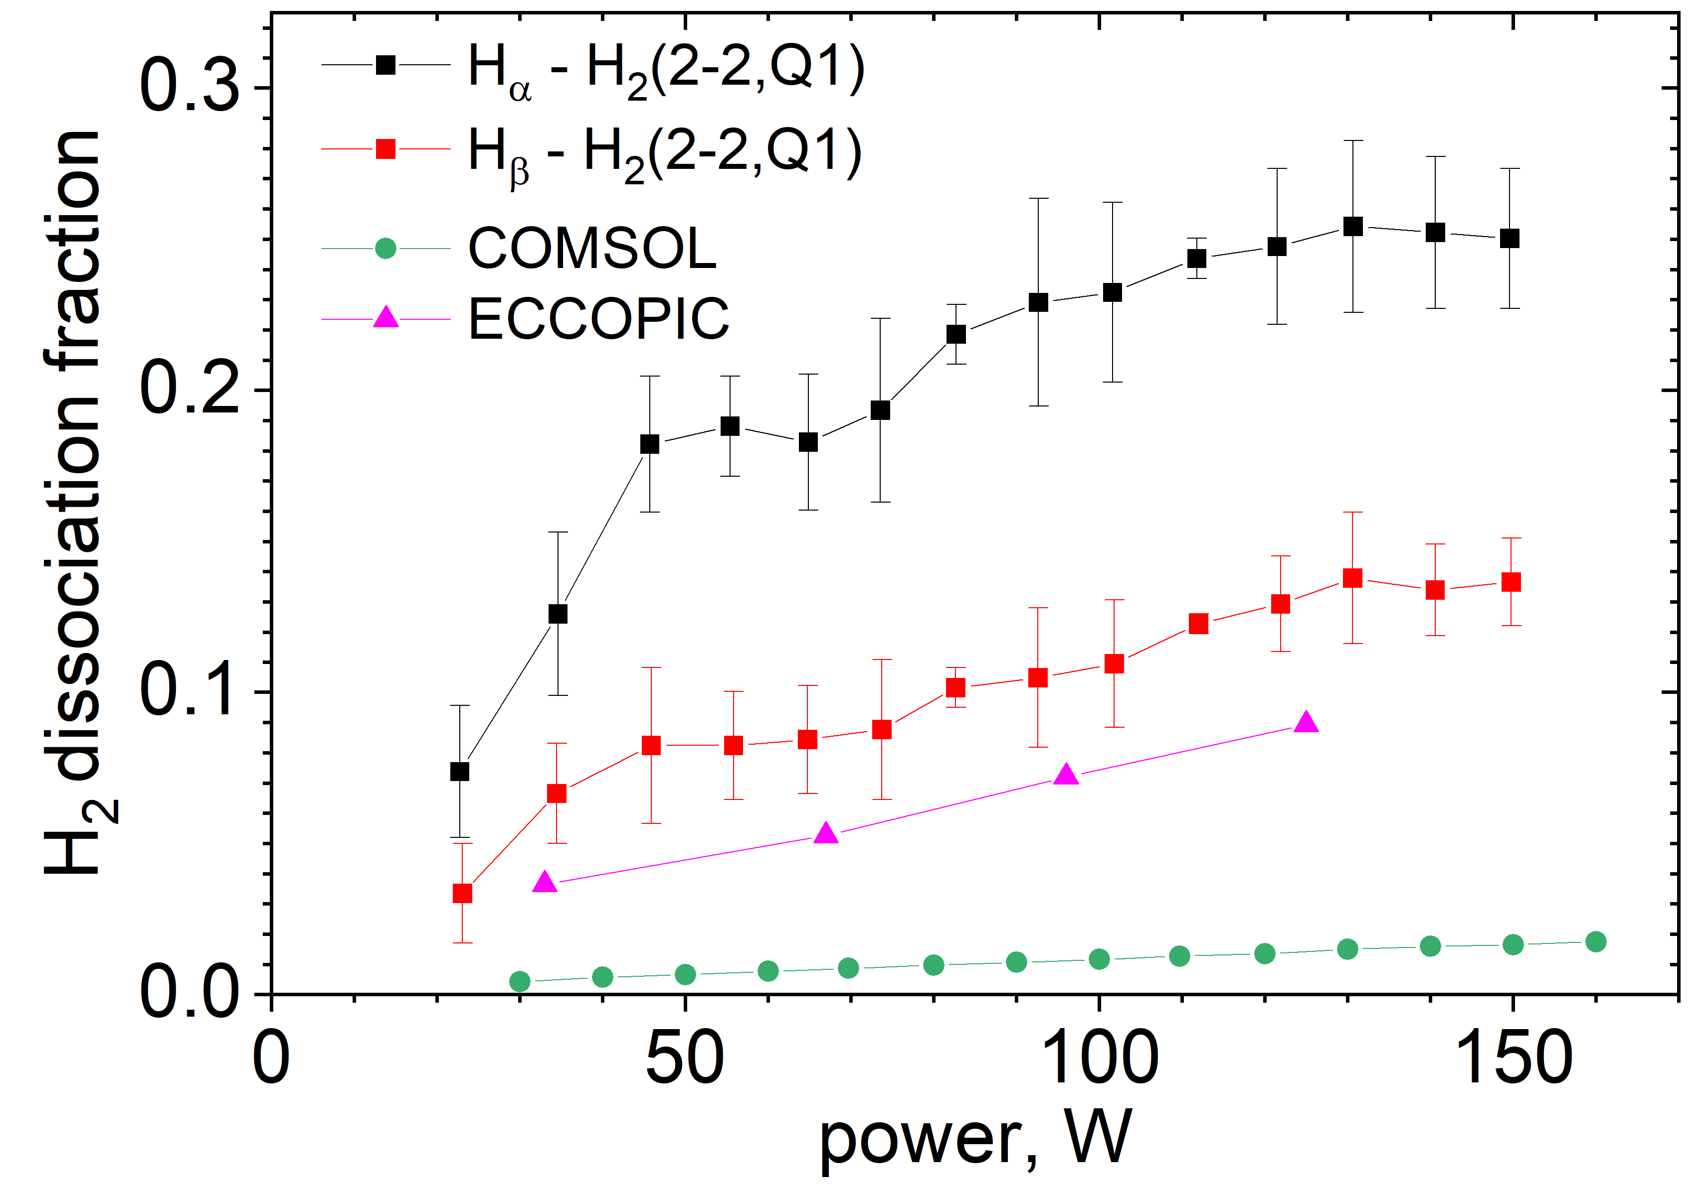
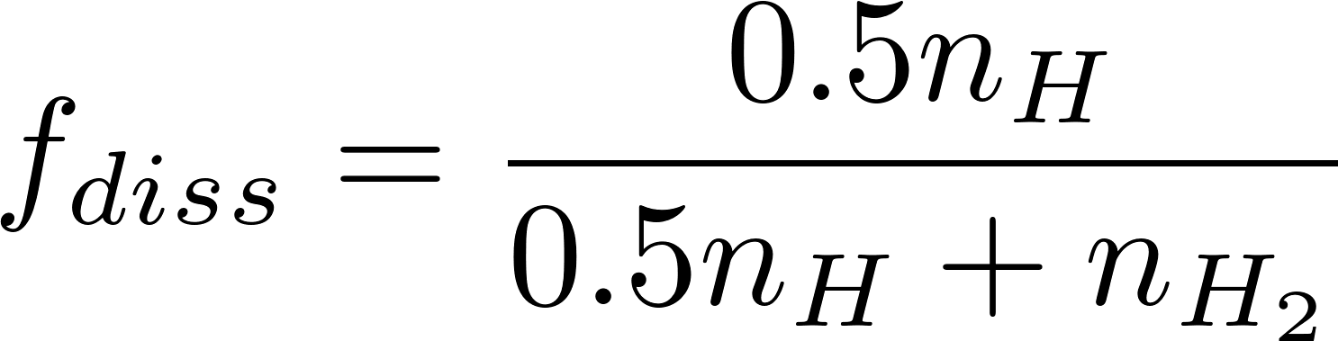
[D. Eremin et al., Plasma Sources Sci. Technol., 34, 065001 (2025)]

Slide 14
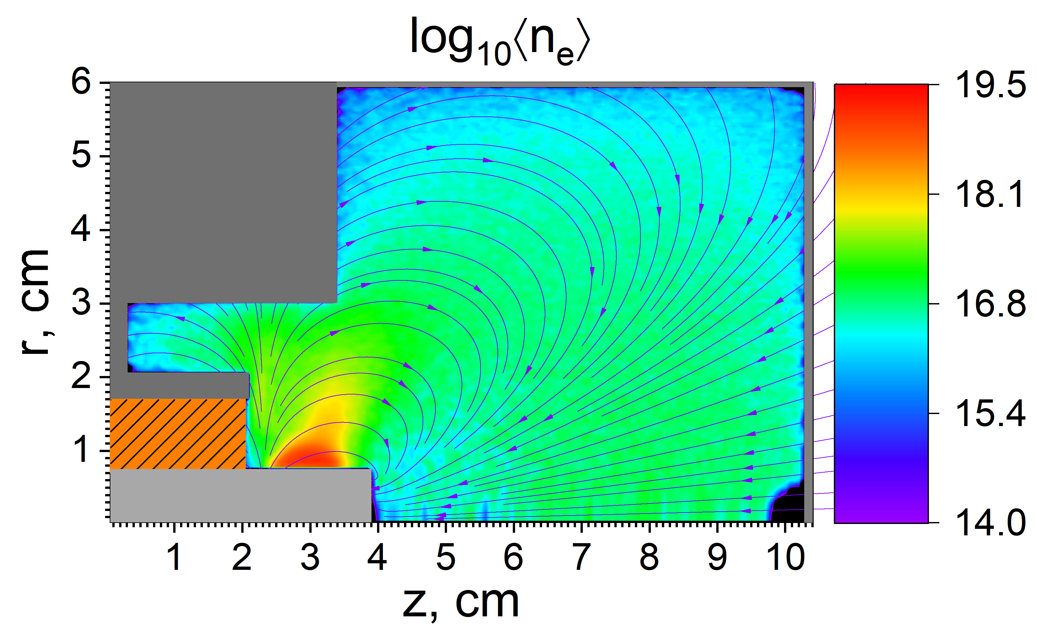
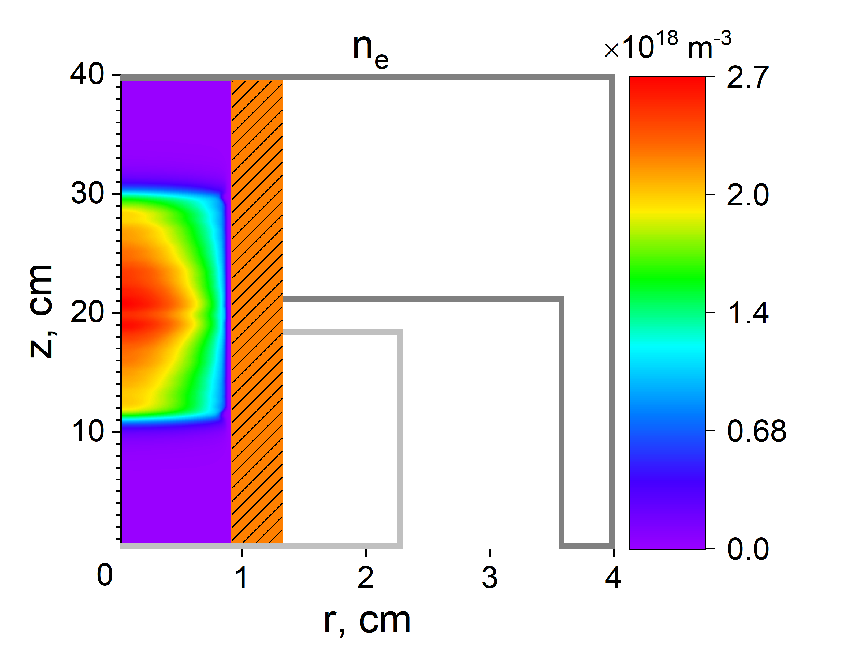
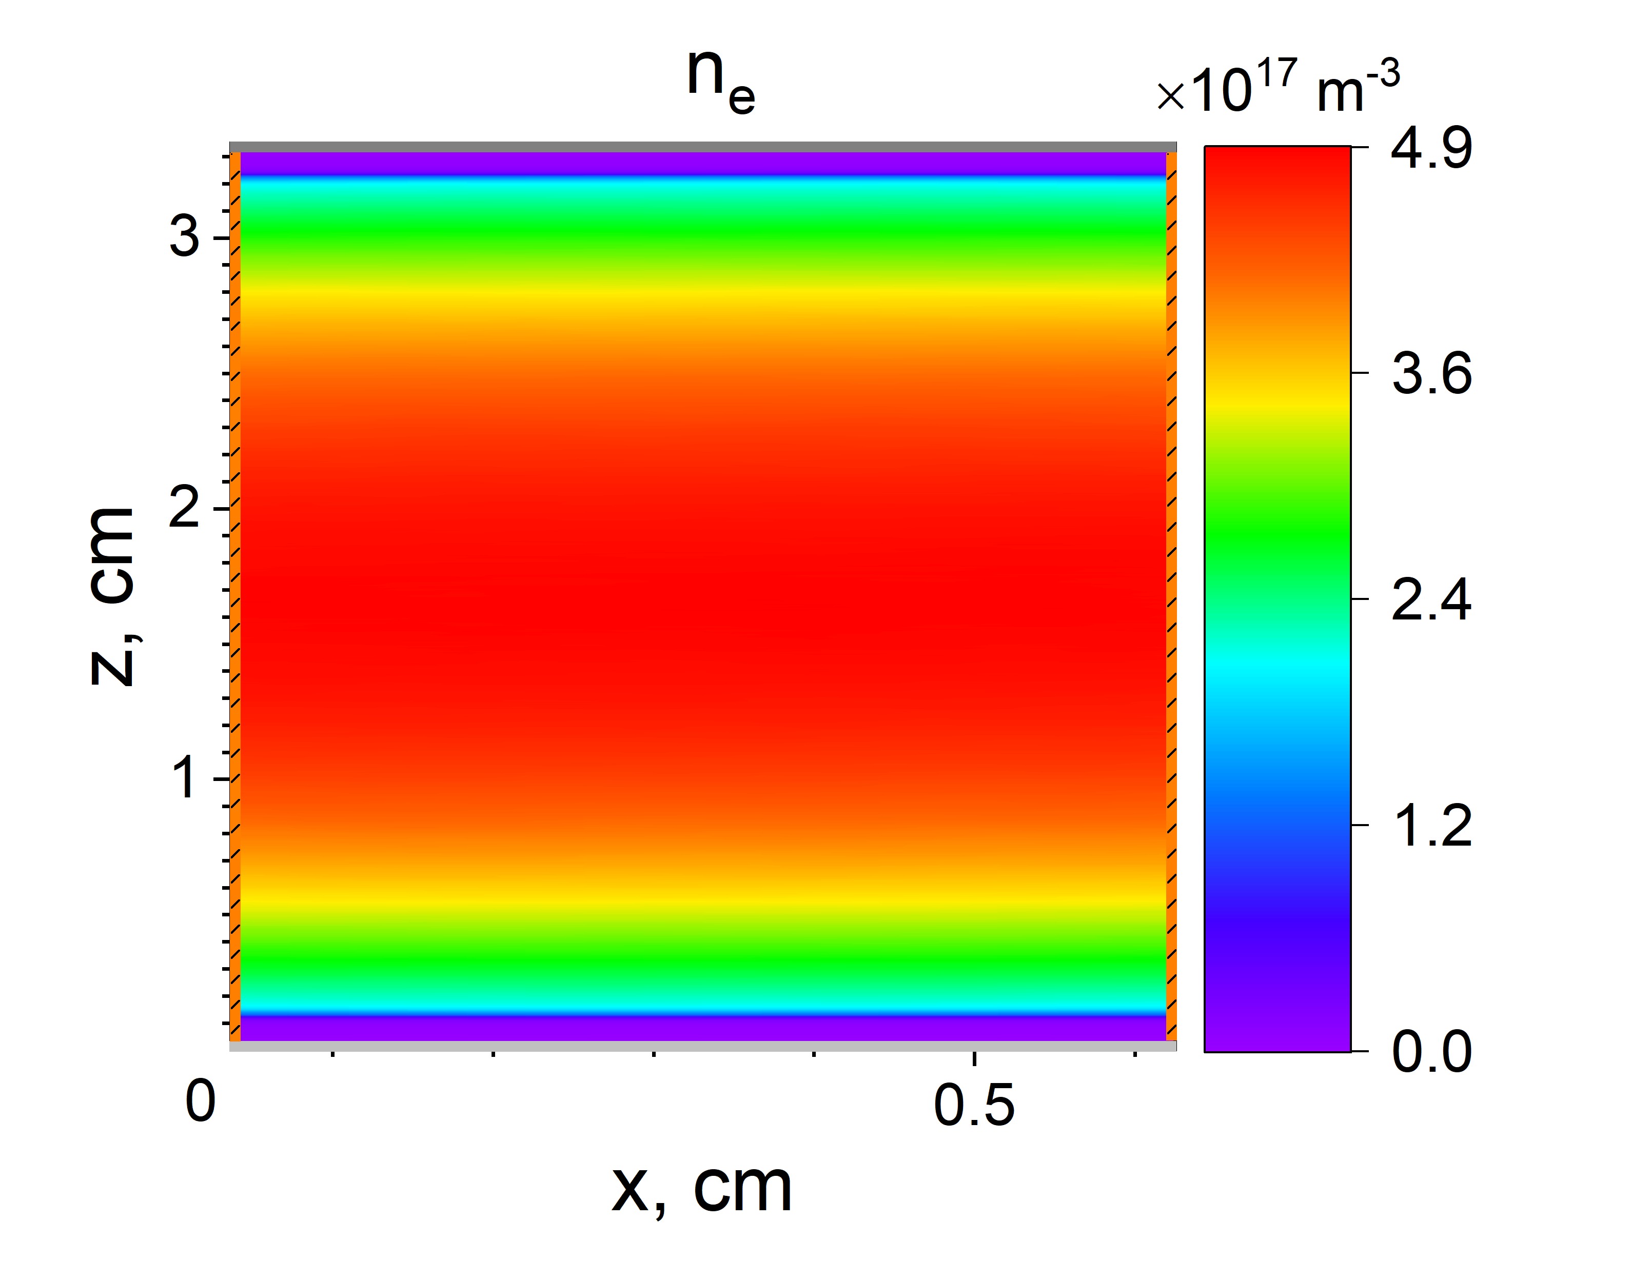
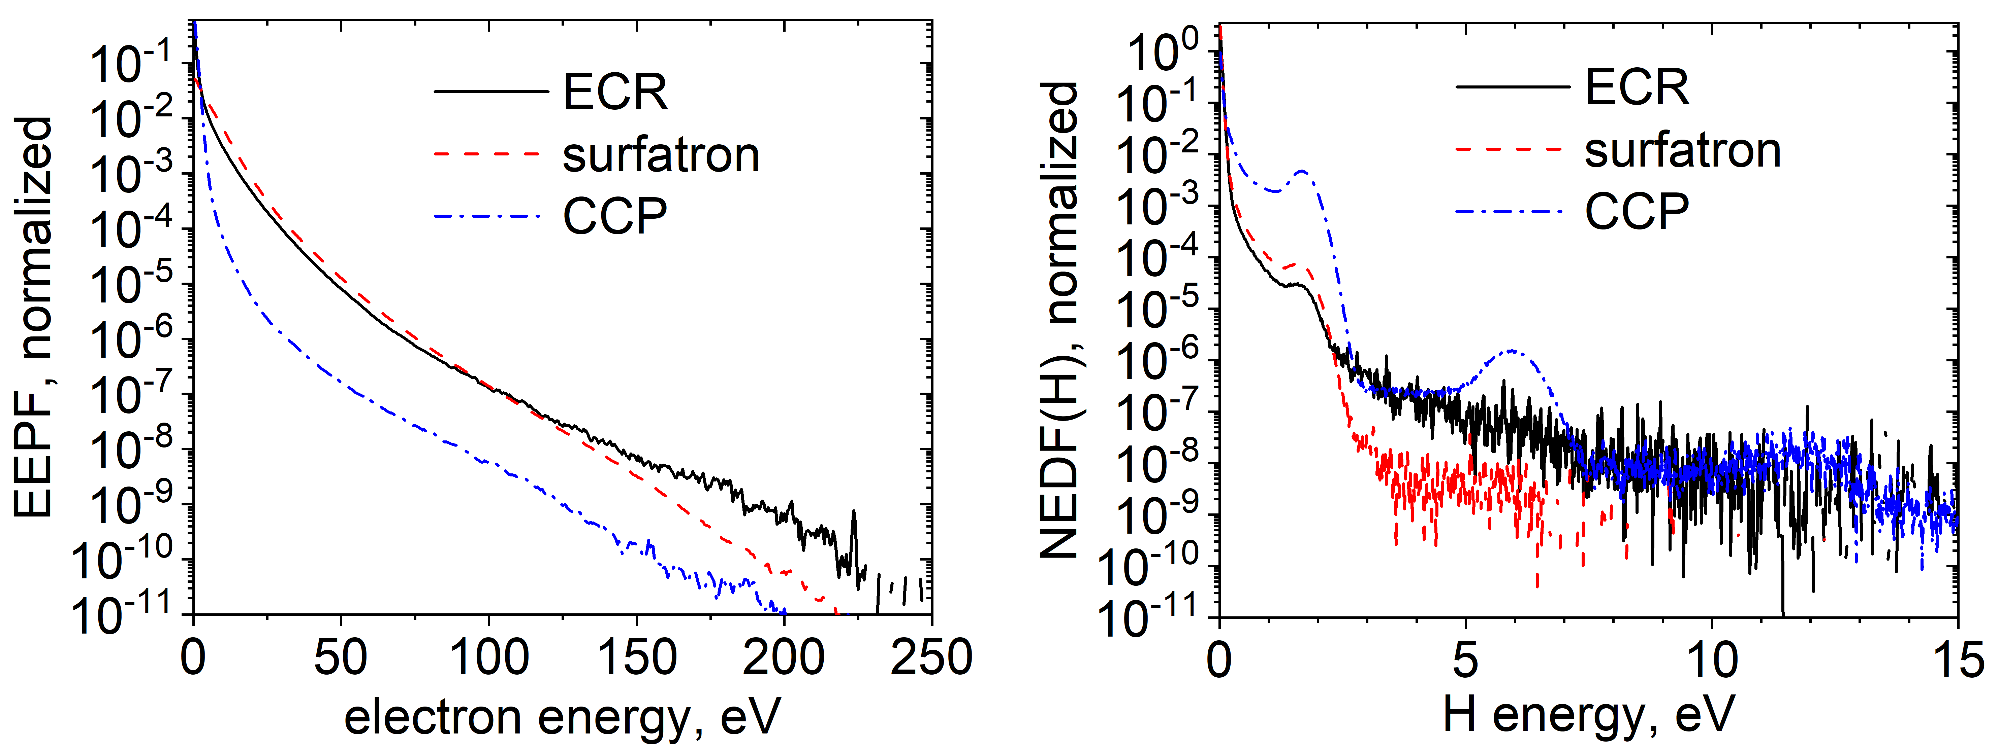
Comparison of 3 Different Discharges: CCP, ICP, and ECR (H )
2
5 Pa, same volume-averaged H dissociation rate
2
ECR
Surfatron
CCP

Slide 15
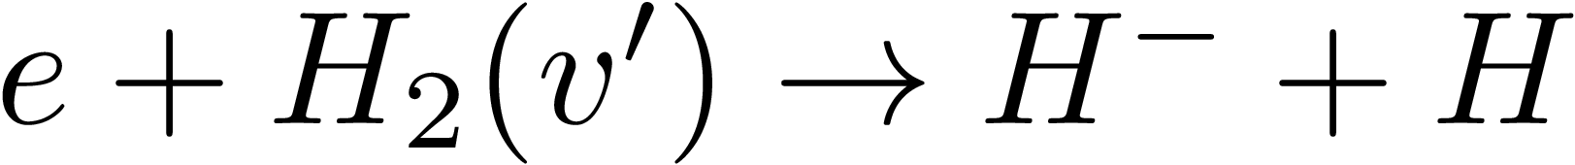



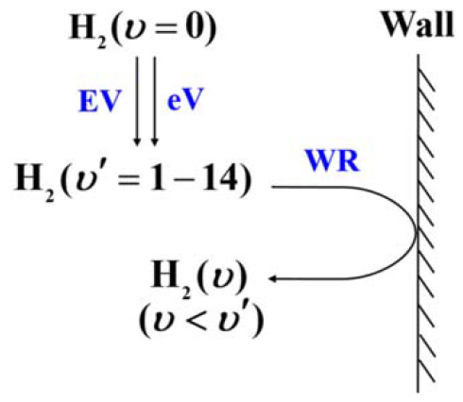
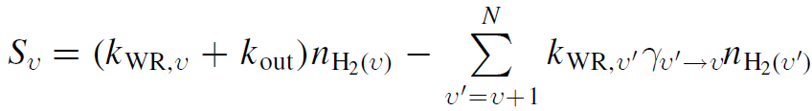
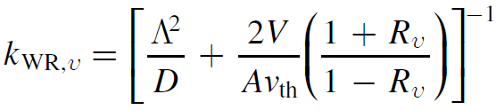



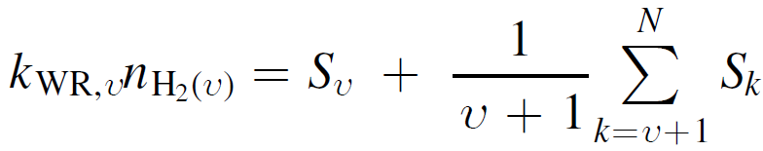
-
Addition of H Ions
Vibrational level pumping:
Reduced Linear Model (RLM) of vibrational kinetics
[W. Yang et al., Plasma Sources Sci. Technol. 28,10LT01 (2019)]
,
,
Key RLM assumption:
In case of no pumping loss,

Slide 16
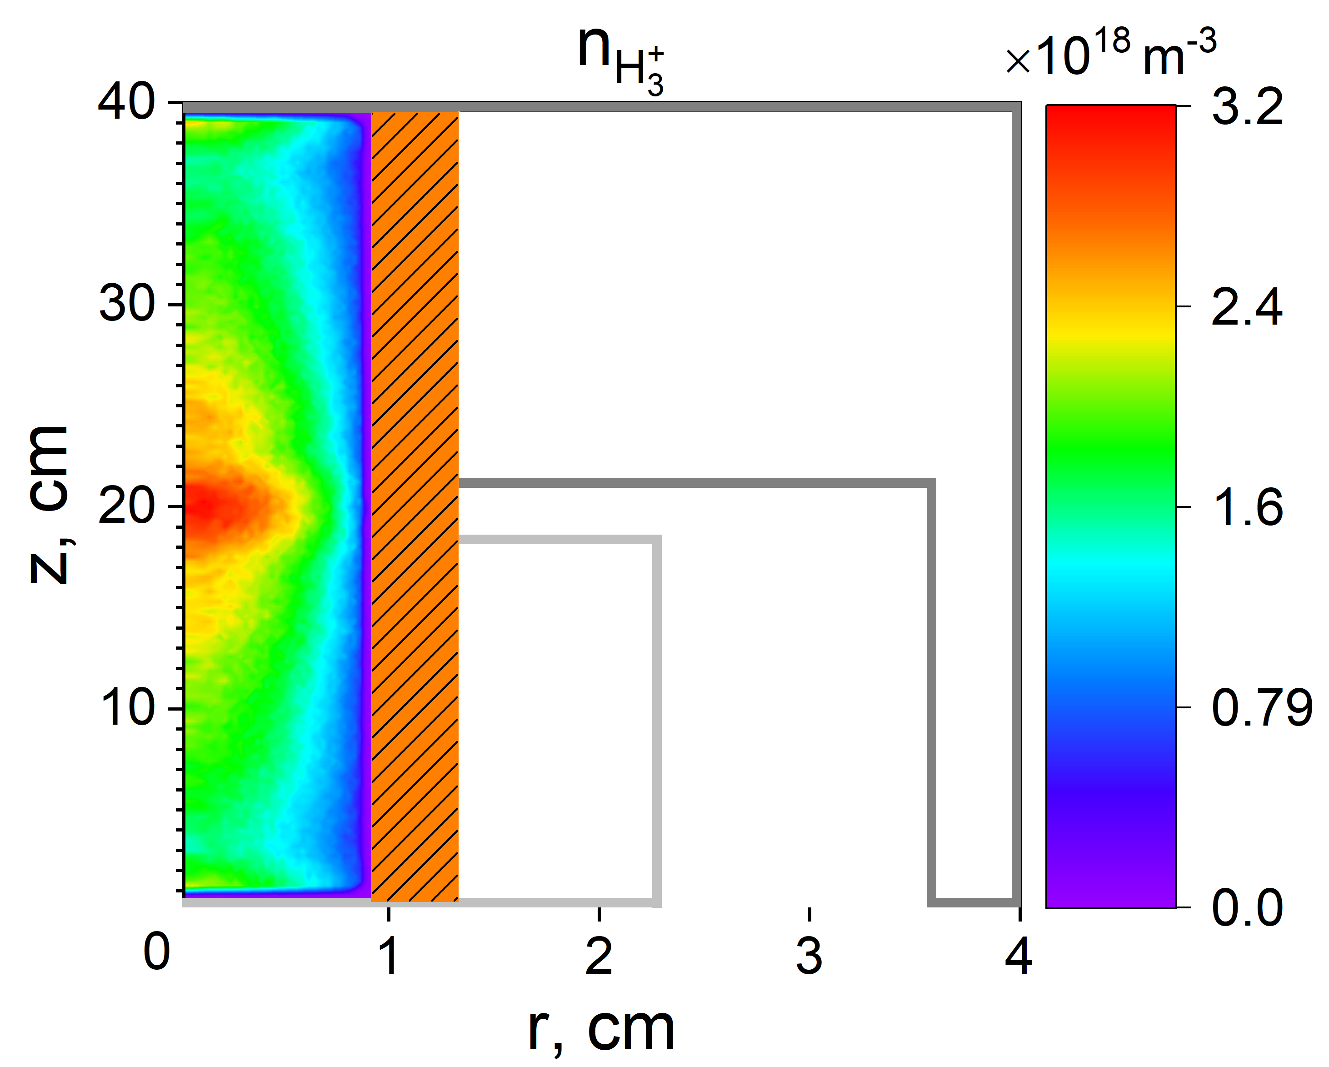
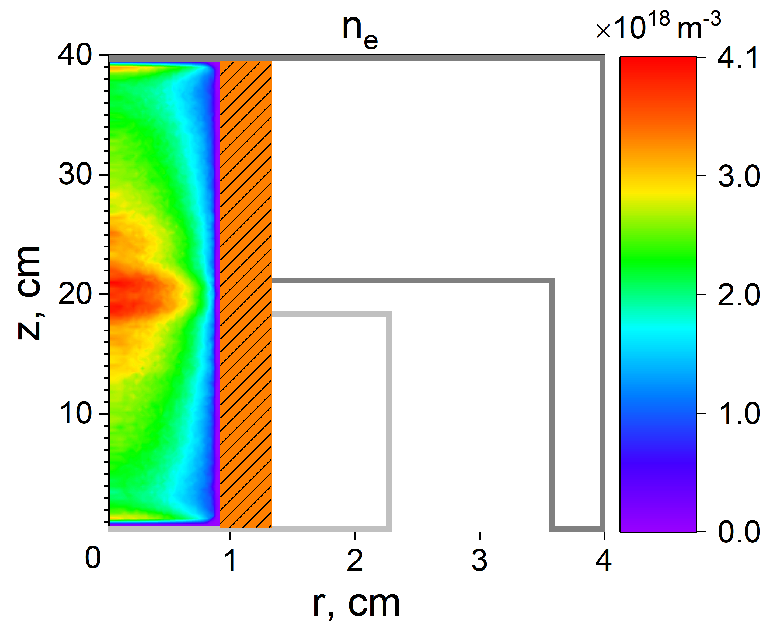
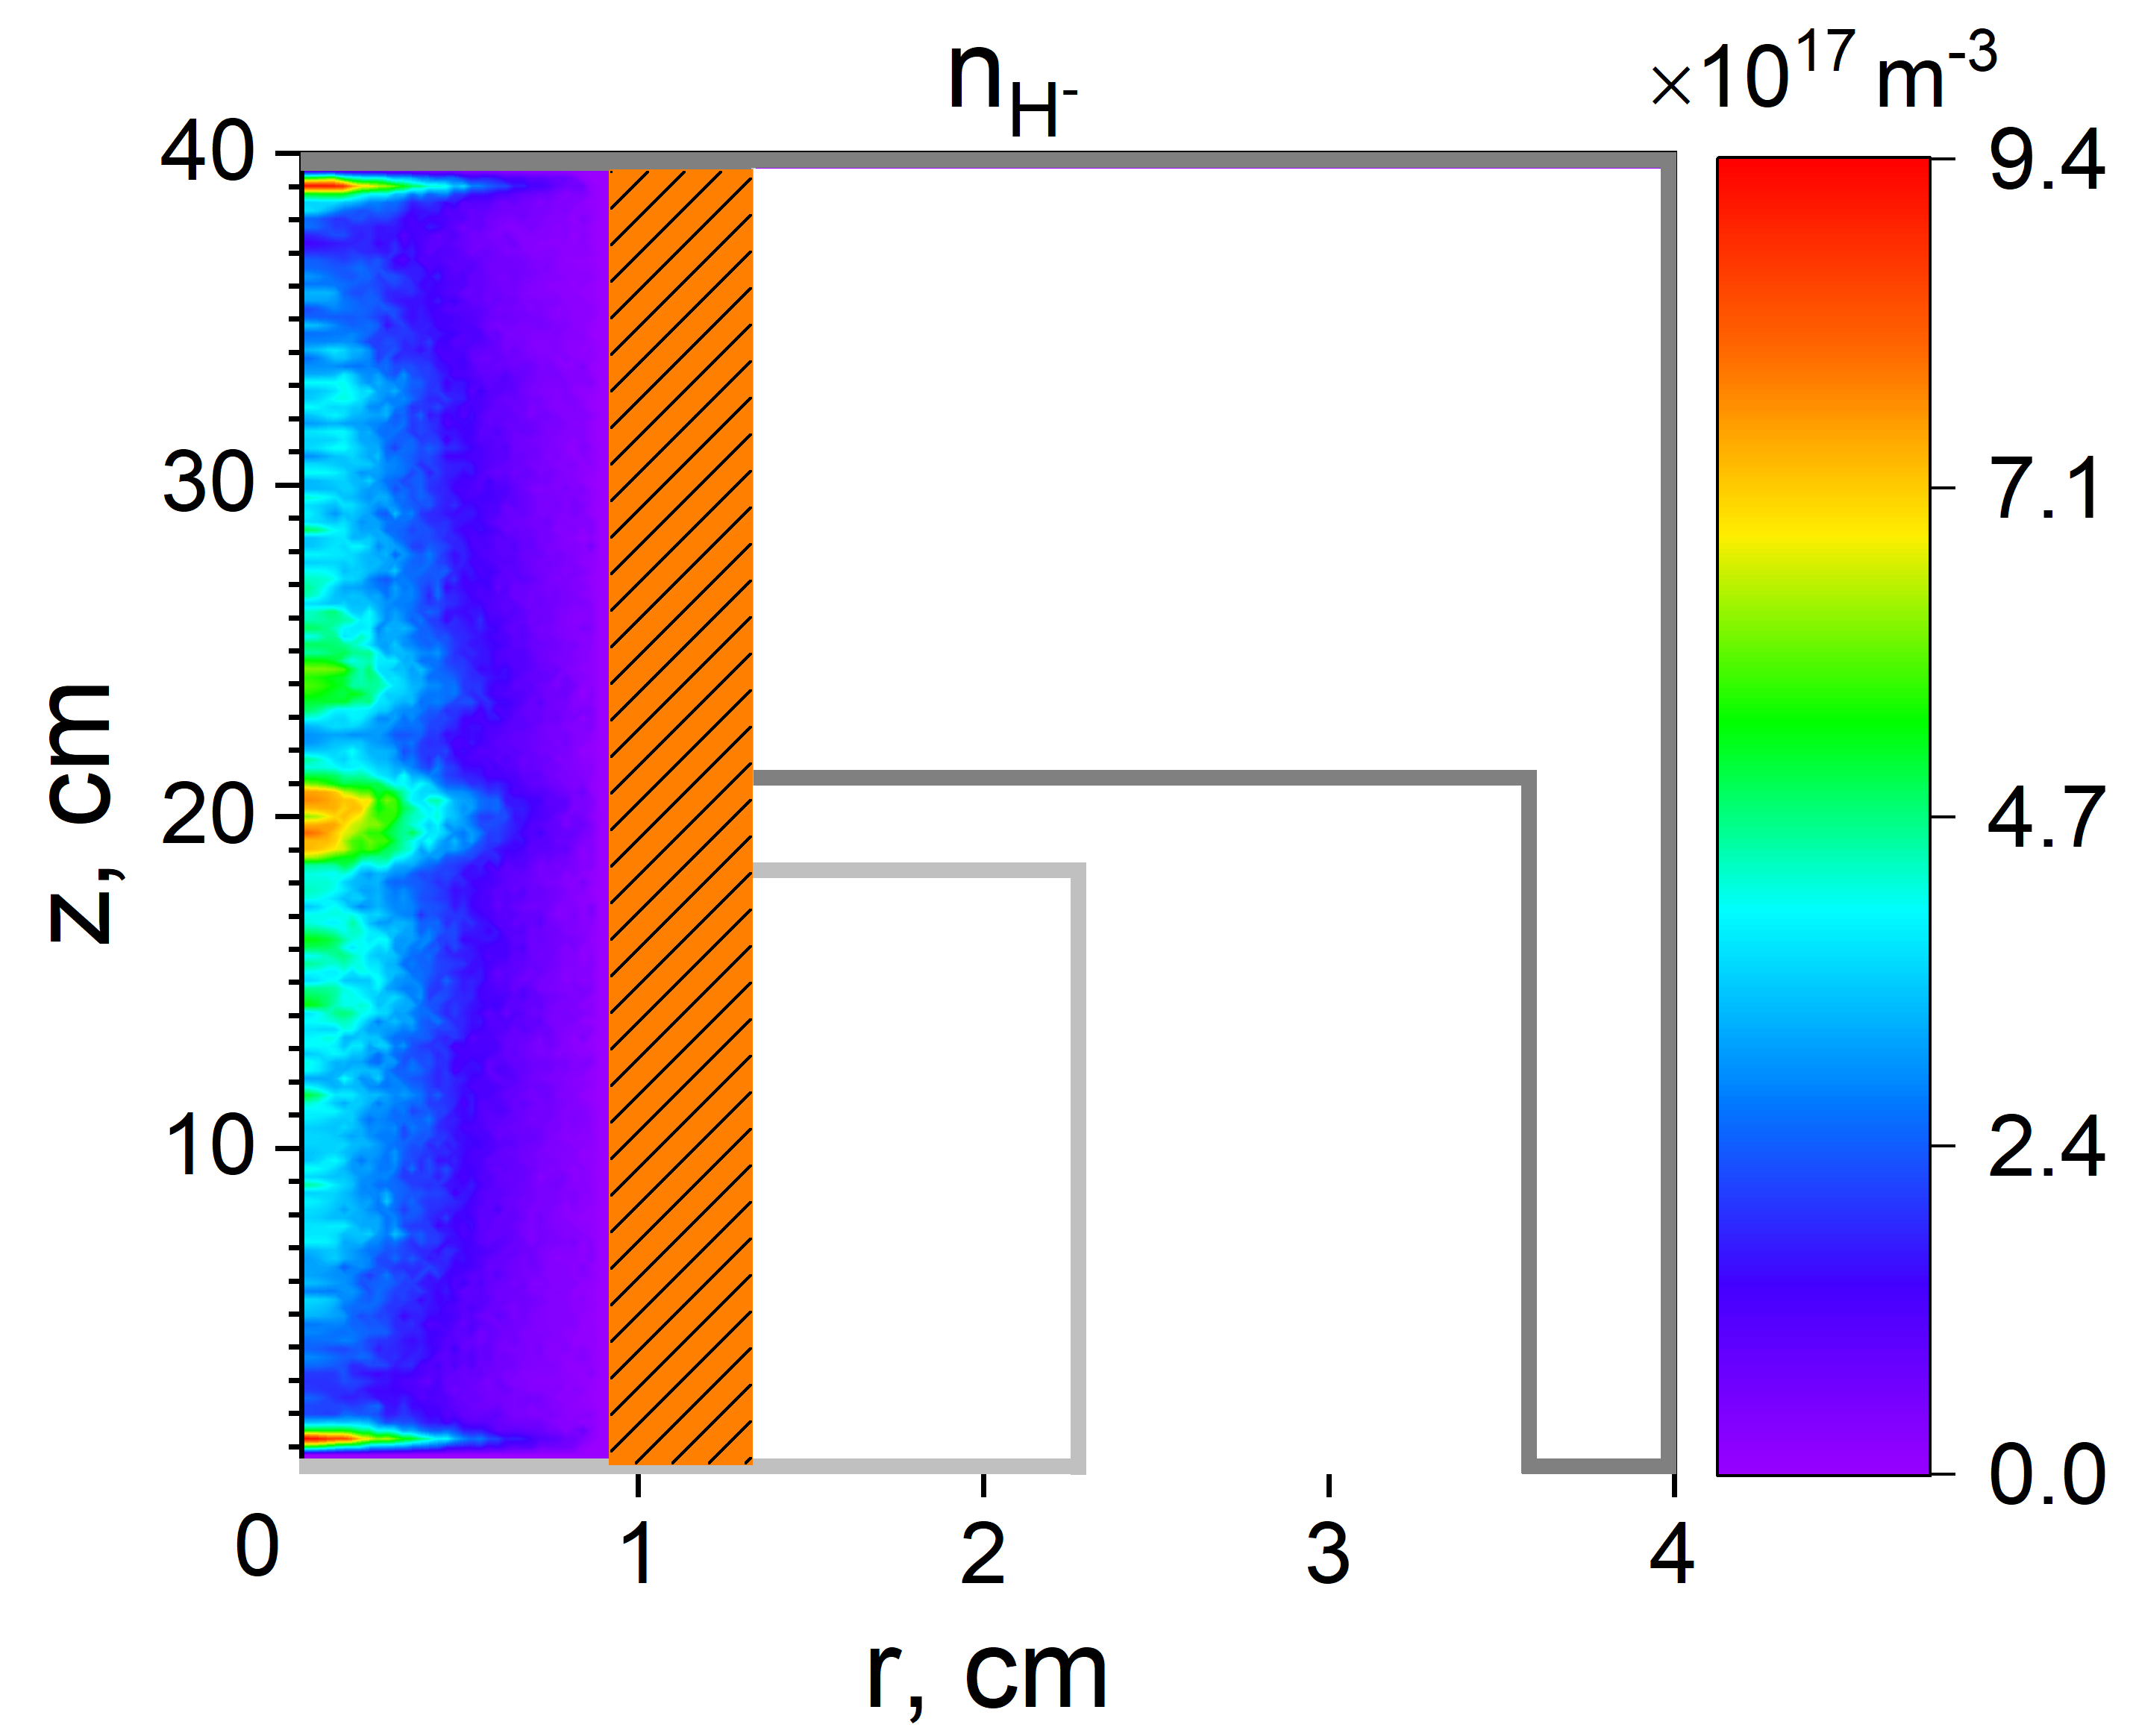
PIC Simulation of a Surfatron Discharge with Negative Ions

Slide 17
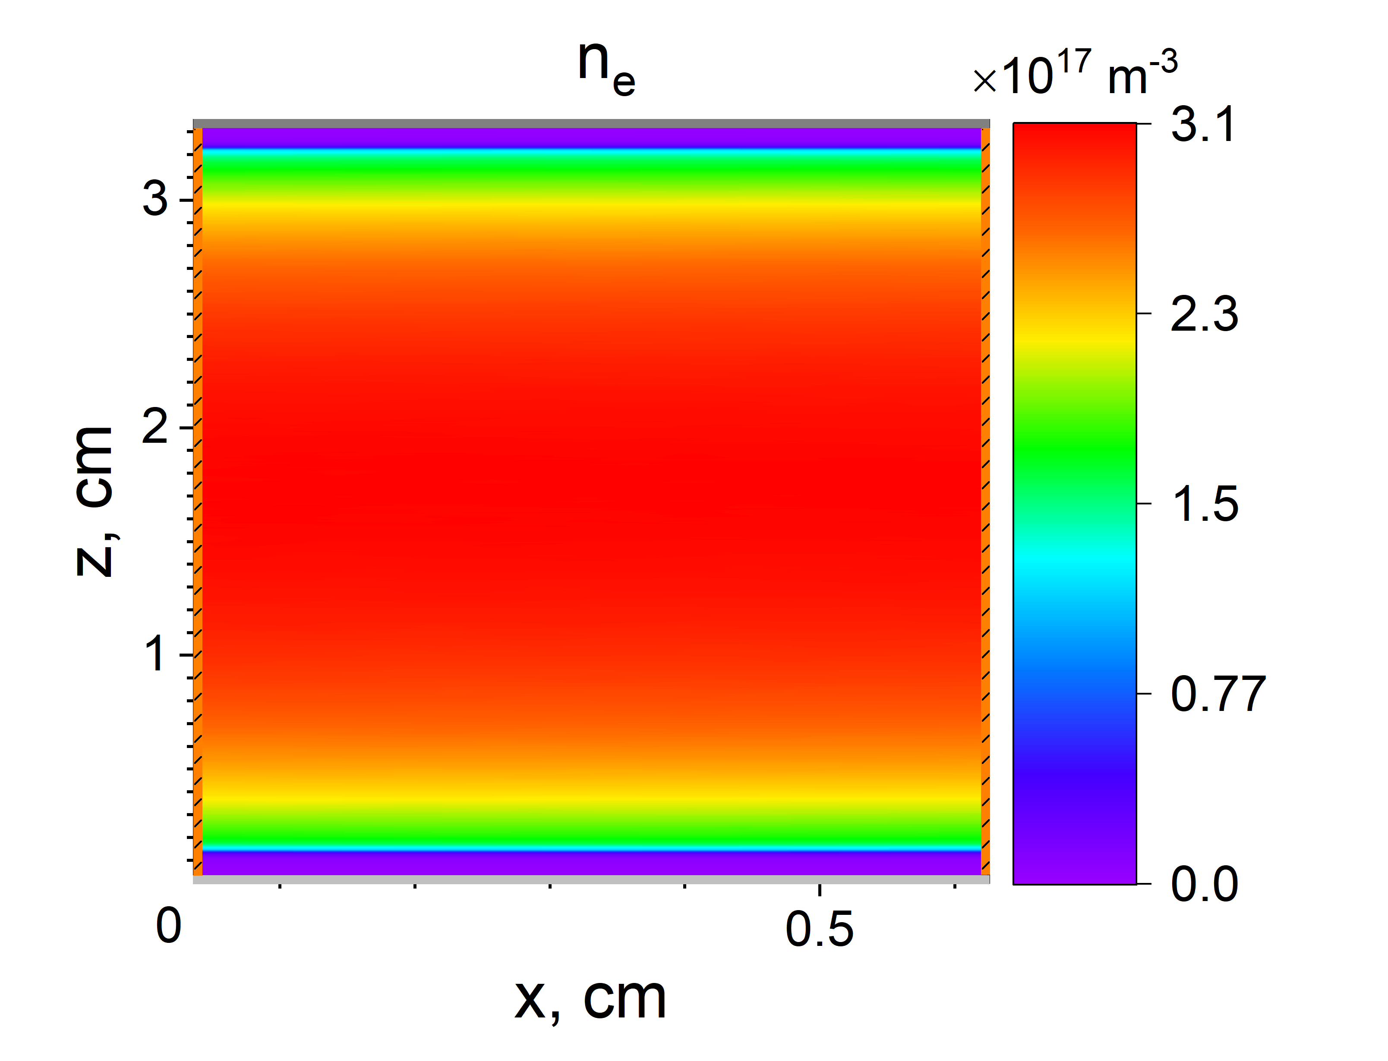
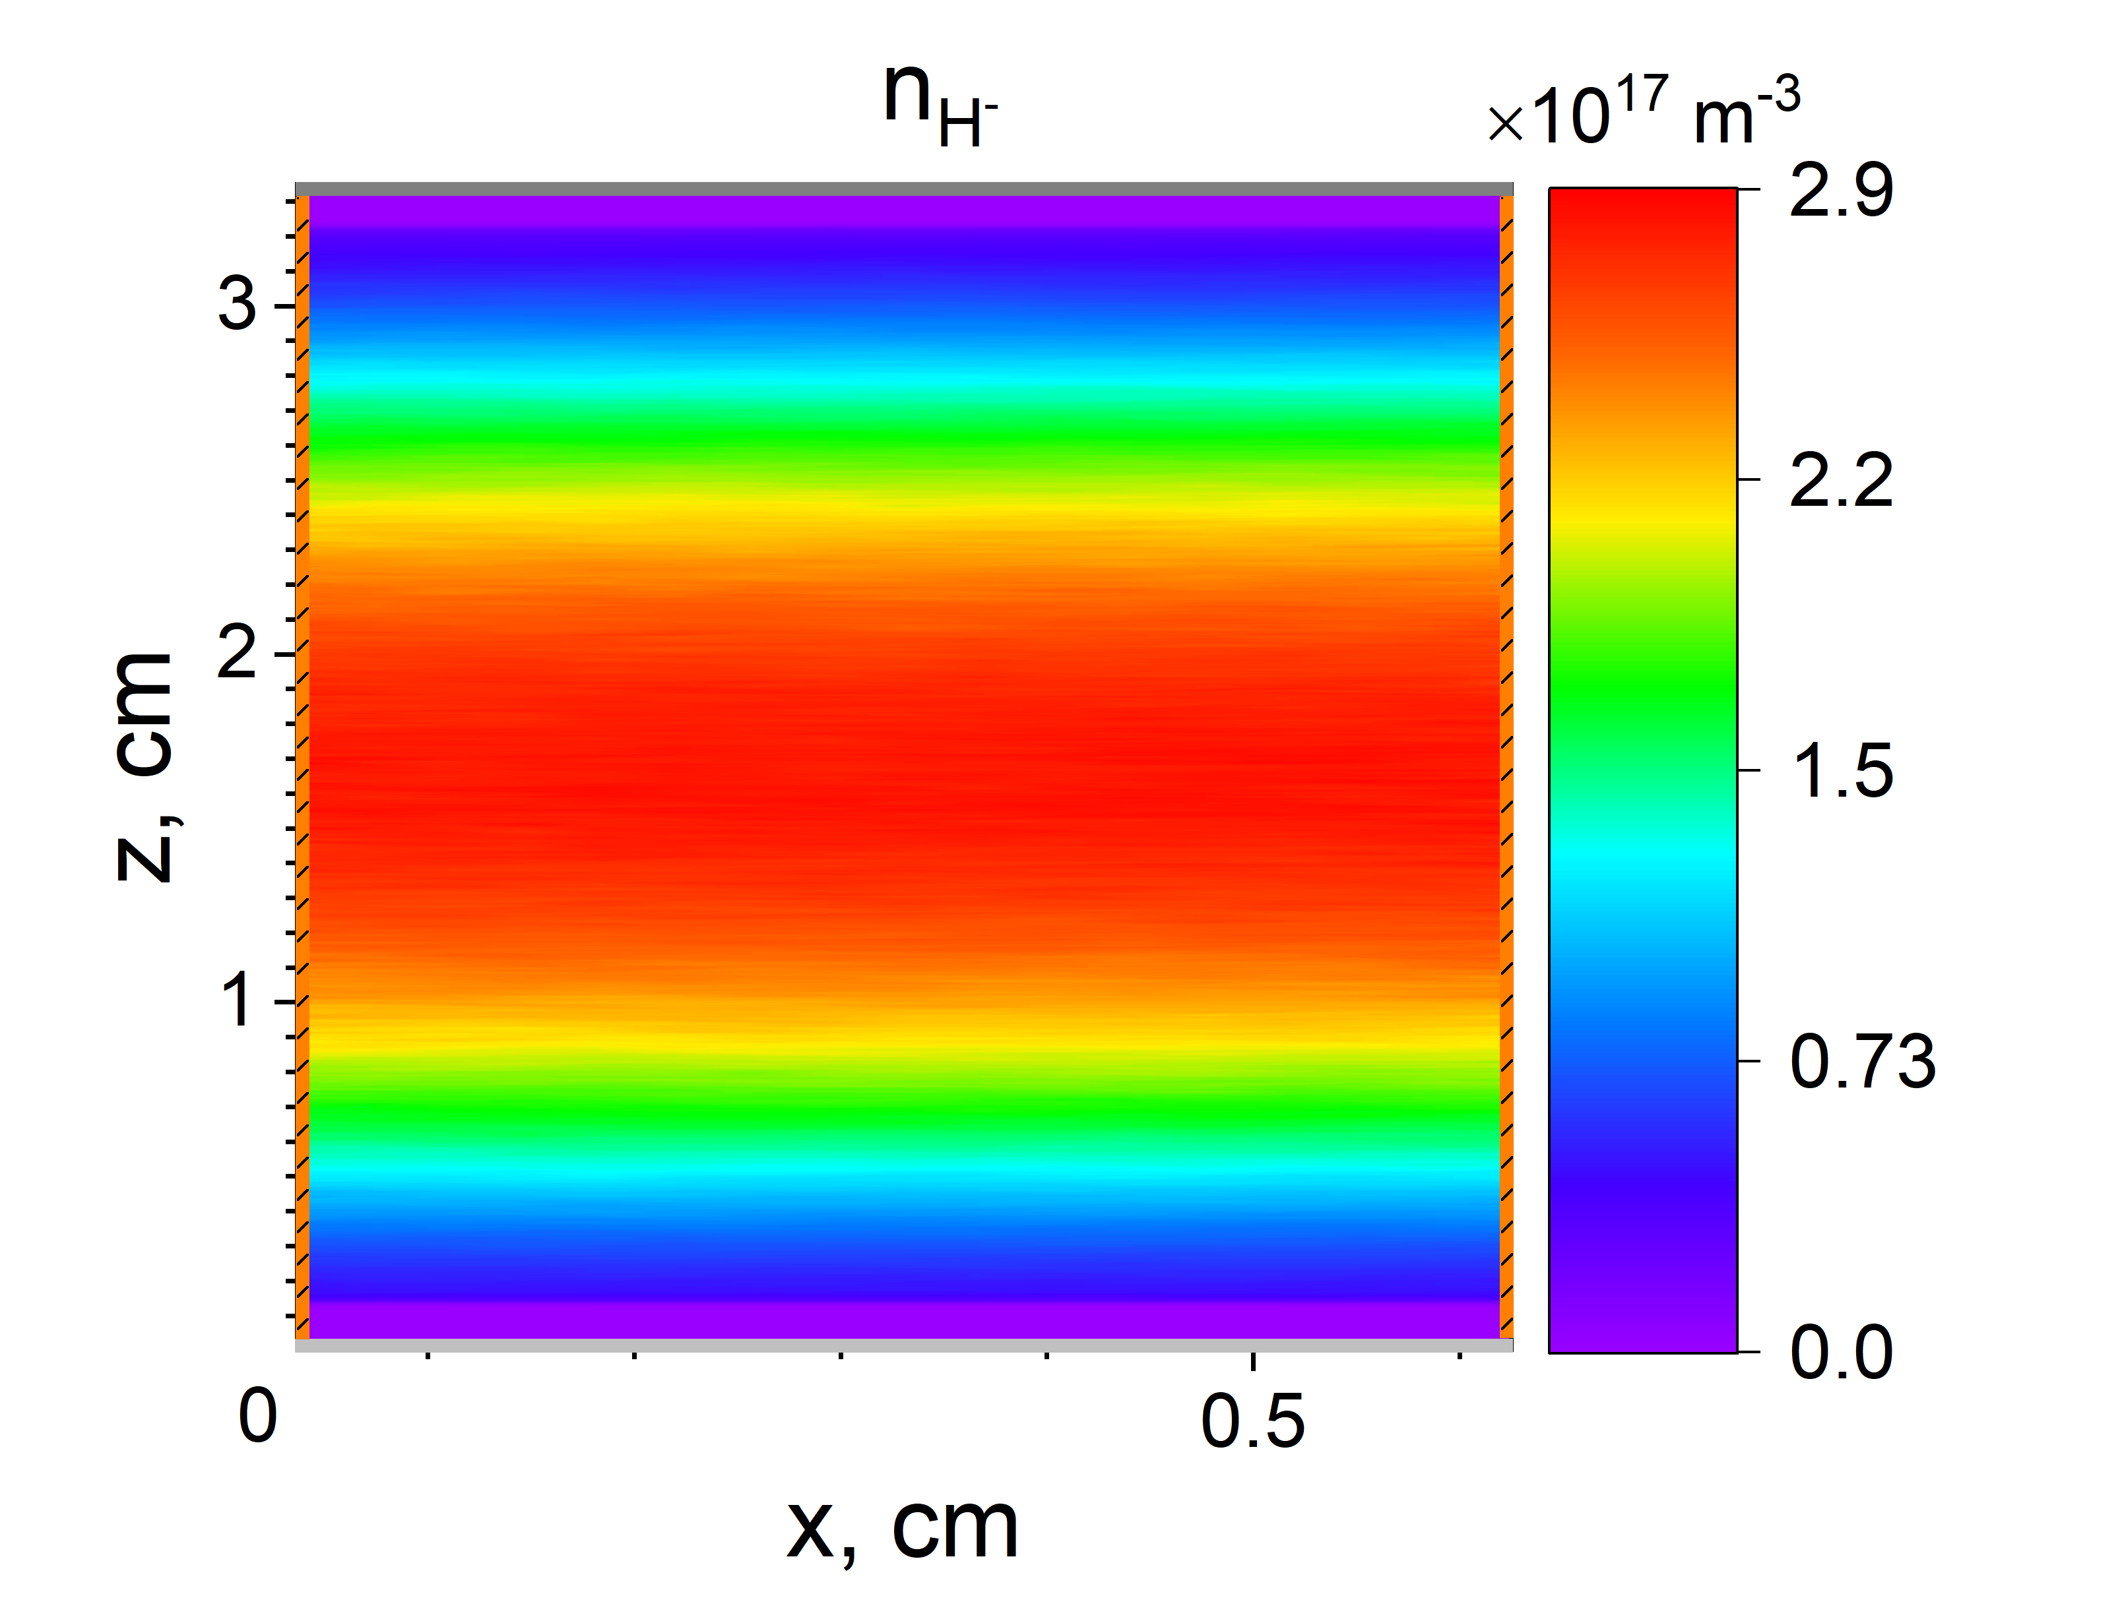
PIC Simulation of a CCP Discharge with Negative Ions

Slide 18
Conclusions
(Implicit) energy-conserving PIC (ECPIC) approach offers an efficient and flexible framework for kinetic plasma simulations of high-density plasmas, possibly with significant electromagnetic effects
It allowed self-consistent modeling of various types of plasma discharges rarely numerically investigated before, such as RF-driven VHF CCP and ICP discharges, MW-driven ECR, surfatron and plasmaline discharges, and magnetized discharges, such as magnetrons operating in the HiPIMS regime
The ECPIC-based ECCOPIC code family was verified in several international benchmarks and validated with VHF CCP, ICP, ECR, and RF magnetron experimental data, showing good agreement with experiment. Ongoing collaborations with TEL, ASML, NewOrbit Space, Osaka University, Silvaco, PPPL
Recent inclusion of negative ion species was based on the Reduced Linear Model developed at PPPL for vibrational kinetics, electron detachment, and associative detachment reactions. Simulations of surfatron and CCP discharges revealed significant production of negative hydrogen ions

Slide 19
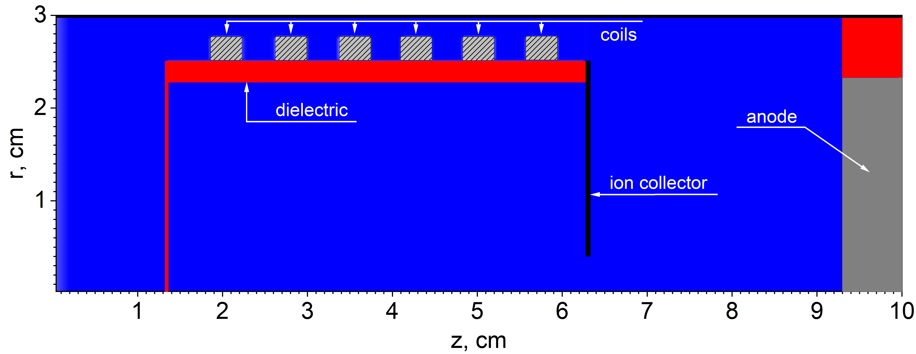
PIC Simulations of RF ICP-Based Cathode
(Collaboration with NewOrbit Space Ltd)

