Slide 1


NIBS 2026
A Comparison of Implicit and
Explicit PIC Schemes in One Dimension
N. Savard G. Fubiani M. Dehnel
nicolas@d-pace.com
Notes:
22 min + 3 min questions. Target pacing: schemes section (slides 2-10) ~8 min, results (11-19) ~9 min, the Comment exchange (20-23) ~3 min, outlook (24-26) ~2 min.
Opening line: the claim in the literature is roughly 10x in 1D and, by extension, 1000x in 3D. This talk is about what happens to that number when you insist on a converged reference solution.

Slide 2
MOTIVATION
Why this matters for practical (negative) ion source simulation
Ion source development is still largely experimental, because simulating the plasma is difficult at the densities involved
Explicit PIC is bounded by Δx ≲ λ_{De}, ≳ 10 particles per cell, and the CFL condition on Δt
  Greater constraint as n_{e} goes up
At n_{e} ≈ 10¹⁸ m⁻³ a steady-state run takes several weeks to months. An engineering study needs many runs, not one
Implicit schemes claim orders-of-magnitude speed-up. The question this talk asks: is that speed-up real once accuracy is held fixed?
higher density, lower temperature
shorter Debye length
finer cells
more cells, and
smaller time step
n_{e} ↑, T_{e} ↓
λ_{De} ∝ √(T_{e} / n_{e}) ↓
Δx ≲ λ_{De}
≥ 10 particles in each
Δt < Δx / (λ_{De} ω_{pe})
every constraint is downstream of the electron density and temperature
N. Savard | Implicit vs. explicit PIC in 1D | NIBS 2026
2
Notes:
Keep this to about a minute. Walk the chain once left to right: the point is that every constraint is downstream of the density, so none can be relaxed on its own. Then state the question the talk answers.

Slide 3
SCHEME 1
Explicit momentum-conserving PIC (MC-PIC)
linear (cloud-in-cell) weights
Macro-particles
Deposit to the grid
x_{p} , v_{p} in continuous space
charge ρ (or current j)
w
Δt
w
1 − w
one time step
Gather E at the particle
Solve the field equation
and push it forward
on the grid → φ , E
node i
x_{p}
node i+1
the same weights deposit ρ and gather E
Leapfrog integration, linear CIC (cloud-in-cell) interpolation for both the charge deposition and the field gather
Cheap per step, simple, popular, uniform cell size
The catch: at Δx > λ_{De} the finite-grid instability forms!
Well behaved right up to the stability bound, but NOT unconditionally stable
N. Savard | Implicit vs. explicit PIC in 1D | NIBS 2026
3
Notes:
The audience knows leapfrog PIC. Spend the time on the right-hand picture: same weights in both directions is what buys momentum conservation.

Slide 4
SCHEME 2
Explicit energy-conserving PIC (EC-PIC)
Nearest-grid-point (NGP) interpolation for the field in 1D, linear for the charge
Energy conserved as Δt → 0, and well enough for CFL-compliant steps (Lewis 1970; Langdon 1973)
Crucially it suppresses the finite-grid instability at low drift velocity (Barnes & Chacón 2021), so Δx > λ_{De} becomes usable
Powis & Kaganovich (2024): works for 1D discharges on non-uniform grids, though with accuracy loss
What you give up: momentum conservation, and Δt is still CFL-limited by the smallest cell
nearest-grid-point field
E piecewise constant per cell
both particles feel the same E
field constant per cell, charge still deposited linearly ⇒ energy conserved as Δt → 0
Energy conservation alone already relaxes Δx.
N. Savard | Implicit vs. explicit PIC in 1D | NIBS 2026
4
Notes:
EC-PIC is the useful middle term: it separates what energy conservation buys from what implicitness buys. That distinction pays off on the passive-sheath slide later.

Slide 5
SCHEME 3
Fully implicit charge- and energy-conserving PIC
one implicit time step
Discretise the divergence of Ampère's law (combination of charge-continuity + Poisson), Crank–Nicolson in time (Chen 2011; Chacón 2013; Eremin 2022)
Fields and particle trajectories are non-linearly coupled. “Kinetic enslavement” hides the particle push inside the field solve
Unconditionally stable, so Δx > λ_{De} and Δt > 1/ω_{pe} possible
guess φ^{n+1,k}
move every particle over Δt
in sub-steps → j^{n+1/2} or ρ^{n+1}
solve the field equation → φ^{n+1,k+1}
Field equation
∇ · ( ε₀ ∂E/∂t + j ) = 0
no (k → k+1)
converged?
yes
Picard iteration
φ^{n+1,k+1} = A⁻¹ b( φ^{n} , j^{n+1/2}(φ^{n+1,k}) )
t^{n+1}
Convergence
‖ φ^{n+1,k+1} − φ^{n+1,k} ‖_{RMS} < ε_{a}
The cost is in the loop
Every iteration k moves every particle over the whole Δt, in sub-steps.
Both resolution constraints are gone. The question is what the non-linear solve (also for particle mover!) costs, and what these relaxed constraints do to accuracy.
N. Savard | Implicit vs. explicit PIC in 1D | NIBS 2026
5
Notes:
Mirror the previous two slides: same loop, but now it does not close until the field and the particles agree. Point at the 'no' branch — that is where the cost lives.

Slide 6
SCHEME 3
The two sub-schemes: INGP and ICIC
cell Δx_{l}
one particle trajectory over Δt
INGP (m = 0)
t^{n+1}
macro-particle
Δτ
nodes: φ , ρ̃
half-nodes: E , j
Δτ
ICIC (m = 1)
Δτ
t^{n}
nodes: E , j
half-nodes: φ , ρ̃
cut at every cell boundary, so no sub-step crosses one ⇒ charge conserved exactly, no CFL limit
INGP (m = 0) and ICIC (m = 1) differ only in interpolation order, which flips where φ, ρ̃ and E, j live on the staggered grid
Both sub-step the particle trajectory so that no sub-step crosses a cell boundary. That is what makes charge conservation exact and removes the CFL constraint. Some schemes allow removal of sub-stepping constraint (Jimenez 2024).
Binomial smoothing in logical space an option
In 1D the INGP sub-step has a closed-form analytic solution (no Picard iterations). ICIC needs Picard, and likely so will schemes in 2D or 3D.
Mapped grids let you keep fine cells in the sheath and coarsen the quasi-neutral bulk. That is the move the speed-up estimate relies on.
N. Savard | Implicit vs. explicit PIC in 1D | NIBS 2026
6
Notes:
The bolded line matters for every timing number later: 1D INGP is the cheapest configuration that exists, and it is the one that does not generalise.

Slide 7
THE EXPECTATION
Where the speed-up comes from (CPU = computational cost)
speed-up = CPU_{exp} / CPU_{imp} = ( Δx_{imp} / Δx_{exp} )^{d} ( Δt_{imp} / Δt_{exp} ) × 1 / ( N_{FE} N_{sub} )
Chen (2011) — the estimate behind implicit-PIC speed-up
You gain one factor of the cell-size ratio per dimension, and one factor of the time-step ratio
You pay for it in N_{FE} (the function evaluations the non-linear solve needs) and N_{sub}, the sub-steps inside each push
The estimate holds the particles per cell fixed. Nothing in it accounts for accuracy.
Cache-friendliness is important!
1D
~10×
measured
2D
~100×
extrapolated
3D
~1000×
extrapolated
N. Savard | NIBS 2026
7
Notes:
This is the hinge of the talk. Read the formula out: it is a statement about work per step, not about accuracy. Everything from here on is what happens when you insist on a converged answer.

Slide 8
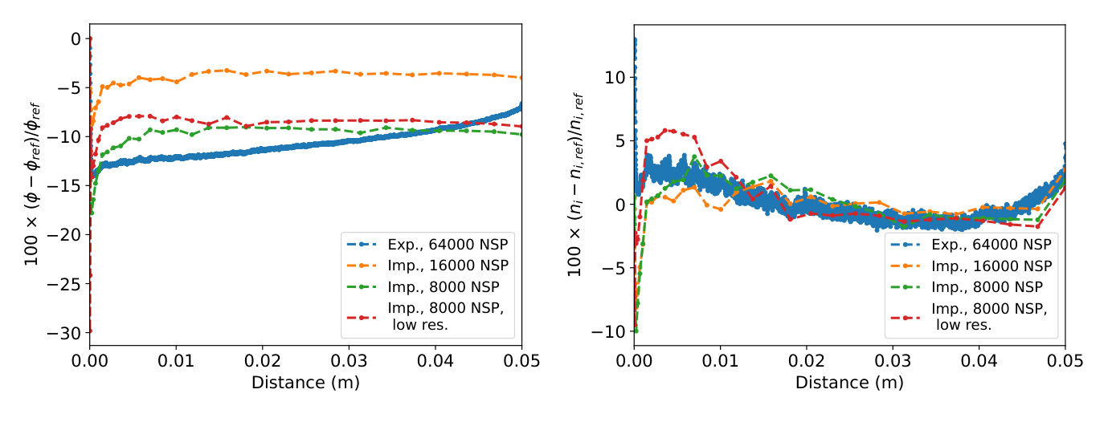
ICIS 2023
First test: a bounded plasma benchmark
What we found
Implicit NGP PIC up to 12× faster than explicit at fixed accuracy in the potential, on 32 nodes with Δt = 2/ω_{pe}
Compared to explicit with Δx = 0.5λ_{De} and Δt = 0.2/ω_{pe}
128 PPC reference, lower resolution to about 11 PPC
What that comparison did not do
NGP with the analytic sub-step push so no Picard iterations anywhere (unlike CIC)
The explicit side was not coarsened in cell size or time step
Not self-consistent: fixed temperatures, a refluxing boundary and a uniform source term
Did not test convergence of reference
J. Phys. Conf. Ser. 2743, 012003 (2024), Fig. 3: Emmert bounded-plasma benchmark, n_{e} = 10¹⁸ m⁻³
A useful first step. What if you remove these caveats?
N. Savard | Implicit vs. explicit PIC in 1D | NIBS 2026
8
Notes:
Owning the limits of your own earlier result buys credibility for everything that follows. Thirty seconds, plainly said, then move on.

Slide 9
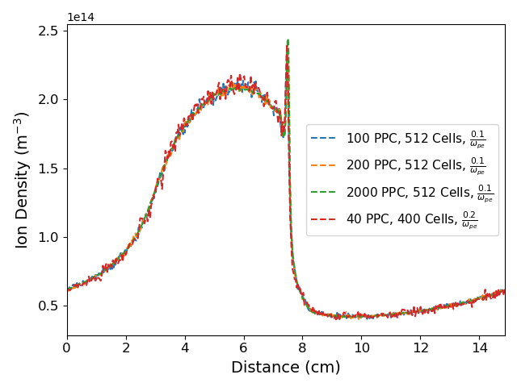
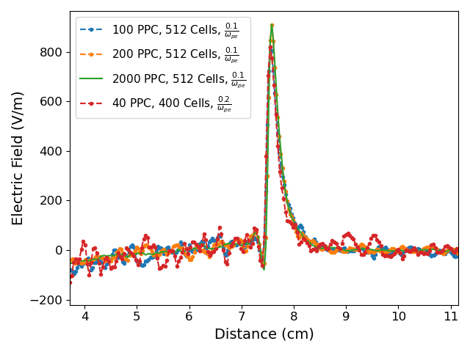
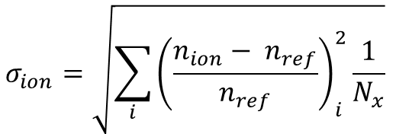
PAPER 1 (2025)
Ion acoustic shockwave: the explicit side
Setup
Ion acoustic shockwave (IASW) from Chacon 2013: periodic, collisionless benchmark; ne = 10¹⁴ m⁻³, Te = 1 eV, L = 200 λ_{De}, t = 3000/ω_{pe}
All three schemes agree at 512 cells and 2000 PPC: the codes are consistent
Coarsening the explicit
Down to 400 cells (Δx = λ_{De}/2), Δt = 0.2/ω_{pe} and 40 PPC: 16 000 particles in the whole domain
Noisier, but density, field and temperature all keep their shape
$$σ_{ion}=\sqrt{\sum_{i}{{\left(\frac{n_{ion}− n_{ref}}{n_{ref}}\right)}_{i}^{2}\frac{1}{N_{x}}}}$$
Phys. Plasmas 32, 073903 (2025), Fig. 3: explicit MC-PIC at reduced cell count and PPC
40 PPC on 400 cells: σ_{ion} = 0.039 in 2.2 s of particle time.
N. Savard | Implicit vs. explicit PIC in 1D | NIBS 2026
9
Notes:
Say the 16 000-particle figure out loud — it is the yardstick for the next slide.

Slide 10
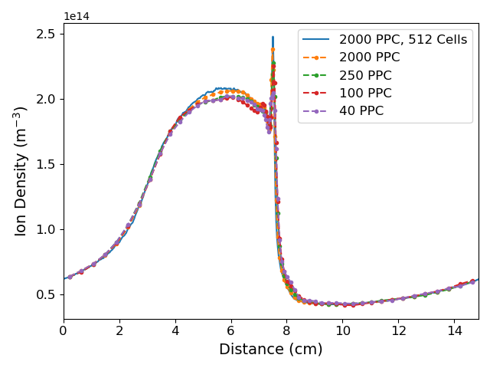
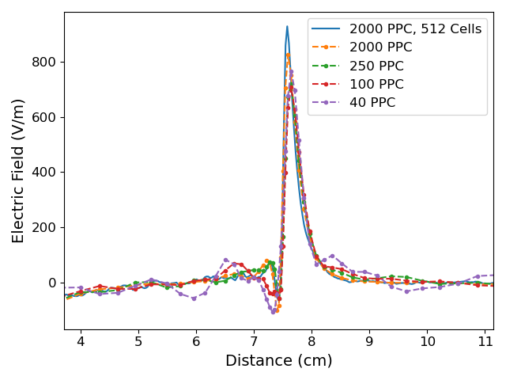
PAPER 1 (2025)
The implicit side does not coarsen as gracefully
ICIC on a 64-cell inverse-sine mapped grid, Δx_{min} = 0.45 λ_{De} to resolve the shock
The peak density falls away as PPC drops, and the field trough stops being resolved
250 PPC was chosen to match the total particle count of the cheapest explicit run: and it is already off
The average number of particles per cell is not the sole figure of merit. The issue is either with cell with fewest particles setting the error, or total number of particles not resolving the total distribution in phase-space.
Phys. Plasmas 32, 073903 (2025), Fig. 4 : ICIC on 64 mapped cells, reference in blue
ICIC, 250 PPC / 64 cells: σ_{ion} = 0.076 in 7.4 s vs explicit, 40 PPC / 400 cells: σ_{ion} = 0.039 in 2.2 s (both 16000 particles)
N. Savard | Implicit vs. explicit PIC in 1D | NIBS 2026
10
Notes:
This is the core result of paper 1. Same total particles, worse answer, three times the runtime.

Slide 11
THE COMMENT
A Comment on the 2025 Physics of Plasmas paper
IASW (Ion Acoustic Shockwave) case
The good
The questionable
Particle loading
No explicit run to compare against
Particles spaced along the cumulative distribution function (CDF) of the density profile: no sampling noise in the initial density.
Accuracy is judged relative to explicit PIC without running the explicit scheme under the same conditions.
Single runs, not ensembles
Errors removed before measuring
Report one run and its scatter rather than an average of ten.
The shock phase shift is removed and the reference is taken on the coarse mesh. These are errors!
Their conclusion: ECC-IPIC accuracy is commensurate with explicit PIC at equal particles per cell.
You cannot claim the same accuracy after removing the errors, so we re-ran everything.
N. Savard | NIBS 2026
12
Notes:
Give the left column genuinely — both points are improvements and we adopted them. The right column is the disagreement: the conclusion is about accuracy relative to explicit PIC, but no explicit run was done under those conditions, and the metric removes the phase shift and the cell-size error before measuring.

Slide 12
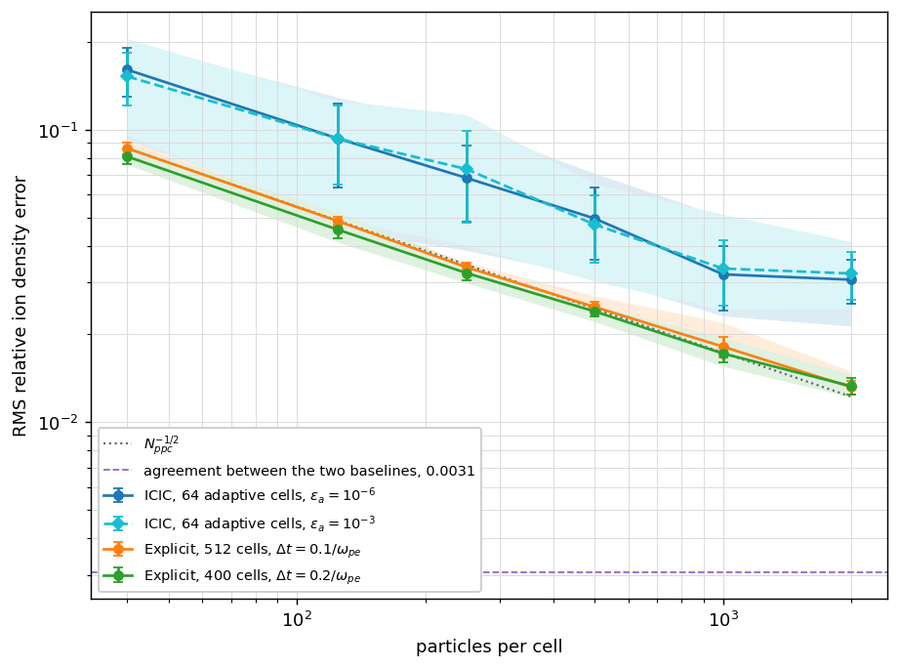
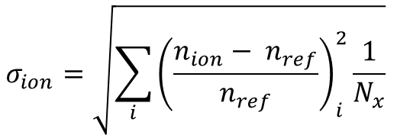
THE COMMENT
Re-run under “better” conditions
What changed
Deterministic loading: particles spaced evenly along the CDF of the density profile in every run, independent of the mesh
Single runs reported, every case repeated over ten seeds so the scatter is visible
Each scheme measured against its own well-resolved solution (20000 PPC, 2048 cells)
$$σ_{ion}=\sqrt{\sum_{i}{{\left(\frac{n_{ion}− n_{ref}}{n_{ref}}\right)}_{i}^{2}\frac{1}{N_{x}}}}$$
RMS relative ion density error vs PPC, mean of 10 seeds, bars = standard deviation
Two independent codes agree to 0.3% when both are resolved. ICIC on 64 adaptive cells still carries about twice the explicit error at the same PPC.
N. Savard | Implicit vs. explicit PIC in 1D | NIBS 2026
13
Notes:
The 0.3% cross-code agreement is the most useful number here — it is the floor below which no comparison can distinguish anything. Note too that a metric chosen after the answer is known is not an independent measurement of it.

Slide 13
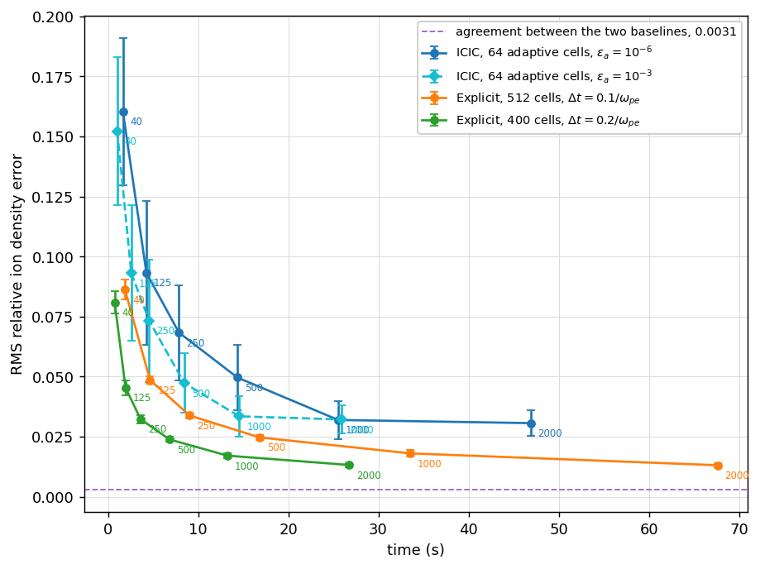
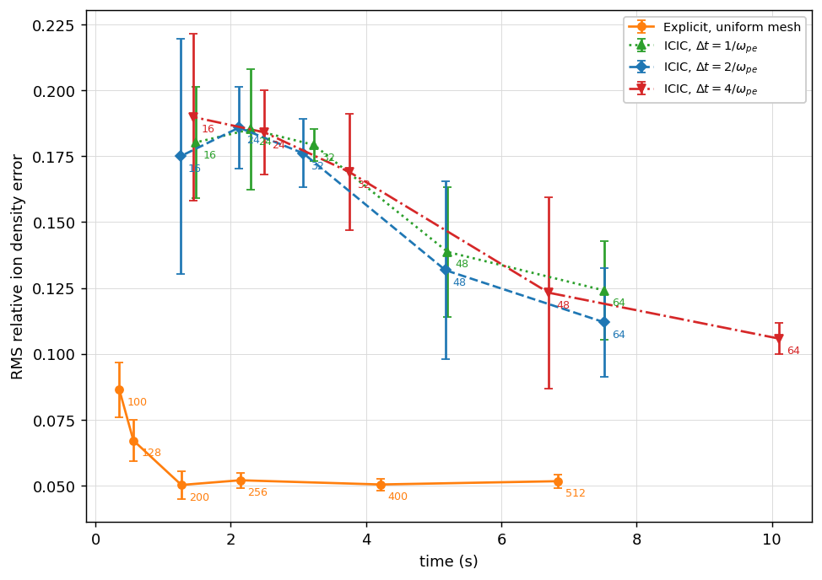
THE COMMENT
The cost of accuracy, when both schemes are coarsened
Error vs particle-mover + deposition + field-solve time, four OpenMP threads
Coarsening both schemes at a fixed 100 PPC, single thread
Left: reaching a given error costs the ICIC scheme more time than the 400-cell explicit configuration, at every error level tested
Right: the explicit scheme is bounded, as expected: at Δx = 3.1 λDe (64 cells) the finite-grid instability heats the electrons and the run does not complete
Up to that bound the explicit scheme is both cheaper and more accurate than any implicit CIC configuration we tested. Beyond it, implicit is the only viable choice, and the errors there may be large enough to prefer a simpler model.
“Implicit will be faster at similar accuracy” should itself be verified! Not true in cases studied here.
N. Savard | Implicit vs. explicit PIC in 1D | NIBS 2026
14
Notes:
Point at the right-hand plot. The explicit curve simply stops — that is the wall. Everything to the right of it is implicit-only territory, and the question there is whether 10–20% error is worth a kinetic code at all.

Slide 14
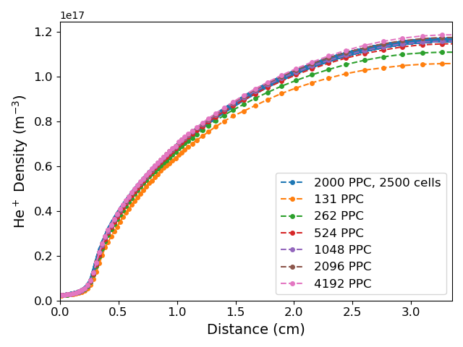
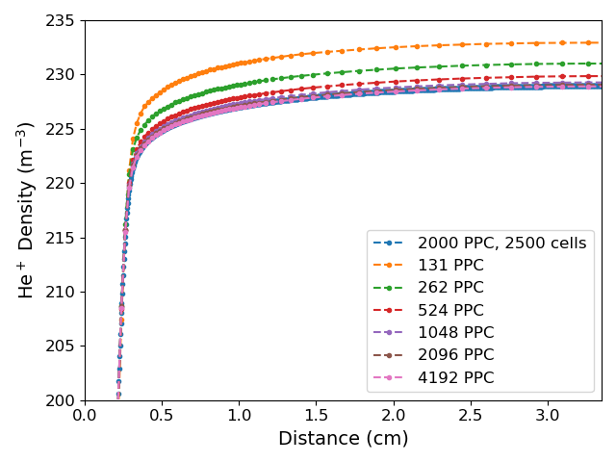
PAPER 1 (2025)
Capacitive RF discharge
Setup
Turner benchmark cross sections in helium with Monte Carlo collisions; n_{e} ≈ 10¹⁷ m⁻³, T_{e} ≈ 4 eV, 100 MHz, 500 V
Mapped grid resolves the sheath and coarsens the bulk
Result
Both sub-schemes converge cleanly in PPC: to a density profile about 6% from the resolved solution
The low-pressure case is worse, around 9%. Collisions add feedback that amplifies the resolution error
Phys. Plasmas 32, 073903 (2025), Fig. 8 : INGP (top) and ICIC (bottom) on mapped grid #1, 128 cells
ICIC at 131 PPC: σ_{ion} = 0.12 in 10.3 min. MC-PIC at 1024 cells and 128 PPC: σ_{ion} = 0.011 in 6 min.
N. Savard | Implicit vs. explicit PIC in 1D | NIBS 2026
11
Notes:
The trap is the word 'converged'. A PPC convergence study on the coarse mesh looks perfectly healthy and still lands on the wrong answer.

Slide 15
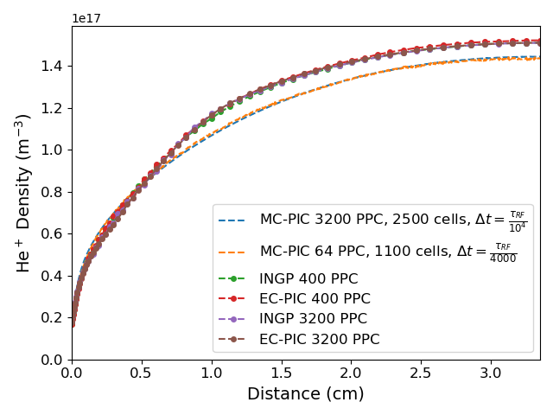
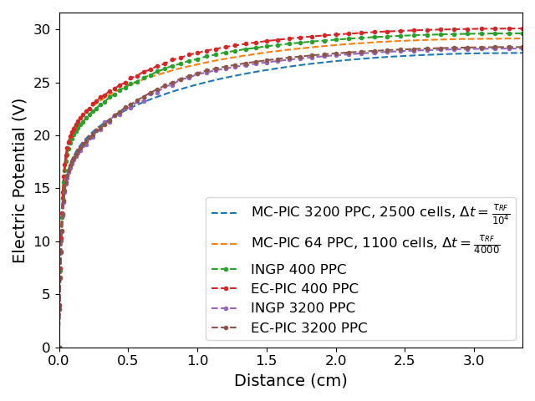
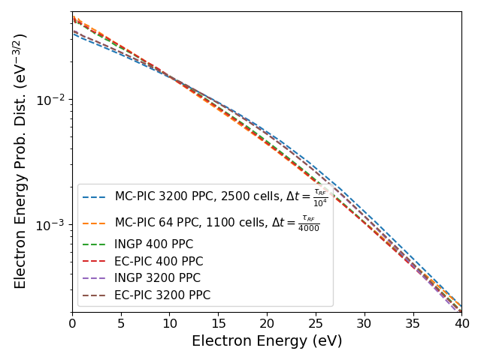
PAPER 2 (2025)
Is the problem stochastic sheath heating?
The hypothesis
An active RF sheath heats electrons stochastically. Maybe that complexity is what the coarse implicit grid fails to capture
The test
Drive the discharge with an RF current density perpendicular to the 1D axis: self-consistent heating, and a passive, DC-like sheath
The answer
The same resolution sensitivity persists. EC-PIC and INGP agree closely with each other, and both differ from the resolved MC-PIC solution
EEPD though is more correlated with total number of particles (normalized quantity)
Savard et al., J. Appl. Phys. 138, 153302 (2025), Fig. 4: map 1, 128 cells
Low-resolution MC-PIC (64 PPC, 1100 cells): σ_{ion} = 0.014 in 141 s : faster and more accurate than INGP at 400 PPC (0.074, 198 s).
N. Savard | Implicit vs. explicit PIC in 1D | NIBS 2026
15
Notes:
The cleanest single comparison in the programme: at the same grid and PPC, EC-PIC and INGP agree — so the discrepancy is about resolution and energy-conserving interpolation, not about implicitness.

Slide 16
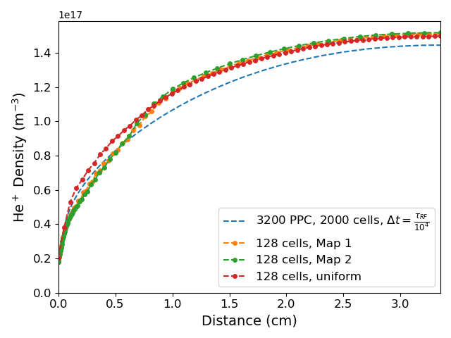
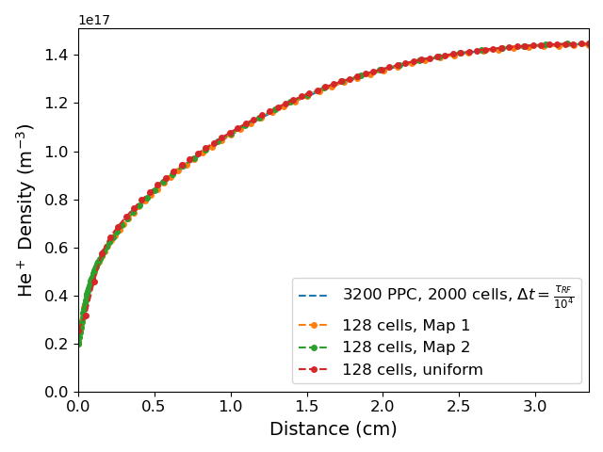
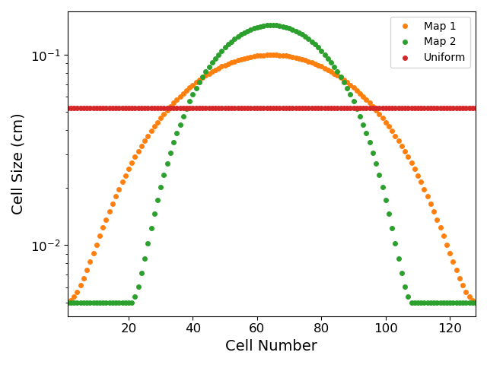
PAPER 2 (2025)
Binomial smoothing does help when the sheath is static
Without smoothing: σ_{ion} = 0.069 map 1
With binomial smoothing: σ_{ion} = 0.0056 map 1
Map 1 at 3200 PPC: σ_{ion} 0.069 → 0.0056 and σ_{φ} 0.021 → 0.012
Smoothing improves result. It did not do this for the active CCRF sheath: the gain is specific to a quasi-static sheath, which is what DC discharges and emissive surfaces give you. It buys accuracy, not speed: the particle time is unchanged. Still need large amount of particles!
N. Savard | Implicit vs. explicit PIC in 1D | NIBS 2026
16
Notes:
Be generous here — this is the strongest positive result for the implicit scheme in the programme, and it points straight at ion-source-relevant configurations.

Slide 17
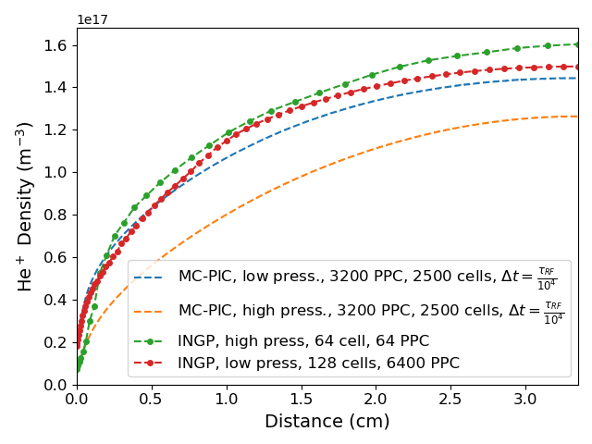
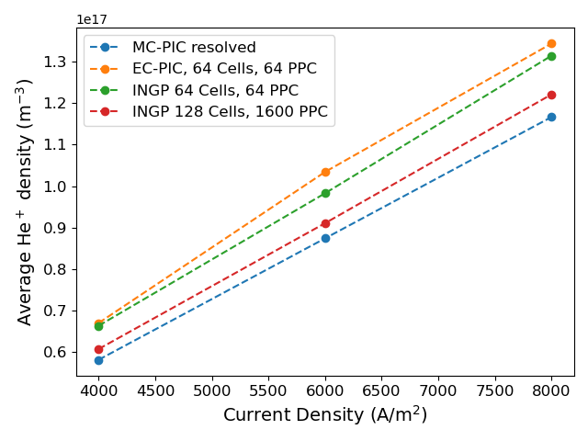
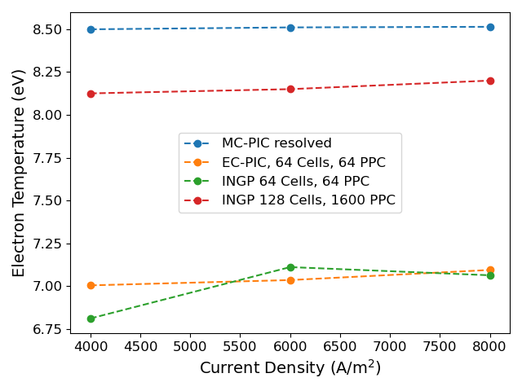
PAPER 2 (2025)
Do the trends survive, even if the values do not?
J. Appl. Phys. 138, 153302 (2025), Fig. 11: sweeping the driving current density JRF
Fig. 13: low- vs high-pressure density, resolved and under-resolved
Good news
Bad news
Worse
Sweeping J_{RF}, the low-resolution energy-conserving runs track the direction of every trend.
Absolute values are off and some slopes differ. Likely trends that can be found with simpler models.
Across a large enough resolution gap the ordering can flip: an under-resolved high-pressure run sits above a resolved low-pressure one.
N. Savard | Implicit vs. explicit PIC in 1D | NIBS 2026
17
Notes:
This is the slide for anyone who says 'I only need the trend'. The trend is usually right, but not reliably so, and you cannot tell which case you are in without a converged run.

Slide 18
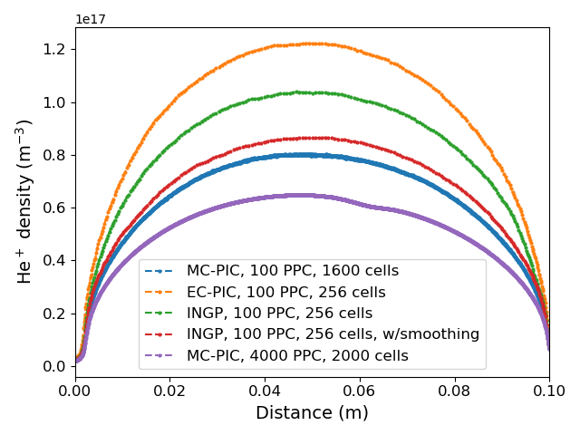
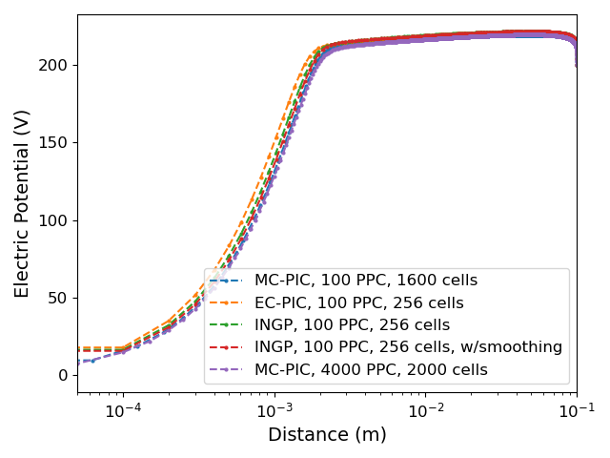
ICIS 2025
Thermionic DC discharge
Setup
10 cm gap, 200 V across it, thermionic emission J_{th} = 50 A/m² from the grounded electrode
Helium, self-consistent through Monte Carlo collisions
Result
INGP with smoothing is the best of the under-resolved runs
And this time, INGP is also the fastest. Accuracy still an issue!
Savard et al., J. Phys. Conf. Ser. 3237, 012014 (2026), Fig. 2: He⁺ density and φ
Run | Particles (s) | Potential (s) | Collisions (s)
MC-PIC · 100 PPC, 1600 cells | 1736 | 443 | 375
EC-PIC · 100 PPC, 256 cells | 706 | 72 | 364
INGP + smoothing · 100 PPC, 256 cells | 412 | 37 | 20
With the 1D analytic push
No Picard iterations here. Adding them in our 1D tests cost a factor of 2–3: which would erase most of this margin.
N. Savard | Implicit vs. explicit PIC in 1D | NIBS 2026
18
Notes:
Be even-handed: this is the case where the implicit scheme wins on time, and it is also the case closest to an ion source. Then give the caveat immediately — the honesty is what makes the rest of the talk land.

Slide 19
TAKEAWAYS
What this means if you are modelling an ion source
Converge everything
Consider total particles
Coarse bulk is not free
Test Δx, Δt and PPC for every scheme. Charge and energy conservation hold at any resolution: they are not accuracy diagnostics.
When the cell counts differ, report the total number of macro-particles. The cell holding the fewest sets the noise floor for the whole domain.
Resolving the sheath while relaxing the quasi-neutral region did not give an accurate answer in any case we ran: active or passive sheath, with or without collisions.
Fair comparison
Consider 1D timings
Try smoothing
Coarsen both schemes, fix the reference before the sweep, and plot error against wall time rather than error alone.
The 1D INGP analytic push has no Picard iterations. Treat every 1D implicit runtime as an optimistic bound on 2D and 3D.
Binomial smoothing decreased density error for a quasi-static sheath: which is what DC discharges and emissive surfaces produce.
The implicit scheme is not a drop-in replacement for explicit PIC. It is a different tool, with a regime where it is the only one that runs at all.
N. Savard | Implicit vs. explicit PIC in 1D | NIBS 2026
19
Notes:
This is the slide people photograph. Pause on it.

Slide 20
OUTLOOK
Open questions
1
Where is the real crossover?
Extend to 2D/3D. The 1D analytic push disappears there, and fully resolved 2D references are expensive, which is exactly why 1D studies remain worth doing. Also changes potential vs particle solver!
2
Algorithmic headroom
Physics-based preconditioning and segment-averaged or otherwise optimised movers are unexplored in our implementation, and could change the timing picture.
3
Coulomb collisions
At high density these may counteract numerical thermalization and reduce the particle count needed at large Δx. Untested, and directly relevant to ion sources.
4
Electromagnetic heating
Does relaxing the Δt < Δx/c constraint cost accuracy the same way relaxing the CFL condition does?
5
Is kinetic the right tool?
If the usable resolution gives ~10% errors, a fluid or hybrid model may serve better, except where the non-Maxwellian tail is the physics you actually need.
N. Savard | NIBS 2026
20
Notes:
Close on question 5 — it reframes the talk as 'pick the right tool' rather than 'implicit PIC is bad', which leaves the audience somewhere constructive for the Q&A.

Slide 21
THANK YOU
Acknowledgements and references
Acknowledgements
Sources, in the order they appear
MITACS (Grant IT29655), TRIUMF and D-Pace, Inc. for support and computational resources.
A. T. Powis and S. Jubin (PPPL) for benchmark data and feedback; D. Eremin (Ruhr University Bochum) for his insights.
N. Savard, G. Fubiani, R. Baartman, M. Dehnel, “Implicit particle-in-cell development for ion source plasmas,” J. Phys. Conf. Ser. 2743, 012003 (2024) — ICIS 2023.
N. Savard, G. Fubiani, D. Eremin, M. Dehnel, “Impact of particle number and cell size in fully implicit charge- and energy-conserving particle-in-cell schemes,” Phys. Plasmas 32, 073903 (2025)..
N. Savard, G. Fubiani, M. Dehnel, “Impact of particle number and cell size on energy-conserving PIC applied to RF-driven bounded plasmas,” J. Appl. Phys. 138, 153302 (2025).
N. Savard, G. Fubiani, M. Dehnel, “Modeling of 1D DC discharges using various particle-in-cell schemes,” J. Phys. Conf. Ser. 3237, 012014 (2026) — ICIS 2025.
G. Chen, L. Chacón, D. Barnes, J. Comput. Phys. 230, 7018 (2011) ·
L. Chacón, G. Chen, D. Barnes, J. Comput. Phys. 233, 1 (2013) ·
D. Eremin, J. Comput. Phys. 452, 110934 (2022) ·
A. T. Powis & I. D. Kaganovich, Phys. Plasmas 31, 023901 (2024).
N. Savard | Implicit vs. explicit PIC in 1D | NIBS 2026
21
Notes:
Leave this up during questions.

