Slide 1
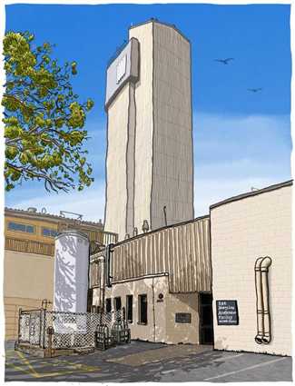
Review on alkali vapor charge exchange canals for He⁻ and HIAF alpha injector
  https://hiaf.anu.edu.au/
Trevor Dickinson www.trevordickinson.com
Nikolai Lobanov, Peter Linardakis, Thomas Kitchen, Thomas Tunningley, Mark Gwyneth and Daniel Tempra
Department Nuclear Physics and Accelerator Applications, ANU, Canberra, Australia

Slide 2
HIAF Facility

Slide 3
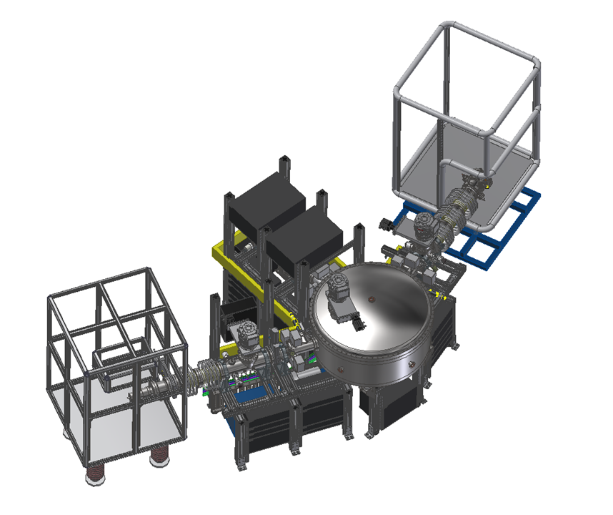
ion injection

Slide 4
The Alpha Injector Project
Installation of a new ion source to produce negative helium ions (ECR/RF/DUOPLASMATRON/Rb CEC ion source)
Installation of a new 110° electrostatic analyser (ESA)
Repositioning the existing multi-cathode MSNICS ion source to integrate with the ESA
Plus additional associated work
  Installation of new safety cages around all three ion sources
  Reconfiguration and upgrade of the high-voltage functional safety interlock system
Motivation
The sensitivity of AMS for heavier nuclide detection is currently constrained by high backgrounds from neighbouring isotopes due to low- and high-energy tails Electrostatic Analyser
Users are demanding 3He and 4He (alpha particles) for research problems New negative He ion (alpha) source

Slide 5
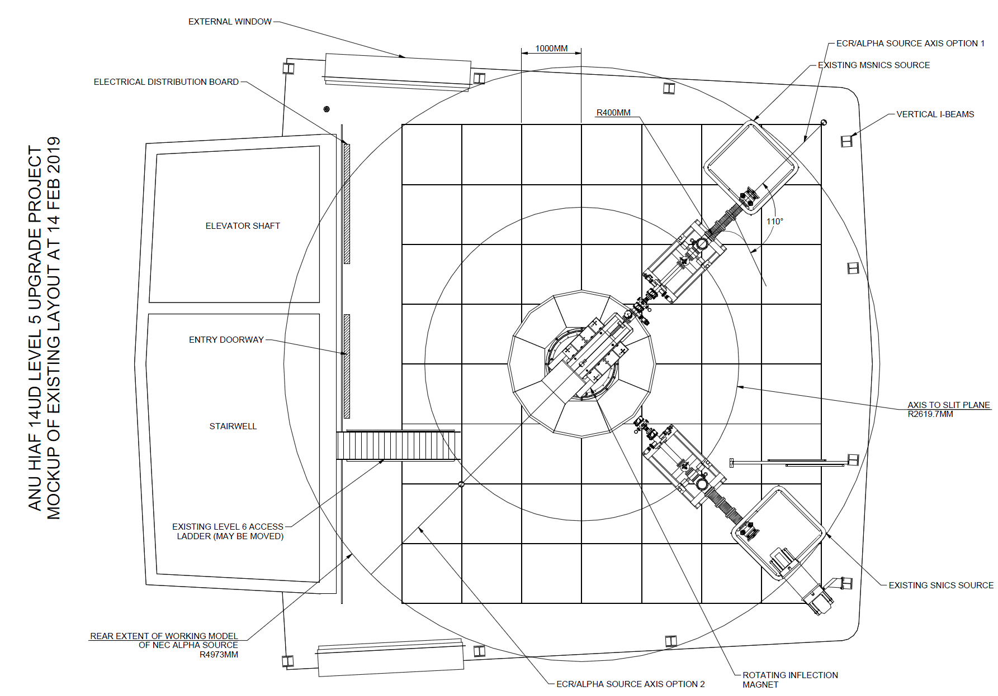
Existing layout

Slide 6
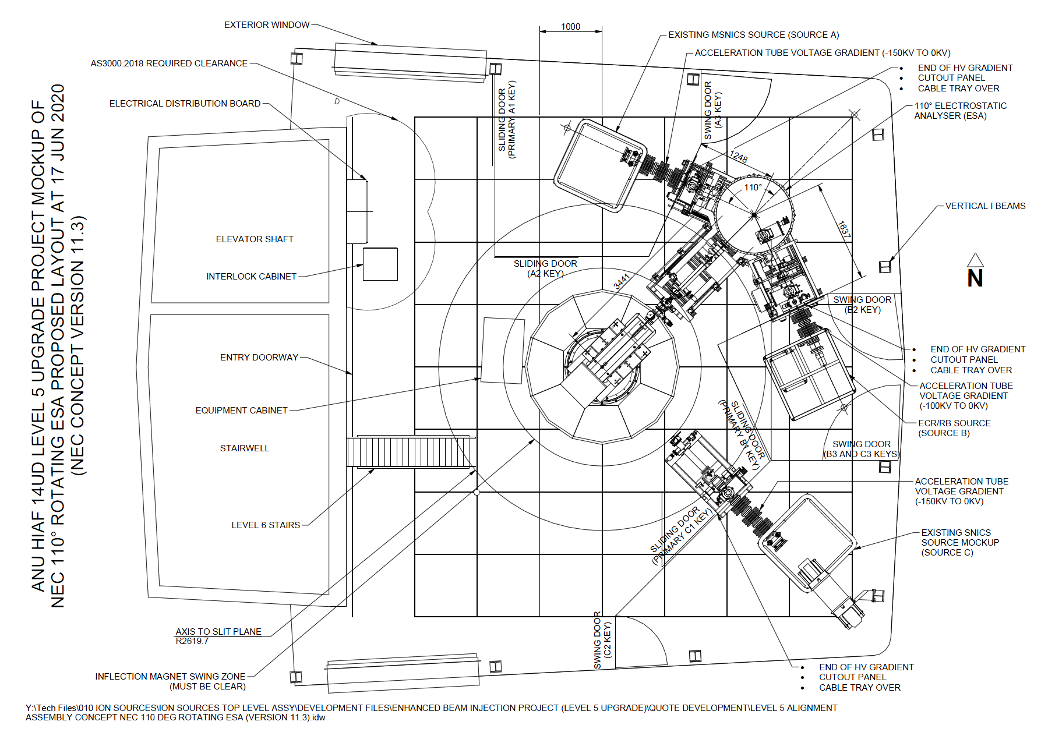
Planned layout

Slide 7
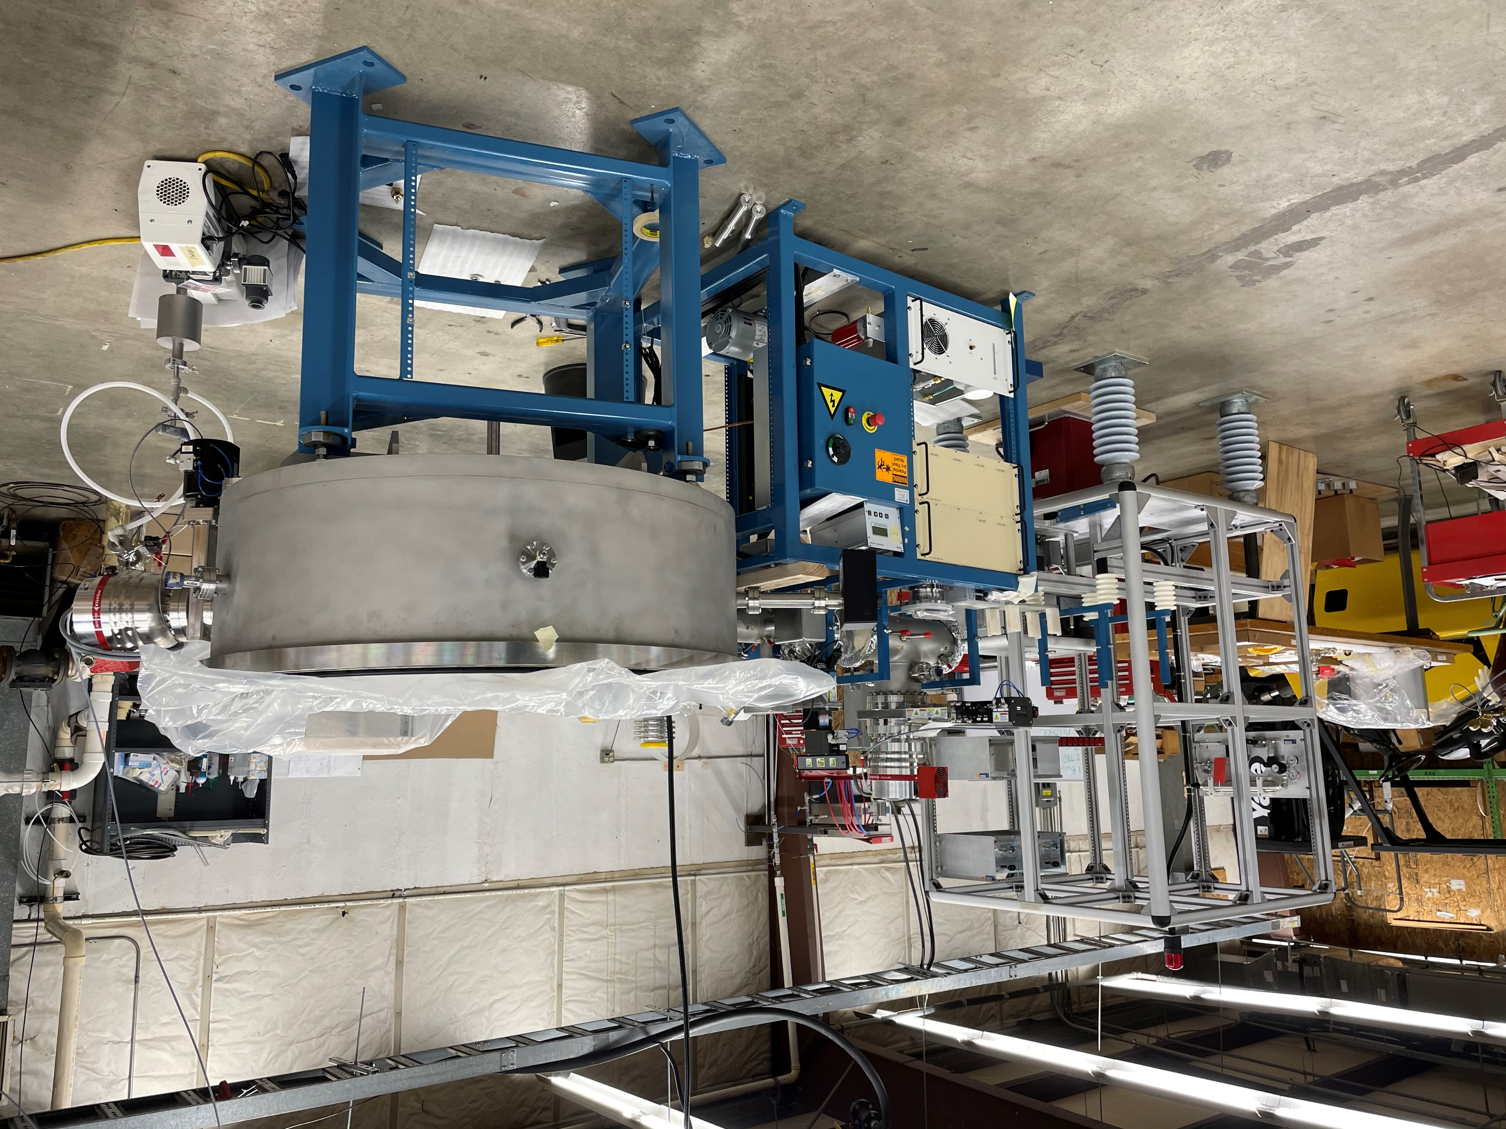
National Electrostatics Corporation
Courtesy NEC
7

Slide 8
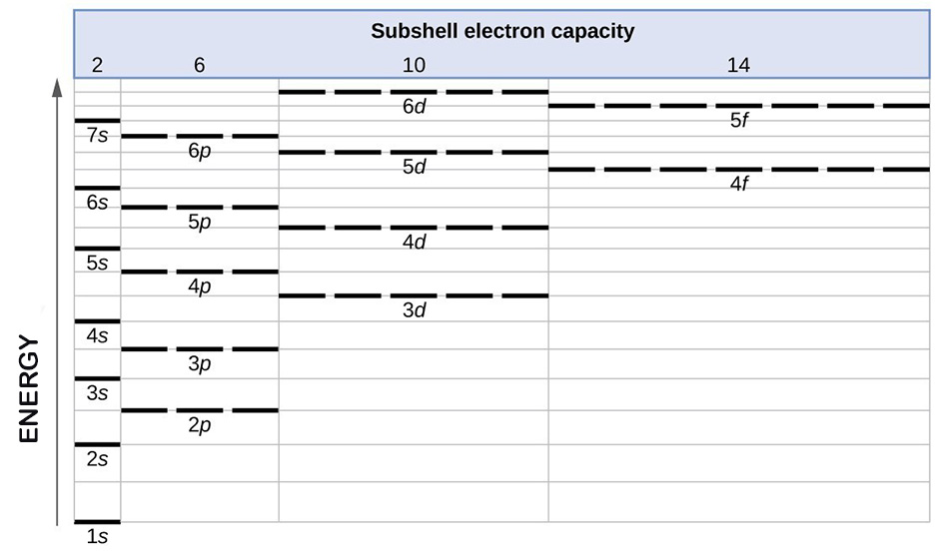
The Fundamentals of He⁻ Beam Formation
Format of atomic term symbols:
^{2S+1}L_{J} L is total orbital angular momentum (upper case from s, p, d, f, g, h, …,) L=0 S; L=1 P
S is total spin quantum number;
J=L+S is total angular momentum
2S+1 is spin multiplicity
Singlet He* state ¹S₀:
2S+1 = 1 (singlet)
Electron spin S= ½-½= 0;
J= 0+0 = 0
Triplet He* state ³S₁:
2S+1 = 3 (triplet)
S= ½+½= 1; 2S+1= 3;
J= L+S= 0+1= 1

Slide 9
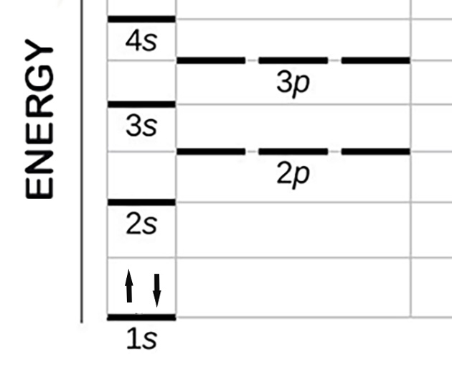
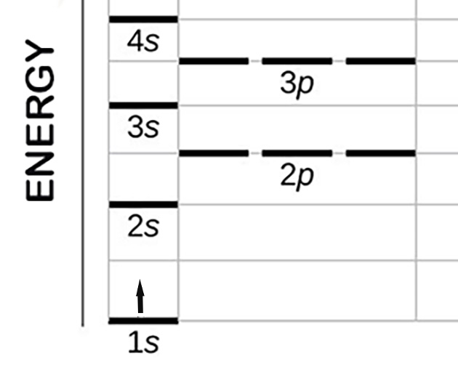
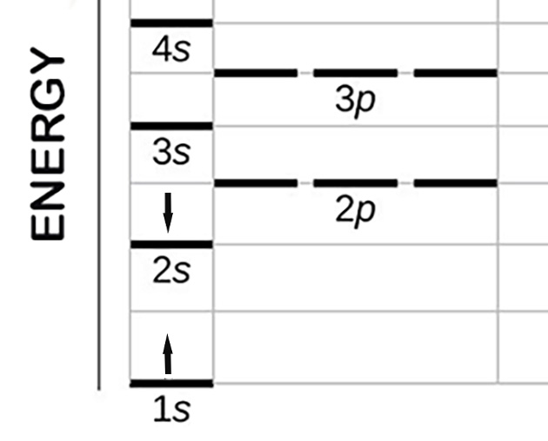

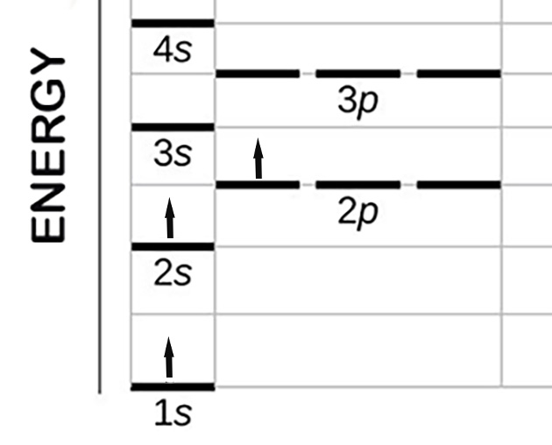
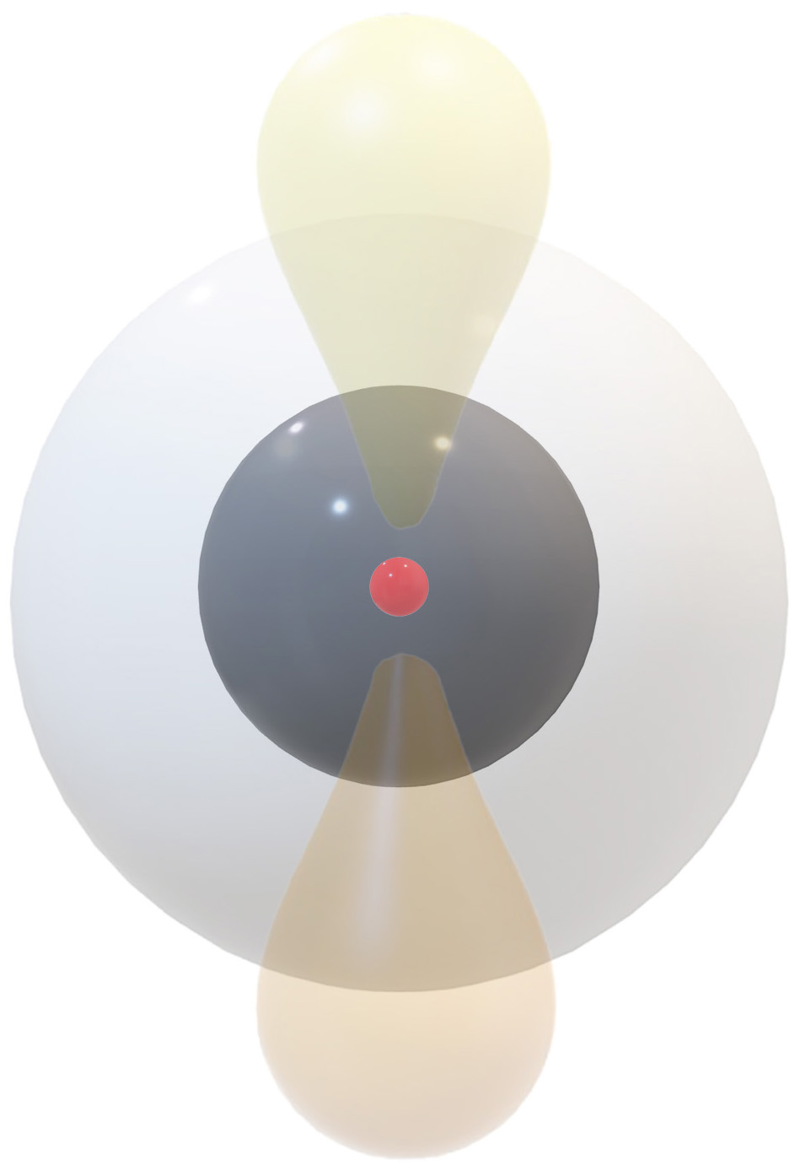

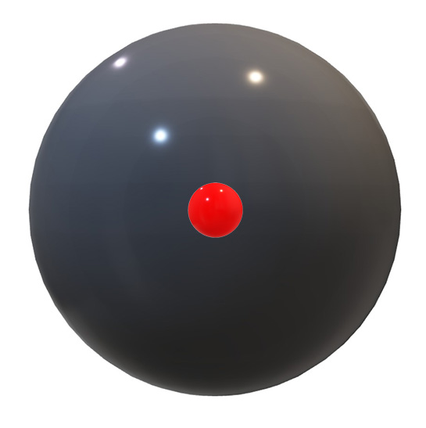

The Fundamentals of He⁻ Beam Formation: Energy Box Diagrams
He ground level 1s² ¹S₀
He⁺ 1s¹ ²S_{1/2}
He* singlet 1s¹2s¹ ¹S₀
He* triplet ³S₁
He⁻ quartet ⁴P_{5/2}
3-D e⁻ probability
clouds (orbitals)
Total Spin S | ½ - ½ =0 | ½ | 0 | ½ + ½ =1 | ½ + ½ +½ =3/2
Orbit. Moment. L | 0 | 0 | 0 | 0 | 1
Angular Moment. J | 0 | 1/2 | 0 | 1 | 5/2
Lifetime | indefinitely stable | indefinitely stable | 19.7 ms | 7800 sec | 350 µs

Slide 10
Key Quantum Mechanical Features of He
He ground level
1s² ¹S₀
No orbital vacancy in core 1s shell accommodating two e⁻ with ↑↓ spin
(Pauli exclusion principle); extreme chemical inertness E_{i1}=24.59 eV;
Absolute bottom 0 eV on He Grotrian diagram; R_{at/ion}=31 pm
He⁺ doublet
1s¹ ²S_{1/2}
Only one 1s orbital e⁻ against 2 nuclear protons, atom shrinks
H-like atom described by Bohr’s or Schrodinger formulas;
Massive Binding Energy E_{i2}=54.42 eV and volume contraction
He* singlet ¹S₀ and
triplet ³S₁
Only two e⁻ creates para/ortho separation; Parahelium energy is 20.61 eV;
Orthohelium is lowest energy excited state 19.82 eV (Hund’s Rule)
since ↑↑ spin causes e⁻ stay further apart
He⁻ quartet
⁴P_{5/2}
Hund’s Rule and ↑↑ spins keep e⁻ spatially separated to minimize Coulomb repulsion; Vacant 1s shell with missing e⁻ acts as energy trap allowing eventual auto-ionization; 2s and 2p e⁻ are far from nucleus and shielded by 1s e⁻, He⁻ ion is large R_{at/ion}=250-320 pm due to shell jump, e⁻ shielding and ↑↑ spin repulsion; Functions like alkali metal atom.

Slide 11
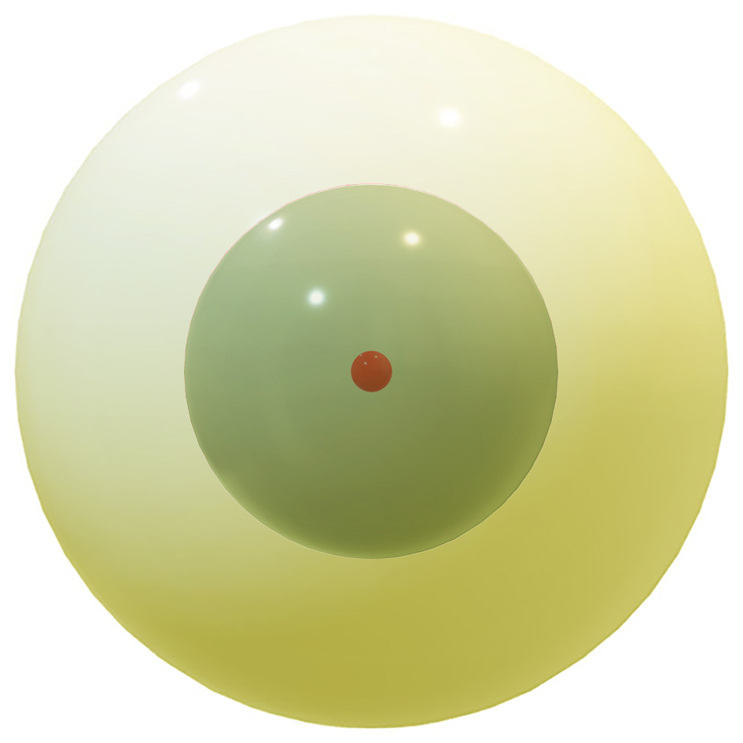
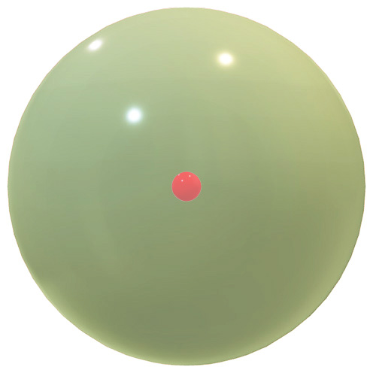

Production of He⁻ via charge exchange
The production of He⁻ relies on two sequential charge-exchange reactions:
A. He⁺ + Rb → He* (triplet) + Rb⁺ triplet production
Rb
He⁺ keV
Rb⁺
He*
He* balloons by ~500% shifting from single to pair of concentric spheres
Rb electron configuration (A=37) is 1s²2s²2p⁶3s²3p⁶4s²3d¹⁰4p⁶5s¹,
or [Kr]5s¹ in noble gas shorthand notation
He⁺ approaches Rb at high-speed sweeping through 5s e⁻ cloud;
He nuclear charge +2 exerts electrostatic pull on Rb weakly bound 5s e⁻.
The e⁻ jumps across gap deserting Rb atom.

Slide 12


Production of He⁻ via charge exchange
B. He* + Rb → He⁻(quartet) + Rb⁺ negative He ion production
Rb
He*
Rb⁺
He⁻
Rb collapses losing giant loosely bound 5s envelope. Remaining 36 e⁻ form spherical Kr-like core.
Composite of two spheres intersected by dumbbell shaped cloud

Slide 13
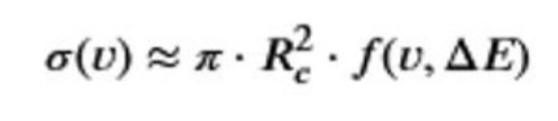
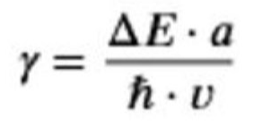
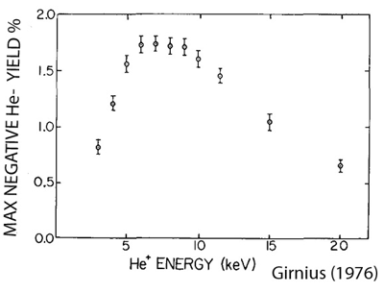
Production of He⁻ via charge exchange: semi-classic cross section
Cross-section σ depends on velocity v of He⁺ and energy mismatch ∆E between initial and final states
πR_{c}² is area of circle where R_{c} is critical internuclear distance where electronic wave functions of He⁺ and Rb significantly overlap. Rb has massive 5s cloud so R_{c} and σ_{+*} are large.
Velocity Matrix Function f(v, ∆E) scales according Massey Criterion
∆E is energy defect, a is effective interaction range ~ size of e⁻ cloud,
h is Planck’s constant
For He* + Rb → He⁻ + Rb⁺ ∆E is difference between energy released when triplet He* becomes He⁻ (~0.07 eV) and ionization energy of Rb (4.18 eV). This leaves small mismatch of ~ -4.1 eV
Because ∆E is small, near resonance, σ has got Massey peak at γ ~1.
He* travel time to cross interaction zone (a/v) matches quantum transition time of e⁻ (h/ ∆E )

Slide 14
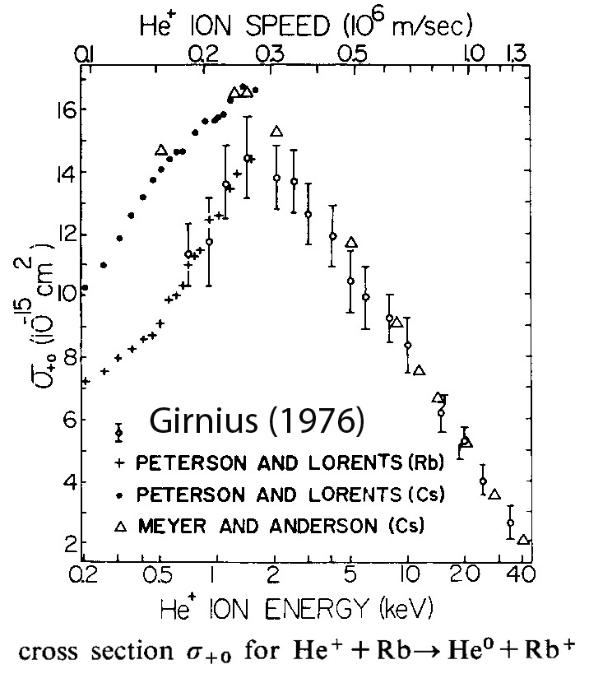
Optimizing Ion Source for Enhanced Beam Generation: Beam Injection Energy
Low energies (~1.5 keV): electron detachment from He⁻ becomes highly probable, while increased beam scattering and geometric spreading reduce overall efficiency.
Intermediate energies (3–7 keV); the charge-exchange cross section is relatively large, enabling more efficient collisions, enhanced production of metastable He* atoms, and a greater likelihood of the secondary collision required for He⁻ formation
At> ~7 keV He⁻ yield decreases since charge-exchange cross section σ₊₀ declines, resulting in fewer He* atoms and a lower probability of secondary collisions due to shorter interaction time.
Direct ionization of Rb by He⁺ becomes more significant at these energies as per He⁺ + Rb → He⁺ + Rb⁺ + e⁻

Slide 15
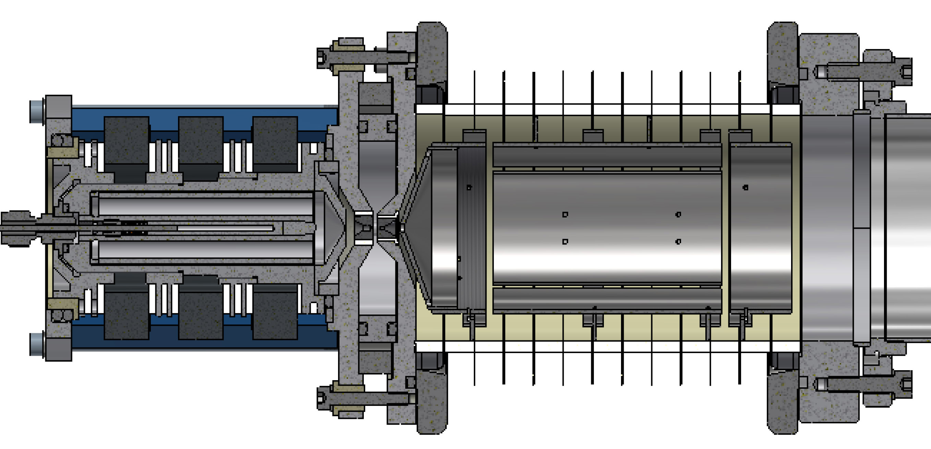
Optimizing Ion Source: IS Performance Considerations and Influence of Gas Flow and Source Pressure
Important parameters include arc current and discharge voltage, electron temperature and plasma density, cathode emission characteristics, plasma confinement efficiency and discharge stability over extended operation.
Maximizing He⁺ current while minimizing vacuum loading with suitable ion source designs, such as multicusp sources with magnetic confinement or duoplasmatron sources.
ANU duoplasmatron with
permanent magnets ,
100 μA He+ at 300 mA
discharge current,
2.6 x 10⁻⁴ Pa in extraction
region with 170 l/s turbo

Slide 16
Vacuum Engineering Requirements for Efficient Negative-Ion Production
Combination of high He⁺ beam intensity and low beam energy results in ion beam transport influenced by space charge. Optimal background pressure to compensate space-charge forces is in ~10⁻⁴ mbar range. Pressure after CEC should be as low as possible to reduce neutralization loss of He⁻. A differentially pumped system comprises three vacuum stages, each with an approximate tenfold pressure reduction.
10⁰ Pa
10⁻² Pa
10⁻³ Pa
10⁻⁴ Pa
Apertures
Ion Source
extraction
CEC
Post acceleration
A1
A2
A3
A1~ 0.5 mm
A2,3~ 5-7 mm
Vacuum pump
Vacuum pump

Slide 17
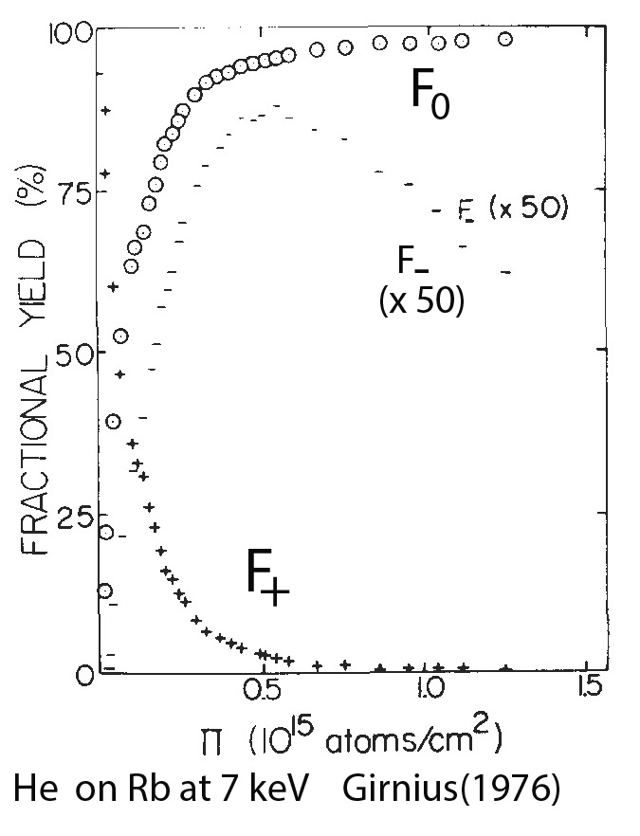
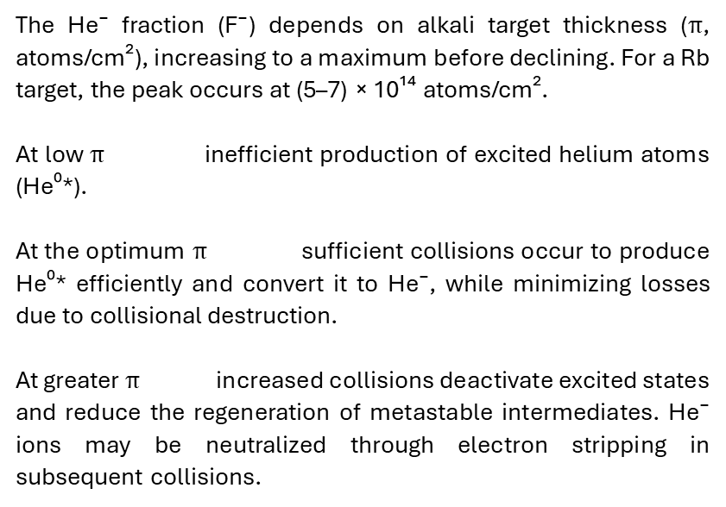
Alkali-Based Charge Exchange; Key Parameters and Challenges: Target Thickness
The He⁻ fraction (F⁻) depends on alkali target thickness ($π$, atoms/cm²), increasing to a maximum before declining. For a Rb target, the peak occurs at (5–7) × 10¹⁴ atoms/cm².
At low $π$ inefficient production of excited helium atoms (He⁰*).
At the optimum $π$ sufficient collisions occur to produce He⁰* efficiently and convert it to He⁻, while minimizing losses due to collisional destruction.
At greater $π$ increased collisions deactivate excited states and reduce the regeneration of metastable intermediates. He⁻ ions may be neutralized through electron stripping in subsequent collisions.

Slide 18
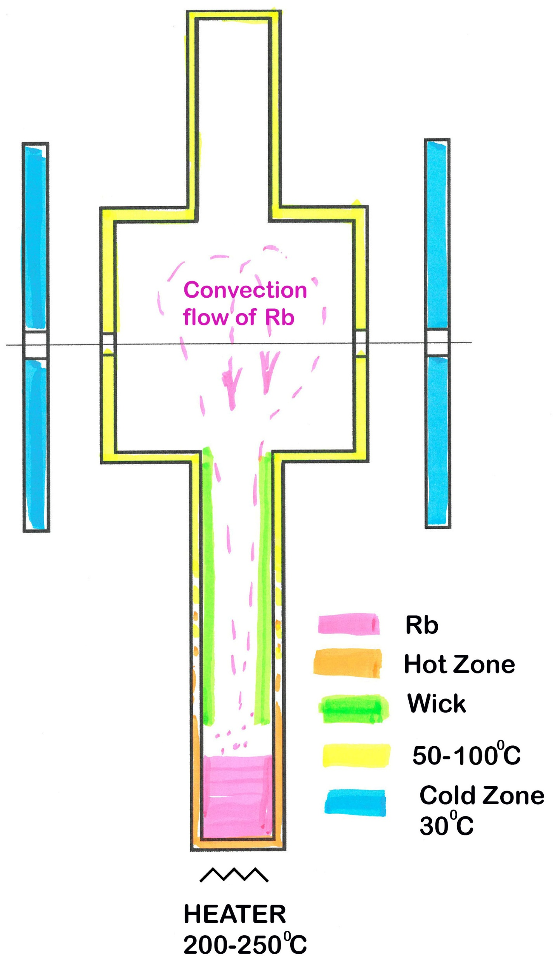
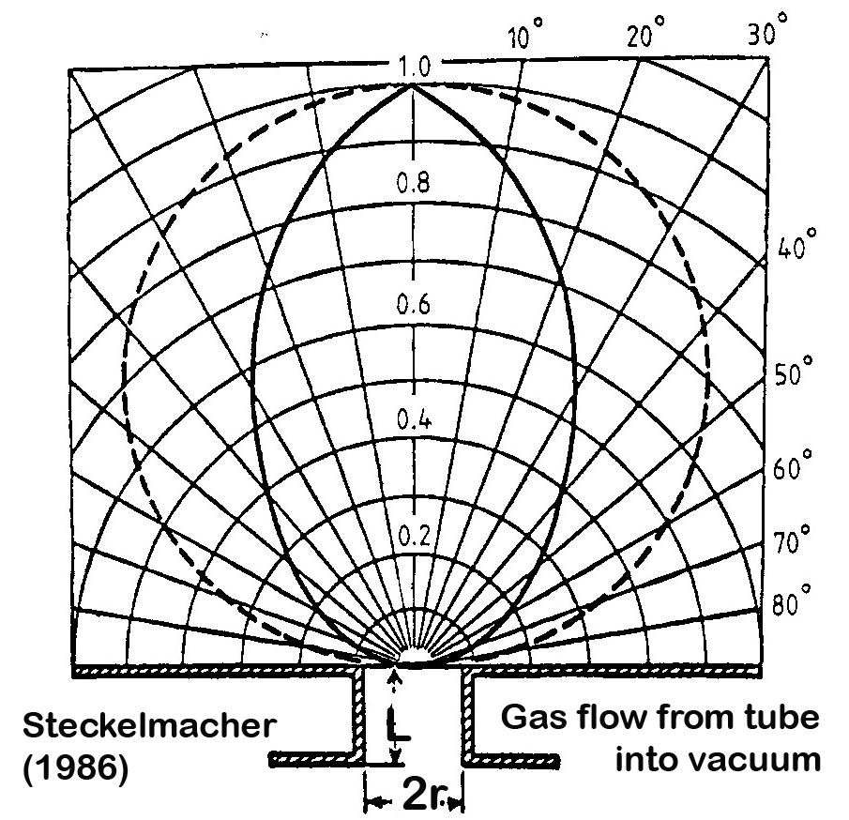
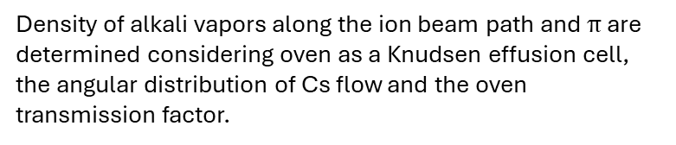
Alkali-Based Charge Exchange: Charge-Exchange Cell Design Considerations
Vertical CEC
CECs operate in horizontal or vertical configurations. Typical CEC has a length of ~50-100 mm exchange region with small entrance/exit apertures (~5-7 mm).
The typical CEC features: better localization of alkali vapor; shielded insulators. The assembly can be sealed/removed in situ without oxidation of the alkali. Alkali is introduced using hypodermic syringe under flow of argon. Mechanical feed-through breaks the seal of alkali ingot under a vacuum .
Cs level device is based on measuring the resistance of a high resistivity electrode immersed in the liquid Cs.
Density of alkali vapors along the ion beam path and $π$ are determined considering oven as a Knudsen effusion cell, the angular distribution of Cs flow and the oven transmission factor.

Slide 19
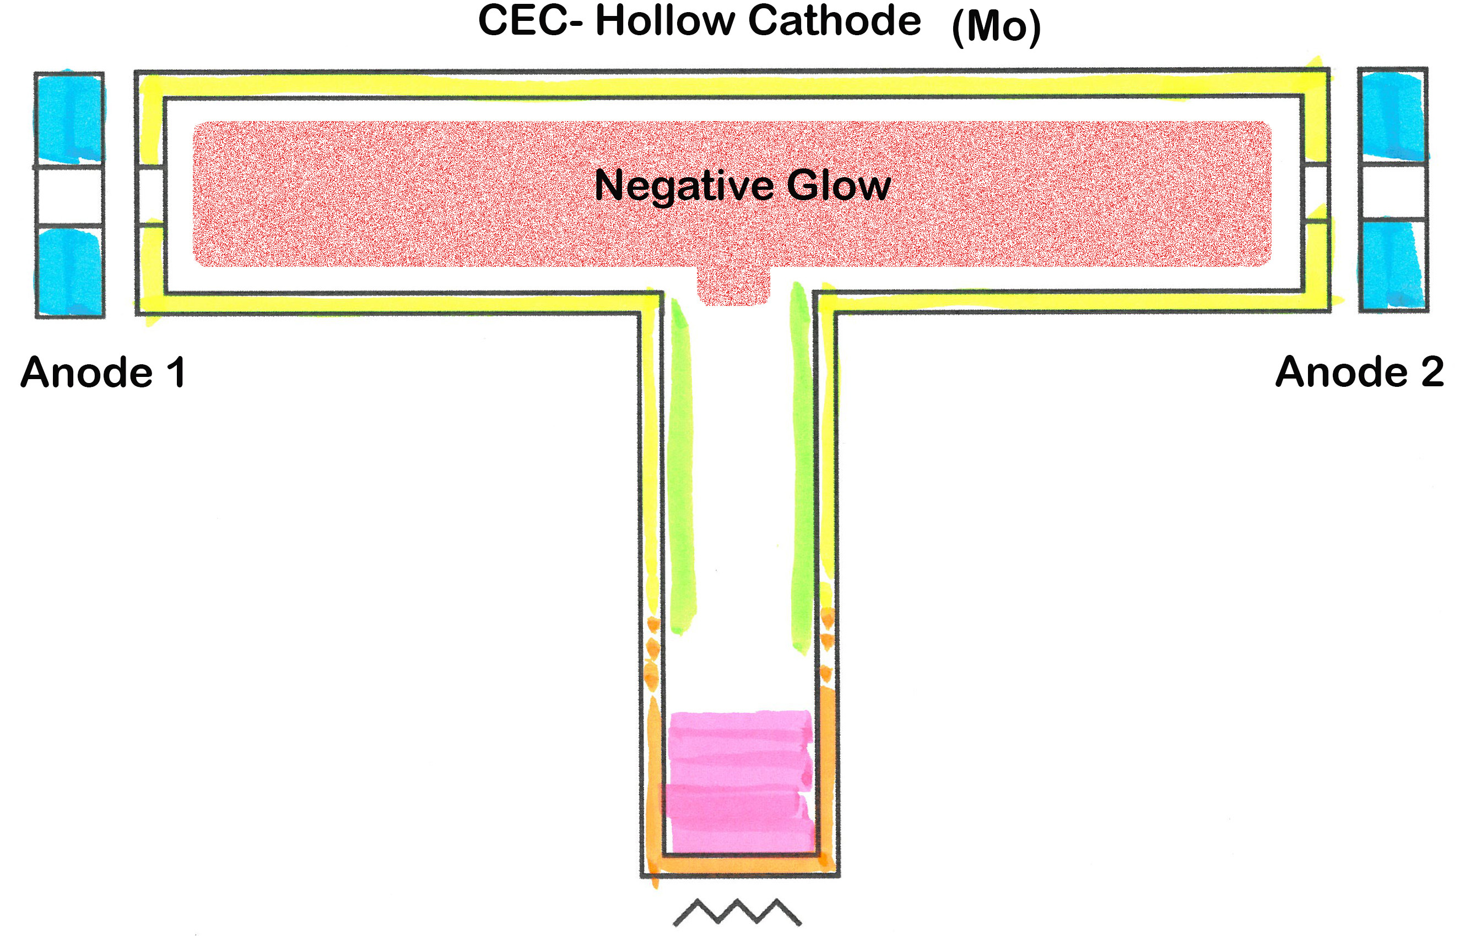
Alkali-Based Charge Exchange: Alkali
Temperature and Thermal Management
CEC maintains thermal gradients, promote alkali vapor circulation, and facilitate condensate return. Capillary recycling system incorporating wick within the canal captures condensed alkali vapor, converts it back to liquid metal, and returns it to the heated region via capillary action.
Light-Induced Atomic Desorption (LIAD) used as a non-thermal control of rubidium vapor density at ~10⁻⁵ Torr in Spin-Exchange Relaxation-Free (SERF) magnetometers.
Controlling alkali vapor density using hollow cathode (HC) effect. Advantages: (a) rapid control of vapor density, (b) improved alkali retention, and (c) enhanced recycling of alkali adsorbed on molybdenum surfaces.
Risks: plasma induced contamination; plasma could alter beam emittance and charge exchange efficiency.

Slide 20
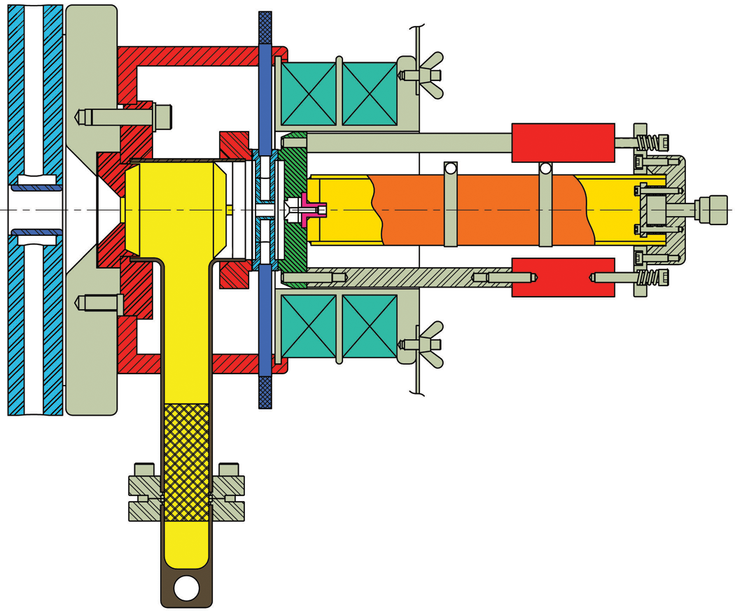

NEC report to SNEAP 2008 (ANU)
And 50th SNEAP 2016 (ANSTO)
Rb Plug
Rb freeze out
Need 50°C air
Leaks
Rb migration
  Rb M.P. = 38.9° C
  V.P. = 0.1 Torr (13.3 Pa)
  Oven = 200° - 250° C
  Air = 50° C
  Liquid = 30° C
Note plasma
color
Source gas contamination or depletion
Rb migration
Leaks
Bottle sputtered
~1500 hours
3µA He⁻
Oscillator tubes fail
5-7 years
Canal erosion
Rb Plug
Random power supply failure
Need 30°C coolant
Insufficient Rb
Need 10 grams

Slide 21
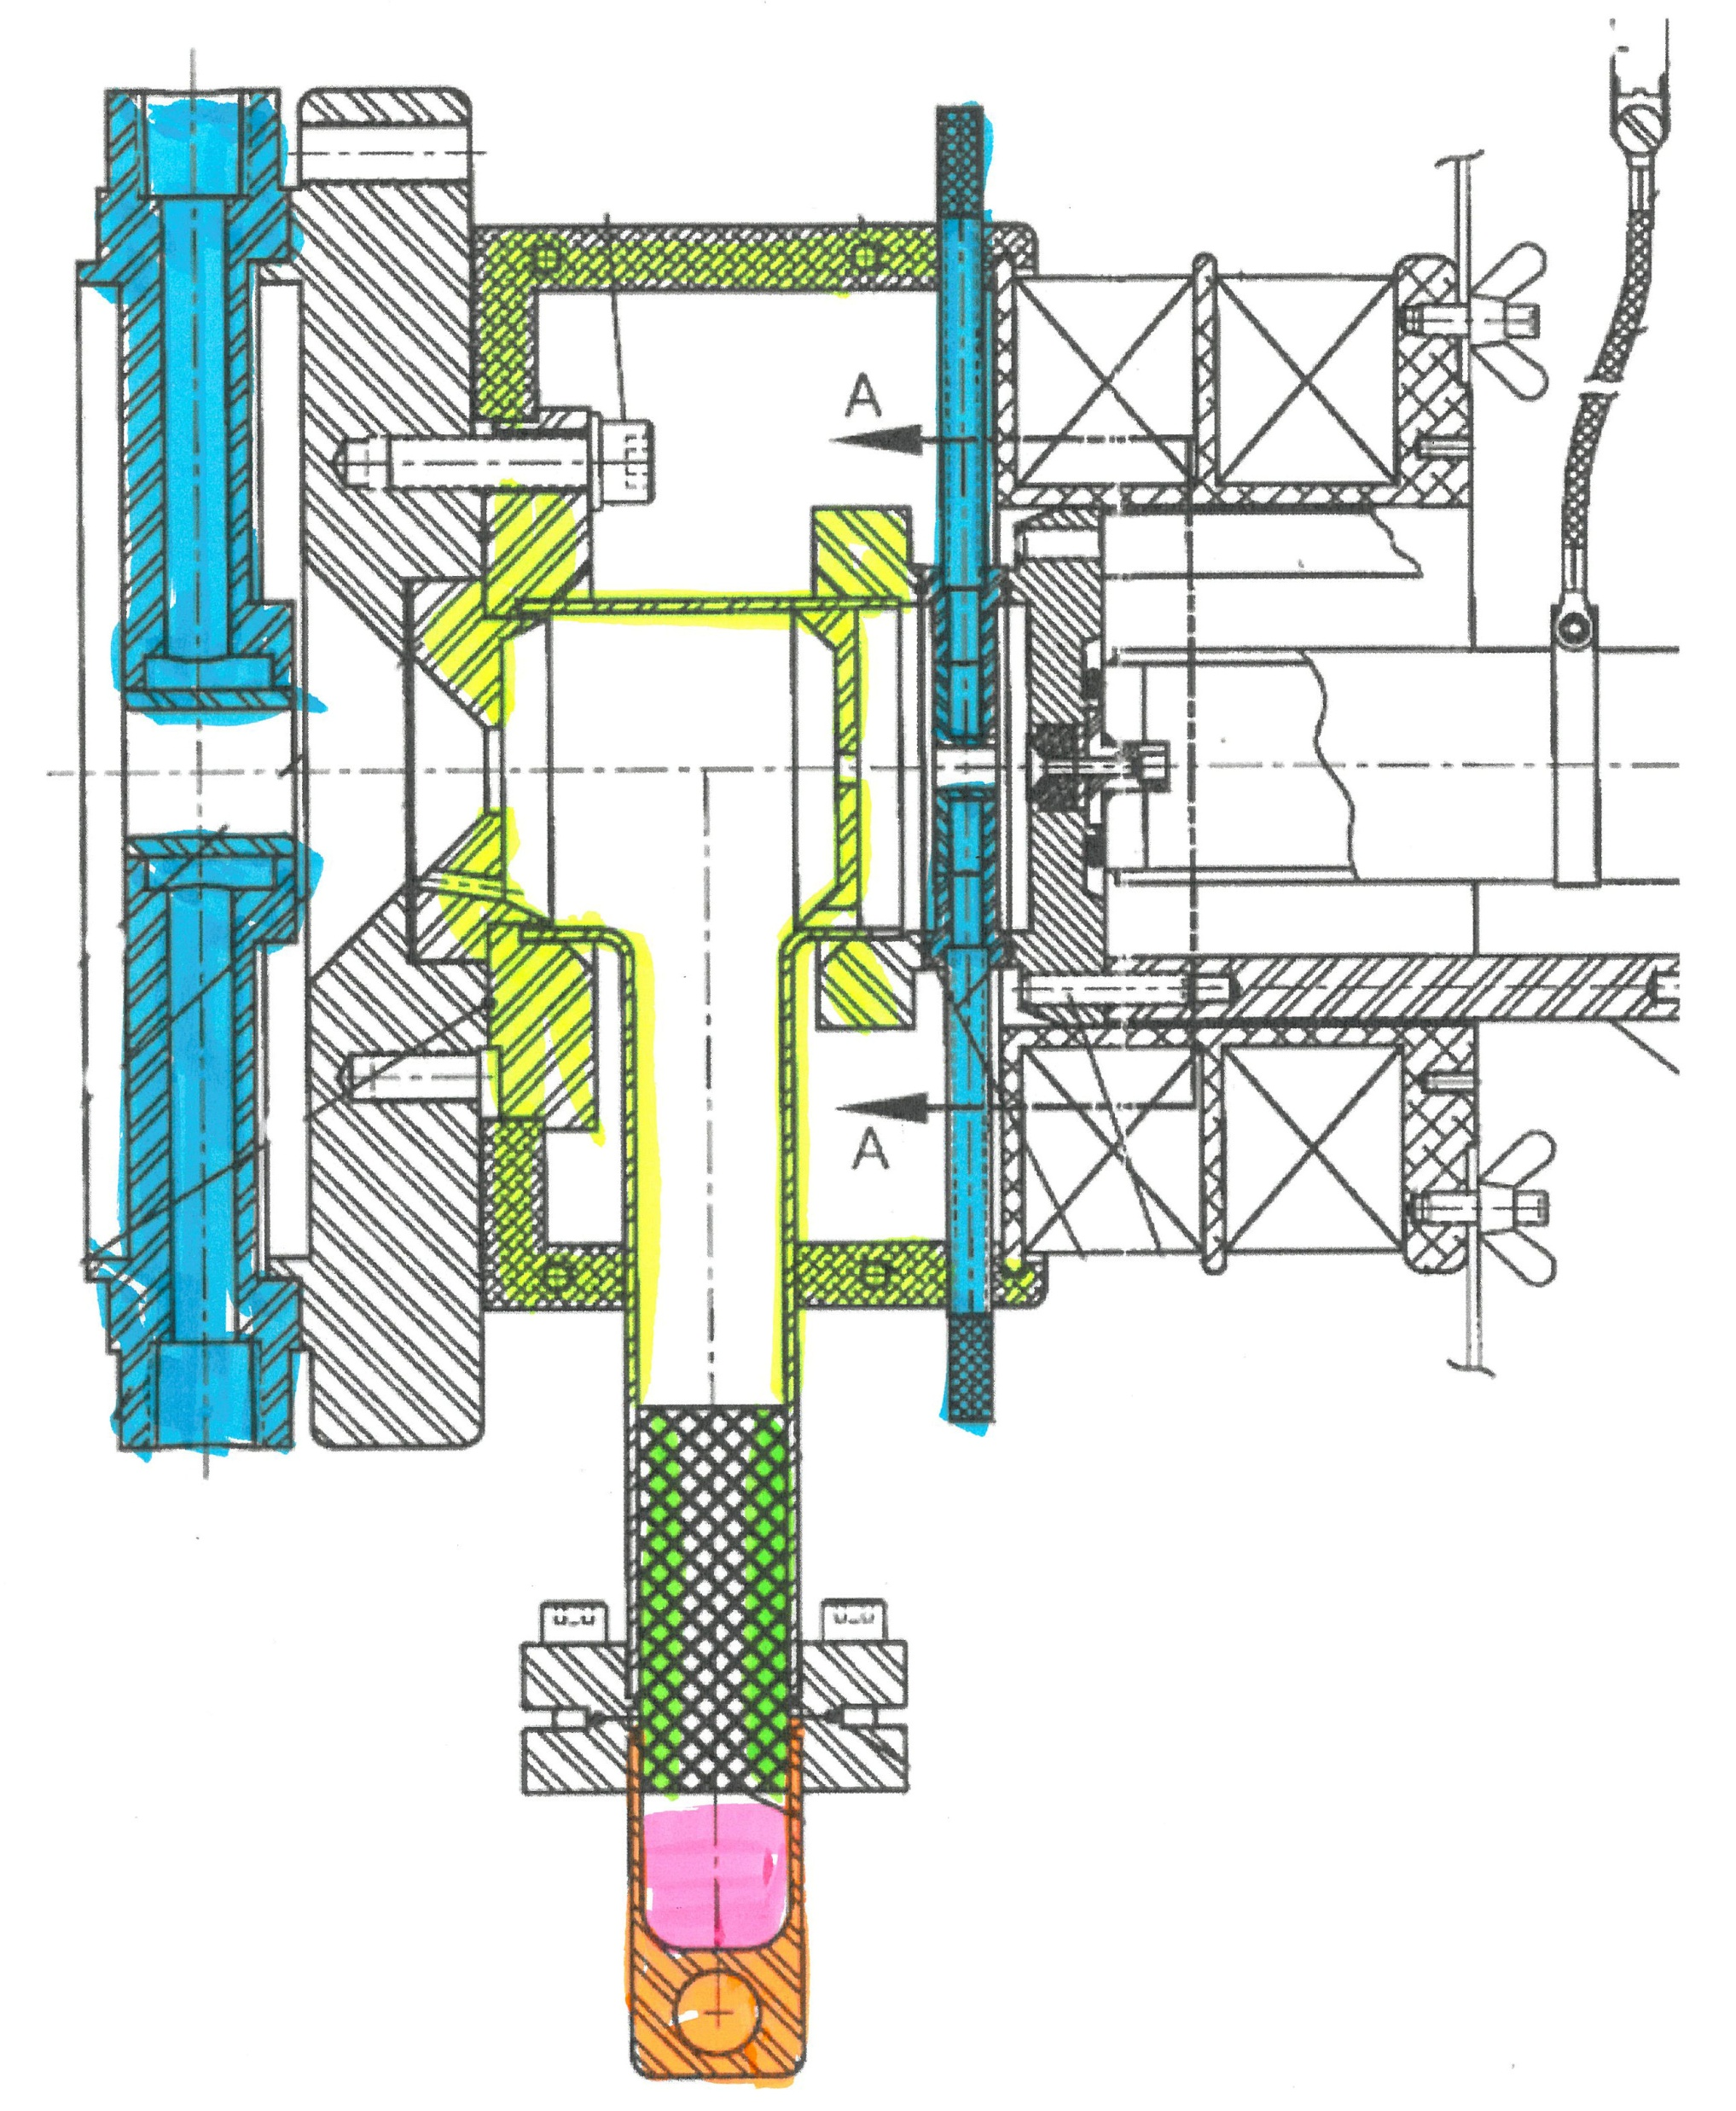
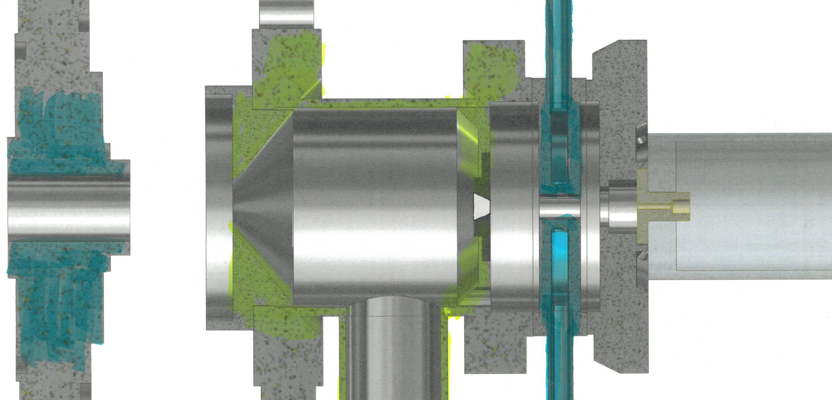
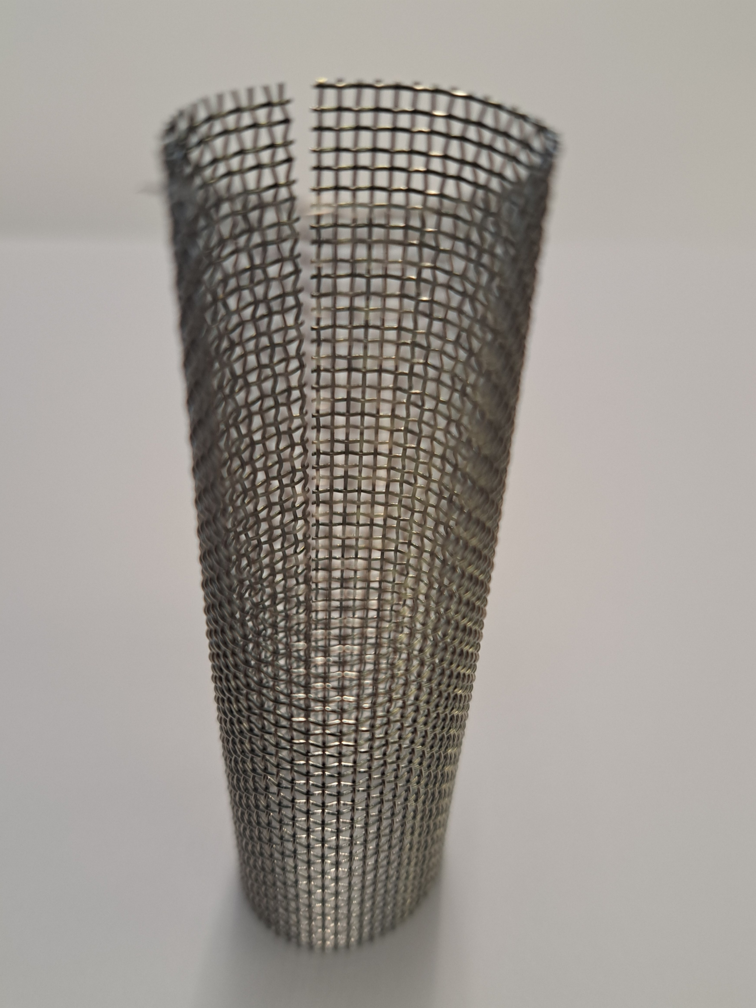
Charge-Exchange Cell Design Considerations: ANU Perspectives
Partition plenum around Rb chamber
Chamber entrance aperture wear & shape
Chamber exit aperture size and shape
Bottle rigidity
Temperature control of Rb oven
G size remote Helium cylinder
Don’t use return wick?
Excessive Rb migration toward RF tube?
H₂ leak chase after each rebuild
Outgas RF bottle before loading Rb
Don’t turn it off!
Old design
New design
circa 2011

Slide 22
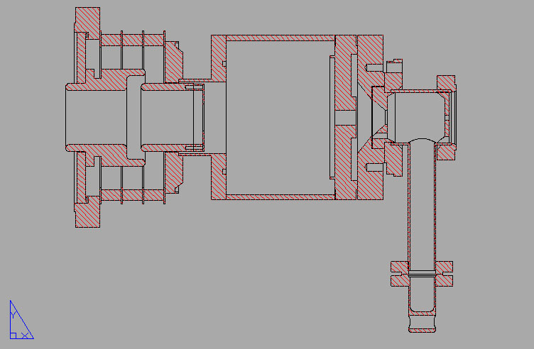
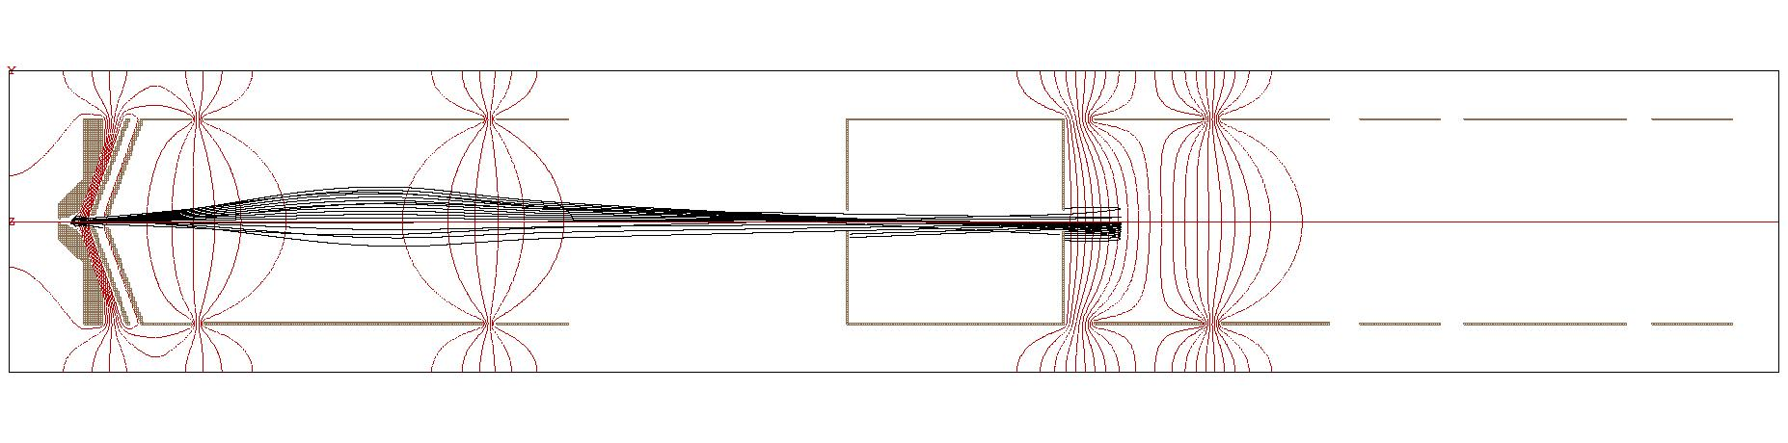
Heater
valve
Liquid cooled aperture
Rb layer
Positive ions reflected in gap lens impact on Rb condensed on electrode causing HV breakdown
Notes:
The NEC manual warns of instabilities caused by positive ions, only a small minority get charge exchanged to negative, reflected by the field in the gap lens. The lens accelerates negative ions.
The positive ions impact onto Rb that has escaped the chamber. This impact generates electrons which load the gap lens supply leading to unstable voltage which, in turn, makes the negative ion beam unstable too.
NEC recommends cleaning the Rb from the lens surfaces to eliminate the instability.
More Rb will collects as the source is used. It can be reduced from this area by heat-gunning the tube between the valve and the insulated section of beam pipe. The vacuum will rise as the Rb is evaporated to land elsewhere – hopefully, a benign location.
It is useful to reduce the amount of Rb that gets to the gap lens by reducing the diameter of the liquid cooled aperture and improving the baffling.
One can add an external heater to keep the Rb from condensing on the gap lens electrodes. I hope to do this some day.

Slide 23
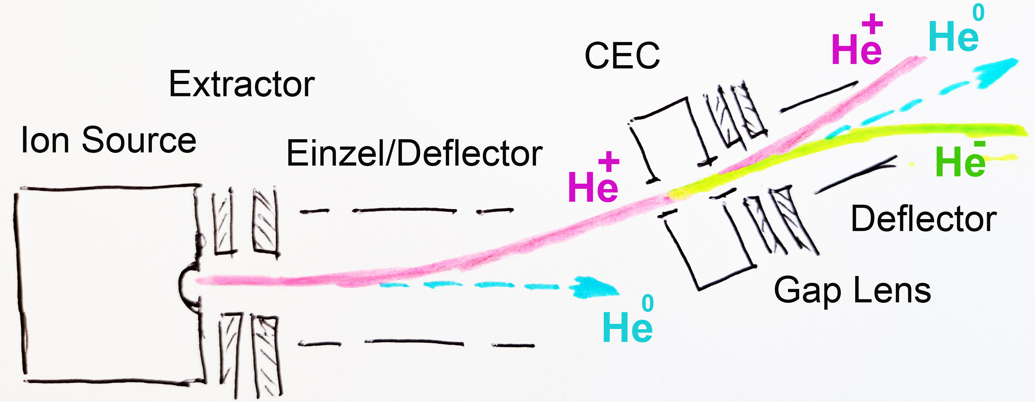
Beam Transport and Emittance Considerations
Lens system provides beam deflection that prevents alkali contamination and blocks plasma/neutral flux entering the CEC.
To prevent intra-beam stripping, the He⁻ beam must be separated from the more intense He⁺ and He⁰ beams using deflector positioned downstream of the CEC.
ε_{n} for 100 μA RF He⁺ ion source is ~0.2 π mm mrad.
Interactions between low-energy ions and alkali vapor cause multiple Coulomb scattering. These collisions produce angular divergence on the milliradian scale and energy spreads of several hundred electron volts.
Normalized rms emittance of He⁻ beam from NEC Alphatross is 1.27 π mm mrad (80% of beam), Tesmer (1989). This is significant growth after passage CEC.

Slide 24
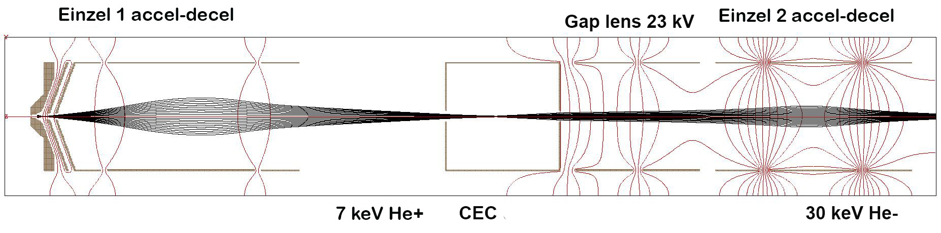
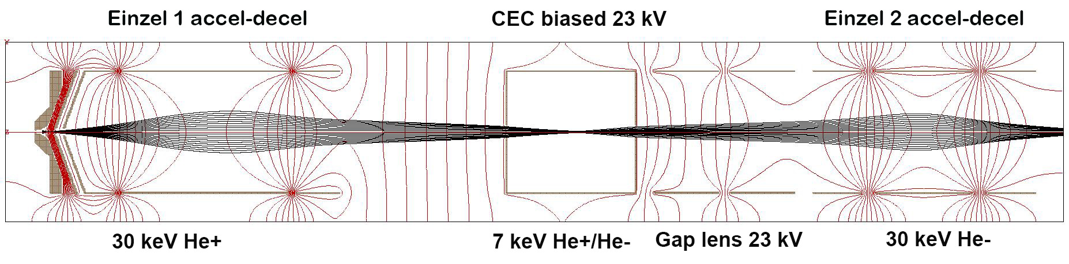
Beam Transport and Emittance Considerations

Slide 25
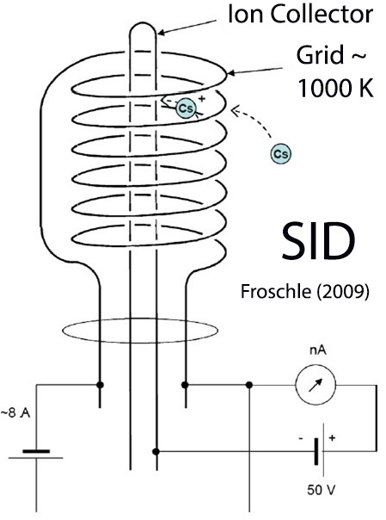
Diagnostics and Operational Reliability:
Beam, Plasma, and System Diagnostics
A suite of diagnostic tools is required for successful operation and/or optimization:
Faraday cups, BPMs, emittance scanner for beam current, profile and quality. Individual Faraday cup should be able to measure fluxes of positive, neutral and negative particles. Also reported designs capable of measuring all three fluxes by reconfiguring operation of modified Faraday cup.
RGA for residual gas composition
Temperature sensors to control alkali vapor density
Laser absorption spectroscopy or Langmuir surface ionization
gauge to measure alkali vapor density, a quartz crystal
microbalance to measure cumulative mass of alkali
deposited on its surface

Slide 26
Diagnostics and Operational Reliability:
Contamination Control and Cleaning Methodologies
Major issues in real systems : (a) Cs/Rb react with residual air resulting in formation of almost solely into ionic compounds, highly corrosive substances such as the strongest water soluble base CsOH etc.; (b) introduced impurities O, N, C degrade overall performance.
The presence of oxygen has the most important role in corrosion of stainless steel and Ni-based alloys caused by Rb. The nuclear industry recommendation is to keep oxygen levels below 100 ppm in Rb- containing systems (storage of the radioactive isotope Kr-85).
Optimization of system performance is achieved by use of inert gas handling (Ar/N₂ purging); avoiding air exposure, contamination and selection of appropriate materials in the design such as stainless steel 316, nickel-plated surfaces and Nb alloys for ultimate performance. Thorough cleaning of vacuum system before operation is essential.

Slide 27
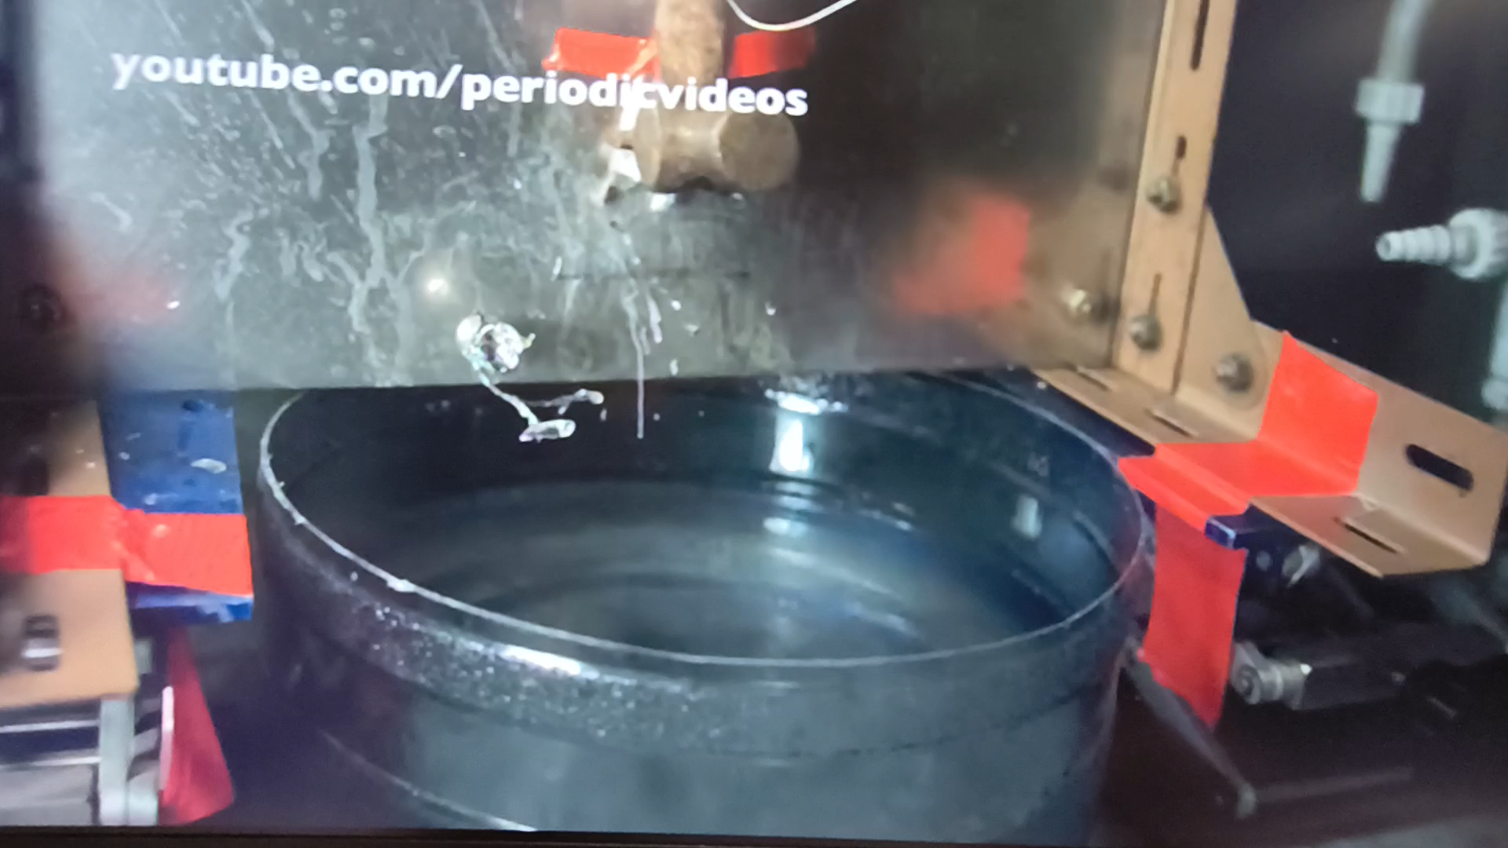
Alkali Free Charge-Exchange Media for He⁻ beams production

Slide 28
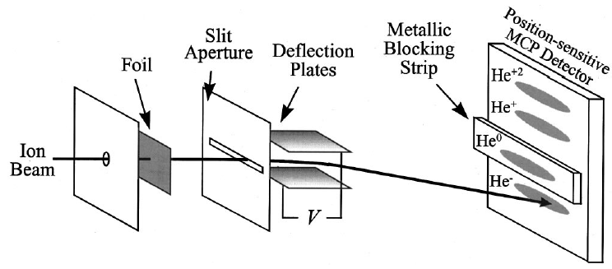
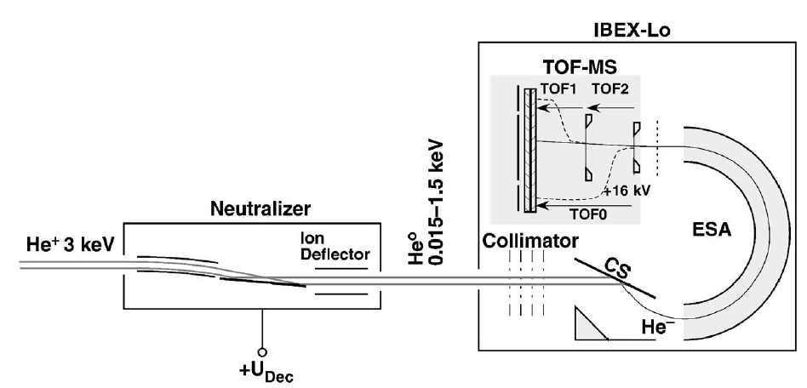
Alkali Free Charge-Exchange Media for He⁻ beams production
Negative ions have been produced by converting positively charged beams in gas charge-exchange cells; however, this method suffers from very low efficiency. For example, hydrogen gas yields a negative helium ion production efficiency of only ~10⁻⁵ , John et.al. (1967)
He⁻ ions have also been observed in the charge-state distributions of 8–80 keV He⁺ ions transmitted through thin carbon foils (~1 µg/cm²), Funsten (2001). At the optimum velocity (~0.7v₀, where v₀ is the Bohr velocity), the maximum He⁻ fraction reaches only 0.026%, significantly lower than that achieved with alkali targets.
He⁻ formation has also been observed during scattering of ground-state helium atoms from DLC-coated silicon surfaces, Wurtz (2008). For incident energies of 10–1500 eV, the negative ion fraction ranges from 7 × 10⁻⁵ to 10⁻⁵. Because metastable He* lies energetically close to the He⁻ state, it may enhance He⁻ production by several orders of magnitude through surface charge-transfer processes.

Slide 29
Alkali Free Charge-Exchange Media for He⁻ beams
production presented at NIBS 2026
Invited S1:
Negative Helium Ion Production Using Nano-Foils P. Jackle
Invited S1:
Alternative Solution to Address the Challenge of Negative Ion Sources for Fusion L. Couedel
Poster session 1:
Alkali-Free Volume Production of He- Ions in Pure Helium Plasma: A Computational Modelling Framework S. Baghel, M. Dehnel et al
Invited S2:
Caesium Free Negative Ion Beam Developments using Microwave Heating of Low-Work Function Materials A. Matsubara

Slide 30
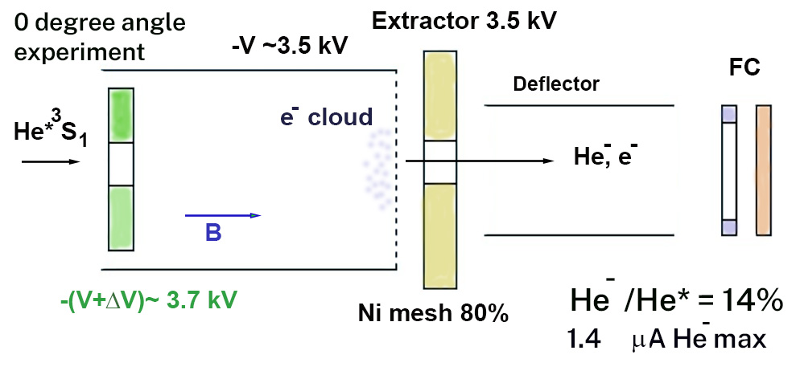
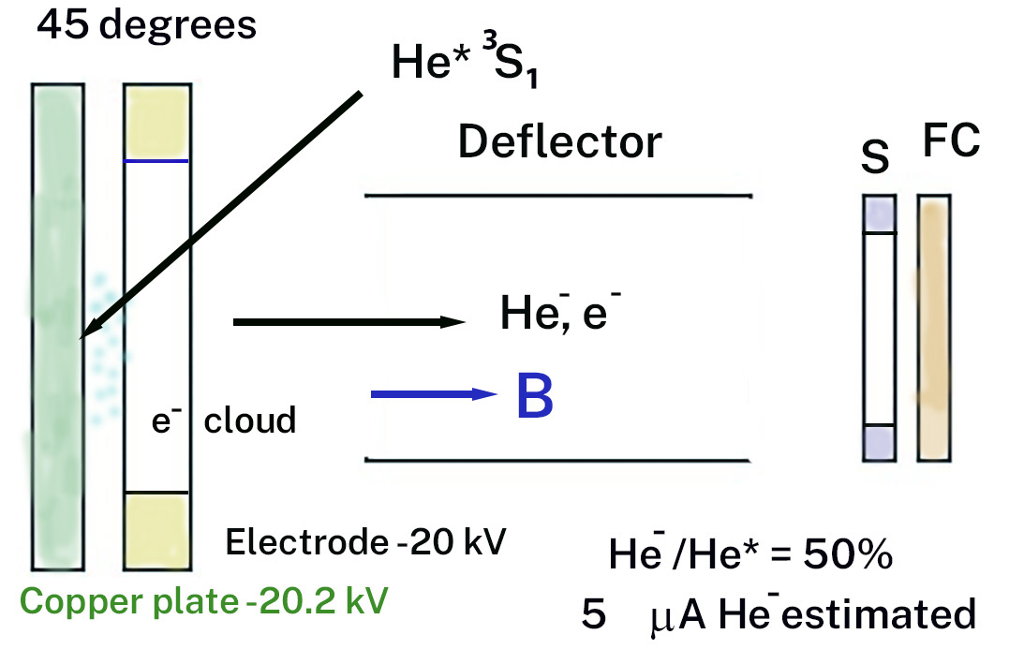
Beyond Alkali: Alternative Charge-Exchange Method for μA He⁻ beams
Direct production of He⁻ from metastable He*(2³S₁) atoms via single-electron capture has been demonstrated, Law (1984). A gas-discharge source generates a dense metastable helium beam that passes through an electron-donor region, producing estimated He⁻ currents of up to 1.4 µA from a 10 µA metastable beam. Conversion efficiencies ~50% reported in a 45° geometry. The proposed mechanism involving capture from a trapped secondary-electron cloud remains debatable. Surface-assisted electron attachment may instead be the dominant formation pathway.

Slide 31
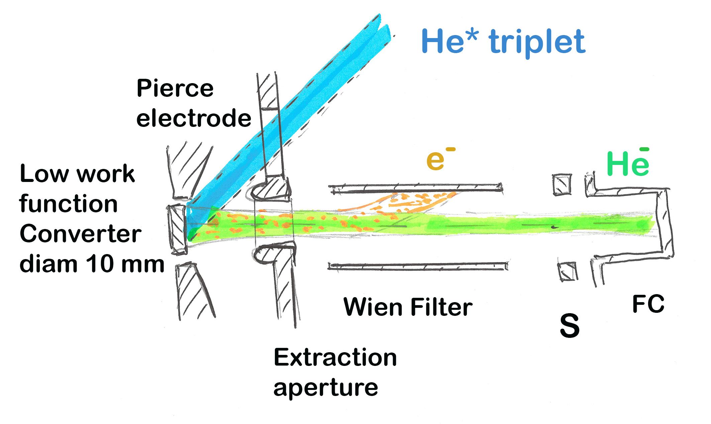
Production μA He⁻ beams at reduced Alkali Target Density
Proposed novel method of He⁻ formation in nearly alkali free environment.
Metastable helium atoms He* can be generated by charge exchange in a Cs or Rb vapor cell with only trace amounts of alkali vapor, Rose et. al (1967).
Metastable helium atoms subsequently interact with low-work-function surfaces where resonant electron-transfer processes produce metastable He⁻ ions. Surface-assisted formation of He⁻ has been experimentally reported by Law et al. (1984)

Slide 32
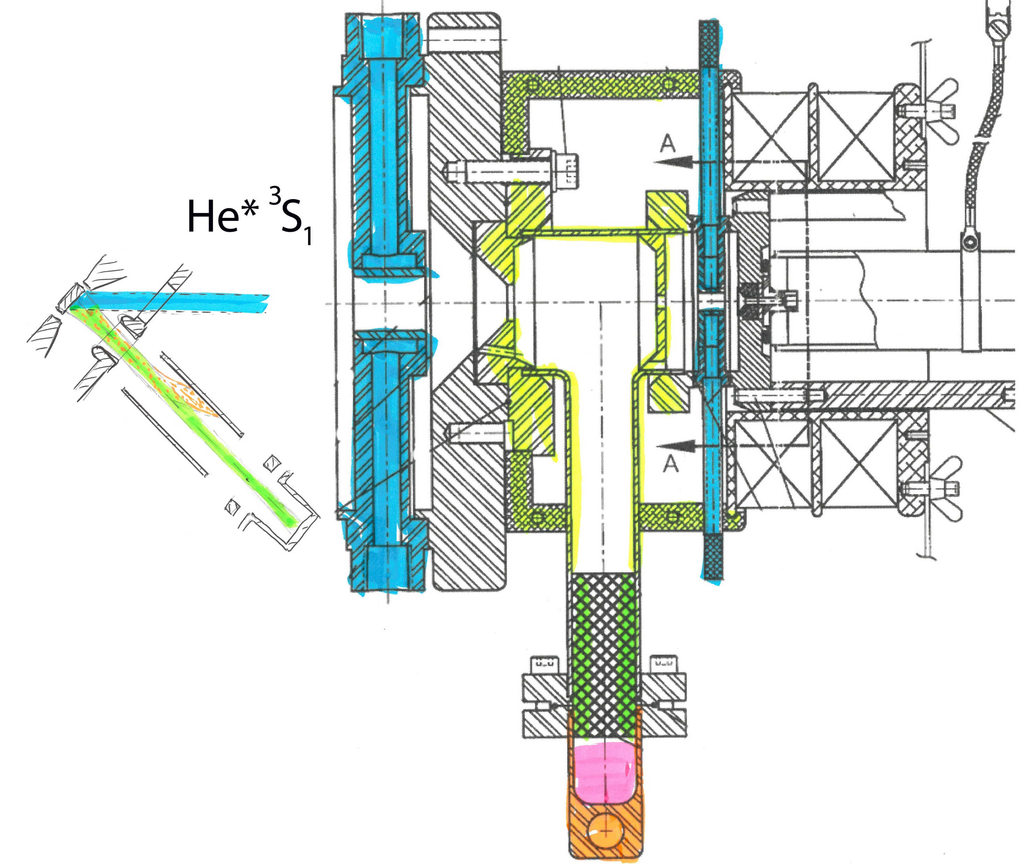
Production μA He⁻ beams at reduced Alkali Target Density

Slide 33
Future Directions: Challenges Toward Alkali Free He⁻ Production
Promising research direction is the alkali free production of He⁻ through metastable-He* interactions with engineered surfaces such as low-work-function, nanostructures electron donor surfaces, diamond-like carbon coatings or two-dimensional materials and metamaterials.
Potential mechanisms of He⁻ formation include resonant surface charge transfer reaction and electron tunneling from low-work-function materials.
Key R&D challenges incorporate negative-ion survival probability, surface-state engineering, electron capture dynamics, surface degradation mechanisms and scalability for accelerator applications.

Slide 34
Conclusions and Outlook
1. Optimization of He⁻ output is multi-parameter problem involving interplay between beam energy, charge-exchange target thickness, alkali-vapor density, ion-source performance, vacuum conditions, and beam transport.
2. Maximum He⁻ beam current is achieved not through optimization of charge-exchange efficiency alone, but through simultaneous optimization of the injected He⁺ beam intensity and the charge-exchange environment.
3. Importance is attributed to maintaining optimum alkali-vapor density, stable thermal conditions, low emittance beam formation/transport, and robust vacuum isolation.
4. Future developments may benefit from investigations of alkali-free conversion techniques based on metastable helium interactions with engineered low-work-function or nanostructured surfaces. Such approaches could potentially mitigate contamination and operational challenges associated with alkali-metal systems while opening new pathways toward compact and reliable He⁻ sources.

Slide 35




Slide 36
Thank you
Contact Us
  Heavy Ion Accelerator Facility
  Australian National University
  T +61 2 6125 2862
  E Nikolai.Lobanov@anu.edu.au
  W hiaf.anu.edu.au

