Slide 1
Design choices, implementation and status of the PIP-II Warm Front End
September Day, 2026
Lionel Prost
PIP-II Warm Front End L3 Manager

Slide 2
Agenda
Fermilab Accelerator Complex & Proton Improvement Plan-II (PIP-II)
PIP-II Warm Front End (WFE)
  Guiding principle & design choices
  Validation at the PIP-II Injector Test (PIP2IT)
Installation status & Outlook

Slide 3
Some Acronyms
AD: Accelerator Directorate
PIP-II: Proton Improvement Plan-II
PIP2IT: PIP-II Injector Test
CAM: Control Account Manager
LEBT: Low Energy Beam Transport
MEBT: Medium Energy Beam Transport
HEBT: High Energy Beam Transport
HBB: PIP-II’s High Bay Building
WFE: Warm Front End
LBNF: Long Baseline Neutrino Facility
DUNE: Deep Underground Neutrino Experiment
DOE: US Department of Energy
FNAL: Fermi National Accelerator Laboratory (a.k.a. Fermilab)
SRF: Superconducting RF
RF: Radio Frequency
RFQ Radio Frequency Quadrupole

Slide 4
Fermilab Accelerator Complex

Slide 5
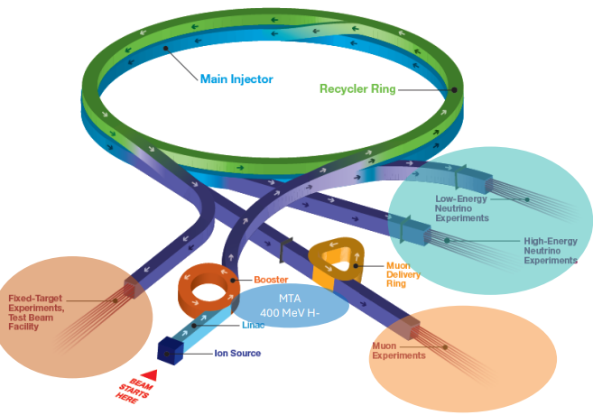
Fermilab Accelerator Complex
National User Facility
Fermilab’s Accelerator Complex is one of 28 DOE Office of Science National User Facilities
Developed over 58 years, the
Accelerator Complex comprises
5 particle accelerators and storage
rings, 2 high-power target stations,
several experimental areas and
miles (kilometers) of beamlines

Slide 6
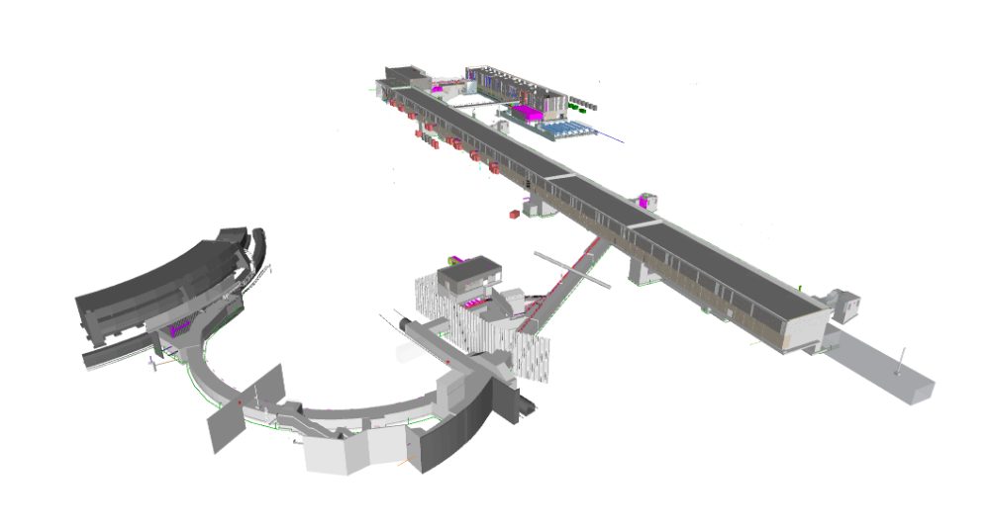
PIP-II Mission
PIP-II is an essential upgrade to Fermilab accelerator complex to enable the world’s most intense beam of neutrinos to LBNF/DUNE, and a broad physics research program for decades to come
PIP-II Capabilities
Beam Power
PIP-II Scope
800 MeV H⁻ SRF linac, to replace the 50+ year-old warm linac CW RF Operations
Linac-to-Booster transfer line
Accelerator Complex Upgrades:
Booster
Recycler
Main Injector
Conventional Facilities
1.2 MW proton beam
Upgradeable to multi-MW
Cryo plant
Flexibility, multi-user capability
H- ion source
CW-compatible
Customized beams
Multi-user delivery
800MeV SRF Linac
Booster
25 kW Dump
Reliability
Modernizes Fermilab accel complex
Dump
Tevatron Tunnel
Beam Transfer Line
The PIP-II scope enables the accelerator complex to reach 1.2 MW proton beam on LBNF target

Slide 7
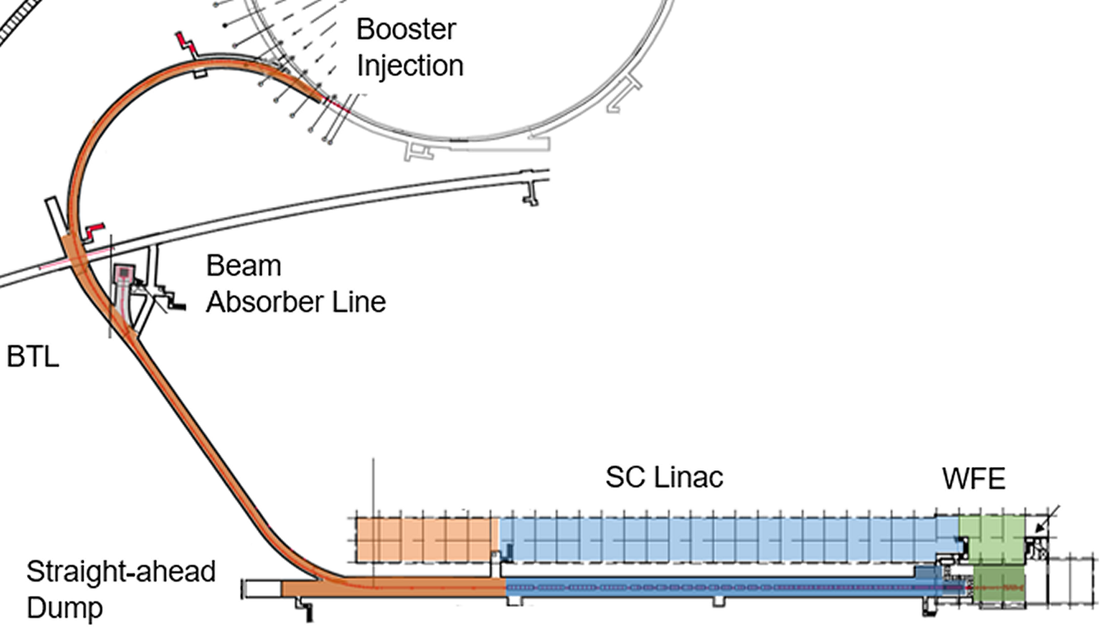
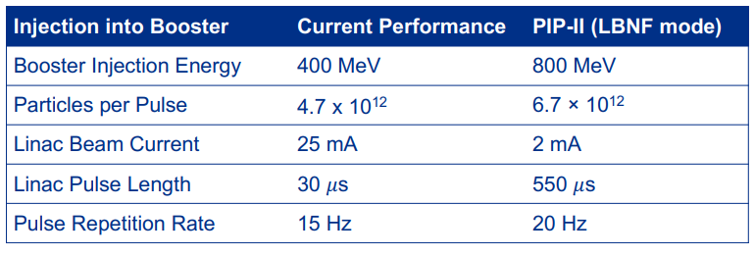
PIP-II Accelerator Overview
Defining parameters

Slide 8
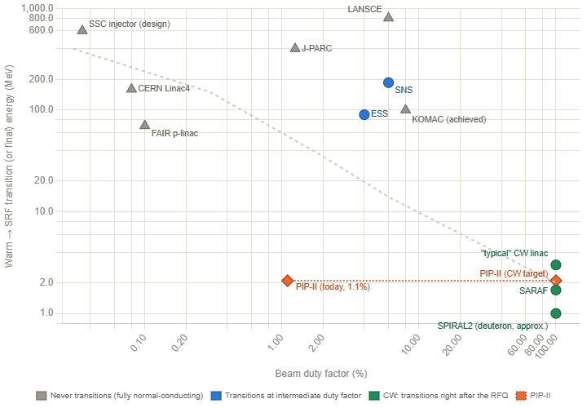
Boundary conditions
CW operations economics
Acceleration in SRF cavities start at low energy (2.1 MeV vs. > ~100 MeV in most other superconducting pulsed linacs)
  Transition from ‘warm’ (i.e. normally
  conducting) technology and ‘cold’
  (i.e. superconducting) technology is
  mostly dictated by RF power
  operational costs
  To first order, the higher the duty
  factor, the lower the transition (but
  there is no universal criterion)
SRF technology would not have been chosen if beam for LBNF/DUNE was the only goal
CW machines
Plot adapted from CERN Accelerator School 2013 (M. Vretenar)

Slide 9
Boundary conditions
CW operation implies stringent loss requirements (absolute)
Generally accepted loss requirements for “hands-on” maintenance: 1 W/m
  Exponential dependence as a function of energy
  ⇨ Fractional loss at 800 MeV (CW): ~10⁻⁶ m⁻¹
“warm”
“cold”
1 W/m assumed or quoted
LBNF/DUNE operation
For LBFN/DUNE (1.1% duty factor) → ~10⁻⁴ m⁻¹ at 800 MeV
Ultimate goal

Slide 10
PIP-II Warm Front End (WFE)

Slide 11
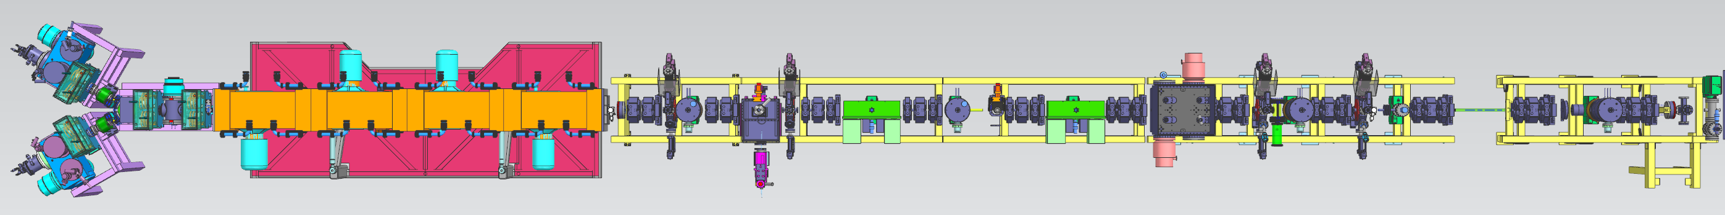

Warm Front End scope
WFE prepares a H⁻ beam optimized for injection into the Booster and provides capabilities for future CW operation
It is composed of:
  Two Ion Sources (IS) and a Low Energy Beam Transport (LEBT)
    DC/long pulse operation
  RFQ (162.5 MHz)
    CW operation (RF)
    30 keV ⇒ 2.1 MeV
  Medium Energy Beam Transport (MEBT)
    Nominal output current: 2 mA averaged over ~μs (from μs to CW operation)
    Bunch-by-bunch chopping
    capability
IS & LEBT
RFQ
MEBT
Tunnel

Slide 12
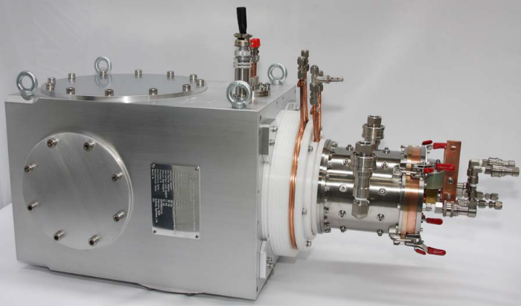
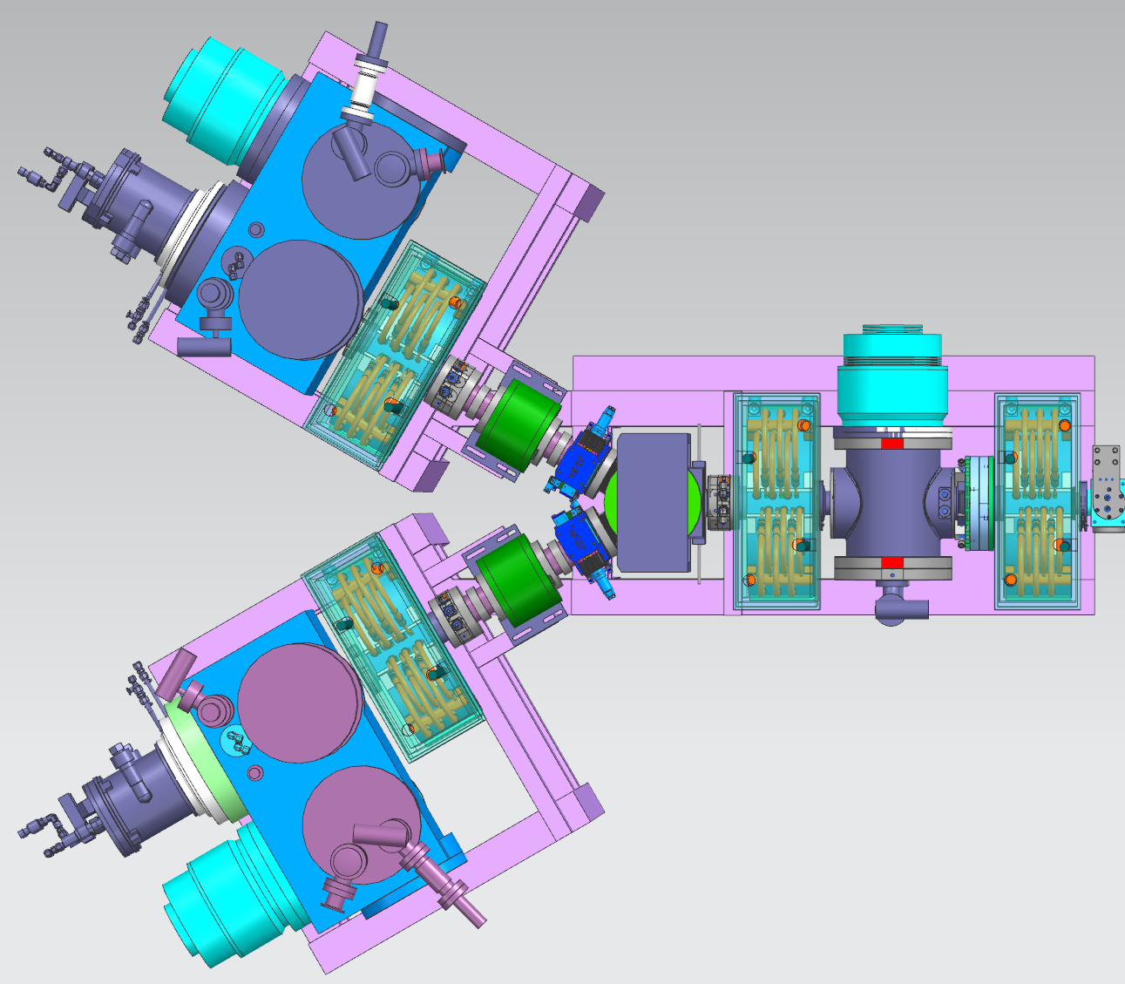
Ion Source
Robust and proven commercial solution
Baseline requirements
  DC, H⁻, 10 mA at 30 keV ⇨ D-Pace’s TRIUMF Type 15 mA H⁻ Volume-Cusp
Filament driven (~300 hours filament lifetime) ⇨ frequent changeout needed
Y-configuration
Significant electron current is ‘dumped’ onto extraction electrode assembly (and surrounding ‘baffles’) ⇨ may affect long term operation reliability and equipment longevity
DC operation is not necessary for LBNF/DUNE
Developed pulsing of the ion source itself

Slide 13
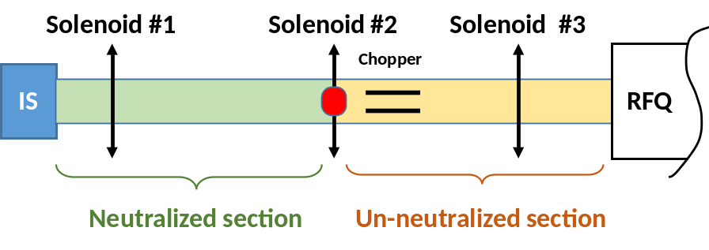
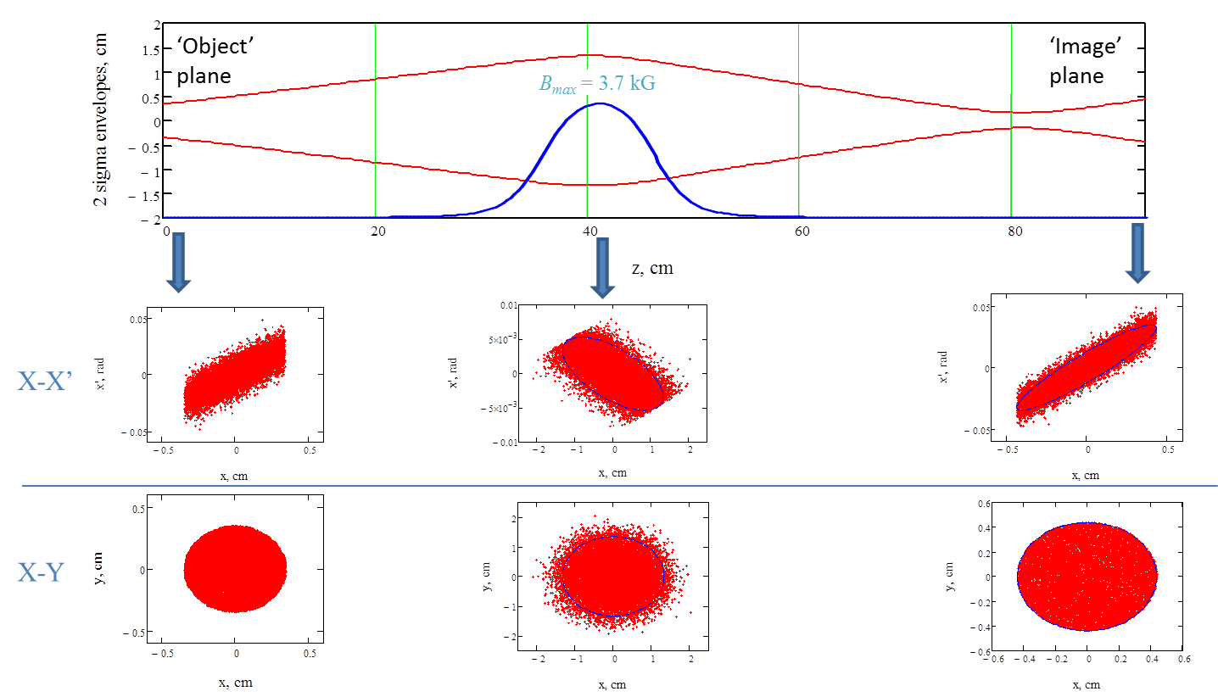
Low Energy Beam Transport (LEBT)
A long LEBT for tuning flexibility, vacuum management and operational robustness
Design determining factors
  Optical matching (α, β) at RFQ entrance
  Capability of tuning the beam line with short pulses representative of long pulse operation (i.e. constant beam parameters throughout the pulse) ⇨ Transport scheme with un-neutralized region (next slide)
2 solenoids
3 solenoids
Scheme of LEBT with un-neutralized section requires transition from (nearly) fully neutralized to (nearly) fully un-neutralized to take place where the beam current density is uniform
PIC-like simulations through one solenoid
  Initial distribution has a uniform current density distribution but Gaussian in the velocity space
Potential barrier
High vacuum pressure
  Gas load from ion source
Neutralizing particles confined by potential barrier
Low vacuum pressure
  Vacuum pumping station
  Limits rate of production of neutralizing particles
Clearing electric field
  Sweeps neutralizing particles out of the beam

Slide 14
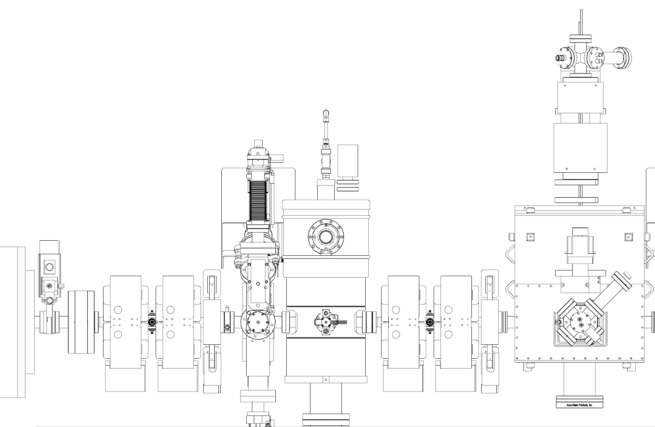
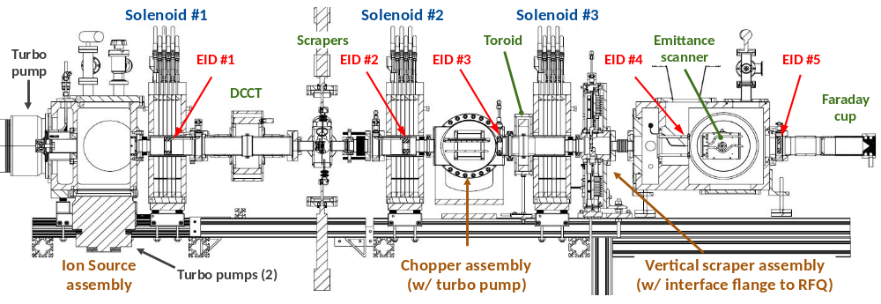
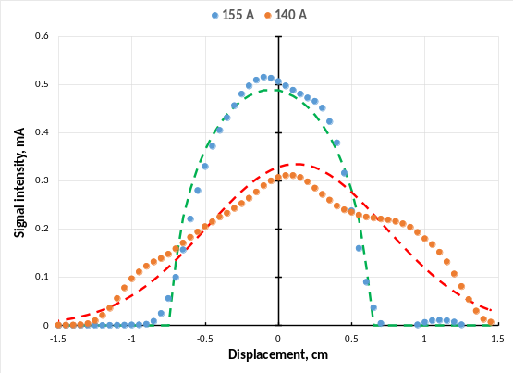
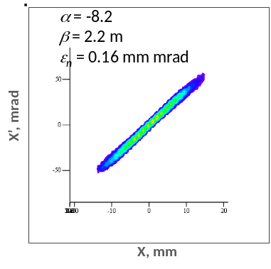
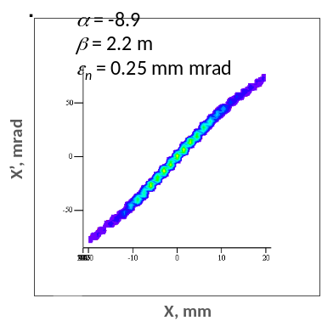
Transport scheme validation at PIP2IT
PIP2IT was a nearly full replica of the PIP-II front-end (WFE + first 2 cryomodules) with all envisioned features
Beam profile and emittance measurements in LEBT
Small beam parameter variations measured in MEBT
Emittance scanner
RFQ
Potential barrier
Beam parameters (current, normalized emittance, α, β) measured downstream of the RFQ over a 500 μs pulse
1D beam profiles at the scrapers. Dashed curves are fits, assuming a uniform (green) or a Gaussian (red) distribution, normalized to give the same integral
Phase space distributions for 2 different focusing solutions but same ion source tune

Slide 15
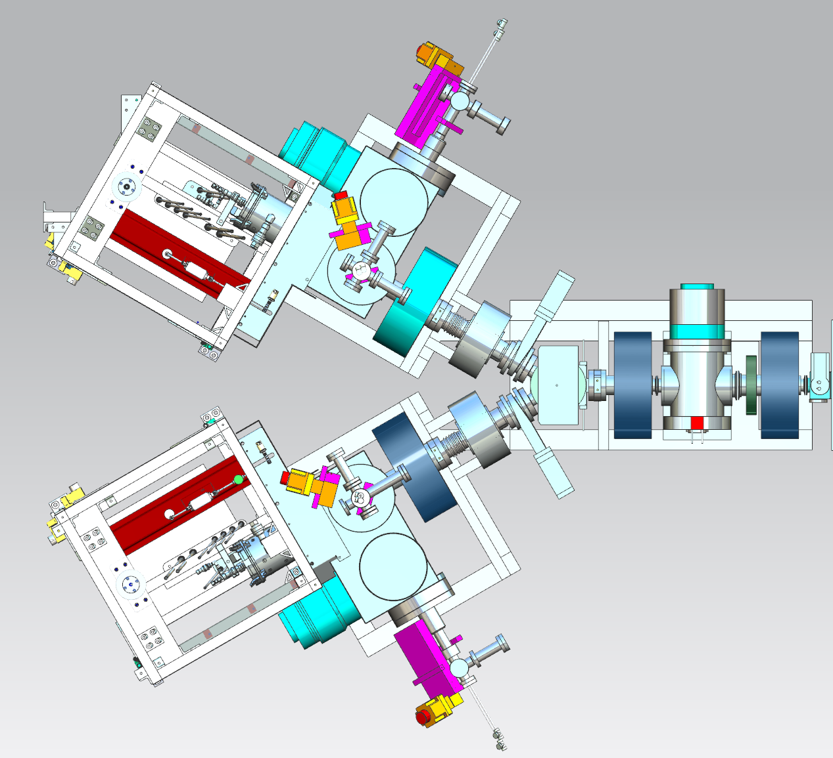
Low Energy Beam Transport (LEBT)
A long LEBT for tuning flexibility, vacuum management and operational robustness
Design determining factors
  Avoid/minimize bombardment of RFQ vanes
    ⇨ No direct line of sight from the source
    ⇨ Addition of multiple aperture restrictions (Electrically Isolated Diaphragms a.k.a. EID)
    ⇨ Robust chopper, which includes a dedicated absorber
Bending dipole magnet
Space/length
Central component of Machine Protection System (MPS) for inhibiting beam
2.1 m

Slide 16
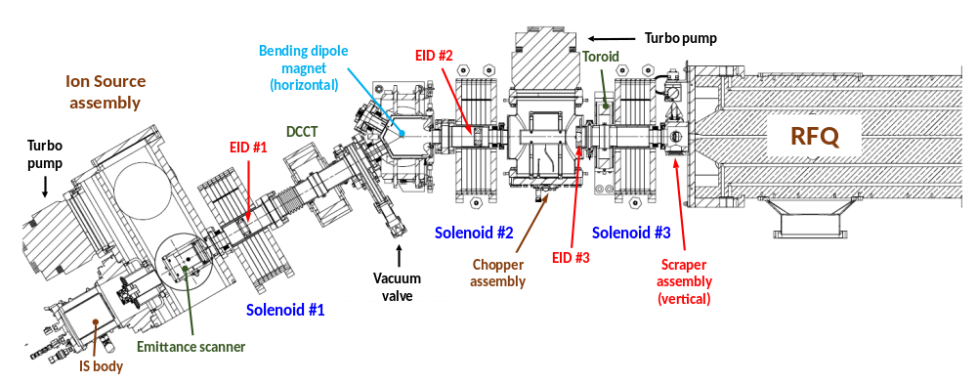
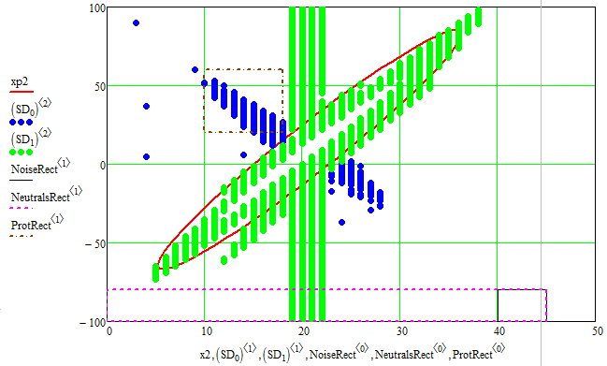
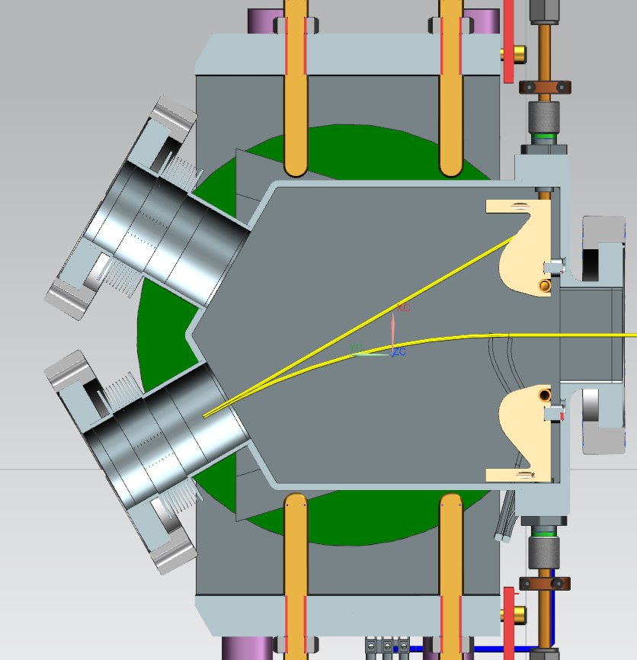
Neutrals and protons
Electron stripping in H⁻ collisions with gas immediately downstream of ion source extraction region
Single stripping → Fast neutrals (~10% of H⁻ beam current near ion source)
  Ballistic flight
Double stripping → Protons (~0.5% of H⁻ beam current near ion source)
  Same envelope as H⁻
Estimated with Allison scanner
Bending magnet naturally ‘filters’ them out
Proton area
1/12/16 data
H⁺
x’, mrad
H⁰
H⁻
Noise area
Neutrals area
x, mm

Slide 17
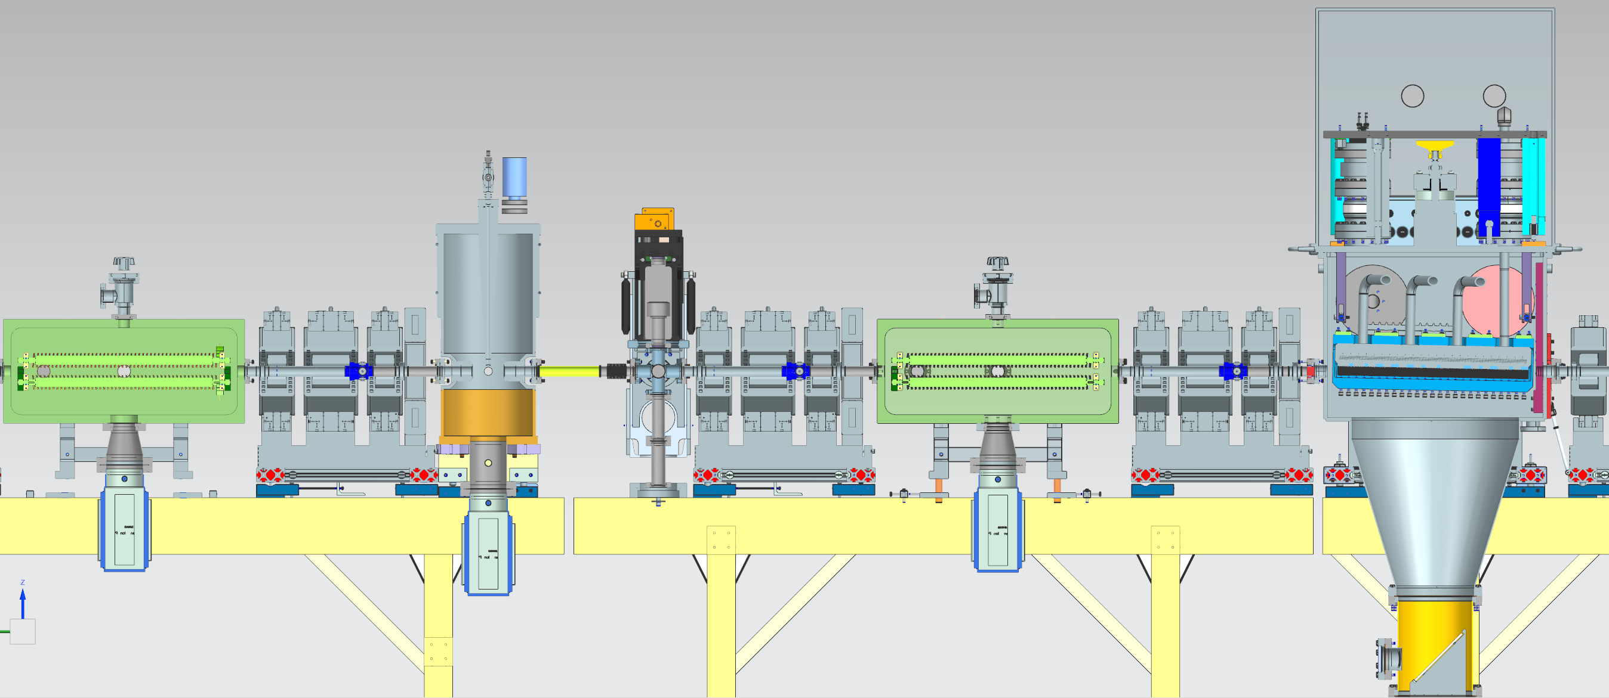
Medium Energy Beam Transport (MEBT)
A long MEBT for bunch-by-bunch chopping and SRF protection
Design determining factors
  Bunch-by-bunch chopping system
Long (~50 cm) restricting apertures
Additional protection (entrance & exit) needed from transverse tails and/or erratic beam
2 kickers
Large & complicated absorber capable of sustaining 21 kW of beam power continuously
Absorber assembly
Lattice needs to accommodate two (2) optics solutions/trajectories (passing and ‘to be removed’ bunches)
Kickers

Slide 18
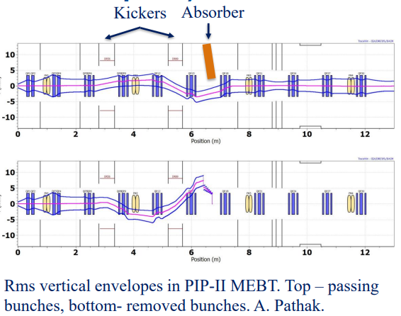
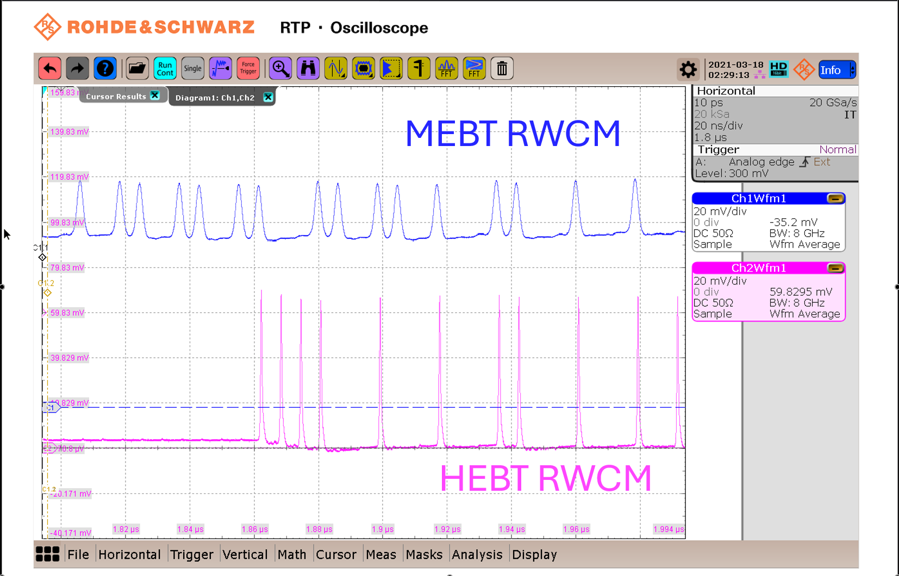
Bunch-by-bunch chopping at PIP2IT
Any bunch from initially CW sequence can be either removed or passed
(6.15 ns bunch spacing ⇨ maximum switching frequency = 81.25 MHz)
Driver electronics maximum average switching frequency is 500 kHz
Measured extinction between bunches <5×10⁻⁴ limited by instrumentation resolution/noise
Example of an arbitrary pattern

Slide 19
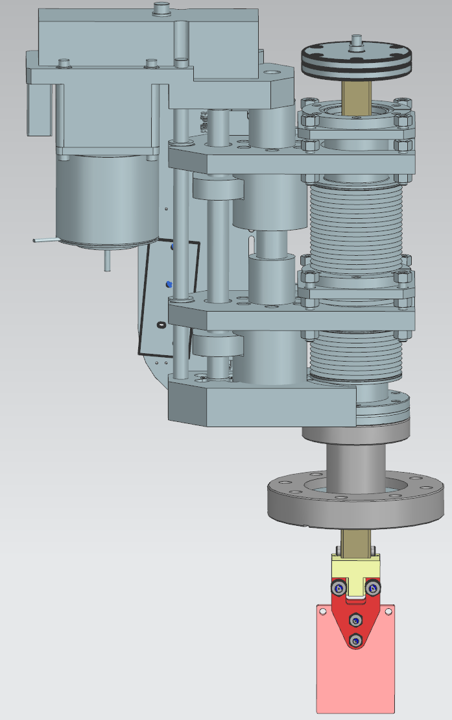
Medium Energy Beam Transport (MEBT)
A long MEBT for bunch-by-bunch chopping and SRF protection
Design determining factors
  Protect SRF from beam far tails and erratic beam loss
  Protect SRF from high vacuum section (absorber in particular) and vacuum incident
Extensive collimation system
Four (4) sets of transverse movable scrapers arranged in pairs separated by ~π/2 phase advance
Differential Pumping Insert (DPI) + beamline ‘buffer’ + Fact Acting Valve (FAV)
Another long aperture restriction (20 cm x ⏀1cm vs. ⏀3cm ) which complicates transport optics
FAV
MEBT scraper assembly
  Scraper is made out of TZM (Molybdenum alloy)
  Radiation cooled, electrically isolated
DPI

Slide 20
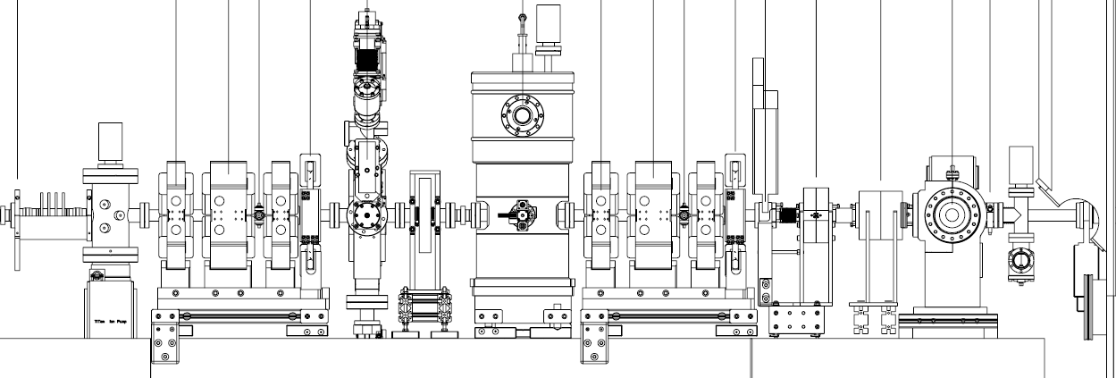
Validation and Demonstration at PIP2IT
Differential Pumping Insert (DPI)
  Provides 2-4 decades of isolation
  In conjunction with Fast Acting Valve (FAV) → <10⁻⁶ torr liter of gas passes through FAV independently of leak size (up to atmosphere) upstream of DPI
PIP2IT setup
Insignificant in terms of monolayer coverage on the cavity surfaces
DPI
FAV
Warm valve to HWR
2.1 m
0.9 m
Particle free practices during assembly

Slide 21
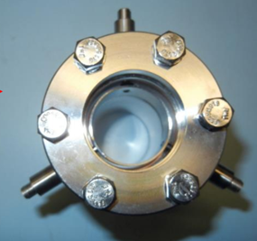
Medium Energy Beam Transport (MEBT)
A long MEBT for bunch-by-bunch chopping and vacuum management
Design determining factors
  Ion Source/LEBT access while running (→ IS maintenance) and WFE beamline visible by the public (→ administrative choice)
  Extensive suite of diagnostics
    Emittance scanner
    Ring Pick Ups (RPU)
    ACCTs, DCCT
    Beam Position Monitors
    Resistive Wall Current Monitor
    Wire-scanners
    Laser wire
    Fast Faraday Cup (FFC)
  All other features already mentioned
Radiation shielding wall separating warm section from SRF section
One more complication for the design of the optics although not an aperture restriction
Very long beamline (13 m)
RPU
Tunnel

Slide 22
Particle free region at PIP2IT
PIP2IT setup
DPI
FAV
Warm valve to HWR
2.1 m
0.9 m

Slide 23
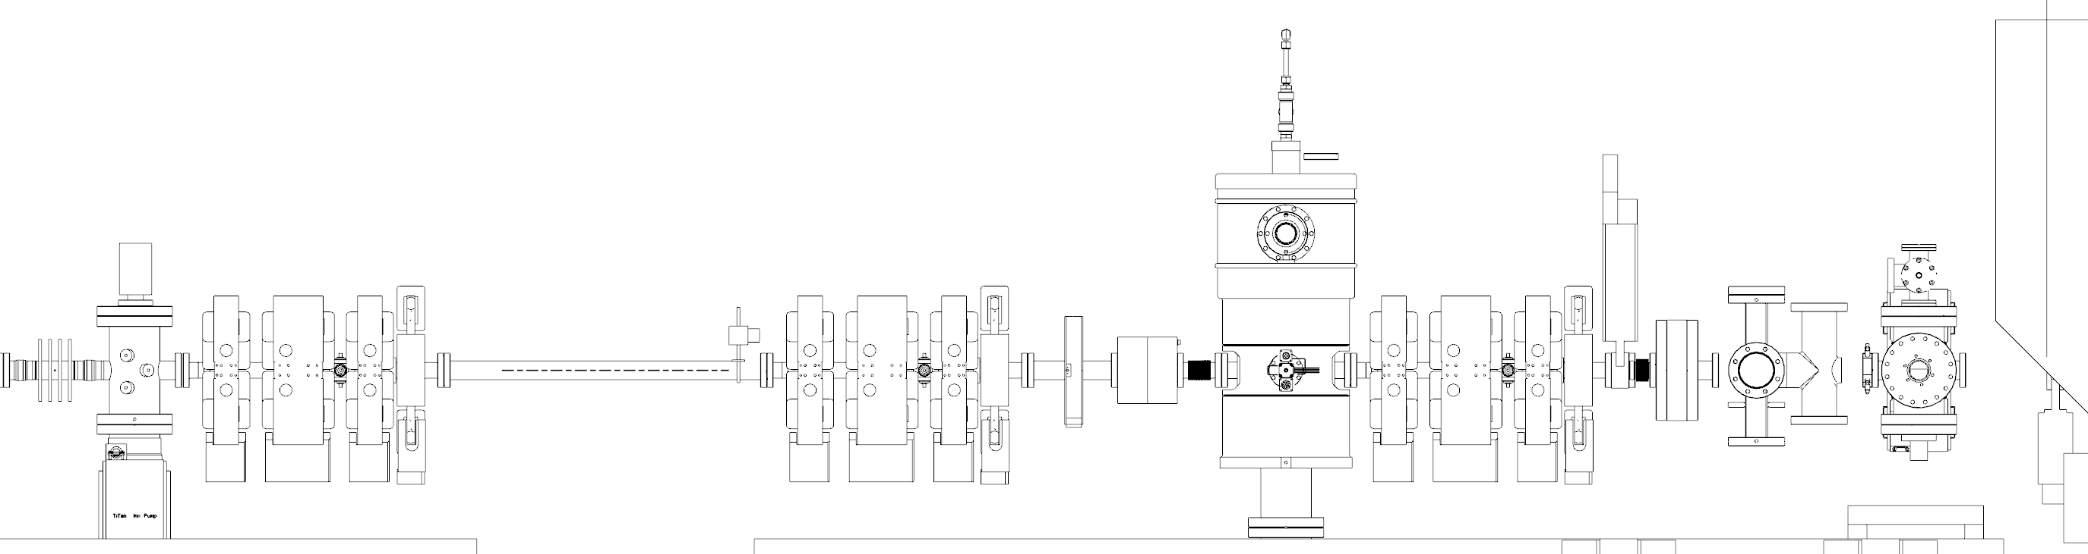
Particle free region at PIP-II
Moved components and extended w.r.t. PIP2IT
Extended to accommodate radiation shield wall
  FAV to HWR distance maintained
  Moved scraper assembly upstream of DPI → Only moving devices are the vacuum valves
Empty section for radiation shield wall
3.2m
0.9m
FAV
Warm valve to HWR
DPI

Slide 24
Installation status & outlook

Slide 25
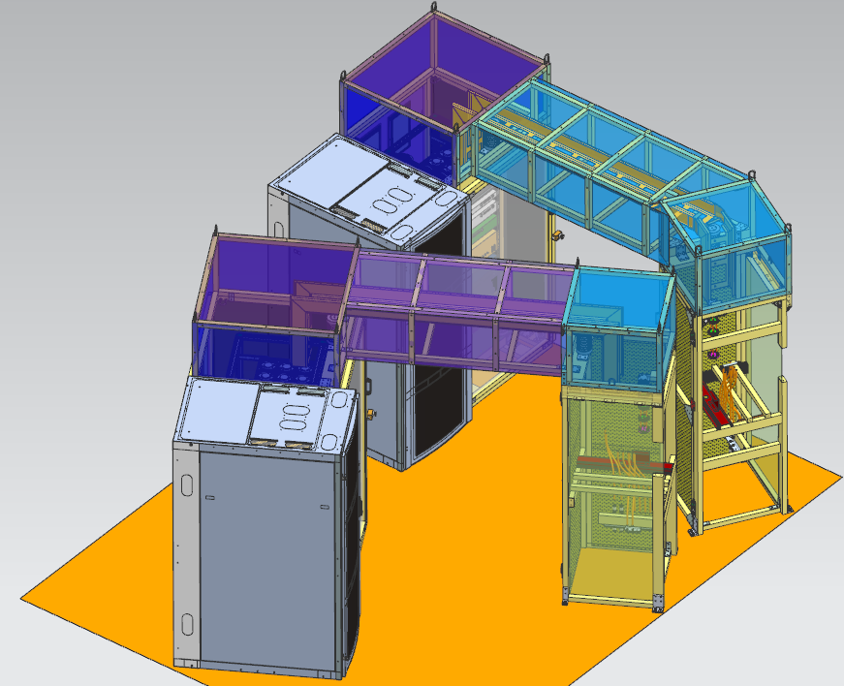
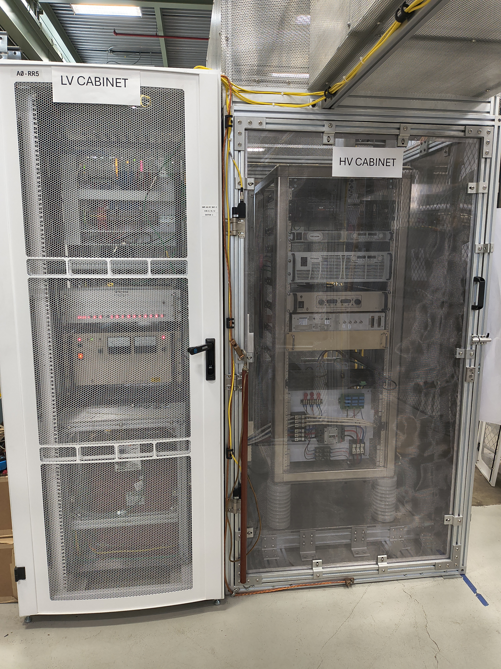
From PIP2IT WFE to PIP-II WFE
Small but important differences from lessons learned
New redesigned ion source power cabinets
New/updated diagnostics (ACCT, DCCT, RWCM, emittance scanner)
New water jacket downstream of MEBT absorber for better heat management of beam tube from secondaries bombardment
Upgraded actuator assemblies for MEBT scrapers
New bunching cavities (same design)
New production kicker drivers (small upgrade)
New MEBT girders/stands
Some shuffling of components (no change to the beamline optics)

Slide 26
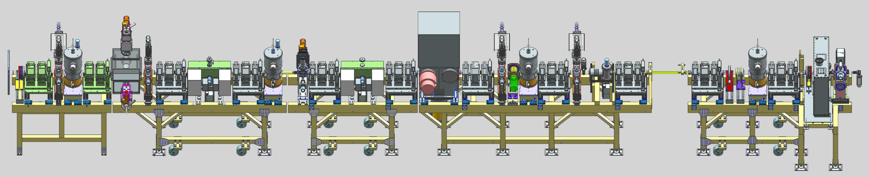
Fabrication/installation status
High-Bay Building (HBB) ready for installation of first beamline components in June
RFQ was the first component moved from PIP2IT to the PIP-II HBB
  Sets the ‘origin’ of the beam line
Started to expand the beamline both upstream and downstream
Cables pulled in August/September → Final alignment of LEBT and most of MEBT girders
  Beamline configuration for WFE commissioning does not include “particle-free” region → Physical air gap + temporary Faraday Cup upstream of bunching cavity 3 to allow for continuation of cryomodules installation during early beam operation
Particle-free region

Slide 27
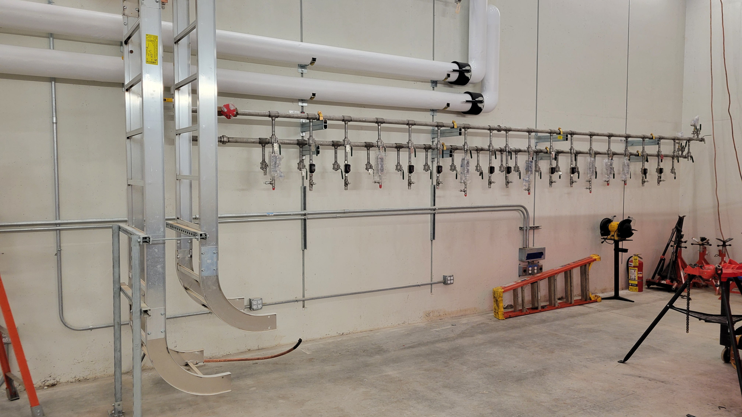
Diaporama

Slide 28
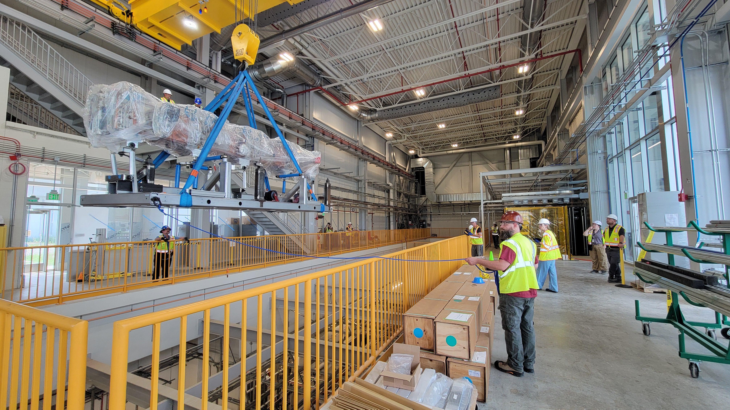
Diaporama

Slide 29
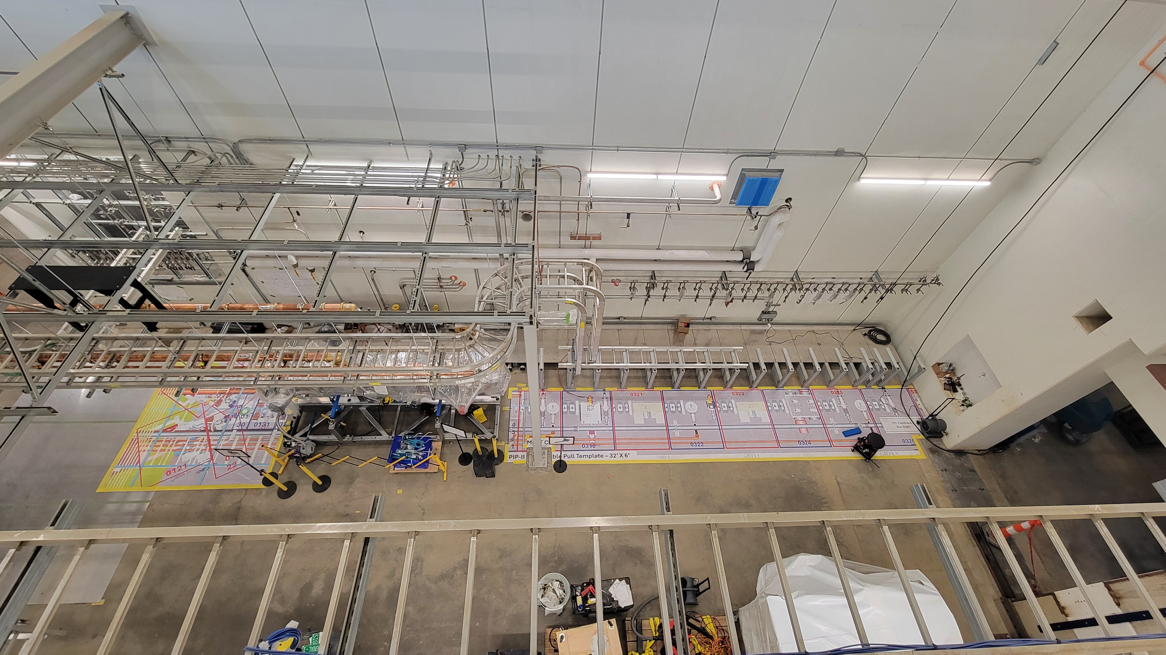
Diaporama

Slide 30
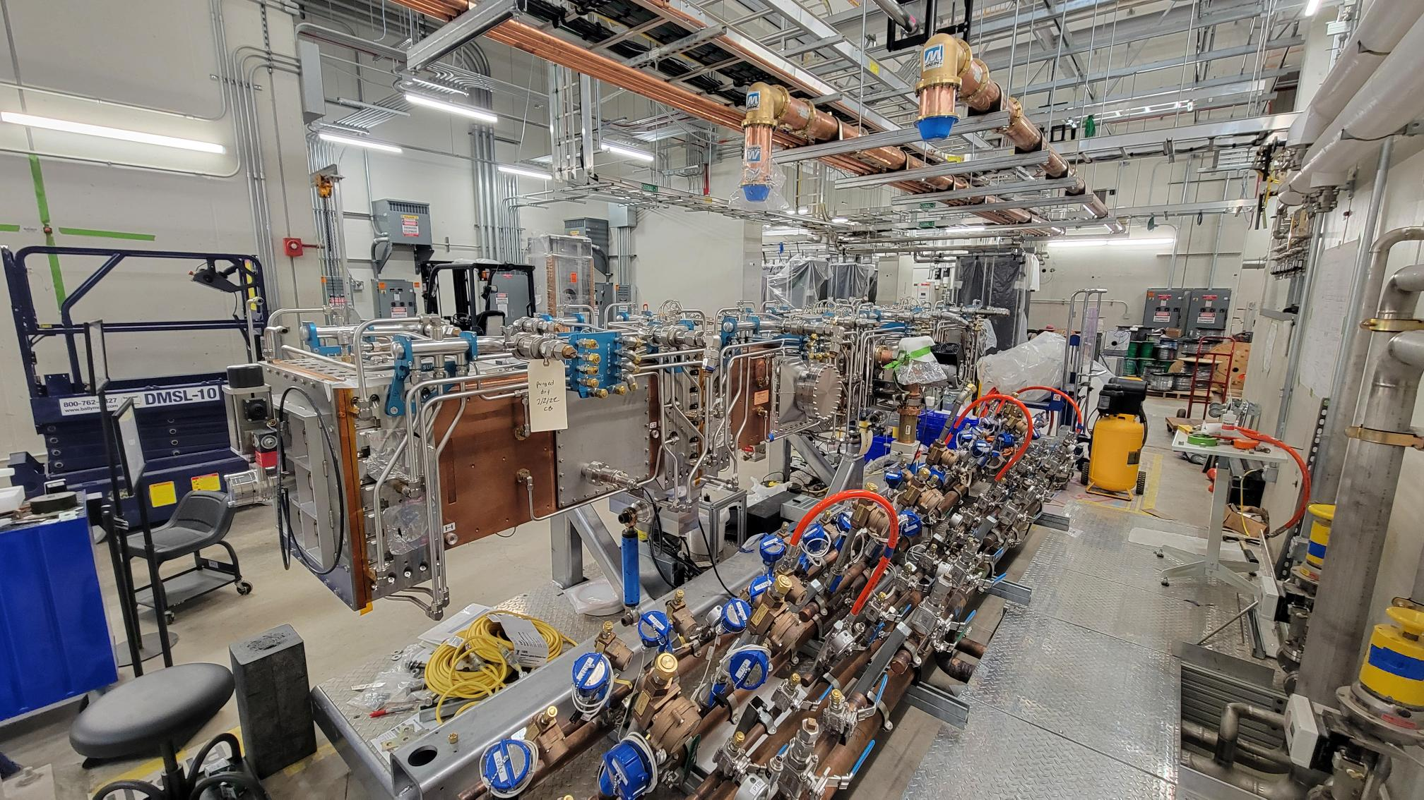
Diaporama

Slide 31
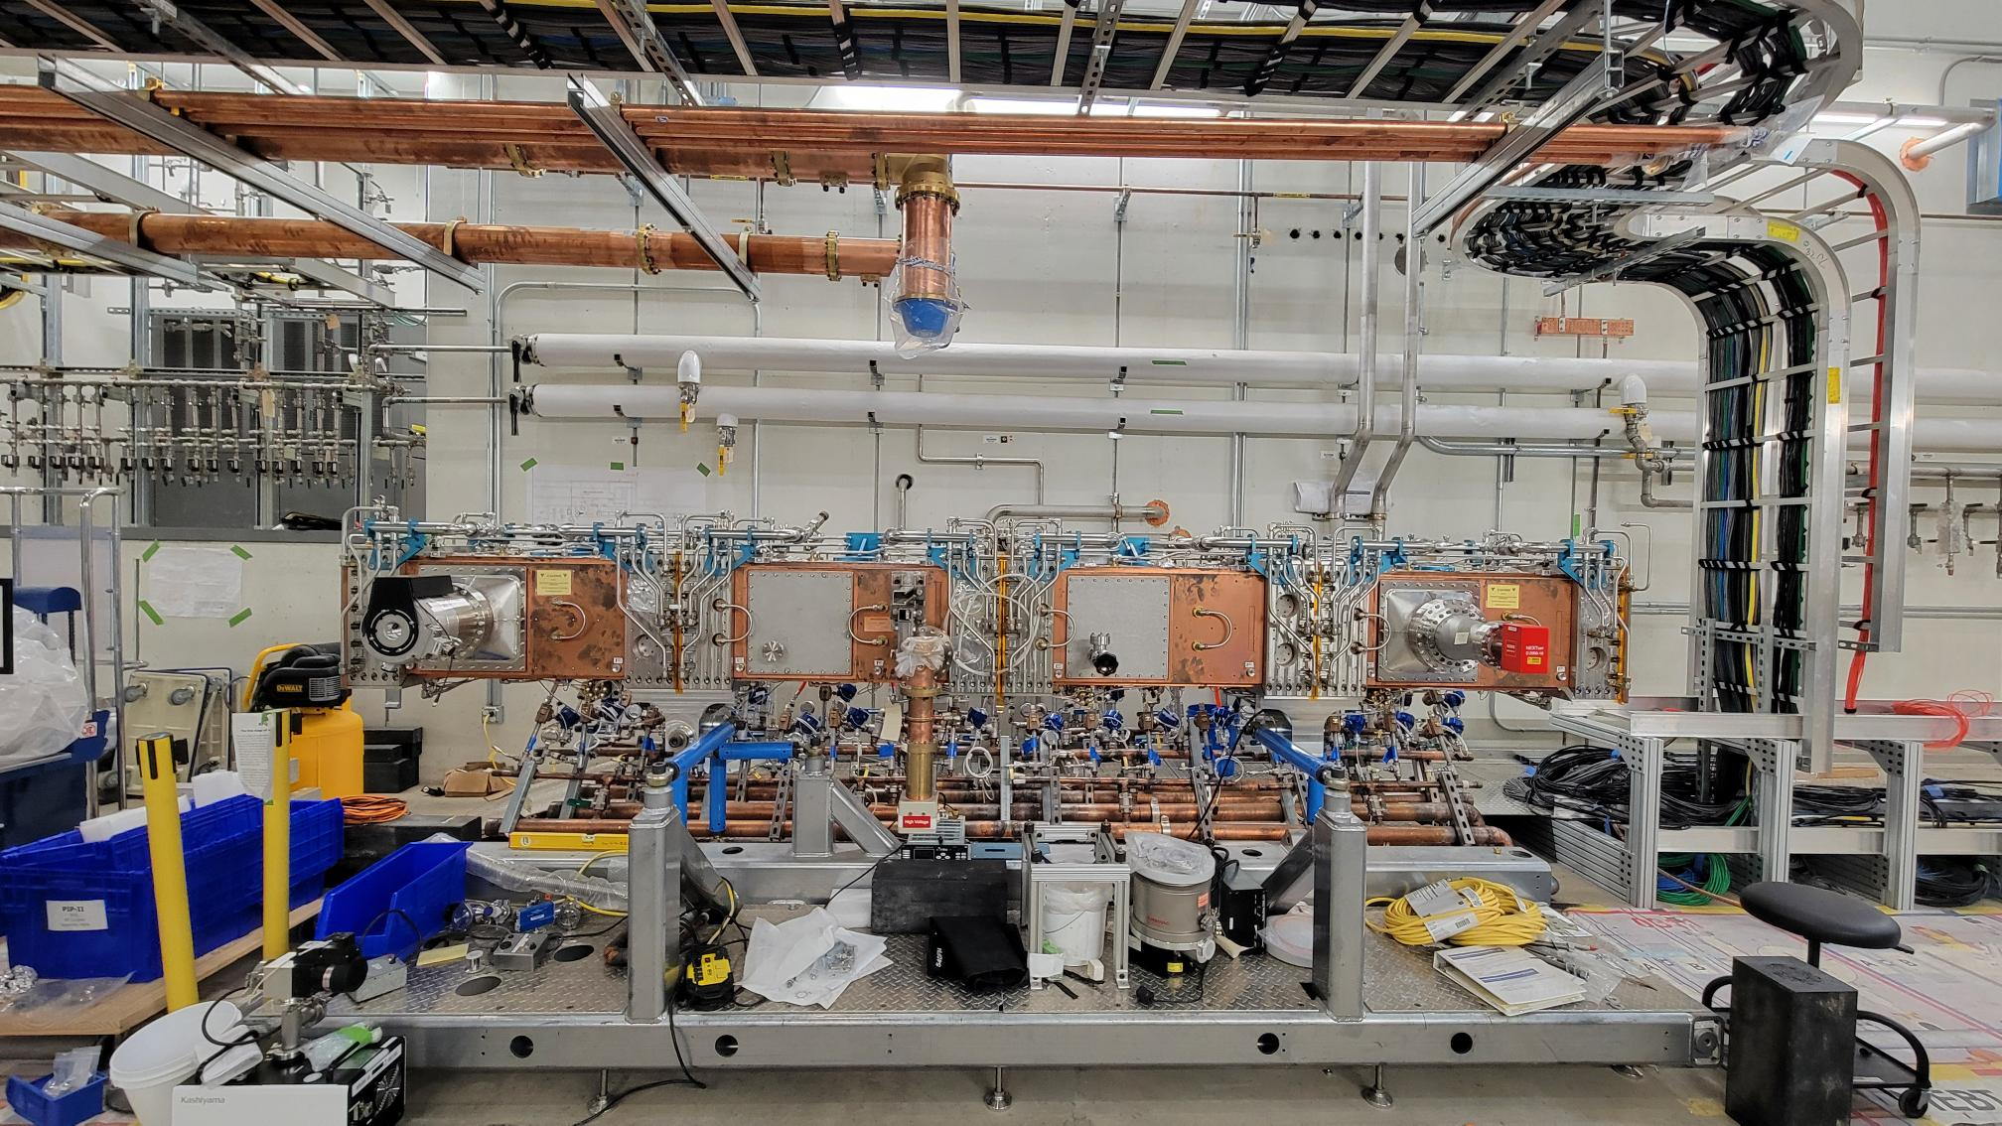
Diaporama

Slide 32
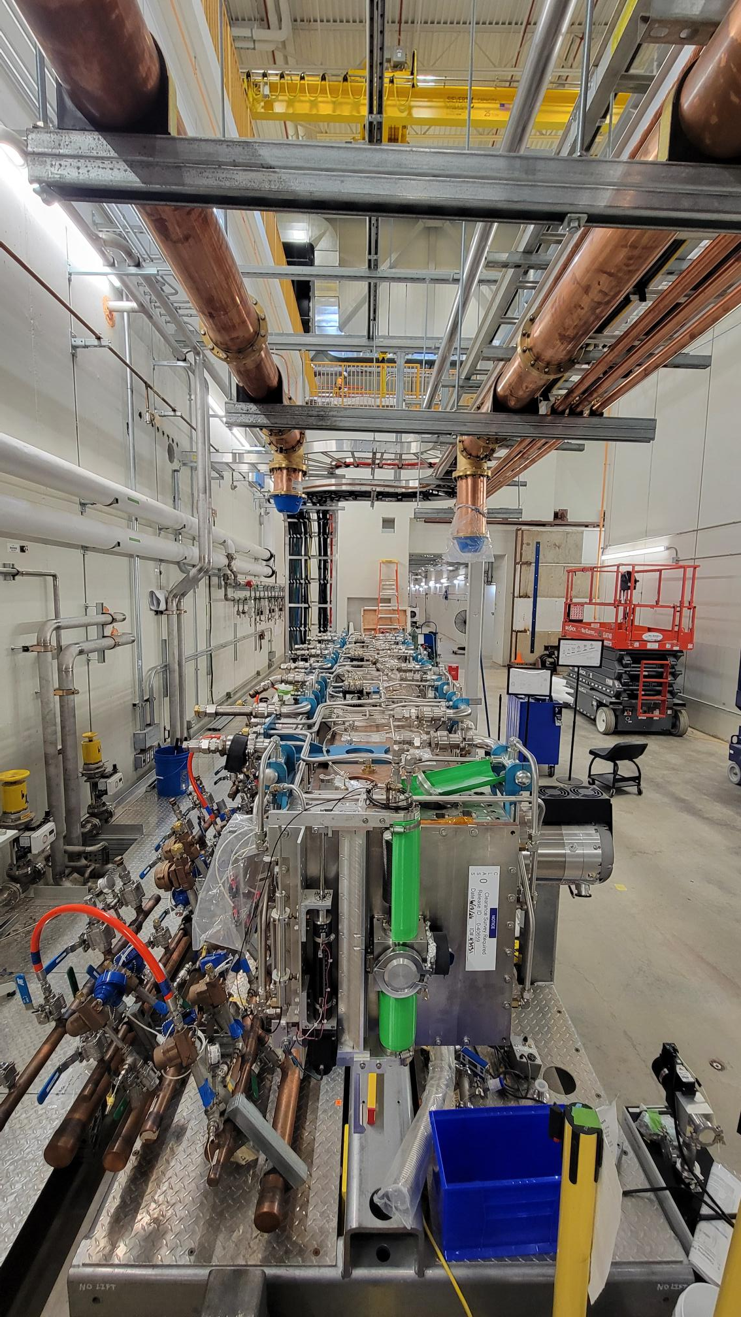
Outlook
Warm Front End beam commissioning starts in 1 year from now

Slide 33
Acknowledgement
This manuscript has been authored by Fermi Forward Discovery Group, LLC under Contract No. 89243024CSC000002 with the U.S. Department of Energy, Office of Science, Office of High Energy Physics
Thank you

Slide 36
Backup slides

Slide 37
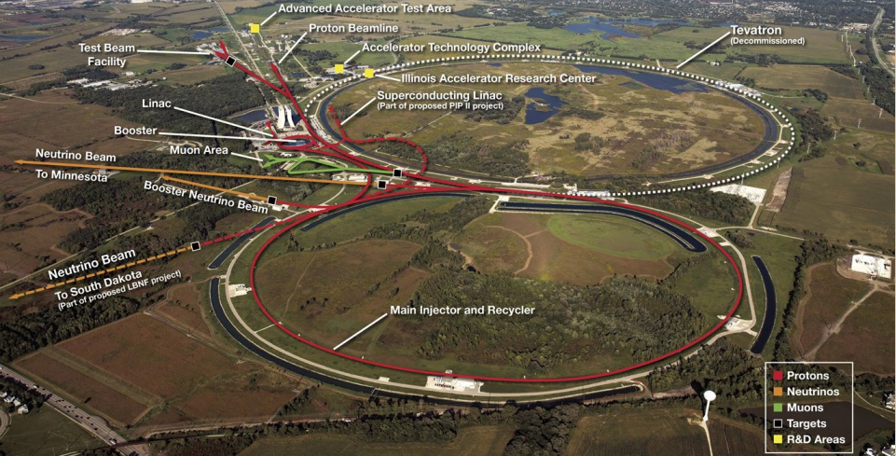
Fermilab Accelerator Complex
Arial overview

