Slide 1


H⁻ source
Developments and Operation at CERN
J.B. Lallement, G. Bellodi, S. Bertolo, F. Di Lorenzo, A. M. Lombardi, A. Mamaras, C. Mastrostefano, M. O’Neil,
E. Pasino, E. Sargsyan
21/09/2026

Slide 2
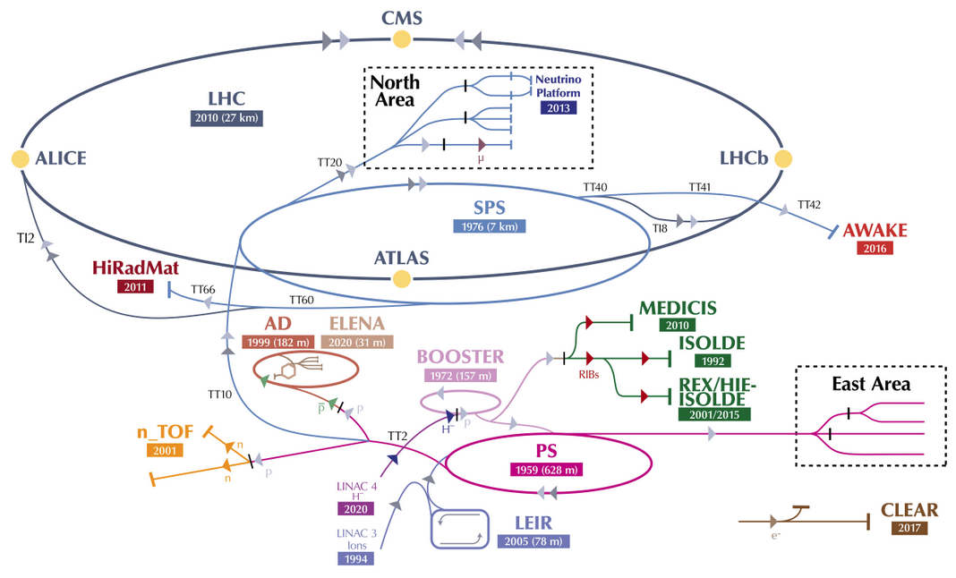
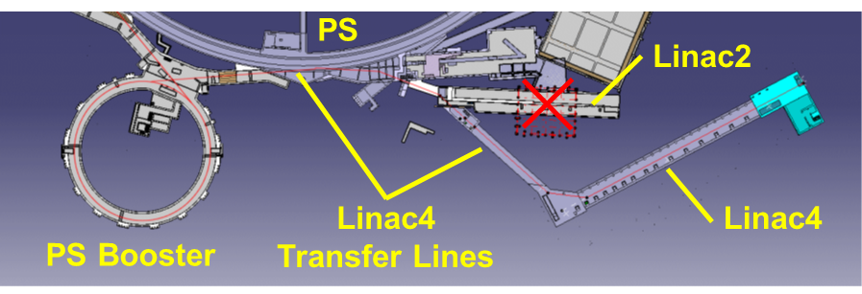
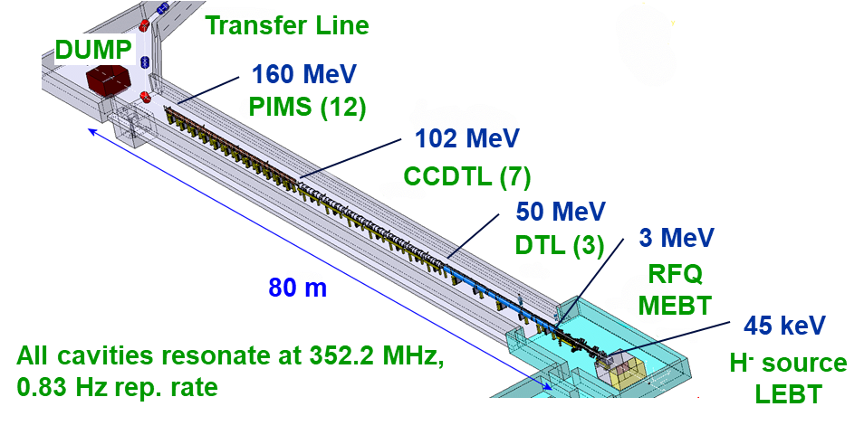
The source for the CERN proton complex
Linac became the proton complex injector in 2021.
  Source First to start – Last to stop.
  24/7 from early Feb. to Dec.

Slide 3
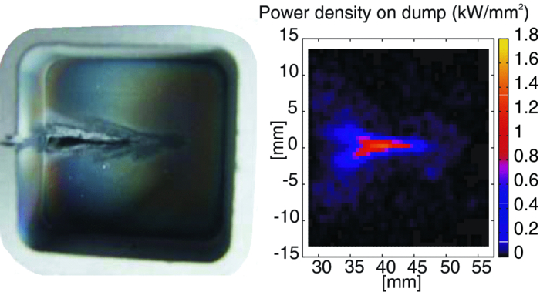
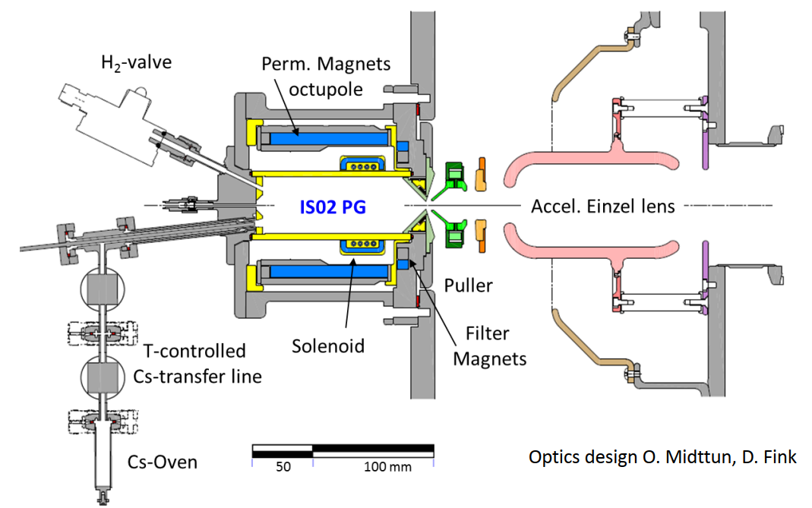
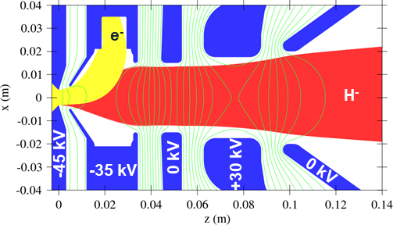
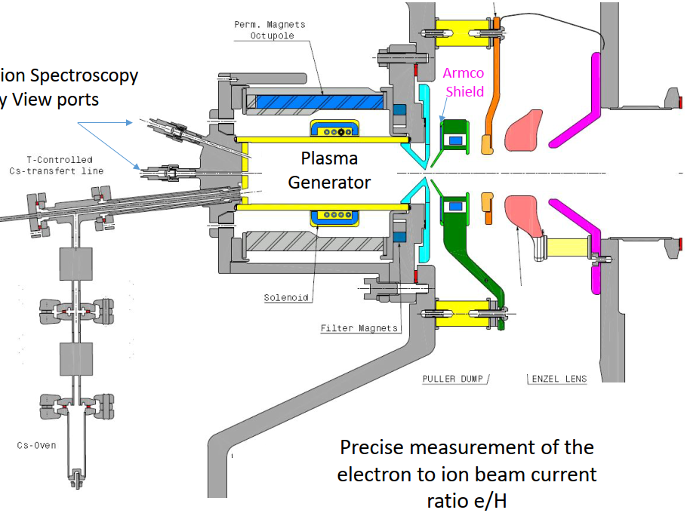
Short Recap. Since 2008
2008-2010: RFQ input set from 95 keV to 45 keV
  DESY (35 kV) adapted to 45 kV.
2010-2015
  IS02: Dumping at 10 keV.
  First cesiation late 2013.
2015-2022
  IS03: Shorter einzel lens.
2023- present
  IS04:
Damaged CERN/DEZY source dump
IS02 sketch
IS03 extraction and beam envelopes
IS03 sketch

Slide 4
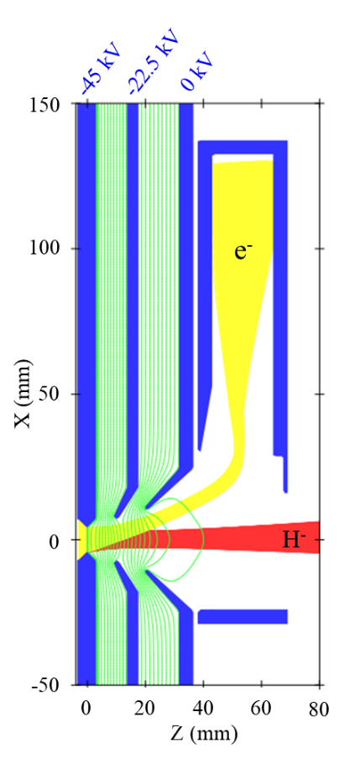
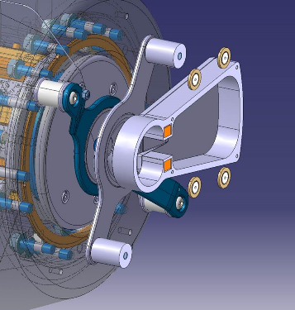
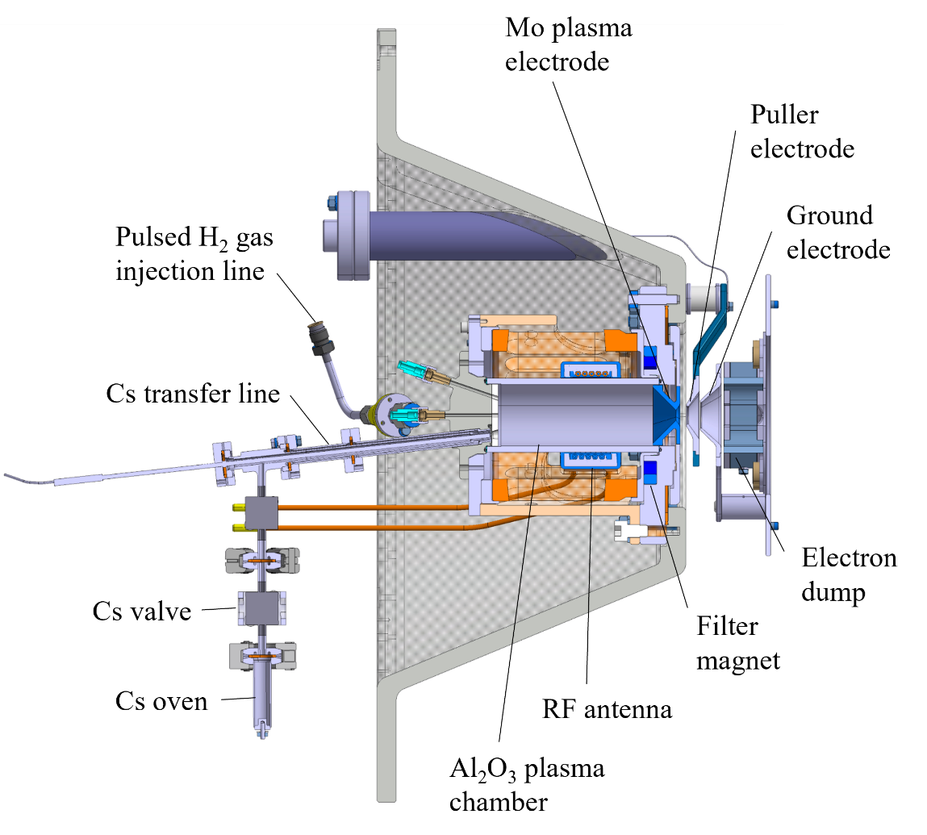
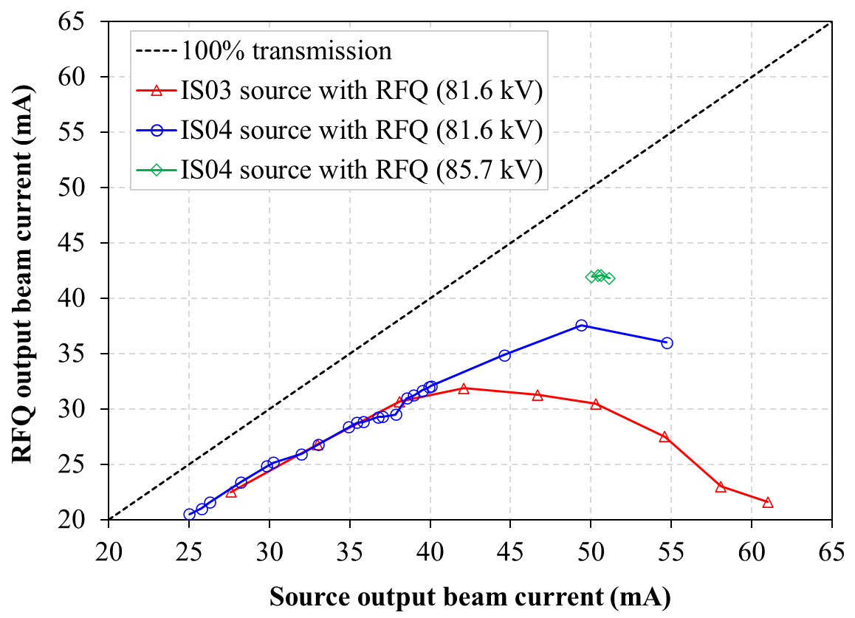
Present Design: IS04
2023 – IS04:
  No einzel anymore.
  2 electrodes: Puller and dump at 45 keV
IS04 extraction and beam envelopes

Slide 5
Main Parameters
Linac4 Source IS04 parameters
Rep. rate | 0.83 Hz
RF power | 2 MHz - ~ 1 kW / mA
Continuous cesiation | Cs reservoir - 1 g - @ 60˚C
Measured Cs consumption | 80 – 100 mg / year
Gas injection | Pulsed
H- current | 40 mA
H- current out of the RFQ | > 32 mA
Pulse length | 850 μs
e/H ratio | From 0.5 to 1
Lifetime | > 1 year
Pulse to pulse stability | < 1 % RMS
Availability | > 99%
Downtime / 10 months | ~ 1 day total

Slide 6
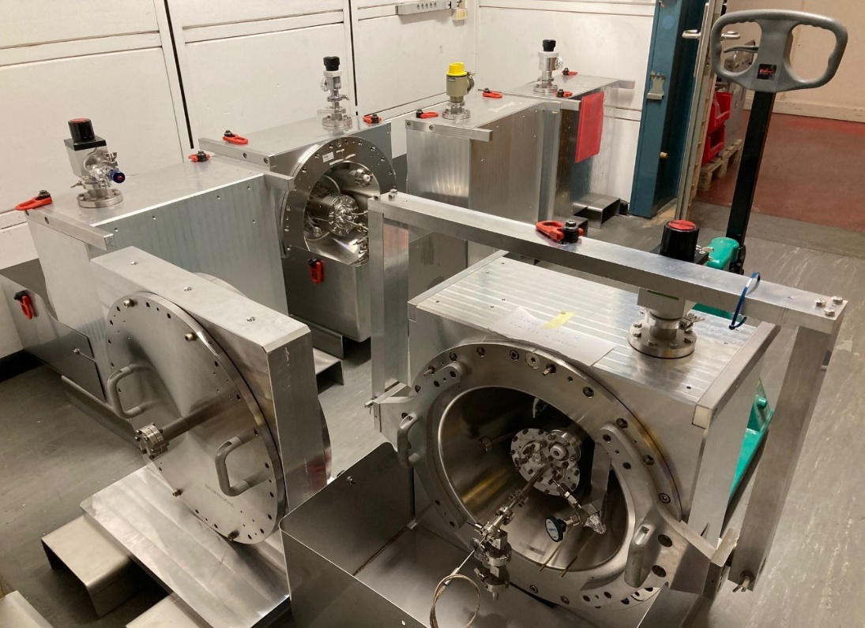
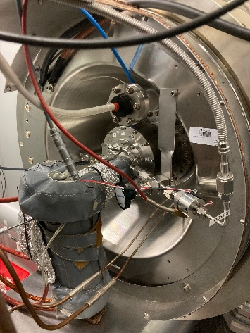
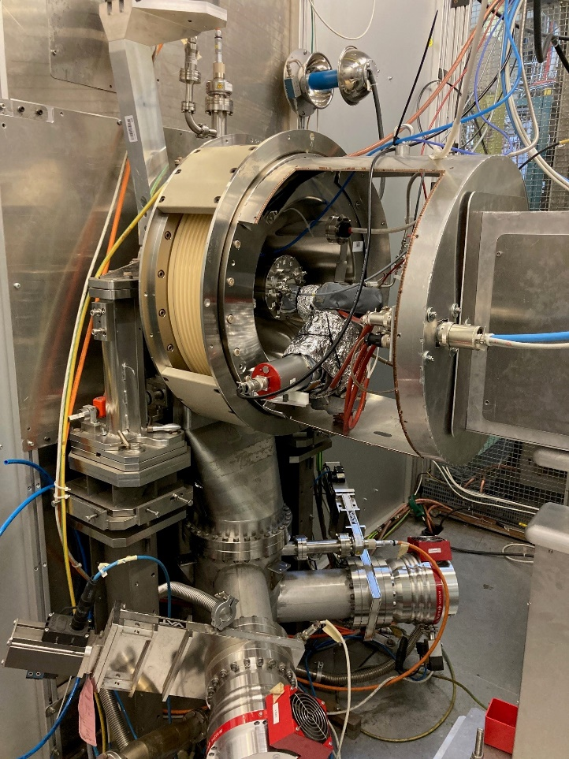
Source units management
A new source unit is installed every year in January – early February.
  We exceptionally ran the same unit from Jan. 2025 to Sep. 2026.
The unit from the previous year is cleaned:
  The plasma chamber is sand blasted / electrodes are cleaned.
  A new Cs reservoir filled with 1 g of cesium is installed.
  The gas injection valve is replaced.
  The source is tested and qualified at the test stand and becomes an “official” spare.
In total 4 x IS04 sources:
    1 operational unit: In the Linac4.
    2 spare units stored under N2.
    1 unit at the source test stand.
2 weeks booked in CERN schedule for source start-up:
    Usually, < 1 week to reach nominal performances.
    1 week for contingency (leak, services, etc…).
    More details on next slide.

Slide 7
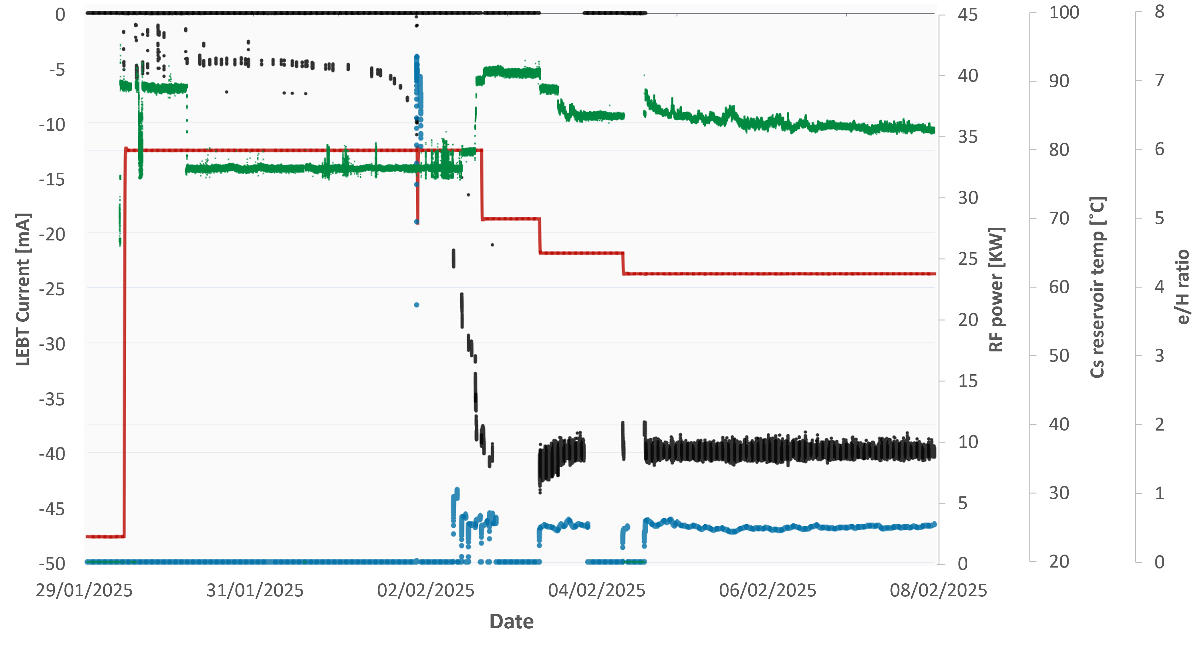
Installation and Start-up
After at least one day under vacuum.
RF power and gas for plasma conditioning.
  Cs reservoir set to 80˚C (upper interlock limit).
  Periodical checks of H⁻ and e⁻ currents switching on HV.
After few days (3-6):
  e/H ratio < 1.
  H- current around 1 mA / kW.
Setting-up for operation
  HV kept on…
  Cs reservoir down to ~ 60˚C.
  Gas and RF phase fine tunned.
  Feedback system turned on at 40 mA.
- LEBT BCT current
- 2 MHz RF power
- e/H ratio
- Cs reservoir temp

Slide 8
Source operation
The team: All in the Hadron Sources and Linac section - HSL
  5 “source specialists” on-call rotating on a weekly basis.
  Support from 4 technicians and technical engineers (mechanics, electronics, control).
  Team far from being 100% L4 source: Linac3, Linac4, L4 test-stand, ELENA, Linac4, medical and societal activities…
Regulation - mainly 2 knobs:
  Feedback on the extracted source current, measured after the first LEBT solenoid – Set to 40 mA – “Autopilot”
  The amount of injected gas – gas pulse width – is adjusted by the specialist:
    Too much gas: higher e/H, impact on the RFQ transmission (pulse shape), risk of HV sparks.
    Not enough: Plasma instabilities, large pulse to pulse current variation.
Main observables:
    Source current.
    Pulse to pulse current stability.
    Vacuum / Gas level and stability e/H ratio.
    https://linac-survey.web.cern.ch/linac4/linac4surv.html

Slide 9
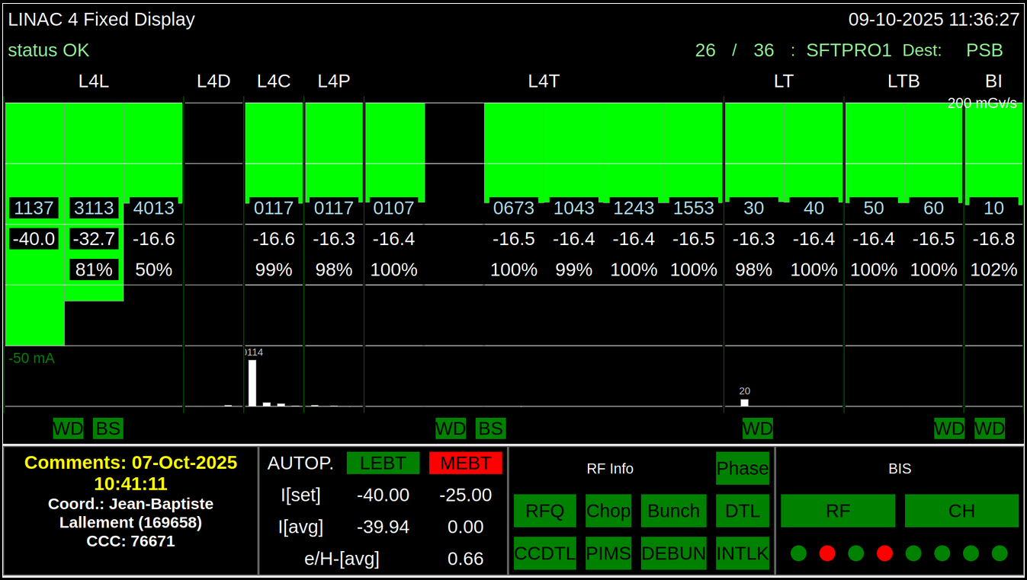
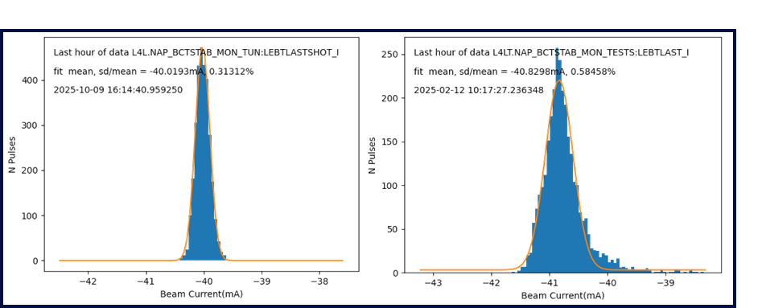
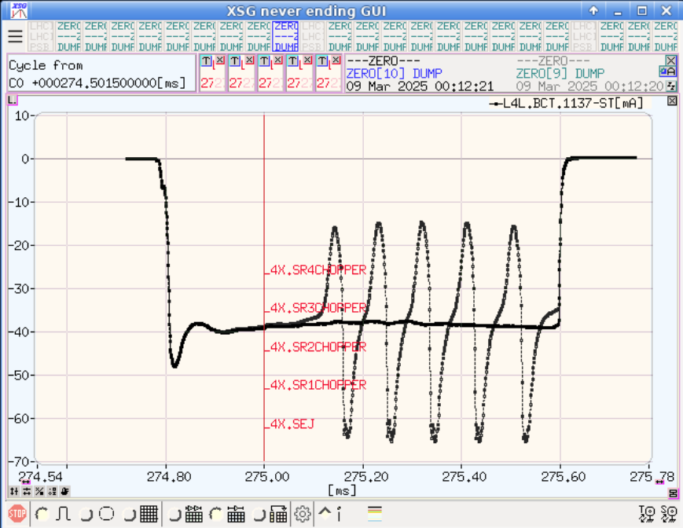
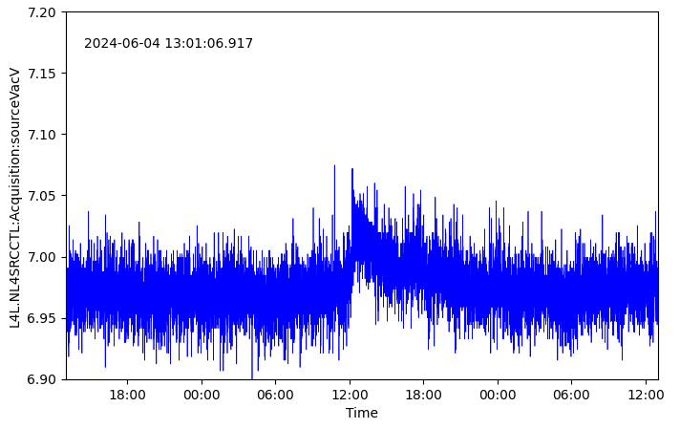
What to look at ?
Main observables:
    Source current and pulse shape.
    Pulse to pulse current stability.
    Vacuum / Gas level and stability.
    e/H ratio.
    https://linac-survey.web.cern.ch/linac4/linac4surv.html [LS3 ;-( ]
“Event” on the source pressure
Source output current distribution over 1 hour.
Left: everything is fine
Right: large distribution and tail
Overlap of two source beam pulses.
Stable and unstable plasma.

Slide 10
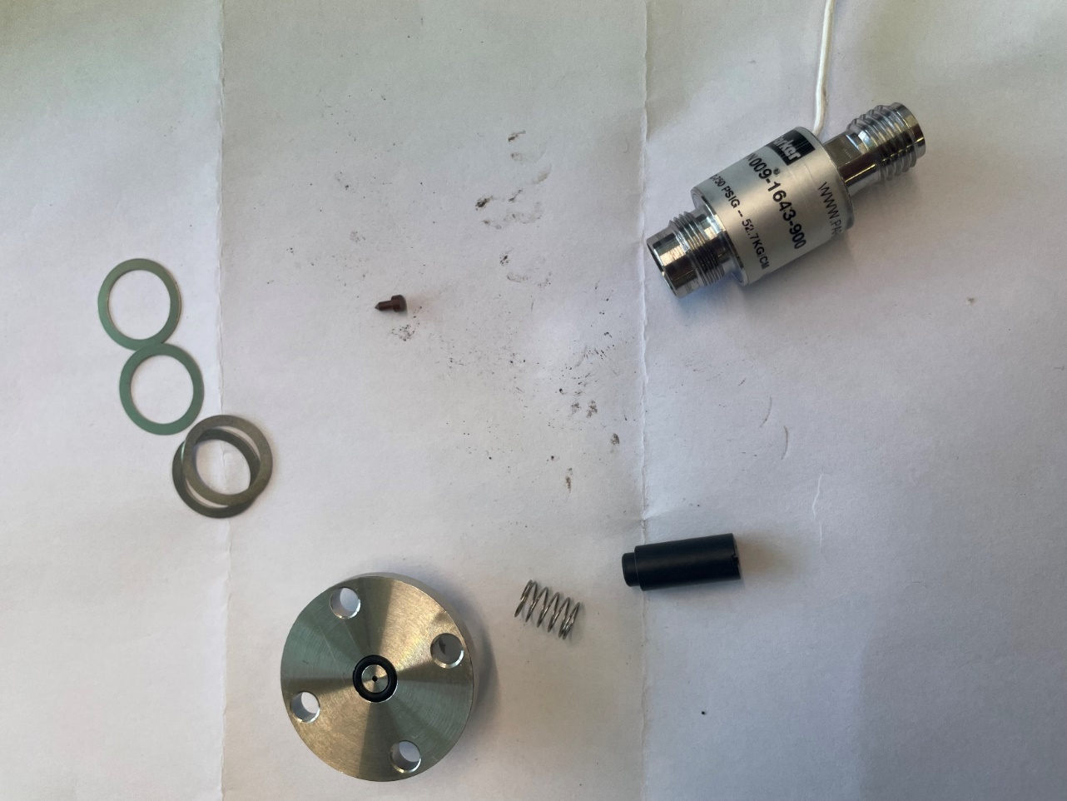
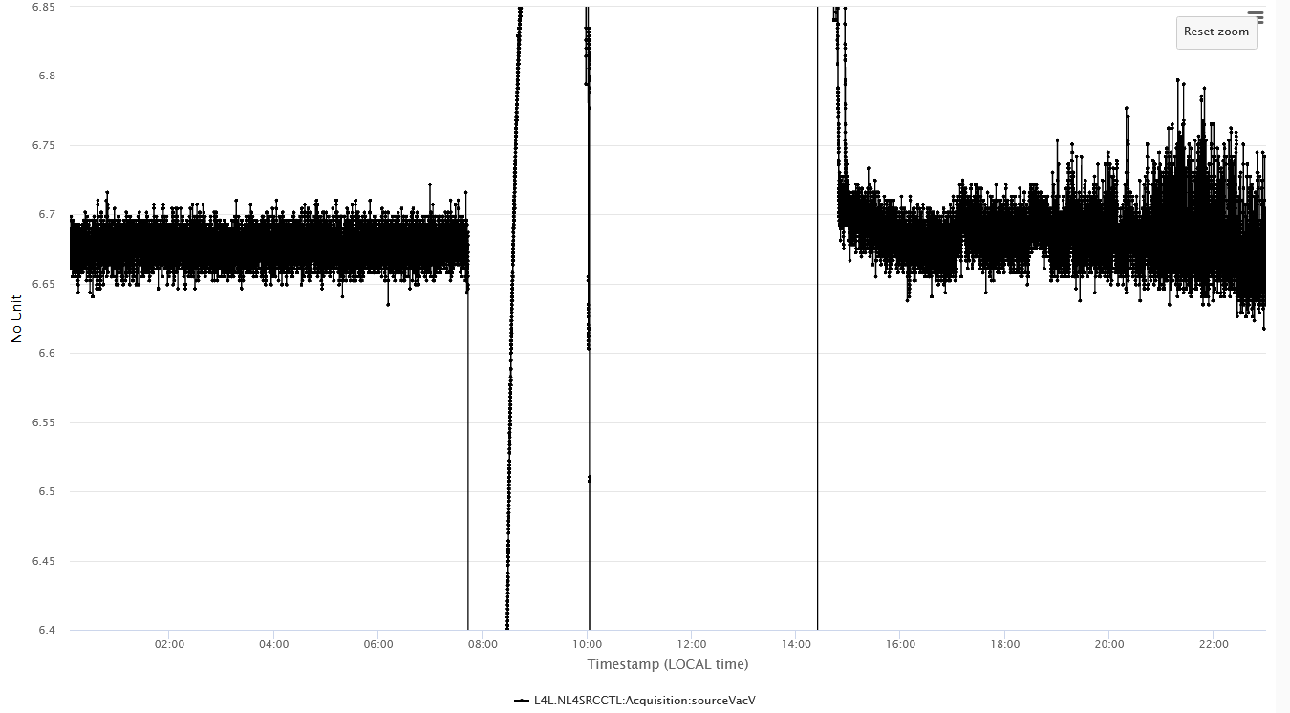
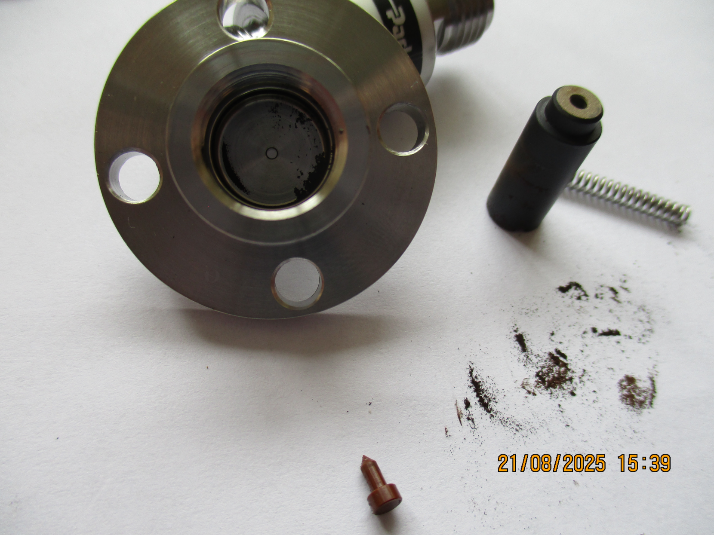
Reliability and Availability
Source yearly availability |  | Downtime
2022 (IS03) | 97.5% | 167 h
2023 (IS04) | 99.9% | 6 h
2024 | 99.6% | 27 h
2025 | 99.7% | 23 h
2026 | 99.99% | 0.5 h
Over 9 to 10 months of 24/7 operation:
  1-day technical stop when “almost” nothing done.
  No HV spark since switched to IS04 design.
  Most of the downtime / instabilities due to source gas injection.
    Too much / too less gas.
    Aging injection valve to be replaced – lifetime ~ 6 months (13 million pulses !).
    A shut-off valve was installed in 2023.
3 cm
Needle

Slide 11
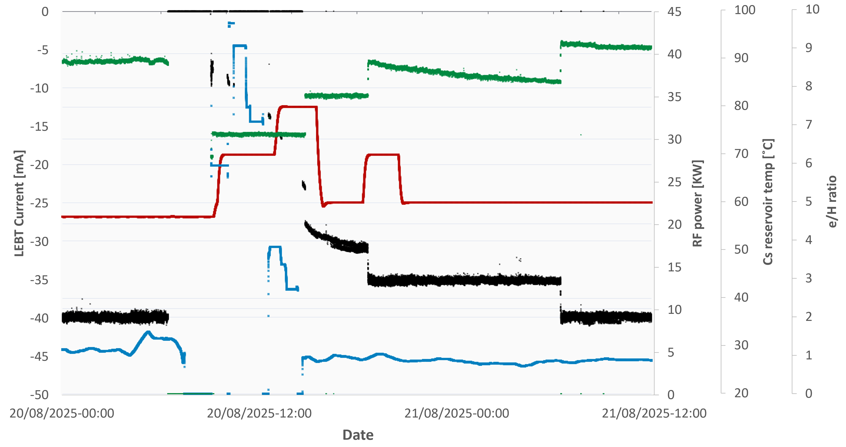
Injection Valve Replacement
Example: Last replacement during a run – August 2025.
  Intervention – 2 hours.
  Restart and cesiation – 9 hours.
  35 mA beam back to PSB
2 h
9 h
Overnight
- LEBT BCT current
- 2 MHz RF power
- e/H ratio
- Cs reservoir temp

Slide 12
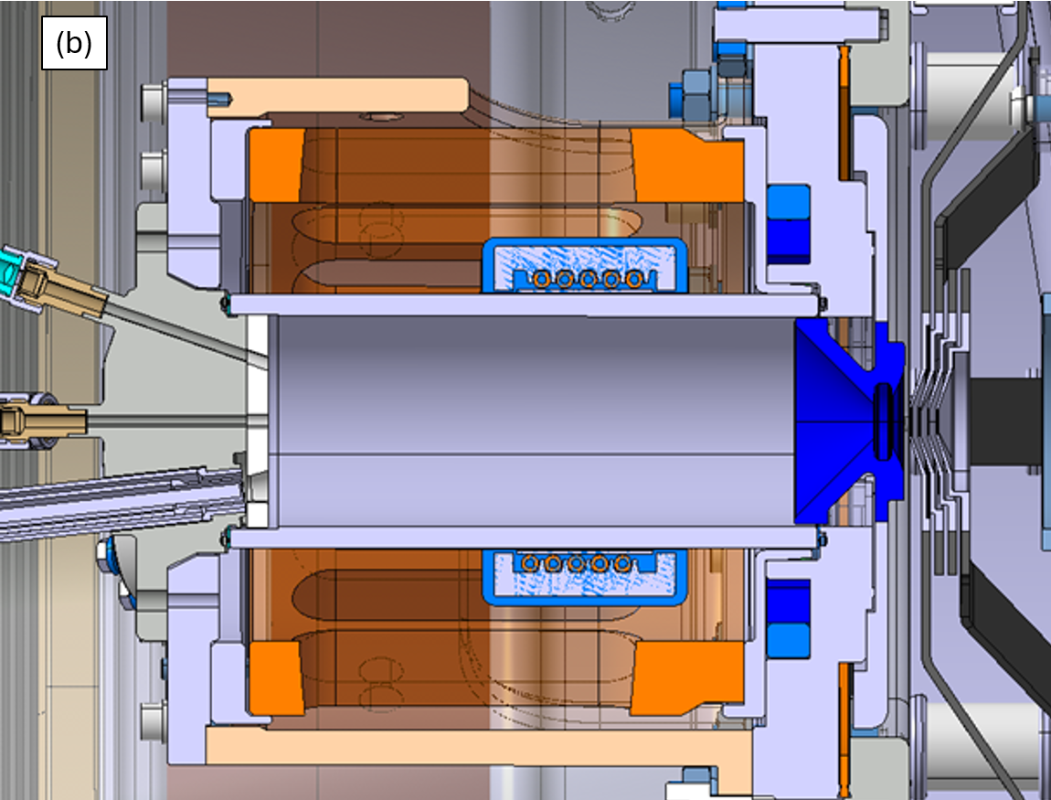
The Shorter the Extraction the Better ?
IS02
25 cm
10-20 mA @ 3 MeV
IS04
6 cm
32-42 mA @ 3 MeV
IS03
14 cm
24-30 mA @ 3 MeV
CEMS proton beam tests
2 cm
~ 50 mA expected @ 3 MeV

Slide 13
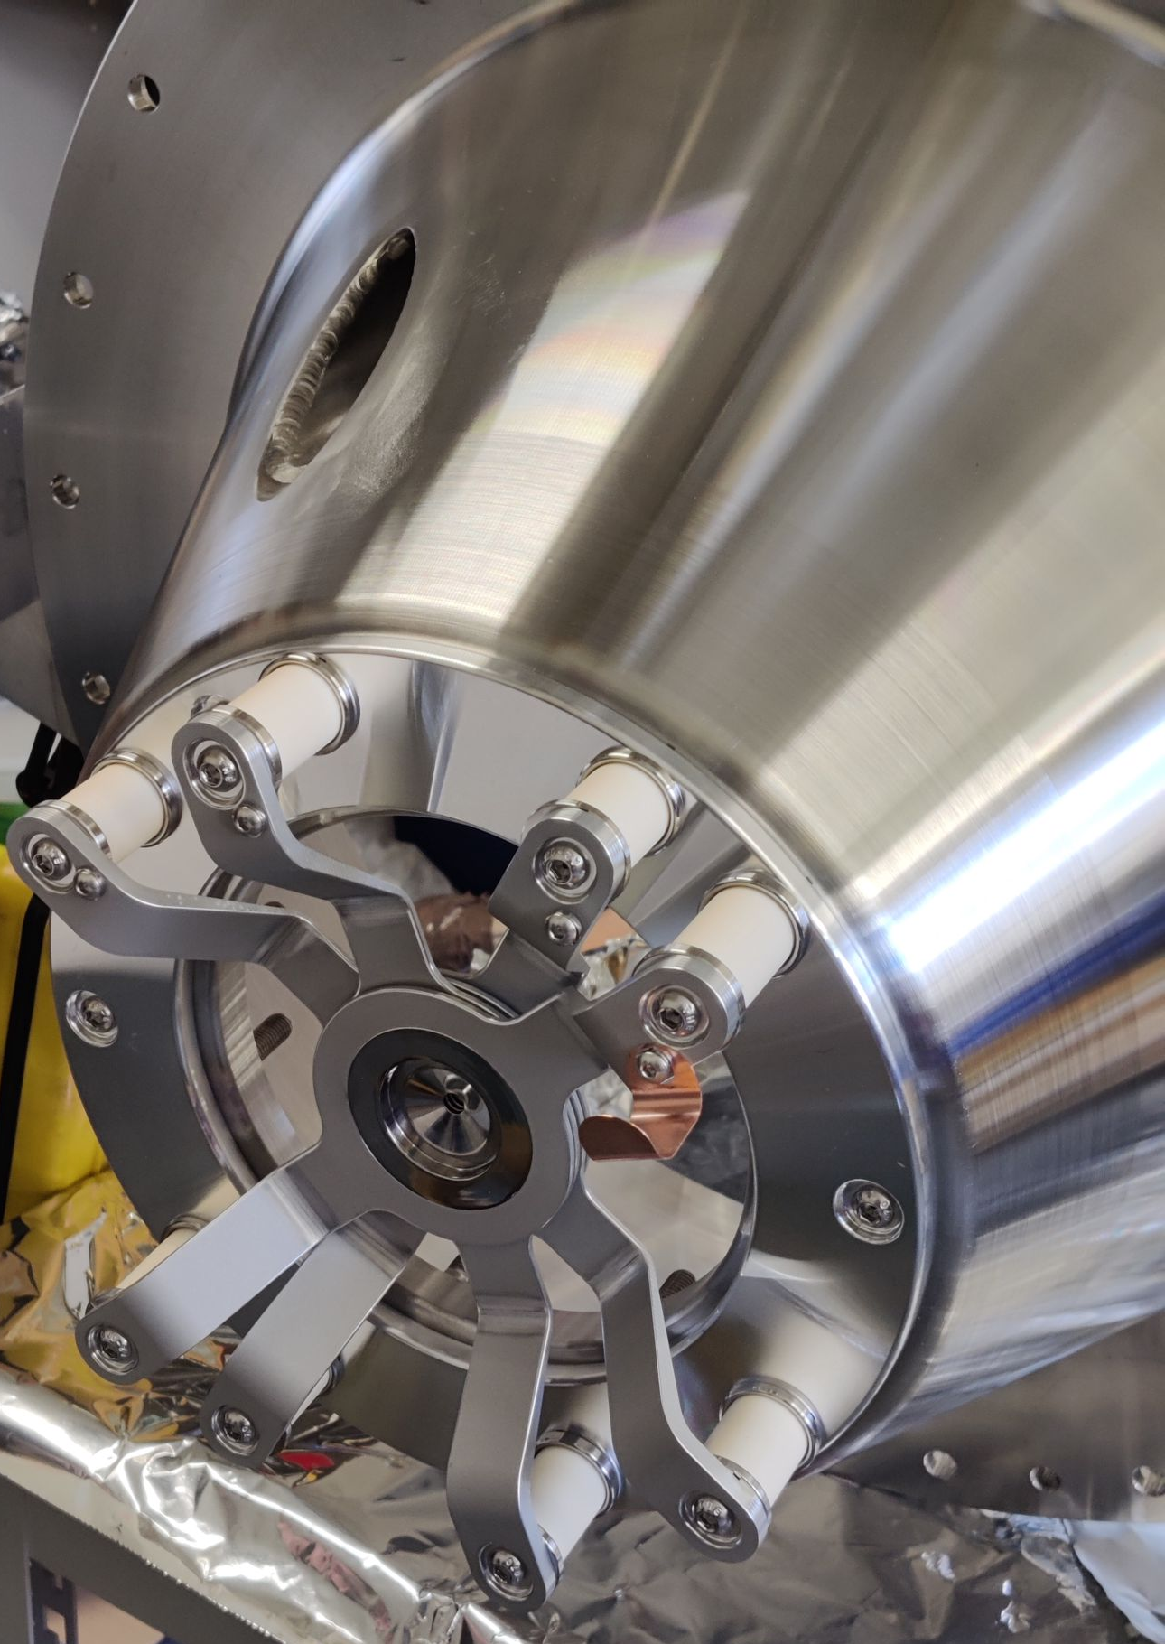
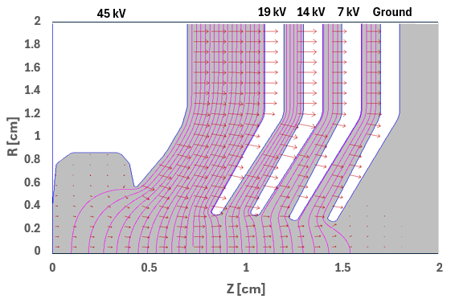
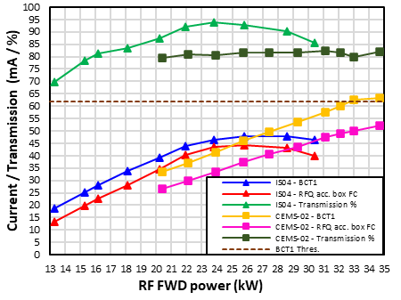
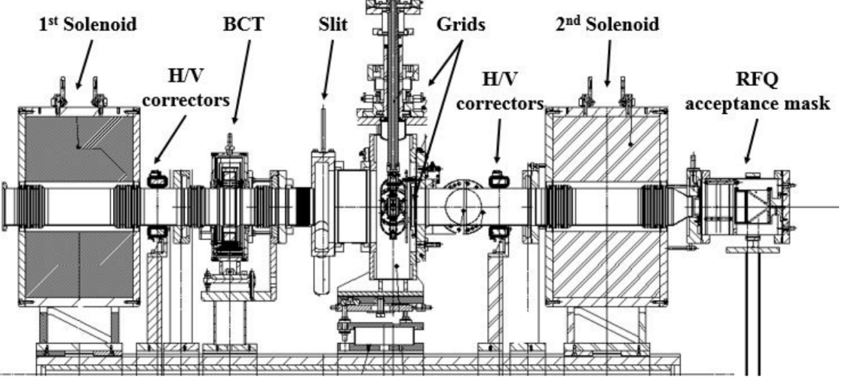
Toward IS05 ?
CEMS proton beam tests
2 cm
~ 50 mA expected @ 3 MeV

Slide 14
Toward IS05 ?

Slide 15
H⁻ source
Developments and Operation at CERN
Thank you !
Almost 20 years of development.
4 source generations.
We learned a LOT.
Now reached a level of maturity making our “clients” very happy.
Still, would like to keep development going on !

