Slide 1
Design of a Negative Oxygen Beamline Facility for Experimental Very Low Earth Orbit Simulation
Lasse Voigt, Martin Eberhart, Kim-Sophie Ellenberger, Olli Tarvainen, Roland Friedl, Ursel Fantz, Anand George, Fabian Hufgard, Marcel Pfeiffer, Stefanos Fasoulas, Stefan Loehle
High Enthalpy Flow Diagnostics Group (HEFDiG),
Institute of Space Systems (IRS), University of Stuttgart
10th International Symposium on Negative Ions, Beams and Sources - NIBS‘26

Slide 2
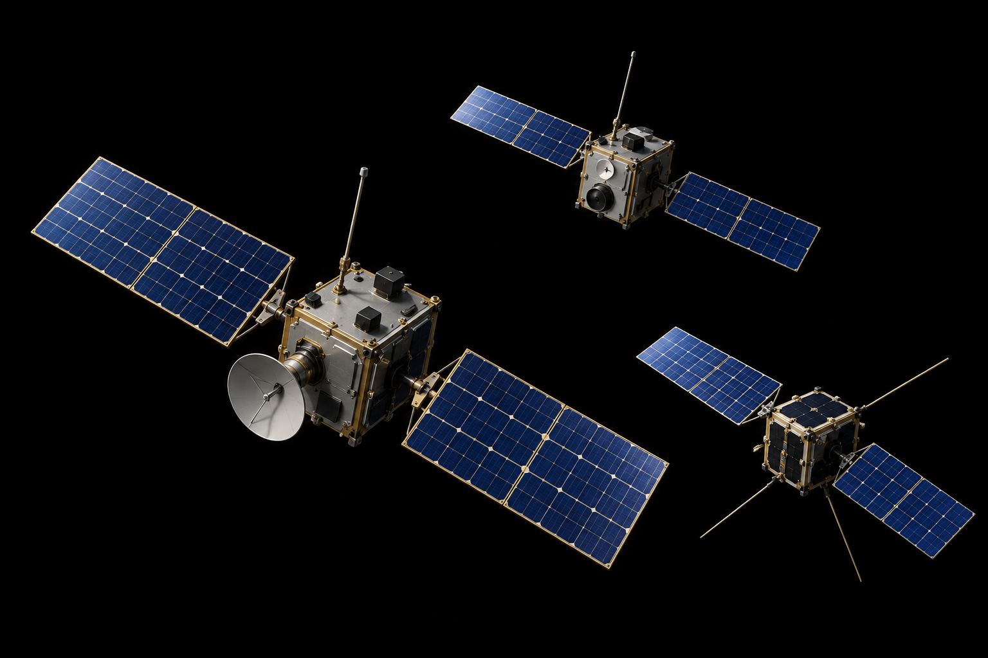
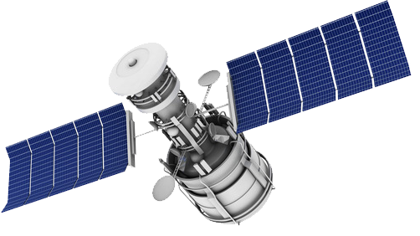
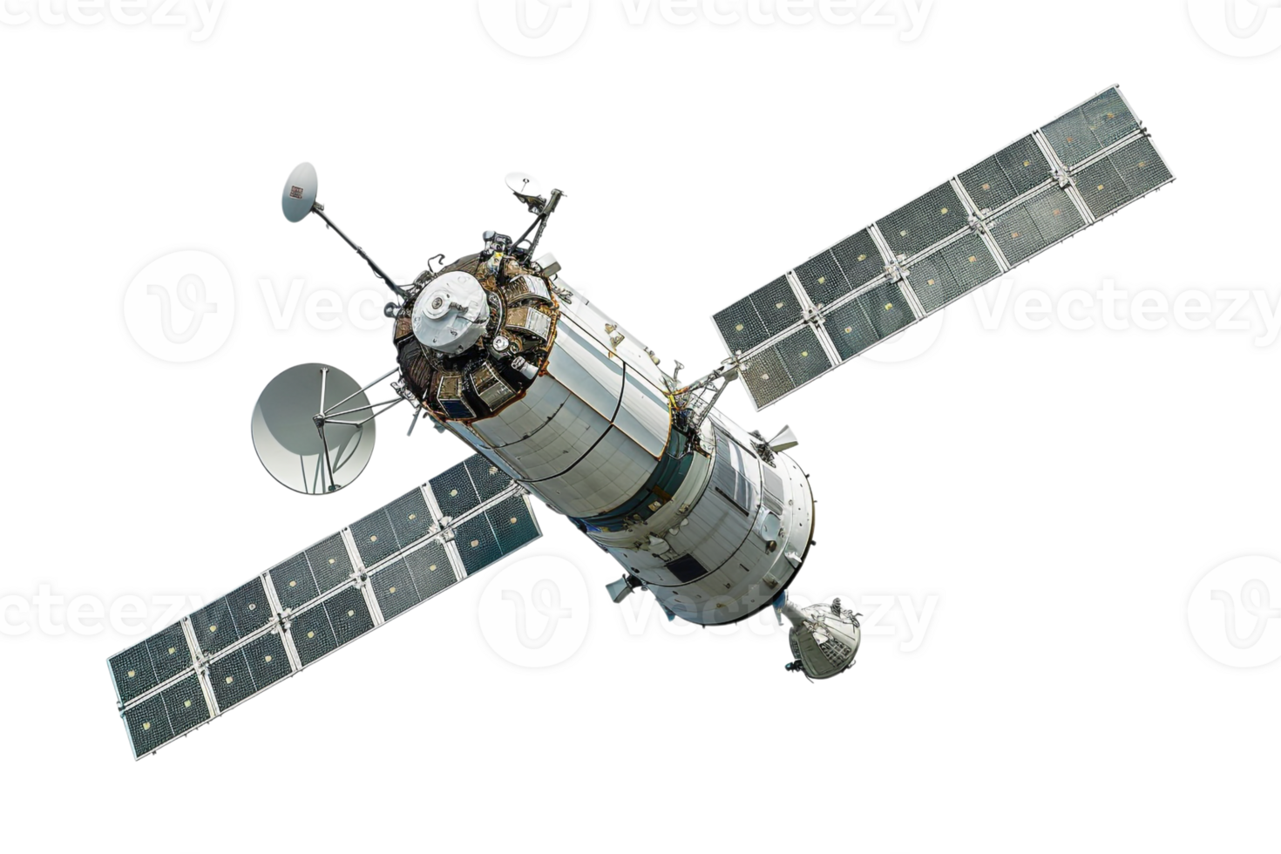
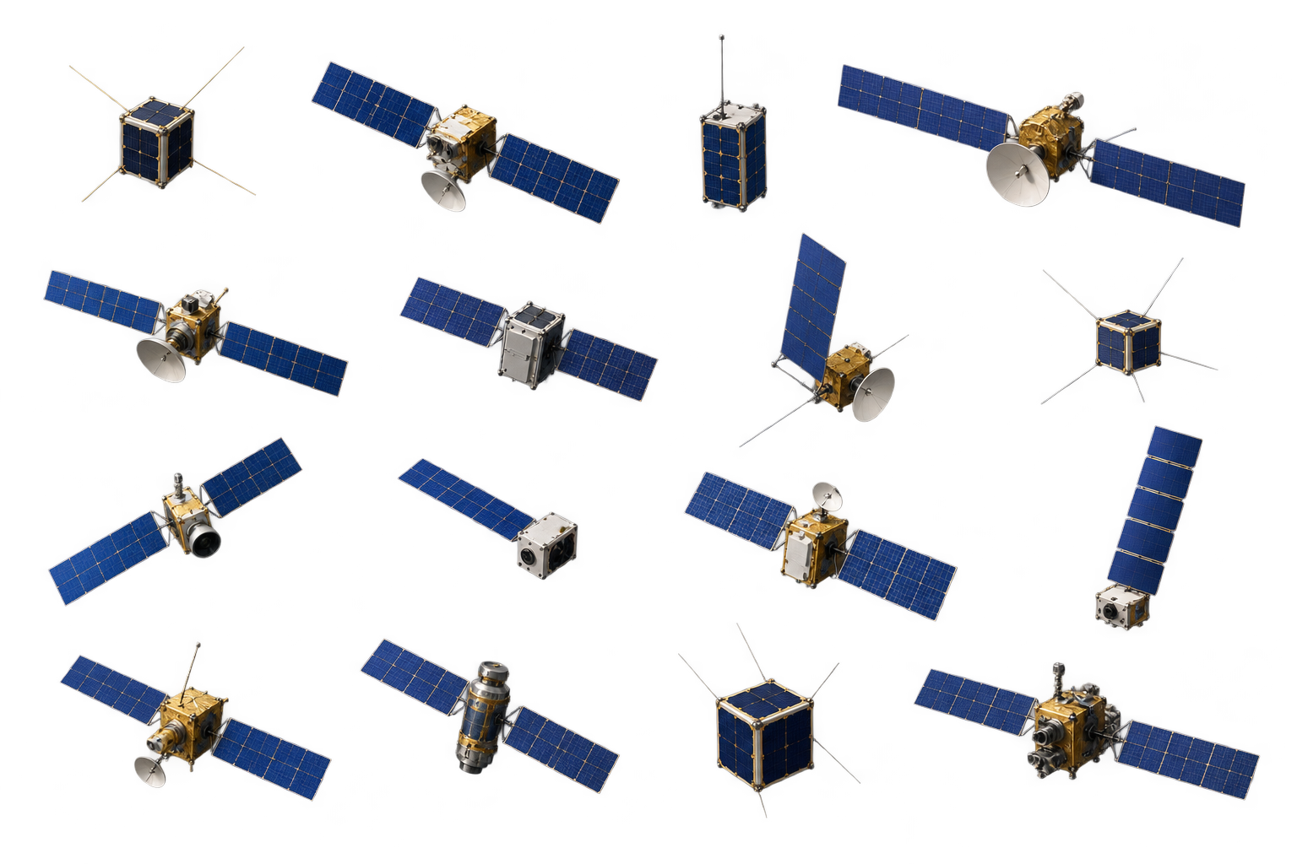

Low Earth Orbit (LEO)

Slide 3
Very Low Earth Orbit (VLEO)
2000 km
Low Earth Orbit (LEO)
450 km
Very Low Earth Orbit (VLEO)
200 km

Slide 4
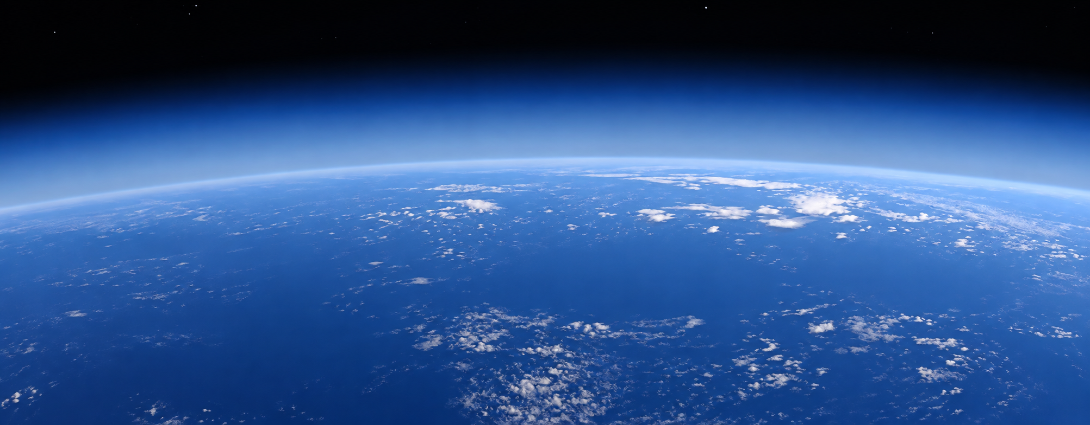
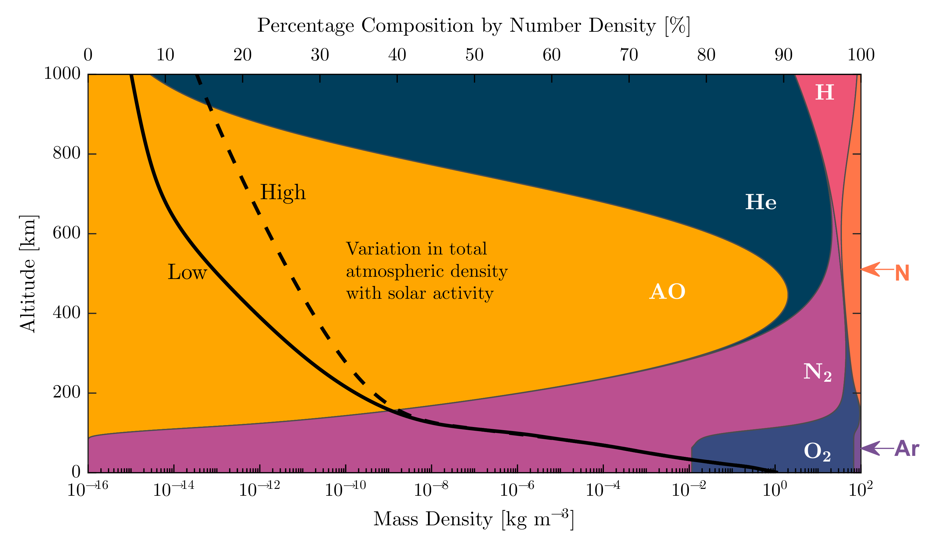



VLEO
Neutral AO
Number Density
~10⁸ 1/cm³
Kinetic Energy
~5eV
Continuous Beam
450 km
,
$$\vec{v}$$
200 km
,
VLEO
,
,
[Crisp, N. H. et al., CEAS Space J., 14, 655–674, 2022, Fig. 1]

Slide 5
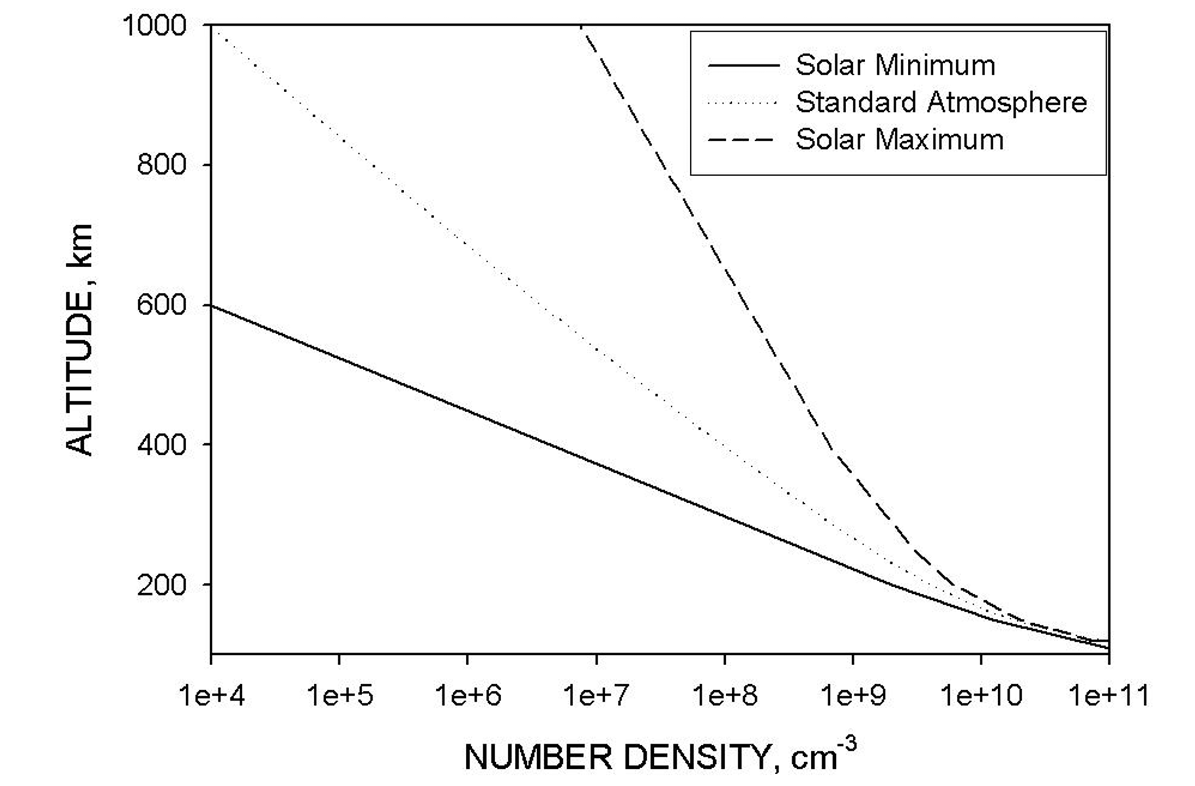
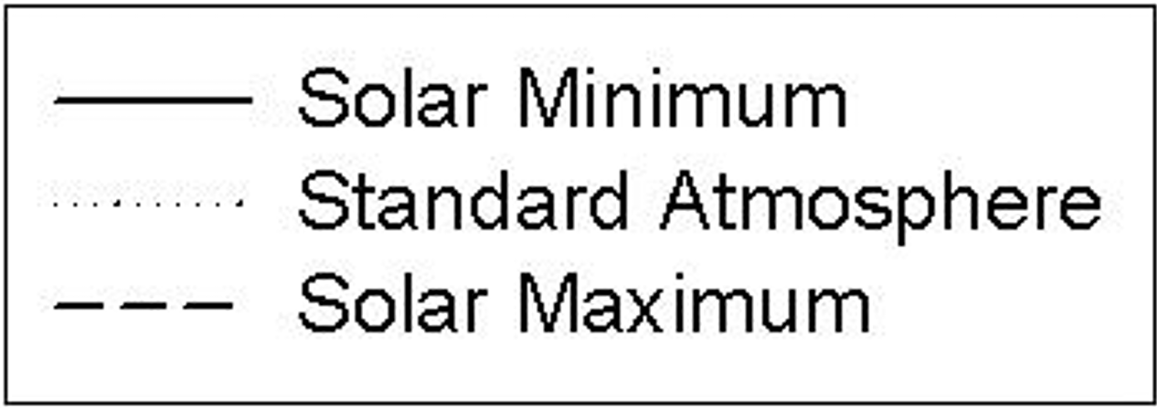
VLEO
Neutral AO
Number Density
~10⁸ 1/cm³
Kinetic Energy
~5eV
Continuous Beam
450 km
$$\vec{v}$$
200 km
VLEO
[NASA, NASA-HDBK-6024, 2014, Fig. 4]

Slide 6
VLEO-Condition
Neutral AO
Number Density
~10⁸ 1/cm³
Kinetic Energy
~5eV
Continuous Beam
Laser detonation
(T. Minton, ESA)
O⁺ acceleration
(VKI)
new concept required
Notes:
Es gibt keine Anlage, die es kann. Ionen sind eine gute Möglichkeit, weil

Slide 7
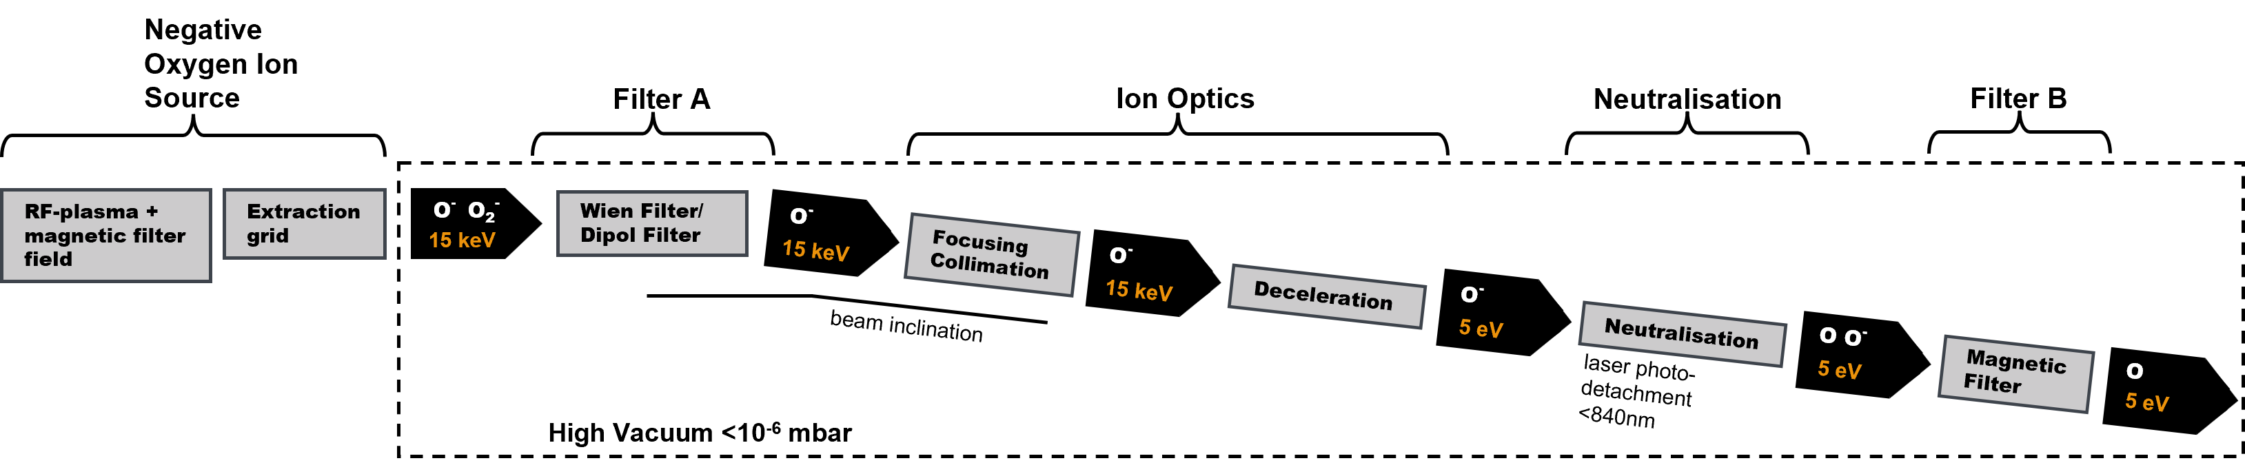
Beamline Concept

Slide 8
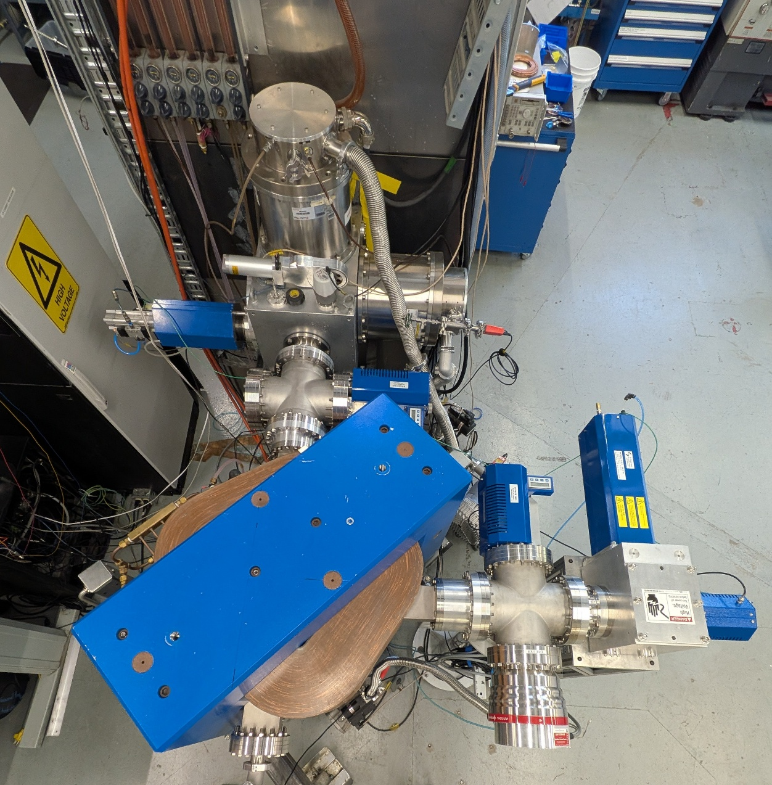
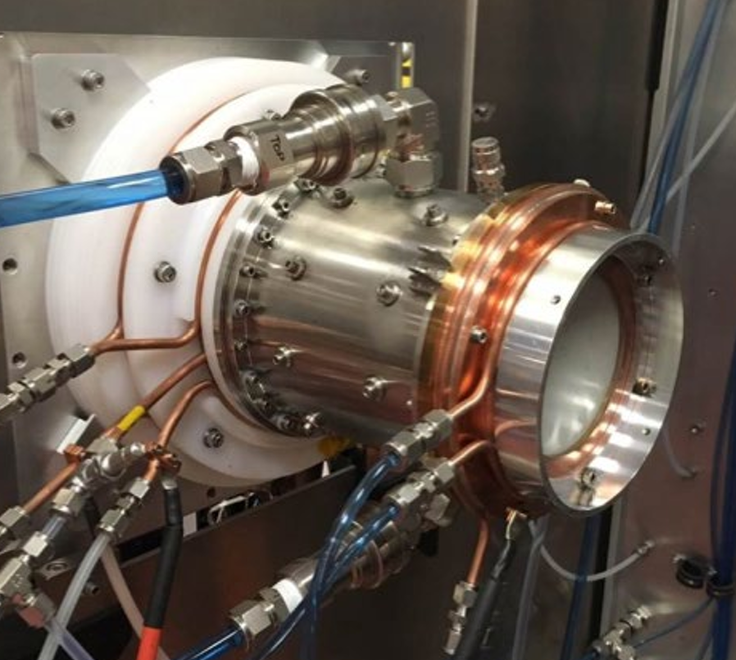

Beamline Concept
,
ISV.RF-030
,
RF Power | 750W
Beam energy | 15 keV
Gas | Oxygen
Gas Flow | 1.6 sccm
Beam current at Faraday Cup | 1.5 mA
[Images and Data by D-Pace Inc.]

Slide 9
Beamline Concept
,
A
,
z′, mrad
y′, mrad
z, mm
y, mm
[Images and Data by D-Pace Inc.]

Slide 10
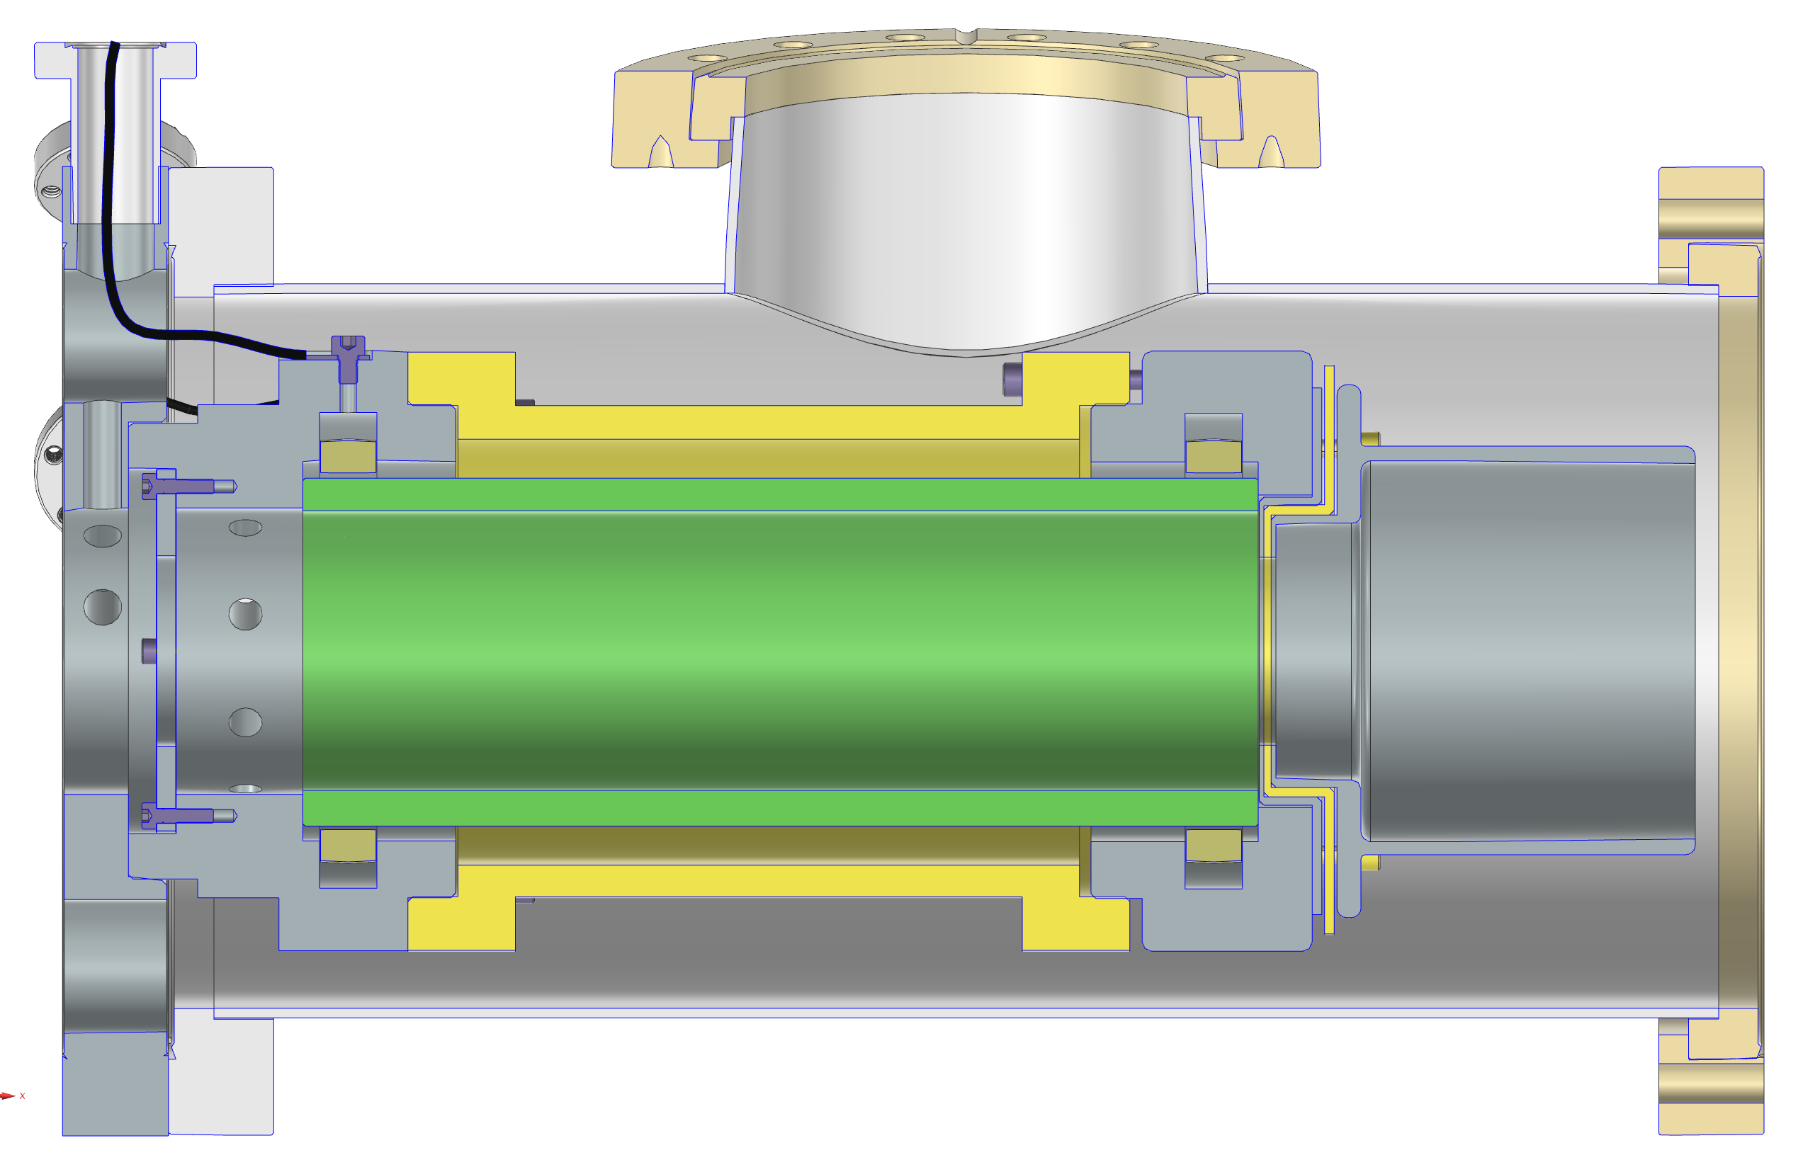
Beamline Concept
y
⌀203 mm
z
x
400 mm

Slide 11
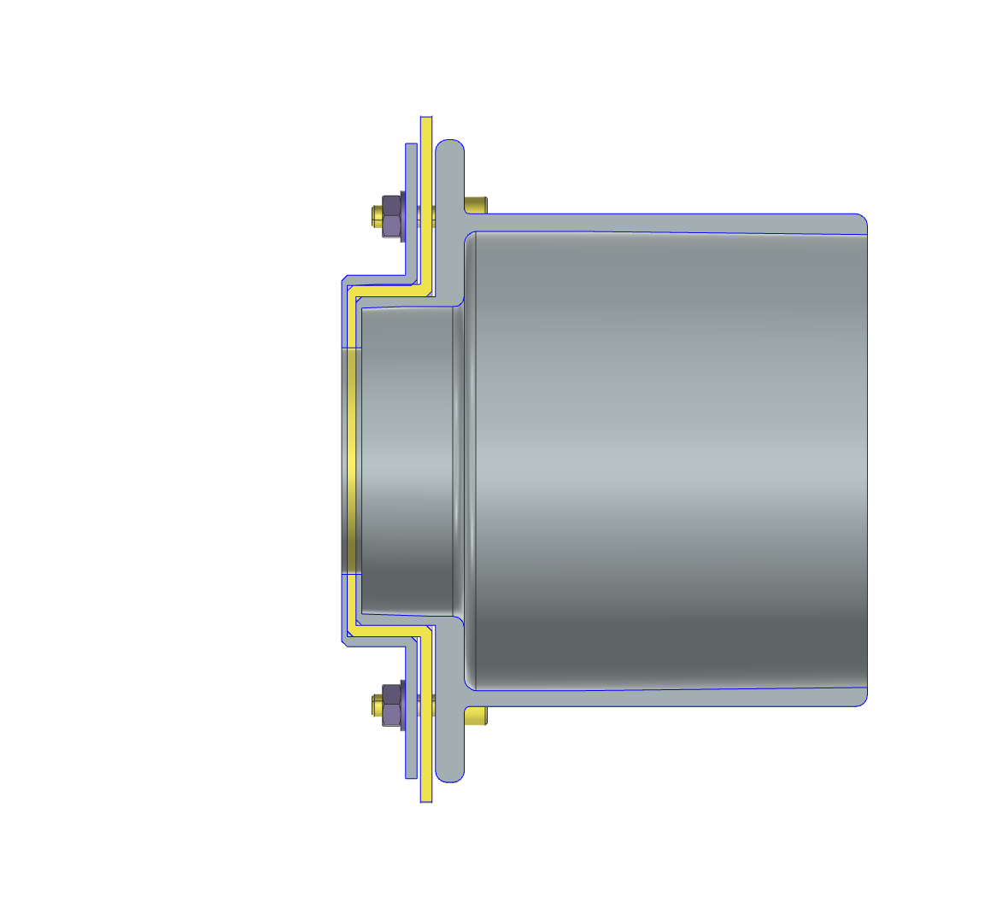


Beamline Concept

Slide 12
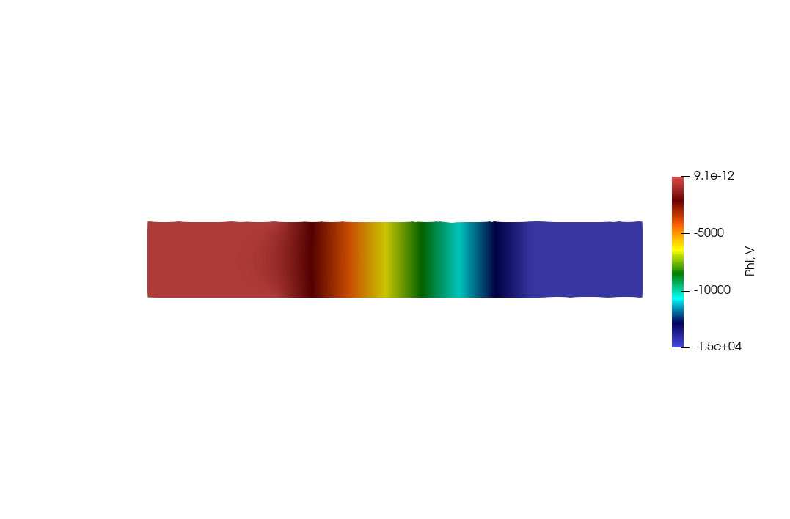
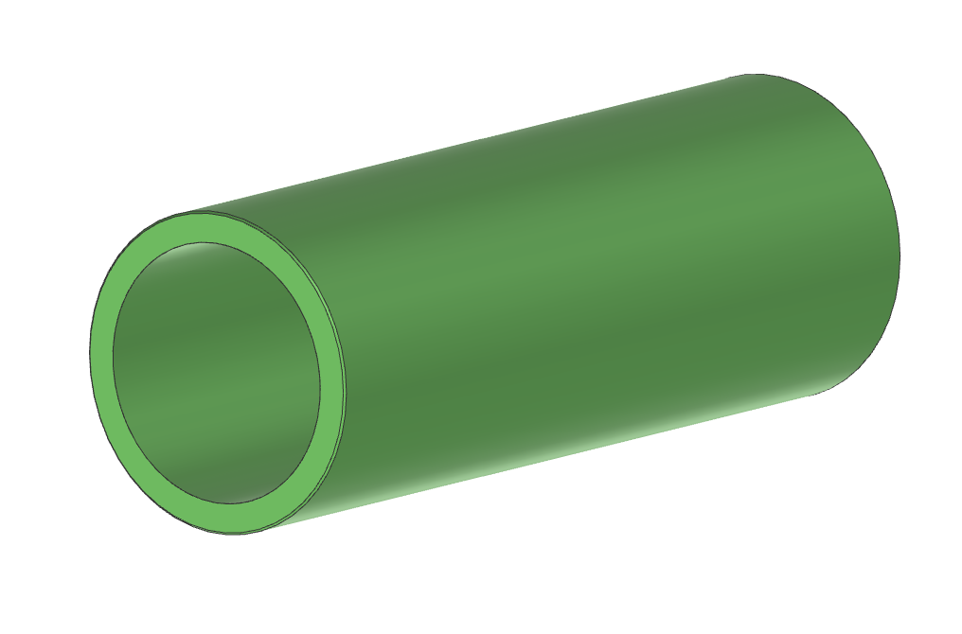
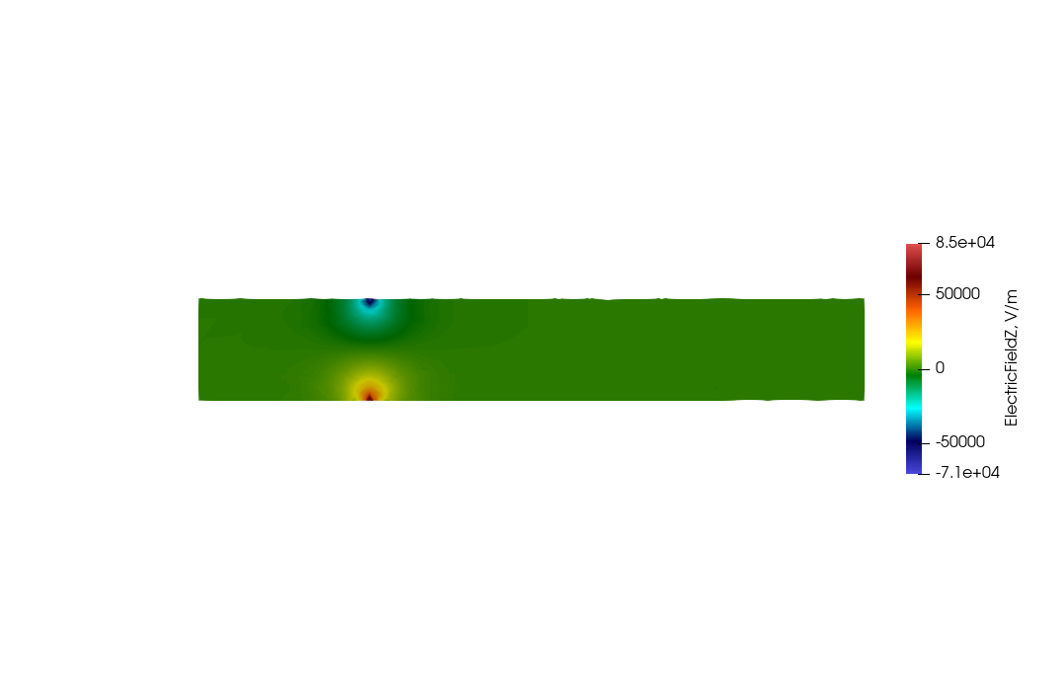
Beamline Concept

Slide 13
Beamline Concept

Slide 14
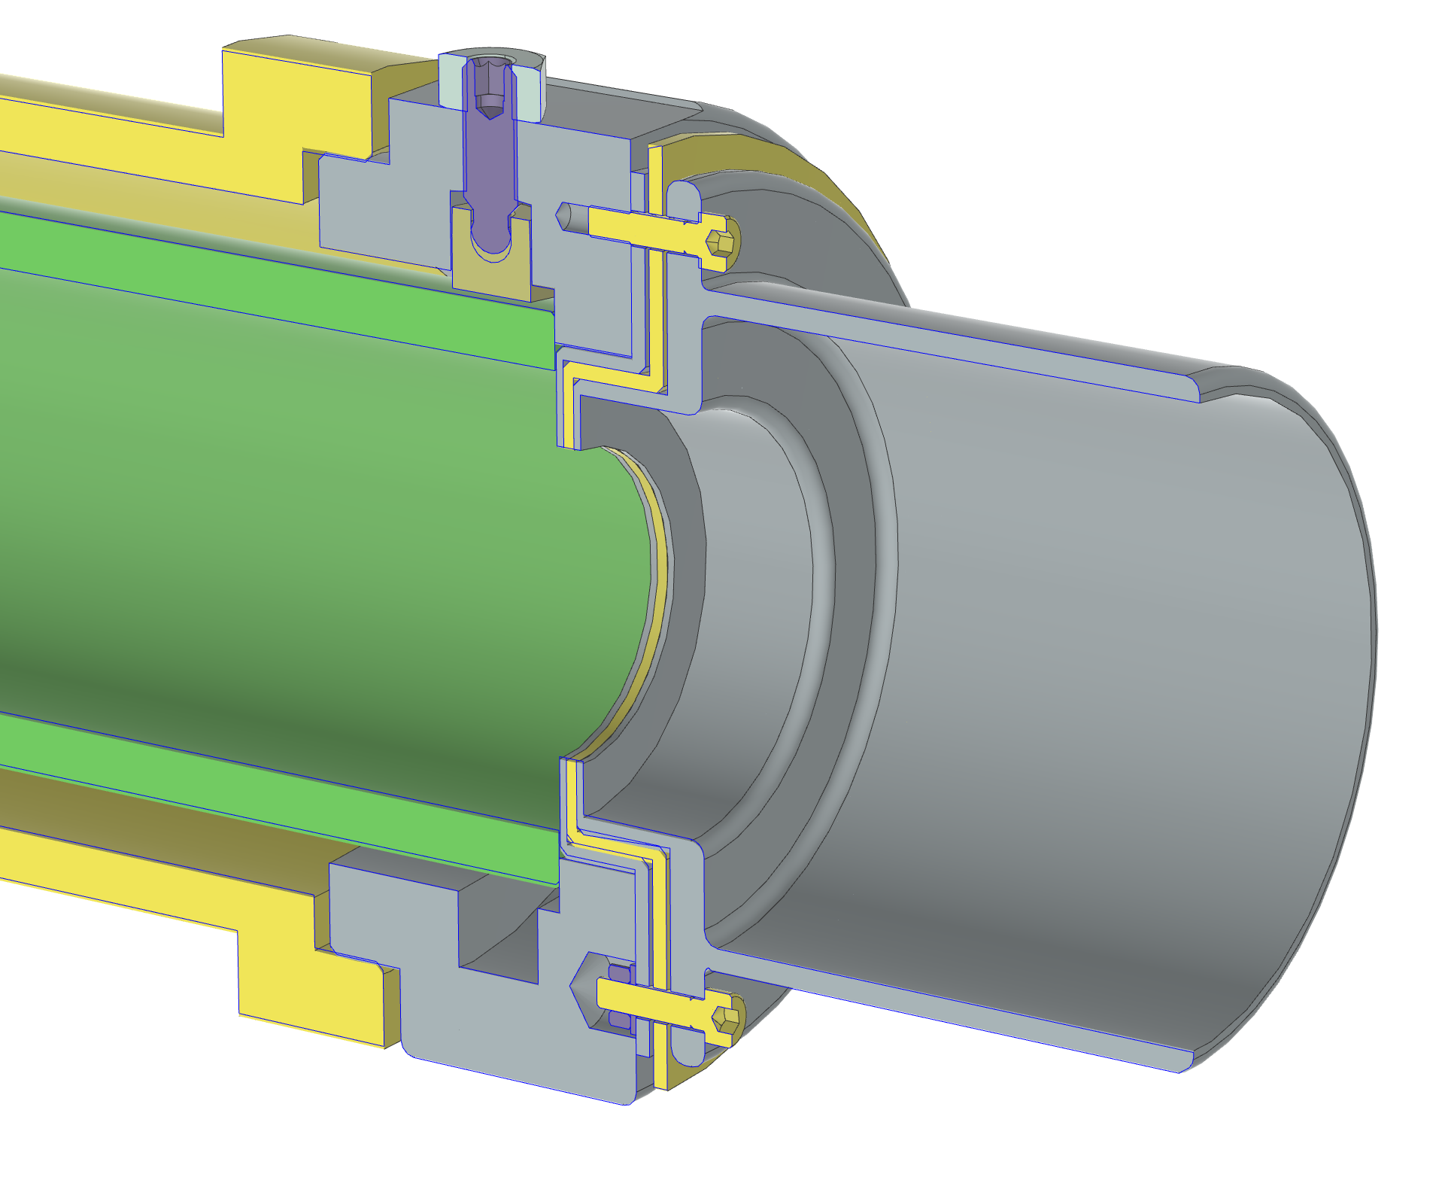
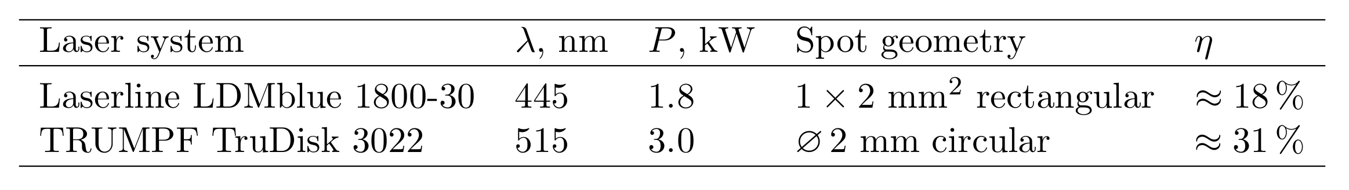
Beamline Concept
y
z
x
x
O-Beam
Laser
O⁻-Beam

Slide 15
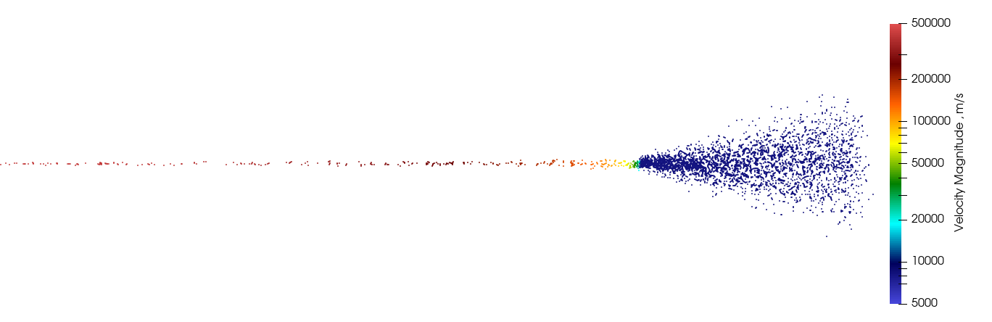
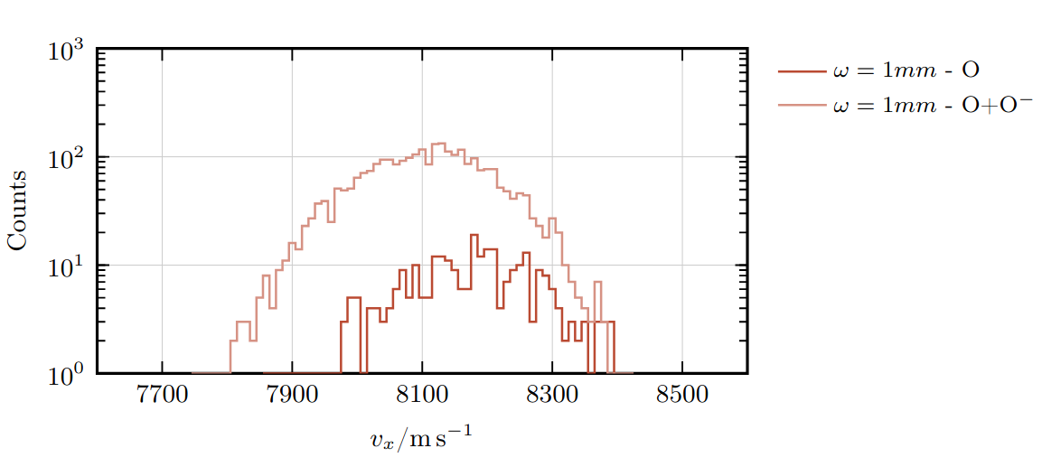
Numerical Simulations
Laser
Velocity distribution within the desired range
Main challenge: achieving the required particle density
Notes:
Hier hinzufügen, wo die neutralisation stattfindet

Slide 16
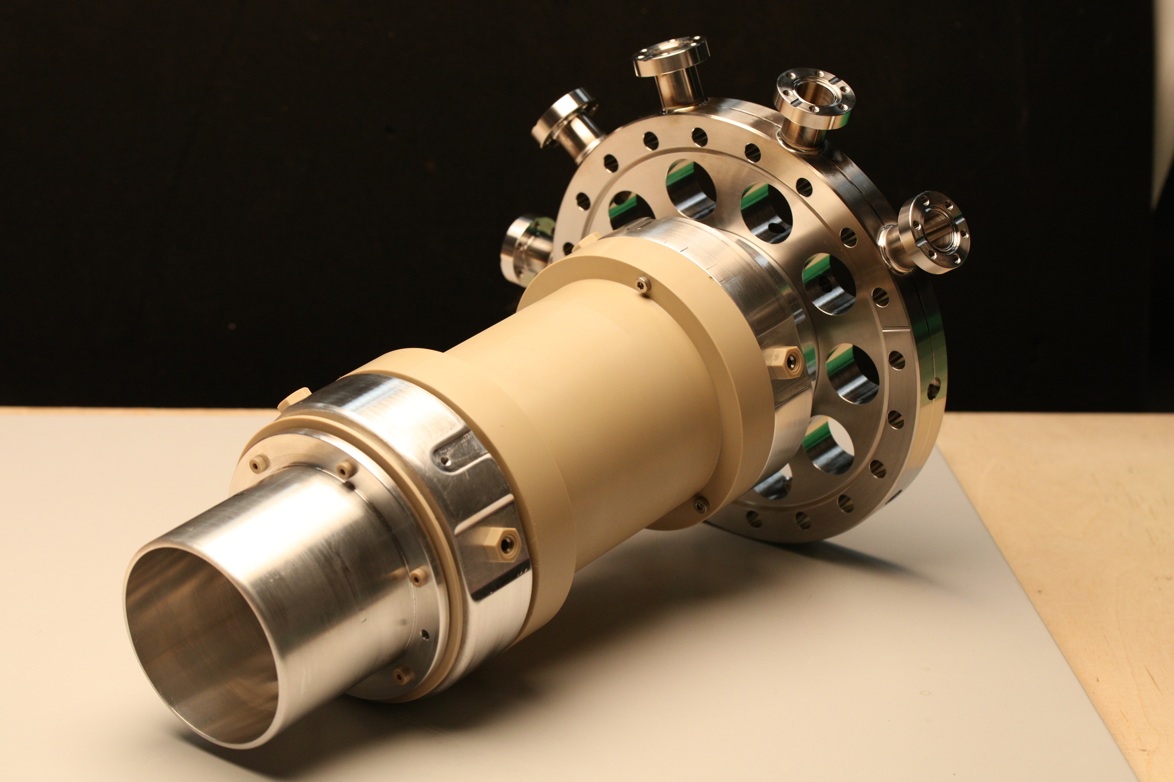
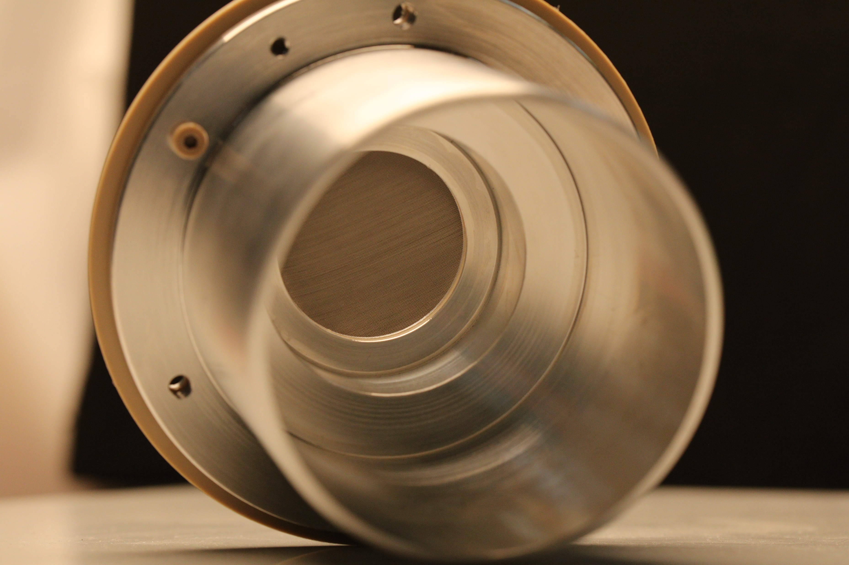
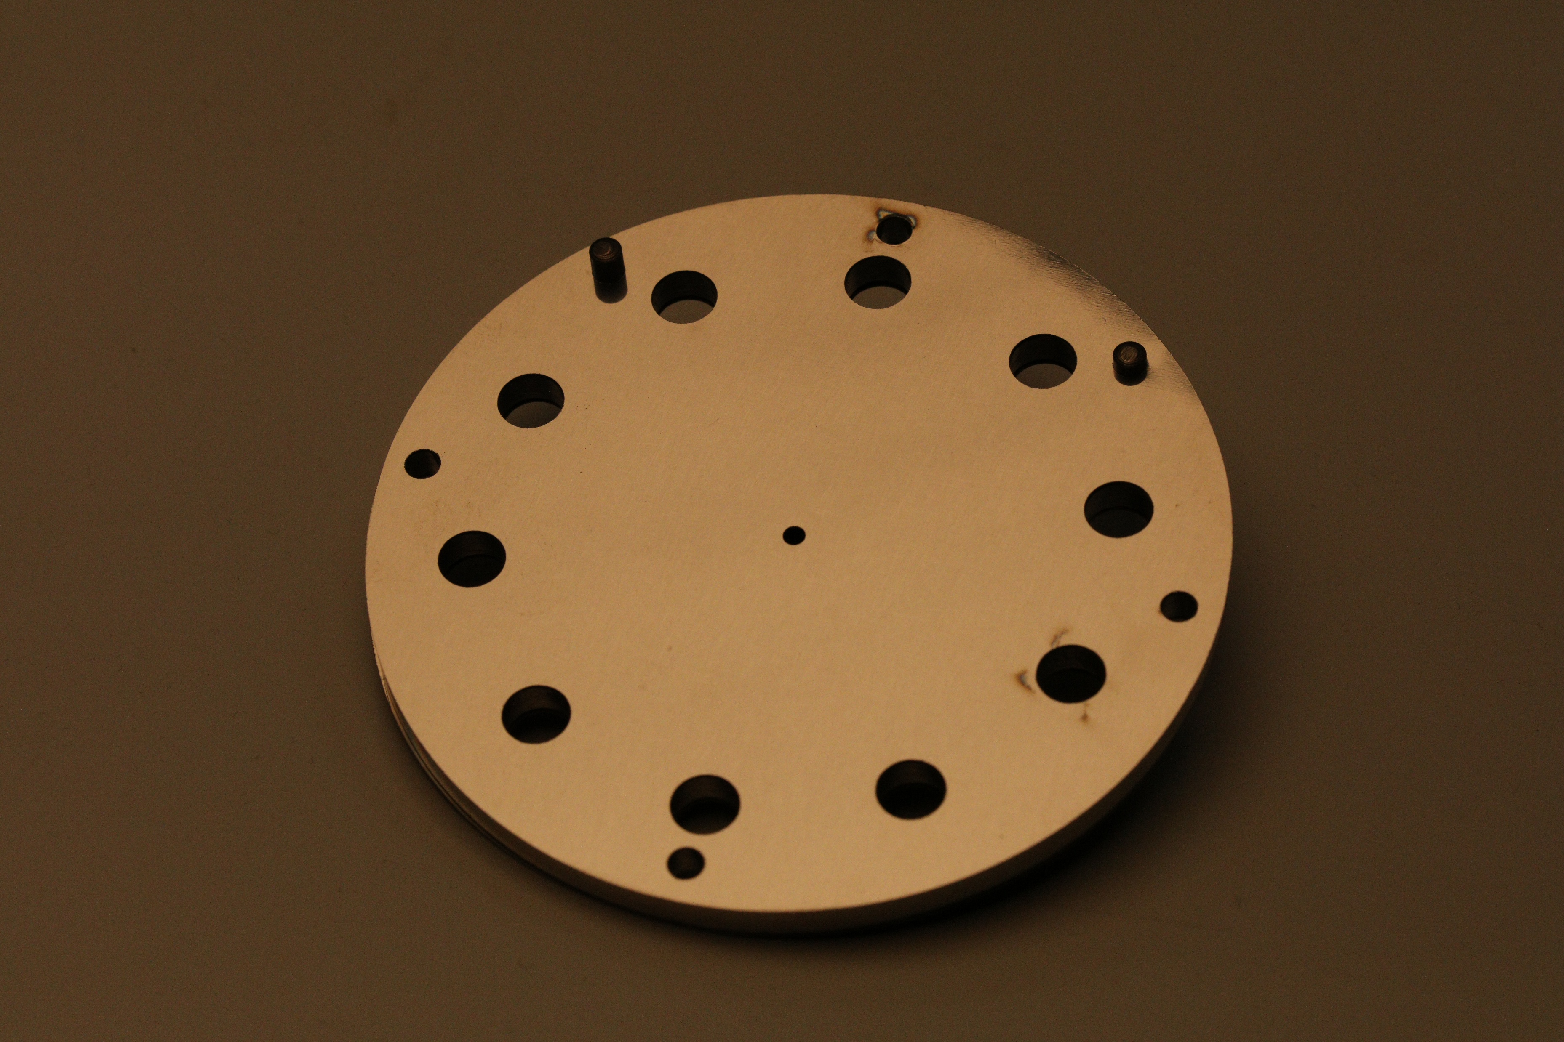
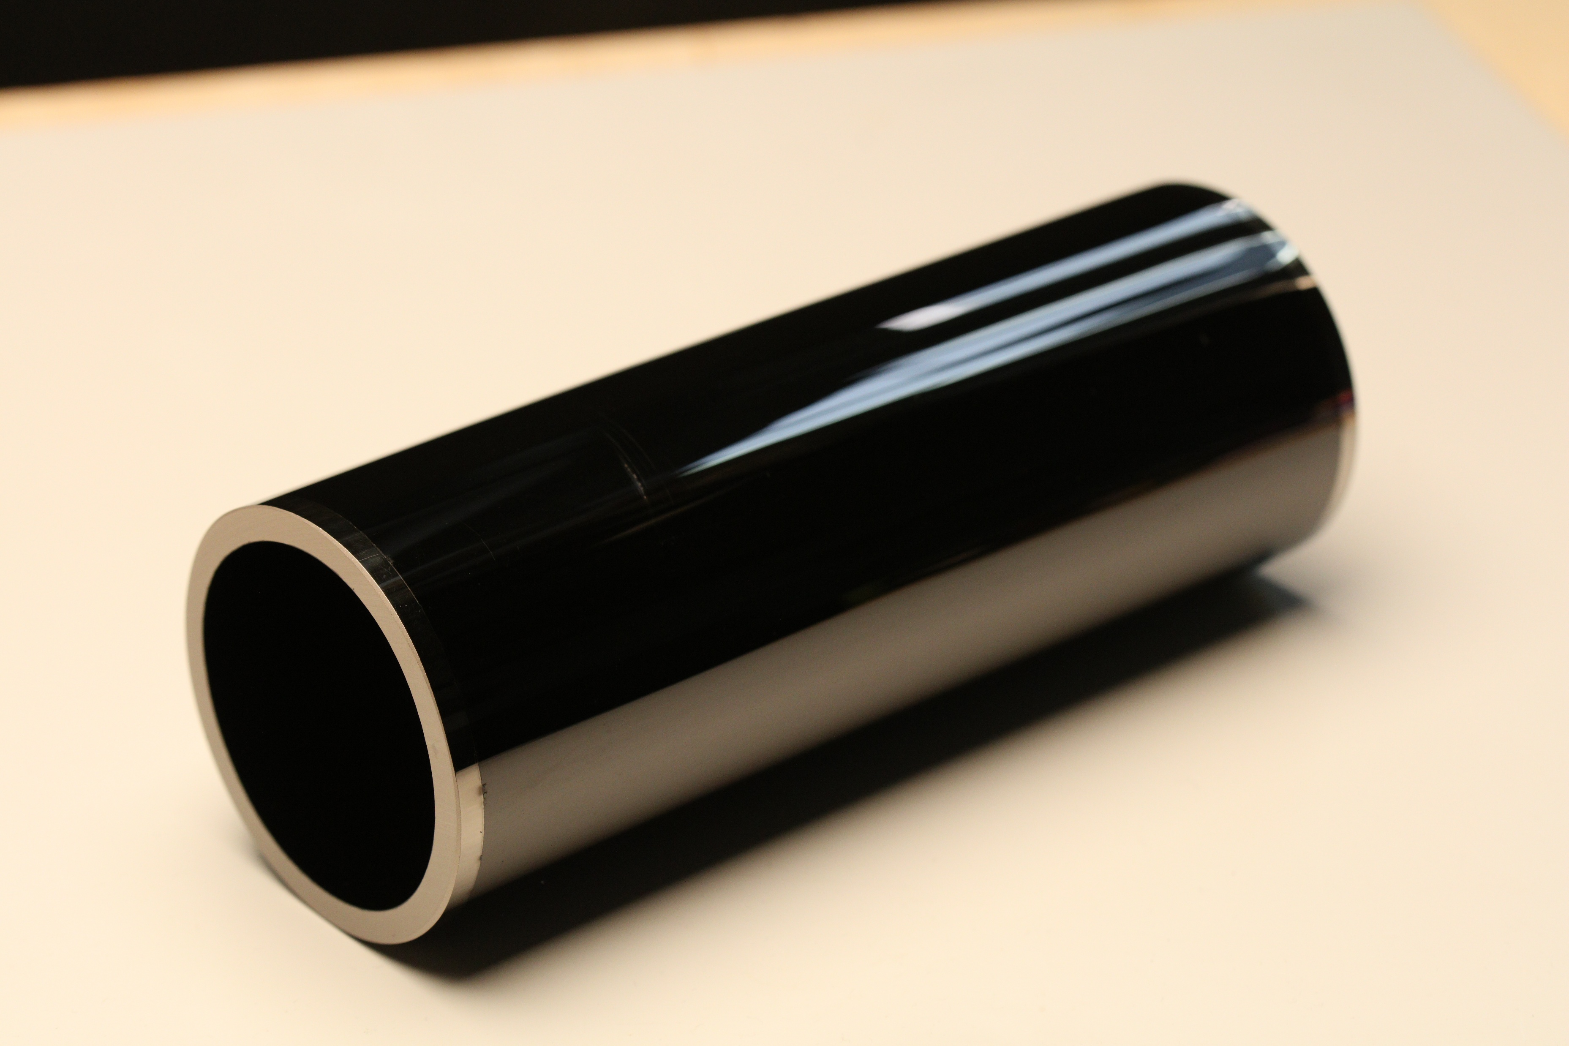
We built it!
Notes:
Hier fotos und danach direkter Übergang damit jetzt experimente

Slide 17
Upcoming Experiments
Test campaign at D-Pace Inc. next week
Further testing of the ion source with oxygen
Testing of the deceleration unit with the RF multicusp ion source and dipole magnet
Main objective: Demonstrate the functionality of the assembly
Measurement of ion currents and beam profiles

Slide 18
Summary
Detailed engineering design of the deceleration unit developed
Theoretical applicability of two commercially available laser systems investigated
Numerical simulations support the feasibility of the proposed beamline concept
Target particle velocity achievable → required particle density remains the main challenge due to beam divergence
Experimental testing of the deceleration unit at D-Pace planned for next week

Slide 19



High Enthalpy Flow Diagnostics Group (HEFDiG)
Martin Eberhart
Igor Hoerner
Fabian Hufgard
Dominik Kuenstler
David Leiser
Stefan Loehle
Clemens Mueller
Oliver Patek
Nuno Pinto de Souza
Benjamin Rusche
David Steuer
Lasse Voigt
Thank you!

