Slide 1
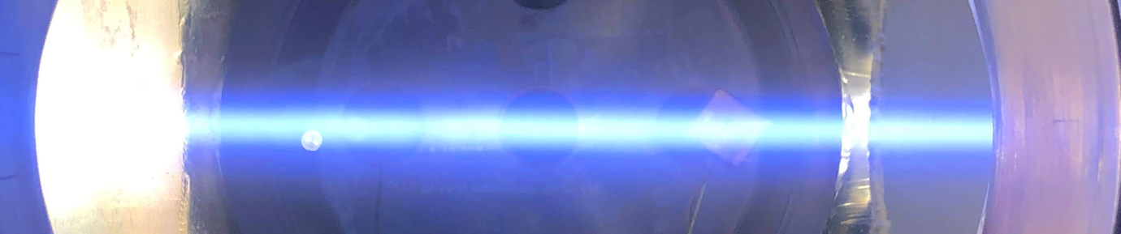
E×B Plasma Generated by Electron Beams and Non-thermal Electrons for Materials Processing
Yevgeny Raitses
Princeton Plasma Physics Laboratory, Princeton, NJ, USA
NIBS’ 2026
Nelson, September 2026

Slide 2






Experiment Team¹: Nirbhav Chopra, Stas Musikhin, Ivan Romadanov, Yerbolat Ussenov, Eduardo Rodrigues, Sunghyun Son
Collaborators:
Plasma modeling: Andrei Smolyakov² and Mikhail Tyushev²
2D Materials: Saien Xie,³ Shoaib Khaild,¹ and Igor Kaganovich¹
Diamond: Kai-Mei Fu,⁴ Christian Pederson,⁴ and Alastair Stacey¹
1
2
3
4

Slide 3
Outline
Motivation: 2D materials for microelectronics
Plasma-enabled 2D materials
    e-beam E×B plasma (Penning source) for gentle processing
        Ion energy, dose of plasma exposure, plasma stability
Next: DEA and negative ions for processing

Slide 4
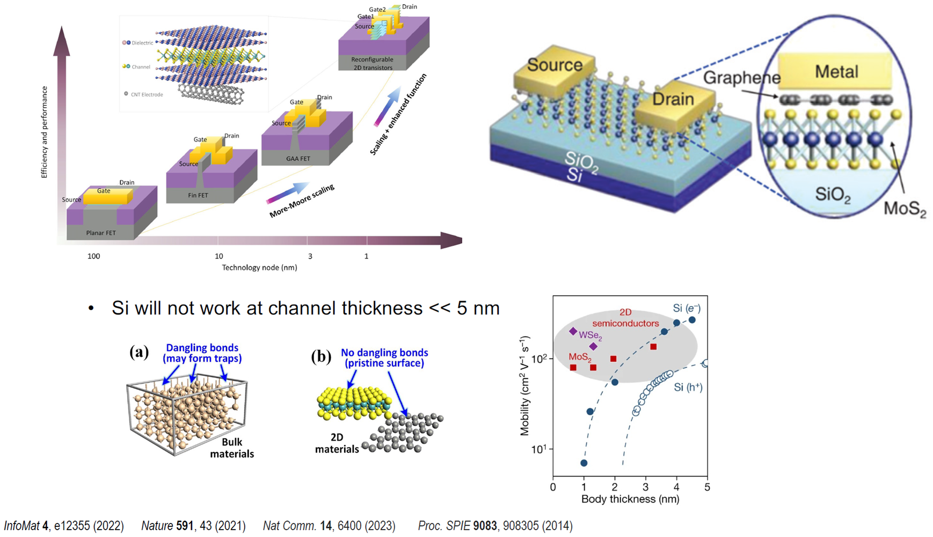
Motivation: from microelectronics to nanoscale electronics
G.-H. Lee et al., ACS Nano (2015)

Slide 5
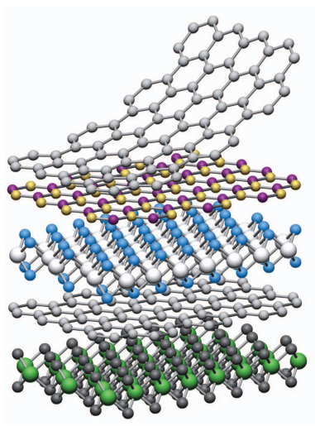
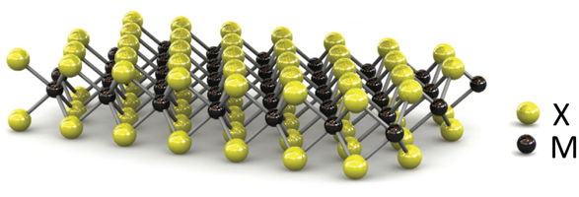

Background: 2D Transition-metal dichalcogenides (TMDs)
2D TMDs: MX₂
High Mobility at Nanoscale
Heterostructures
Stable van der Waals surfaces
Direct bandgap, 1.5-2.2 eV
Tunable properties
Y. Liu et al., Nature 591 (2021)
Nature 499, 419 (2013)

Slide 6
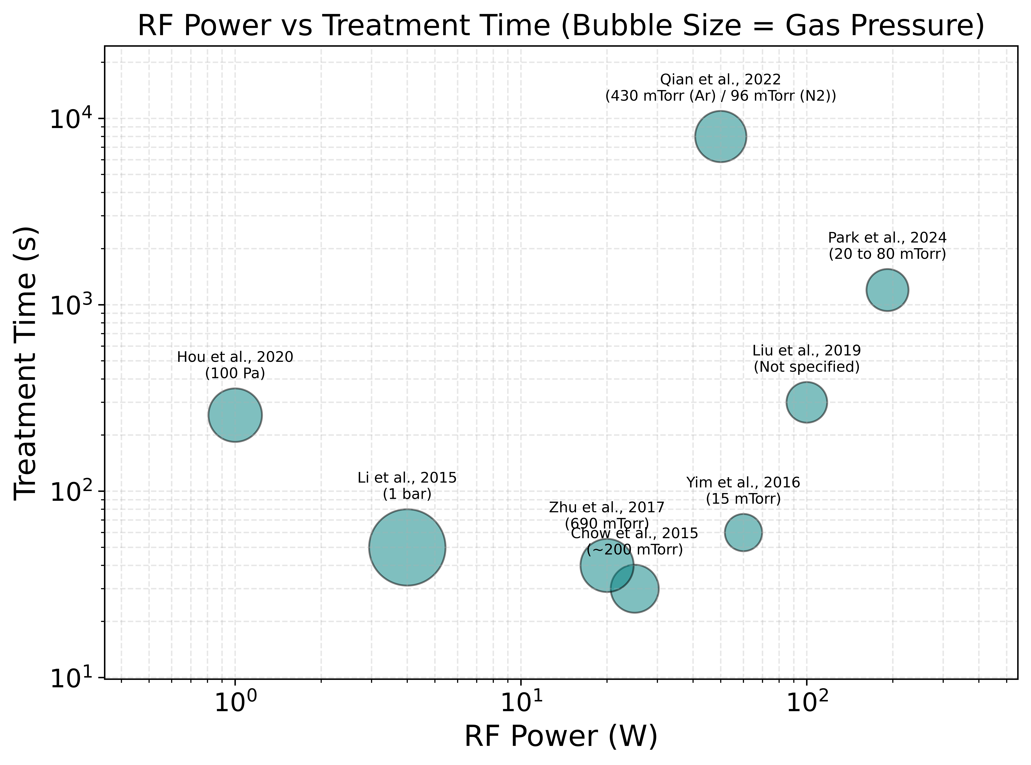
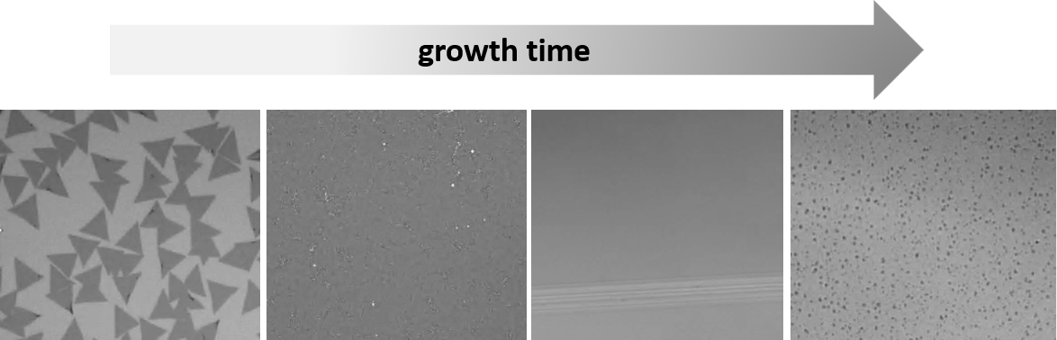
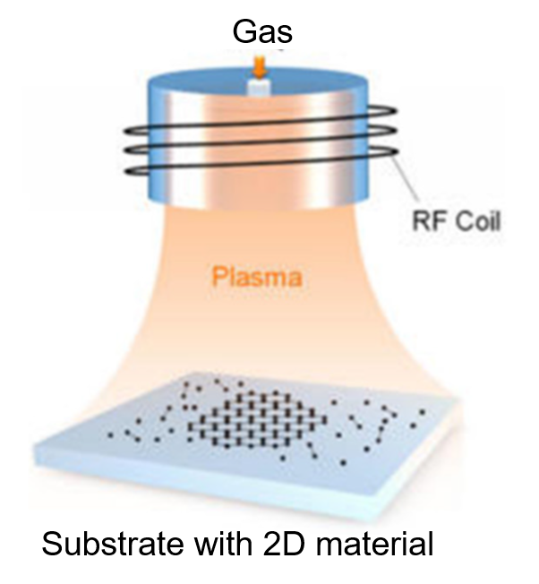
Plasma processing of MOCVD growth 2D TMDs
MOCVD growth of 2D MoS₂ film
Exposure to ICP plasma
Examples of 2D MoS₂ processing in inert gas RF plasmas
H. Suzuki et al., Nano Lett. 23 (2023)

Slide 7
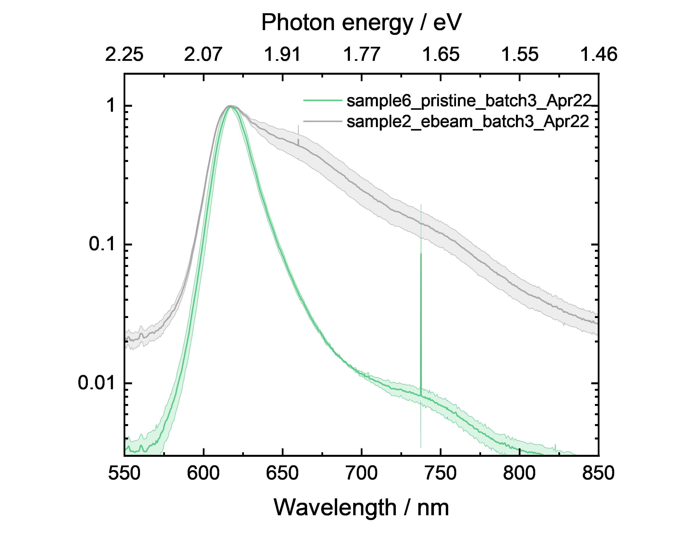


Plasma effects on optical properties of TMDs
Ex-situ photoluminescence (PL) spectra of monolayer WS₂,
before and after argon plasma exposure
Measures recombination of electrons and holes in TMD
Sensitive to changes in the electronic structure
Sensitive to defects, doping, and strain
X⁰ peak
X^{D} peak
Conduction Band
e⁻
E_{b}
~1.67 eV
X⁰
$$hν$$
e⁻
X^{D}
E_{g}
h⁺
Valence Band
From DFT, X^{D}~ 1.62 eV corresponds to sulfur vacancy defect
Notes:
Missing sulfur atoms(S vacancy) create defect sites in MoS₂
These defect sites can trap excited electrons
Trapped electrons can emit light at a lower energy, around 1.62 eV

Slide 8
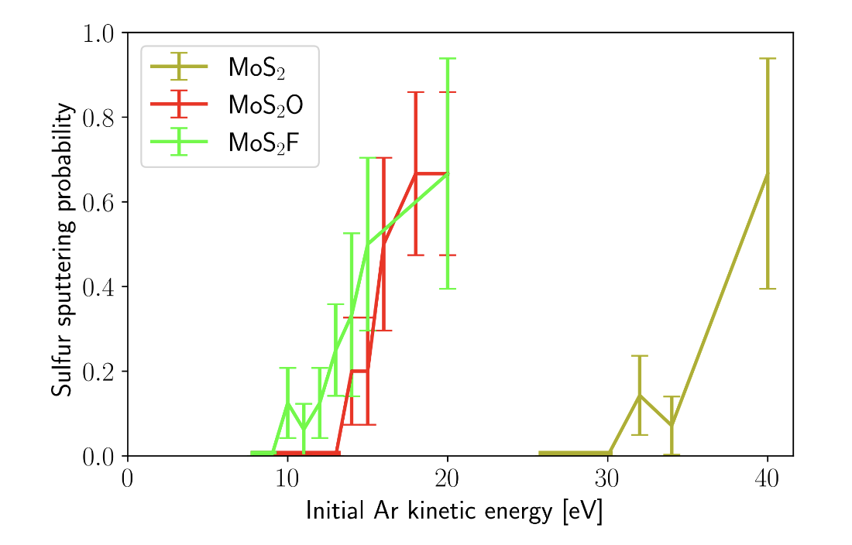
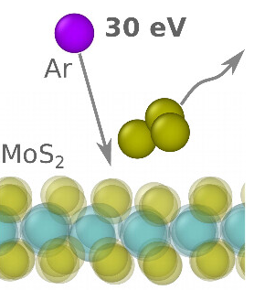
Sputtering of TMD by argon ions
Sputtering studies using ab-initio Molecular Dynamics for various Ar ion energies
Y. Polyachenko et al., J. Phys. Chem. Lett. 17 (2026)
Sputtering energy threshold for sulfur from MoS₂, $ε_{Sv}≈$ 30 eV

Slide 9
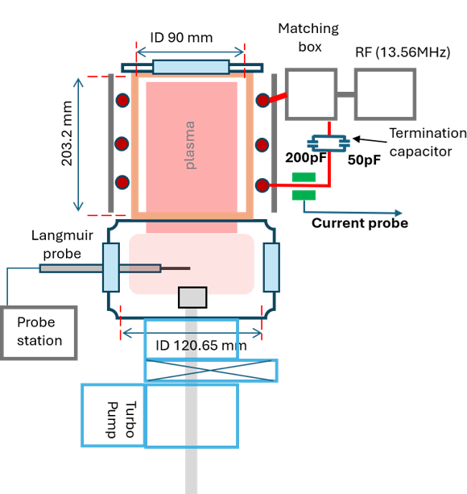
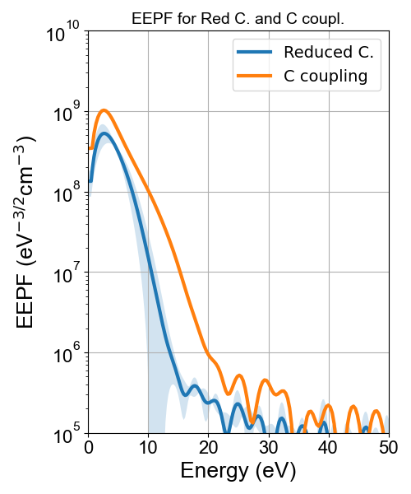
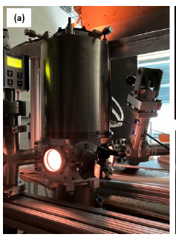
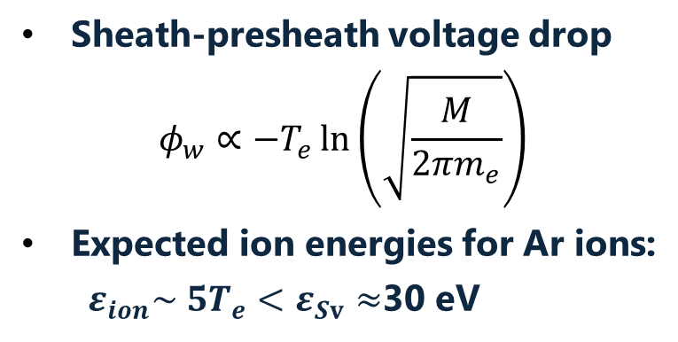
RF ICP: Plasma measurements (EEDF, OES, IEDF)
13.56 MHz, RF ICP reactor
Operating regime
Power: 80 W
Gas: Argon
Pressure: 10 mtorr
Sheath-presheath voltage drop
$$φ_{w}∝−T_{e}\ln\left(\sqrt{\frac{M}{2πm_{e}}}\right)$$
Expected ion energies for Ar ions:
  $ε_{ion}\sim 5T_{e}<ε_{Sv}≈$30 eV
Coupling | T_{e,} eV | N_{e}, cm⁻³
Reduced C. | 2.6 | 0.5 x 10¹⁰
C coupling | 3.6 | 1x 10¹⁰

Slide 10
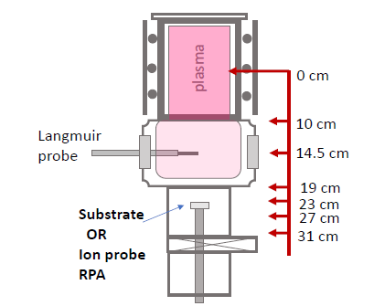
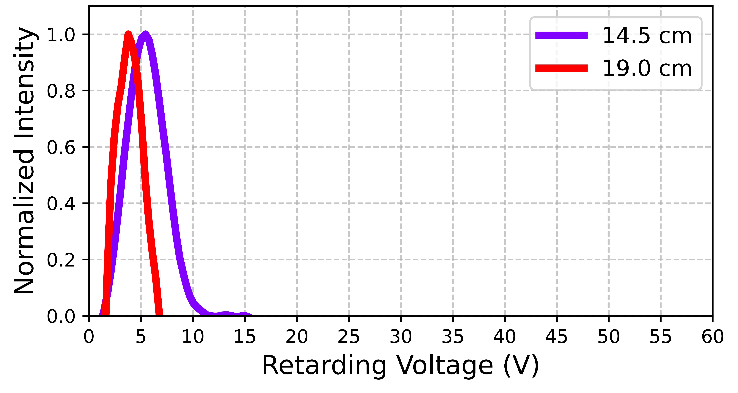
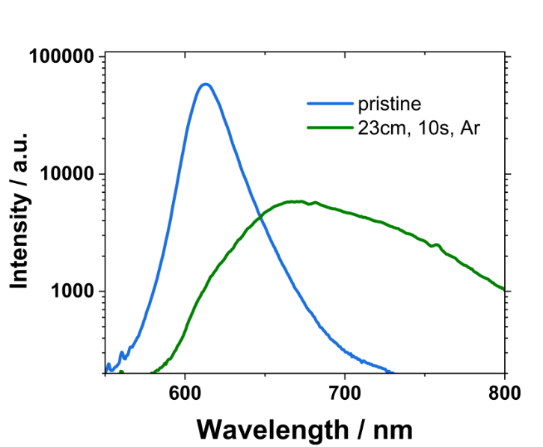
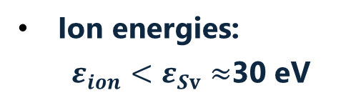
ICP-induced damage to 2D materials
Ion energies with RPA
Ion energies:
  $ε_{ion}<ε_{Sv}≈$30 eV
Ex-situ Photoluminescence (PL) at 23 cm
Operating regime
Power: 80 W
Gas: Argon
Pressure: 10 mtorr
Reduced C-mode

Slide 11
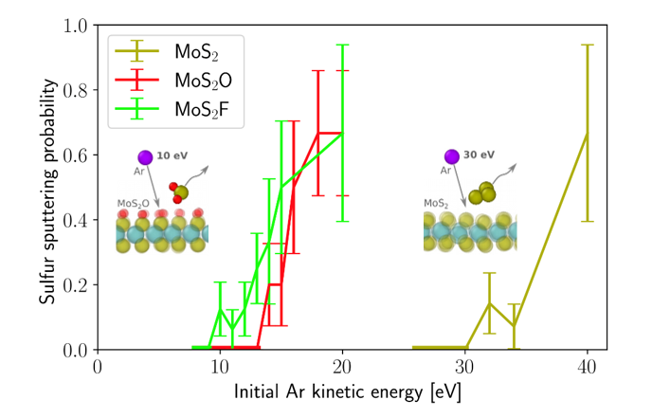
Plausible explanation of low ion energy damage to TMD
If TMD is oxidized, sputtering energy threshold of sulfur, drops 2.5 times (from ab-initio MD)
For oxidized MoS₂, sputtering of sulfur by Ar ions $≤$ 12 eV
In oxidized MoS₂, sulfur sputtering by Ar ions is via formation and desorption of stable SO₂, whereas in pristine MoS₂ it is driven by mechanical bond breaking and Sₙ cluster formation.
Because of a stronger electronegativity, Oxygen-Sulfur bound weakens Sulfur-Moly bonds.
Oxygen in the ICP reactor could be from a water residual: base pressure ~ 10⁻⁴- 10⁻⁵ Pa.
Similar reduced sputtering yield is predicted for fluorinated MoS₂ with formation SF₄.
Y. Polyachenko et al., J. Phys. Chem. Lett. 17 (2026)
To avoid sulfur sputtering electron temperature should be < 2.5 eV

Slide 12
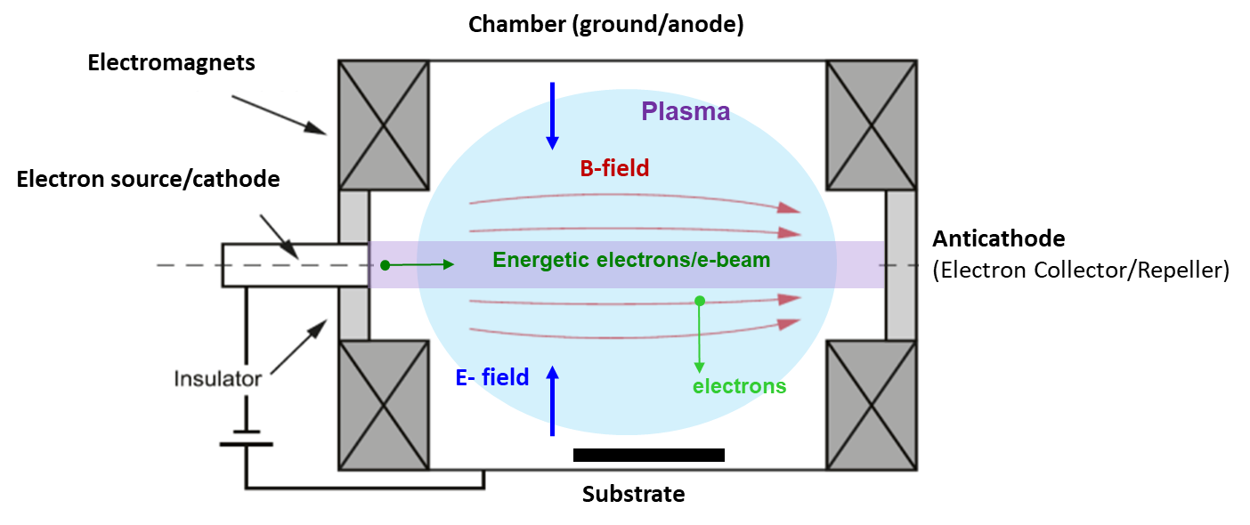
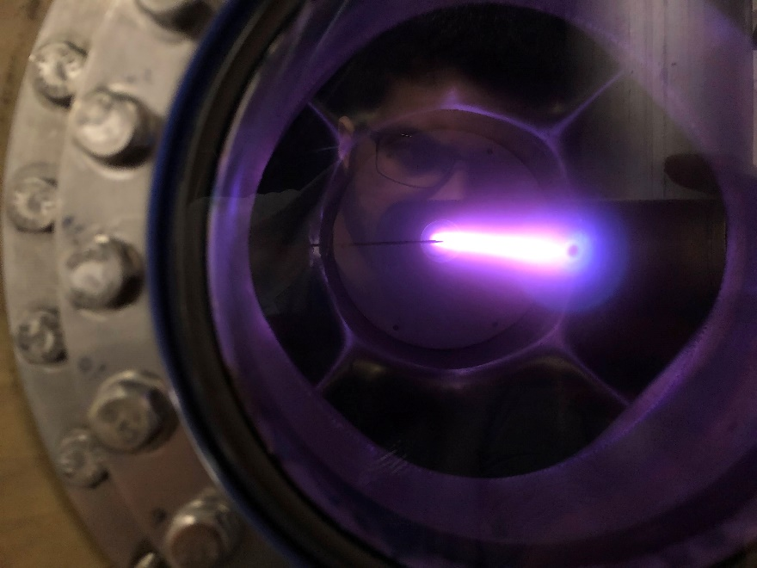
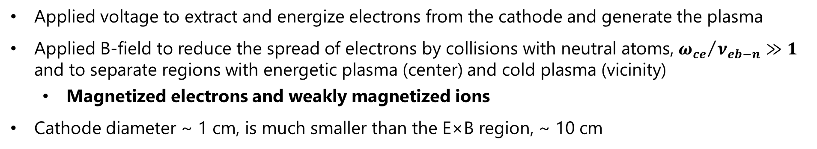
Access to lower ion energies with E×B Penning source
2 keV x 1 mA e- beam in Argon gas
100 mtorr, B= 100 Gauss
or Floating boundary (conductive or dielectric)
10 cm
Applied voltage to extract and energize electrons from the cathode and generate the plasma
Applied B-field to reduce the spread of electrons by collisions with neutral atoms, ${ω_{ce}}/{ν_{eb−n}}≫1$ and to separate regions with energetic plasma (center) and cold plasma (vicinity)
  Magnetized electrons and weakly magnetized ions
Cathode diameter ~ 1 cm, is much smaller than the E×B region, ~ 10 cm
12
Notes:
12

Slide 13
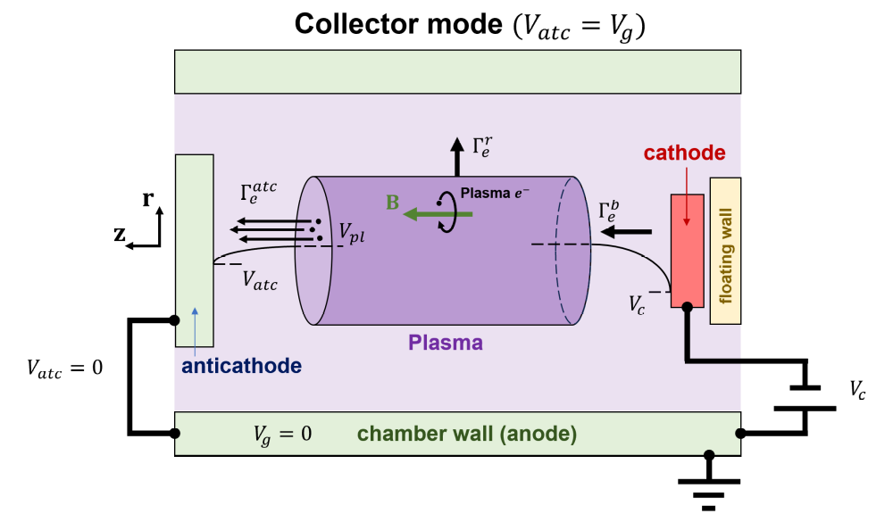
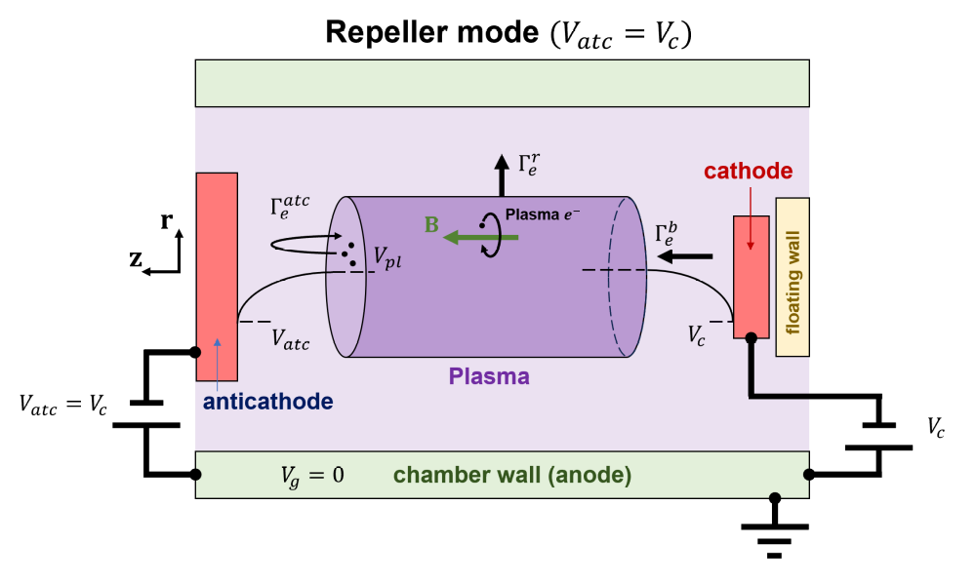
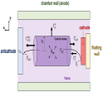

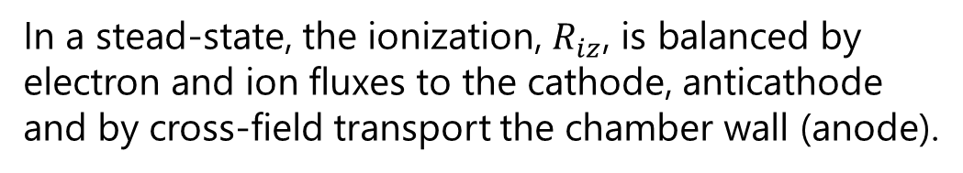










Studied cases of plasma boundaries
$$Γ_{i}^{r} ?$$
$$Γ_{i}^{r} ?$$
$$Γ_{i}^{r}$$
$$Γ_{i}^{z}$$
$$Γ_{i}^{c}$$
$$Γ_{i}^{z}$$
$$Γ_{i}^{c}$$
$$Γ_{i}^{z}$$
$$Γ_{i}^{c}$$
Floating (metal or dielectric)
In a stead-state, the ionization, $R_{iz}$, is balanced by electron and ion fluxes to the cathode, anticathode and by cross-field transport the chamber wall (anode).
$$Γ_{i}^{r} ?$$
$$Γ_{i}^{r}$$
$$∇∙Γ_{e,i}=R_{iz}$$
$$Γ_{i}^{z}$$
$$Γ_{i}^{c}$$
$$Γ_{i}^{z}$$
$$Γ_{i}^{c}$$
Chopra, Romadanov, YR, Plasma Sources Sci. Technol. 33 (2024)
Tyushev, Papahn Zadeh, Sharma, Sengupta,YR, Boeuf, Smolyakov, Phys. Plasmas 30 (2022)
13

Slide 14
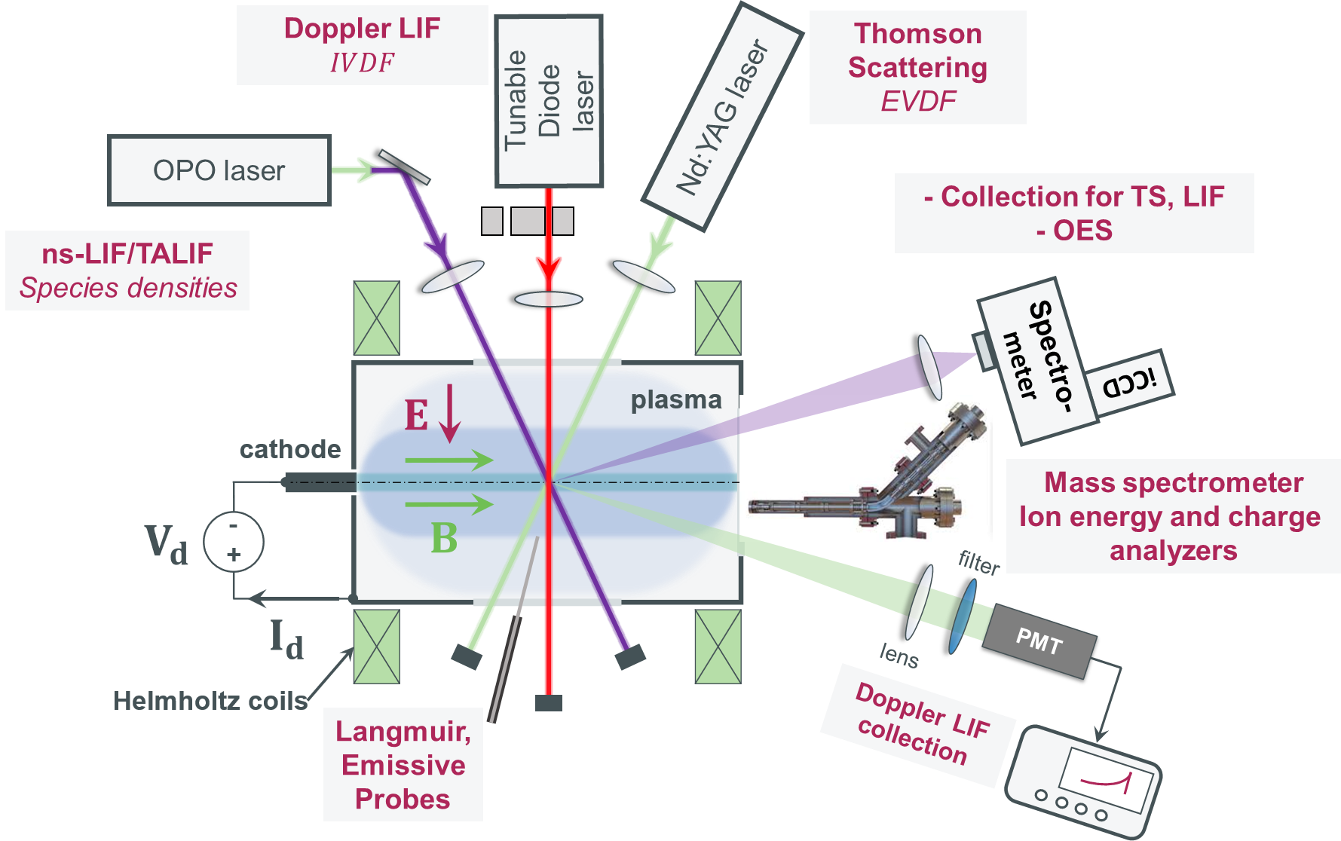
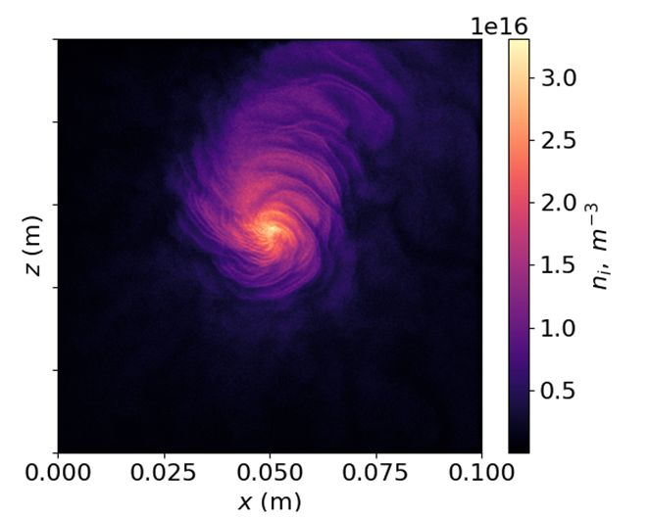
Research resources, http://pcrf.pppl.gov
PPPL E×B LTP setups accessible to major plasma diagnostics
Advanced kinetic simulations:
Andrei Smolyakov’s group at University of Saskatchewan using 2D & 3D WarpX, 2D EDIPIC, and 3D Vsim by Tech-X
Snapshot of simulated ion density
20cm
Up to 100cm
All diagnostics are available through PCRF!
14
Notes:
14

Slide 15
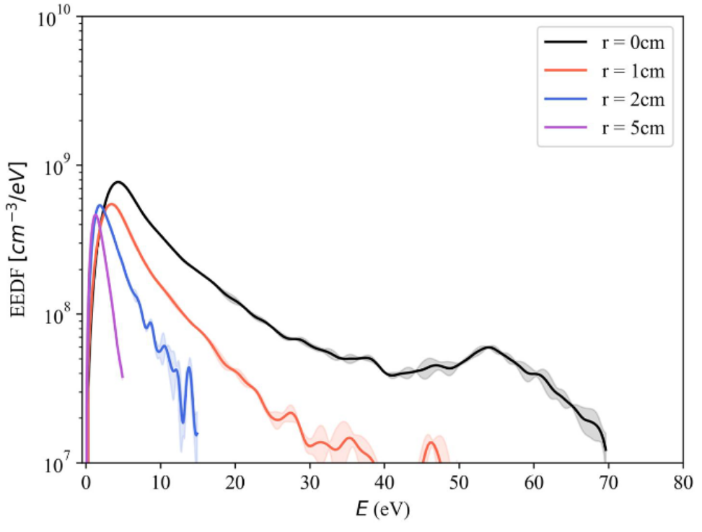
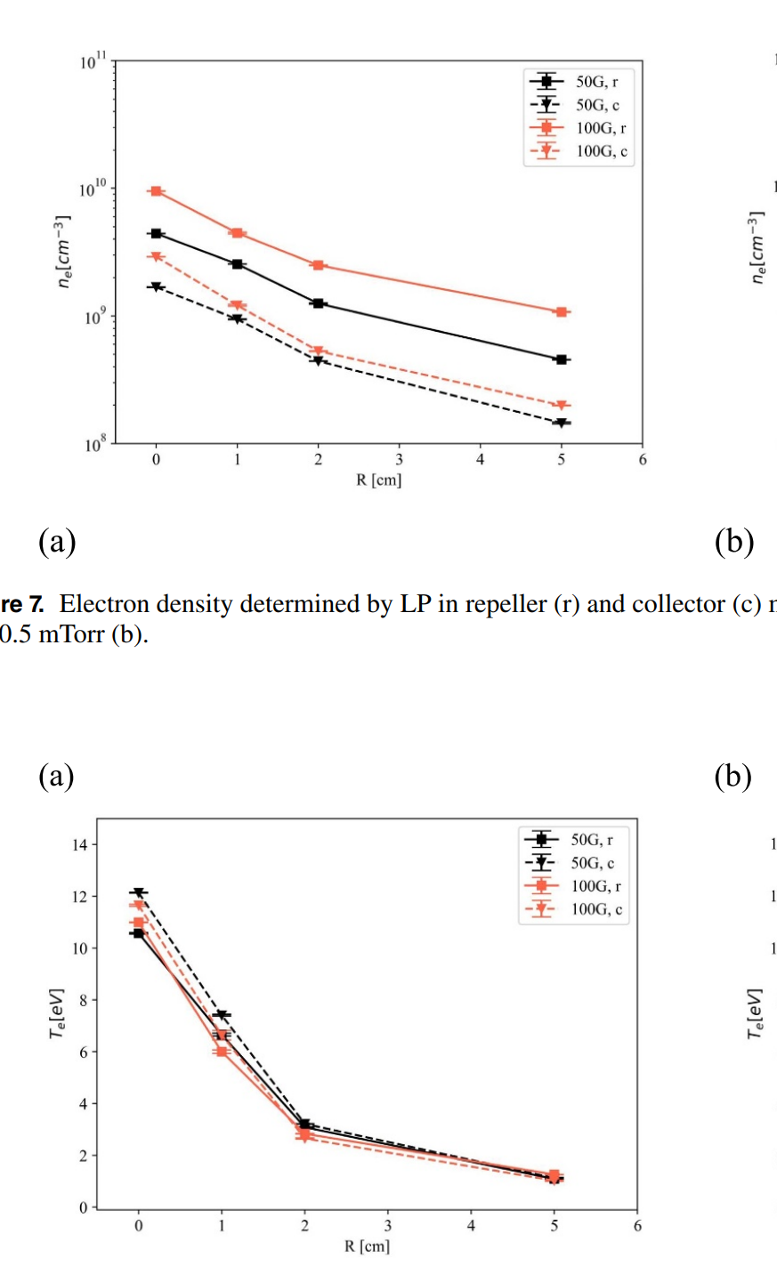
Radial (⊥B) profiles of EEDF, plasma density & electron temperature
Time-averaged plasma properties measured by probes in e-beam E×B plasma at 0.2 mtorr Argon
EEDF
Langmuir
Probe
Plasma density, cm⁻³
Electron temperature, eV
Chopra et al., Plasma Sources Sci. Technol. 33 (2024)
15

Slide 16
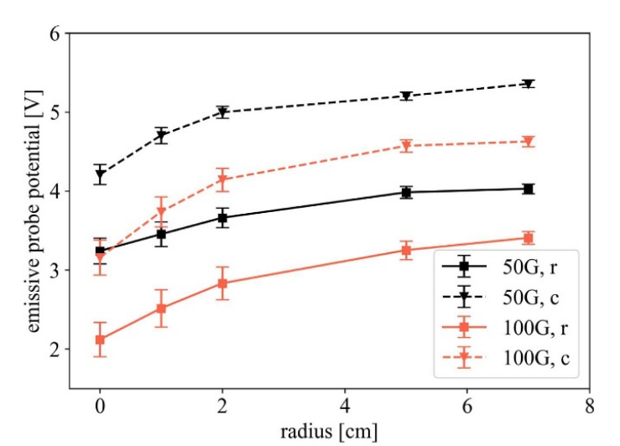
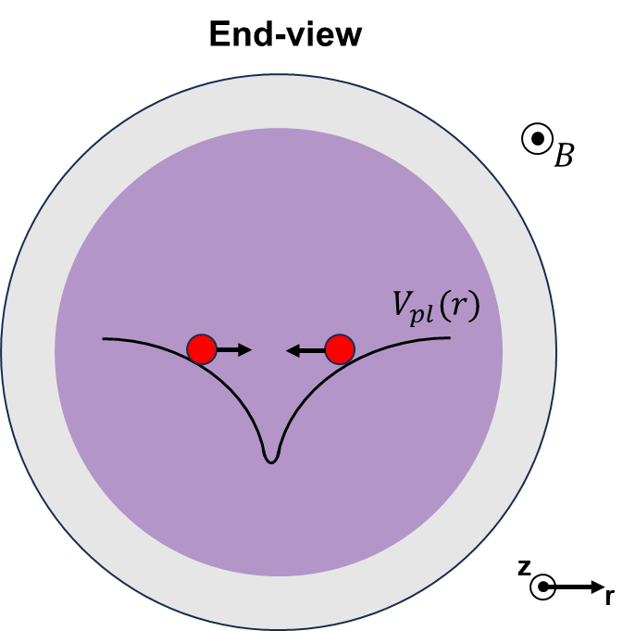
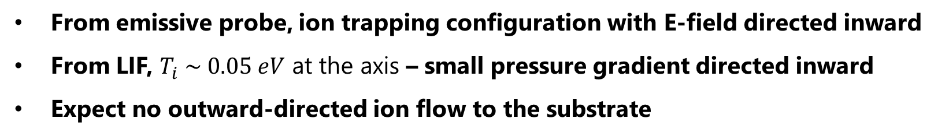
Radial (⊥B) profiles of plasma potential with emissive probe
From emissive probe, ion trapping configuration with E-field directed inward
From LIF, $T_{i} \sim 0.05 eV$ at the axis – small pressure gradient directed inward
Expect no outward-directed ion flow to the substrate
Chopra et al., Plasma Sources Sci. Technol. 33 (2024)
Chopra et al., Appl. Phys. Lett. 124 (2024)
16

Slide 17
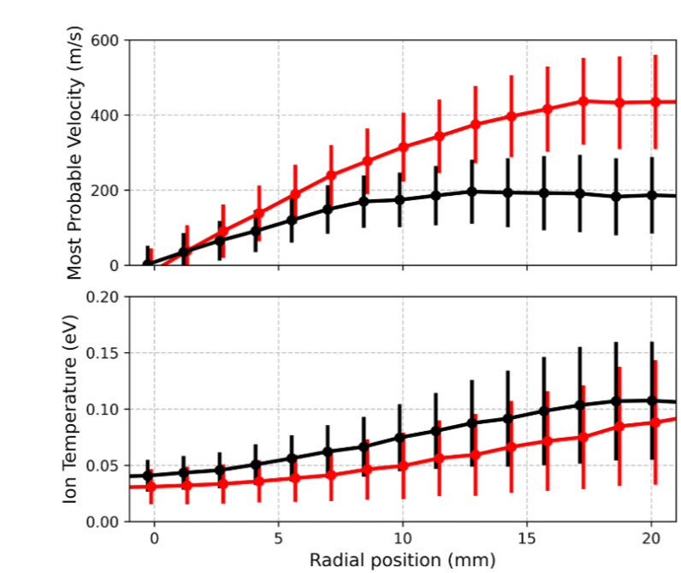
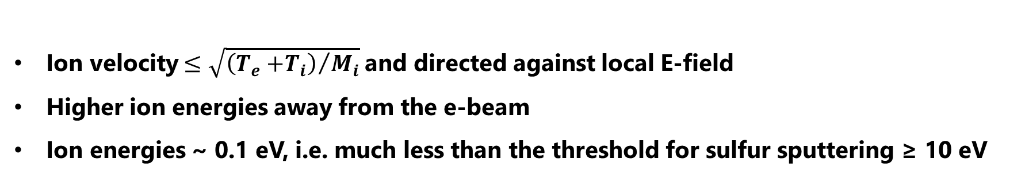
Time-average Laser-Induced Fluorescence: back ion flow
Most probable ion velocity
Outward flow
Ion temperature
Axis
Son et al., Plasma Sources Sci. Technol 34 (2025)
Ion velocity $≤\sqrt{{\left(T_{e}{+T}_{i}\right)}/{M_{i}}}$and directed against local E-field
Higher ion energies away from the e-beam
Ion energies ~ 0.1 eV, i.e. much less than the threshold for sulfur sputtering ≥ 10 eV
17

Slide 18
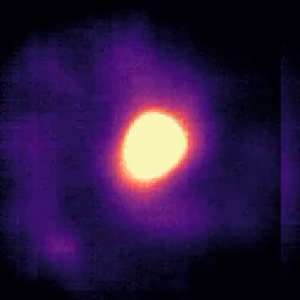
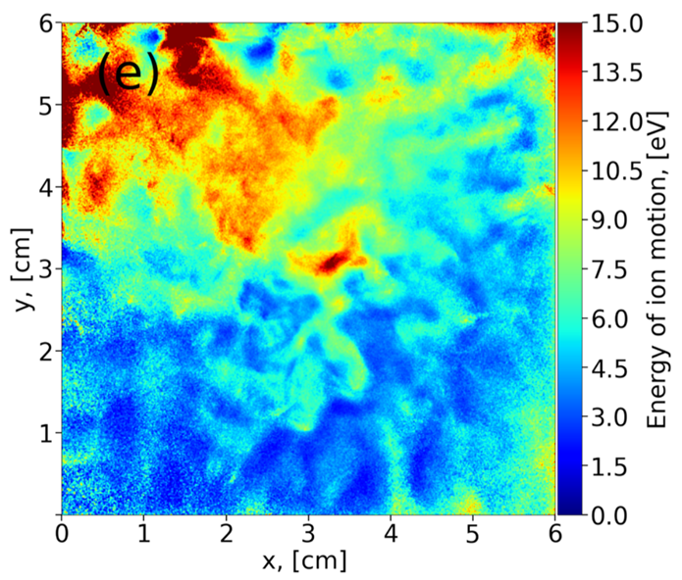
Ion heating by plasma instabilities
ExB spoke, 10⁴ Hz
Ion heating by spoke, EDIPIC-2D
Azimuthal oscillations (~ 10 kHz), often m=1, much slower than $E×B$ frequency
Ions heated up at plasma periphery
PIC simulations predict that peak ion energies during oscillations can be sufficient to damage the substrate!
M. Tyushev et al., Phys. Plasmas 30 (2023)
M. Papahn Zadeh et al., Plasma Sources Sci. Technol. 34 (2025)
18
Notes:
18

Slide 19
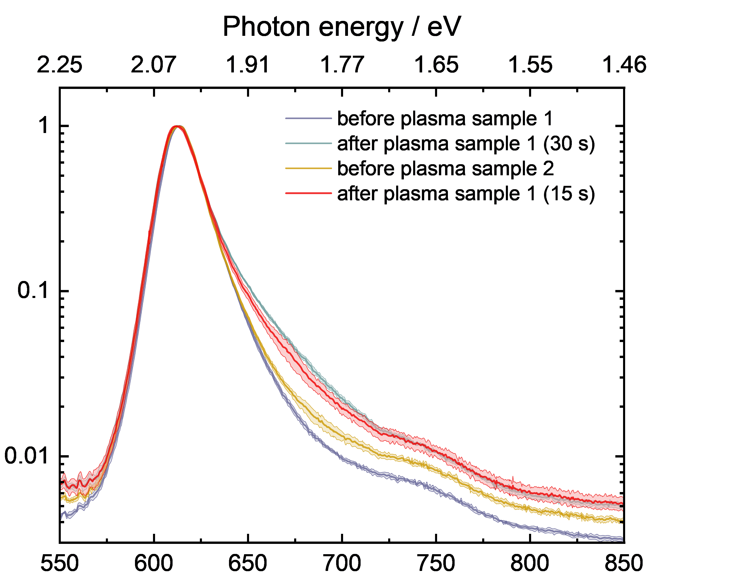
Exposure of WS₂ to e-beam E×B plasma: Photoluminescence at RT
X⁰
longer exposure
Changes in PL signal (possible damage to TMD) increase with the exposure time.
Measured time-average ion energies are small < 0.5 eV, but in fluctuations ion energies are ~ 15eV, sufficient to knock out sulfur from TMD.
X^{D}
Wavelength / nm
19
Notes:
19

Slide 20
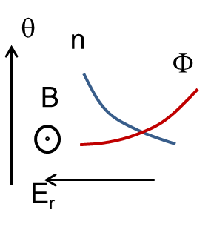
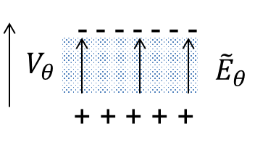
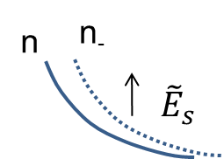
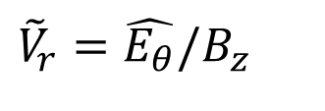
Gradient drift instability: collisionless Simon-Hoh instability¹
Equilibrium
Density perturbation
$${\tilde{V}}_{r}=\hat{E_{θ}}/B_{z}$$
Perturbation
  Conditions: ∇n_{eo} ≠ 0 and ∇n_{eo} ⋅ E_{r0} > 0
Ω_{ci} << ω << Ω_{ce}
Sakawa at al., Phys. Fluids B: Plasma Phys. 5 (1993)
Smolyakov et al., Plasma Phys. Control. Fusion 59 (2017)
20
Notes:
20

Slide 21
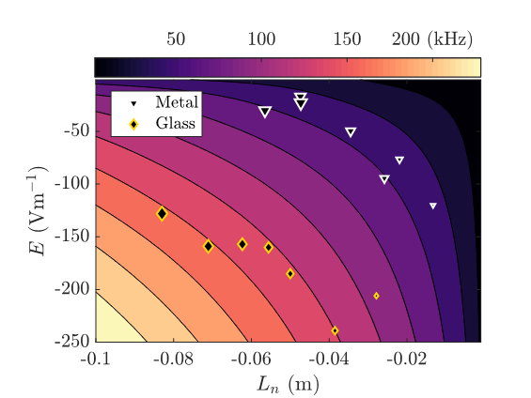
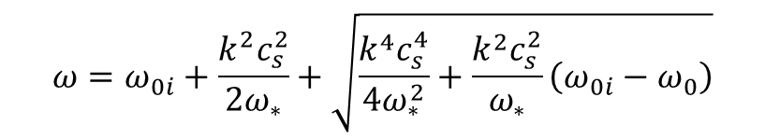



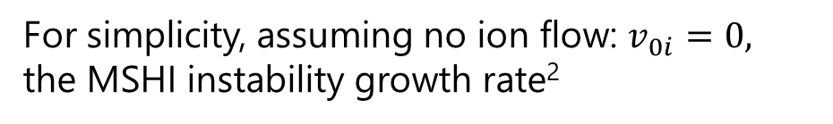
Gradient drift instability: modified Simon-Hoh instability (MSHI)¹
Dispersion relation of MSHI¹
For simplicity, assuming no ion flow: $v_{0i}=0,$ the MSHI instability growth rate²
$$ω=ω_{0i}+\frac{k^{2}c_{s}^{2}}{2ω_{∗}}+\sqrt{\frac{k^{4}c_{s}^{4}}{4ω_{∗}^{2}}+\frac{k^{2}c_{s}^{2}}{ω_{∗}}\left(ω_{0i}−ω_{0}\right)}$$
$ω_{0i}=k_{r}v_{0i}$ - ion response
$ω_{∗}={−k}_{θ}k_{B}{T_{e}/eBL}_{n}$ -electron diamagnetic drift frequency
$ω_{0}=k_{θ}{E_{r}/B}_{z}$ - E×B drift frequency
$c_{s}=\sqrt{k_{b}T/M_{Ar}}$ - ion sound speed
¹Smolyakov et al., Plasma Phys. Control. Fusion 59 (2017)
²Rodriguez et al. Phys. Plasmas 26 (2019)
21
Notes:
21

Slide 22
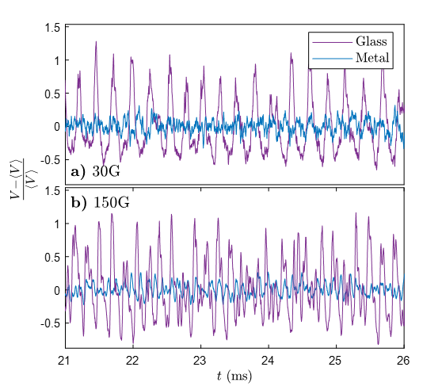
Suppression of spoke oscillations with electron collecting boundary
Oscillations of the plasma density (probe measurements) with different boundaries
¹Rodriguez et al., Phys. Plasmas 26 (2019)
²Chopra and YR, Appl. Phys. Lett. 126 (2025)
22

Slide 23
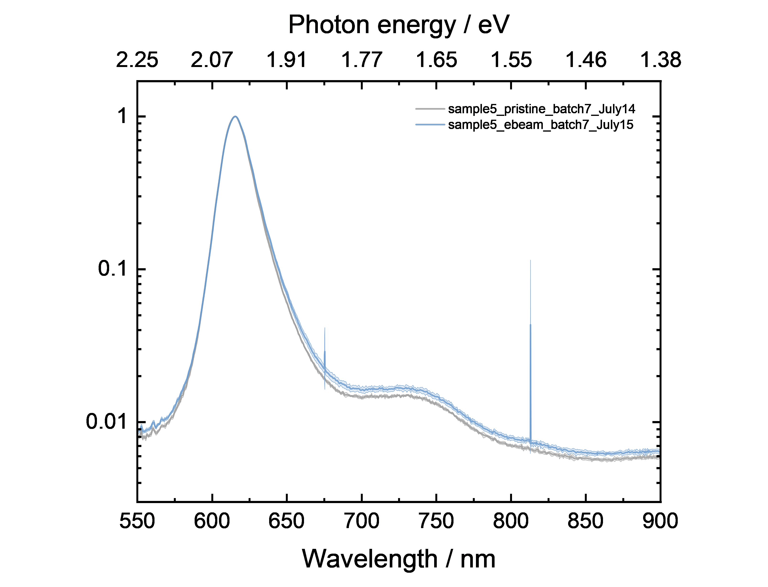
Photoluminescence signal after exposure to a quiet plasma

Slide 24
Concluding remarks
Plasma-induced damage of 2D WS₂ observed for ion energies much lower than sputtering yield of sulfur atoms (10x).
Plausible mechanisms are related to:
  plasma-chemical reactions such as oxidation by residual impurities (e.g. water)
  defects in MOCVD produced TMDs
  plasma oscillations and associated oscillations of the ion energy
Minimizing damage
  by minimizing the dose of plasma exposure and impurities in the reactor
  by mitigating oscillations
Next: controlled removal of sulfur utilizing halogenated surfaces exposed to cold plasma, and dissoative electron attachment (i.e. formation of negative halide ion).
24
Notes:
24

Slide 25

Acknowledgement
Research is based upon work supported by the U.S. Department of Energy, Office of Science, Fusion Energy Sciences and Basic Energy Sciences, as part of the Extreme Lithography & Materials Innovation Center (ELMIC), a Microelectronics Science Research Center (MSRC) through the Plasma-enabled 2D Materials project at the Princeton Plasma Physics Laboratory (PPPL), under contract number No.DEAC02-09CH11466.
http://elmic.ppp.gov
25
Notes:
25

Slide 26




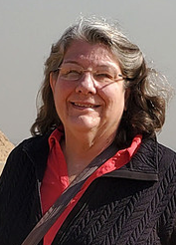





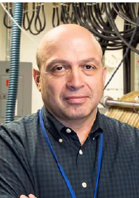


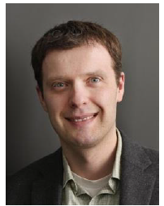






















MSRC project: Plasma-enabled 2D Materials (PlasMat2D)
6 institutions
19 researchers
Eric Joseph
Industry AC
Robert Bruce
Luxherta Buzi
Marco
Hopstaken
Lynne Gignac
11 students
Mark Kushner
Goncalo Cardoso
Jane Chang
Yevgeny Raitses
Director
Yerbolat Ussenov
Stanislav Musikhin
Barry Rand
Co-Director
Seamus Lowe
Xavier
Lee
Daniel Cho
Igor
Kaganovich
Thrust 2 Lead
Shoaib Khalid
Yury Polyachenko
David Graves
Thrust 3 Lead
Russell Kwon
Sofiia Yarytska
Sei-won Chung
Vincent
Donnelly
Jeremy Mettler
Justin
Boles
Saien Xie
Thrust 1 Lead
Satya Butler
Jingtao Tan
Alice Kunin
Connor Reilly

Slide 27











Princeton Collaborative Low Temperature Plasma Research Facility (PCRF)
Advanced diagnostics of plasma, flow, nanoparticles, plasma-surface interactions (charging, emission)
Experts in plasma theory, modeling, experiments and diagnostics
Wide range of plasma sources for basic LTP science and applied plasma research
Basic LTP science
Plasma for sustainability
Low pressure ExB plasma
Mist-plasma jets
Unique computational resources: codes, HPC: CPU-GPU hybrid architecture with open codes
Advanced atomic scale materials processing for microelectronics
Decarbonization and dusty plasmas
ExB Plasma thruster physics
1-D, 2-D and 3-D PIC, hybrid, fluid codes
e-beam generated LTPs: low to moderate (~ torr) pressures
Arc discharges
CFD, nano, diamond for QIS
Plasma for healthcare, energy environmental, catalysis applications
3-D PIC: ExB plasma structures
Scalable flexible DBDs
Notes:
27

Slide 28

http://pcrf.pppl.gov

Slide 29


Additional remarks
CVD grown WS₂
For cracks, voids and edges in TMD, AIMD predicts the reduced energy threshold for sulfur sputtering ~ 4eV
Changes of PL when exposed to ambient atmosphere, even without plasma – indicative of chemically driven modifications + light
With plasma, degradation processes may be accelerated.
Kept in ambient
29
Notes:
29

