Slide 1


The role of plasma-facing surfaces in high-current negative hydrogen ion sources
Olli Tarvainen, Dan Faircloth, Erin L. Flannigan
STFC ISIS Pulsed Spallation Neutron and Muon Source
Robert F. Welton
Spallation Neutron Source, Oak Ridge National Laboratory

Slide 2
Introduction
This is a review talk
The focus is on the importance of
Discharge power coupling method
Plasma-facing material selection
for optimising the H⁻ (or D⁻) yield especially in the surface production mode.
Predictions on the relative H⁻ yields from different caesiated metal surfaces.
Recommendations for experimental and theoretical work.

Slide 3
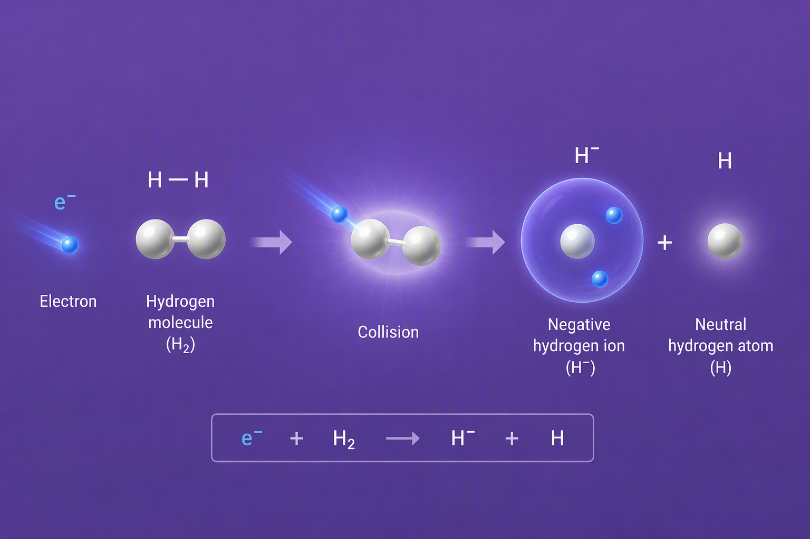
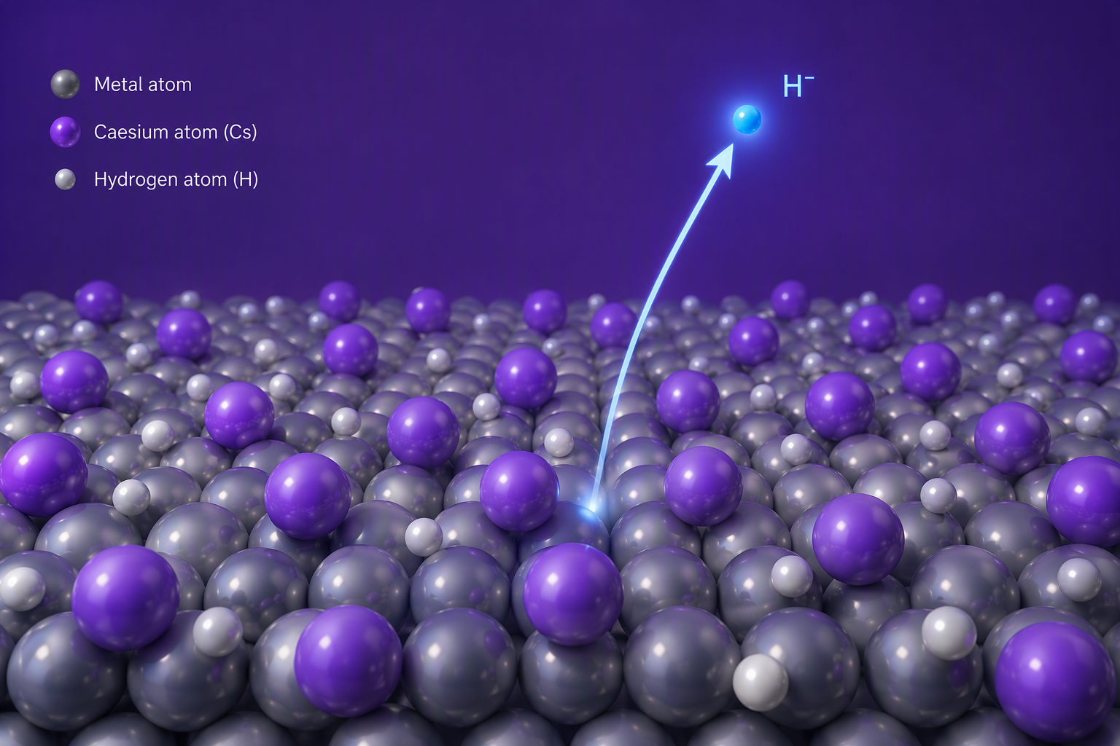
Two main production channels of H⁻
Dissociative Electron Attachment (DEA) in plasma volume
Electron tunnelling from
caesiated metal surface
Image by Microsoft Copilot
Image by Microsoft Copilot
How does the discharge power coupling and surface material selection affect each?

Slide 4
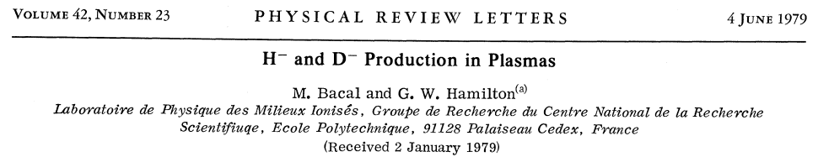
Dissociative Electron Attachment (DEA)
Requires ro-vibrational excitation of the H₂ molecules and high (cold) electron density
H₂(ν>0)
e⁻
H⁻
e⁻
H₂(ν=0)
H
H₂(ν>0)
Notes:
Main point: two step process with contrast in preferential EED

Slide 5
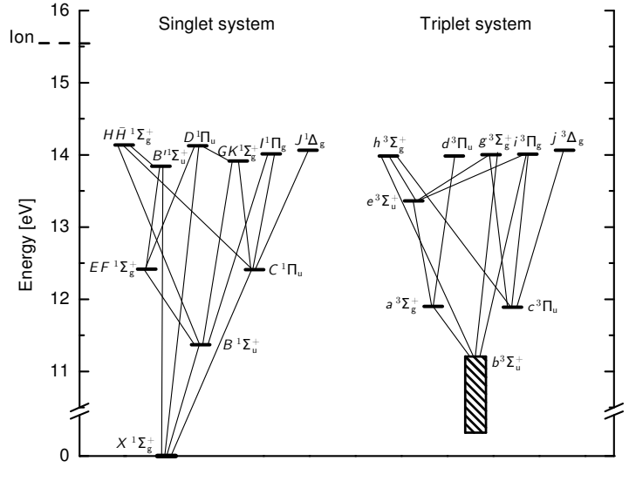
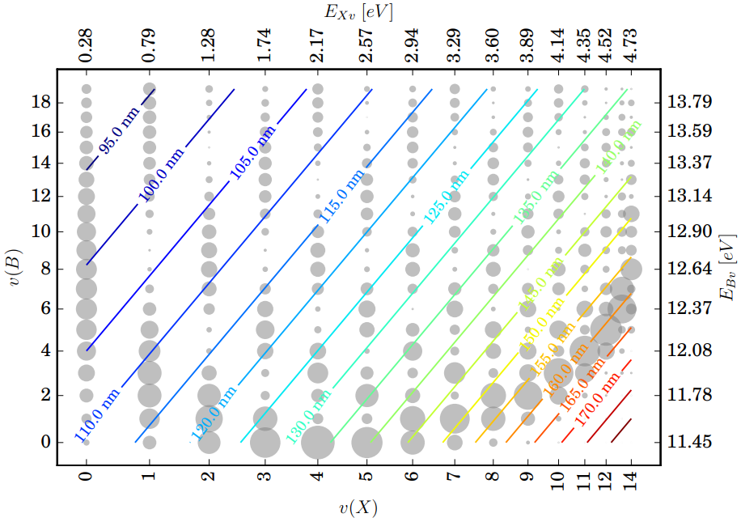
H₂ vibrational excitation
The predominant channel for the excitations of high vibrational levels in the plasma volume is electronic excitation to B¹Σ⁺_{u} and C¹Πu singlet states, followed by VUV-emitting radiative decay to high vibrational levels (ν’’ ≥ 5) of the X¹Σ⁺_{g} ground state
J.R. Hiskes, J. Appl. Phys. 51 4592, (1980) -
Notes:
Main point: singlet excitation populates high vibrational states (overlap of wave functions).

Slide 6
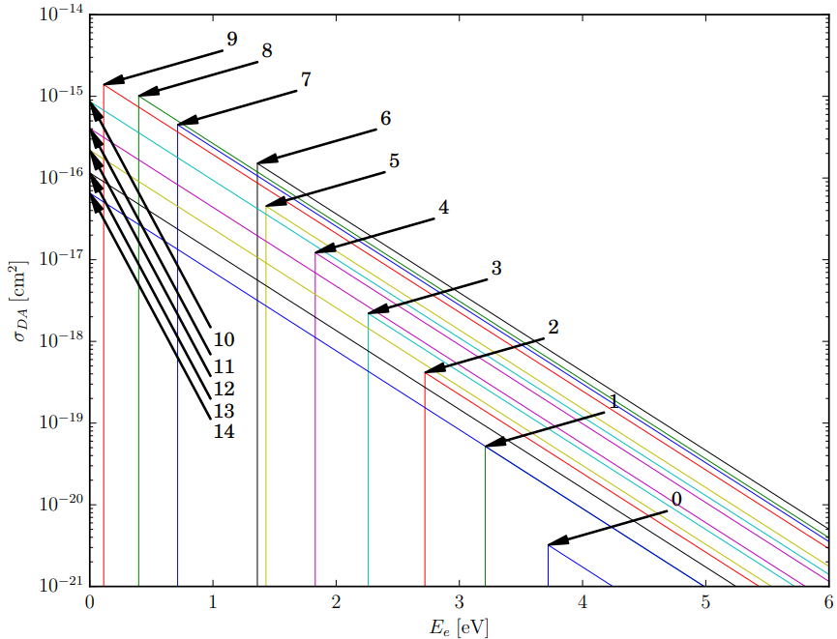
Dissociative Electron Attachment (DEA)
The DEA cross section increases by 6 orders of magnitude with increasing vibrational state.
At the same time the threshold DEA electrons energy becomes very low.
Vibrationally excited molecules and low energy electrons!
Either one can be a bottle neck limiting the DEA rate…
e⁻
H⁻
H
H₂(ν>0)
Notes:
Main point: high vibrational states AND COLD ELECTRONS required for DEA

Slide 7
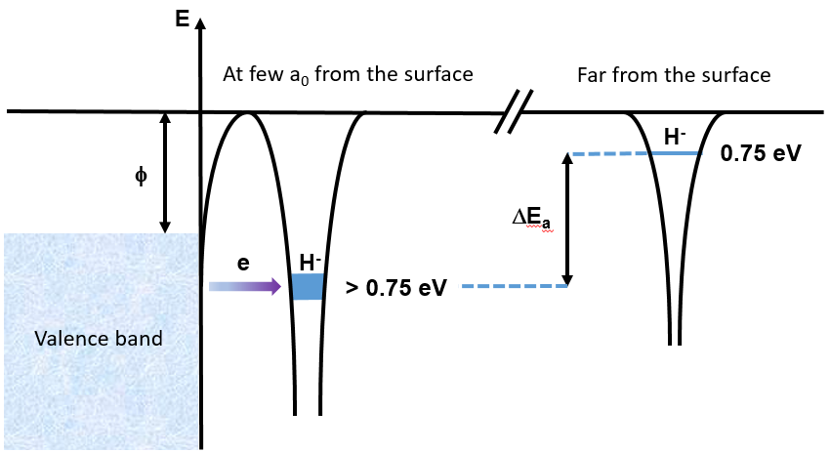
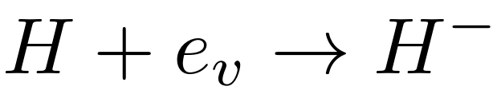
Surface production of H⁻
Electron tunnelling through the potential
barrier requires low work function
Notes:
Main point: surface production is a tunnelling process governed by quantum mechanics – requires atomic precursors!

Slide 8
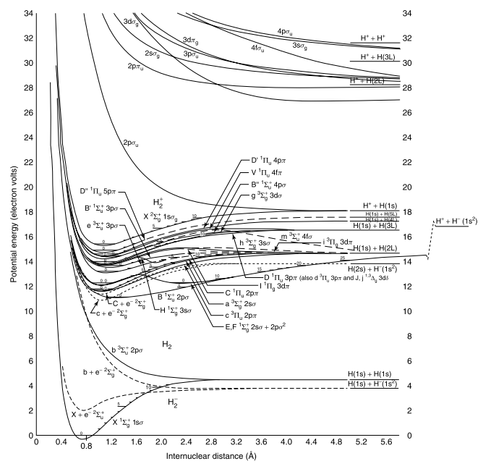
H₂ dissociation
The most significant dissociation channel of the hydrogen molecule is excitation to triplet states.
The majority of triplet excitations lead to the repulsive b³Σ⁺_{u} state.
R. Celiberto et al. At. Data Nucl. Data Tables, 77(2):161, 2001 –
Notes:
Main point: the predominant dissociation channel in the plasma volume is triplet excitation and relaxation to repulsive b-state

Slide 9
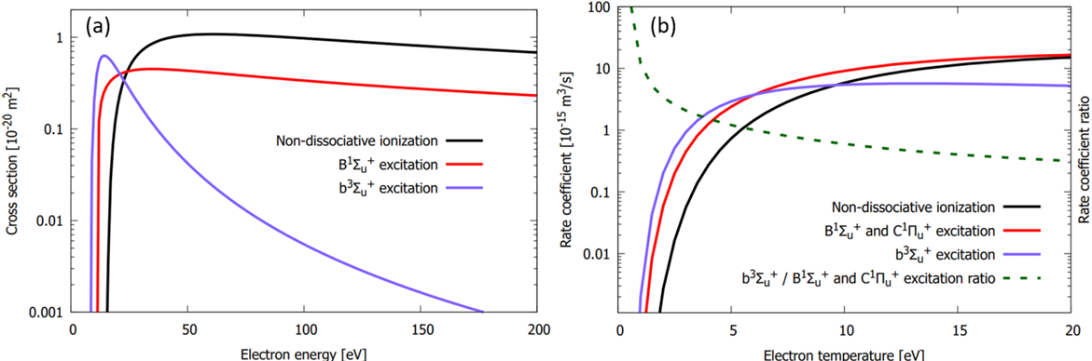

Optimising volume vs. surface production
Optimising the volume production requires optimising the vibrational excitation of the H₂ molecules.
This can be achieved by optimising electronic excitation to singlet states.
Optimising the surface production requires optimising molecular dissociation to supply H atoms.
This can be achieved by optimising electronic excitation to triplet states.
The most probable excitations to singlet and triplet states are X¹Σ_{g}⁺ → B¹Σ_{u}+ and X¹Σ_{g}⁺ → b³Σ_{u}⁺
Their cross sections peak at very different electron energy affecting the rate coefficient ratio vs T_{e}
Notes:
Main point: the EED can favour either volume or surface production

Slide 10
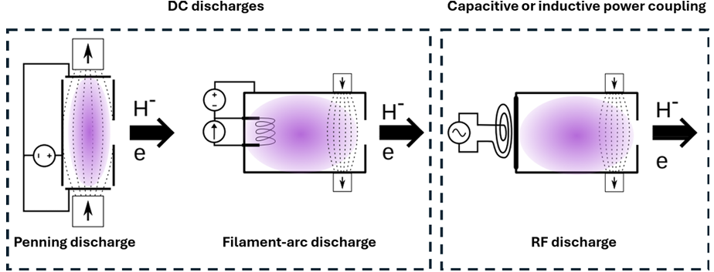
Importance of discharge type
Electron Energy Distribution (EED)
with hot tail favours volume production
Maxwellian EED better suited for surface production
Notes:
Main point: practically the EED is set by the ion source design. Control parameters have a limited effect.

Slide 11
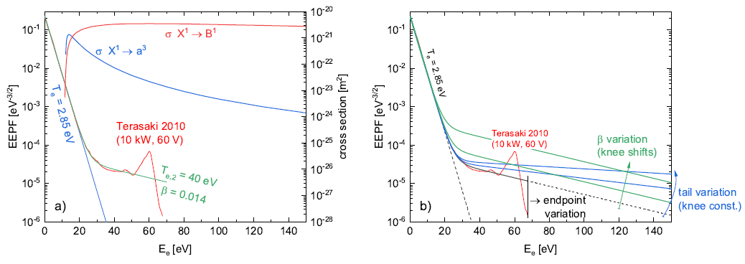
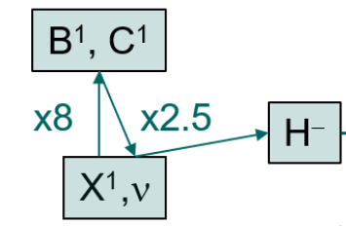
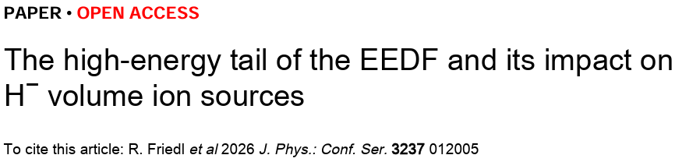
Collisional radiative modelling
Hot tail vs. Maxwellian
Notes:
Main point: this is supported by collisional radiative modelling predicting different H- yields.

Slide 12
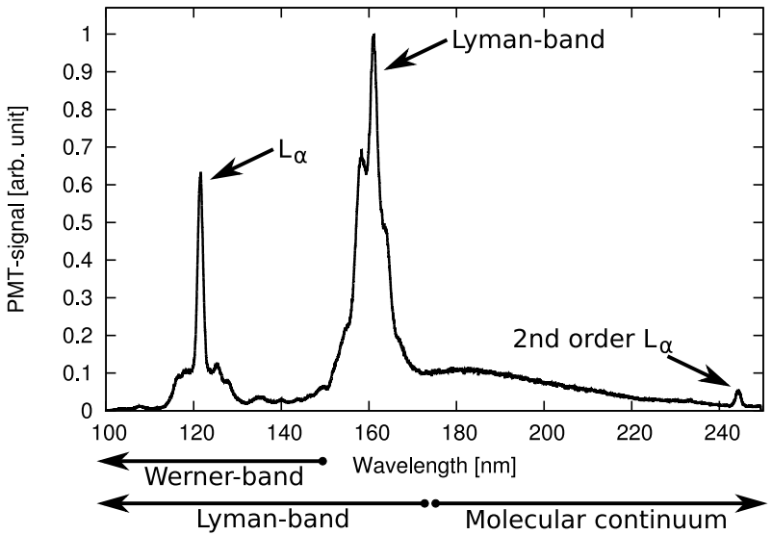
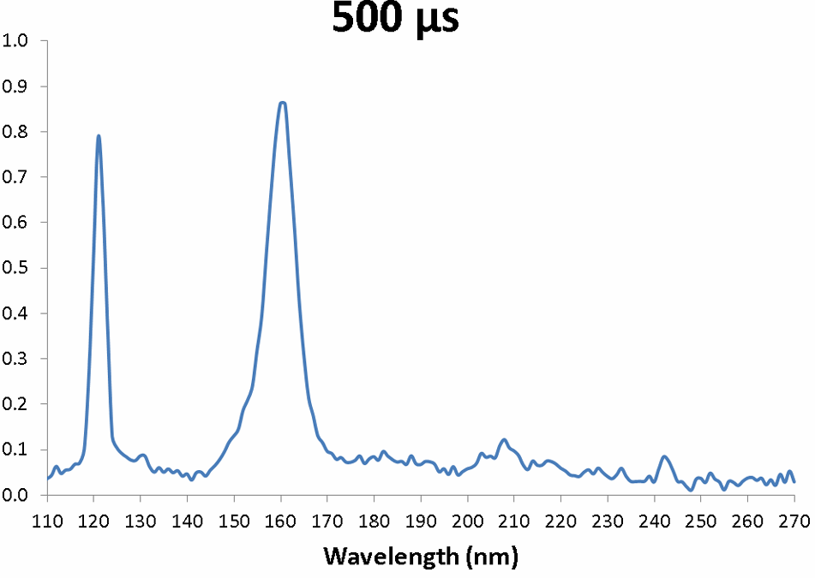

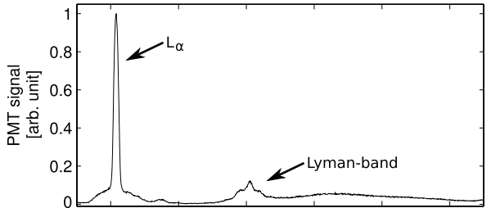
VUV-spectroscopy
Lyman-band
Filament source
Penning source
Microwave source
The discharge type matters!
Mol. continuum
Notes:
Main point: the singlet and triplet excitations can be probed by VUV-spectroscopy revealing differences between power coupling techniques

Slide 13
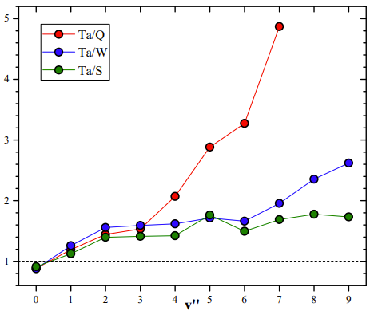
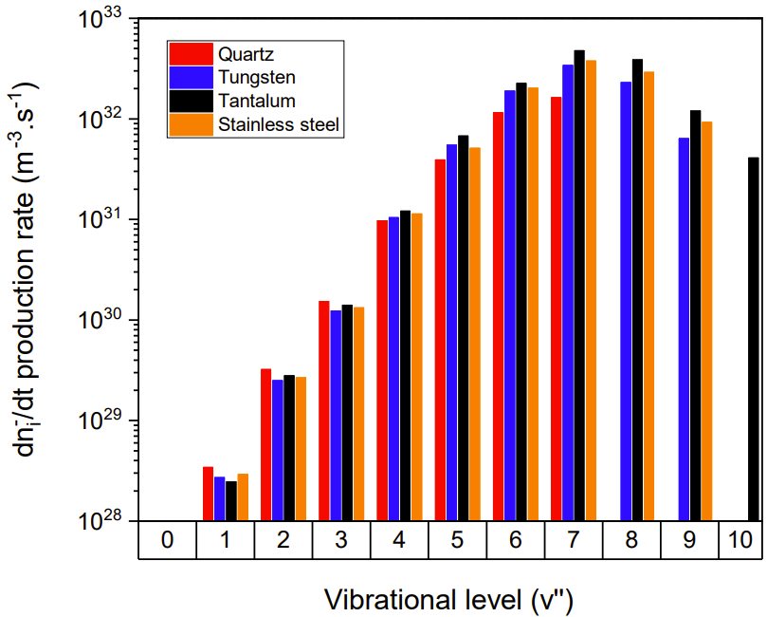
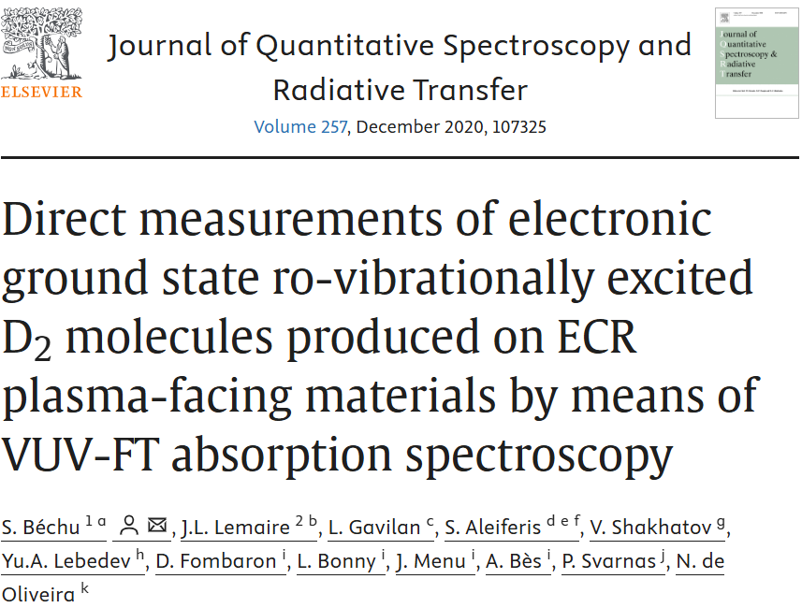
Surfaces affecting vibrational excitation
The vibrational distribution of H₂ molecules can be affected by surface interactions
Recombination of atoms
Auger relaxation of the repulsive b₃Σ_{u}⁺ state quenching to high vibrational level
Electronic recombination and dissociation of H₃ compound molecule
Notes:
Main point: SURFACES AFFECT VIBRATIONAL DISTRIBUTION!

Slide 14
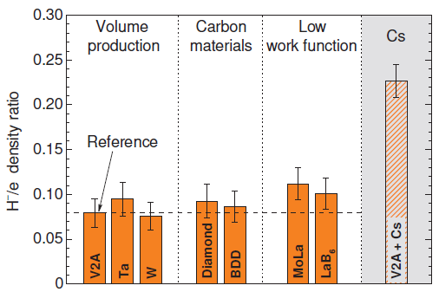
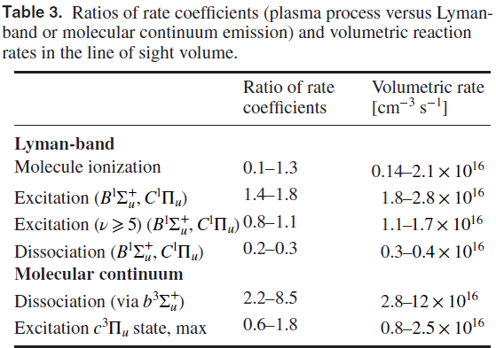
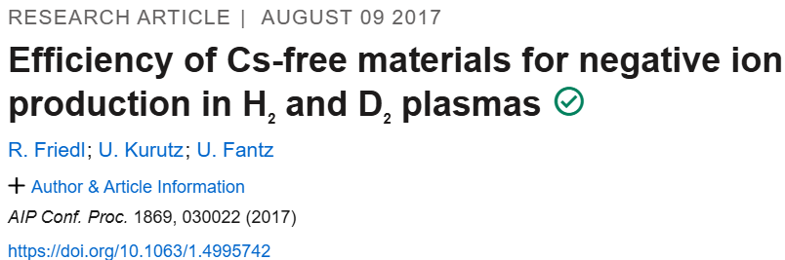
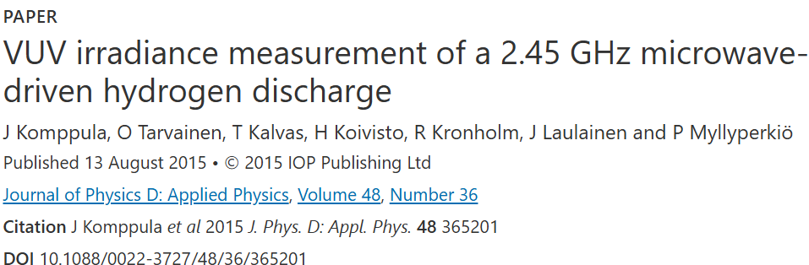
Does this translate to H⁻ density?
VUV-irradiance measurement (microwave source)
Each molecule is ionised, excited and dissociated
several times as it passes through the ion source
Microwave source with electrostatic filter
Notes:
Main point: Not clear if this translates to H- density. VUV-irradiance measurements imply that vibrational excitation is not limiting.

Slide 15
The surfaces contribute to volume production of H⁻ via DEA if the vibrational excitation rate via volumetric processes is not sufficient.
In the opposite case the cold electron density is the limiting factor.
Altogether it can be expected that the contribution of surfaces on DEA depends on the discharge type and filter field strength.

Slide 16

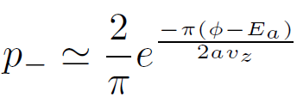
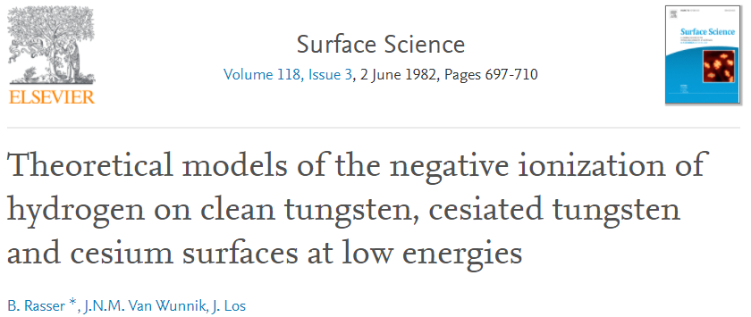
Surface production of H⁻
Electron transition rate
H⁻ survival probability
Conduction electron density and surface work function
Notes:
Main point: Surface production governed by conduction electron density and work function. The first one often ignored and hidden in constant “a”

Slide 17
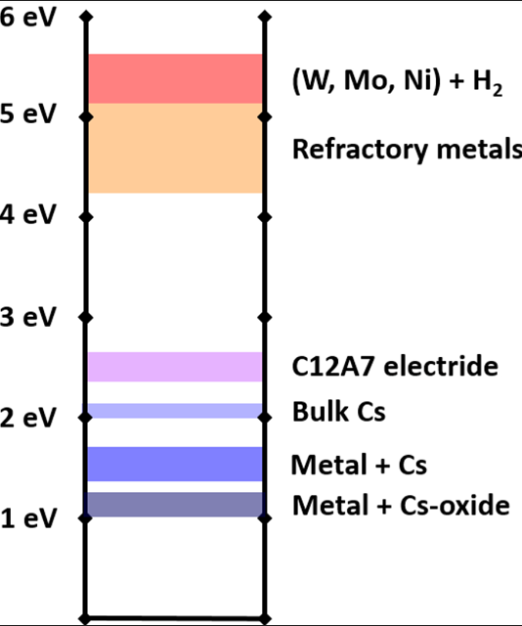




Work function
Notes:
Main point: caesiated metals in hydrogen environment have low work function (oxides even lower). Semi-empirical model used historically.

Slide 18
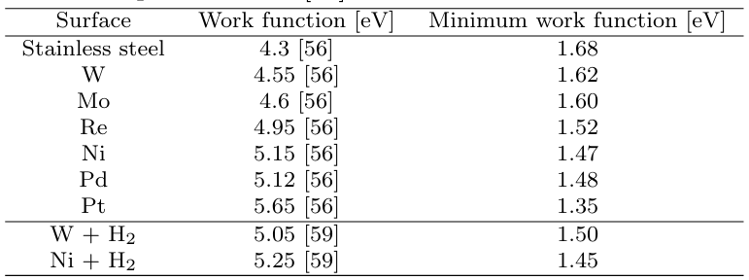
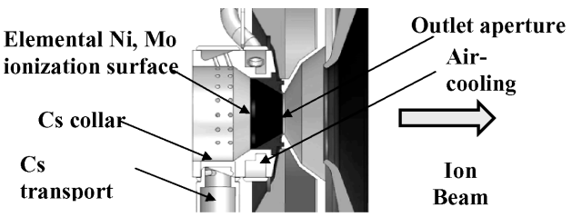
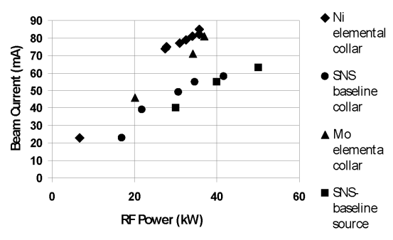

Work function
Known
catalysts
Ni is ferromagnetic below 360 °C
Ni is paramagnetic above 360 °C
Notes:
Main point: predicts some known catalyst surfaces to reach lower work function than Mo+Cs. Early attempt at SNS but not conclusive.

Slide 19
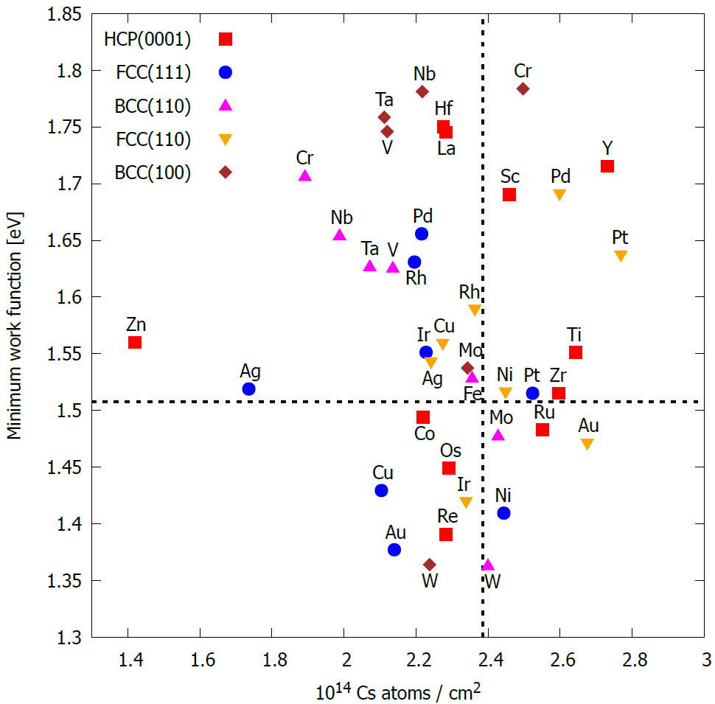

Work function – orbital overlap model
Metals of interest:
Molybdenum
Nickel
Palladium
Platinum
Rhenium
Tungsten
Tantalum
Niobium
Note: The optimum coverage changes!
Notes:
Main point: the minimum work function can be predicted more accurately. Depends on the solid crystal structure. Interesting materials highlighted.

Slide 20
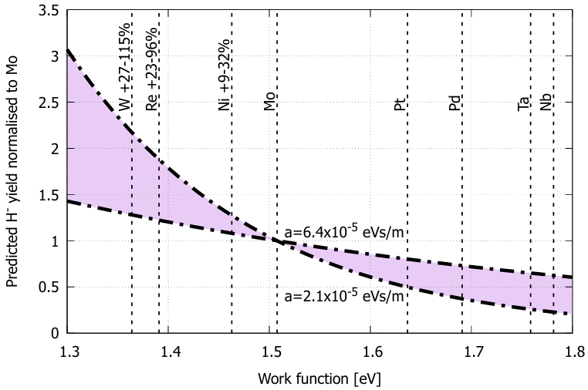
Predicted H- yield relative to Mo
BUT…
Notes:
Main point: Allows predicting H- yield relative to Molybdenum BUT does not account the conduction electron density

Slide 21
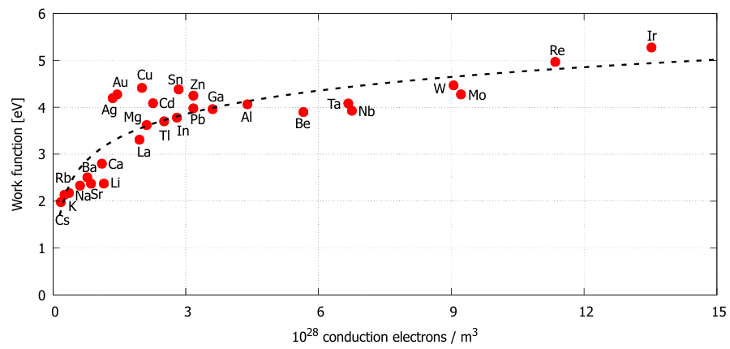
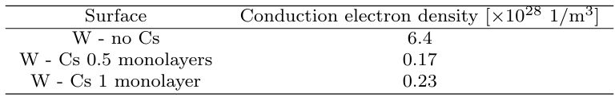
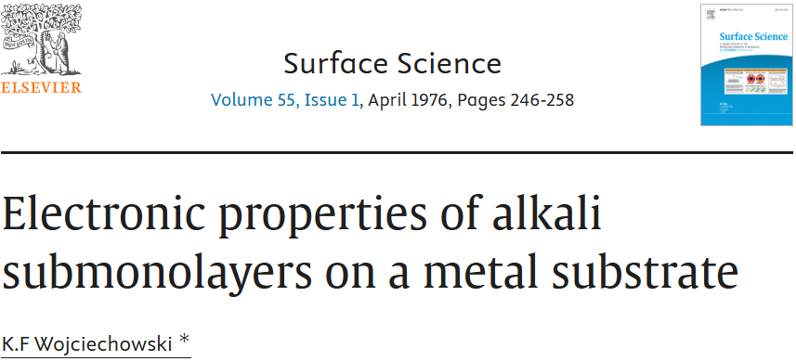
Conduction electron density (Fermi energy)
Density Functional Theory calculations of work function AND conduction electron density required
Notes:
Main point: Very limited data on the conduction electron density of caesiated metals

Slide 22
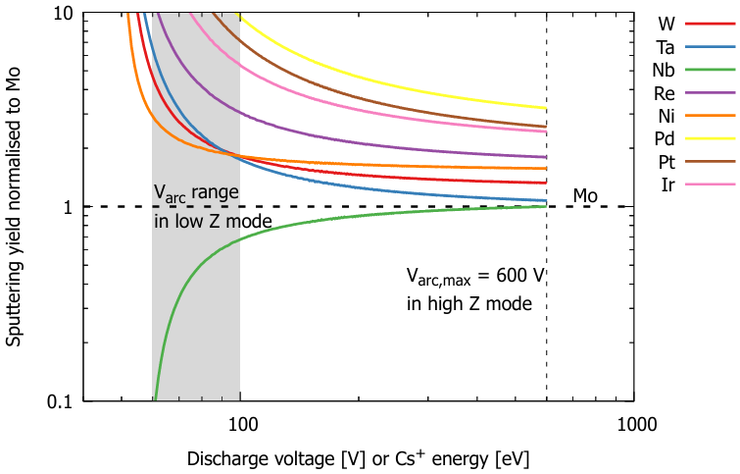

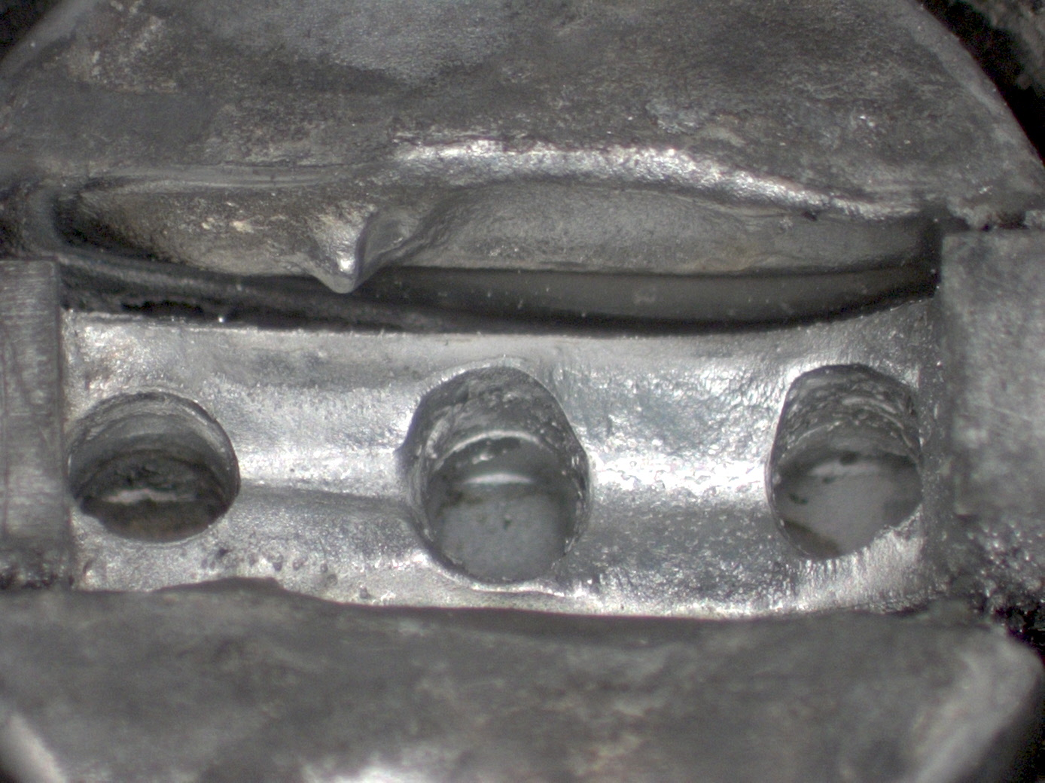
Other material selection considerations
Material deposition: in filament-sources the surfaces becomes covered by Ta
Sputtering: unwanted deposition and lifetime of the ionisation surface
After operation
Notes:
Main point: Deposition and sputtering are important. Ta and Nb not great for surface production. Best studied in an RF ion source.

Slide 23
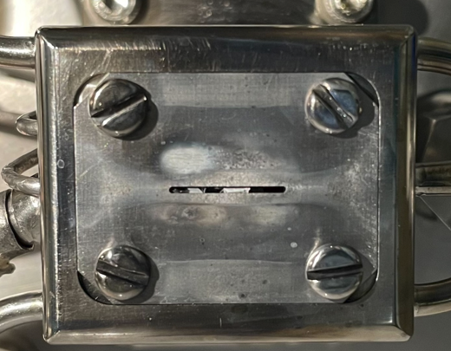
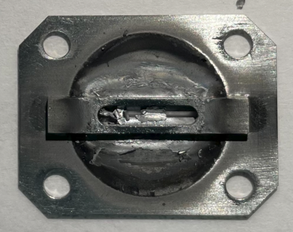
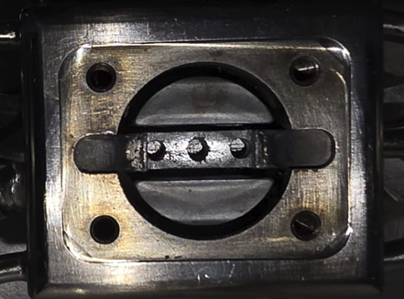
Other material selection considerations
Thermal cycling of materials facing pulsed plasmas causes spalling (flaking).
Molybdenum has low dynamic spall strength (< 1GPa) and is brittle. Internal stresses cause material to delaminate at grain boundaries.
Flake formation is a known failure mode of Penning sources (short circuit, blockages).
Potential solutions: brittle-to-ductile transition via heat treatment (800-900 °C) or Mo-Re alloy?
16/9/2026
16/9/2026
18/9/2026
Notes:
Main point: Can heat treatment be applied?

Slide 24
Recommendations
Comparison of the VUV-emission spectrum of an arc discharge and an RF discharge
H⁻ ion source.
Measurement of the H⁻ density in an RF plasma near different metal surfaces at different magnetic filter fields.
Measurement of the work function in high-current ion source and comparison to DFT calculation.
DFT calculation of the conduction electron densities of caesiated metals.
Comparison of H⁻ beam current in high-current RF source with different converter materials (Mo, W, Re, Ni, Pt, Pd) at different surface temperatures.

Slide 25

Thank you
isis.stfc.ac.uk
STFC

