Slide 1


Ion Source Development
for AMS at WHOI
Mark L. Roberts¹ and Joshua D. Hlavenka^{1,2}
¹Woods Hole Oceanographic Institution
^{1,2}Argonne National Laboratory
NIBS ’26
Sep 20 – 25, 2026
Nelson, British Columbia, Canada

Slide 2
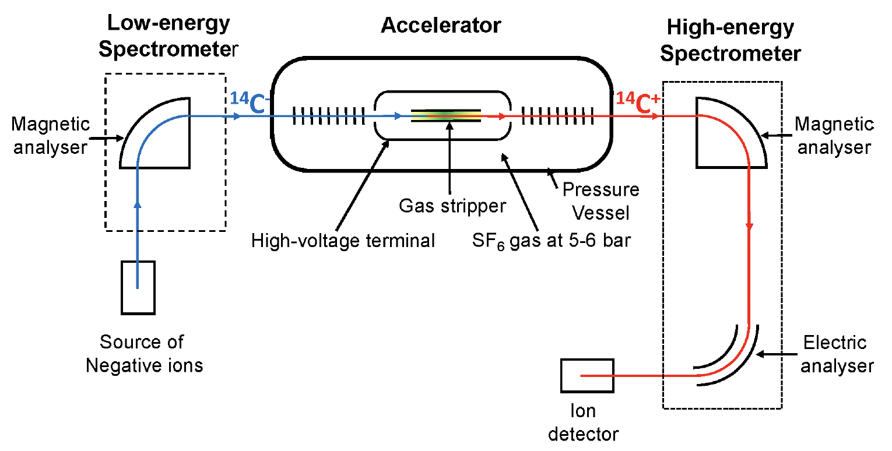
What is AMS?
Accelerator mass spectrometry (AMS) is a method to count atoms of rare, long-lived radioactive isotopes (like ¹⁴C) by accelerating ions to high kinetic energies using an accelerator and separating isotopes by mass.
Schematic from ‘The Methodology and
Physics of AMS’, L. Keith Fifield

Slide 3
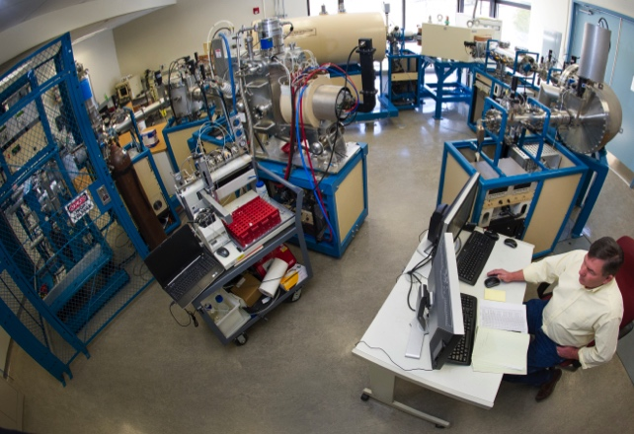
One of two AMS systems at WHOI
CFAMS System

Slide 4
Why a negative ion source?
Why electrostatic tandem acceleration?
AMS uses a negative ion source to eliminate background interference from isobars.
An accelerator because molecular breakup in the high voltage terminal stripper eliminates molecular ions.
The best example of this is that ¹⁴N does not form a stable negative ion. If ¹⁴N made a negative ion, radiocarbon dating using AMS would not be possible.
For example, in ¹⁴C AMS, the terminal stripper destroys interfering ¹²CH₂ and ¹³CH molecules.

Slide 5
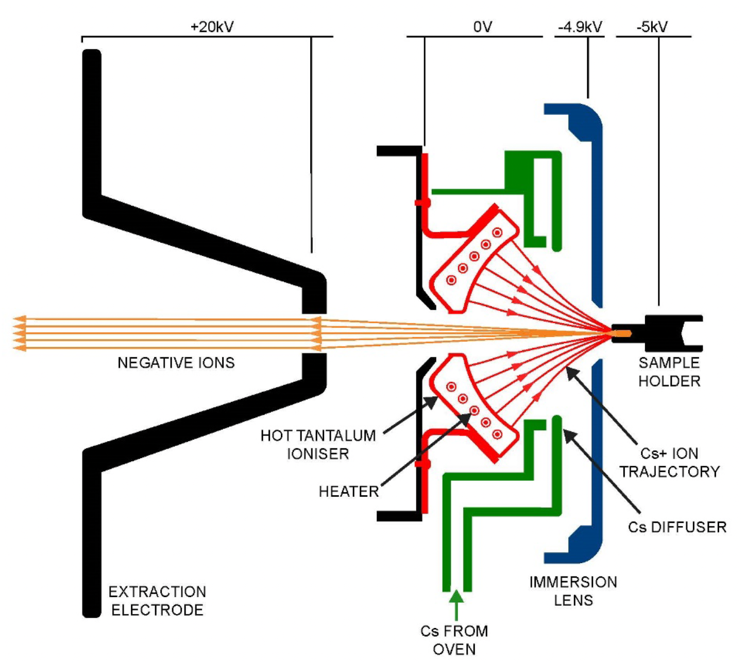
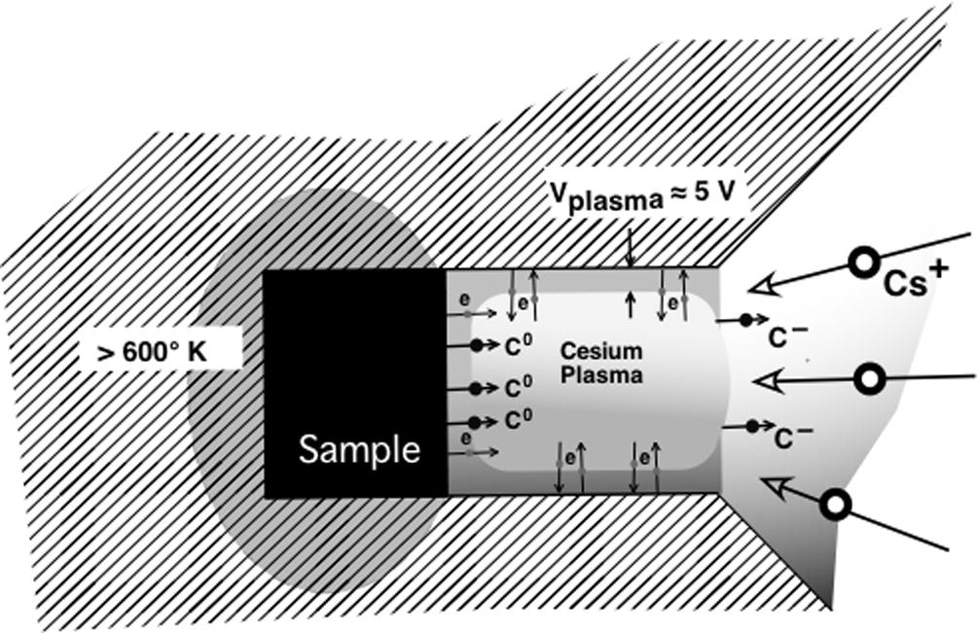
Principle of the Negative Ion Cesium Sputtering Source
-5 kV
-4.6 kV
O V
+ 20 kV
Sample
Holder
Negative Ions
Hot Tantalum
Ionizer
Cs+ Ion
Trajectory
Heater
Cs Diffuser
From ‘The Methodology and
Physics of AMS’, L. Keith Fifield
Immersion
Lens
Extraction
Electrode
Cs From
Oven

Slide 6
Important Metrics for a Negative Ion Source
Ion Current
At 100 μA of ¹²C⁻, the ¹⁴C count rate from a modern sample is ~ 300 cps. Hence, to get to a total of 250,000 counts (0.2%) takes ~ 14 minutes
Efficiency
A 30 μg, 11,500 year old sample has ~ 370,000 ¹⁴C atoms.
With a 10% source efficiency and 50% stripping efficency, we can only detect a maximum of ~ 18,000 ¹⁴C atoms (0.7%).
Beam Emittance
Need a reasonably small beam emittance. Too large a beam emittance and isotope fraction becomes a problem.
The accelerator stripping canal diameter is typically the limiting factor.

Slide 7
Ion Source Modeling
Numerical Electrodynamics Laboratory (NEDLab). A 2.5-dimensional (cylindrical or Cartesian) particle and field simulation software.
Important considerations:
  Child’s Law modeling (Cs⁺ from ionizer)
  Ion emission with thermal energy distribution and randomized angles
  Space charge

Slide 8
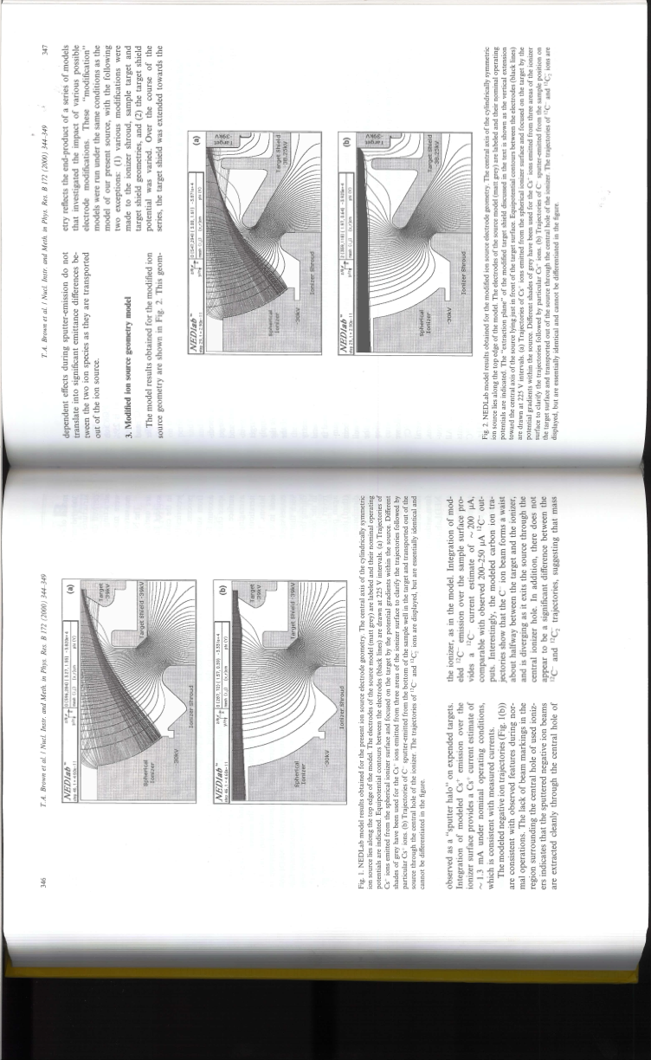
Ion Source Modeling
Cs⁺
C⁻
Old electrode geometry
New electrode geometry
Model predicted 2X Current. In practice, currents increased from ~ 200 μA to ~370 μA.
From Brown, Roberts, and Southon
NIM B 172 (2000) 344-349

Slide 9
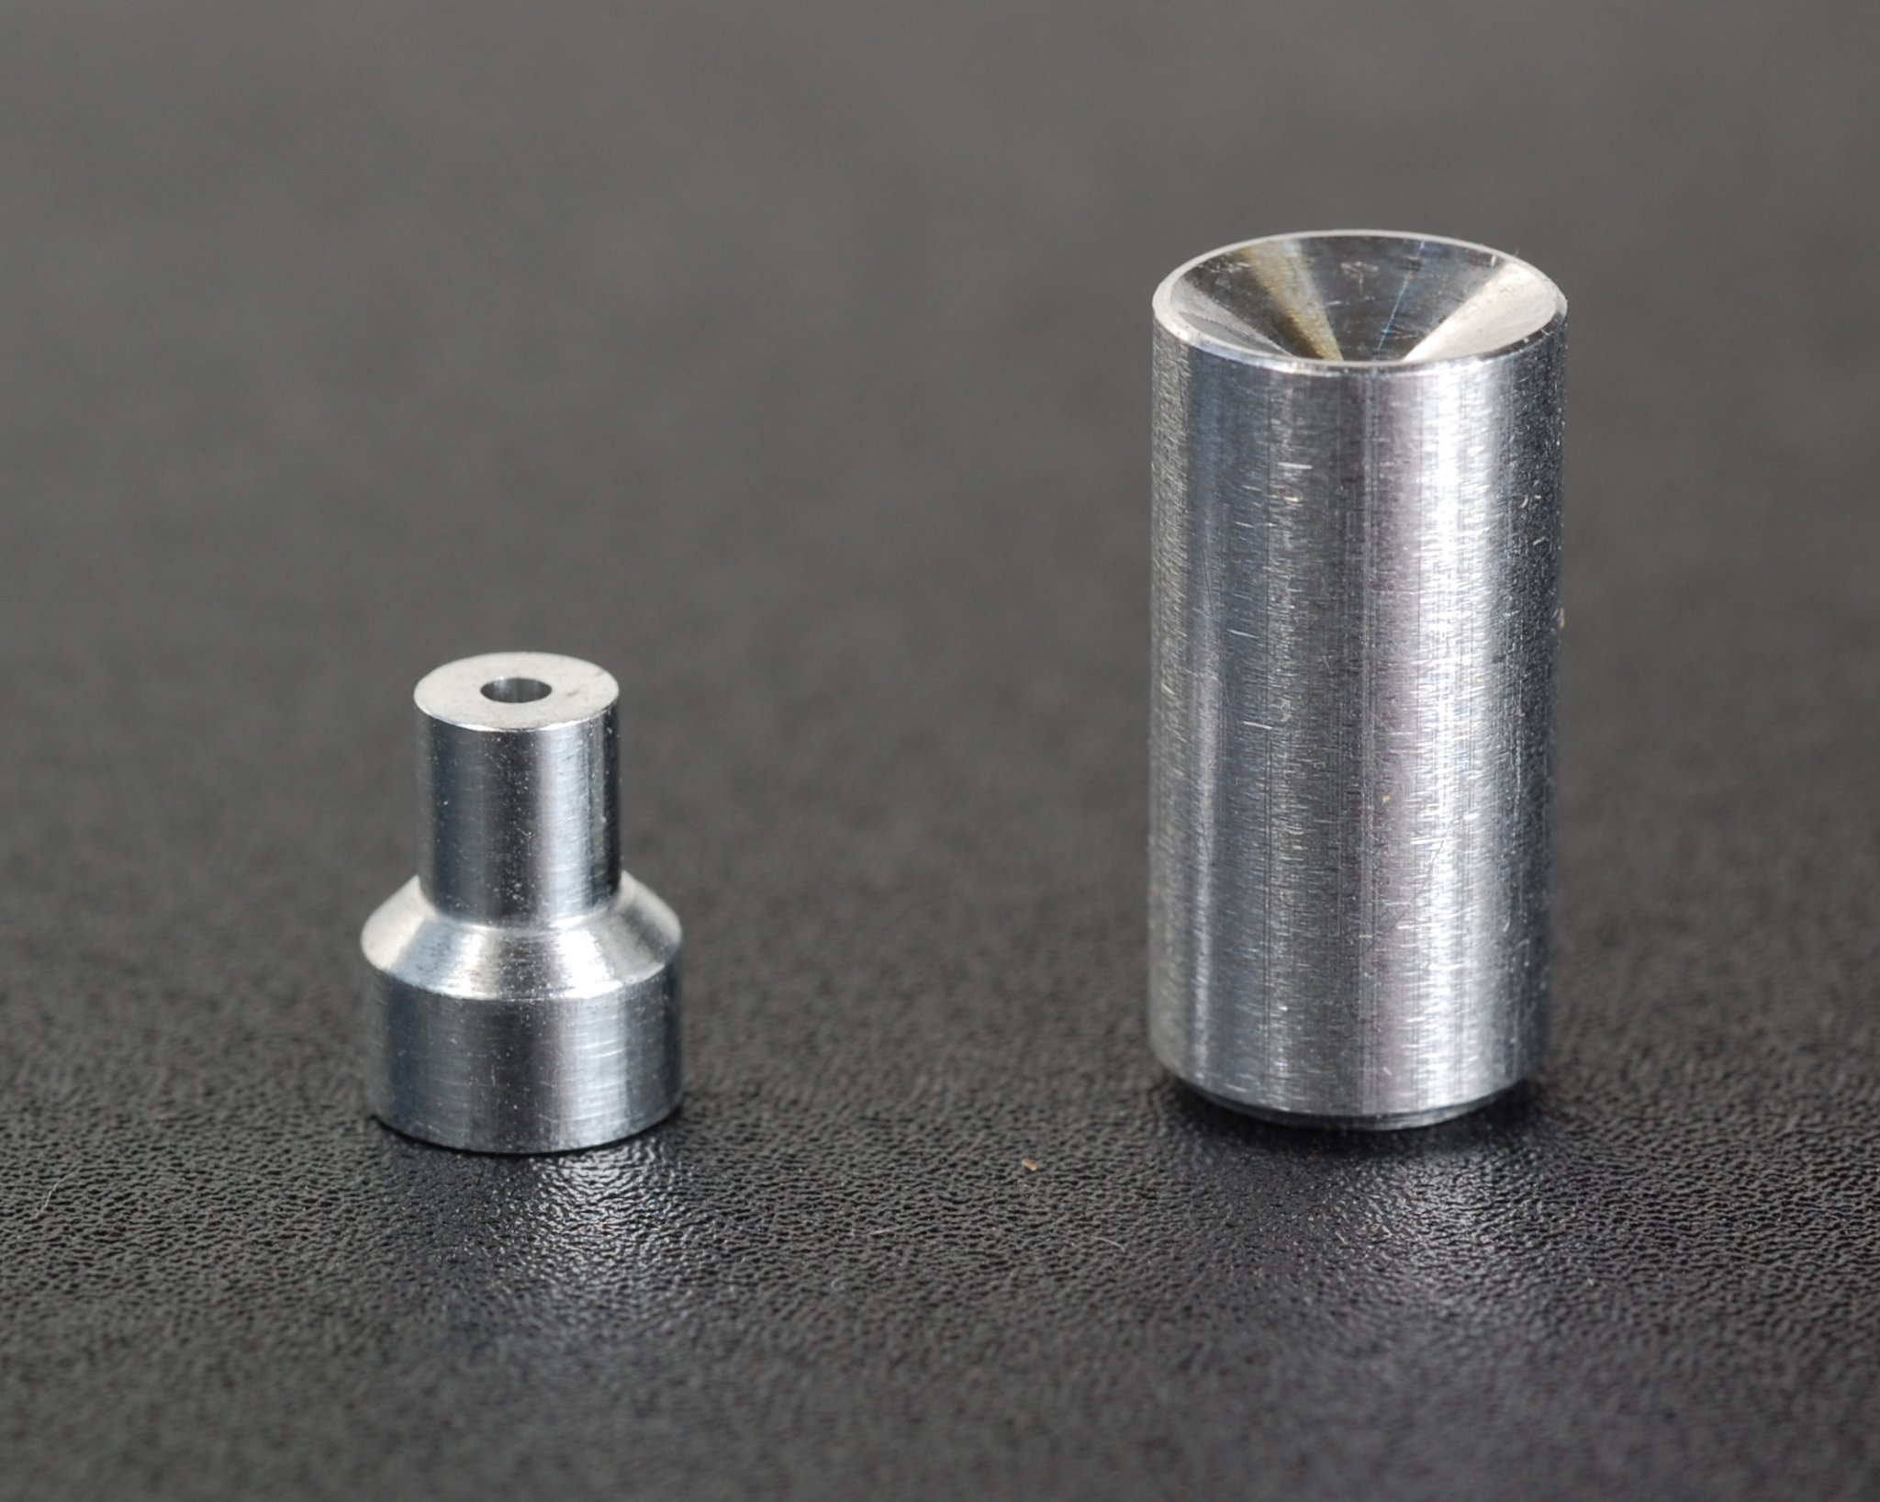
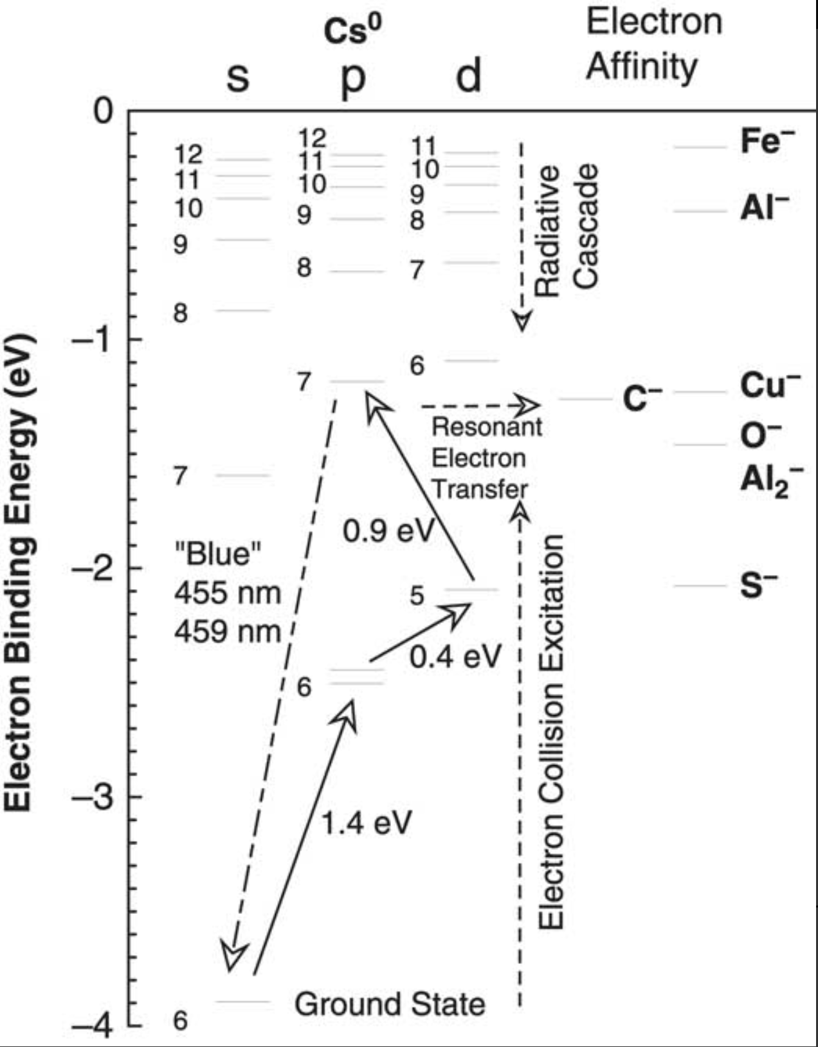
Ionization potentials of Cs compared to the electron affinities of C and other elements,

Slide 10
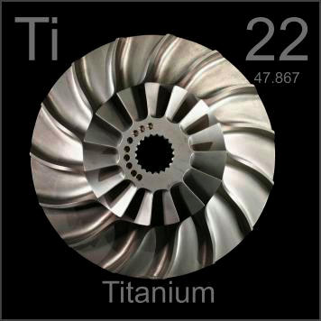
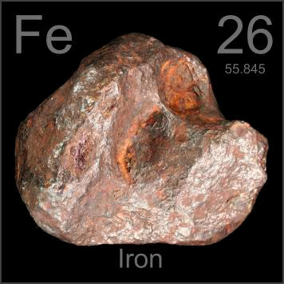
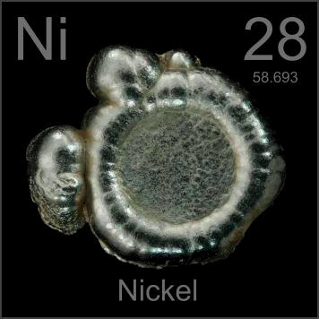
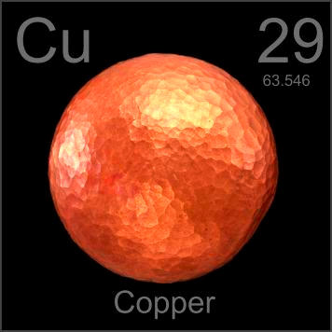
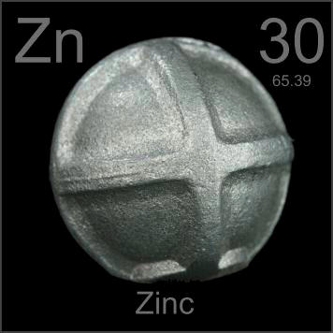
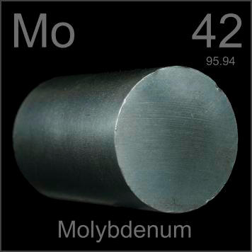
Different Cathode Material
Graphite
Zinc Insert
Aluminum
Cathode
Cross-section of NOSAMS cathode with zinc insert.
From http://www.periodictable.com

Slide 11
Different Cathode Material

Slide 12
Different Cathode Material
Insert Material | Electron Affinity (eV) | Ion Source Efficiency
Zinc | - | 19.60%
Titanium | 0.085 | 20.60%
Iron | 0.153 | 16.60%
Aluminum (Al₂) | 0.433 (1.461) | 11.80%
Molybdenum | 0.747 | 10.30%
Nickel | 1.157 | 5.00%
Copper | 1.236 | 5.50%
Cross section of a sample holder with sample being sputtered by Cs⁺ beam.
From J.S. Vogel
NIM B 361(2015) 156-162

Slide 13
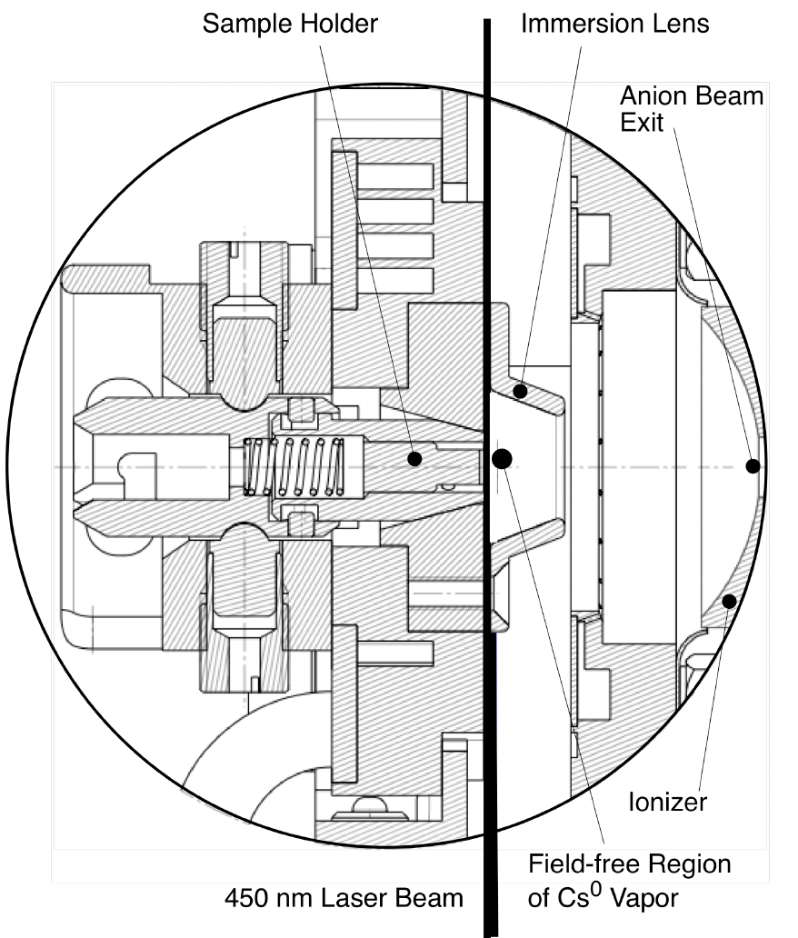
LASER Assisted Sputtering
From Vogel
NIMB V438 (2019) 89-95
From Vogel and Giacomo
Radiocarbon V59 (2017) 957-965
450 nm 5 W LASER
10-15% Increase in negative ion current

Slide 14
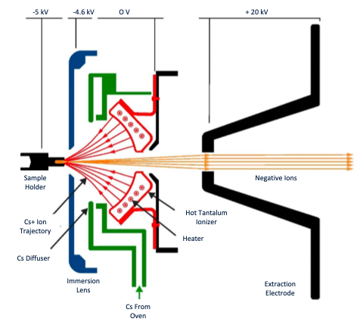
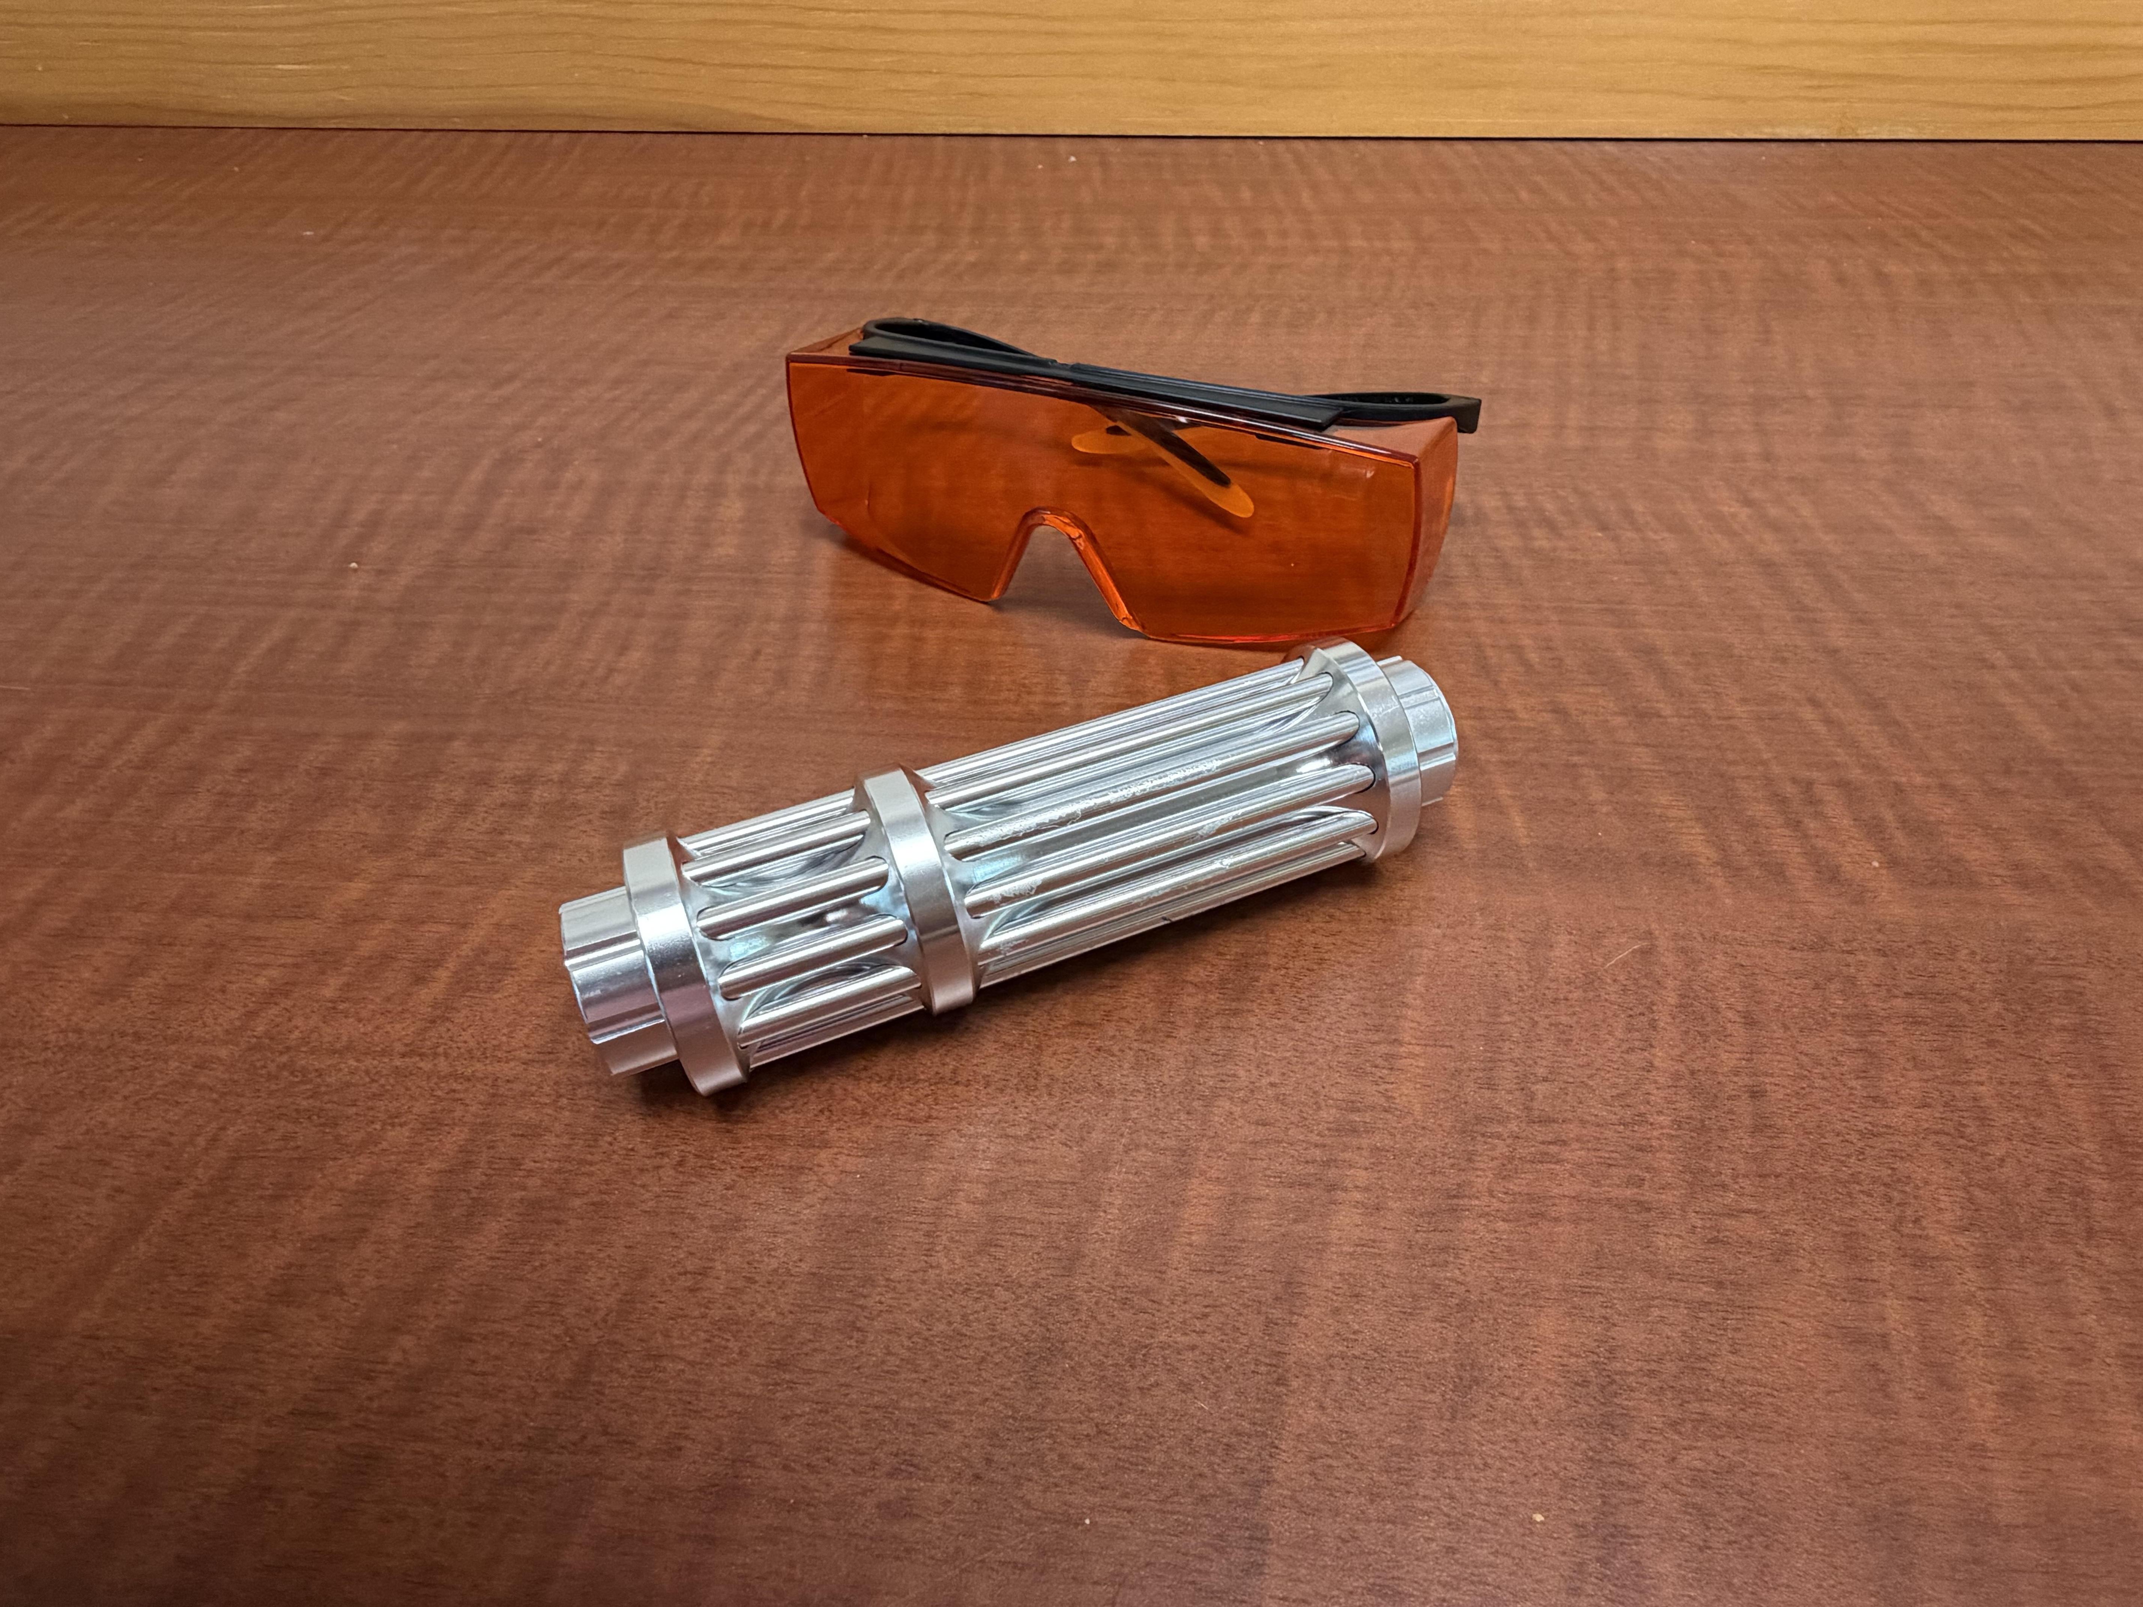
LASER Assisted Sputtering
LASER
450 nm 5 W LASER
No increase in
negative ion current

Slide 15
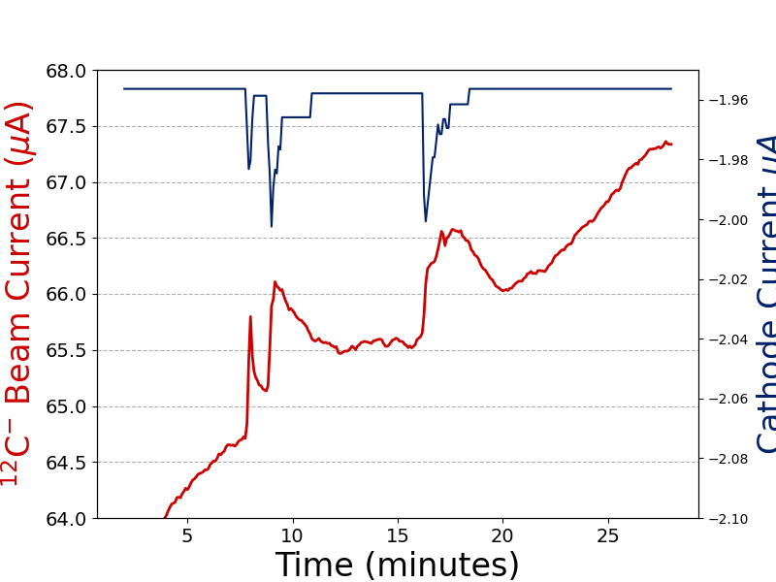
LASER Assisted Sputtering
2-3% Increase in negative ion current
450 nm 5 W LASER

Slide 16
Summary
The development of AMS was/is intimately linked to negative ion cesium sputter sources.
The development of negative ion cesium sputter sources was/is intimately linked to the development of AMS.
Despite decades of development, the ion source remains the most maintenance-intensive and least-understood component of an AMS system.

Slide 17
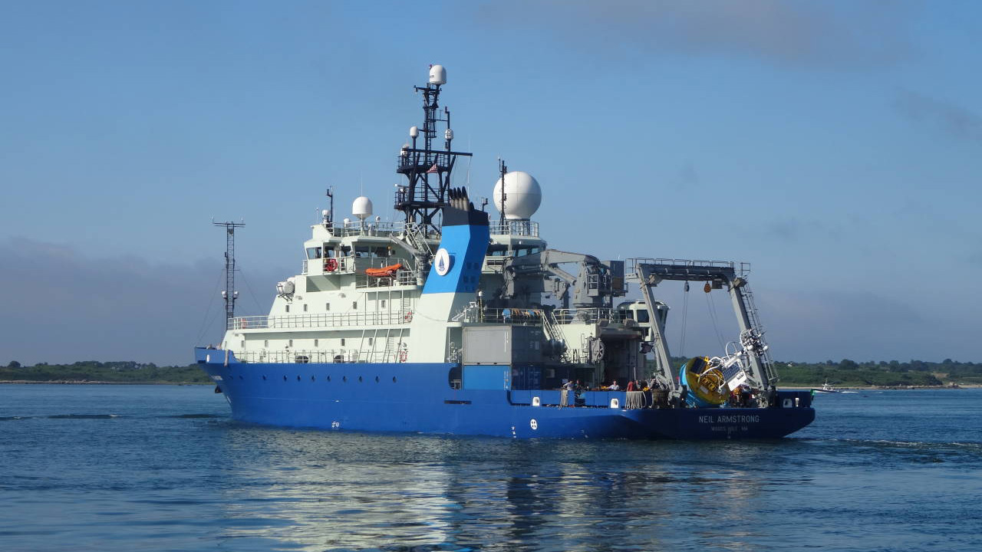
Thank you

