Slide 1


Ion Source Development
for AMS at WHOI
Mark L. Roberts¹ and Joshua D. Hlavenka^{1,2}
¹Woods Hole Oceanographic Institution
^{1,2}Argonne National Laboratory
NIBS ’26
Sep 20 – 25, 2026
Nelson, British Columbia, Canada

Slide 2
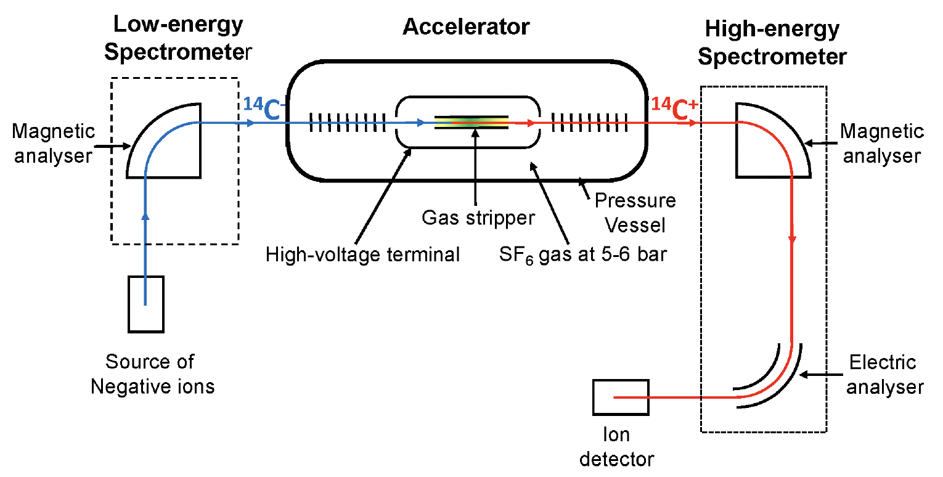
What is AMS?
Accelerator mass spectrometry (AMS) is a method to count atoms of rare, long-lived radioactive isotopes (like ¹⁴C) by accelerating ions to high kinetic energies using an accelerator and separating isotopes by mass.
Schematic from ‘The Methodology and
Physics of AMS’, L. Keith Fifield

Slide 3
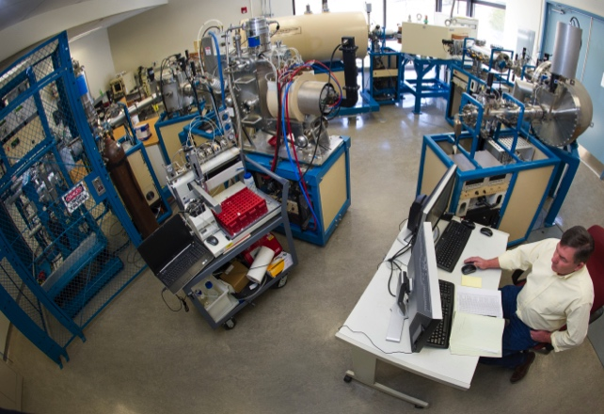
One of two AMS systems at WHOI
CFAMS System

Slide 4
Why a negative ion source?
Why electrostatic tandem acceleration?
AMS uses a negative ion source to eliminate background interference from molecular isobars.
An accelerator because molecular breakup in the high voltage terminal stripper eliminates molecular ions.
The best example of this is that ¹⁴N does not form a stable negative ion. If ¹⁴N made a negative ion, radiocarbon dating using AMS would not be possible.
For example, in ¹⁴C AMS, the terminal stripper destroys interfering ¹²CH₂ and ¹³CH molecules.

Slide 5
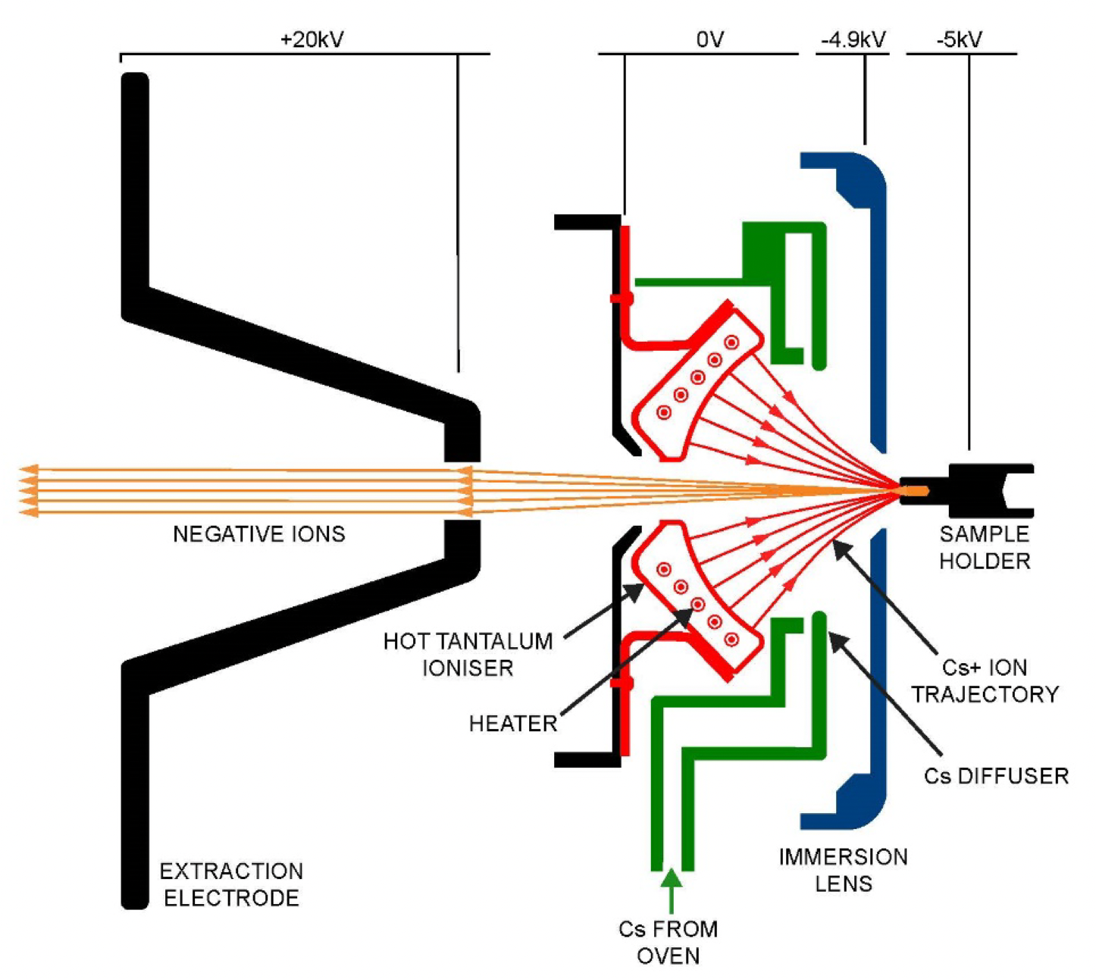
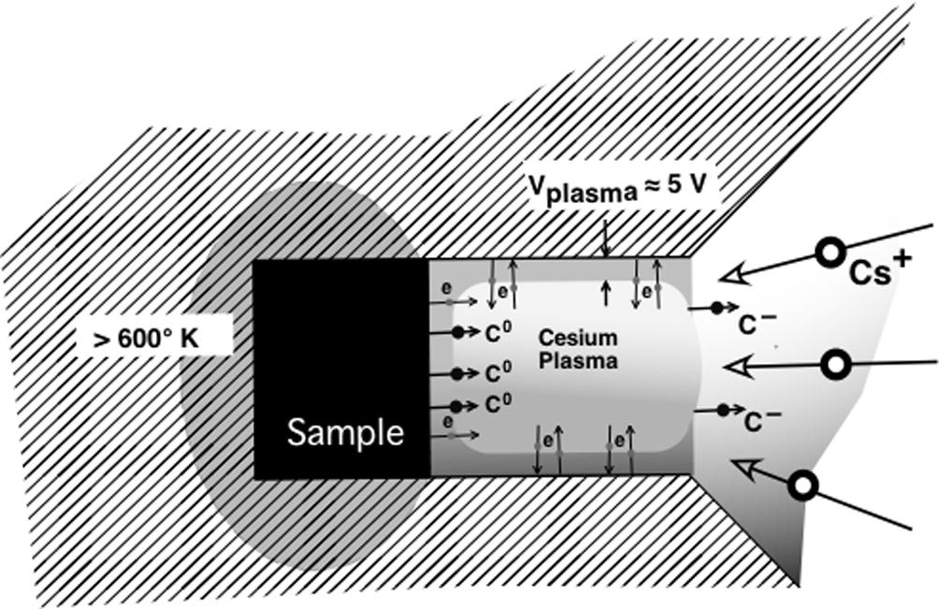
Principle of the Negative Ion Cesium Sputtering Source
-5 kV
-4.6 kV
O V
+ 20 kV
Sample
Holder
Negative Ions
Hot Tantalum
Ionizer
Cs+ Ion
Trajectory
Heater
Cs Diffuser
From ‘The Methodology and
Physics of AMS’, L. Keith Fifield
Immersion
Lens
Extraction
Electrode
Cs From
Oven

Slide 6
Important Metrics for a Negative Ion Source
Ion Current
At 100 μA of ¹²C⁻, the ¹⁴C count rate from a modern sample is ~ 300 cps. Hence, to get to a total of 250,000 counts (0.2%) takes ~ 14 minutes
Efficiency
A 30 μg, 11,500 year old sample has ~ 370,000 ¹⁴C atoms.
With a 10% source efficiency and 50% charge exchange (transmission), we can only detect a maximum of ~ 18,000 ¹⁴C atoms (0.7%).
Beam Emittance
Need a reasonably small beam emittance. Too large a beam emittance and isotope fraction becomes a problem.
The accelerator stripping canal diameter is typically the limiting factor.

Slide 7
Ion Source Modeling
Numerical Electrodynamics Laboratory (NEDLab). A 2.5-dimensional (cylindrical or Cartesian) particle and field simulation software.
Important considerations:
  Child’s Law modeling (Cs⁺ from ionizer)
  Ion emission with thermal energy distribution and randomized angles
  Space charge

Slide 8
Ion Source Modeling
Cs⁺
C⁻
Old electrode geometry
New electrode geometry
Model predicted 2X Current. In practice, currents increased from ~ 200 μA to ~370 μA.
From Brown, Roberts, and Southon
NIM B 172 (2000) 344-349

Slide 9
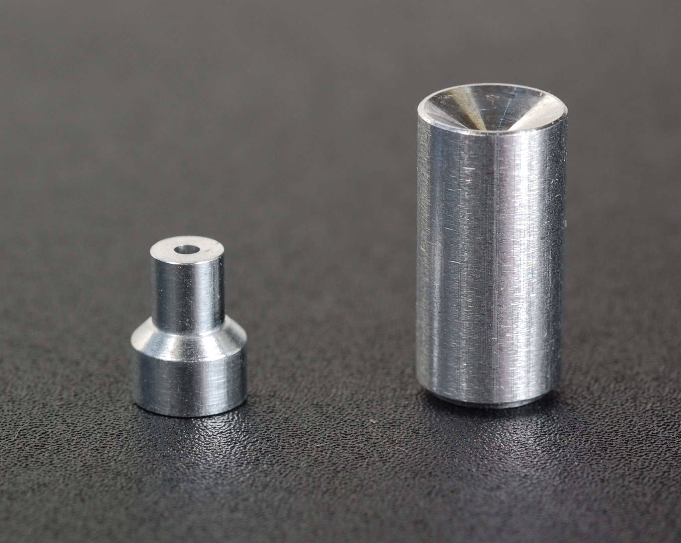
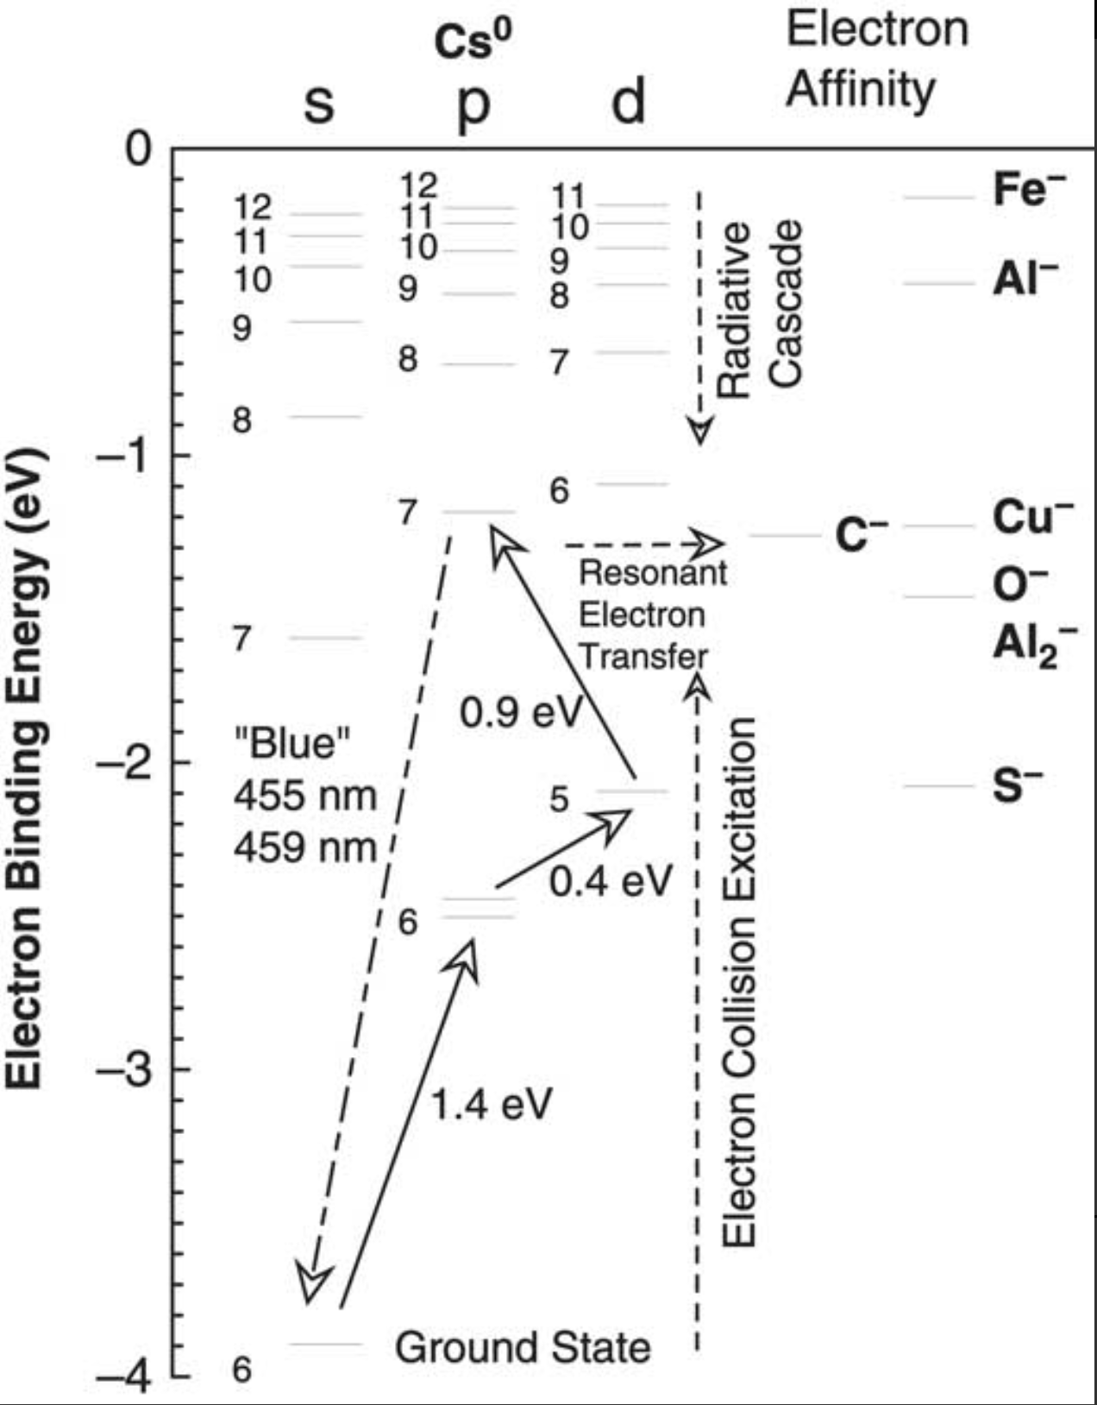
Ionization potentials of Cs compared to the electron affinities of C and other elements,

Slide 10
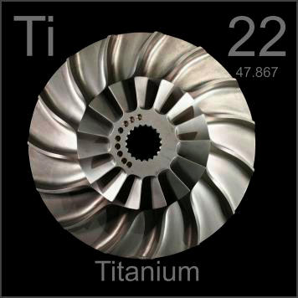
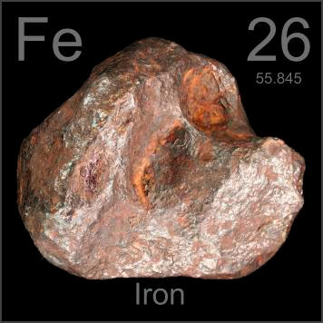
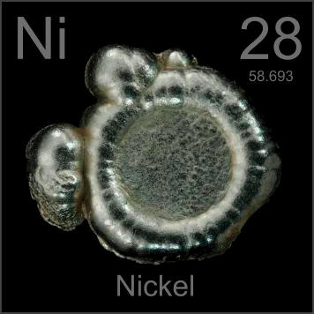
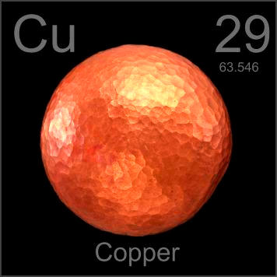
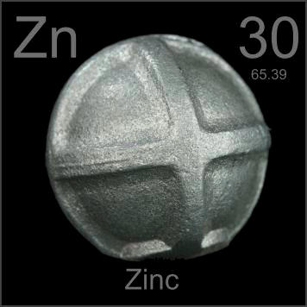
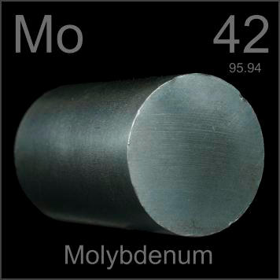
Different Cathode Material
Graphite
Zinc Insert
Aluminum
Cathode
Cross-section of NOSAMS cathode with zinc insert.
From http://www.periodictable.com

Slide 11
Different Cathode Material

Slide 12
Different Cathode Material
Insert Material | Electron Affinity (eV) | Ion Source Efficiency
Zinc | - | 19.60%
Titanium | 0.085 | 20.60%
Iron | 0.153 | 16.60%
Aluminum (Al₂) | 0.433 (1.461) | 11.80%
Molybdenum | 0.747 | 10.30%
Nickel | 1.157 | 5.00%
Copper | 1.236 | 5.50%
Cross section of a sample holder with sample being sputtered by Cs⁺ beam.
From J.S. Vogel
NIM B 361(2015) 156-162

Slide 13
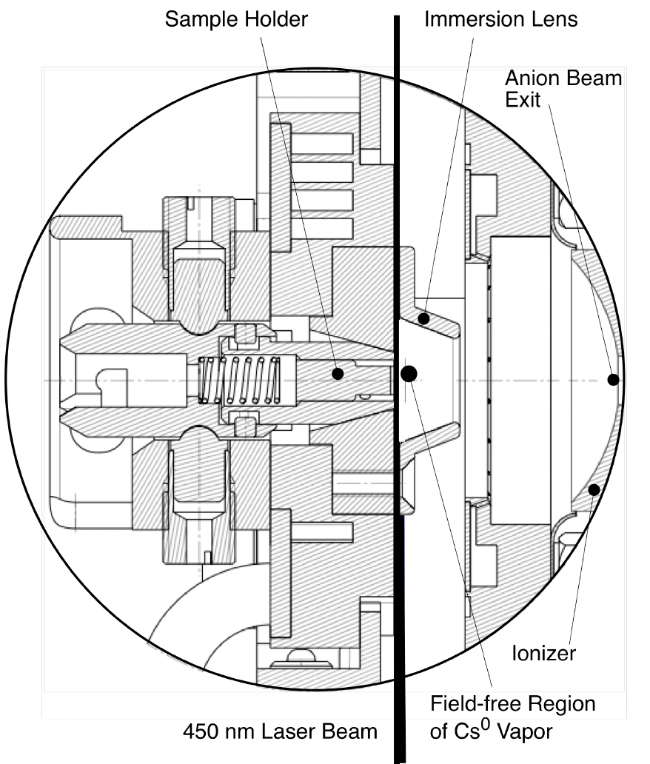
LASER Assisted Sputtering
From Vogel
NIMB V438 (2019) 89-95
From Vogel and Giacomo
Radiocarbon V59 (2017) 957-965
450 nm 5 W LASER
10-15% Increase in negative ion current

Slide 14
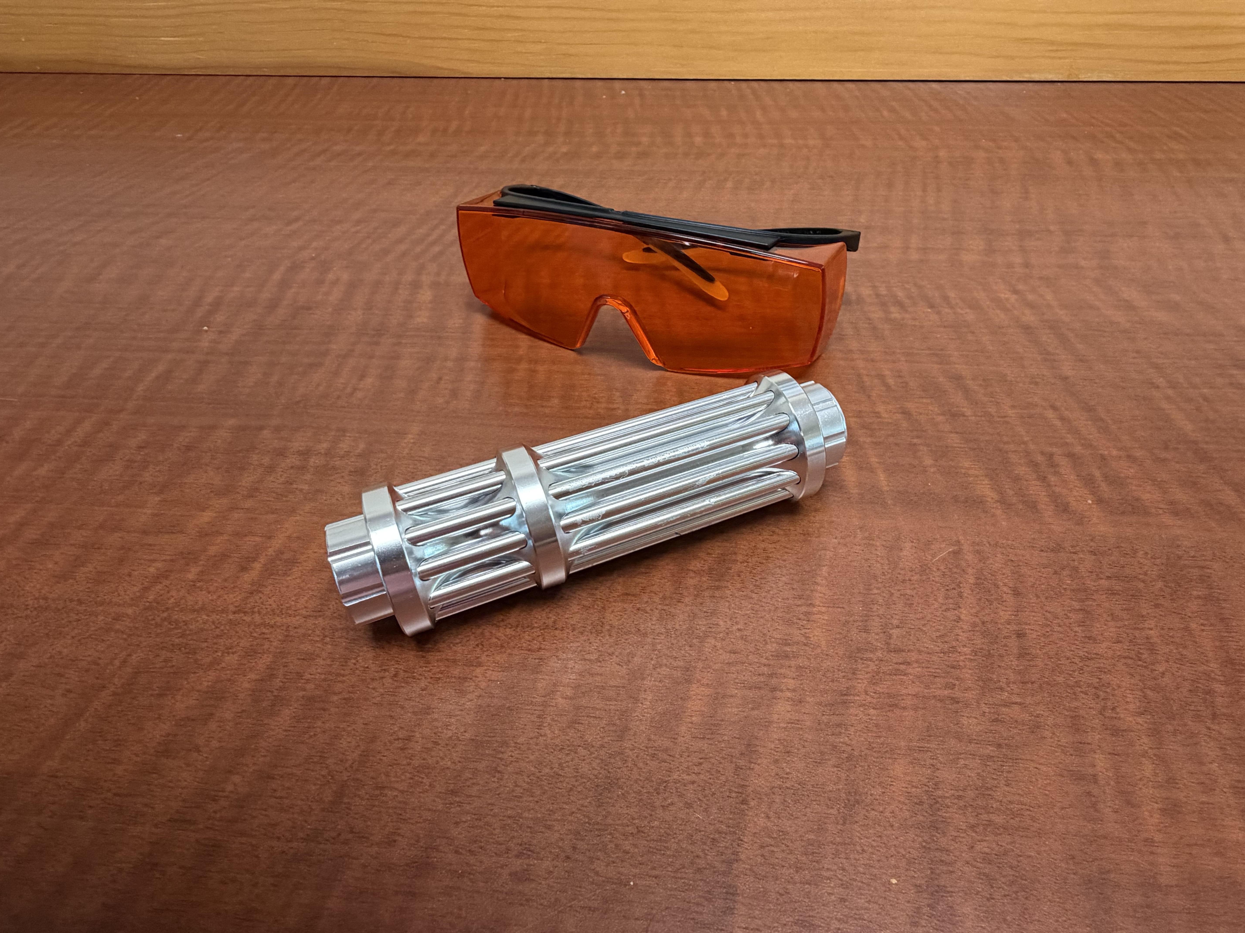
LASER Assisted Sputtering
LASER
450 nm 5 W LASER
No increase in
negative ion current

Slide 15
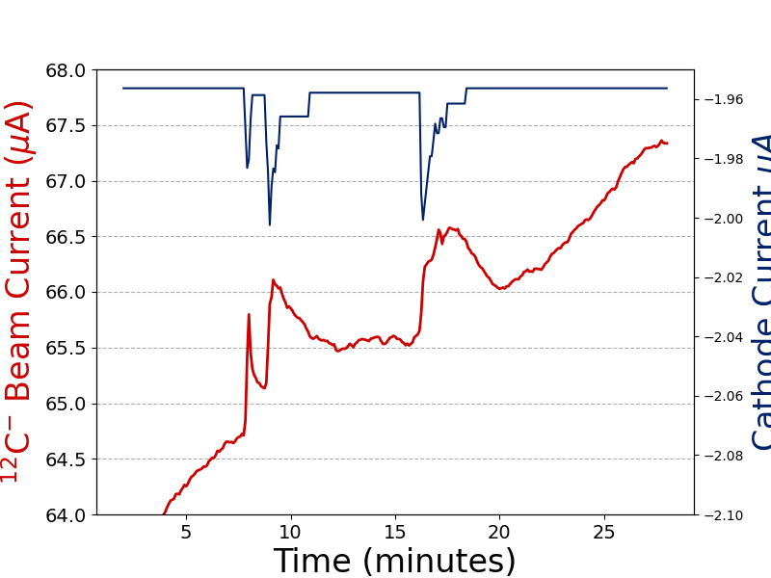
LASER Assisted Sputtering
2-3% Increase in negative ion current
450 nm 5 W LASER

Slide 16
Summary
The development of AMS was/is intimately linked to negative ion cesium sputter sources.
The development of negative ion cesium sputter sources was/is intimately linked to the development of AMS.
Despite decades of development, the ion source remains the most maintenance-intensive and least-understood component of an AMS system.

Slide 17
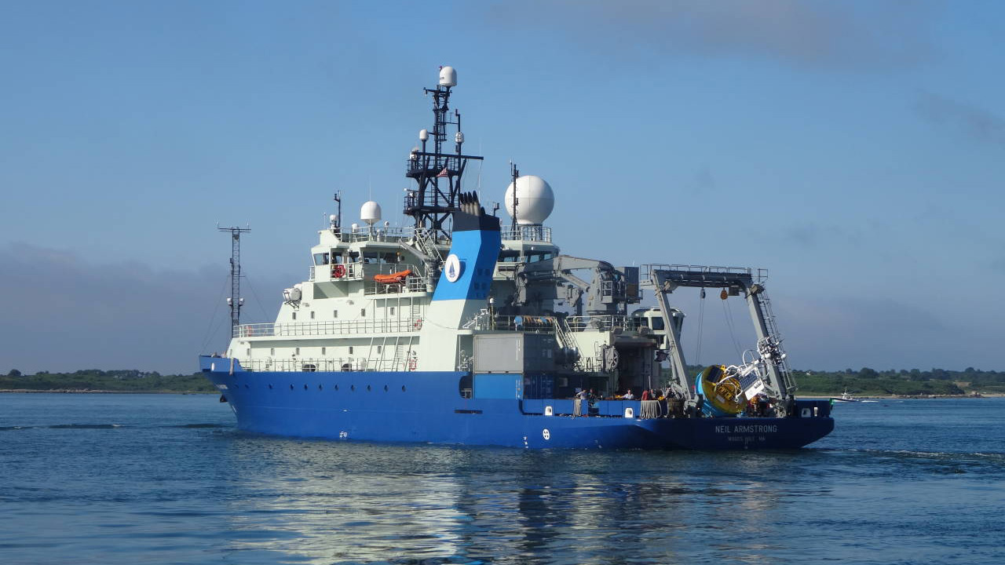
Thank you

