Slide 1
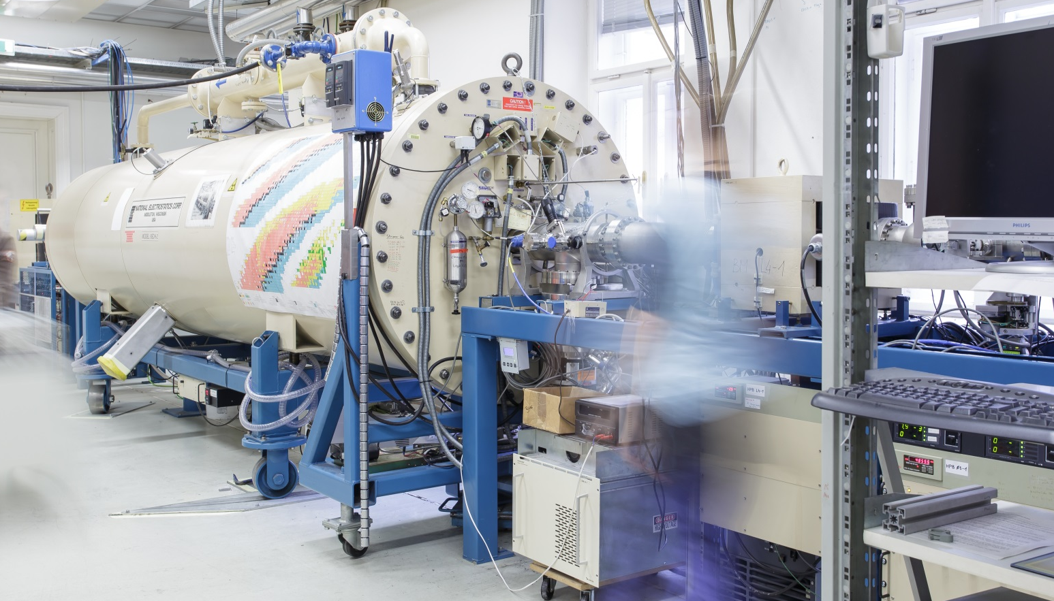
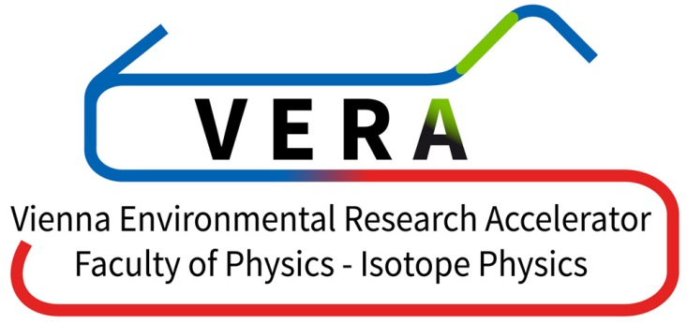


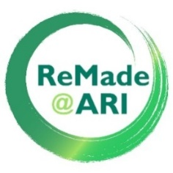


Shedding light on the cesium sputter ion source
Martin Martschini, Robin Golser,
Peter Steier, Karin Hain
University of Vienna, Faculty of Physics -
Isotope Physics, VERA Laboratory

Slide 2


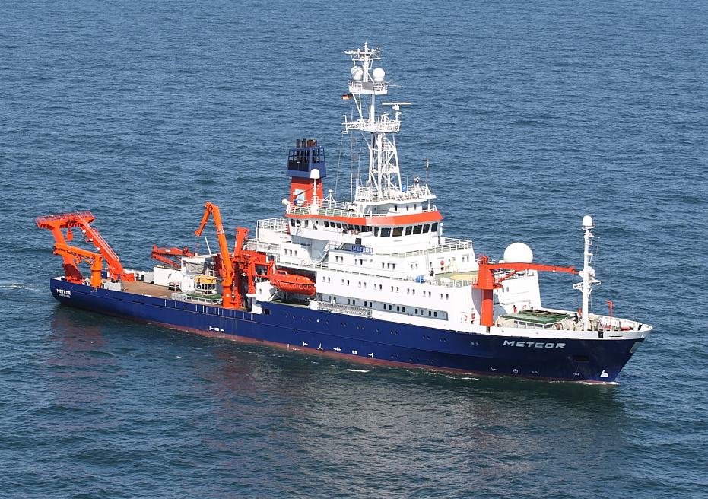
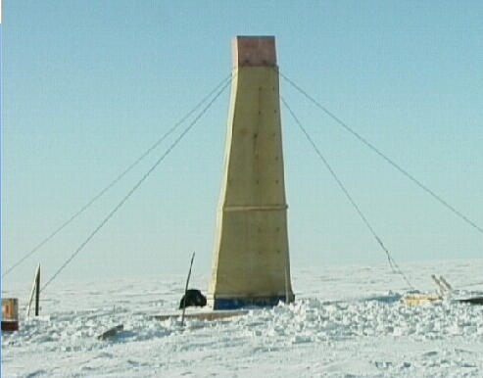
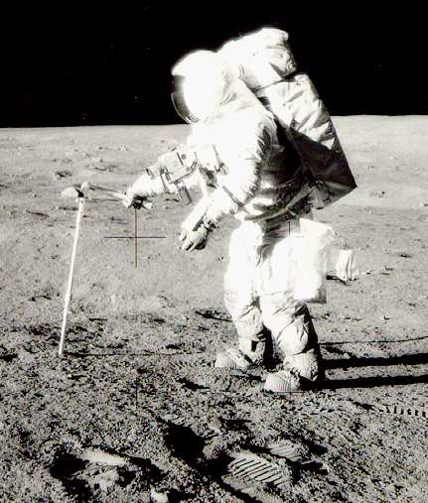
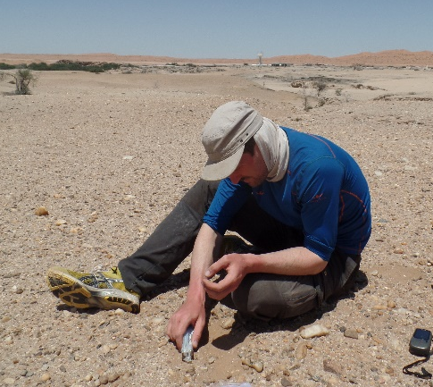
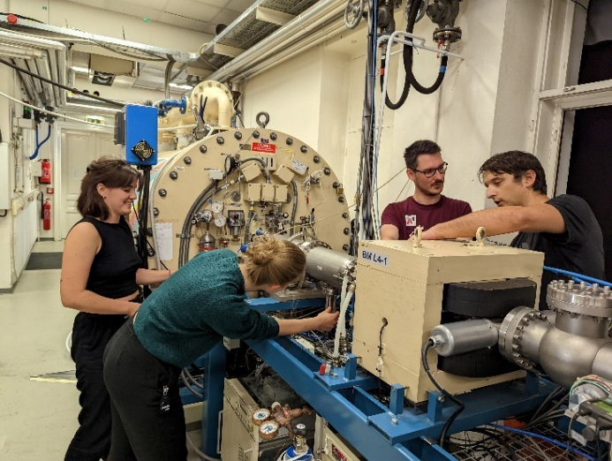
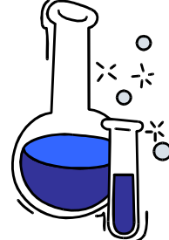
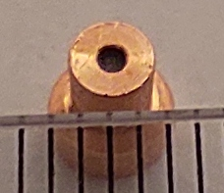
Scientific Goal
detection of rare radioisotopes in enviromental samples = interdisciplinary research!
it all starts with sampling …
www.lpi.usra.edu/lunar/samples/apollo/tools/images/core_lg.gif
© Denecke / LAEISZ; U Hamburg
© AWI
NIBS 10, 2026, Nelson Martin Martschini, University of Vienna
1

Slide 3
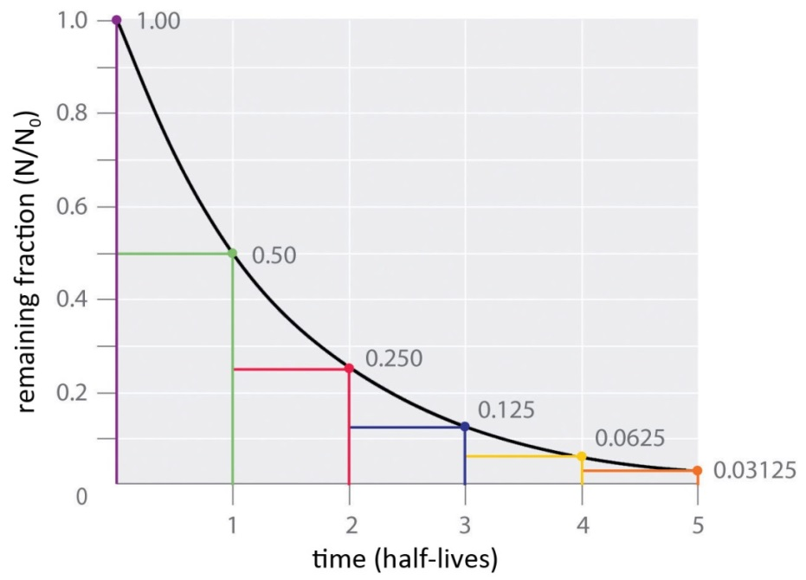
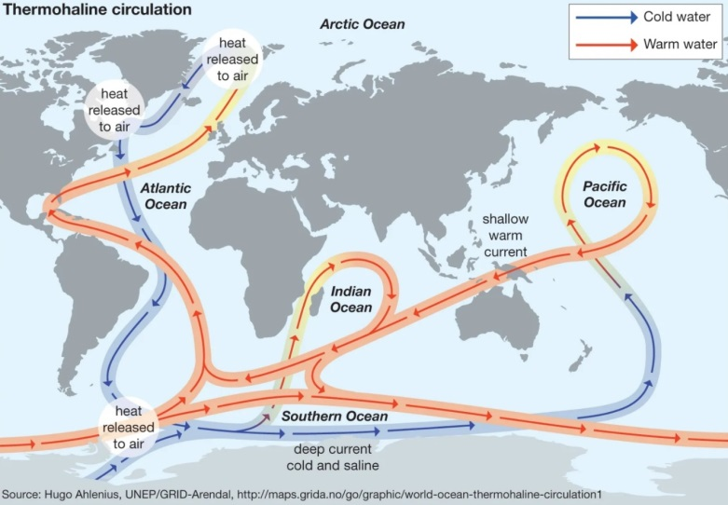
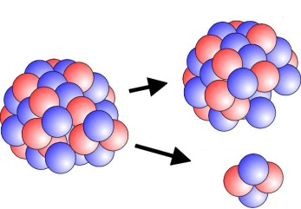
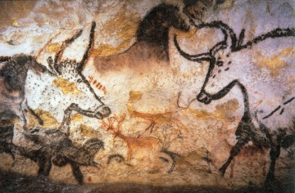
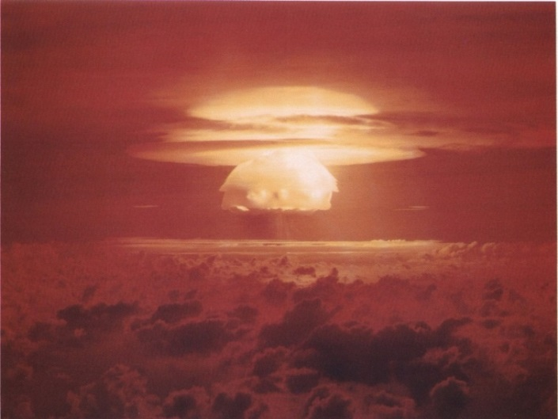
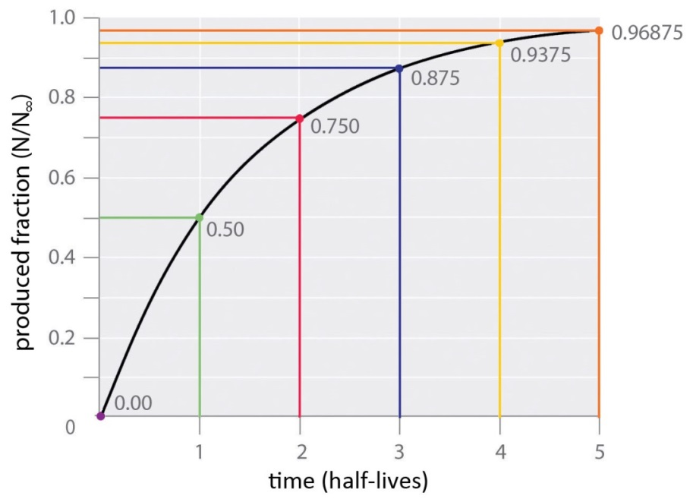
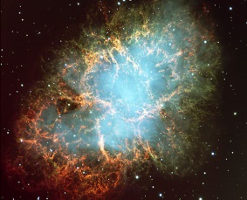
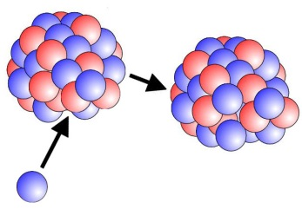
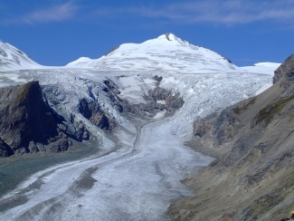
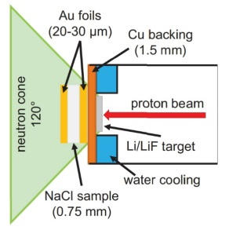
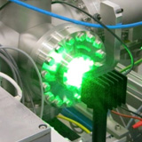
Scientific applications
decay dating
environmental
tracing
&
monitoring
in all cases, samples will contain some
10⁴ – 10¹⁰ atoms
of long-lived radioisotope(s)
exposure dating
nuclear astrophysics:
e.g. search for rare nucleo-synthesis traces on Earth
atomic & nuclear physics:
cross section measurements
NIBS 10, 2026, Nelson Martin Martschini, University of Vienna
2

Slide 4
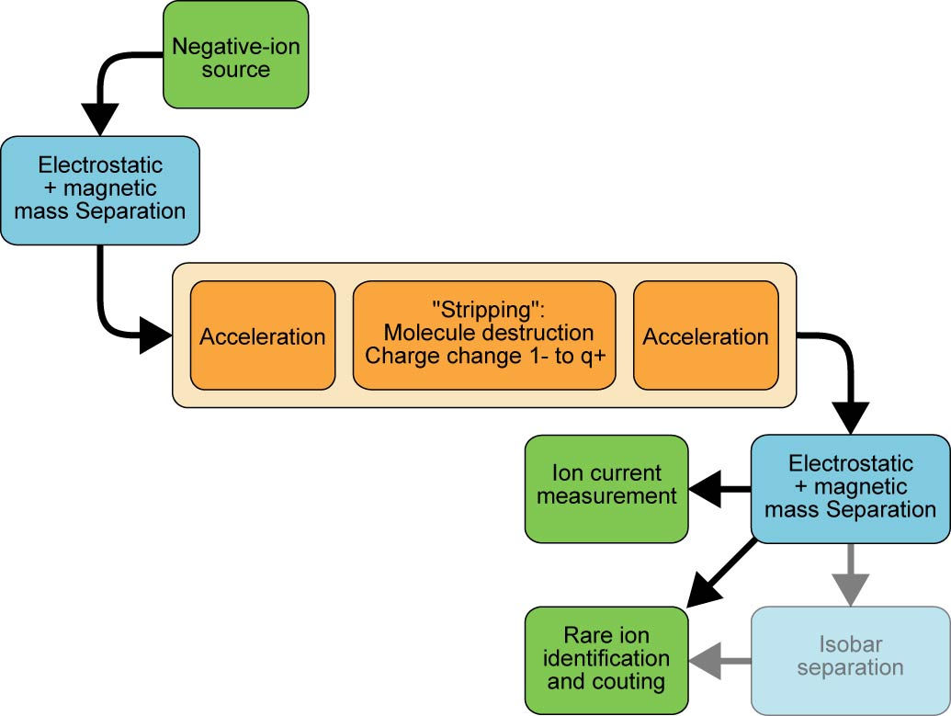
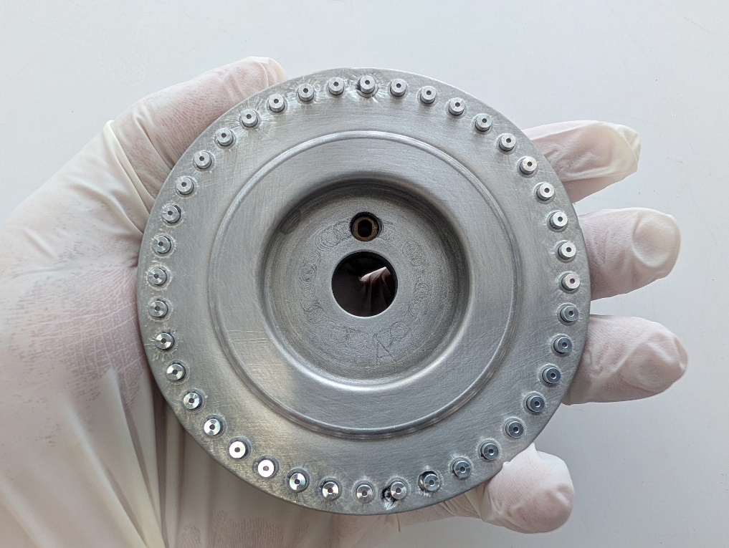
Accelerator Mass Spectrometry
sample wheel
2 cm
NIBS 10, 2026, Nelson Martin Martschini, University of Vienna
3

Slide 5
Accelerator Mass Spectrometry
AMS formula for success:
generate, transport and detect
many ions of the desired species
10¹²
atoms
³⁵Cl
3×10¹¹
atoms
³⁷Cl
1 atom
³⁶Cl
NIBS 10, 2026, Nelson Martin Martschini, University of Vienna
4

Slide 6
Accelerator Mass Spectrometry
AMS formula for success:
generate, transport and detect
many ions of the desired species
10¹²
atoms
³⁵Cl
3×10¹¹
atoms
³⁷Cl
10⁶
molecules
with mass 36
e.g. ³⁵ClH,
¹²C₃
10⁷
atoms
¹⁴N
1 atom
¹⁴C
NIBS 10, 2026, Nelson Martin Martschini, University of Vienna
4

Slide 7
Accelerator Mass Spectrometry
AMS formula for success:
generate, transport and detect
many ions of the desired species
completely suppress molecular isobars in the stripping process
10¹²
atoms
³⁵Cl
3×10¹¹
atoms
³⁷Cl
10⁷
atoms
³⁶S
1 atom
¹⁴C
NIBS 10, 2026, Nelson Martin Martschini, University of Vienna
4

Slide 8
Accelerator Mass Spectrometry
AMS formula for success:
generate, transport and detect
many ions of the desired species
completely suppress molecular isobars in the stripping process
suppress atomic isobars by single ion identification in detector at MeV ion energies (or in ion source)
10¹²
atoms
³⁵Cl
3×10¹¹
atoms
³⁷Cl
normalize detector counts to stable isotope and reference material (rare/stable typ. 10⁻¹⁰ – 10⁻¹⁶)
10⁷
atoms
³⁶S
1 atom
³⁶Cl
NIBS 10, 2026, Nelson Martin Martschini, University of Vienna
4

Slide 9
Accelerator Mass Spectrometry
0.1-10%
overall AMS-efficiency:
1 out of 100-25 000 atoms
typical stable isotope
negative ion currents:
200 nA-100 μA
measurement times
per sample: 1 h - 6 h
100%
20-50%
100%
aims:
high ion output/ion yield
elementally pure ion beam
20-100%
NIBS 10, 2026, Nelson Martin Martschini, University of Vienna
5

Slide 10
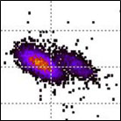
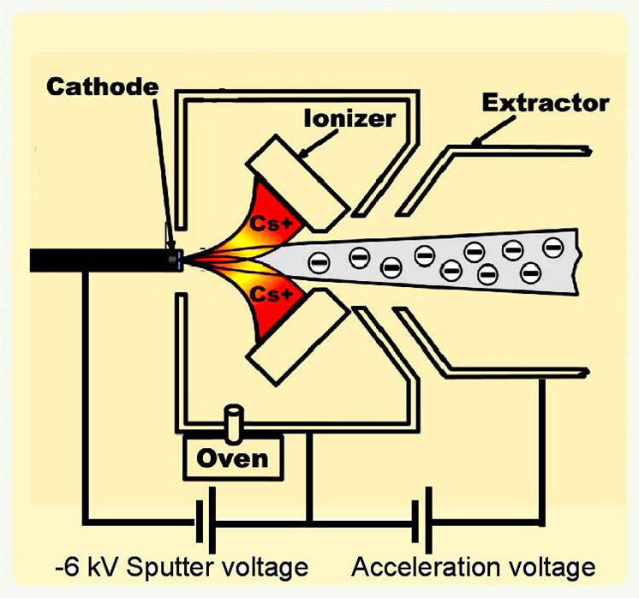
Middleton-type cesium sputter ion source
mechanism of negative ion formation in Middleton-type ion sources is generally described by SIMS theory but not fully agreed upon, many important parameters not accessible
different “recipes“ for high ion output are very source specific
NIBS 10, 2026, Nelson Martin Martschini, University of Vienna
6

Slide 11
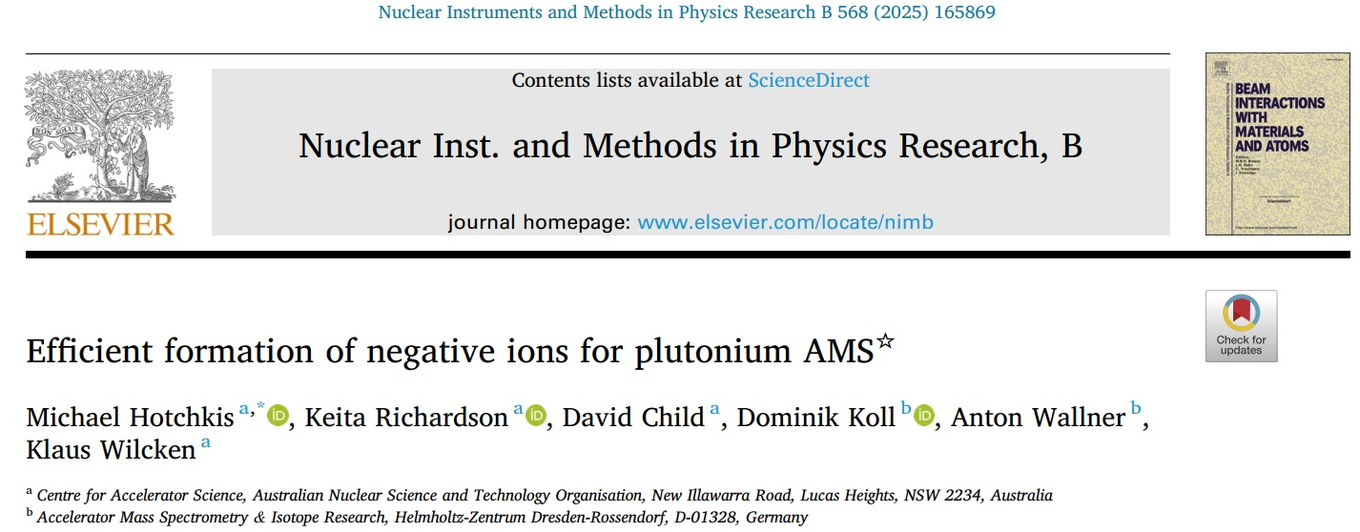
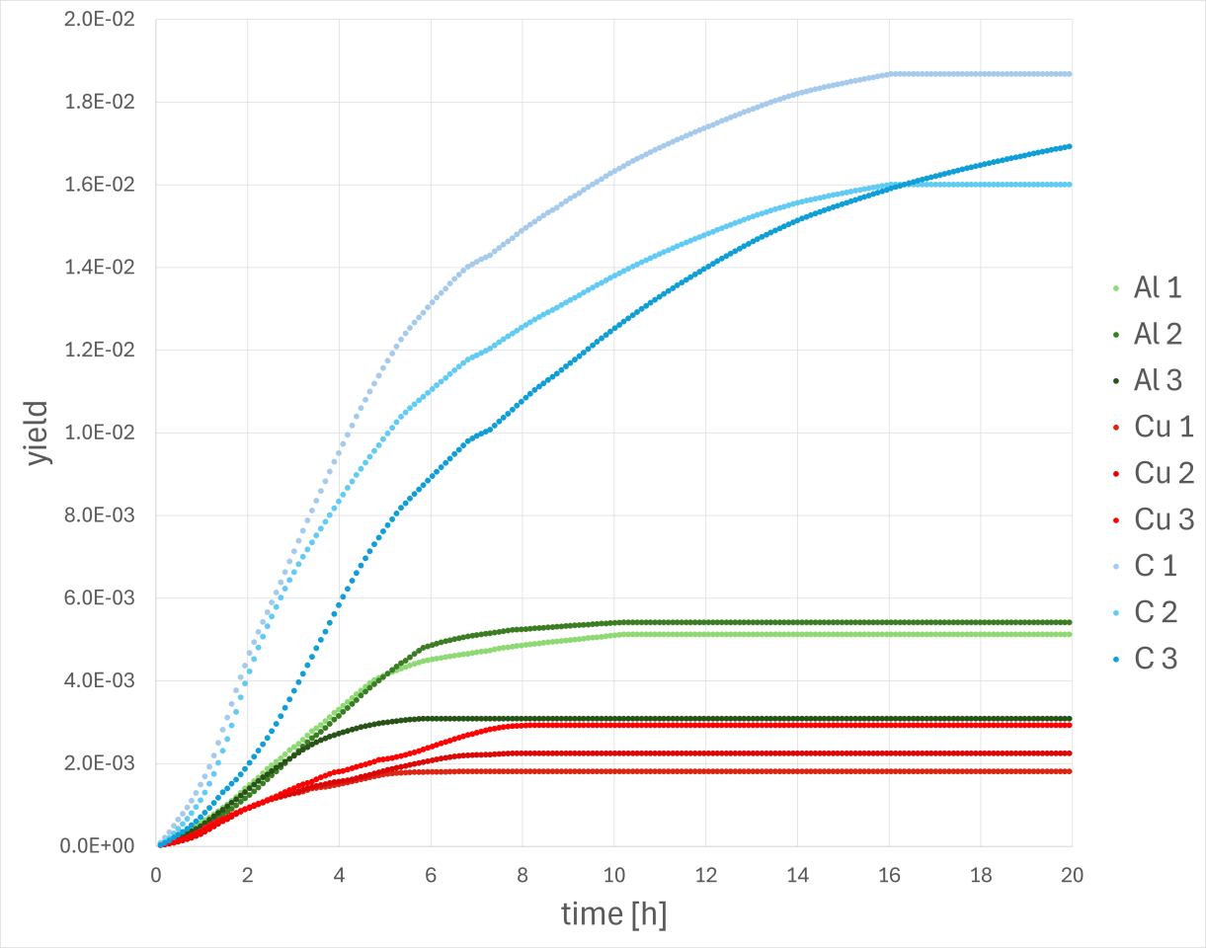
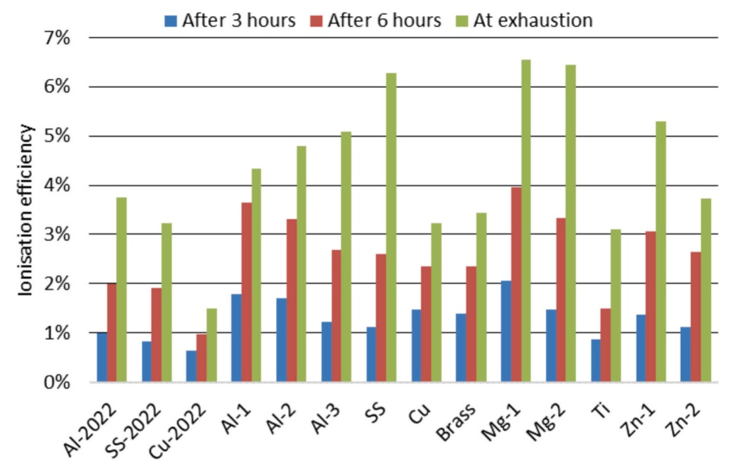
Ion sourcery
UO⁻ yield from different cathode materials
NIBS 10, 2026, Nelson Martin Martschini, University of Vienna
7

Slide 12
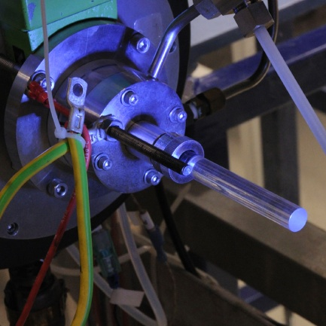
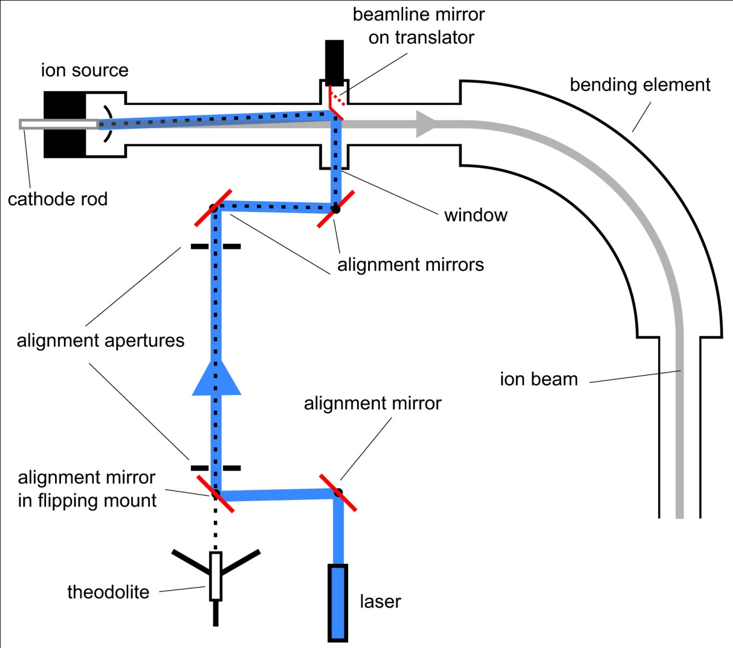
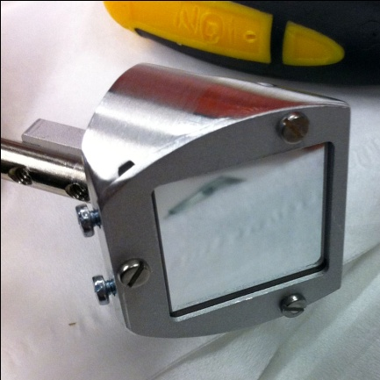
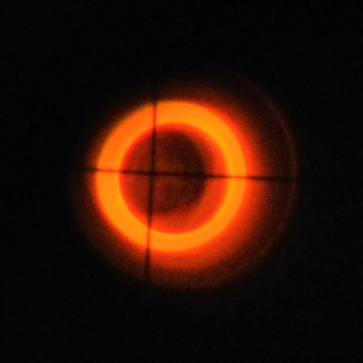
Light-induced suppression of sulfur
investigation of additional
³⁶S suppression for AMS of ³⁶Cl via selective neutralization in source
thresholds: Cl: 3.6 eV
S: 2.1 eV
experiments at:
• GUNILLA, Gothenburg
• VERA, Vienna
cw-laser: 1.2W, 445±5 nm (2.79 eV)
power at sample: 100 – 400 mW
NIBS 10, 2026, Nelson Martin Martschini, University of Vienna
8

Slide 13
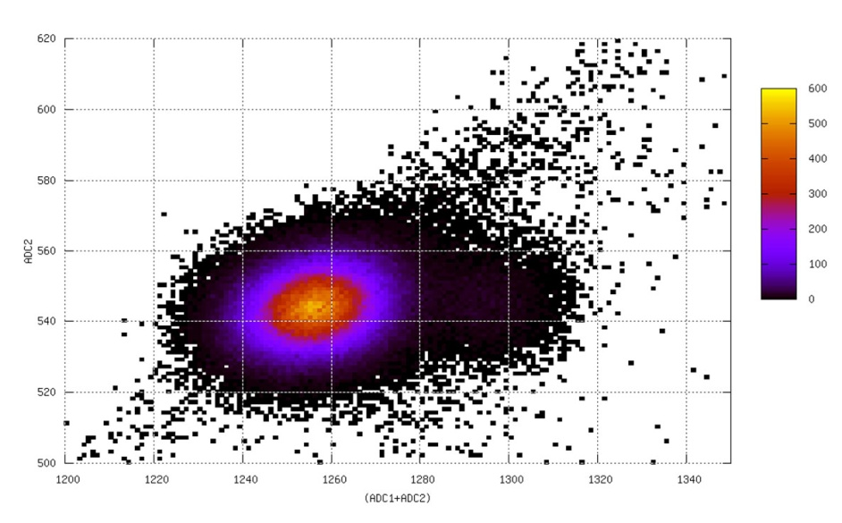
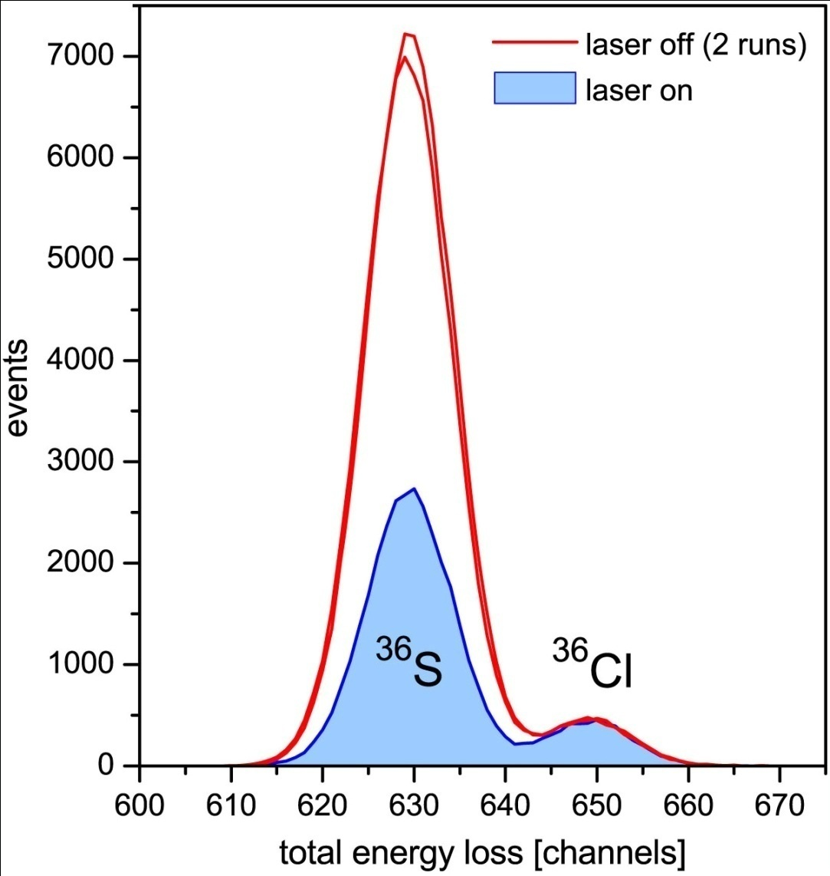
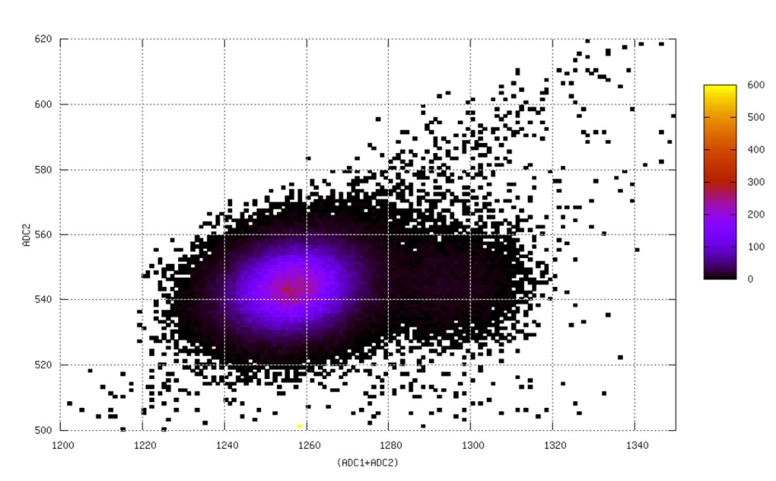
Light-induced changes in ion production
laser off
→ interference of isobar ³⁶S reduced by factor 2.5
³⁶S
³⁶Cl
laser on
NIBS 10, 2026, Nelson Martin Martschini, University of Vienna
9

Slide 14
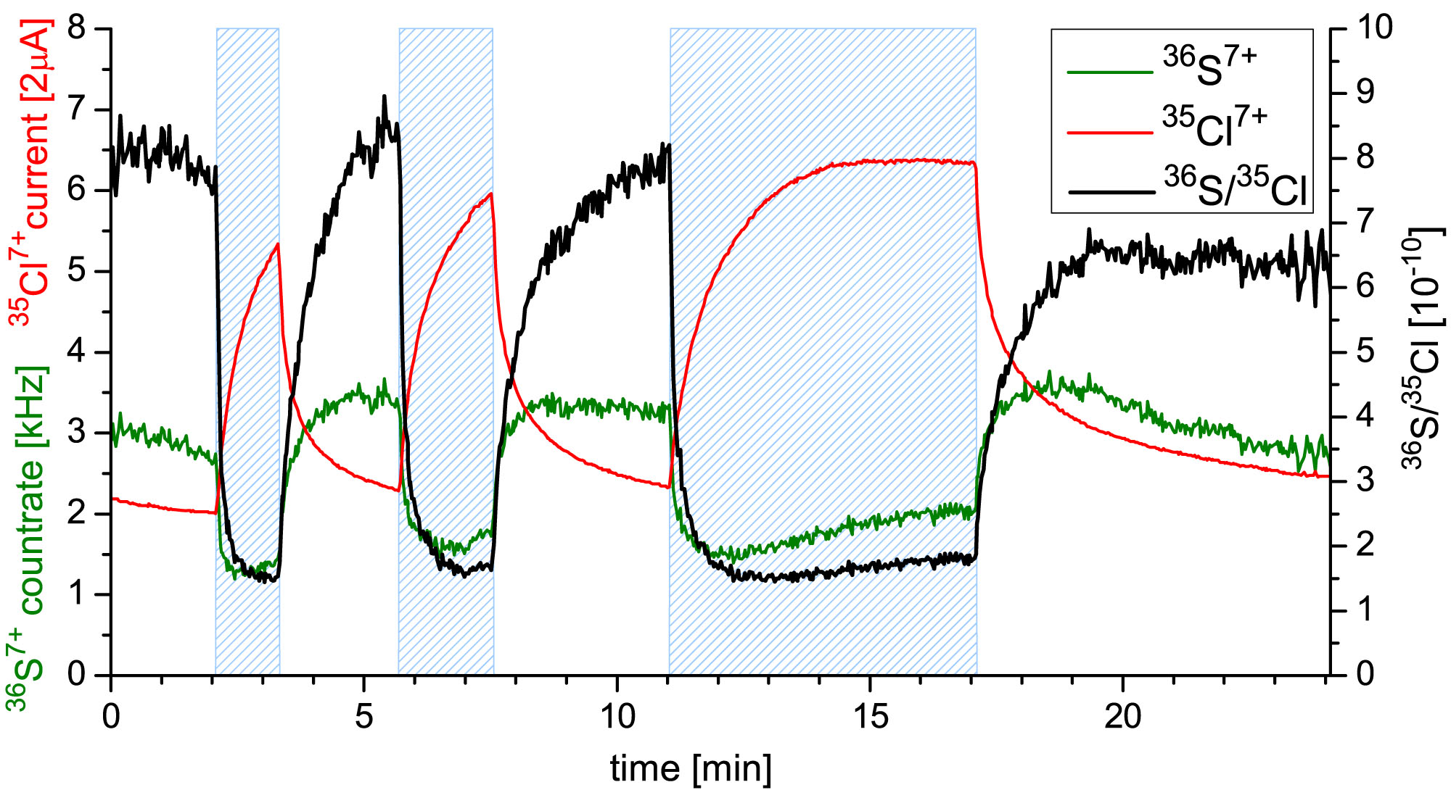
Time structure of induced changes
NIBS 10, 2026, Nelson Martin Martschini, University of Vienna
10

Slide 15
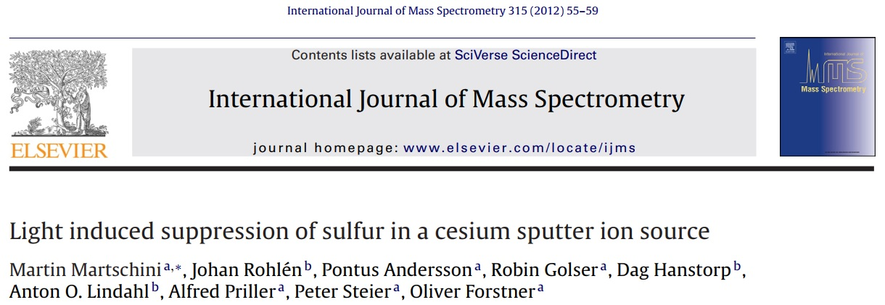
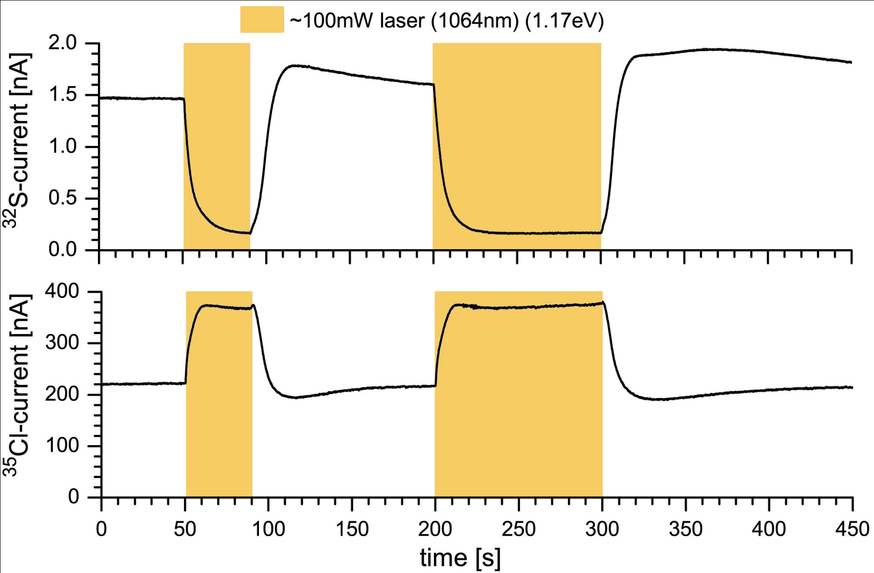

Wavelength dependence
same effect with IR-laser-light
-> rules out photodetachment of sulfur
M. Laitinen
Tue 14:15 h
ion source mystery
NIBS 10, 2026, Nelson Martin Martschini, University of Vienna
11

Slide 16
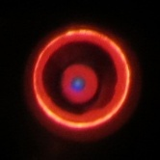
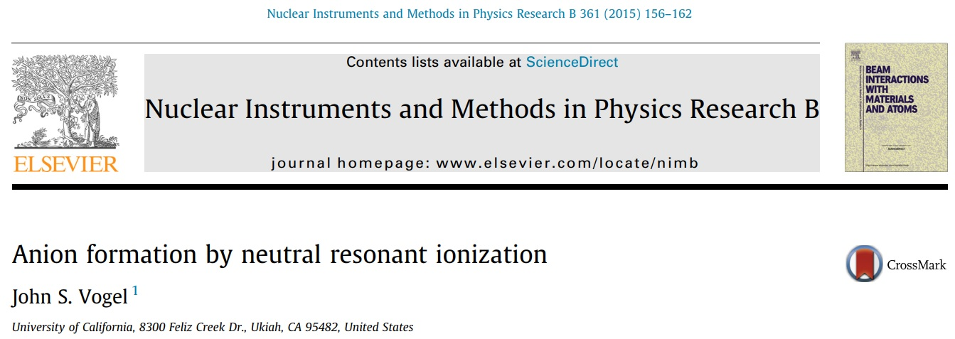
Resonant neutral ionization?
at intense negative ion output there is blue light visible close to the
sample surface
already Middleton observed “the formation of a small ball of bright
(often pale blue) plasma”
(Negative Ion Cookbook)
NIBS 10, 2026, Nelson Martin Martschini, University of Vienna
12

Slide 17
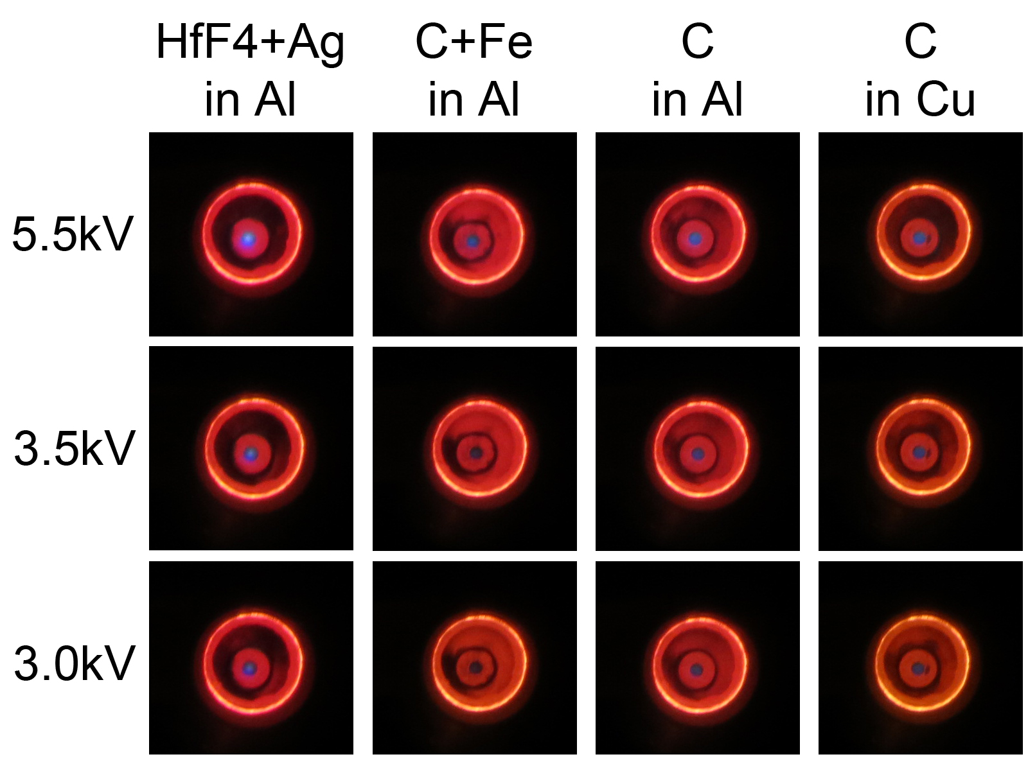
Plasma observation
NIBS 10, 2026, Nelson Martin Martschini, University of Vienna
13

Slide 18
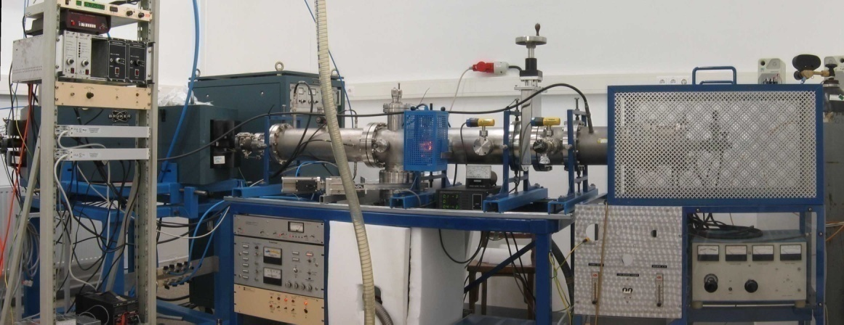
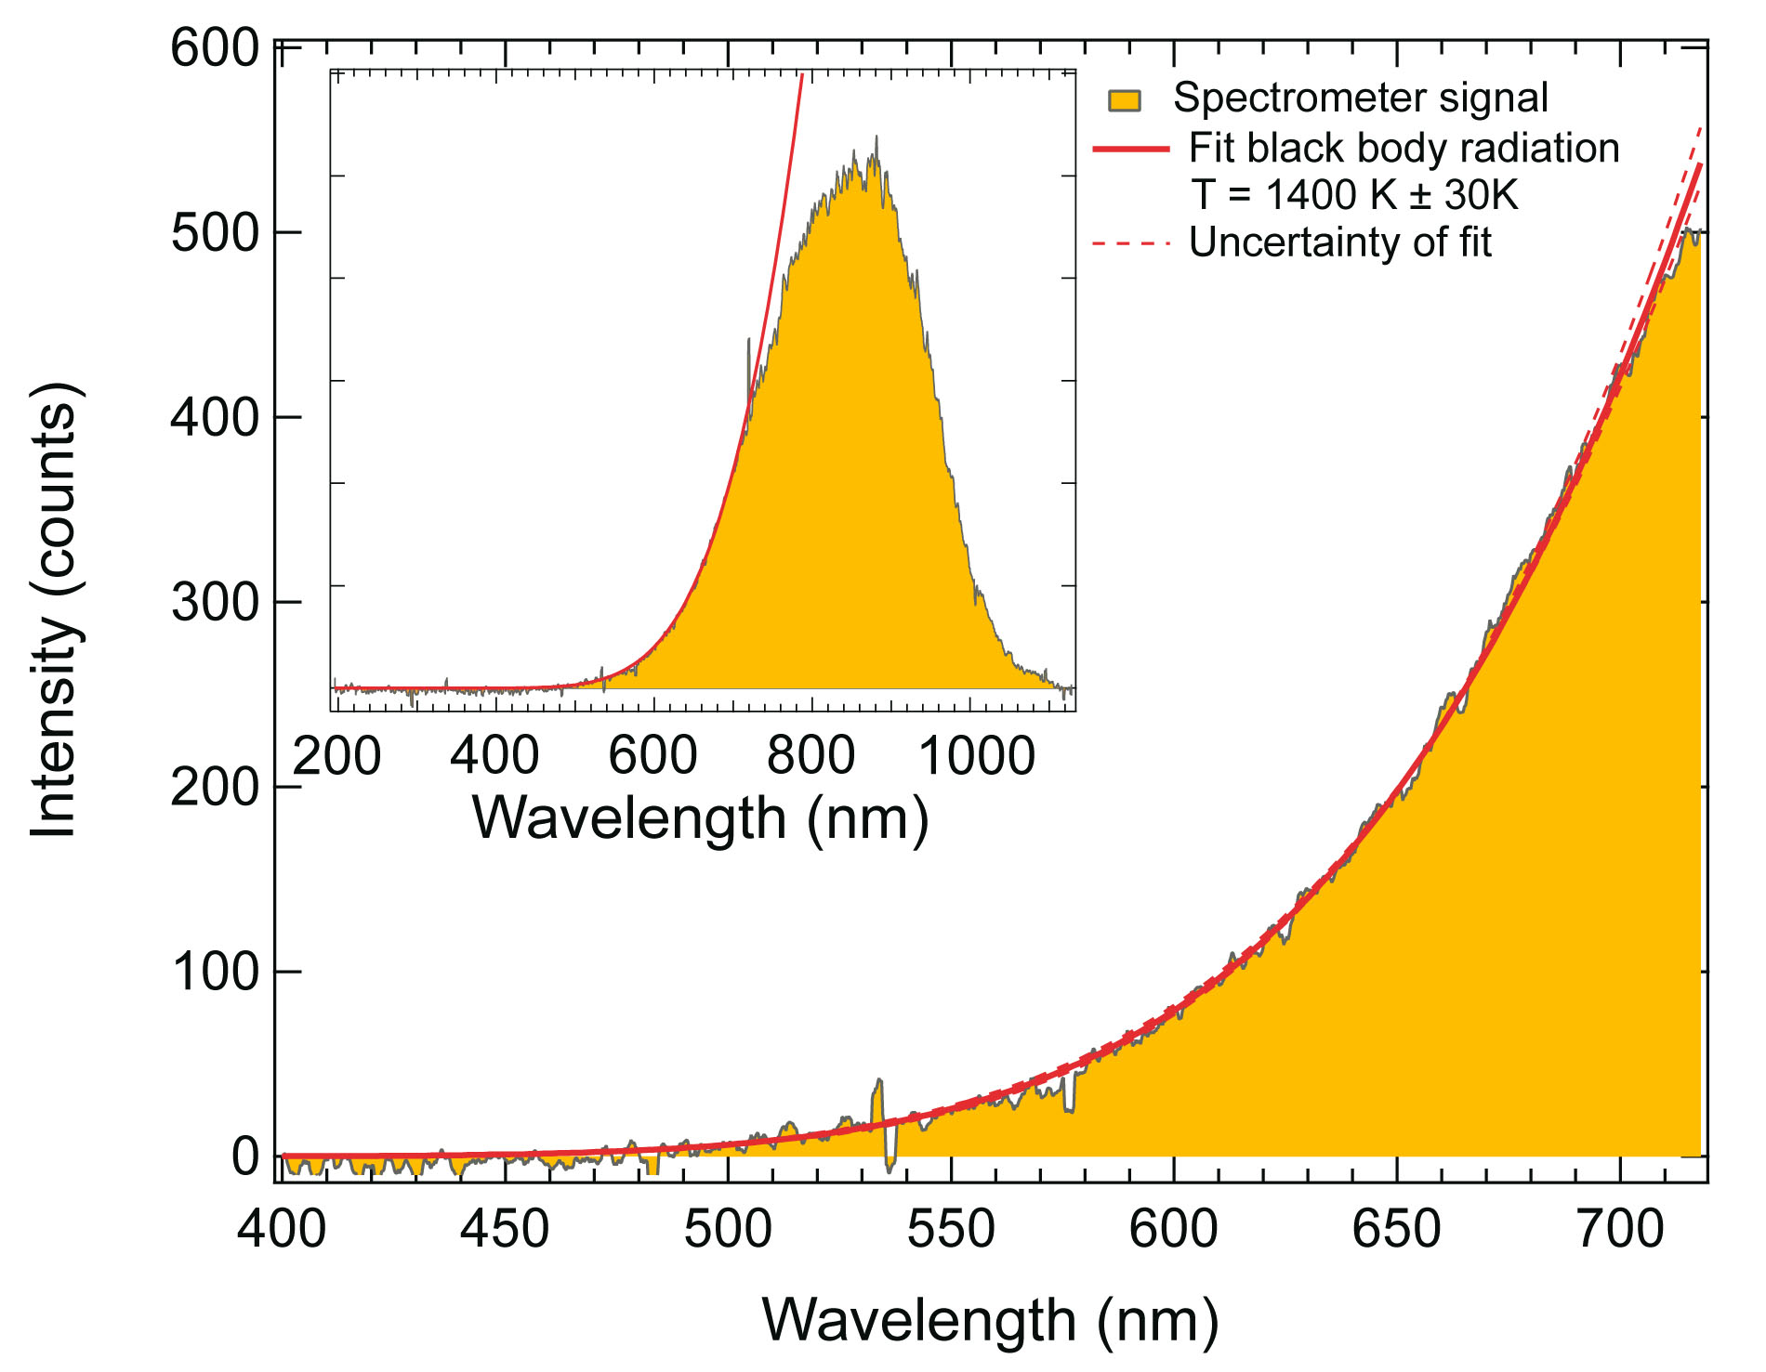
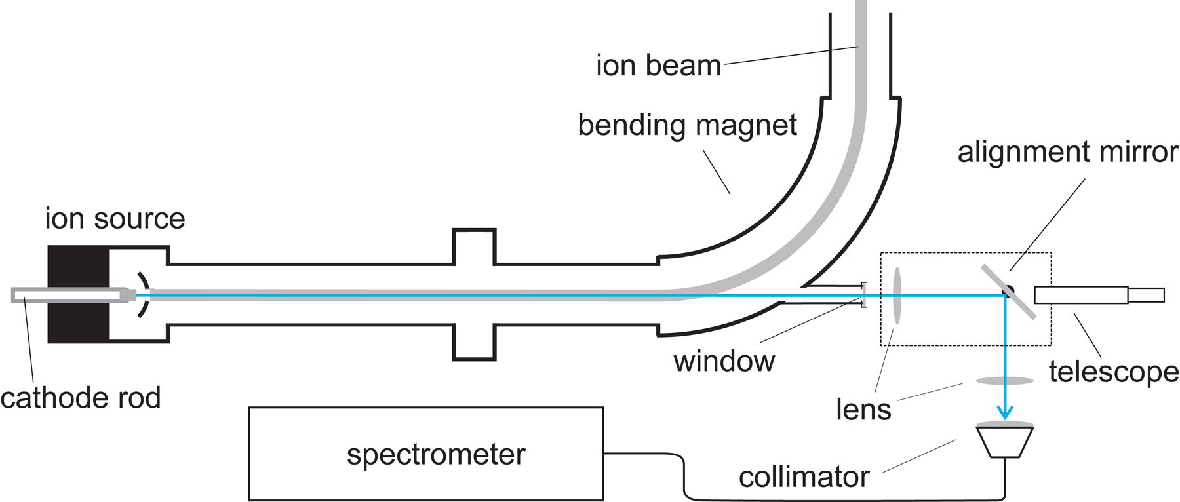
Plasma spectroscopy
NIBS 10, 2026, Nelson Martin Martschini, University of Vienna
14

Slide 19
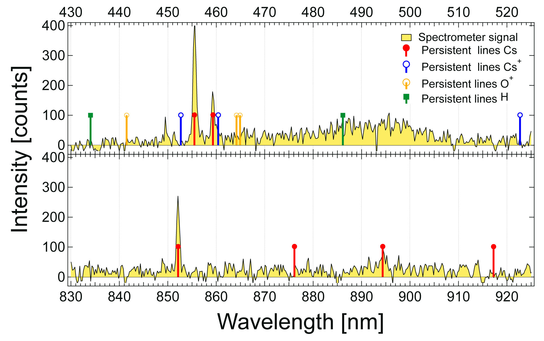
Plasma spectroscopy on carbon
excited neutral Cs detected
no excited Cs⁺ observed
NIBS 10, 2026, Nelson Martin Martschini, University of Vienna
15

Slide 20
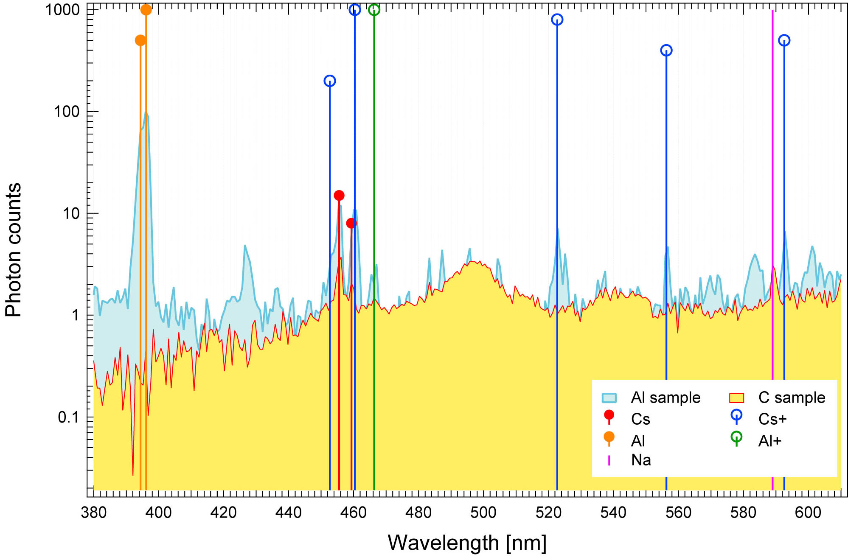
Plasma spectroscopy on aluminum
excited neutral Cs and excited Cs⁺ observed
Andersson et al., NIMB. 2012, DOI:10.1016/j.nimb.2012.11.009
NIBS 10, 2026, Nelson Martin Martschini, University of Vienna
16

Slide 21
Any hints for laser-enhanced neutral resonant ionization?
scanning of laser wavelength across ~455 nm lines
no resonant effect
negative results confirmed by:
ETH Zurich
WHOI
University of Jyväskylä
Tarvainen et al., J. Appl. Phys. 2020, DOI:10.1063/5.0020751
NIBS 10, 2026, Nelson Martin Martschini, University of Vienna
17

Slide 22
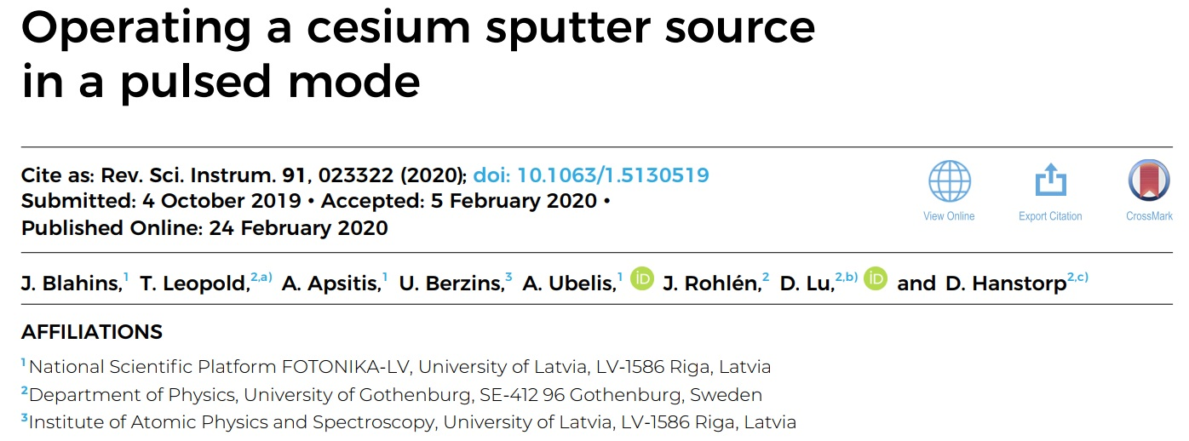
Pulsing of a SNICS source
with 10% duty cycle pulsing: factor 3.7 enhancement in C⁻-current
NIBS 10, 2026, Nelson Martin Martschini, University of Vienna
18

Slide 23
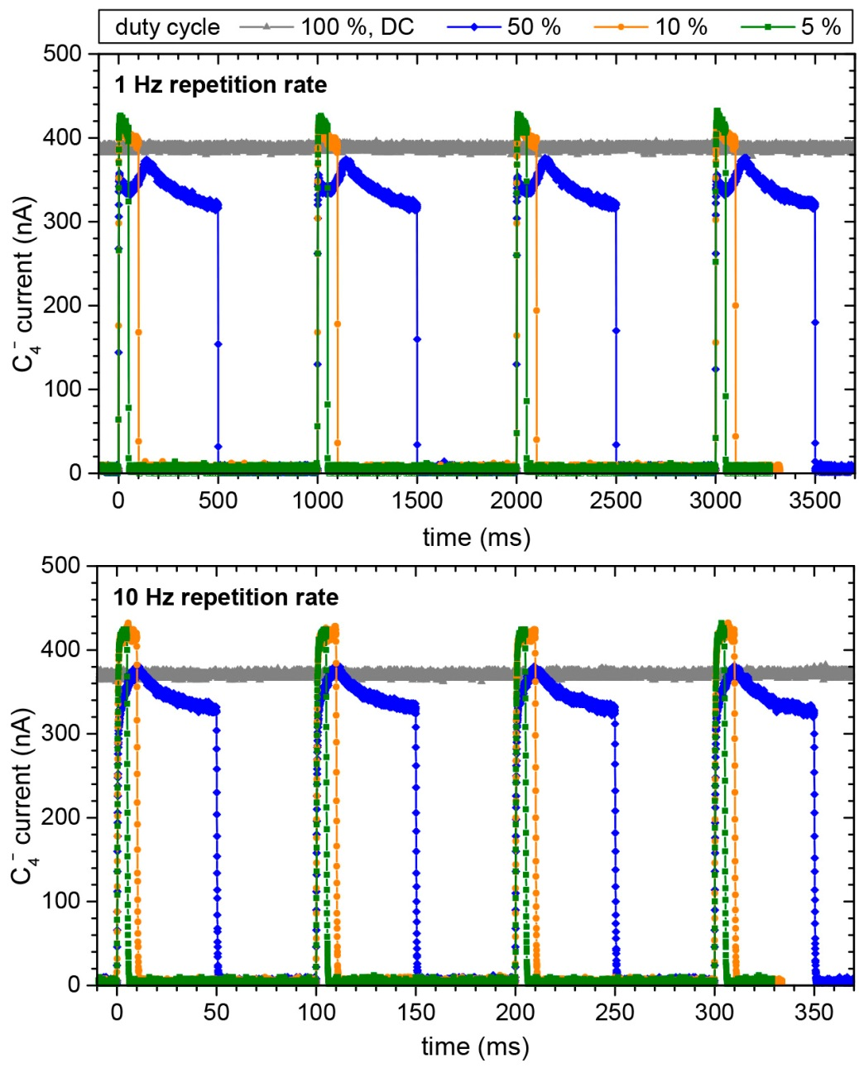
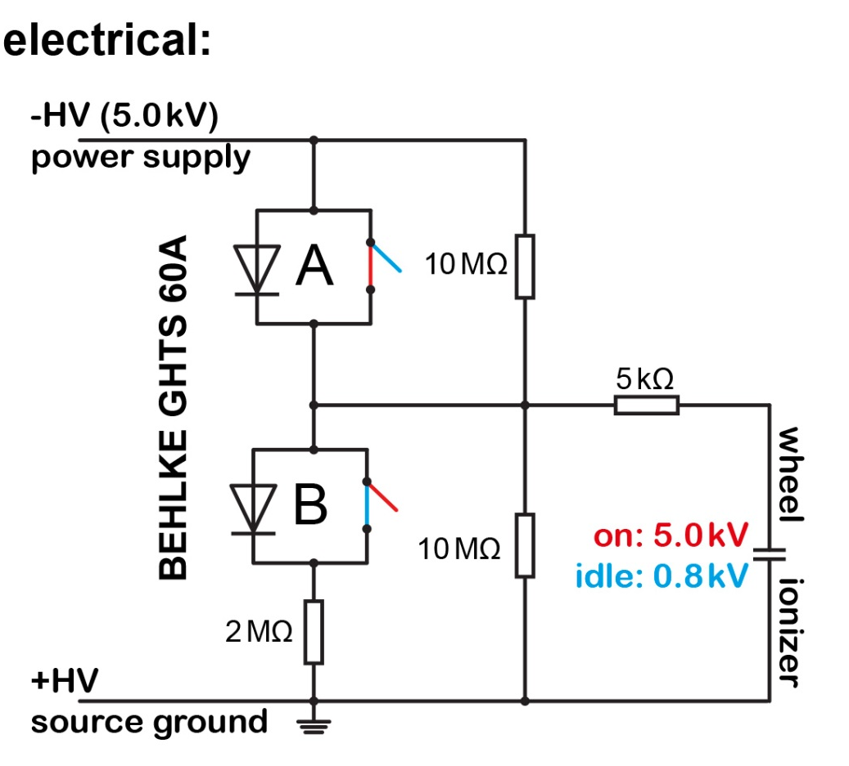
Pulsing of a SNICS source
NIBS 10, 2026, Nelson Martin Martschini, University of Vienna
19

Slide 24
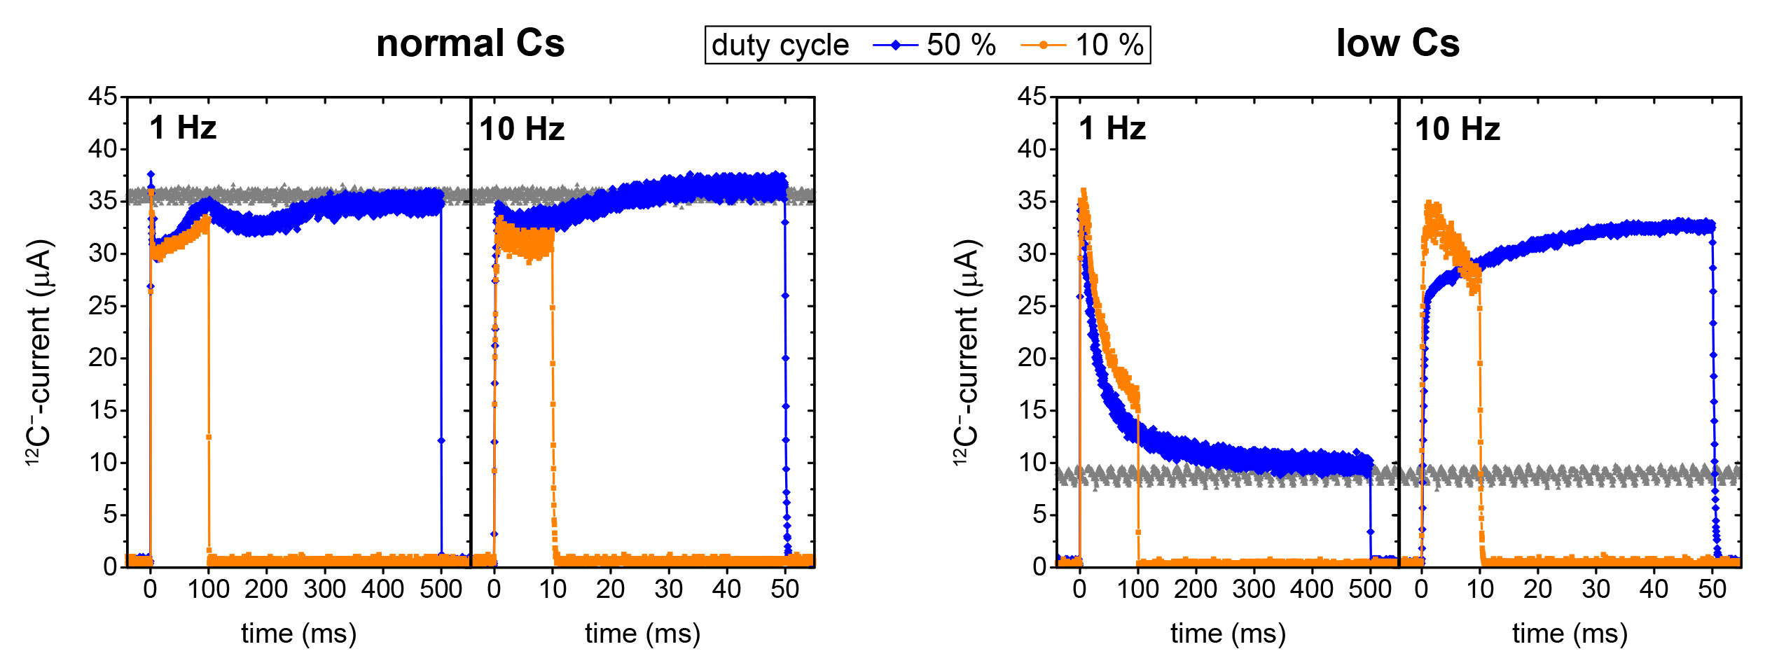
Pulsed output at low Cs-supply
Cs-collection during idle periods becomes beneficial
NIBS 10, 2026, Nelson Martin Martschini, University of Vienna
20

Slide 25

Negative ion yields with source pulsing
sputter weighed C-targets with 0.3-0.8 mg to exhaustion at various Cs-supply settings, both DC and pulsed sputtering
pulsed source operation with enhancement factor 2, 20% duty cycle
net sputtering times of 12-20h
NIBS 10, 2026, Nelson Martin Martschini, University of Vienna
21

Slide 26


Ion Laser InterAction Mass Spectrometry
Slow ions – an alternative to big AMS systems for isobar suppression:
deceleration step of ions before injection into accelerator
slow ions have time for
  physical interaction (lasers!)
  chemical transformation
ion source
electrostatic
& mechanic deceleration
ion source
magnetic separation
electrostatic acceleration & stripping
Z
magnetic separation
Lasers
electrostatic
separation
ion detection
& identification
Mass
Separator
isobars
isobars!
N
NIBS 10, 2026, Nelson Martin Martschini, University of Vienna
22

Slide 27


Laser photodetachment of anions - principle
non-resonant neutralization of anions
with electron affinities < photon energy
laser
unwanted isobar
$$N_{surv}={N_{0}^{}∙e}^{−σφt}$$
cross section (typ. Mb)
isotope of
interest
σ cross section (Mb)
Φ photon flux
t interaction time between photons and ions
photon energy (typ. eV)
2.33 eV
m | EA isobar | EA ion of int. | suppr.
36 | S⁻: 2.08 eV | Cl⁻: 3.61 eV | >10¹¹
43 | MgO⁻: 1.63 eV | AlO⁻: 2.60 eV | >10¹²
NIBS 10, 2026, Nelson Martin Martschini, University of Vienna
23

Slide 28


Laser photodetachment of anions - principle
non-resonant neutralization of anions
with electron affinities < photon energy
extend ion laser-interaction times in He-filled
RF-ion guide:
laser
unwanted isobar
cross section (typ. Mb)
isotope of
interest
photon energy (typ. eV)
2.33 eV
m | EA isobar | EA ion of int. | suppr.
36 | S⁻: 2.08 eV | Cl⁻: 3.61 eV | >10¹¹
43 | MgO⁻: 1.63 eV | AlO⁻: 2.60 eV | >10¹²
NIBS 10, 2026, Nelson Martin Martschini, University of Vienna
23

Slide 29



Isobar suppression in pictures: ³⁶Cl – ³⁶S
10 W 532 nm cw laser:
Chemical sulfur removal to ppm ³⁶S/³⁵Cl ~ 10^{–8}
→ ³⁶S-induced background: ³⁶S/³⁵Cl < 10^{–19}
>10¹¹ suppression
by ILIAMS
NIBS 10, 2026, Nelson Martin Martschini, University of Vienna
24

Slide 30


Laser and AMS – present status
AMS at VERA
²³⁶Np
²³⁷Np
^{210m}Bi
Only largest AMS-facilities
²⁰⁸Bi
²⁴³Am
Laser + AMS at VERA
under development
²⁰⁵Pb
^{186m}Re
²⁴⁴Pu
¹⁵⁴Dy
²³⁹Pu
¹⁴⁶Sm
²³³U
²³⁶U
¹³⁷La
⁹⁴Nb
²⁰²Pb
²¹⁰Pb
⁹³Mo
¹²⁹I
¹⁸²Hf
⁹¹Nb
¹⁵⁰Gd
¹³⁷Cs
⁵⁹Ni
¹³⁵Cs
⁵³Mn
¹²⁶Zn
⁴⁴Ti
¹⁰⁷Pd
⁴¹Ca
⁹³Zr
⁹⁹Tc
³⁶Cl
⁹⁰Sr
Martschini et al., Radiocarbon 2022, DOI:10.1017/RDC.2021.73
⁷⁹Se
²⁶Al
⁶⁰Fe
⁵⁵Fe
¹⁰Be
³²Si
(some more actinides not shown)
¹⁴C
NIBS 10, 2026, Nelson Martin Martschini, University of Vienna
25

Slide 31



ILIAMS for TiO⁻
isobar suppression of CaO⁻ in pure He (no laser!)
isobar suppression of CaO⁻ with OPO laser
~10⁶
>10⁵
NIBS 10, 2026, Nelson Martin Martschini, University of Vienna
26

Slide 32

Take home messages
Middleton type cesium sputter ion sources are full of surprises
key for high output is optimum Cs coverage
ILIAMS opens up exciting new possibilities/radionuclides
NIBS 10, 2026, Nelson Martin Martschini, University of Vienna

Slide 33





Acknowledgement
Collaborators:
Funding:
Thank you for
your attention
Johannes Lachner
Alfred Priller
Pontus Andersson
Oliver Forstner
Esad Hrnjic
Tamara Bachmayer
Petra Holzer
Dag Hanstorp
Johan Rohlèn
Anton Lindahl
Jakob Welander
Haimei Liang
This project received funding from the European Union under grant agreement No 101008324 (ChETEC-INFRA) and No 101058414 (ReMade@ARI)
NIBS 10, 2026, Nelson Martin Martschini, University of Vienna

Slide 34

Accelerator Mass Spectrometry
NIBS 10, 2026, Nelson Martin Martschini, University of Vienna
7

Slide 35

Light-induced changes in ion production
stronger effect at cold source conditions
NIBS 10, 2026, Nelson Martin Martschini, University of Vienna
8

Slide 36

Pulsing effect on different target materials
NIBS 10, 2026, Nelson Martin Martschini, University of Vienna
8

Slide 37

Power dependence
NIBS 10, 2026, Nelson Martin Martschini, University of Vienna
8

Slide 38

Laser cleaning of ion beam
mixed target (Al₂O₃+ MgO +³⁵Cl enriched AgCl)
NIBS 10, 2026, Nelson Martin Martschini, University of Vienna
11

Slide 39

AMS performance for ⁹⁰Sr with ILIAMS
Zr suppression:
10¹³
10⁷
ILIAMS: 532 nm laser & He+O₂ gas remove ZrF₃ –
SrF₃ – transmission:
40% @200 nA
10³
SrF₃ – extraction
30 keV, ~1% yield
LE transport efficiency:
100%
He-stripping @ 3.0 MV
to 3+ charge-state
23% transmission & yield
overall ⁹⁰Sr efficiency:
>1 out of 4000 atoms
typical ion currents:
⁸⁸SrF₃– : 200 nA
⁸⁸Sr³⁺: 40-50 nA
measurement times
per sample: 1 h - 6 h
HE transport efficiency:
100%
10³
Gas Ionization chamber
10x10 mm, 100 nm SiN window
Efficiency: 100%
>50% in ROI
NIBS 10, 2026, Nelson Martin Martschini, University of Vienna
19

