Slide 1
Selkirk
Technology
Access
Centre
What’s a TAC?
A specialized College R&D centre that provides Canadian businesses with applied research and innovation services to:
precision prototypes
advanced manufacturing
provide customized training on the latest equipment and emerging technologies.
www.selkirk.ca/stac

Slide 2
Selkirk
Technology
Access
Centre
Technology Highlights
3D printing engineering grade materials like PEEK, and Refractory Metals
3d Scanning and Reverse Engineering
High Precision Machining
Advanced Computing
Internet of Things (IoT)
Robotics and Automation
High-Performance Computing
AI, Machine Learning and Machine Vision
Geographic Information Systems
Drones and Remotely Piloted Aircraft Systems
LiDAR
Ground Penetrating Radar
Multispectral and Hyperspectral Imaging
www.selkirk.ca/stac

Slide 3
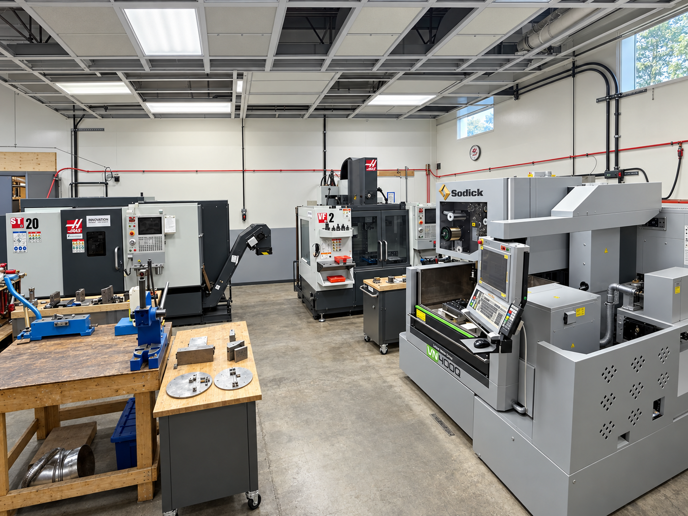
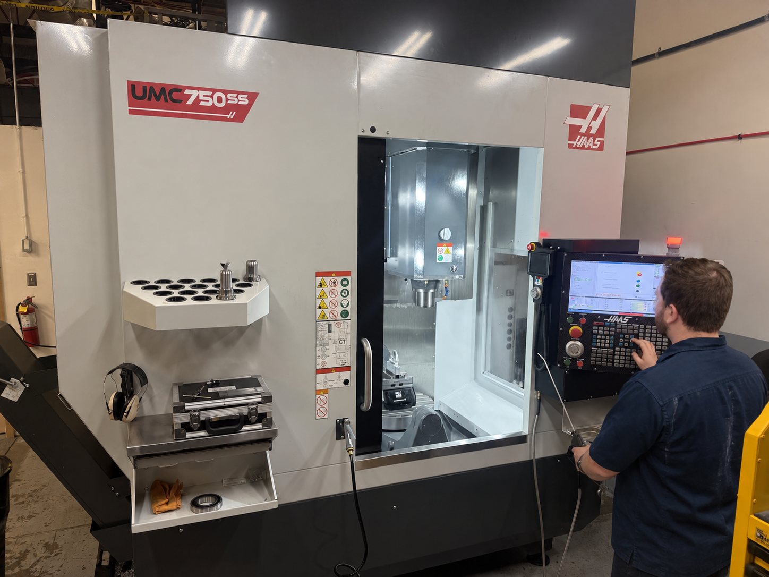
www.selkirk.ca/stac
Notes:
CNC Lathe, 3 axis Mill and 5 axis

Slide 4
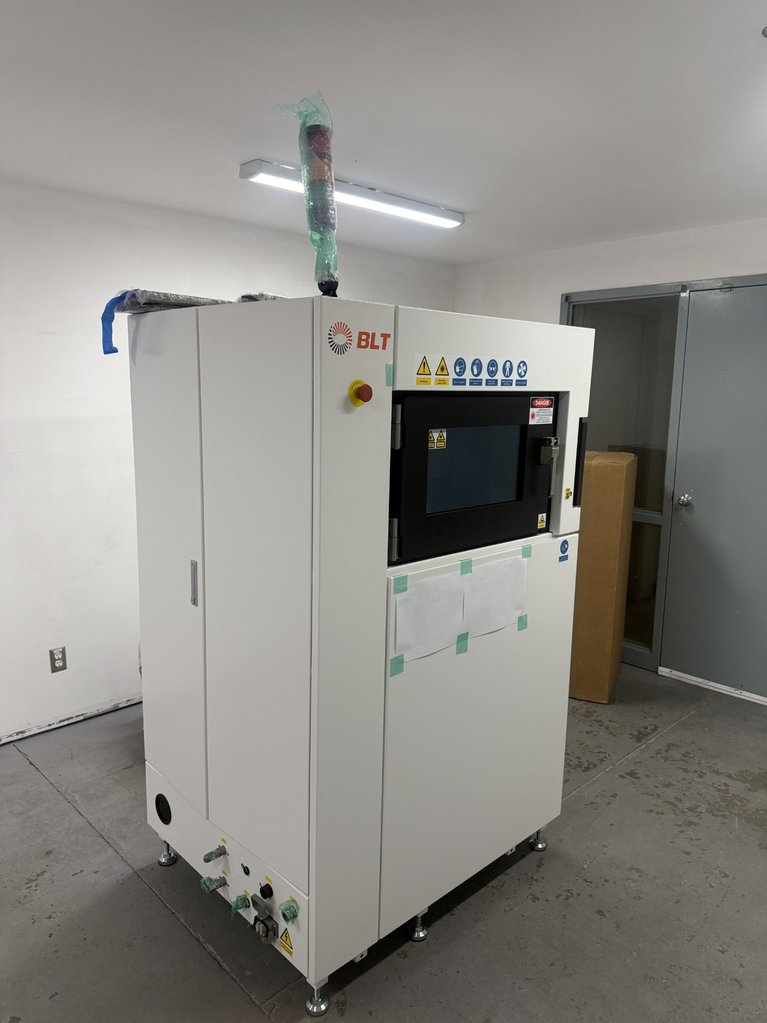
Metal 3d Printer
Ta, W, Re (experimental), Ti, Co, Cr, Ag, Cu, Steels
Resolution:
approximately 60–70 µm XY laser spot size, with 20–100 µm selectable layer thickness
www.selkirk.ca/stac
Notes:
Tantalum , Tungsten , Rhenium , Titanium , Cobalt , Chromium , Silver , Copper
Aluminum and Steels

Slide 5
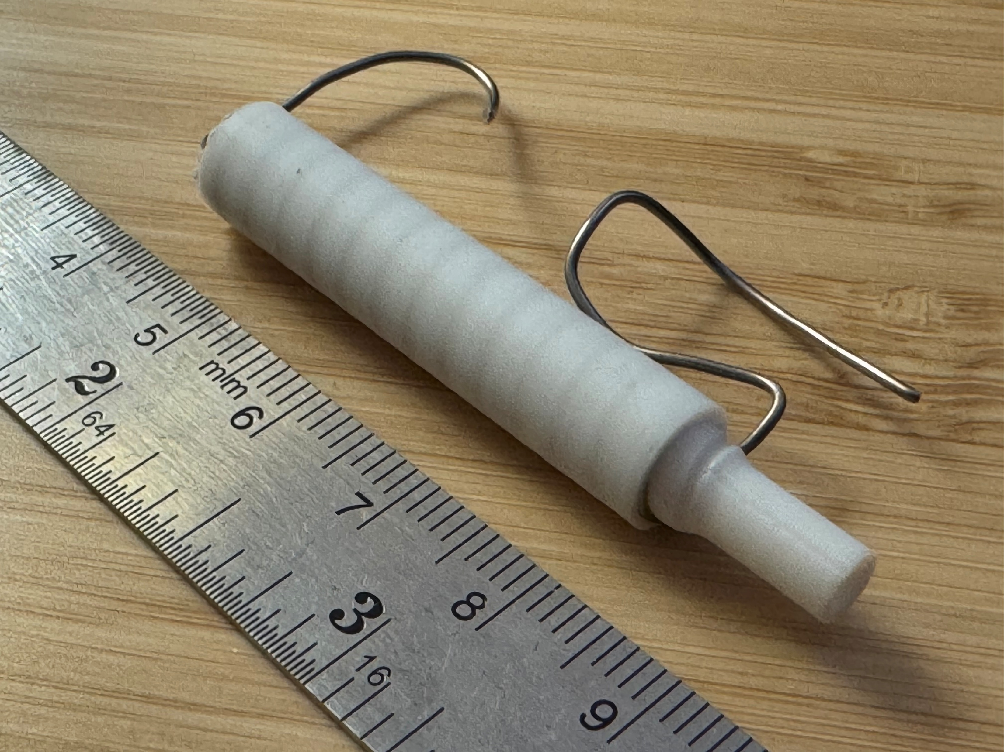
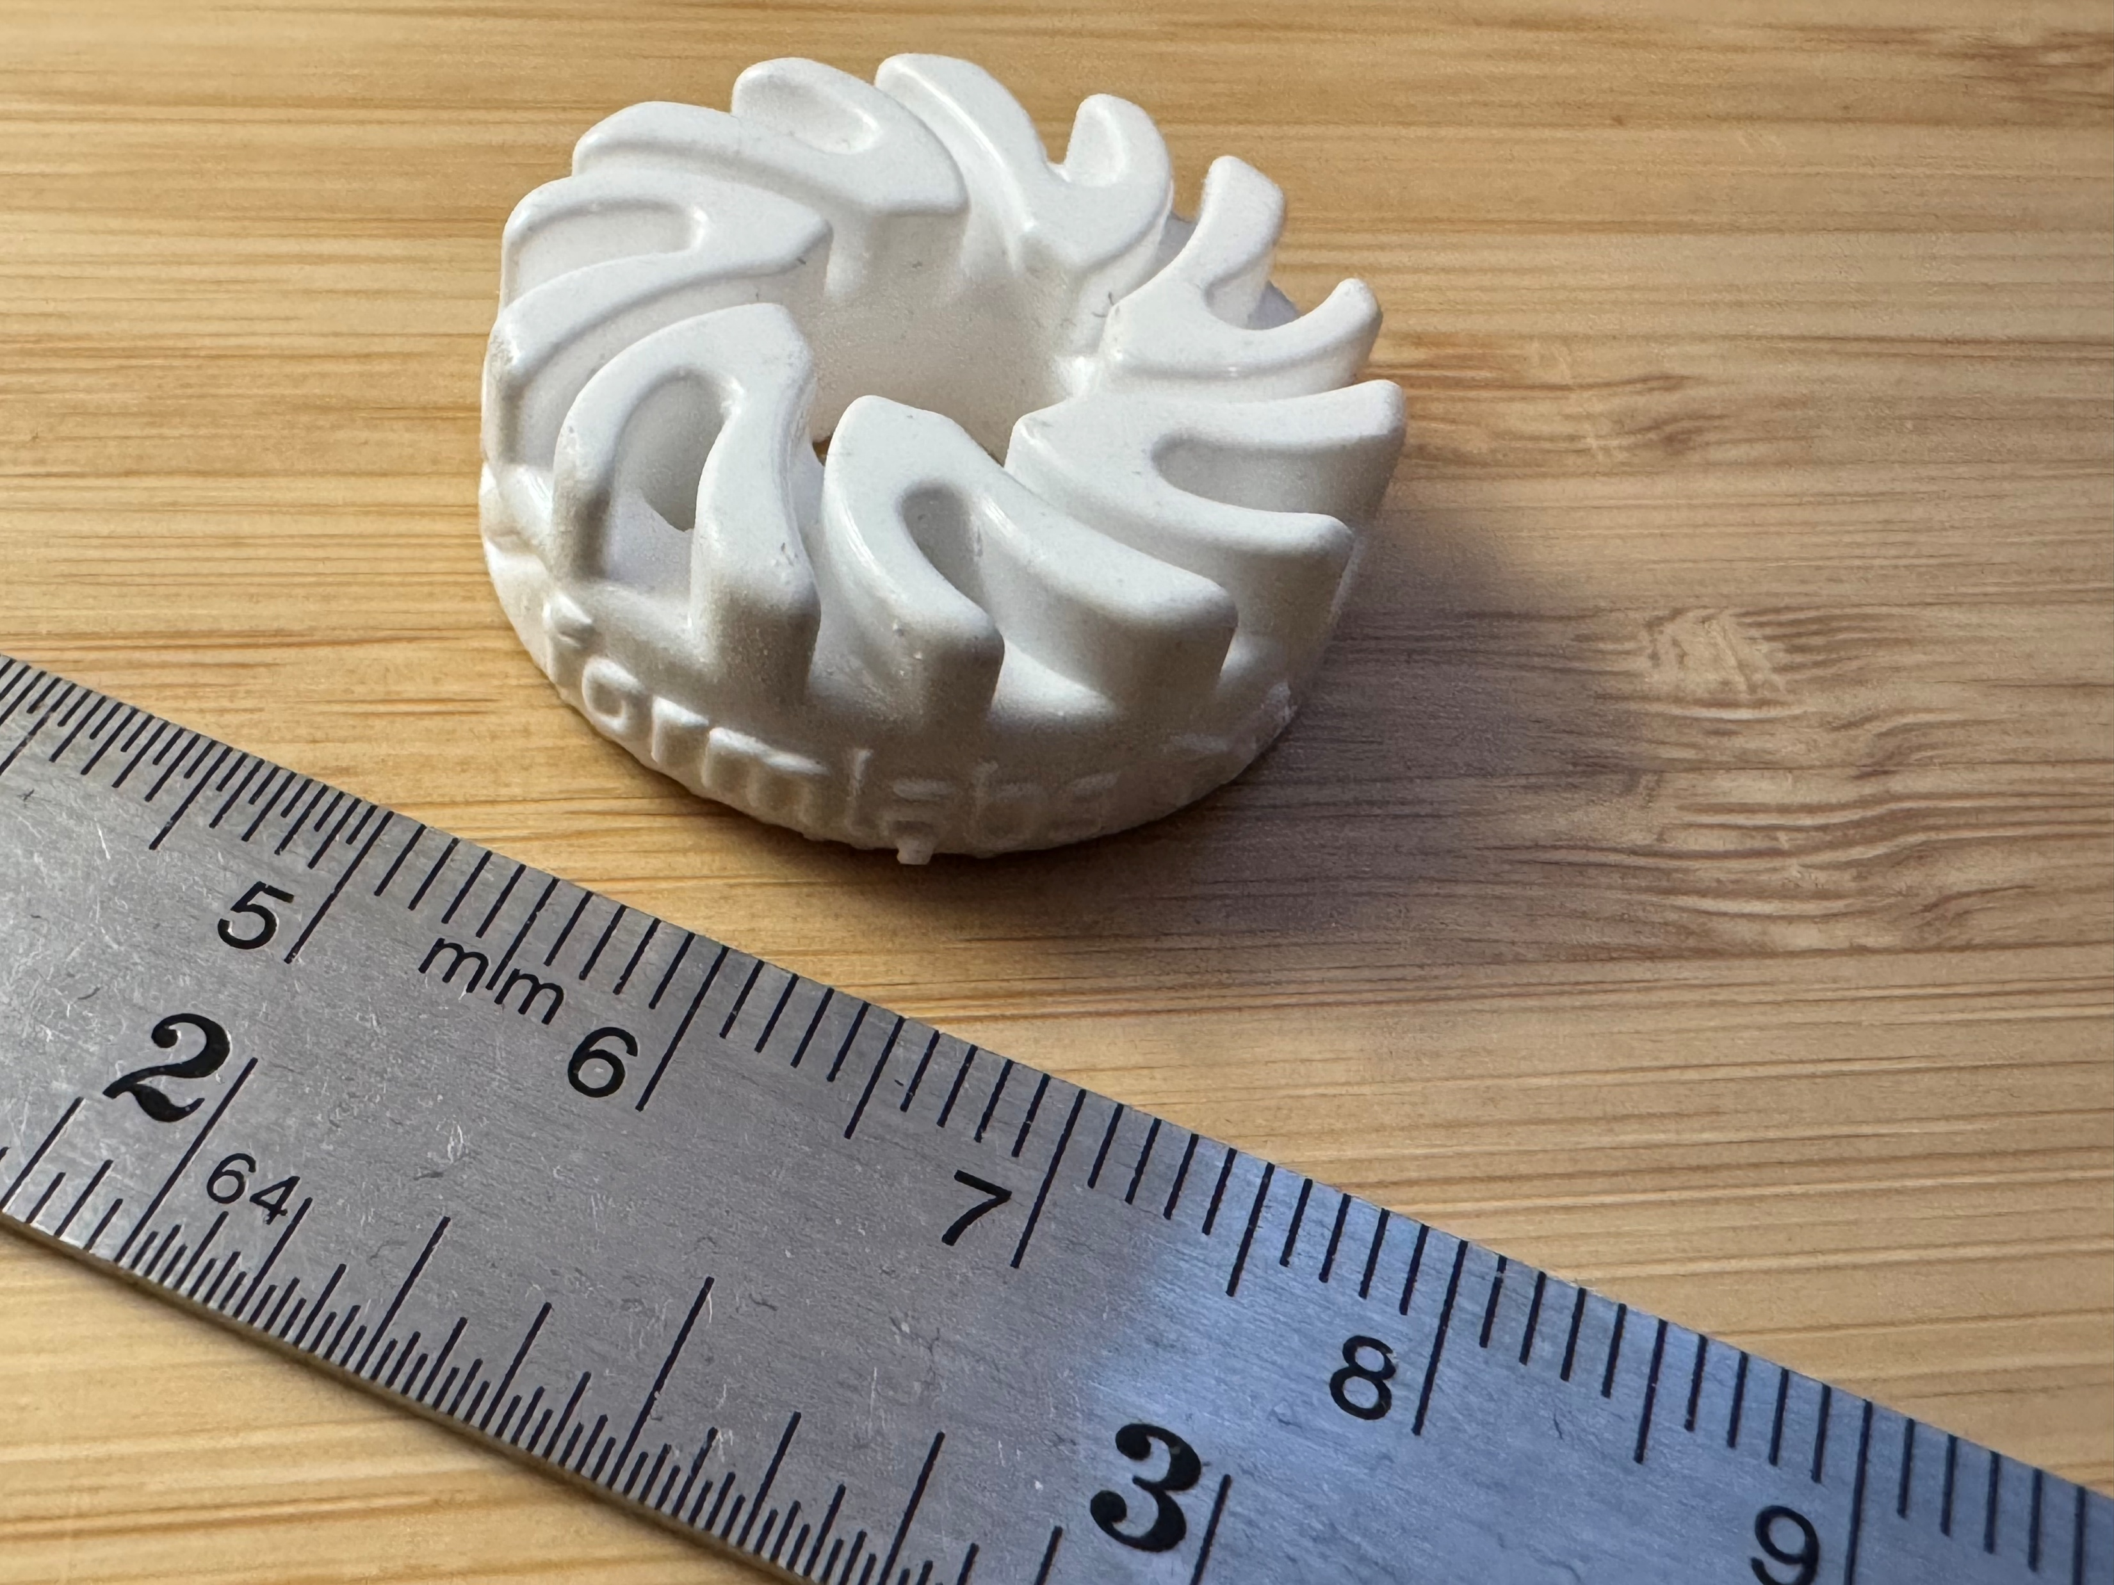
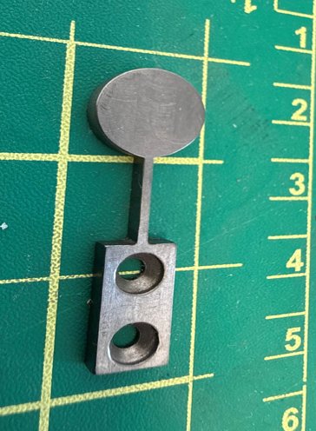
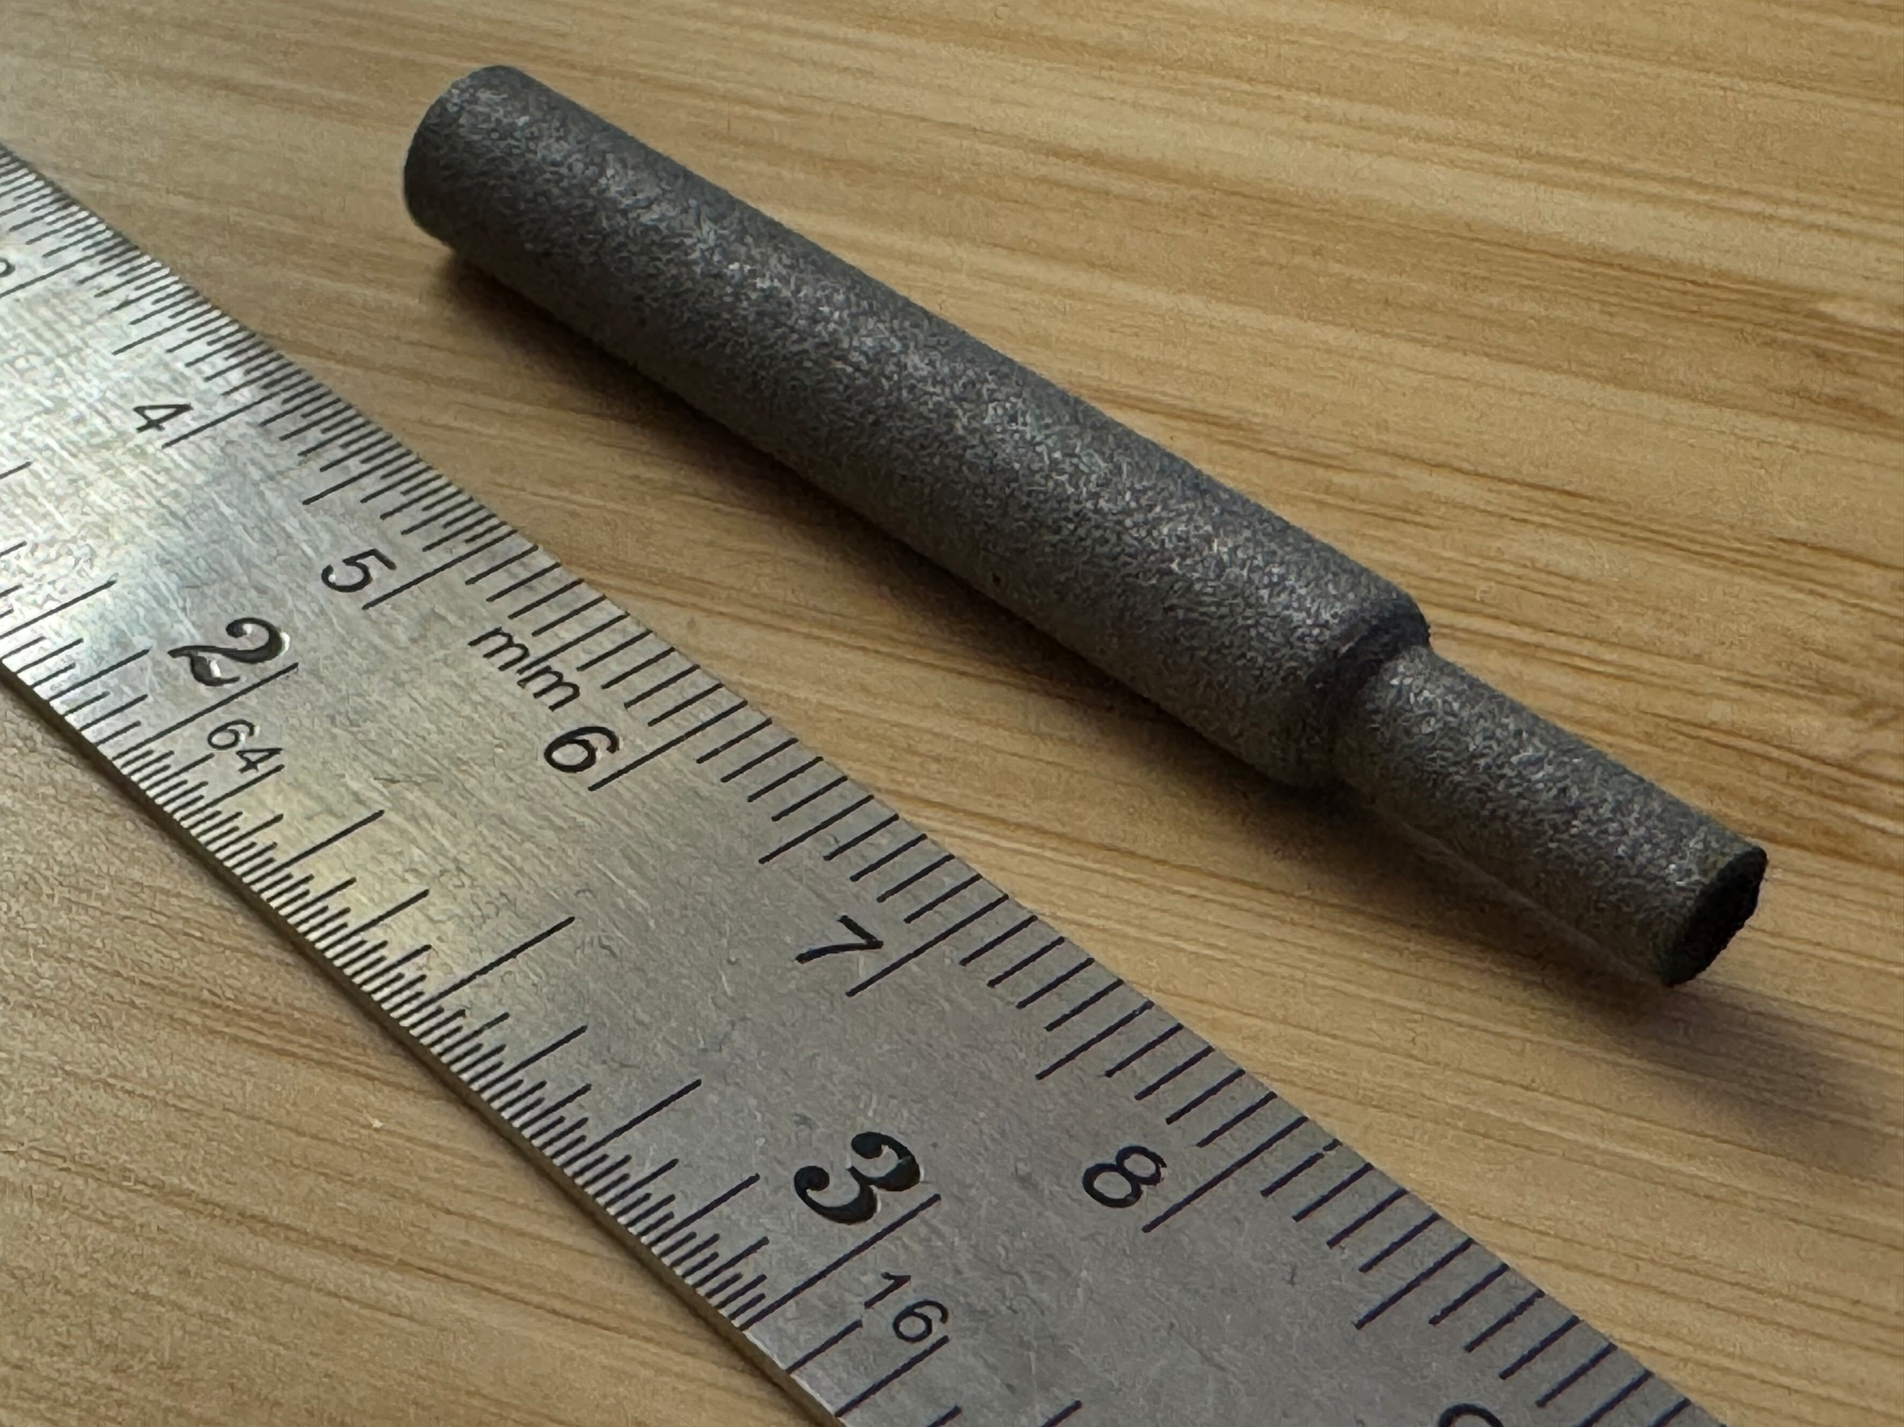
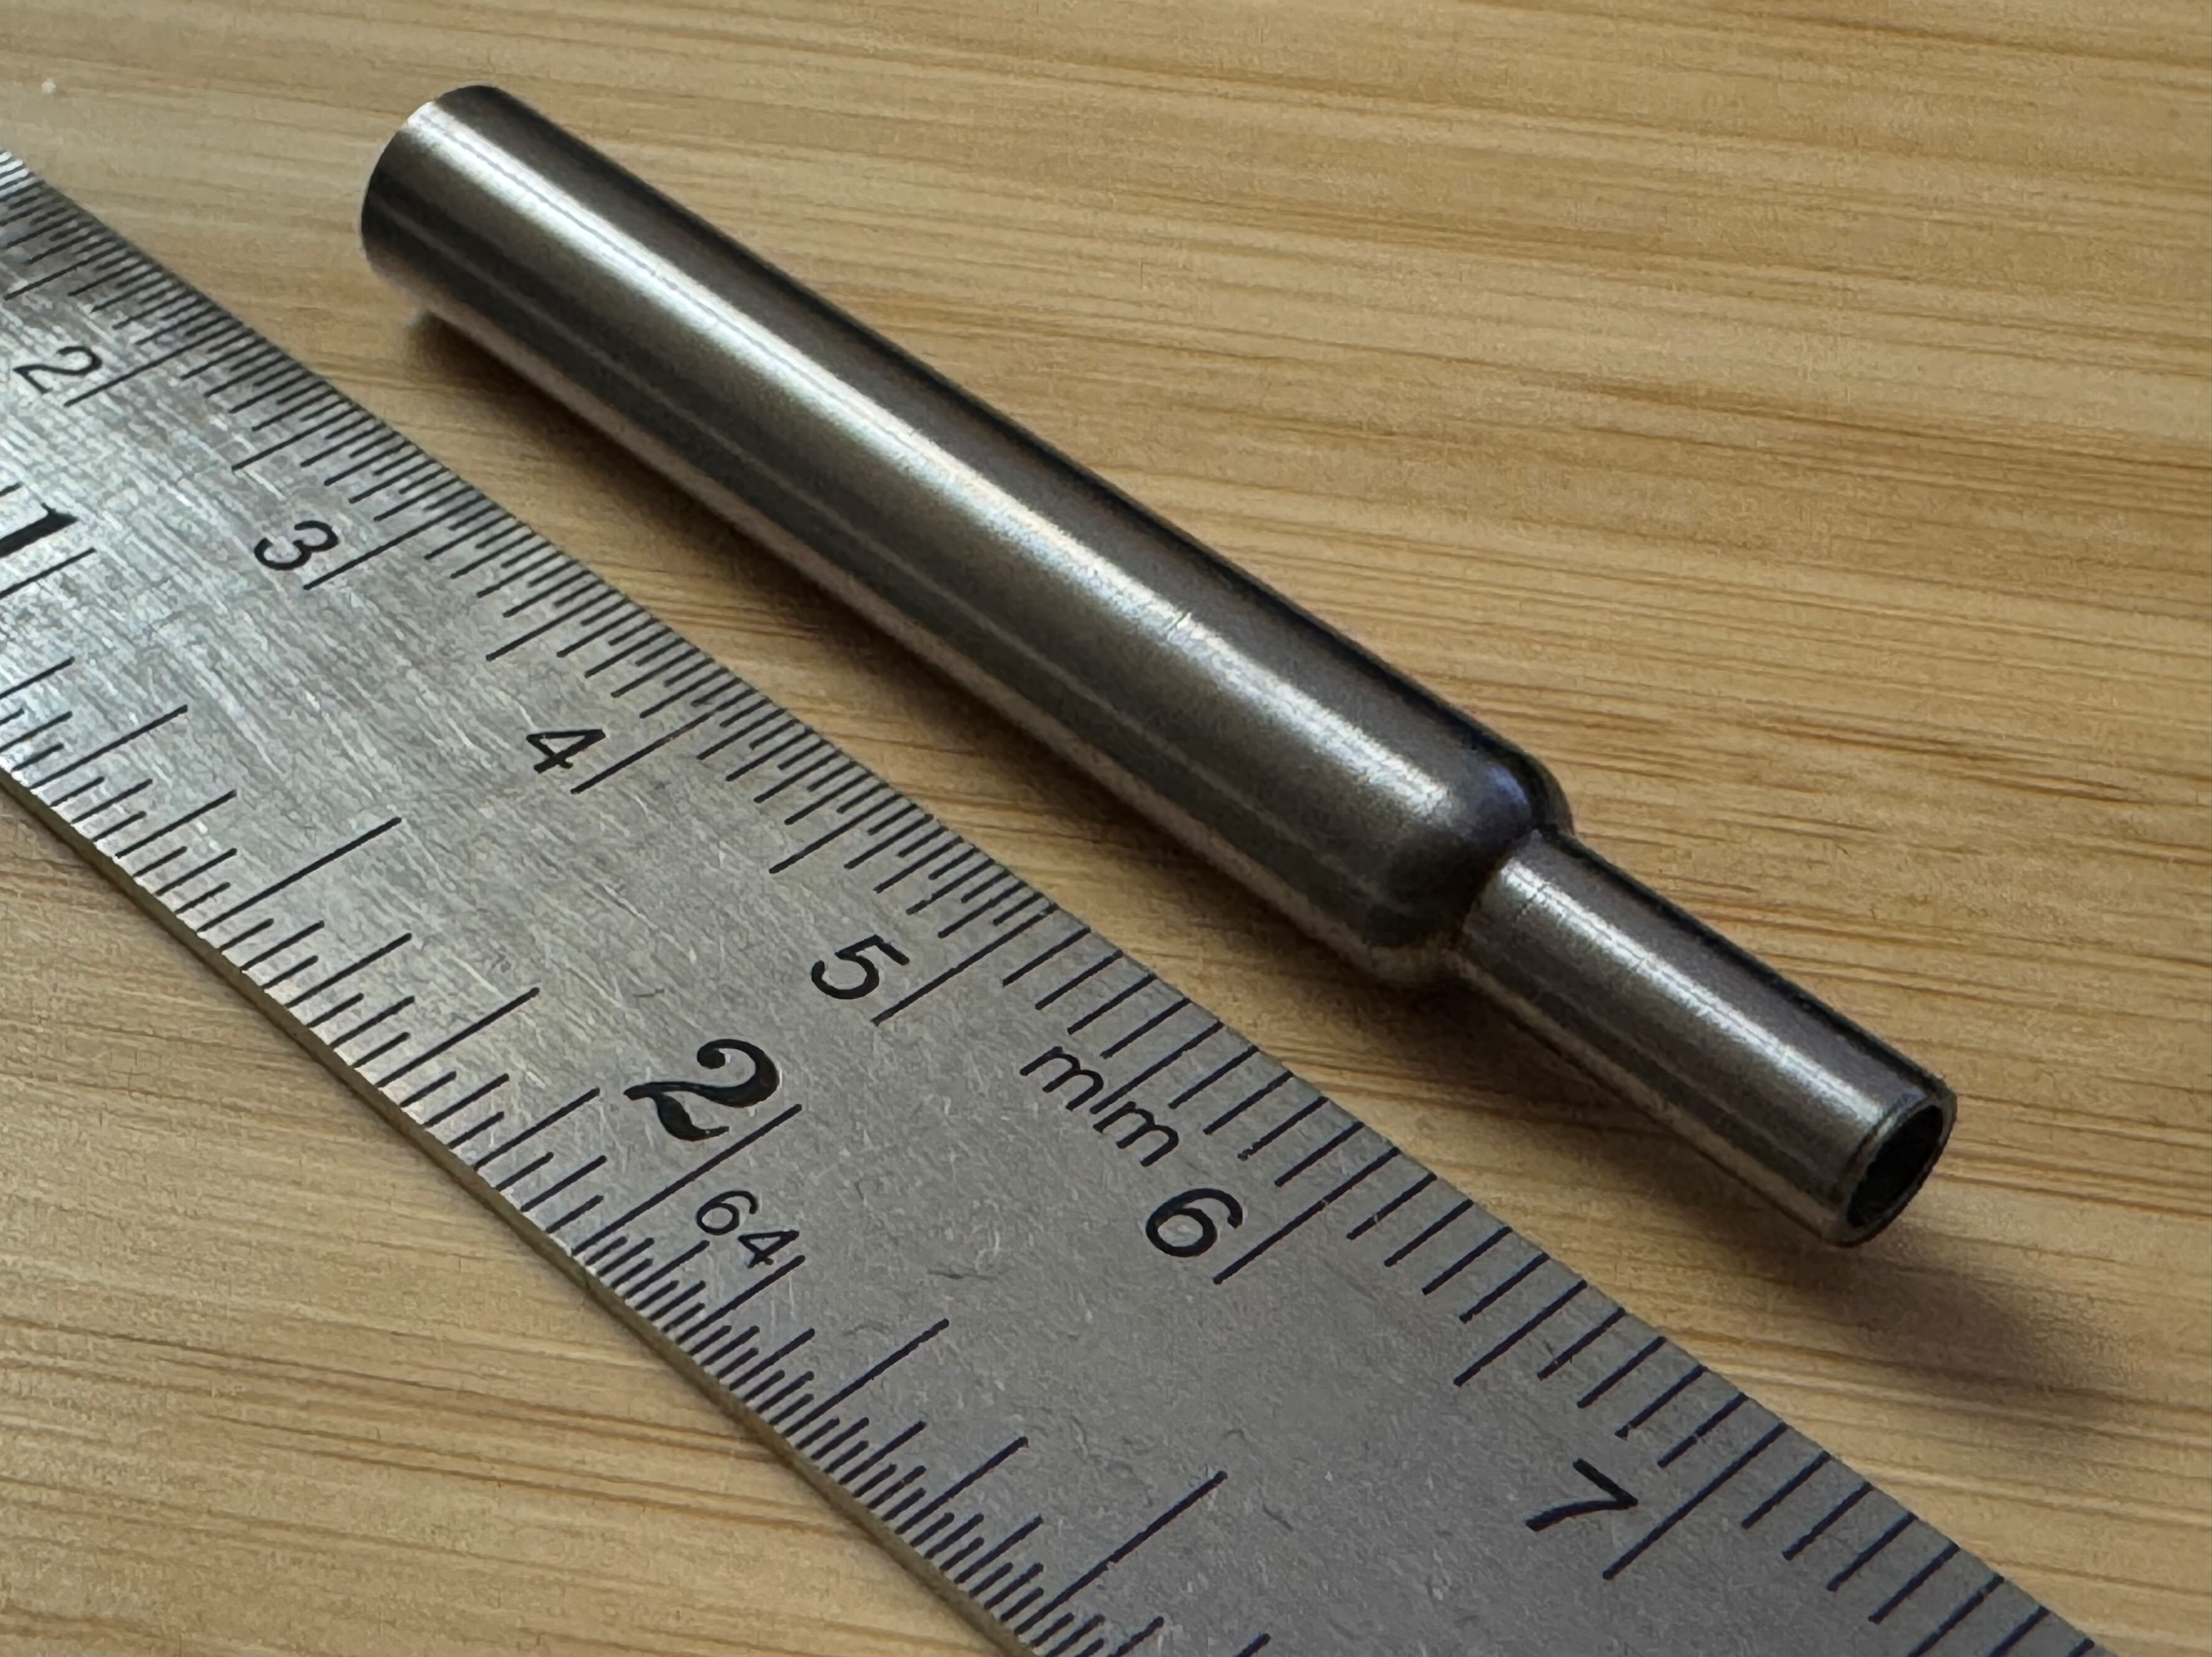
www.selkirk.ca/stac
Notes:
Al₂O₃ = Alumina
ZrO₂ = Zirconia
SiC = Silicon Carbide
Si₃N₄ = Silicon Nitride
More examples of tantalum parts – raw and polished.

Slide 6
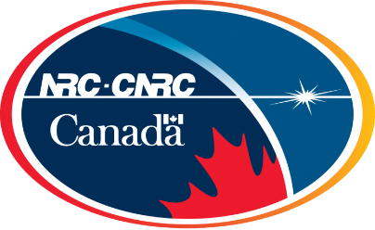







Slide 7

Jason Taylor
jtaylor@selkirk.ca
Jonathan Doyle
jdoyle@selkirk.ca
www.selkirk.ca/stac

