Slide 1
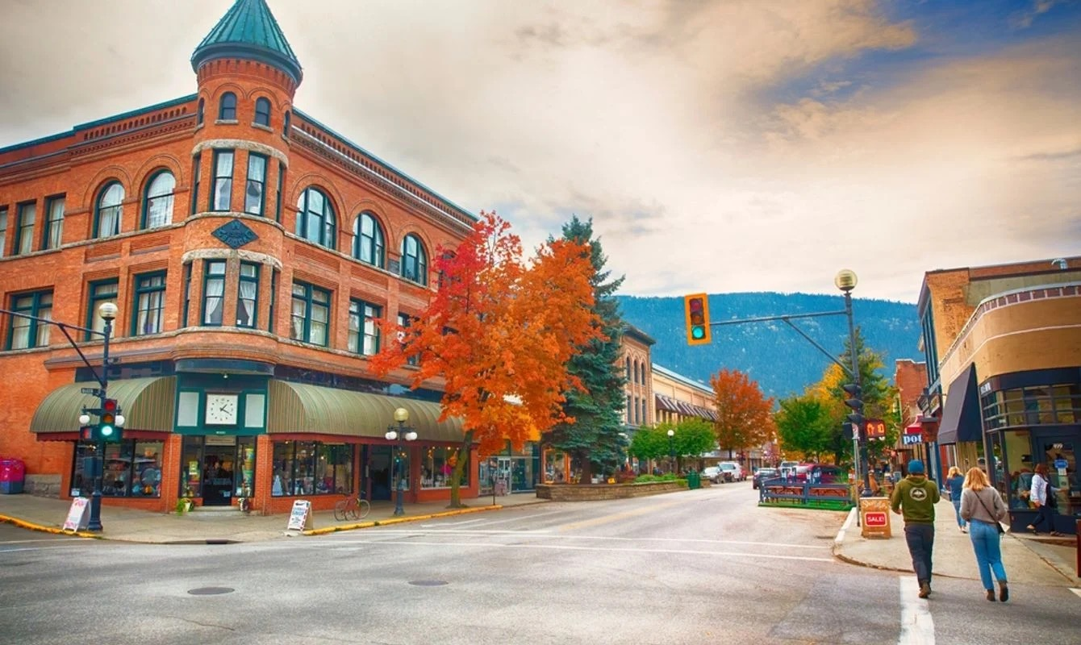



















Welcome to NIBS’26
&
Land Acknowledgement
-
Maggie Matear
President, Selkirk College
Notes:
Seventeen sponsor logos surround the slide perimeter. NIBS2026 and Selkirk College logos appear only in the central area, as requested. Logo sources are the user-supplied sponsor folders and NIBS BOB Logo.png.

