Slide 1
Neutral Beam Roadmap at Realta Fusion
September 24th, 2026
Anthony Cooper, Kai Shih, Joey Eickman, Miral Shah, Eleanor Powell, & Ikhlas Addow
Notes:
Hello everyone and thank you for coming to my talk.
My name is Anthony Cooper and today, I will present Realta Fusion’s Neutral Beam roadmap.
To explain a little about my background, I have obtained education surrounding plasma physics and aerospace engineering at SUNY Geneseo, UCI, & the University of Illinois Urbana-Champaign. While simultaneously gaining over a decade of experimental experience with particle accelerators from SUNY Geneseo to TAE Technologies and most recently Realta fusion.

Slide 2

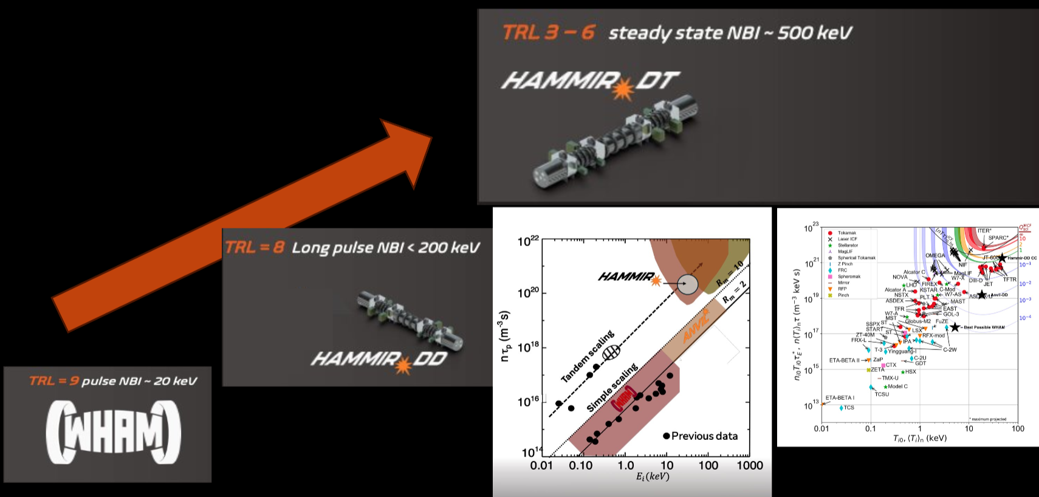
Presentation Overview
Realta Fusion: Who We Are
NBI in Axisymmetric Tandem Mirrors
Realta’s NBI Roadmap
  Overview
  WHAM: Current Experimental NBI
  NARSIL: Single Module Derisking Device
  Hammir-DD: First Reactor Like Device
Presenter: Anthony Cooper
Notes:
To give a brief overview of my presentation, I will first tell you who Realta Fusion is, how NBI’s enhance axisymmetric tandem mirrors and summarize our roadmap to a fusion based power plant. Along the way I will highlight how crucial of a role Negative ion based NBIs will play throughout our anticipated journey.

Slide 3
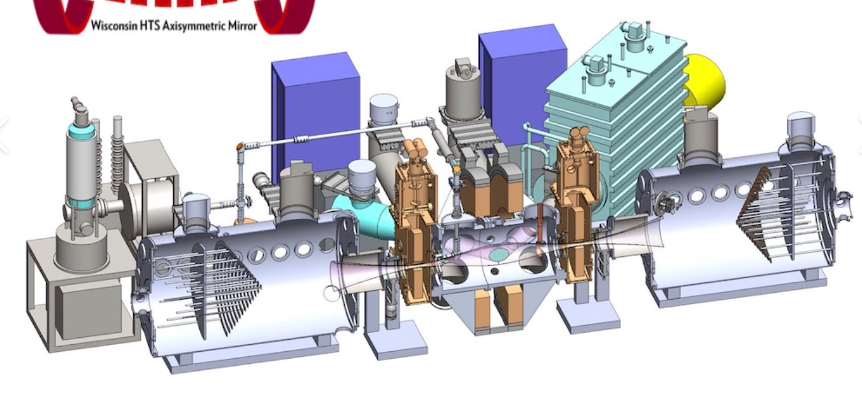
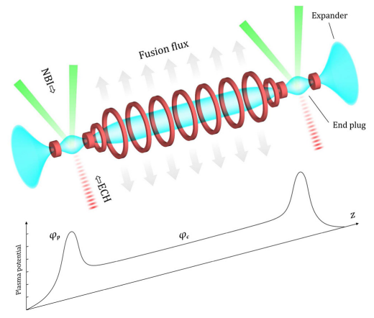
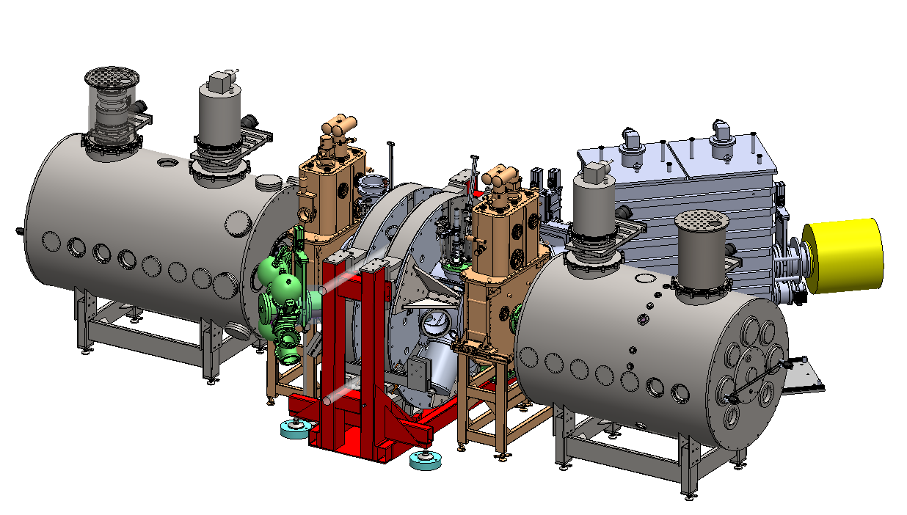
Realta Fusion: Who We Are
Location:
Madison, Wisconsin
Current Status:
Our current experiment is WHAM
Fusion Power Plant Concept:
Axisymmetric Tandem Mirror
Wisconsin High temperature superconducting magnet, Axisymmetric simple Mirror device (WHAM)
Diverter
End Plug
Central Mirror
T.K. Fowler et. al, A new simpler way to obtain high fusion power gain in tandem mirrors. 2017, Nucl. Fusion 57, 056014​
Presenter: Anthony Cooper
Notes:
So lets get started, Realta Fusion is a rapidly growing, privately fusion company located in Madison, Wisconsin. Being here unlocks the ability to collaborate with one of North America’s top plasma physics graduate programs… the University of Wisconsin - Madison.
Together we conduct modeled experiments on the Wisconsin, High temperature superconducting magnet, Axisymmetric simple Mirror device or WHAM for short. This device gives us a suitable platform to study the physics in simple mirrors equipped with NBIs and Electron Cyclotron Heating, or ECH.
Utilizing the knowledge gained on WHAM will unlock our ability to focus on our final fusion power plant concept, the Axisymmetric Tandem Mirror. Which is basically just one large mirror, the “central mirror” sandwiched between 2 smaller mirrors, the ‘end plugs’. This magnetic configuration enhances the confinement within the central plasma. To maximize this confining phenomenon we boost our end plug plasma metrics by equipping them with NBI and ECH.
[NEXT]

Slide 4
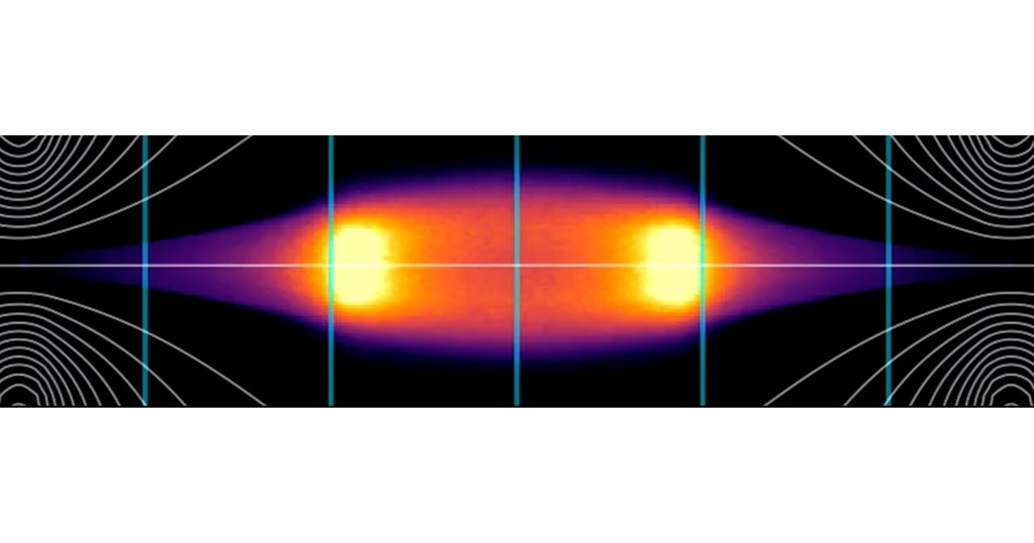
NBI in Axisymmetric Tandem Mirrors
Diverter
End plug plasmas must have a high density, high temperature plasma
The “sloshing” ions effect produces a Central Cell confining ambipolar potential
NBI provides direct power injection deep within the plasma core
NBI stabilizes plasma against Alven-ion cyclotron (AIC) instabilities
End Plug
Central Cell
T.K. Fowler et. al, A new simpler way to obtain high fusion power gain in tandem mirrors. 2017, Nucl. Fusion 57, 056014​
Representation of the “Sloshing” ion distribution within the end plugs
Presenter: Anthony Cooper
Notes:
Actually, this confining property is attributed to an ambipolar potential established between the end plug and the central cell. Such potentials are proportional to the build up of a dense, hot-ion population which “sloshes” back and forth within these end plugs. NBI is most effective at producing this population due to its direct ion heating, ability to penetrate the plasma core, and its lack of density cutoff limitation.
Another benefit of injecting neutral beams into these plasmas is the momentum and rotational drive that it provides. This drive acts as a stabilization component to the infamous mirror related MHD instabilities that have been observed in previous experiments.
So, between plasma heating and MHD wave stabilization the importance of NBI within a tandem mirror has been established within our experiment. With the benefits of NBI systems coupled with axisymmetric mirrors highlighted, let's discuss how we plan to execute the a clear, goal-oriented strategy to build this complex device..

Slide 5
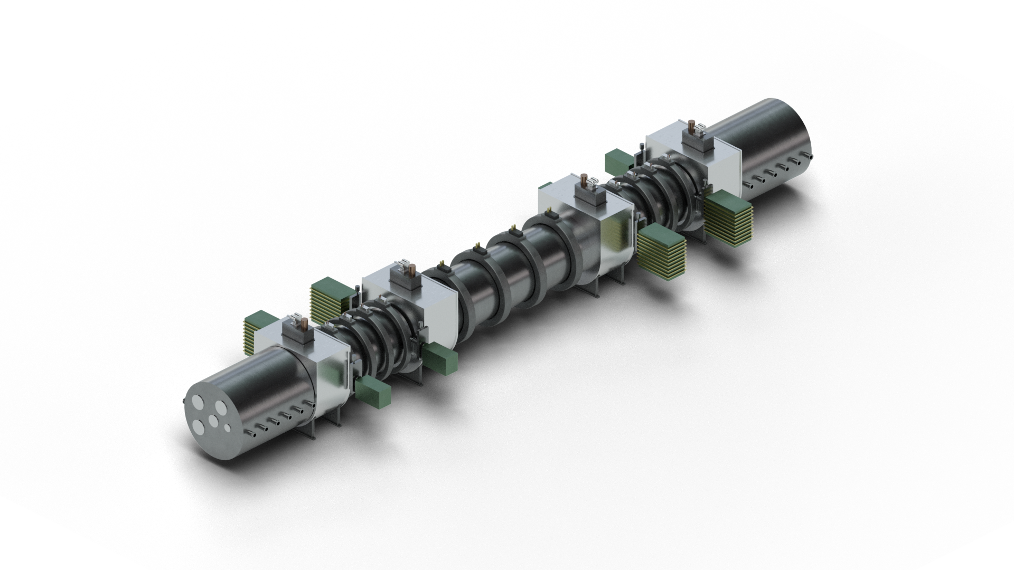
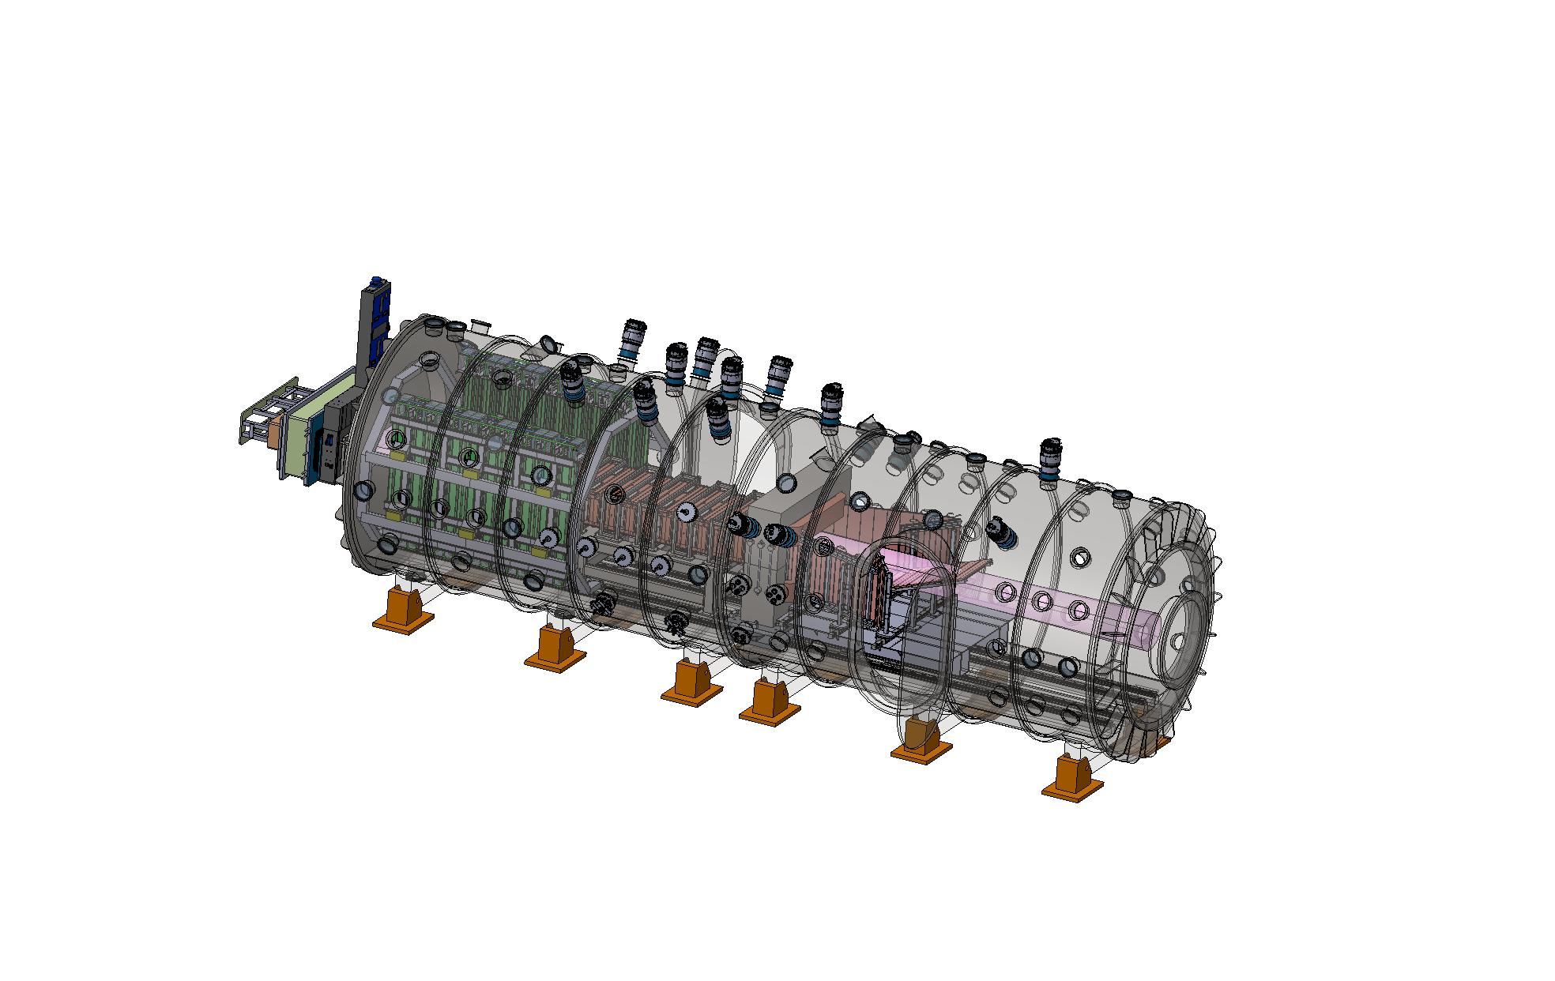
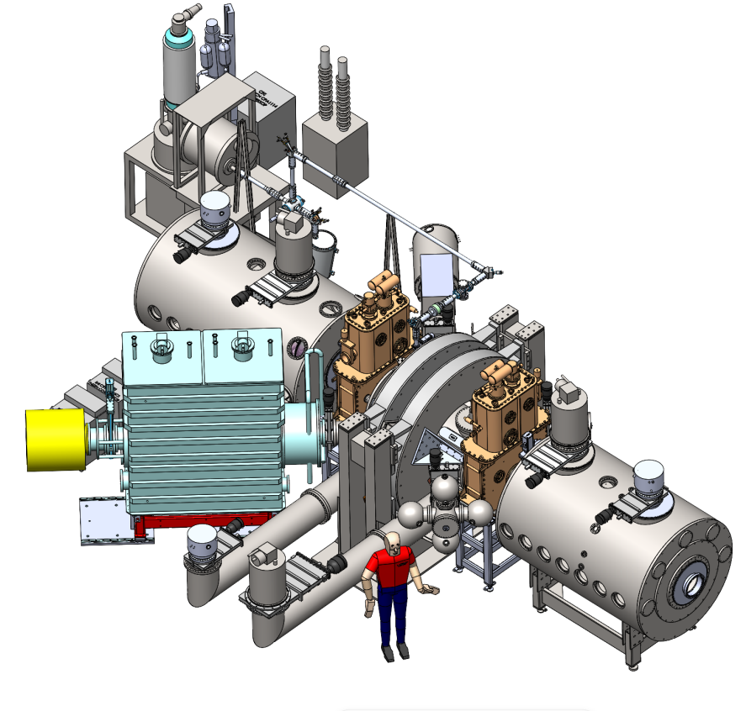
Realta NBI Roadmap
HAMMIR-DT
Positive ions
Negative ions
500 keV
HAMMIR-DD
200 keV
Deuterium-Tritium
WHAM
NARSIL
200 keV
Deuterium-Deuterium
25 keV
Presenter: Anthony Cooper
Notes:
First, we start with WHAM, which is currently equipped with a positive NBI. Once we have demonstrated success here, we will execute the building of our first Axisymmetric Tandem mirror named Hammir-DD where we will demonstrate fusion relevant plasma performance with Deuterium-Deuterium reactions. This device will require about 10 MW of symmetrically injected neutral beam power at 200 keV into each end plug. And considering the degradation of neutralization efficiencies of a positive beam at these energies, we must utilize negative beam technology.
Today, several other experiments have demonstrated technology readiness for high-power, 200 keV negative-ion-based NBI systems, giving us confidence to proceed with an ion source design built around these parameters.
Regardless of demonstrated designs, we still must ensure a successful execution. To do this, we are designing a test stand, named NARSIL, which will conduct performance-based experiments aiming to measure 1.5 MW of neutral power. The success of these tests will allow us to replicate these sources to meet the demand of HAMMIR-DD.
And,
After completion of our fusion experiments on Hammir DD we may then focus on deploying our commercial fusion power plant, Hammir DT, for deuterium tritium fusion… The main goal of this device is to demonstrate a Q much greater than 1. To reach this goal we must first address the major engineering challenges of deploying a NBI compatible with a 24/7, high performing fusion power plant.
As hinted at by this graph, our path to a fusion power plant will involve building complex devices and solving complex problems.

Slide 6
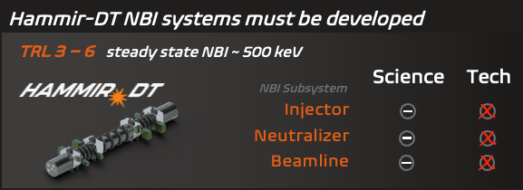


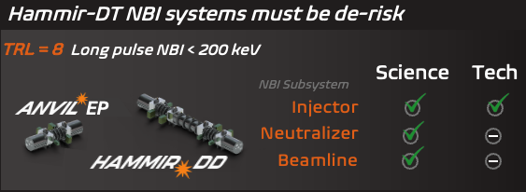
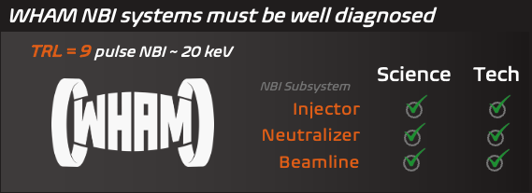
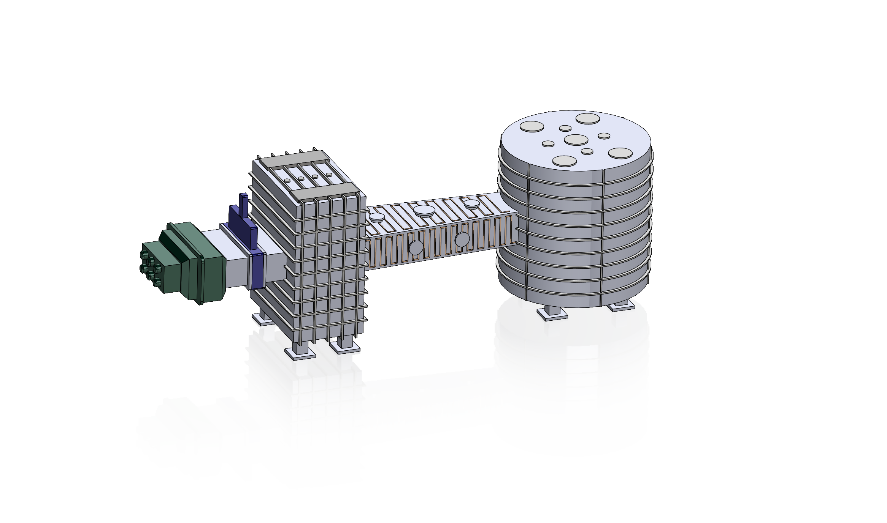
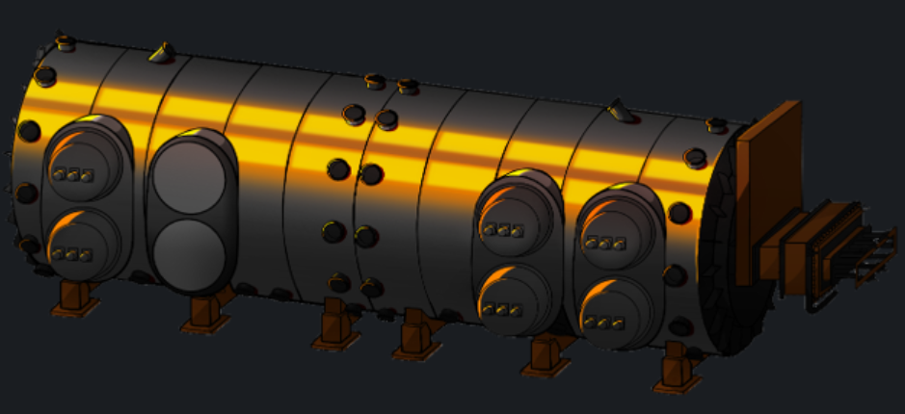
Realta NBI Roadmap
Advanced-neutralization
CW operation
Hammir-DD
Capability Track
(Learn & Develop)
Beam Diagnostics
Operations
NARSIL
Modeling
N-NBI Test Stand
Engineering constrains
System Track
(Validate)
Notes:
And to solve these problems Realta must execute a reliable, scientifically informed solution, outlined here.
As of today, Realta’s NBI roadmap follows a dual-track development strategy.
The first track is the system track, where we build and operate systems step by step starting with WHAM. WHAM will develop NBI diagnostics, modeling and beam characterization techniques to help us understand the beam–plasma interaction. While NARSIL, our N-NBI test stand, will allow us to validate negative-ion source technology, beamline components, and operational procedures. Which will help us achieve our goals for the HAMMIR-DD NBI systems.
At the same time, we run a second track, the capability development track.
This focuses on the long-term technologies required for HAMMIR-DT, particularly high-current continuous-wave negative-ion beams and advanced-neutralization techniques, which are essential for the tandem mirror power plants but still at relatively low technology readiness levels today.
These low TRL related issues may be addressed in parallel to the building and operating HAMMIR-DD. The experience from which will assist in reducing engineering risks related to full beamline architecture and system operation for the DT power plant.
By advancing these two tracks at the same time—system deployment and capability development—we can steadily reduce both scientific and engineering risks for the execution of Hammir DT, our high Q commercial power plant
With this approach, we can progress the development of NBI in step with the over arching roadmap that we have built.

Slide 7
Realta NBI Roadmap
Advanced-neutralization
CW operation
Hammir-DD
Capability Track
(Learn & Develop)
Beam Diagnostics
Operations
NARSIL
Modeling
N-NBI Test Stand
Engineering constrains
System Track
(Validate)
Notes:
Now, With the entirety of the roadmap described, I will now highlight our very first step… Validating our diagnostic capability and modeling techniques on WHAM.

Slide 8
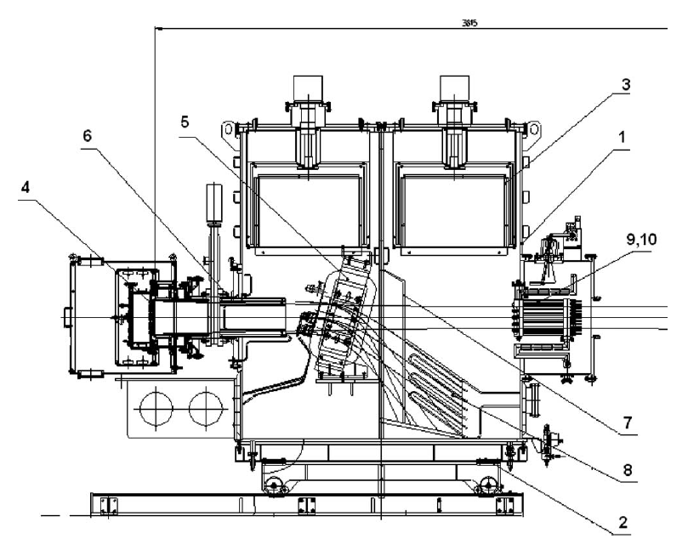
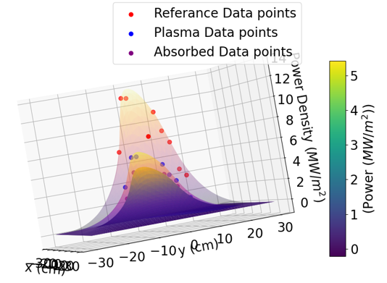
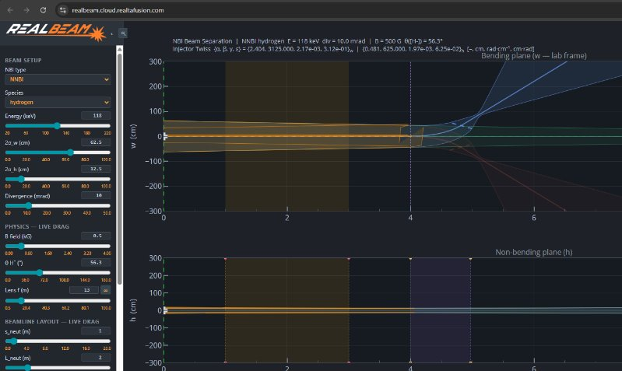
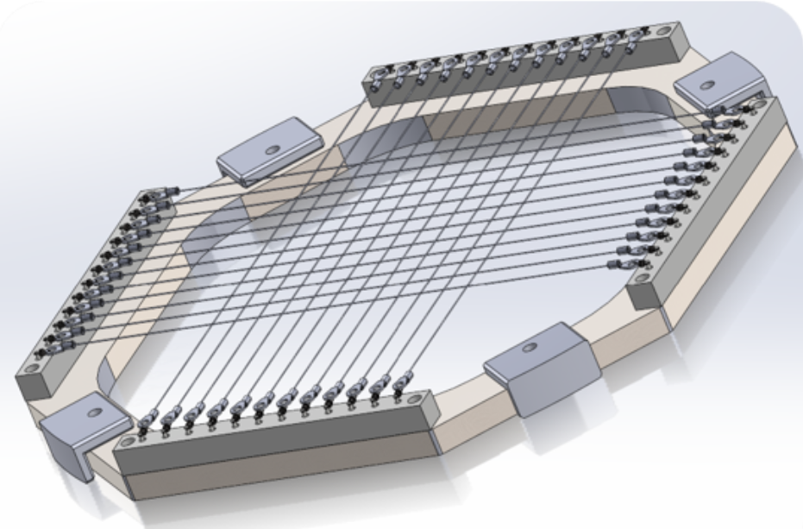
WHAM: NBI Validation Platform
This device allows us to gain experience with:
Operating and maintaining an NBI system
Handling of control parameters and DAQ
Building and deploying NBI relevant diagnostics
Verify a suite of modeling NBI relevant parameters
Beam Parameters | Value
Ion Type | H+ or D+
Beam Energy | 25 keV
Extracted Current | 50 A
Duration | 15 ms
Composition Fraction | 70:25:5
Divergence | <1deg
WHAM NBI Diagram
Neutral Beam Power Density Profiles & Absorption Profiles
In-house developed NBI modeling tool for beam dynamics
In-house CAD of WHAM NBI's wire calorimeter
Characterization of 1 MW, 40 keV, 1 s neutral beam for plasma heating, by A.Sorokin et. al, 2010, Rev. Of Sci. Inst. 81, 02B108.
Presenter: Anthony Cooper
Notes:
The WHAM NBI serves as a validation platform and is capable of reliably achieving an ion energy of 25 keV while extracting a sub 20 mRad beam at about 50 A of current in hydrogen and deuterium for about 15 ms while maintaining a decent molecular composition fraction within its RF ion source.
The in-house deployed and maintained diagnostic suite on this beam produces measurements via multiple negative ion beam relevant techniques such as optical emission spectroscopy within the ion source, Doppler Shift Spectroscopy of the neutral beam, multiple forms of calorimetry, Secondary Electron Emission detectors, & temporally well resolved vacuum gauges.
With this beam, we are gaining experience:
Operating and maintaining NBI systems and their power supplies,
Handling NBI relevant control parameters and DAQ devices
building + deploying NBI relevant diagnostics such as this wire calorimeter
And Verifying modelling techniques of certain NBI components such as ion sources, ion extraction systems, and power absorption processes within our plasmas.. please see Joey Eickmans presentation for a more detailed explanation of our modeling capabilities…
Ultimately, this device is being utilized to derisk multiple concepts which are critical to properly deploying a Hammir-DD relevant NBI system.
Still, it is obvious to recognize that there are certain things about a negative ion based NBI system which cannot be derisked while utilizing a positive ion source, other than just negative ion production. Such as the prediction of cesium dynamics, minimization of coextracted electron & backstreaming ions, and compensation for drift derived non-uniformities of the beam, and so-on. The cruciality of derisking these things is not lost on us.

Slide 9
Realta NBI Roadmap
Advanced-neutralization
CW operation
Hammir-DD
Capability Track
(Learn & Develop)
Beam Diagnostics
Operations
NARSIL
Modeling
N-NBI Test Stand
Engineering constrains
System Track
(Validate)
Notes:
Which is exactly why we plan to deploy NARSIL as soon as possible. With this test stand we are executing our first step in the system track, which will allow us to validate our negative ion source related modeling and engineering constraints…..

Slide 10
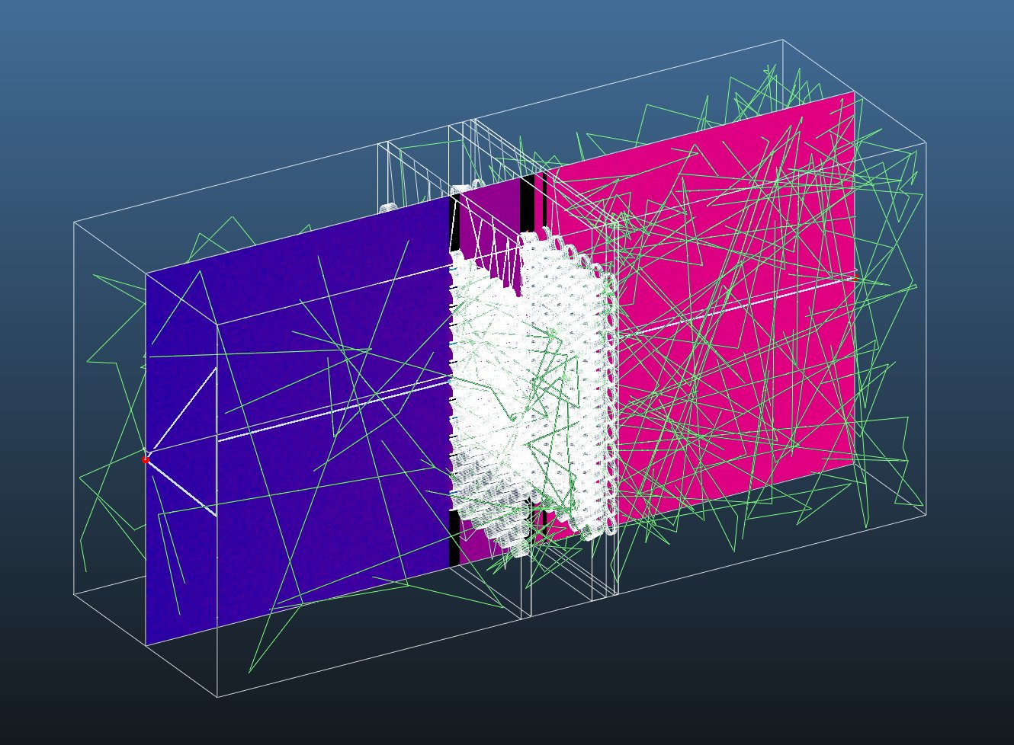
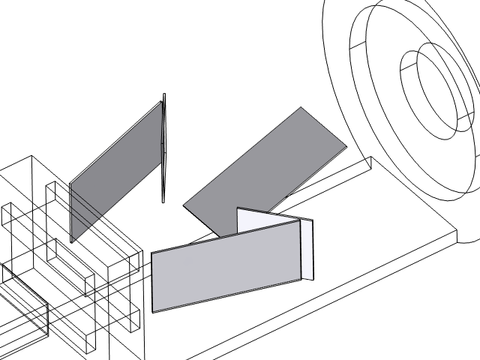
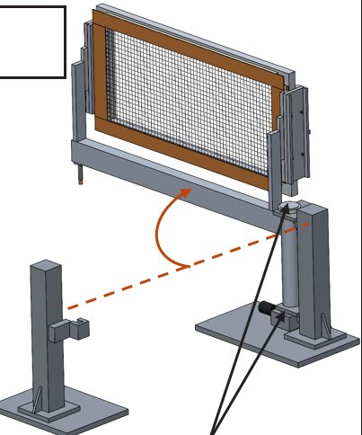
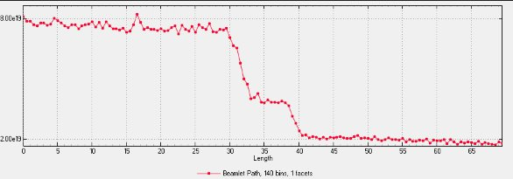
NARSIL: Single Module Derisking Device
NARSIL is one MODULE of the Hammir-DD NBI design.
Validate key physics and engineering models
Provide operational experience with NNBI
Allow for a complete diagnosis of a large negative ion source + high powered neutral beam
Optimize source for high power deuterium operation
Parameter | NARSIL NBI | Hammir-DD Beamline
NBI Power (MW) | 1.5 | 5
Beam Energy (keV) | 200 | 200
Pulse Duration (s) | 1.5 | 10
Gas Dynamics
Heat Deposition
Diagnostic Designs
Presenter: Anthony Cooper
Notes:
Along with this model verification, NARSIL will also :
Give us experience building, operating, and controlling a negative NBI system
Refine our ability to develope a full suite of negative ion source and beamline diagnostics
And provide a platform to optimize high power deuterium operations
As currently designed, NARSIL will serve as Hammir-DD’s single module derisking device. Each ion source is rated for 1.5 MW of injected neutral power while extracting about 15-20 A at the energy of about 200 keV. Our modeling and design efforts should unlock our ability to operate the NARSIL device up to 1.5 seconds. Once validated, we will utilize these models to extend the pulse length to 10s for the Hammir-DD NBI system which will need about 5 of these ion sources per beam line to meet the previously mentioned requirement of symmetrically injecting 10 MWs of NBI power into each of the 2 end plugs.
Upon achieving our goals on NARSIL, we will have unlocked our capability to build Hammir-DD.

Slide 11
Realta NBI Roadmap
Advanced-neutralization
CW operation
Hammir-DD
Capability Track
(Learn & Develop)
Beam Diagnostics
Operations
NARSIL
Modeling
N-NBI Test Stand
Engineering constrains
System Track
(Validate)
Notes:
In parallel with this development, we'll advance our capability track by developing advanced neutralization techniques and an NBI system suitable for continuous-wave operation on our final demonstration power plant. Hammir-DD will serve as the platform for proving our ability to successfully couple high-energy neutral beam injectors onto an axisymmetric tandem mirror while also validating our ability to produce high-performing plasmas.

Slide 12
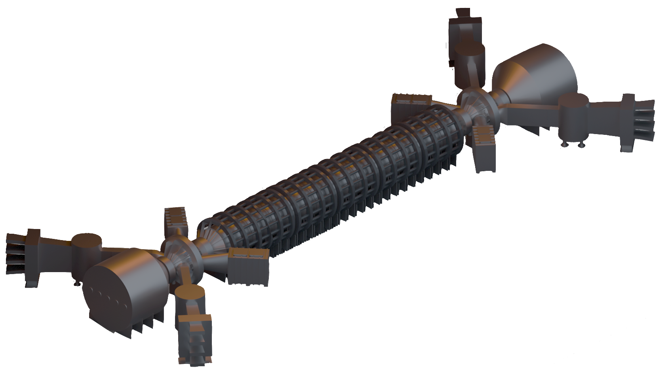






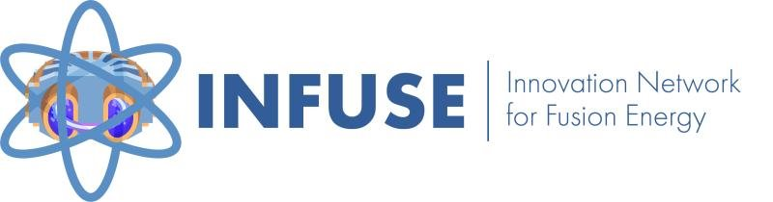


Hammir-DD: First Power-Plant Like Device
Hammir-DD
Hammir-DD is an axisymmetric tandem mirror
The end plugs are primarily heated and fueled by neutral beam injection
Hammir-DD requires 20 MW of injected neutral power in each end plug
5 sources per beamline
2 beamlines per end plug
20 total ion sources
Opposite of each beam is a neutral beam dump to absorb the shine-through power
NBI Beamline
Neutral Beam Dump
Collaboration subset:
X
International Laboratories
Presenter: Anthony Cooper
Notes:
With this successful demonstration, we will have built our first power plant like device…
To reiterate this devices NBI demands, wll require 10 MW of symmetric power injection on each end plug totaling for 20 MW of required neutral power originating from 2 separate beam lines equipped with 5 ion sources each.
This means that HAMMIR-DD’s entire NBI system has up to 20 total ion sources.
Additional to these ion sources, we must construct 4 neutral beam dumps to appropriately absorb the shinethrough power of the neutral beams on the opposite side of each beamline. These dumps are also scoped to serve as a diagnostic region to measure the power profile of the beams, estimate the power deposition into the target plasma, and to act as a line integrated plasma density diagnostic……
The development of this NBI system is no small task. To achieve this within an appropriate timeline will take a massive feat of physics, engineering and manufacturability. Which is exactly why we are calling on all our international & domestic collaborations to construct the complex physics modeling tools, staple down a plan to appropriately handle the high-power deposition of the beam, and to establish the correct supply chains to make this roadmap a reality…...
At this stage, HAMMIR DD is not only a technical challenge, but also, a political one. Over the last year or so, Realta has established deep ties within the political sector of Wisconsin. Utilizing these political ties and collaborating with the local electric company, we have been able to lock down a relatively cost-effective, and a completely suitable factory to host this device. We are now leveraging our man-power to retrofit an existing facility to meet our needs for HAMMIR DD and beyond.

Slide 13
Realta NBI Roadmap
Advanced-neutralization
CW operation
Hammir-DD
Capability Track
(Learn & Develop)
Beam Diagnostics
Operations
NARSIL
Modeling
N-NBI Test Stand
Engineering constrains
System Track
(Validate)
Notes:
Beyond being Hammir DT! The tasks in front of our team in order to achieve these goals are complex and will require time, effort, and dedication. Realta has established a strategic plan to address each of these issues and we will leverage all our connections to make this dream a reality.

Slide 14
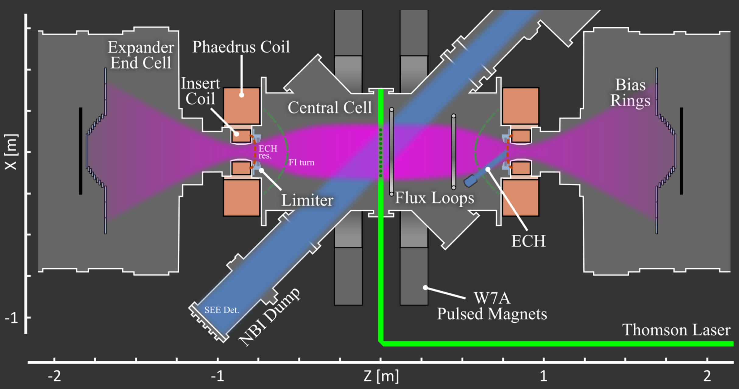
A Summary of Realta’s Operational Concept
While leveraging all of our collaborations, and with the use of multiple devices, intelligent modelling, and an extensive diagnostic suite we unlock the ability to:
Derisk our designs
Optimize operational parameters
Create a digital twin of each newly developed NBI system
Pinpoint/predict system failures
Presenter: Anthony Cooper
Notes:
To summarize all of our efforts… to develop an NBI for a viable commercial power plant we will utilized our domestic and international collaborations while building multiple devices, creating intelligent modeling, and deploy an extensive diagnostic suite, we’ve thus far been able to unlock the ability to derisk our designs, optimize operational parameters, create digital twins of each newly developed NBI system to pinpoint/predict critical system failures.

Slide 15
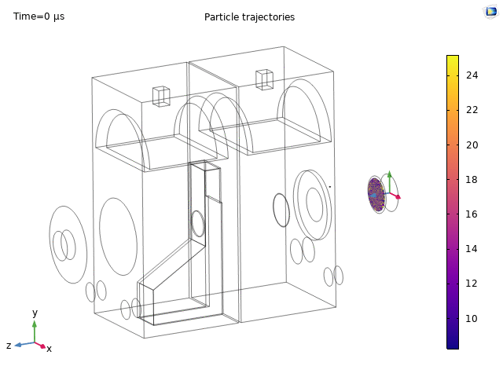
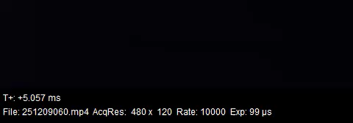
Thank you! Questions?
Please stay tuned for Joey Eickman’s presentation on our modeling capabilities!
@ 3:35 PM
Presenter: Anthony Cooper
Notes:
Thank you all again for listening to my talk, please stay tuned for Joey Eickman’s presentation at 3:35 PM today where he will discuss all of our modeling capabilities! Do you have any further questions for me?

