Slide 1

Aspects of Negative Ions in Microwave PECVD Plasmas for Diamond Thin Film Deposition
Michael P. Bradley
Professor, Physics & Engineering Physics & Dean, College of Engineering
University of Saskatchewan

Slide 2
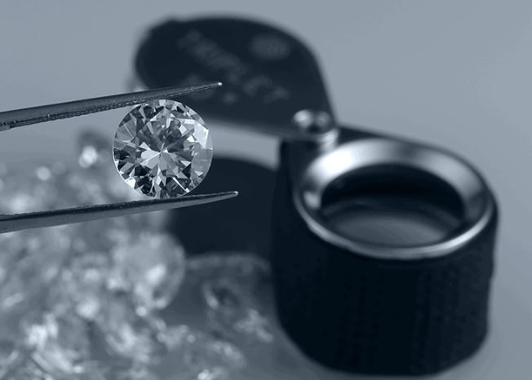
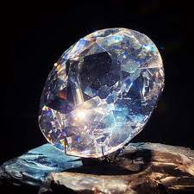
Diamonds!
Koh-i-noor
(Persian: light of the mountain)
Gemstone diamonds
Diamonds have fascinated humanity since ancient times.
In addition to their great natural beauty as gemstones, diamonds
were the hardest known natural material.

Slide 3
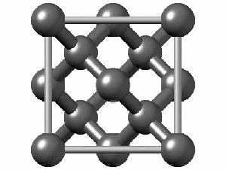
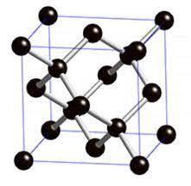
Diamond to the physicist
Diamond to the physicist is a little more prosaic: it is carbon bonded in a tetrahedral configuration
The group-IV crystalline semiconductors silicon and germanium have this same lattice structure
→ usually just called the diamond lattice

Slide 4
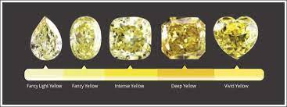
Defects in Diamonds
Impurities (Dopants) give rise to coloured Diamonds, e.g.
Boron→ Blue
Nitrogen→ Yellow
https://www.capetowndiamondmuseum.org/blog/2019/05/5666/

Slide 5
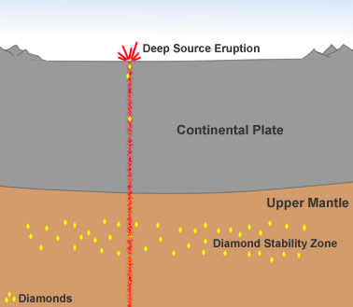
Diamond Growth
Naturally occurring diamonds are formed
mantle of the Earth, under conditions of
high temperature and pressure
In the laboratory, diamond films can be
grown using microwave plasma chemical
vapour deposition (MPCVD) using a
feedstock of methane gas with excess H₂
Figure credit: geology.com

Slide 6
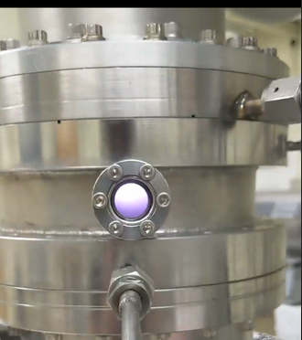
Plasmas & Connection to Catalysis
In the laboratory, diamond films can be
grown using microwave plasma chemical
vapour deposition (MPCVD) using a
feedstock of methane gas with excess H₂
Analogy to catalysis- energetic plasma electrons
enable reactions
Figure credit: geology.com

Slide 7
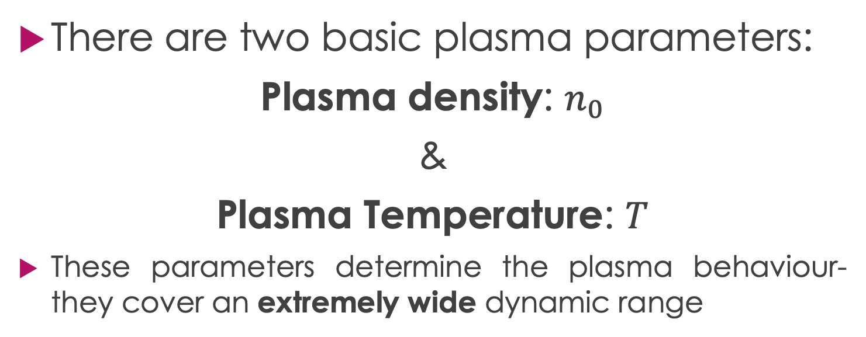
Plasma Parameters
There are two basic plasma parameters:
Plasma density: $n_{0}$
&
Plasma Temperature: $T$
These parameters determine the plasma behaviour- they cover an extremely wide dynamic range

Slide 8
Plasma Density & Temperature: a
Very Wide Dynamic Range
Logarithmic scale. 1 eV ⟷ 11,608 K
100 keV
10 keV
Plasma
Temperature
Scale:
1eV → 11000 K
1 keV
100 eV
10 eV
1 eV
0.1 eV
Figure credit: LPP, Ecole Polytechnique, Palaiseau, France

Slide 9
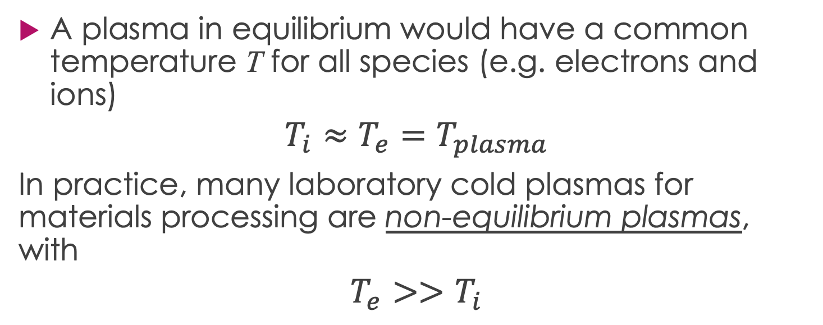
Cold Plasmas- Not in Equilibrium
A plasma in equilibrium would have a common temperature T for all species (e.g. electrons and ions)
$$T_{i}≈T_{e}=T_{plasma}$$
In practice, many laboratory cold plasmas for materials processing are non-equilibrium plasmas, with
$$T_{e}>>T_{i}$$

Slide 10
Cold Plasmas- Connection to Catalysis
T_{gas} ~ 350 K
T_{i} ~ 600 K
k_{B}T_{e}/e ~ 2-5 eV → T_{e} ~ 20000 – 50000 K (!)
Analogy to catalysis- energetic plasma electrons
enable reactions

Slide 11
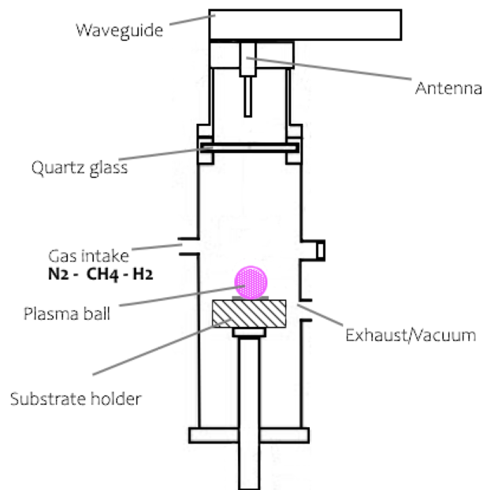
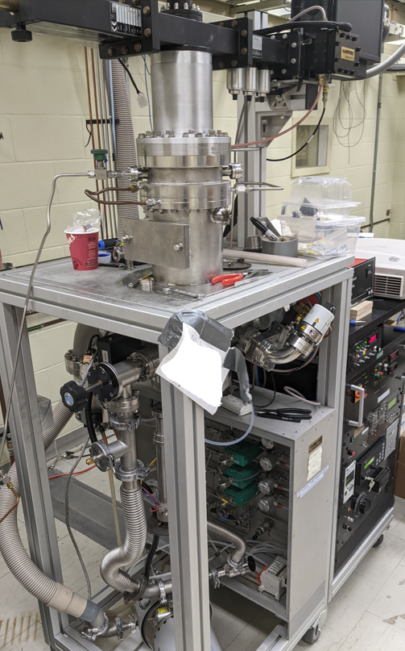
MPECVD System Schematic

Slide 12
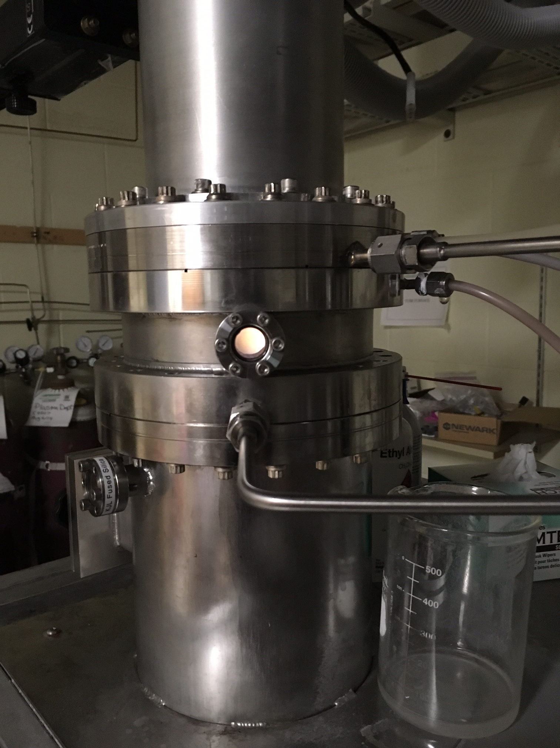
Microwave Plasma-Enhanced CVD for diamond film growth
Microwave Plasma
Chamber
Frequency 2.45 GHz
Power: 500 - 800 Watt
Pressure: 23 - 100 Torr
Substrate Temperatures >500 C
Feed gas ratio ~ 99% H₂/1% CH₄
(excess hydrogen)
Film growth rate:
~ 0.1 – 1 𝜇m/hour

Slide 13
Applications
Hard Coatings
Semiconductor Chip Applications
  Thermal conductivity of diamond ~ 2400 W/m.K (!)
  ~6x copper
N-doped Diamond Films: Diamond NV- Centres

Slide 14
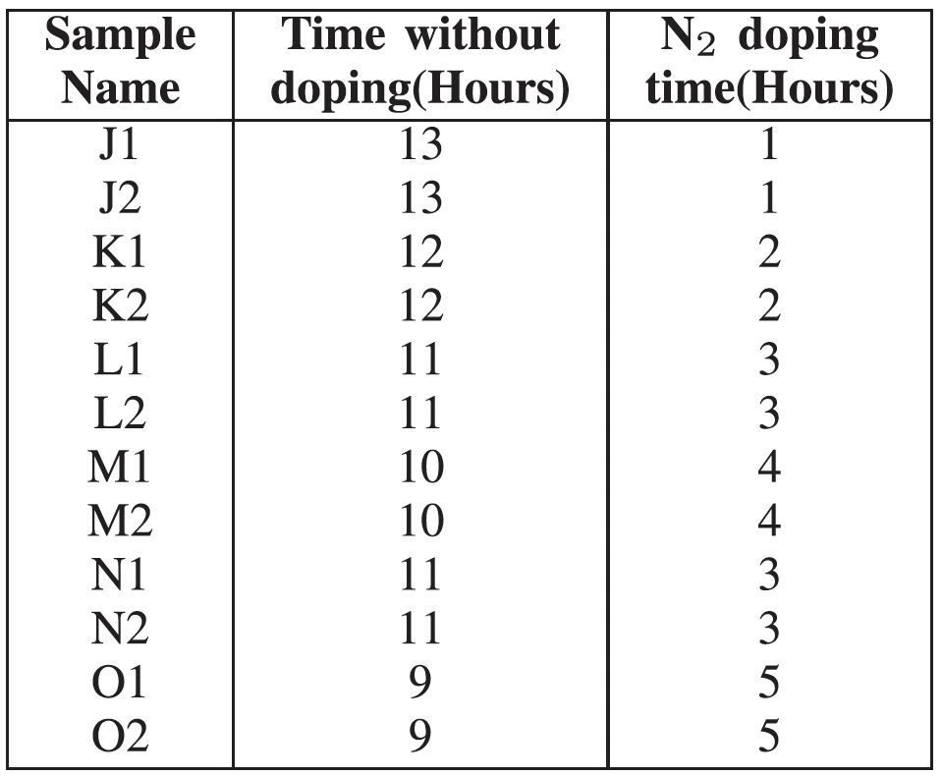
Growth of in-situ N-doped diamond films
Grown on p-doped (111) silicon
MPECVD Conditions:
30 Torr
800 Watt
Feed gas flow rates:
CH₄ 1 sccm
H₂ 100 sccm
During doping:
N₂ 10 sccm

Slide 15
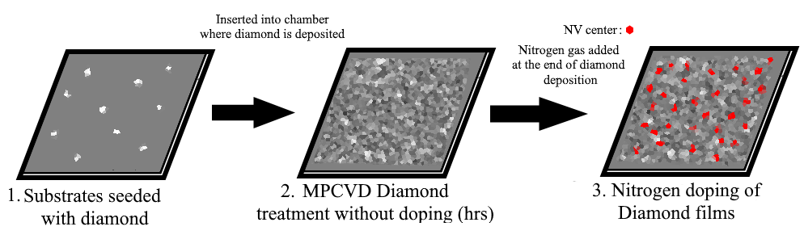
Growth of in-situ N-doped diamond films
Grown on p-doped (111) silicon
MPECVD Conditions:
30 Torr
800 Watt
Feed gas flow rates:
CH₄ 1 sccm
H₂ 100 sccm
During doping:
N₂ 10 sccm

Slide 16
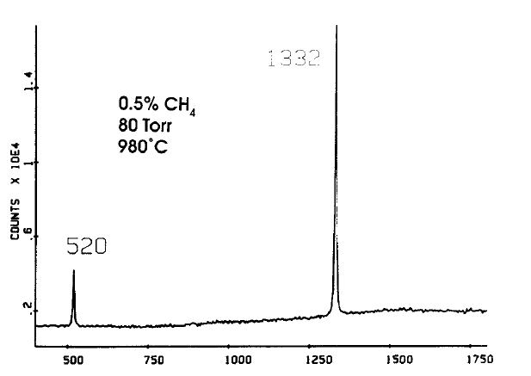
Signatures of Diamond: Raman line at 1332 cm⁻¹
D.S. Knight and W.B. White, J. Mater. Res., Vol. 4, No. 2, Mar/Apr 1989

Slide 17
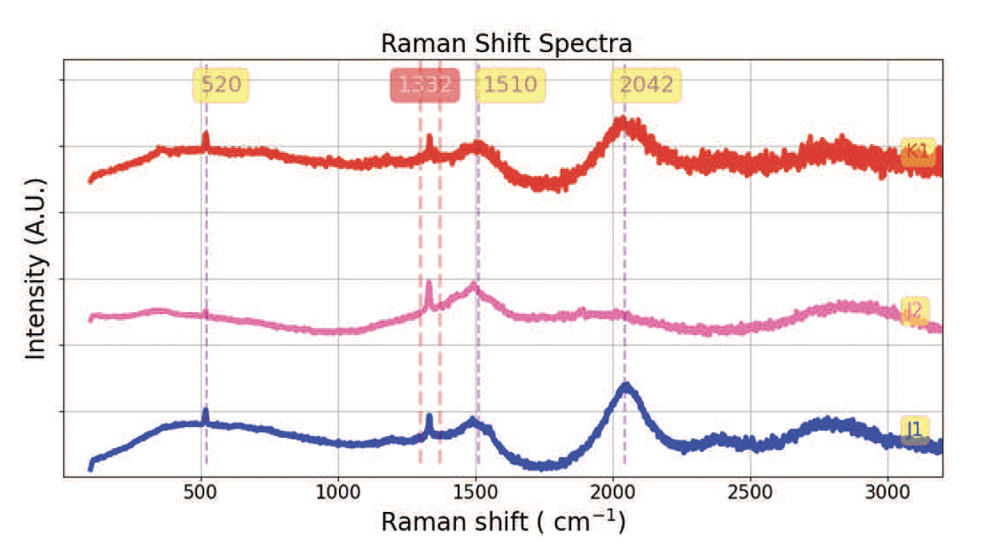
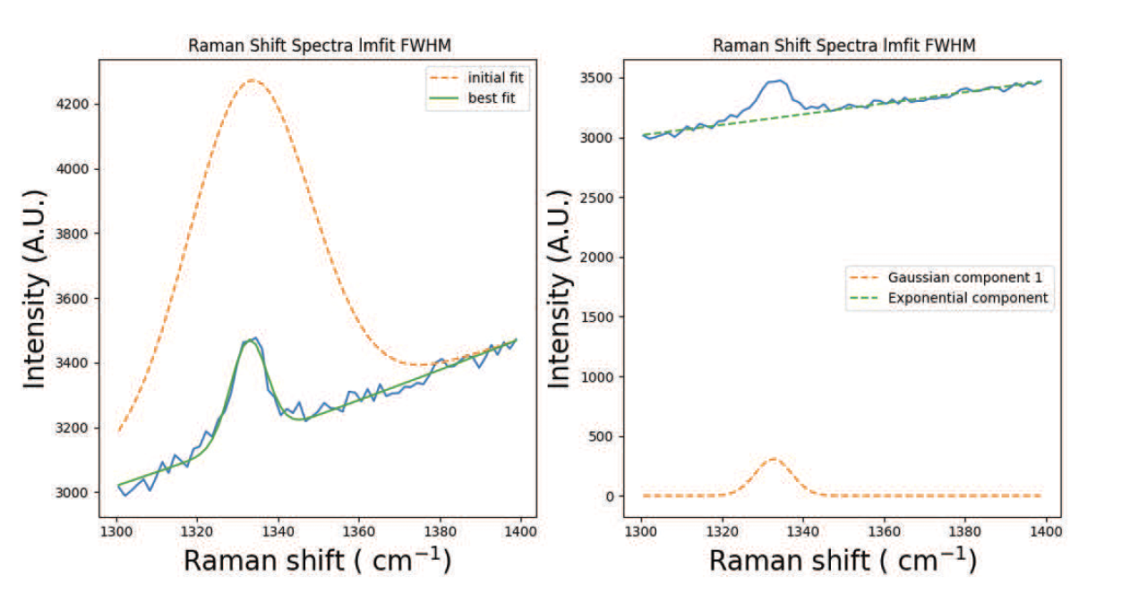
Signatures of Diamond: Raman line at 1332 cm⁻¹
IEEE TRANSACTIONS ON PLASMA SCIENCE, VOL. 53, NO. 10, OCTOBER 2025

Slide 18
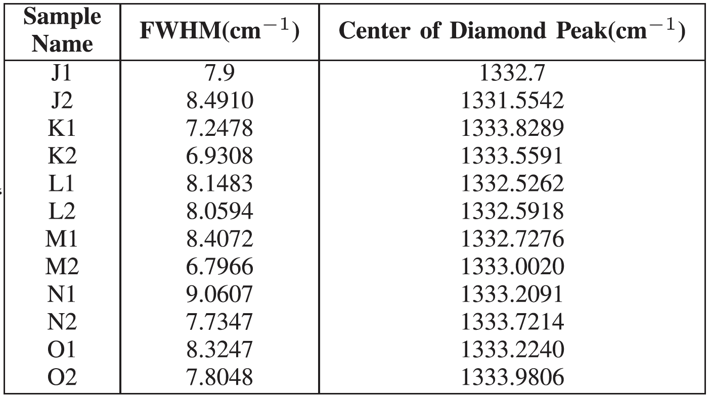
Signatures of Diamond: Raman line at 1332 cm⁻¹
IEEE TRANSACTIONS ON PLASMA SCIENCE, VOL. 53, NO. 10, OCTOBER 2025

Slide 19
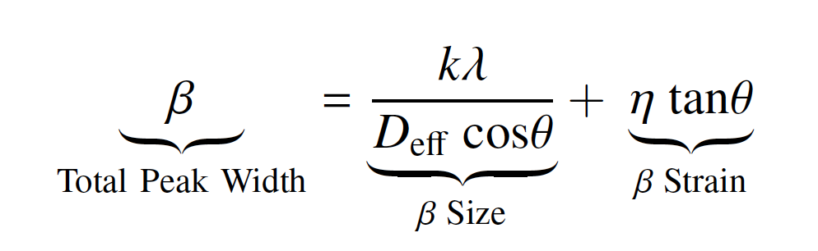
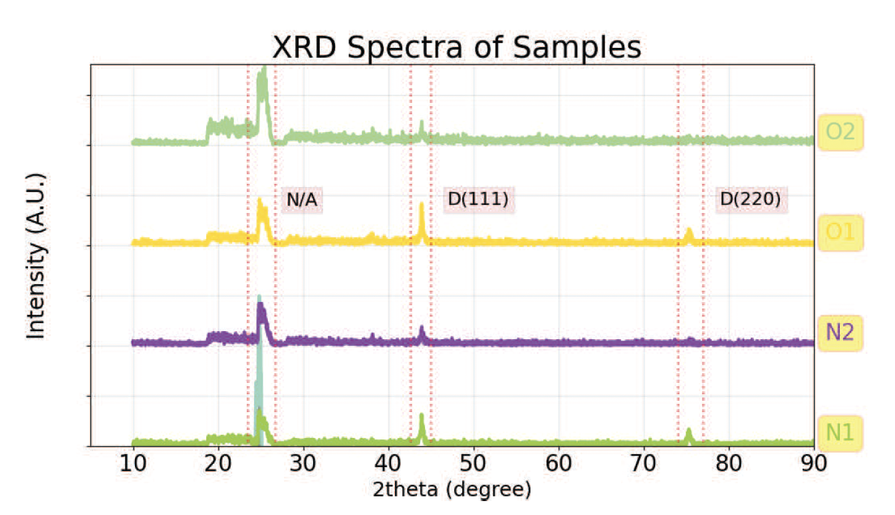
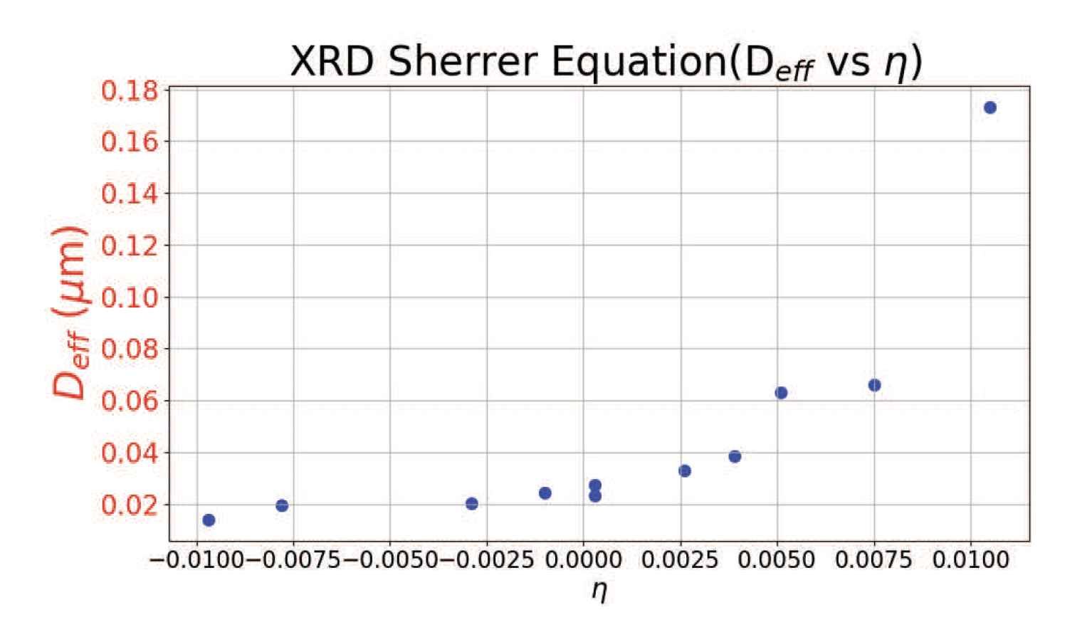
^{XRD}

Slide 20
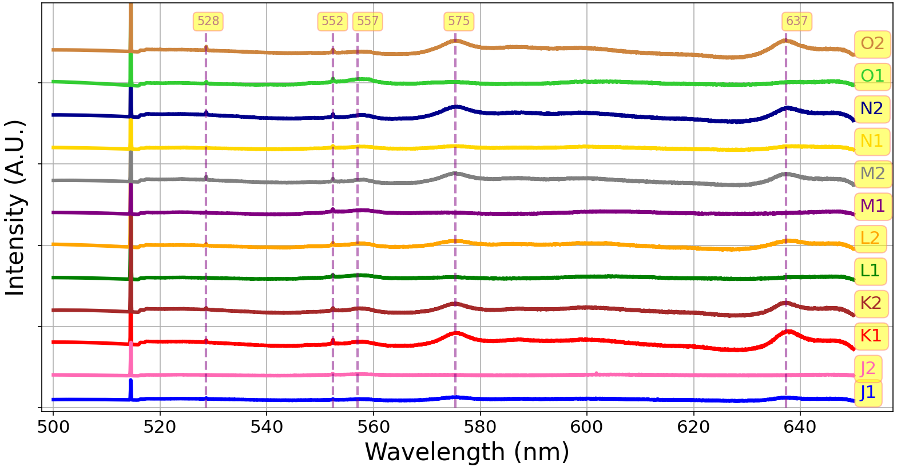
Photoluminescence Results

Slide 21
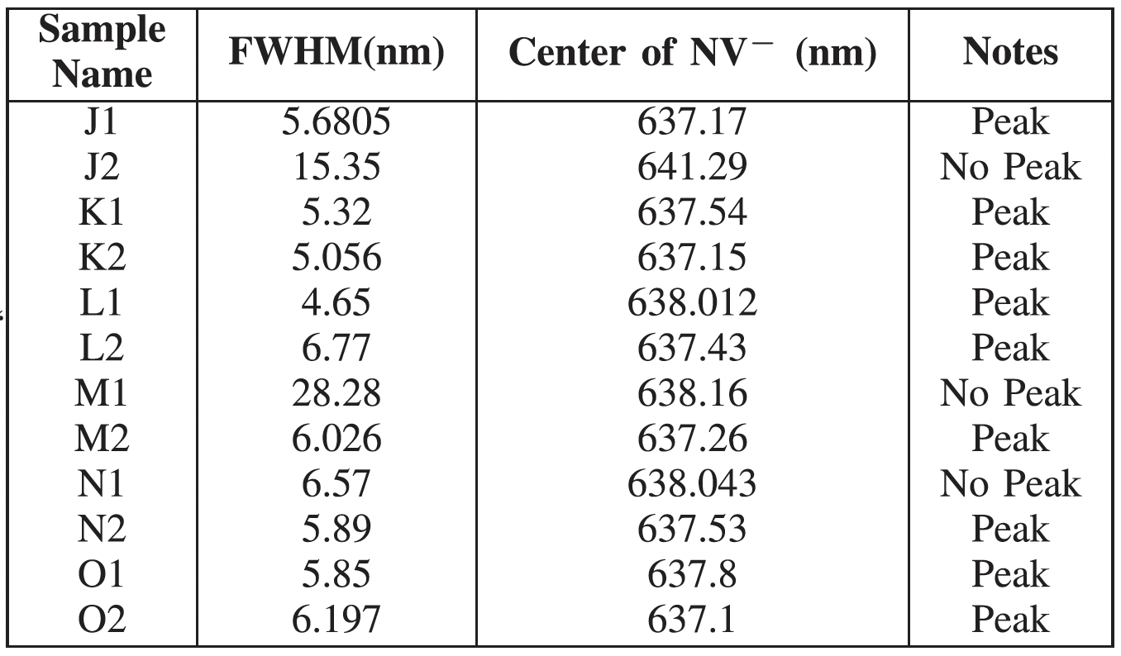
^{NV- Photoluminescence (PL)}

Slide 22
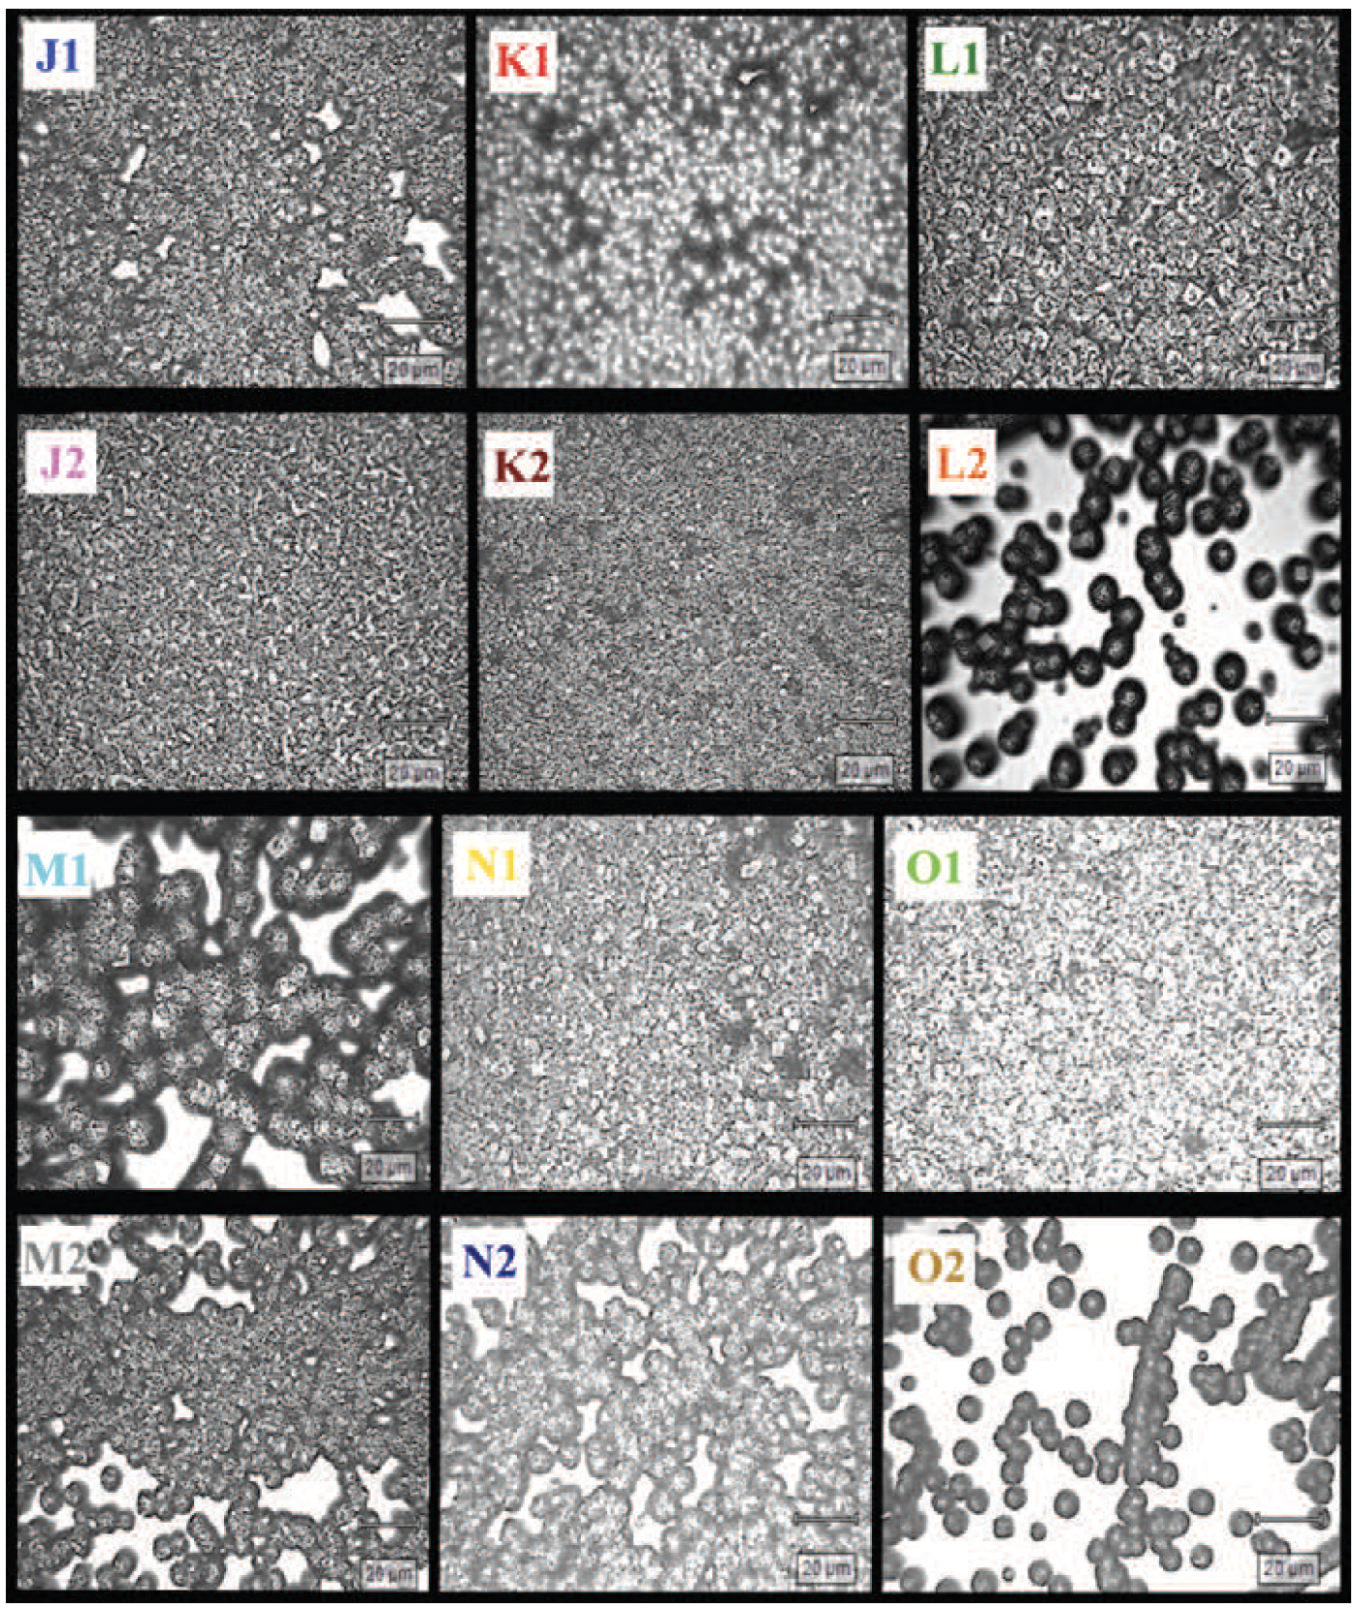
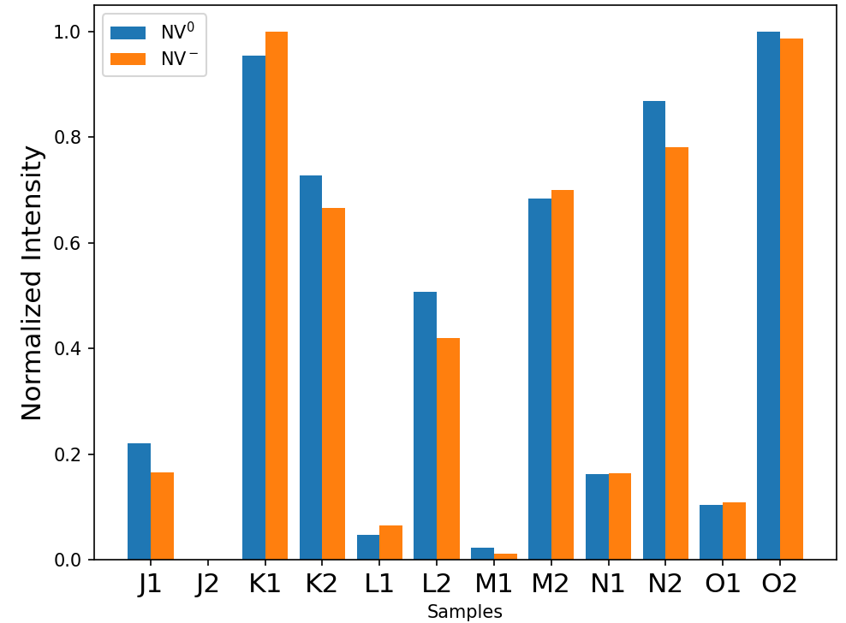
PL Intensity and Film Structure
Less tightly packed films→ higher PL intensity

Slide 23
Negative Ions in Processing Plasmas
Negative ions can form in materials processing plasmas:
Kono et al. measured negative ions in SF₆, NF₃, CF₄, and C₄F₈ gases diluted with Ar
Used a laser photodetachment method combined with millimeter-wave resonance
At a molecular-gas mixing ratio as low as 5–10% and n_{e}~10¹¹ the negative ion density was comparable to or higher than the electron density.
Kono et al., Thin Solid Films 407 (2002) 198–203.

Slide 24
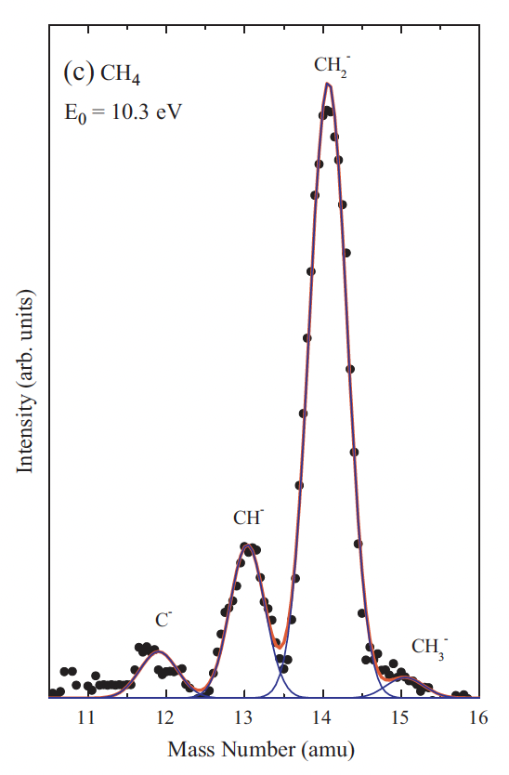
Negative Ions in Processing Plasmas: Methane Feedstock
Hoshino et al.→ Negative ion formation in CH₄ for electron energies from 6-11 eV
Resonant dissociative electron attachment ~ 10.3 eV
M. Hoshino et al. / International Journal of Mass Spectrometry 306 (2011) 51– 56

Slide 25
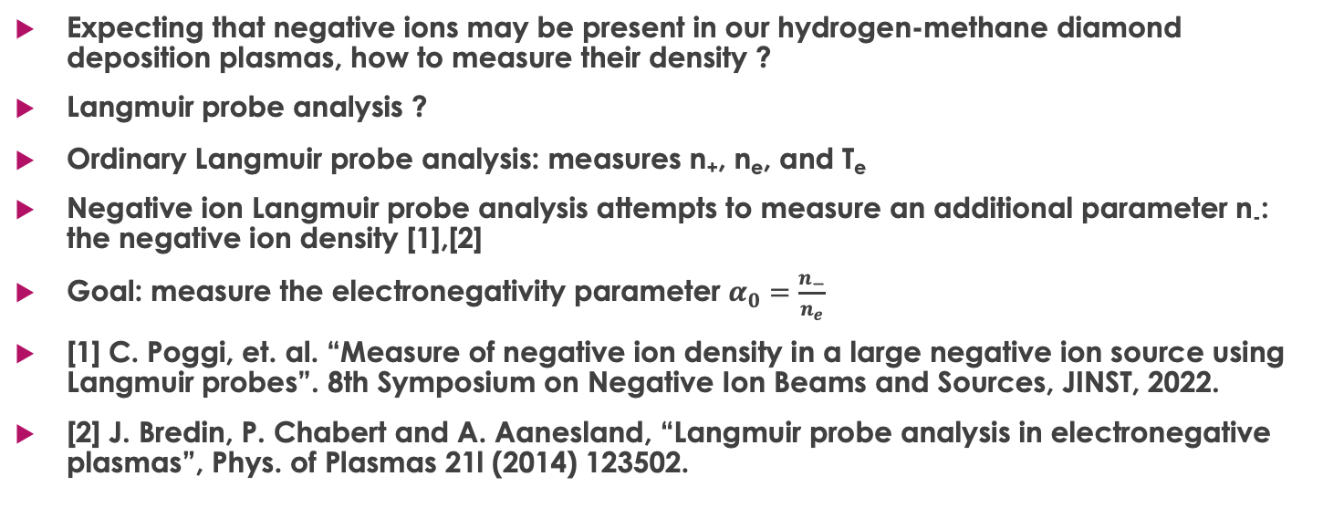
Langmuir Probes for Negative Ion Measurements
Expecting that negative ions may be present in our hydrogen-methane diamond deposition plasmas, how to measure their density ?
Langmuir probe analysis ?
Ordinary Langmuir probe analysis: measures n₊, n_{e}, and T_{e}
Negative ion Langmuir probe analysis attempts to measure an additional parameter n₋: the negative ion density [1],[2]
Goal: measure the electronegativity parameter $α_{0}=\frac{n_{−}}{n_{e}}$
[1] C. Poggi, et. al. “Measure of negative ion density in a large negative ion source using Langmuir probes”. 8th Symposium on Negative Ion Beams and Sources, JINST, 2022.
[2] J. Bredin, P. Chabert and A. Aanesland, “Langmuir probe analysis in electronegative plasmas”, Phys. of Plasmas 21l (2014) 123502.

Slide 26
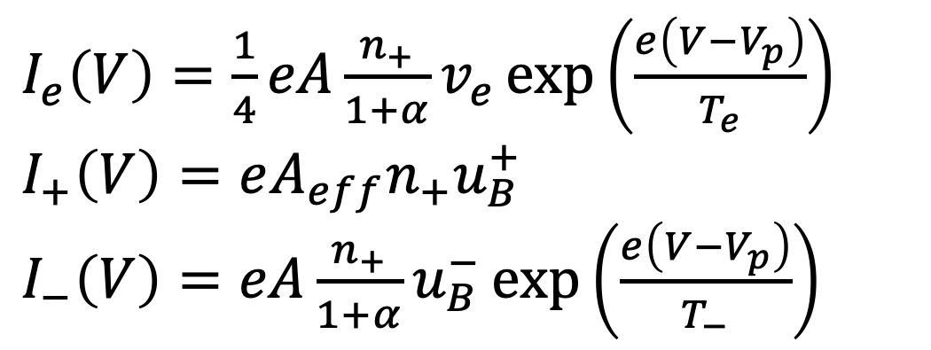
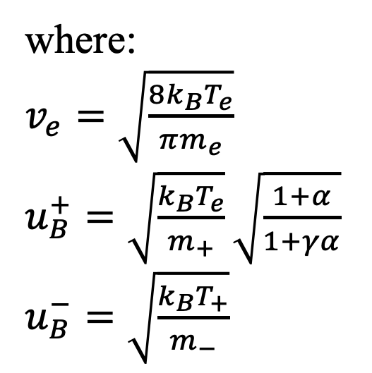

Langmuir Probe Equations [1], [2]
For $V<V_{p}:$
where:
$v_{e}=\sqrt{\frac{8k_{B}T_{e}}{πm_{e}}}$
$u_{B}^{+}=\sqrt{\frac{k_{B}T_{e}}{m_{+}}}\sqrt{\frac{1+α}{1+γα}}$
$u_{B}^{−}=\sqrt{\frac{k_{B}T_{+}}{m_{−}}}$
$I_{e}\left(V\right)=\frac{1}{4}eA\frac{n_{+}}{1+α}v_{e}\exp\left(\frac{e\left(V−V_{p}\right)}{T_{e}}\right)$
$I_{+}\left(V\right)=eA_{eff}n_{+}u_{B}^{+}$
$I_{−}\left(V\right)=eA\frac{n_{+}}{1+α}u_{B}^{−}\exp\left(\frac{e\left(V−V_{p}\right)}{T_{−}}\right)$
[1] C. Poggi, et. al. “Measure of negative ion density in a large negative ion source using Langmuir probes”. 8th Symposium on Negative Ion Beams and Sources, JINST, 2022.
[2] J. Bredin, P. Chabert and A. Aanesland, “Langmuir probe analysis in electronegative plasmas”, Phys. of Plasmas 21l (2014) 123502.

Slide 27
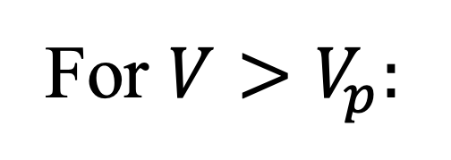
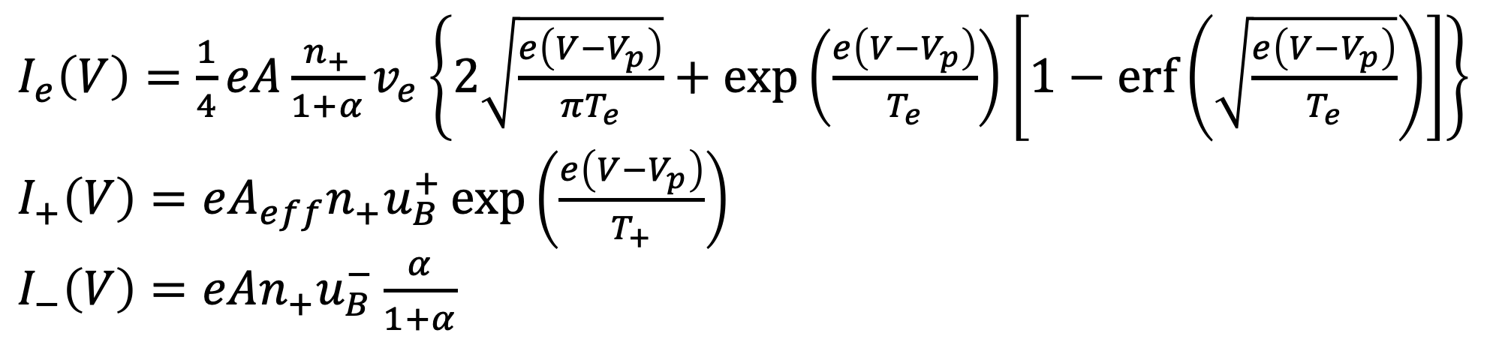
Langmuir Probe Equations
For $V>V_{p}:$
$I_{e}\left(V\right)=\frac{1}{4}eA\frac{n_{+}}{1+α}v_{e}\left\{2\sqrt{\frac{e\left(V−V_{p}\right)}{πT_{e}}}+\exp\left(\frac{e\left(V−V_{p}\right)}{T_{e}}\right)\left[1−\operatorname{erf}\left(\sqrt{\frac{e\left(V−V_{p}\right)}{T_{e}}}\right)\right]\right\}$
$I_{+}\left(V\right)=eA_{eff}n_{+}u_{B}^{+}\exp\left(\frac{e\left(V−V_{p}\right)}{T_{+}}\right)$
$I_{−}\left(V\right)=eAn_{+}u_{B}^{−}\frac{α}{1+α}$
[1] C. Poggi, et. al. “Measure of negative ion density in a large negative ion source using Langmuir probes”. 8th Symposium on Negative Ion Beams and Sources, JINST, 2022.
[2] J. Bredin, P. Chabert and A. Aanesland, “Langmuir probe analysis in electronegative plasmas”, Phys. of Plasmas 21l (2014) 123502.

Slide 28
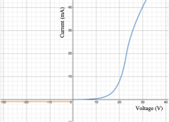
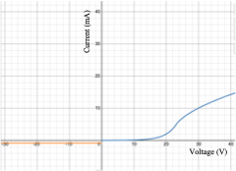
Langmuir Probe Theoretical Curves
(α=0 and α=3)

Slide 29
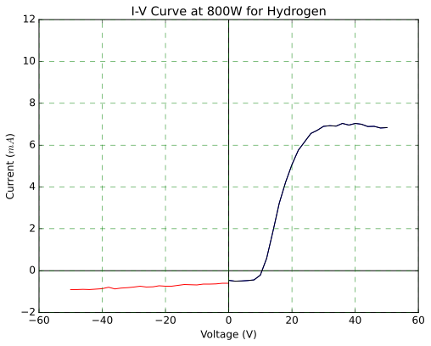
Representative Data
800 W microwave discharge
Pure hydrogen (100 sccm)
P=30 Torr
Cylindrical Langmuir Probe
A_{probe}= 25.3×10⁻⁶ m²

Slide 30
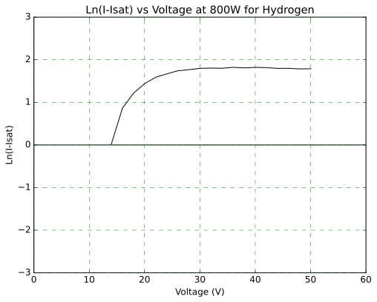

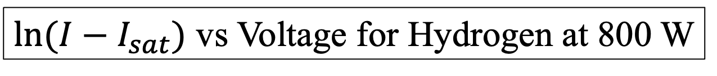
T_{e}
$\ln{(I−I_{sat})}$ vs Voltage for Hydrogen at 800 W
$$y=0.2987x−4.067$$
T_{e} = 3.4 eV

Slide 31
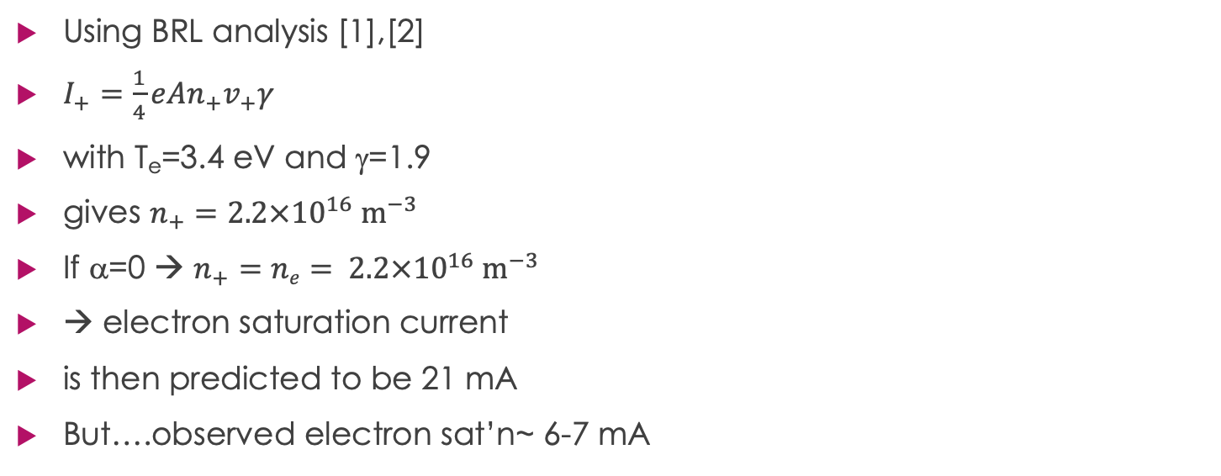
Analysis
Using BRL analysis [1],[2]
$I_{+}=\frac{1}{4}eAn_{+}v_{+}γ$
with T_{e}=3.4 eV and γ=1.9
gives $n_{+}=2.2×{10}^{16} m^{−3}$
If α=0 → $n_{+}=ne= 2.2×{10}^{16} m^{−3}$
→ electron saturation current
is then predicted to be 21 mA
But….observed electron sat’n~ 6-7 mA
[1] M Tuszewski and J A Tobin 1996 Plasma Sources Sci. Technol. 5 640
[2] Laframboise J G 1966 University of Toronto Institute for Aerospace Studies Report 100

Slide 32
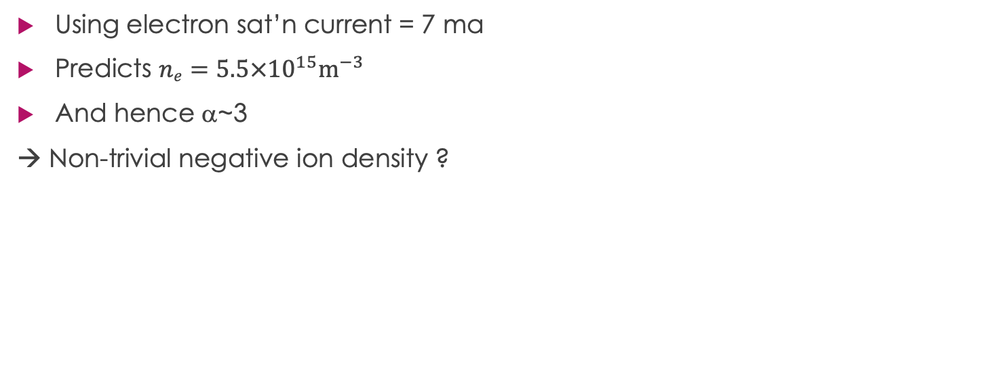
Analysis II
Using electron sat’n current = 7 ma
Predicts $ne=5.5×{10}^{15}m^{−3}$
And hence α~3
→ Non-trivial negative ion density ?

Slide 33
Conclusions
Diamond films can be grown effectively on silicon substrates using MPECVD
This has many applications: hard coatings, thermal interface layer for advanced chip cooling, and NV- centre work
H₂:CH₄ plasmas are used for diamond film growth
Both hydrogen and methane plasma can contain negative ions
Therefore study of negative ion densities in MPECVD Chambers is relevant
Preliminary results suggest a~ 3 for common processing conditions

Slide 34


Acknowledgements
Portia Switzer (see poster)
William Davis MSc thesis & current PhD work
Hammed Ejalonibu PhD thesis
SSSC for materials characterization
The diamond growth work was financially supported by the NSERC
Discovery Grants program as well as a Canadian Space Agency (CSA)
FAST grant for development of a compact spaceborne MRI

Slide 35




Funders: NSERC, DND, CSA
NSERC Discovery Grants Program
NSERC/DND Defence Supplement
Canada-UK Joint-Quantum Technologies grant program (w/ M Squared Lasers (Glasgow), and Prof. Mark Fromhold of the University of Nottingham)
CSA FAST Grant with Prof. G. Sarty

