Slide 1

How Low Can We Go?
Routine Reliability and Low Energy Limits for AMS with a Cs Sputter Source
Lauren T Bezzina
C. Vockenhuber, P. Gautschi, L. Wacker, U. Ramsperger, A. Müller
Laboratory of Ion Beam Physics, ETH Zürich
NIBS2026 – September 2026

Slide 2
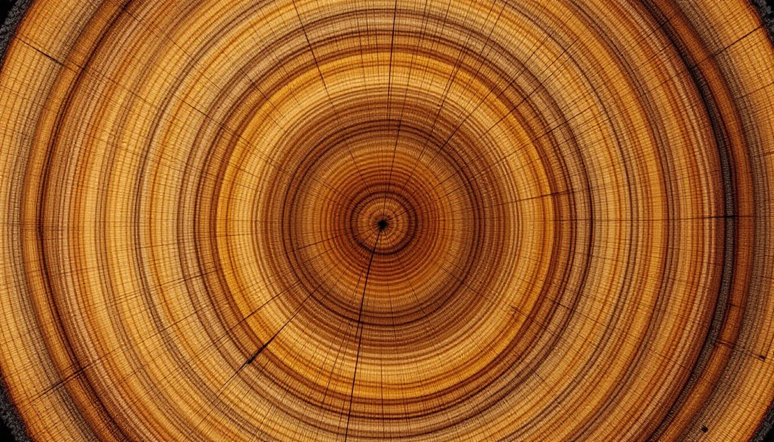
AMS – Why do we do it?
  AMS is an ultra-sensitive method to detect trace amounts of long-lived radionuclides.
  With both cosmogenic and anthropogenic sources, these nuclides can used as a ‘clock’ for:
  Archeology/paleoclimate (¹⁴C 5.7 x 10³ yr)
  Earth sciences/geomorphology – ¹⁰Be (1.38 x 10⁶ yr), ²⁶Al (717 x 10³ yr)
  Environmental/hydrology — ³⁶Cl (300 x 10³ yr), ¹²⁹I (15.7 x10⁶ yr)
  Biomedicine — ¹⁴C, ⁴¹Ca (99 x 10³ yr)
  Nuclear science/oceanography — actinides (Pu isotopes, U, etc.)
1

Slide 3
AMS – Why do we do it?
  AMS is an ultra-sensitive method to detect trace amounts of long-lived radionuclides.
  With both cosmogenic and anthropogenic sources, these nuclides can used as a ‘clock’ for:
  Archeology/paleoclimate (¹⁴C 5.7 x 10³ yr)
  Earth sciences/geomorphology – ¹⁰Be (1.38 x 10⁶ yr), ²⁶Al (717 x 10³ yr)
  Environmental/hydrology — ³⁶Cl (300 x 10³ yr), ¹²⁹I (15.7 x10⁶ yr)
  Biomedicine — ¹⁴C, ⁴¹Ca (99 x 10³ yr)
  Nuclear science/oceanography — actinides (Pu isotopes, U, etc.)
1

Slide 4
AMS – Why do we do it?
  AMS is an ultra-sensitive method to detect trace amounts of long-lived radionuclides.
  With both cosmogenic and anthropogenic sources, these nuclides can used as a ‘clock’ for:
  Archeology/paleoclimate (¹⁴C 5.7 x 10³ yr)
  Earth sciences/geomorphology – ¹⁰Be (1.38 x 10⁶ yr), ²⁶Al (717 x 10³ yr)
  Environmental/hydrology — ³⁶Cl (300 x 10³ yr), ¹²⁹I (15.7 x10⁶ yr)
  Biomedicine — ¹⁴C, ⁴¹Ca (99 x 10³ yr)
  Nuclear science/oceanography — actinides (Pu isotopes, U, etc.)
Decay counting counts atoms that decay over time: grams of sample, days of counting
1

Slide 5
AMS – Why do we do it?
  AMS is an ultra-sensitive method to detect trace amounts of long-lived radionuclides.
  With both cosmogenic and anthropogenic sources, these nuclides can used as a ‘clock’ for:
  Archeology/paleoclimate (¹⁴C 5.7 x 10³ yr)
  Earth sciences/geomorphology – ¹⁰Be (1.38 x 10⁶ yr), ²⁶Al (717 x 10³ yr)
  Environmental/hydrology — ³⁶Cl (300 x 10³ yr), ¹²⁹I (15.7 x10⁶ yr)
  Biomedicine — ¹⁴C, ⁴¹Ca (99 x 10³ yr)
  Nuclear science/oceanography — actinides (Pu isotopes, U, etc.)
Decay counting counts atoms that decay over time: grams of sample, days of counting
AMS utilizes direct detection – potentially every atom can be extracted and detected: mg of sample, minutes of counting
1

Slide 6
The main challenge of (A)MS?
The isobar
2

Slide 7
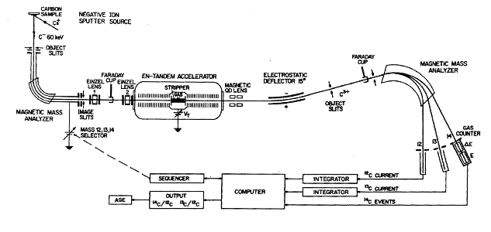
AMS – how do we do it?
3

Slide 8
AMS – how do we do it? (isobar suppression)
Suppressed negative ion formation
dE/dx separation
E_{ion}
Molecular destruction
3

Slide 9
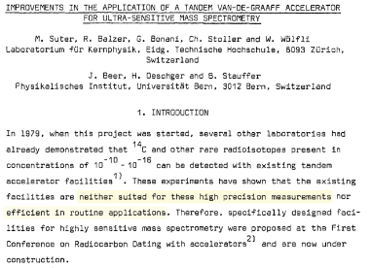
AMS – how do we do it?
3

Slide 10
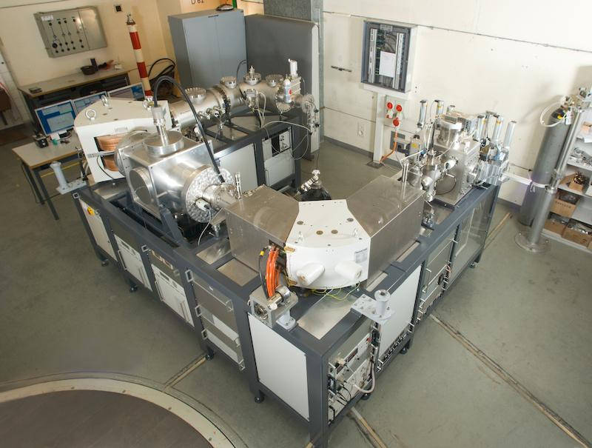

AMS – how do we do it? (compact AMS)
  The working solution at ETH Zürich: compact AMS.
  Use of He as stripper gas allows lower energies → better transmission
  200kV MICADAS (46%) (¹²C¹⁺– 50%)
  50kV LEA (50%) (¹²C¹⁺ – 60%)
4

Slide 11
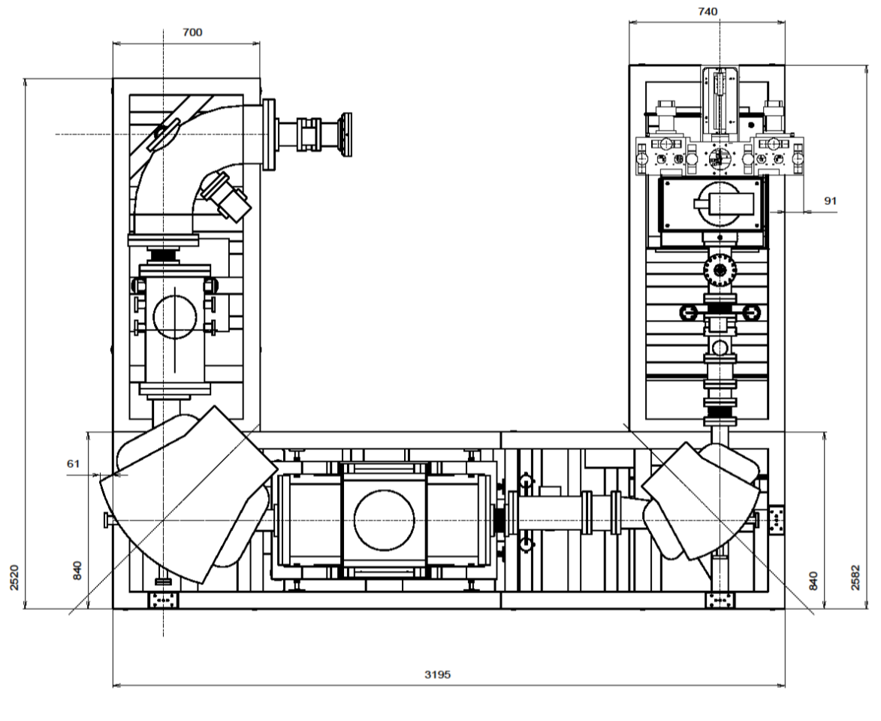
AMS – how do we do it? (compact AMS)
2582
3195
5

Slide 12
AMS – how do we do it? (compact AMS)
HE ESA
(stigmatic correction)
Ion Source
(negative ion production)
LE Magnet
(mass selection)
HE Magnet
(charge state selection)
200 kV Accelerator
(electron stripping, molecular destruction)
3195
5

Slide 13
What do we need from the source?
Good efficiency – both sputtering efficiency and extraction, so that we can use the smallest amount of sample possible and that measurements do not take too long
  1 mg of carbon
Good stability – so that optimum tuning parameters further downstream do not drift too far during the measurement
Ideally also: low maintenance!
6

Slide 14
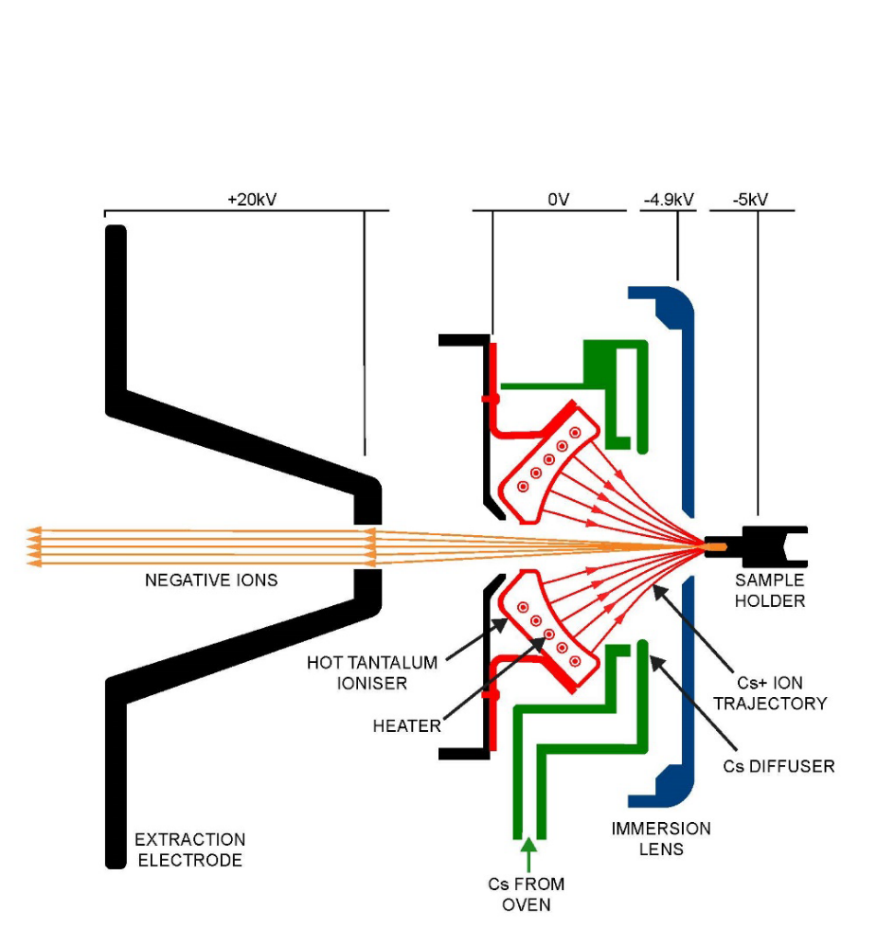
What is a Cs sputter source?
K. Fifield, The Methodology and Physics of Accelerator Mass Spectrometry (2025)
7

Slide 15
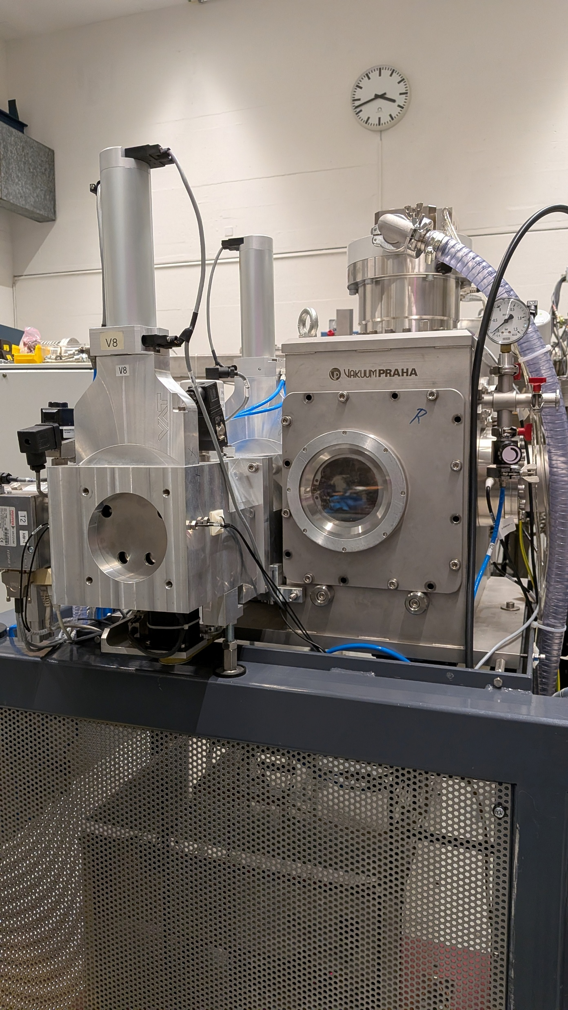
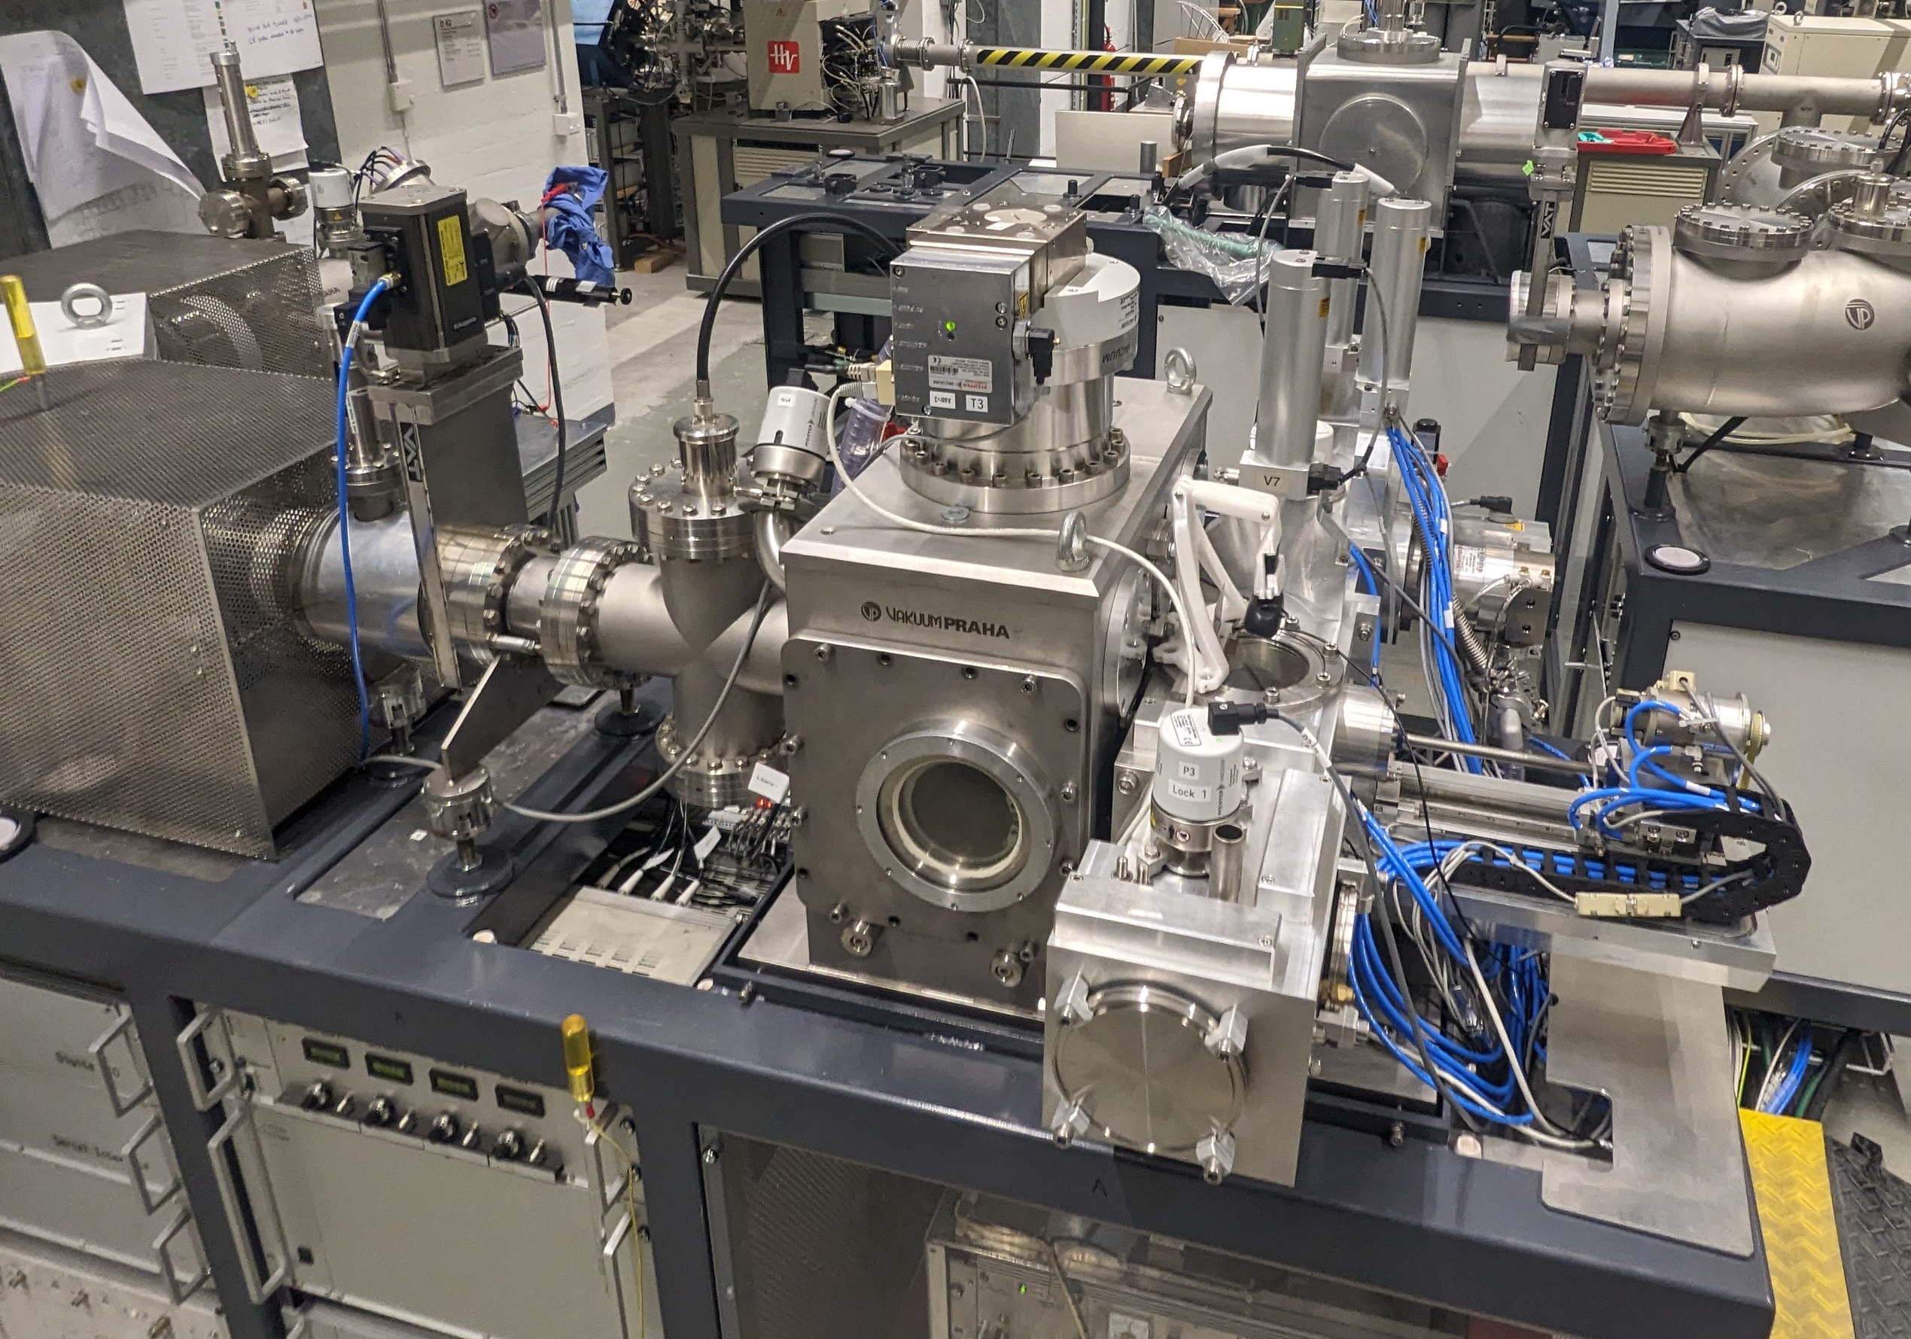
ETH source design
Vacuum lock sample ‘magazine’
Automatic sample changer
HV below

Slide 16
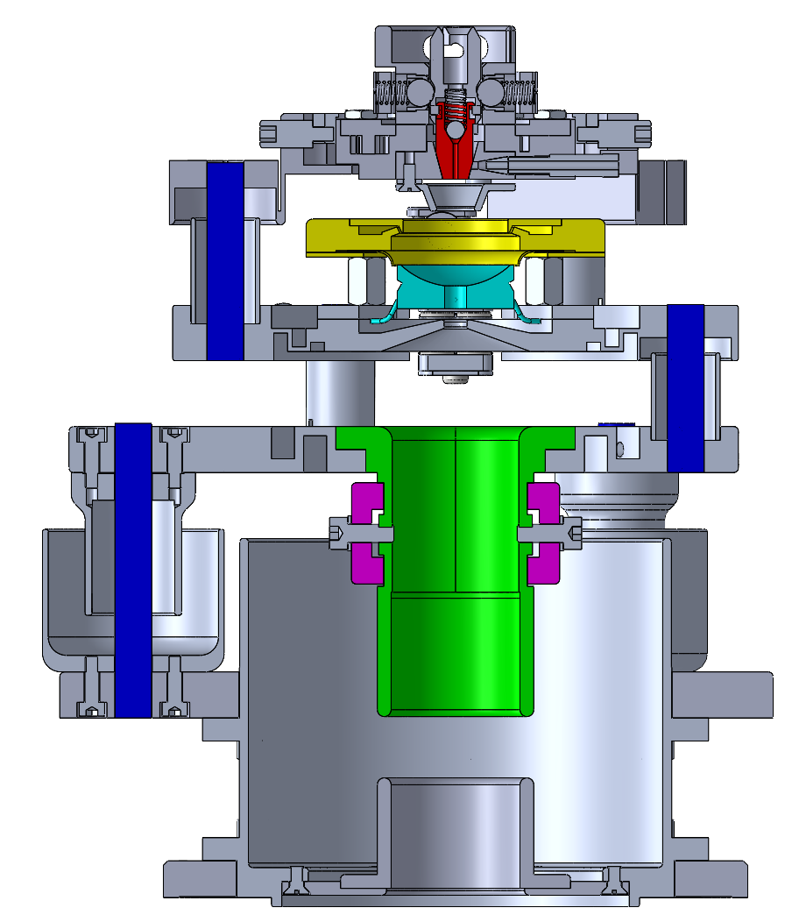
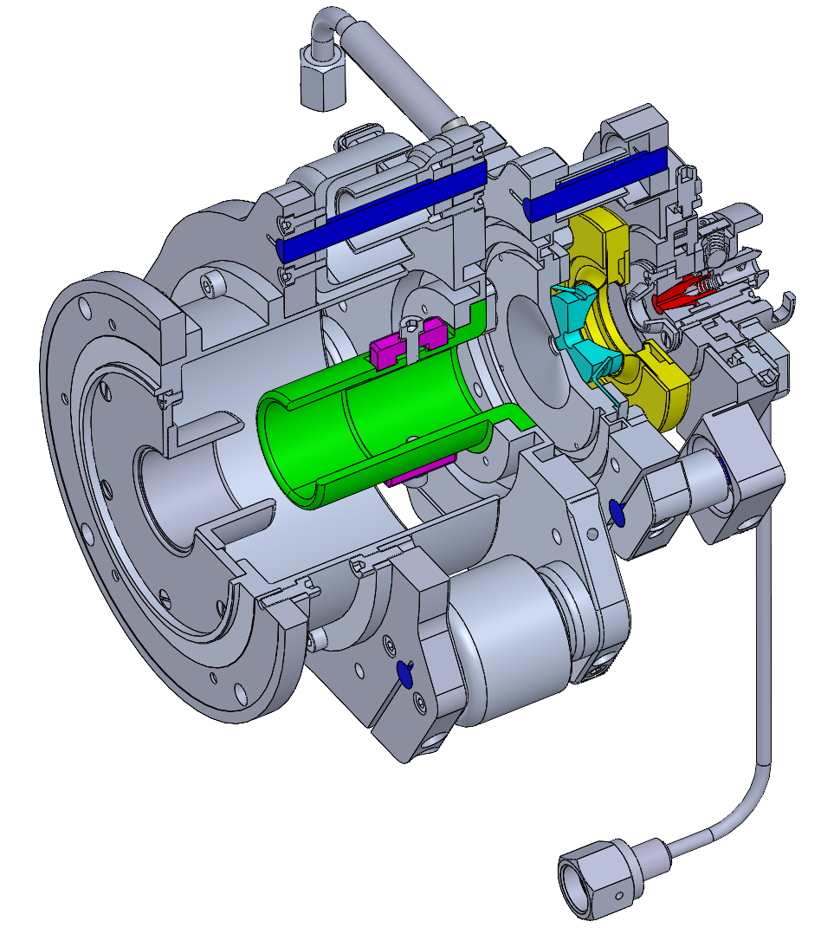
Target/cathode (on potential)
Cs nozzle
Ioniser
Ø 191.3
Permanent magnets
Extractor lens
Isolating ceramics (Macor)
8
Ø 127

Slide 17
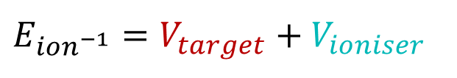



Target/cathode (on potential)
Cs nozzle
$$V_{target}$$
Ioniser
$$V_{extr.}$$
Ø 191.3
Permanent magnets
$$V_{ioniser}$$
Extractor lens
Isolating ceramics (Macor)
$$E_{ion^{−1}}=V_{target}+V_{ioniser}$$
8
Ø 127

Slide 18
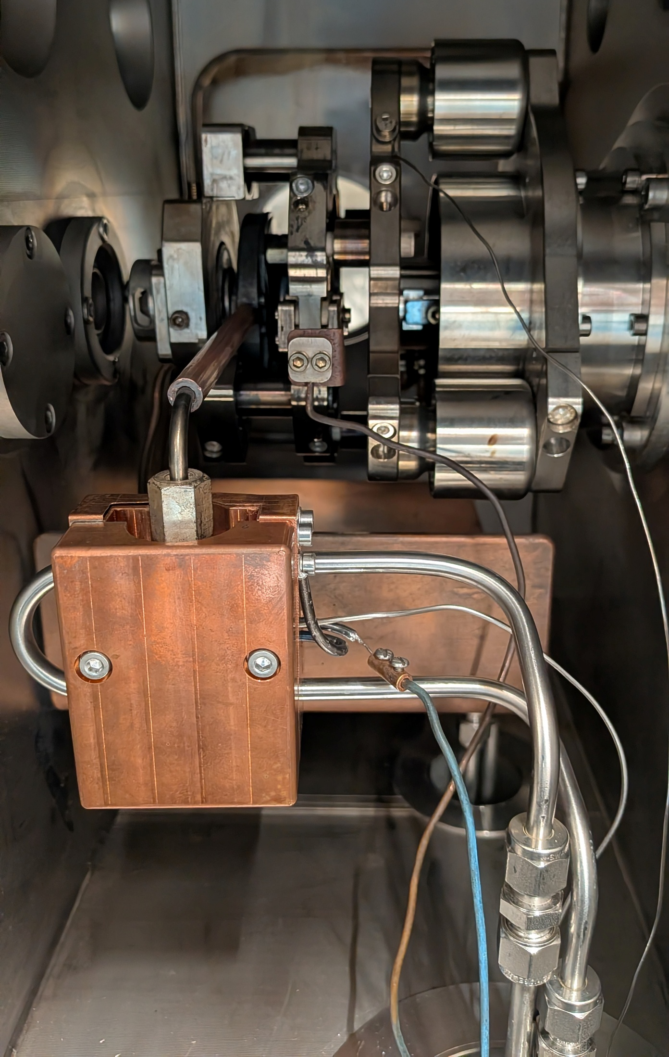
Ioniser platform (Cu wire for heating ioniser, generally operated at 15 A, 6V → 90 W)
Extraction potential (up to 10 kV)
Target/cathode
(-6 kV )
Ceramic spacers between each voltage platform, with shields to protect from excessive carbon build up
Cs nozzle
Cu block for Cs heating
-Cs reservoir inside (5g Cs)
- air-cooled (1/4” pipe)

Slide 19
ETH source parameters and performance
‘Typical’ operation:
Ioniser = -36 kV
Target = -5.5 kV
Extractor = 5.6 kV
Corresponds to ~10s keV injection energy
“If the machine is running 24/7 (30uA ¹²C at the high energy end), then the source needs to be cleaned every 45-60 days”
9

Slide 20
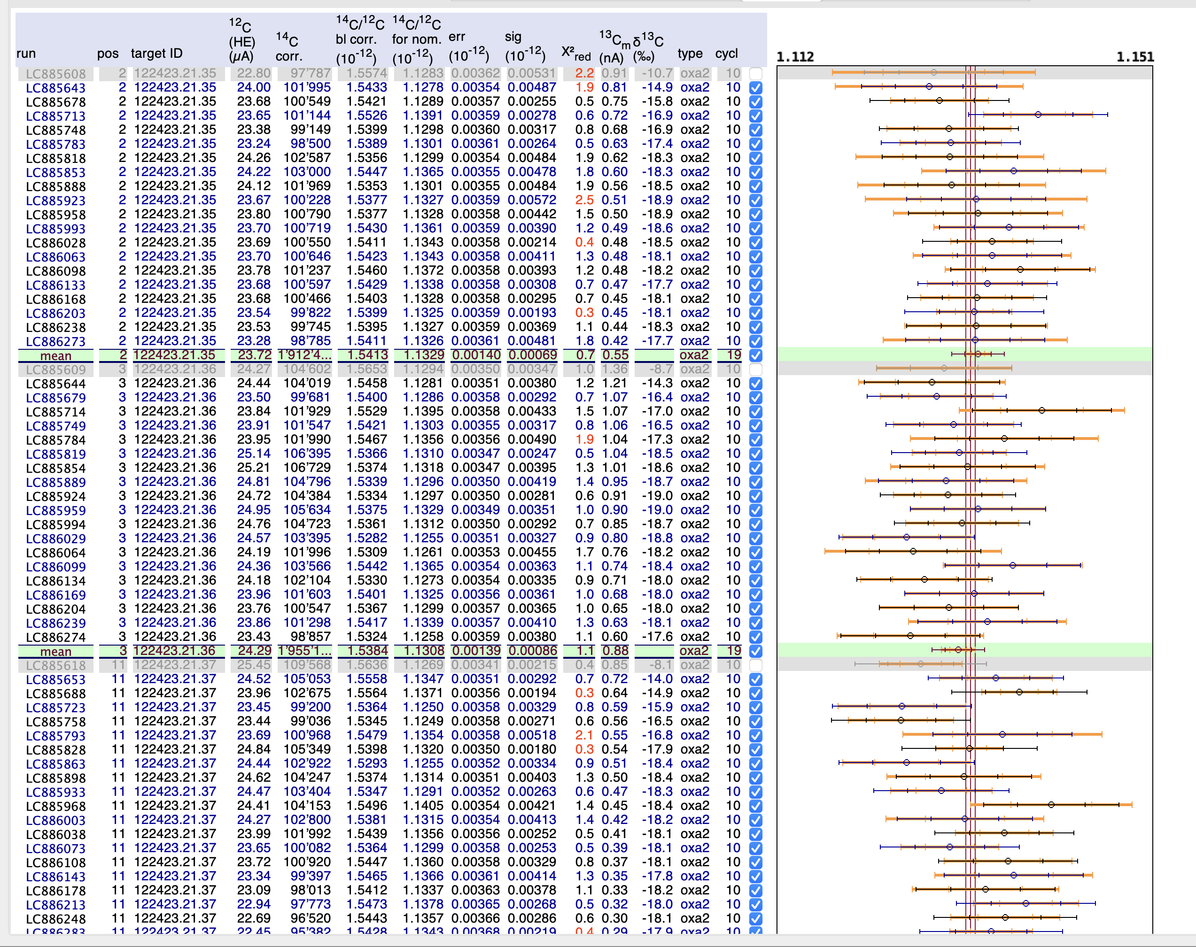
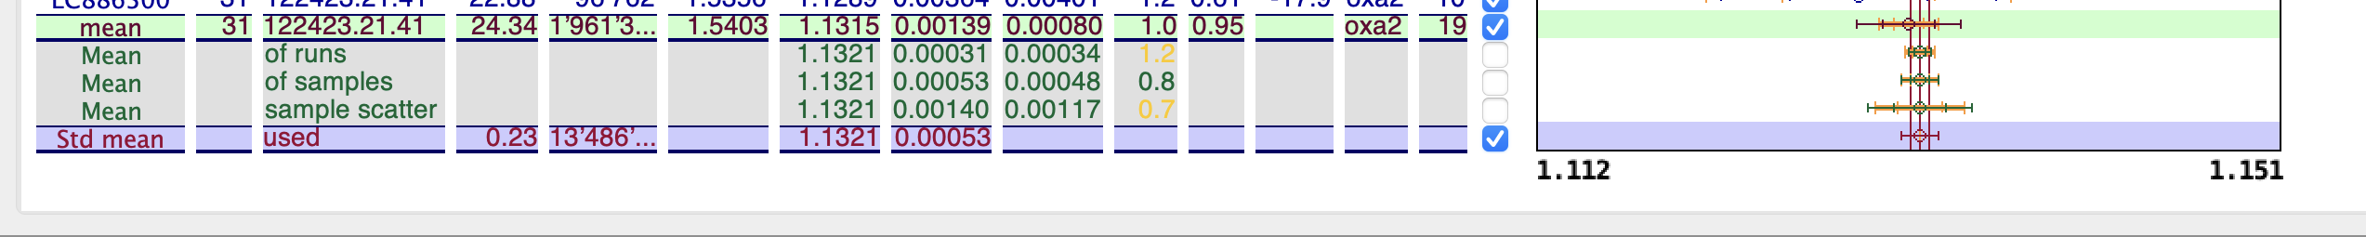
ETH source parameters and performance
¹⁴C/¹²C x10⁻¹²
1.91 M
7 oxa2 standards (only 3 shown), close to 2 M counts each in 8500 s (2.3 hrs) each
1.96 M
1.96 M
10

Slide 21
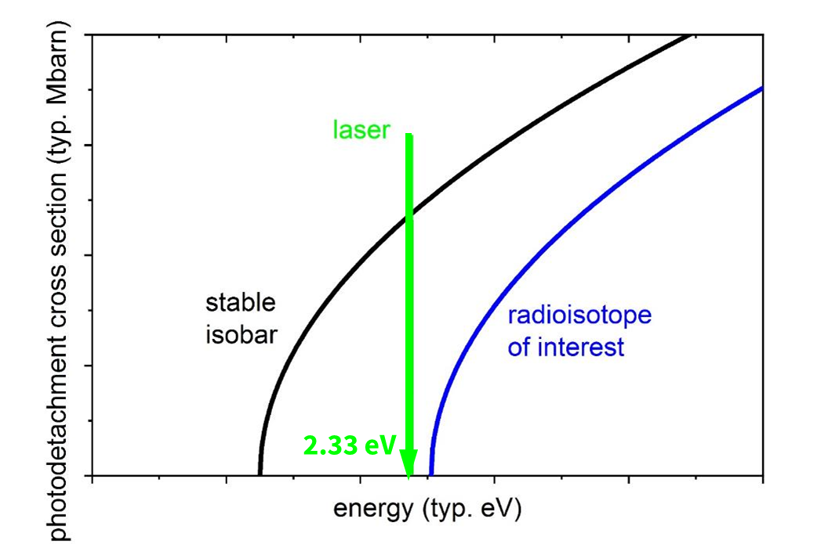
Why push to even lower energy?
(It’s isobar suppression again)
532nm
N_{surviving}=N₀⋅e^{(-σϕt)}
σ: detachment cross section
ϕ: photon flux
t: interaction time
³⁶S⁻
(2.08eV)
³⁶Cl⁻
(3.61eV)
11

Slide 22
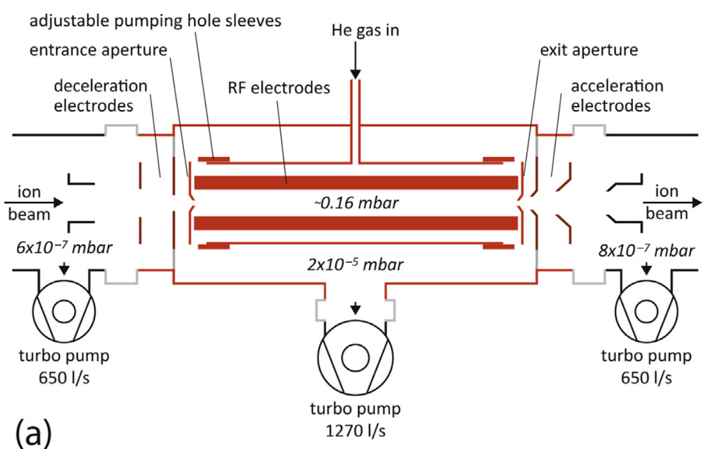
Why push to even lower energy?
532nm
³⁶S⁻
(2.08eV)
³⁶Cl⁻
(3.61eV)
M. Martischini et al, IJMS 415, 9-17 (2017)
11

Slide 23
Why push to even lower energy?
532nm
³⁶S⁻
(2.08eV)
³⁶Cl⁻
(3.61eV)
M. Martischini et al, IJMS 415, 9-17 (2017)
Reason 1: ease of RFQ construction
11

Slide 24
Why push to even lower energy?
For a maximum field of 0.695 T at LE magnet:
³⁶Cl⁻ = 40 keV
⁴¹CaH⁻ = 32 keV
⁴¹CaF₃⁻ = 14 keV (!!!)
2582
Reason 2: existing LE magnet limit
3195
12

Slide 25
Why push to even lower energy?
Reason 1: ease of RFQ construction
Reason 2: existing LE magnet limit
Reason 3: utilize the benefits of compact AMS for more isotopes
13

Slide 26
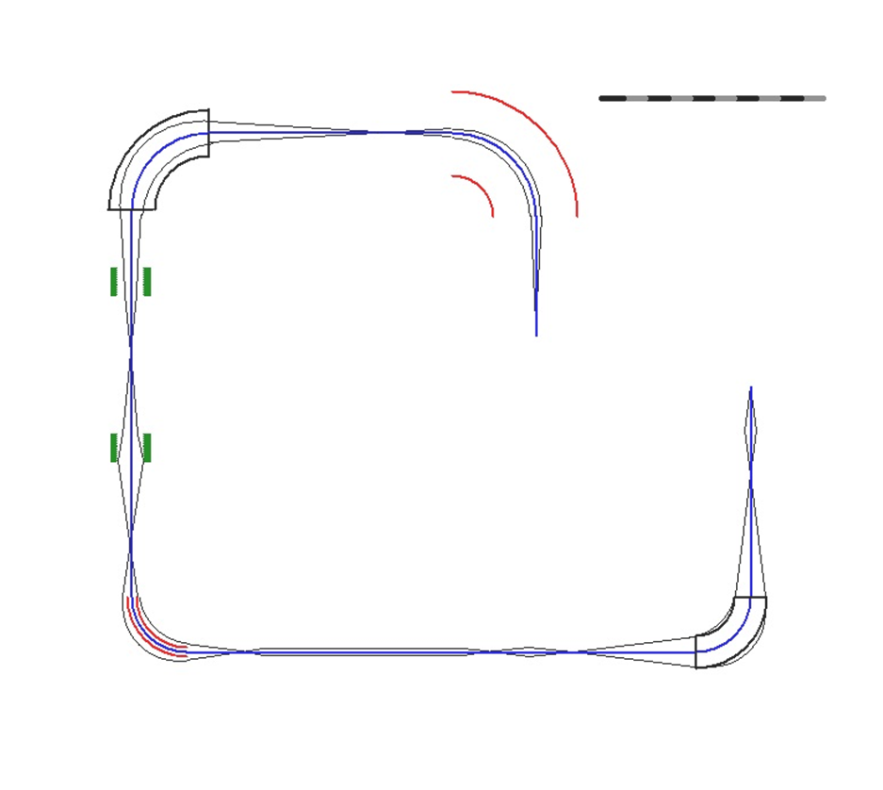
³⁶Cl
Diagnostics
Einzel Lens
LE ESA
RFQ
³⁵Cl
³⁷Cl
Reacceleration
Deceleration
14

Slide 27
What parameters can we optimise?
For the same total energy, we can independently control:
Target/sputter potential and ioniser potential
Ioniser-sample distance
Cs temperature
Plus more (!)
15

Slide 28
What parameters can we optimise?
For the same total energy, we can independently control:
Target/sputter potential and ioniser potential
Ioniser-sample distance
Cs temperature
Plus more (!)
15

Slide 29
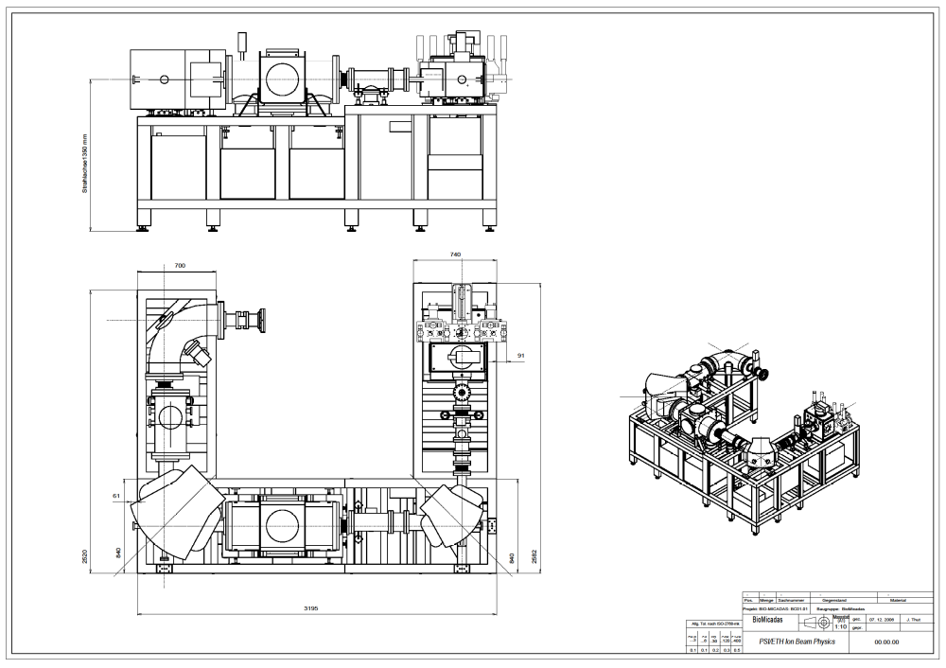
How were these measurements made?
Cs sputter ion source
Einzel (box) Lens
¹²C⁻
BPM
Beam Dump
LE magnet
16

Slide 30
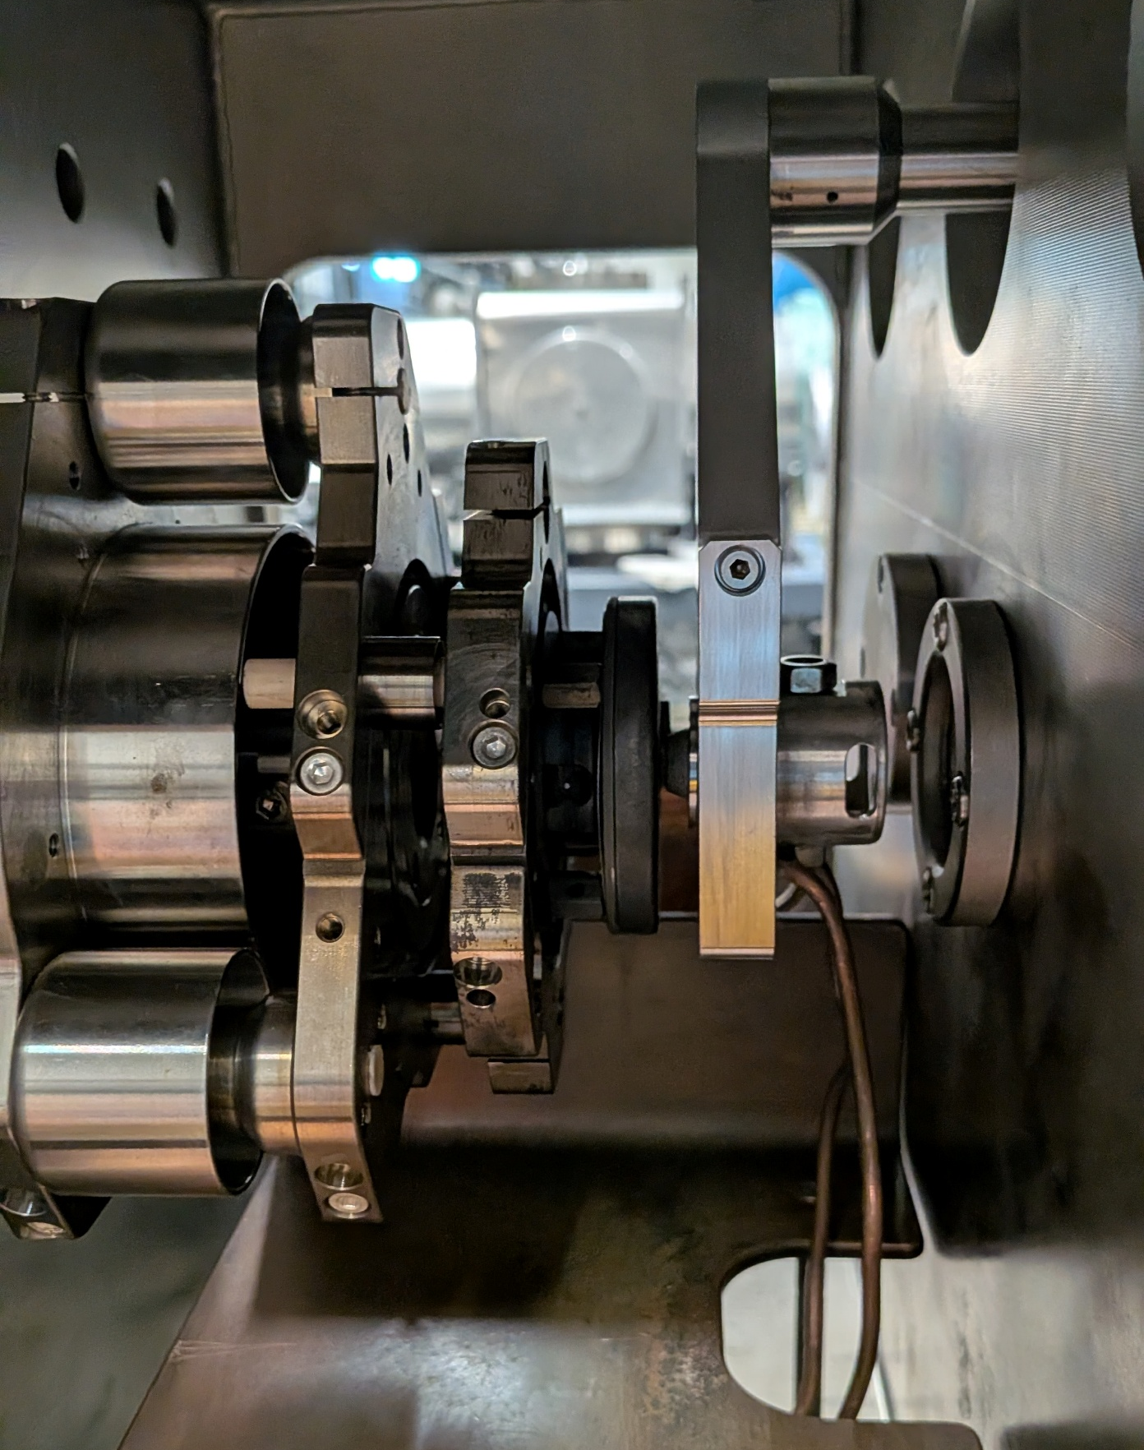
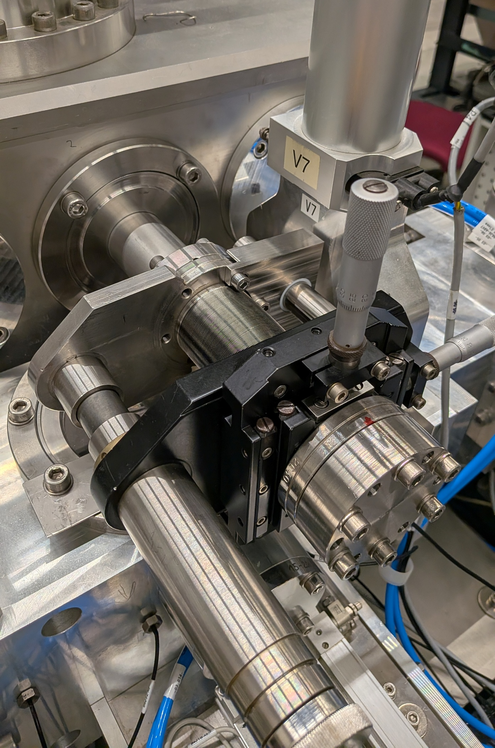
How were these measurements made?
Cs sputter ion source
Einzel (box) Lens
¹²C⁻
BPM
Beam Dump
LE magnet
16

Slide 31
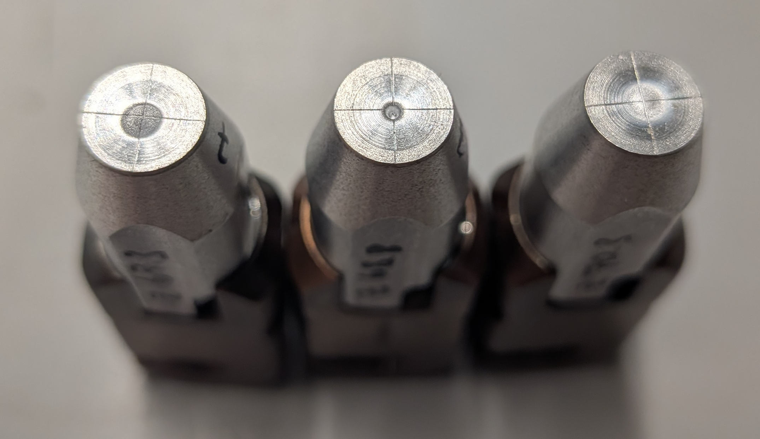
First examination: target potential and distance
-1.5mm
+1.5mm
Closer to
ioniser
Further from
ioniser
Examined using aluminium ‘dummy’ targets
                Optimum sputter spot (size, ‘sharpness’) found for fixed target potentials
5.7 mm
Target potential 4 kV
Ioniser potential 22 kV
Total energy 26 keV
17

Slide 32
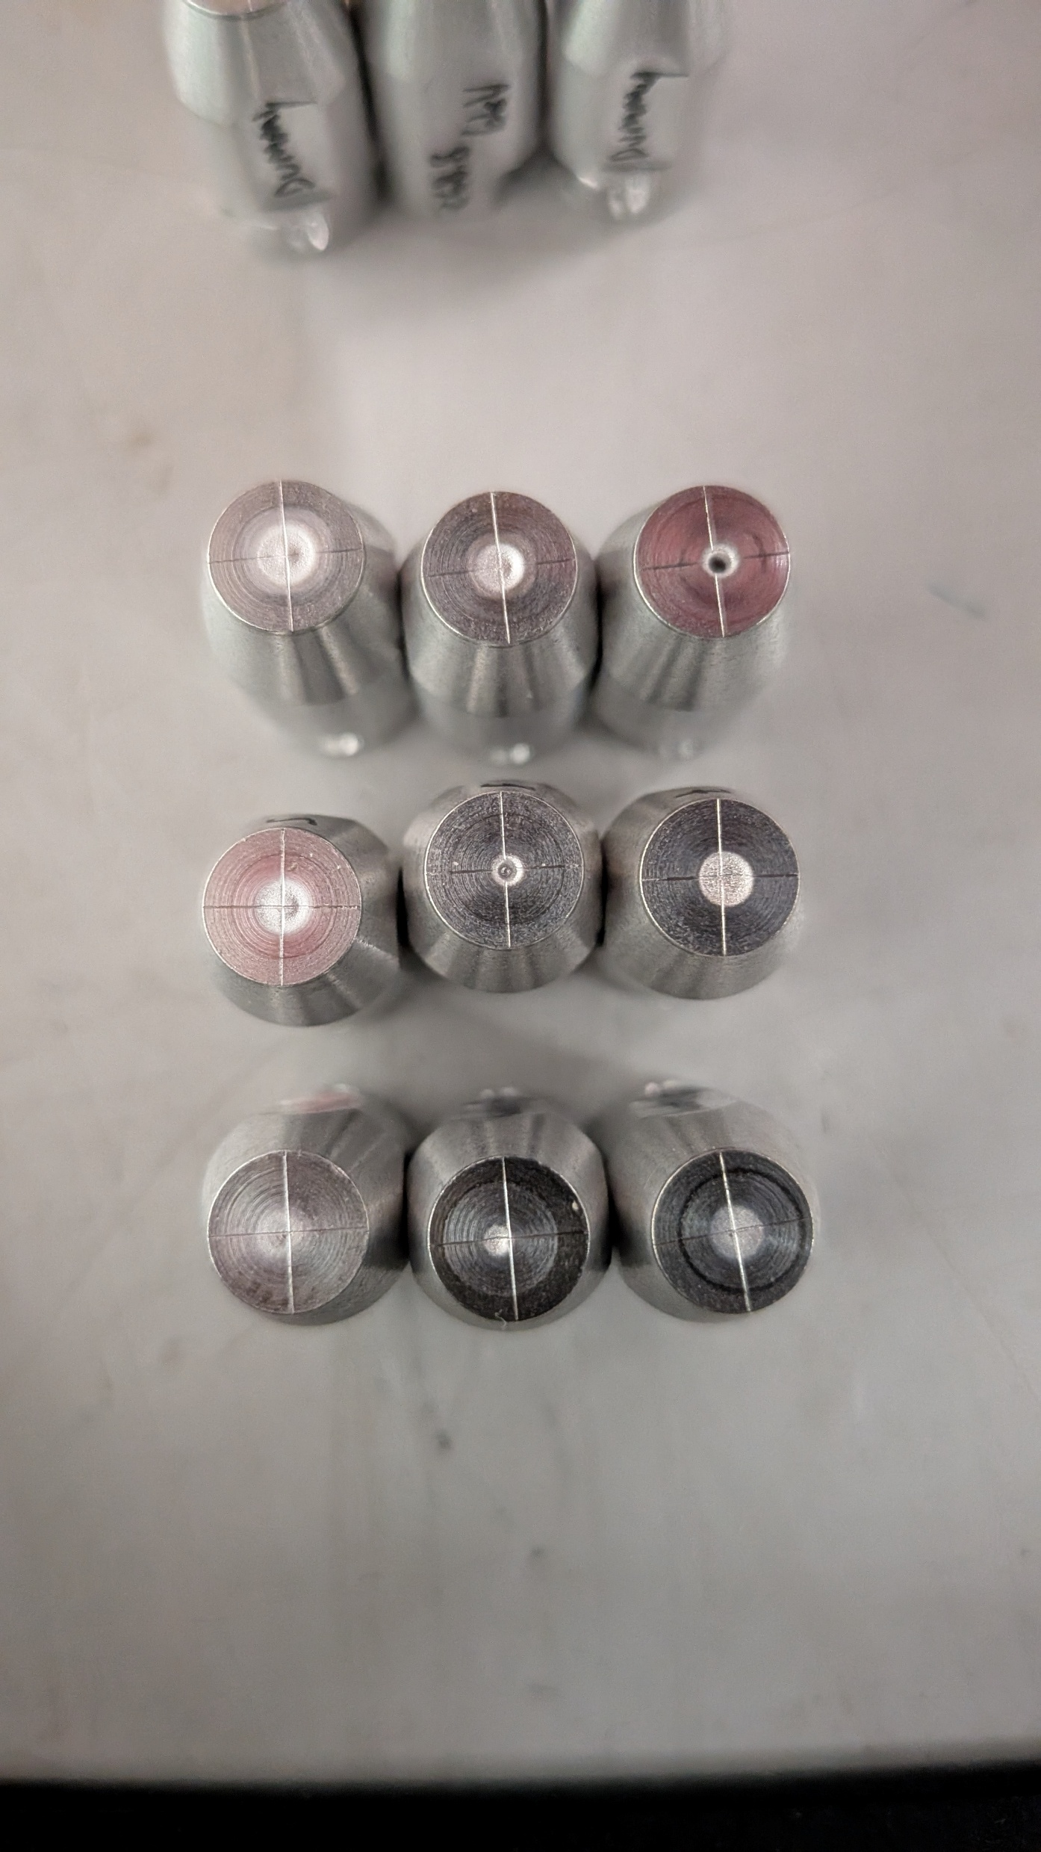
-1.5mm
+1.5mm
Closer to
ioniser
Further from
ioniser
2kV sputter energy
4kV sputter energy
6kV sputter energy
18

Slide 33
-1.5mm
+1.5mm
Closer to
ioniser
Further from
ioniser
2kV sputter energy
As sputter energy increases, the ‘ideal’ sputter spot is created when the sample is closer to the ioniser
Why?
4kV sputter energy
6kV sputter energy
18

Slide 34
2kV sputter energy
4kV sputter energy
6kV sputter energy
Sample + immersion lens
Ioniser + Cs nozzle
19

Slide 35
2kV sputter energy
4kV sputter energy
6kV sputter energy
Sample + immersion lens
Ioniser + Cs nozzle
As sputter energy increases, gradient between ioniser and sample is stronger, bringing Cs+ to a focus in a shorter distance → sample needs to be moved closer
19

Slide 36
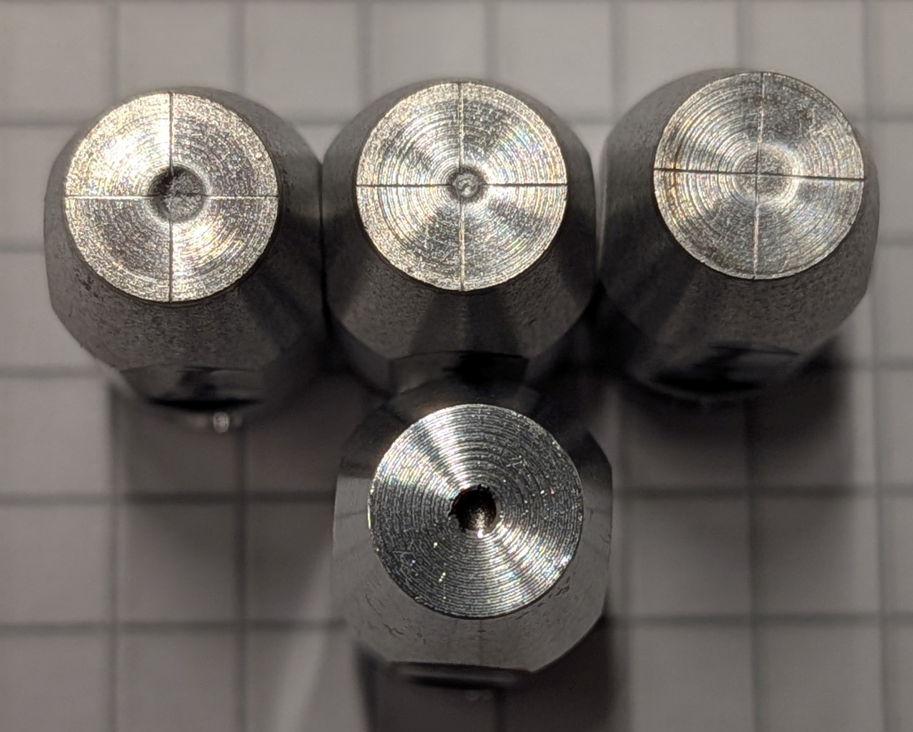
Second examination: temperature and ionizer potential
130°C
120°C
110°C
More Cs temperature gives a greater Cs⁺ density, which ‘shields’ the target, hence needing a greater sputter energy to overcome it
20

Slide 37
21
Notes:
Should be able to see extractor current change CHECK WITH GRAFANA AT TIMES OF MEASUREMENT

Slide 38
Seem to be extractor limited at the low energies
  That is, the lens formed between the extractor and the ioniser is not appropriate to extract all of the beam formed at these energies
21
Notes:
Should be able to see extractor current change CHECK WITH GRAFANA AT TIMES OF MEASUREMENT

Slide 39
Seem to be extractor limited at the low energies
  That is, the lens formed between the extractor and the ioniser is not appropriate to extract all of the beam formed at these energies
The other possibility is that the phase space is so large, that the beam is hitting the magnet chamber
21
Notes:
Should be able to see extractor current change CHECK WITH GRAFANA AT TIMES OF MEASUREMENT

Slide 40
22

Slide 41
22

Slide 42
What about the phase space?
Cs sputter ion source
Einzel (box) Lens
Object aperture
BPM
Beam Dump
Image aperture
LE magnet
23

Slide 43





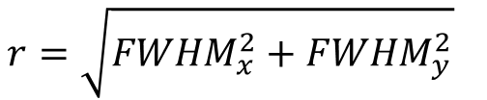
What about the phase space?
$$r=\sqrt{FWHM_{x}^{2}+FWHM_{y}^{2}}$$
$$r′=\frac{r−a}{d}$$
Cs sputter ion source
$$ε=r×r^{′}×1000 \text{[mm mrad]}$$
$$ε_{norm}=ε\sqrt{E}$$
Einzel (box) Lens
Object aperture
$$a=\text{aperture diameter = 3 mm}$$
$$d=\text{drift length}=247 \text{mm}$$
BPM
Beam Dump
* Calculations assume image aperture is size-defining
Image aperture
LE magnet
23

Slide 44
What about the phase space?
24

Slide 45
What about the phase space?
Could we be sampling only part of the phase space?
24

Slide 46
What about the phase space?
Could we be sampling only part of the phase space?
24

Slide 47
What did we learn? - Conclusions
Low energy operation seems to be extraction-optics limited
Beam quality doesn’t behave as expected – phase space vs magnet chamber?
25

Slide 48
What next? – Future work
Diagnostics and measurement technique:
  Quad-scan emittance using box lens
  Change aperture + BPM setup
Ion optics:
  Introduce negative extractor potential
Open physics question:
  Is the low-energy limitation dominated by re-neutralization or phase-space blow-up?
26

Slide 49
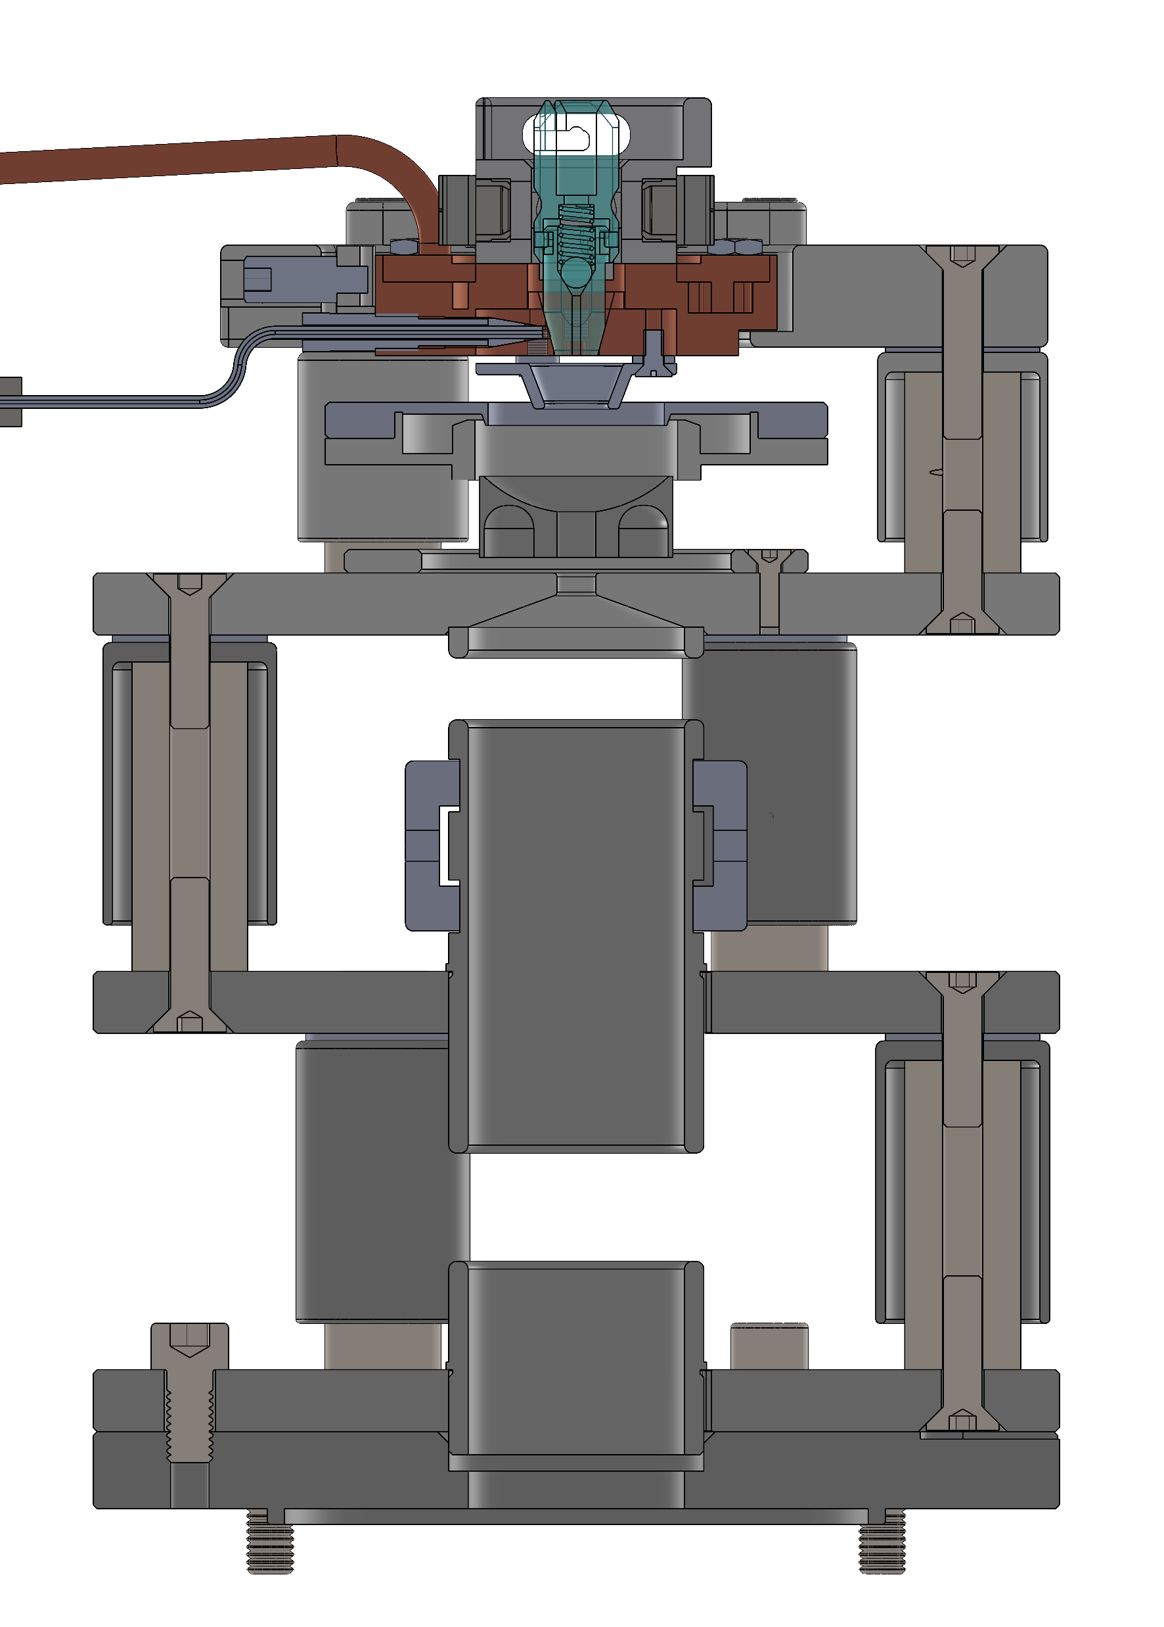
What next? – Future work
Diagnostics and measurement technique:
  Quad-scan emittance using box lens
  Change aperture + BPM setup
Ion optics:
  Introduce negative extractor potential
Open physics question:
  Is the low-energy limitation dominated by re-neutralization or phase-space blow-up?
26

Slide 50
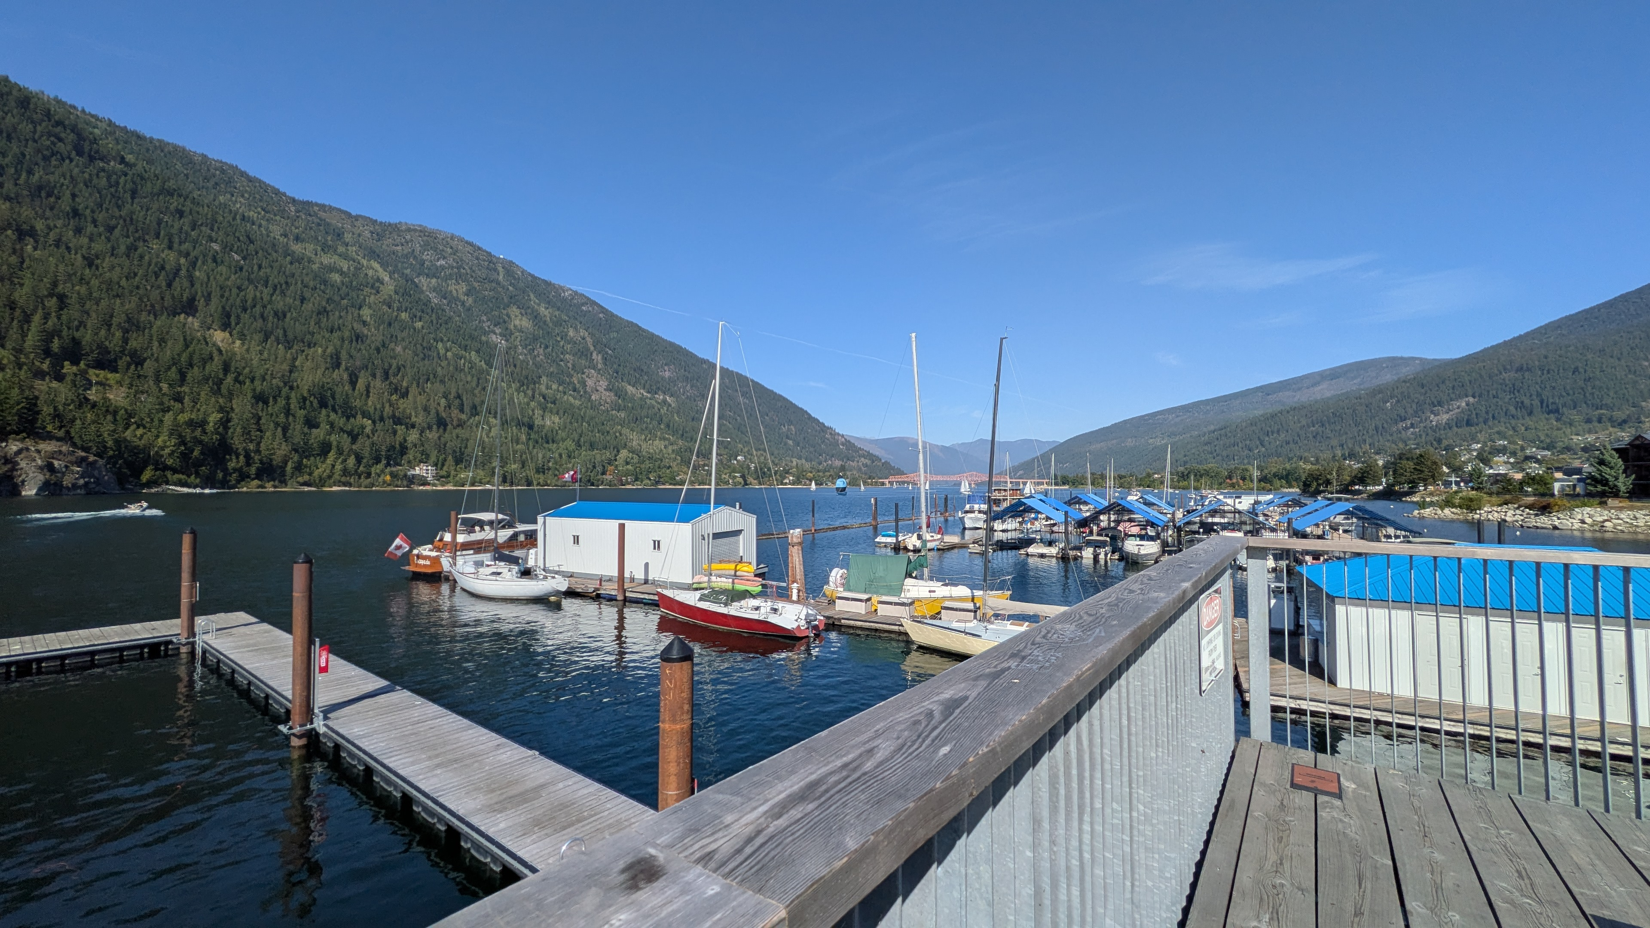
Acknowledgements
Laboratory of Ion Beam Physics technical staff, and the many semester students and apprentices
Thank you for you attention!
27

Slide 51
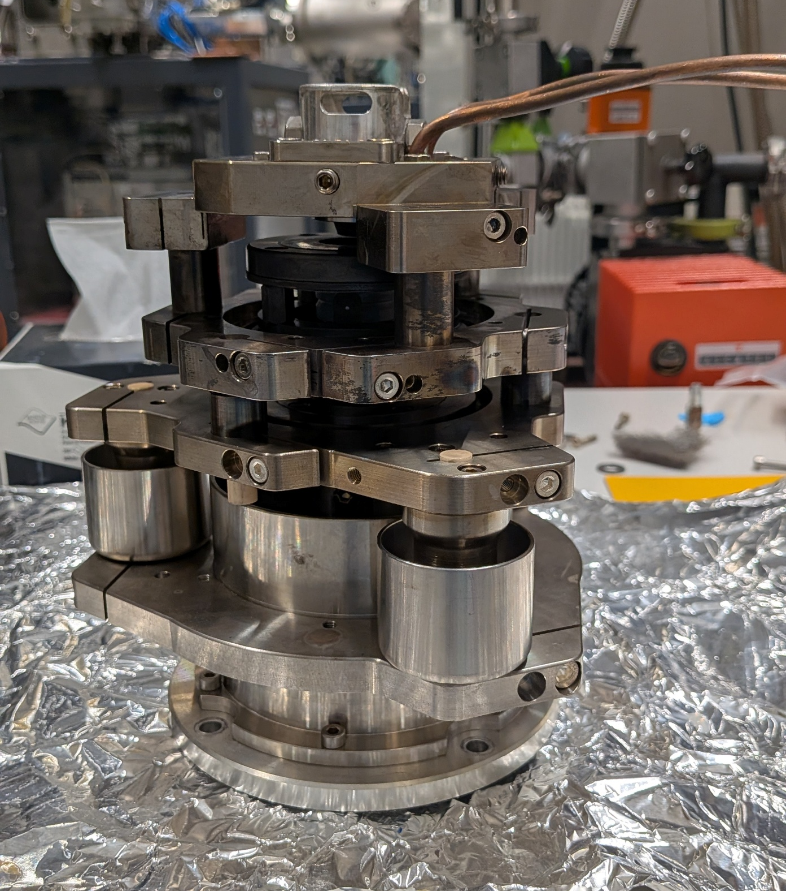
ETH Cs sputter source

Slide 52
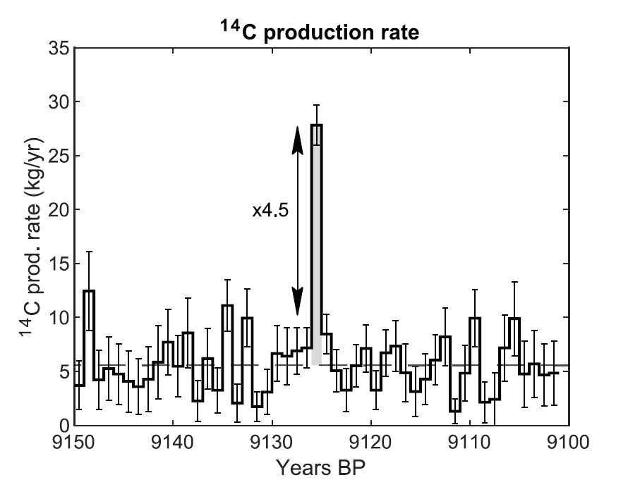
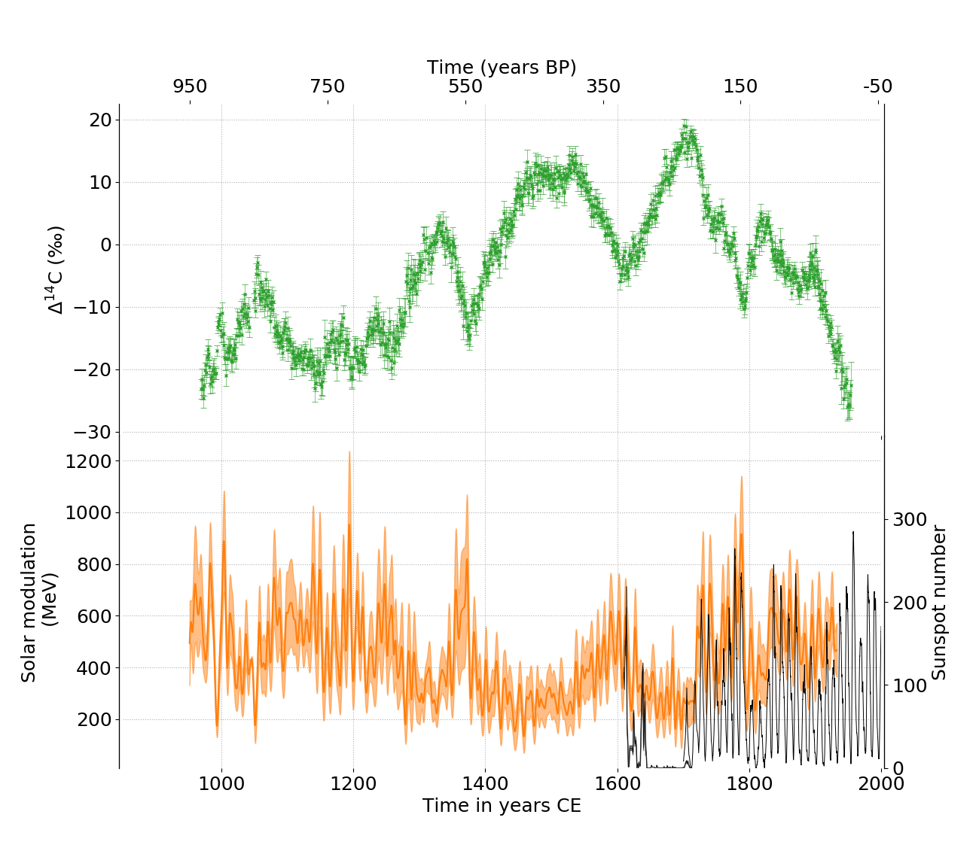
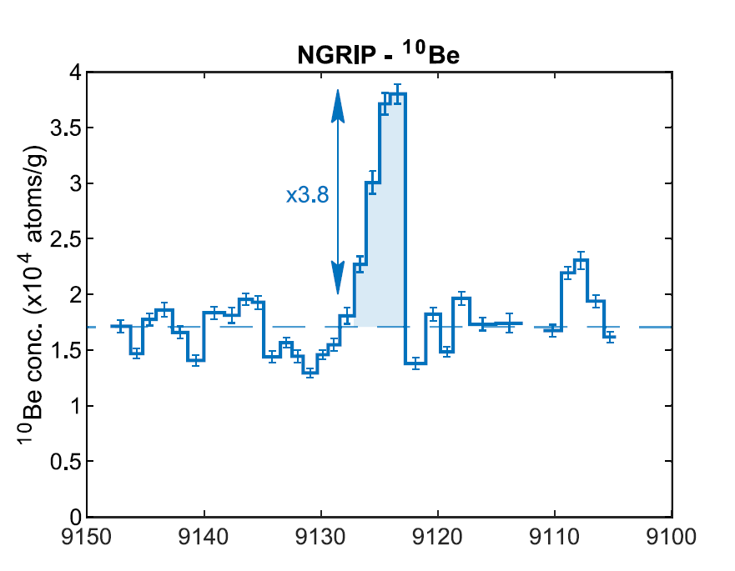
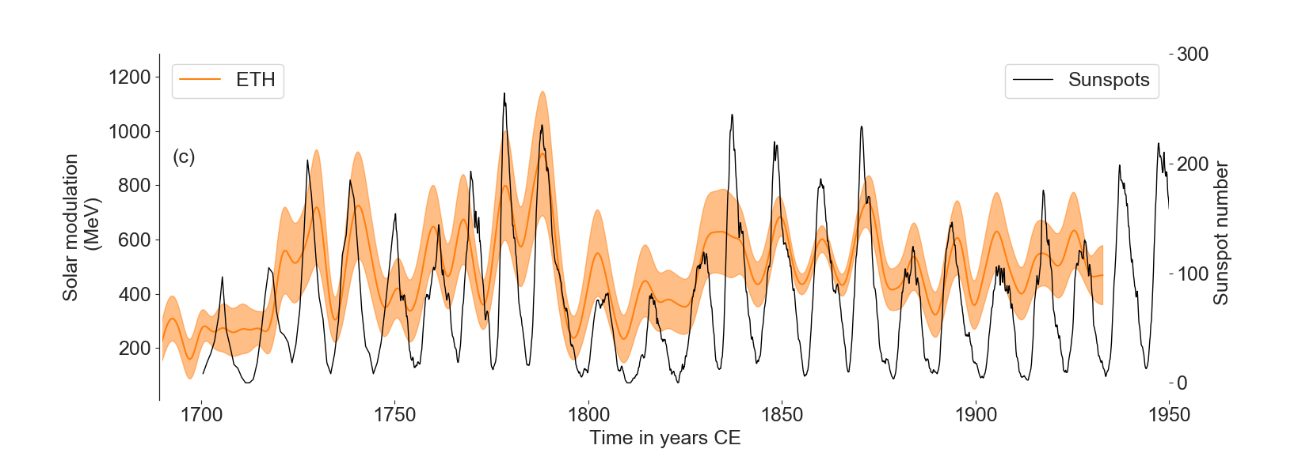
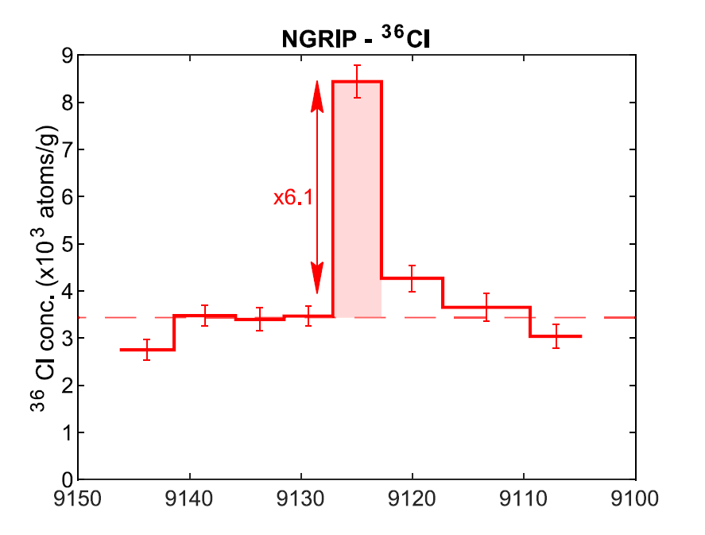
Oort
Wolf
Spörer
Maunder
Dalton

Slide 53
ETH source performance - temperature

Slide 54
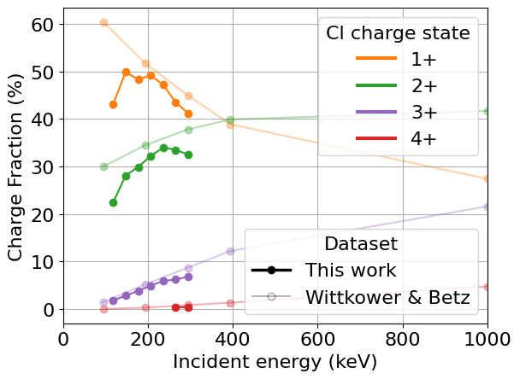
Compact AMS - Cl charge states
Charge state yield for Cl⁺ around 50% for compact accelerator energies (150-200 keV), while high energy tandem energies (46 MeV) requires use of a higher charge state 7+, which gives a much lower yield, around 15%
Measurements by L. Danini, semester project
23

Slide 55
Why push to even lower energy?
RFQ + LPD: magnet limited for the higher masses (example for 36Cl, 41Ca), construction of RFQ, optimum ratio of accelerator to source potential (where we might want to operate - ~100kV accelerator)
  200kV MICADAS (46%) (CSY – 50%)
  50kV LEA (50%) (CSY – 60%)
    Basically, better performance as you go down in energy (transmission wins in particular) but compromise on molecular destruction and angular spread/scatter
Big advantage to move to low energy for Cl
He advantage – anomaly in the 1+ CSY due to lack of ‘back reaction’/neutralisation reaction
Ultimate question: how low can we operate the source while retaining a useful, transportable beam?
  i.e. small/reasonable phase space, good transmission
M. Martischini et al, IJMS 415, 9-17 (2017)
For a maximum field of 0.695 T at LE magnet
36Cl- = 40 keV
41CaH- = 32 keV
41CaF3- = 14 keV (!!!)

