Slide 1



Modeling of Beam Focusing with
Radio Frequency Electric Field Perturbations
NIBS’26 Conference 2026/09/24 S3
T.Yasui^{A}, T.Hamajima^{A}, K.Nagaoka^{B,A}, H.Nakano^{B,A},
M.Osakabe^{B,C}, R.T.Ishikawa^{B,C}, K.Emoto^{B}
^{A} Nagoya University, ^{B}NIFS, ^{C}SOKENDAI
Notes:
My name is Tsuyoshi Yasui from Nagoya University. The title of my talk is "Modeling of Beam Focusing with Radio Frequency Electric Field Perturbations." [15s]

Slide 2
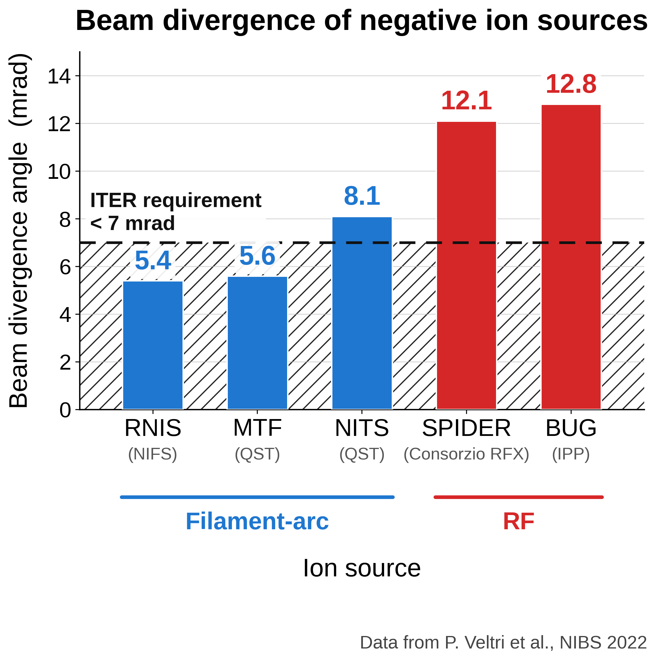
Background
1
◾️ RF negative ion sources are in development for ITER-NBI.
◾️ Beam divergence of RF sources is about
twice that of Filament-Arc (FA) sources.
◾️ Improving beam focusing of RF sources
is an urgent issue for ITER.
◾️ The mechanism of focusing degradation
must be identified.
Notes:
Let me start with the background.
RF negative ion sources for the ITER NBI are currently under development.
The figure on the right shows the beam divergence angle, the spread angle of the extracted beam, for the major negative ion sources.
The RF sources in red have a larger divergence angle than the filament-arc sources in blue, and do not meet the ITER requirement of 7 milliradians shown by the shaded band.
Suppressing the divergence angle, that is, improving beam focusing, is an urgent issue for ITER, and it requires understanding the mechanism of focusing degrades.

Slide 3
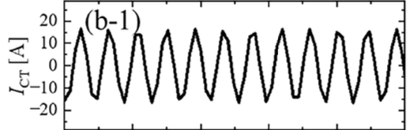
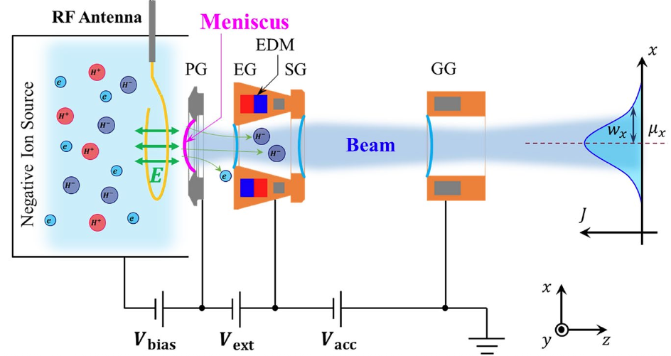
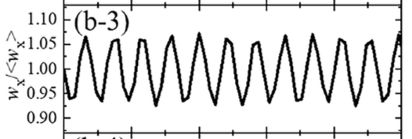

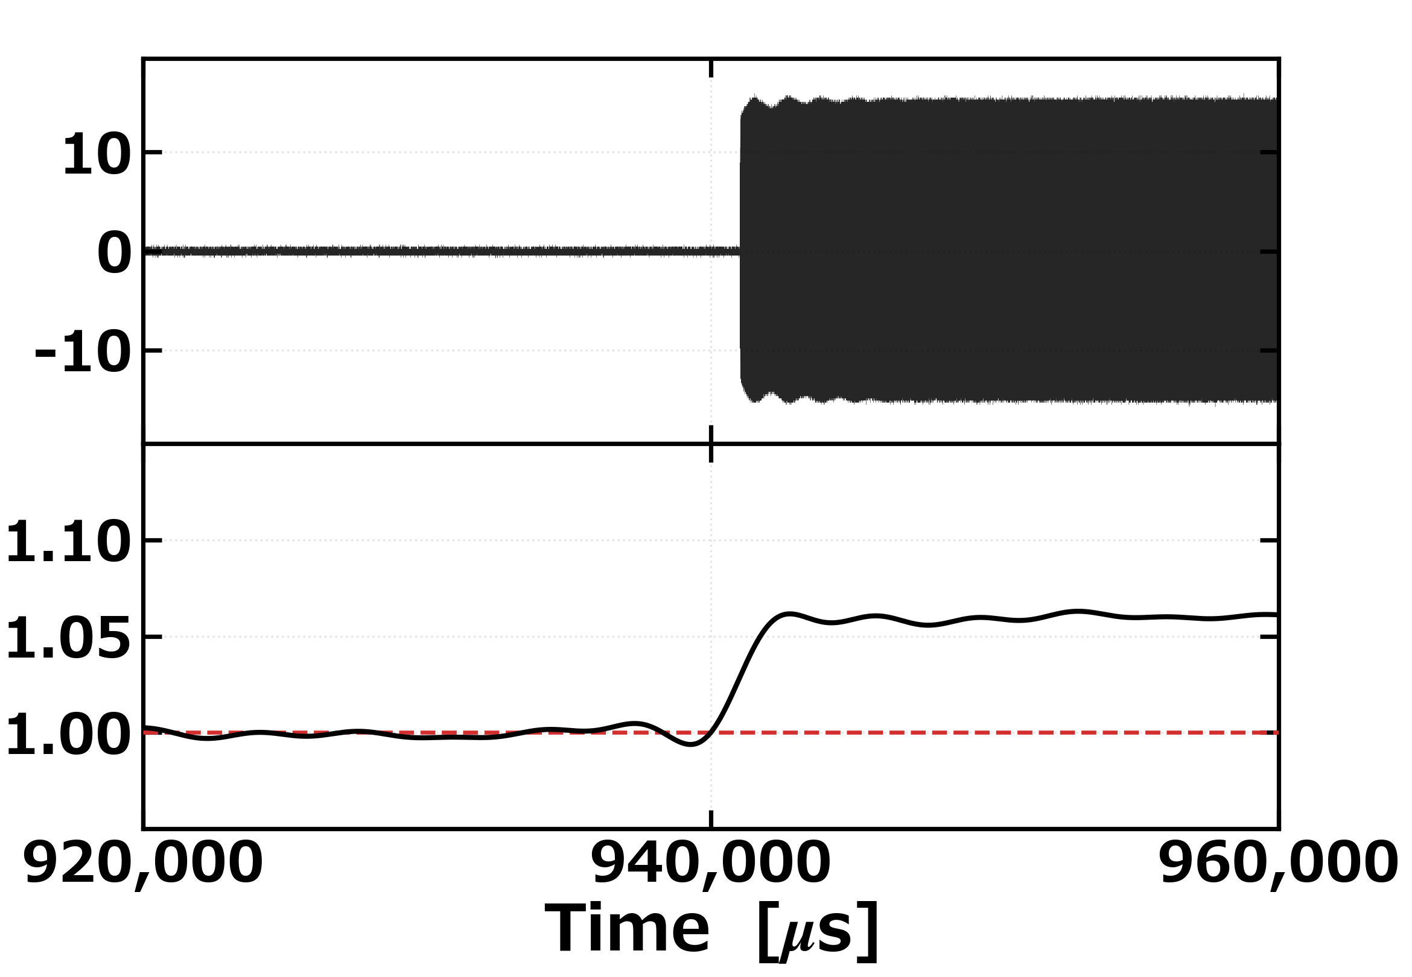
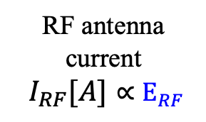
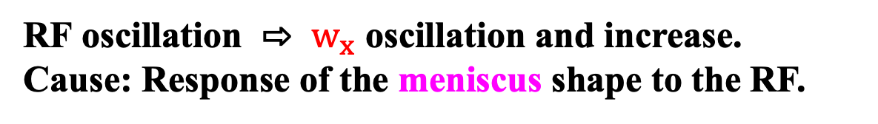
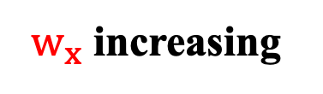

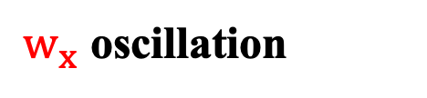
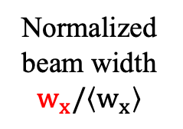
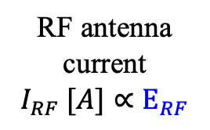
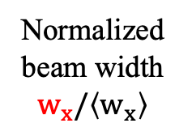
[Previous work] Beam responses to RF
２
◾️ Experimental setup
$w_{x}$ oscillation
RF Power
RF antenna
current
$$I_{RF} [A]∝E_{RF}$$
$$w_{x}$$
Normalized
beam width $w_{x}/\left\langle w_{x}\right\rangle$
$w_{x}$ increasing
RF antenna
current
$$I_{RF}[A]∝E_{RF}$$
Normalized
beam width $w_{x}/\left\langle w_{x}\right\rangle$
LPF=300Hz
RF ON
RF oscillation ⇨ $w_{x}$ oscillation and increase.
Cause: Response of the meniscus shape to the RF.
K. Nagaoka et al., Sci. Rep. 15, 1494 (2025).
T.Hamajima et al., ITC30 (2021).
Notes:
To identify this mechanism, an experiment was carried out.
An electric field mimicking the RF field was driven from an antenna which is installed inside a filament-arc negative ion source, and the response of the beam width was observed.
The two figures on the right show that response. In both, the upper graph shows the time evolution of current in the RF antenna which is proportional to RF electric field. and the lower graph shows the time evolution of the normalized beam width.
The upper figure shows the response on a time scale comparable to the RF period.
The beam width oscillates at the same frequency as the RF.
The lower figure captures the time evolution of the mean beam width.
When the RF is applied, the mean beam width increases.
This response is thought to come from the response to the RF of the electrostatic lens structure inside the source, called the meniscus, which determines the beam focusing.

Slide 4
Objective and method
3
Objective
Developing a model of the negative ion beam divergence response to the RF electric field.
Method
A model for negative ion beams is NOT established.
→ Based on the positive-ion beam model.
Static beam divergence model
+
RF field perturbation
Comparison
Beam divergence model with RF
Experimental results
Notes:
The purpose of the study is developing a model of the negative ion beam divergence response to the RF electric field.
The model will give a way to evaluate the degradation mechanism of RF negative ion sources.
We build it by adding an RF field perturbation to the model of the static state, which means the model without RF.
However, there is no established static beam model for negative ion beams due to the complexity of co-extracted electrons and the sheath structure which is made by H+,electron and H-.
We therefore start from the established beam model for positive ions.
comparison to experimental result

Slide 5
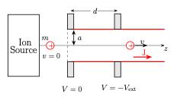
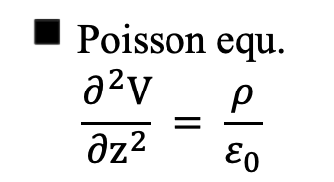
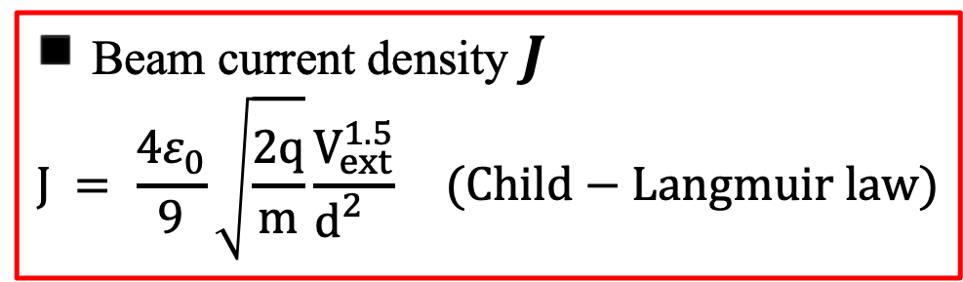

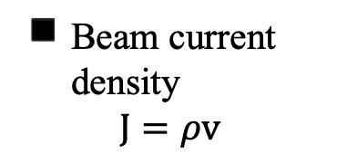
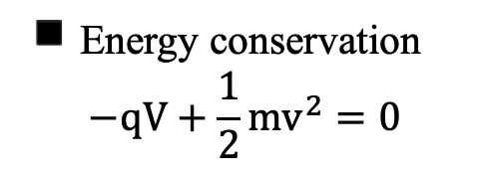
[Previous work] 1D Static beam model
4
◾️ 1D positive ion beam extraction model
◾️ Poisson equ.
$$\frac{∂^{2}V}{{∂z}^{2}} = \frac{ρ}{ε_{0}}$$
◾️ Energy conservation
$$−qV+\frac{1}{2}mv^{2}=0$$
◾️ Beam current
density
$$J=ρv$$
$$\frac{∂^{2}V}{{∂z}^{2}}=\frac{J_{ }}{ε_{0}}\sqrt{\frac{m}{2qV}}$$
◾️ Beam current density $J$
$$J_{ }= \frac{{4ε}_{0}}{9}\sqrt{\frac{2q}{m}}\frac{V_{ext}^{1.5}}{d_{ }^{2}} (Child−Langmuir law)$$
I.Langmuir et al., Phys. Rev. 24, 49 (1924).
This model is conventionally used for negative beams.
Notes:
First, let’s look the one-dimensional static extraction model for positive ions.
The plasma is located on the left side of the pair of electrodes.
When a potential difference V_extract is applied between the two electrodes, ions at rest near the left electrode are accelerated and ion beam of current density J is produced.
The z axis is taken along the beam propagation direction.
As you know, this current density follows the Child-Langmuir law, obtained from Poisson's equation, energy conservation and the definition of current density.
It is known that this model is conventionally used for negative ion beams.

Slide 6
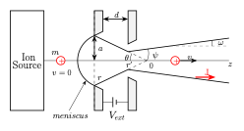
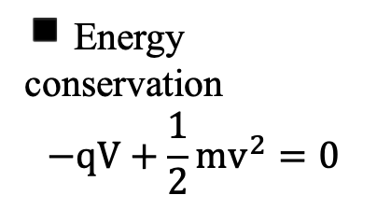
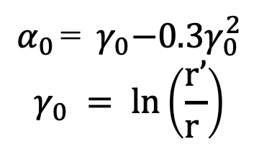
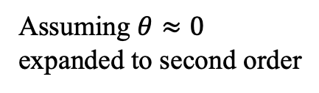
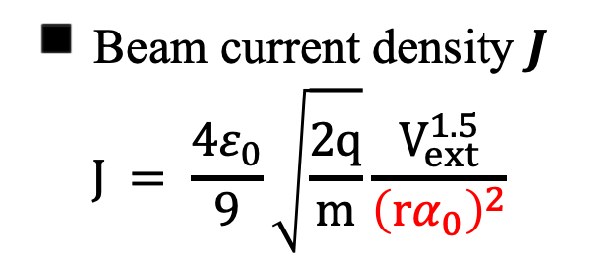
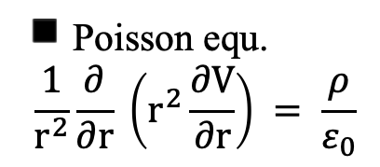
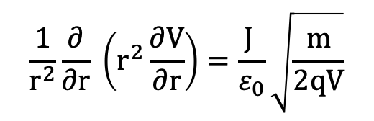
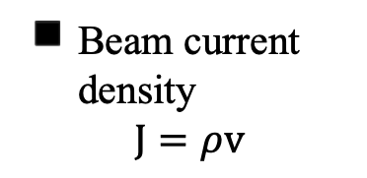
[Previous work] 2D Static beam model
5
◾️ Axisymmetric 2D beam
extraction model
◾️ Poisson equ.
$$\frac{1}{r^{2}}\frac{∂}{∂r} \left(r^{2}\frac{∂V}{∂r}\right) = \frac{ρ}{ε_{0}}$$
◾️ Energy conservation
$$−qV+\frac{1}{2}mv^{2}=0$$
◾️ Beam current
density
$$J=ρv$$
$$\frac{1}{r^{2}}\frac{∂}{∂r} \left(r^{2}\frac{∂V}{∂r}\right)=\frac{J_{ }}{ε_{0}}\sqrt{\frac{m}{2qV}}$$
(non-analytic)
Assuming $θ≈0$
expanded to second order
◾️ Beam current density $J$
$$J_{ }= \frac{{4ε}_{0}}{9}\sqrt{\frac{2q}{m}}\frac{V_{ext}^{1.5}}{{\left(rα_{0}\right)}^{2}}$$
$α_{0 }$=${ γ}_{0}−0.3γ_{0}^{2}$
$$γ_{0} = ln\left(\frac{r’}{r_{ }}\right)$$
I.Langmuir et al., Phys. Rev. 24, 49 (1924).
Notes:
Next, we extend the one-dimensional model to an axisymmetric two-dimensional system.
In this system, the electrostatic field between the electrodes penetrate into the plasma, and the plasma-beam boundary, which is called that meniscus, forms an arched shape.
The meniscus acts as a lens focusing the beam to a single point at an angle theta, and the beam divergence angle omega can be derived from that theta.
Now, let’s derive omega.
First, the Child–Langmuir law can be derived approximately , with a correction factor α₀, as shown in the red box.
It comes from combining the three equations and expanding the solution to second order under the assumption θ ≈ 0.

Slide 7

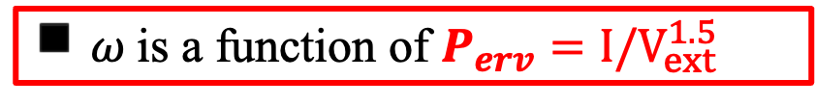
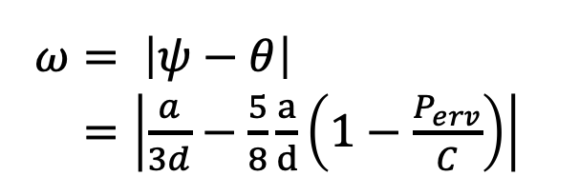
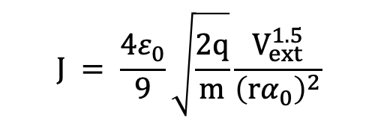
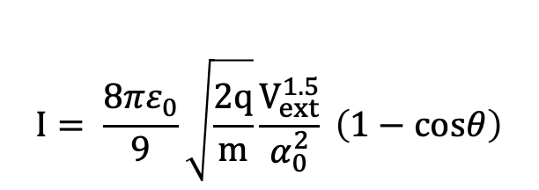
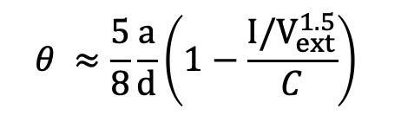
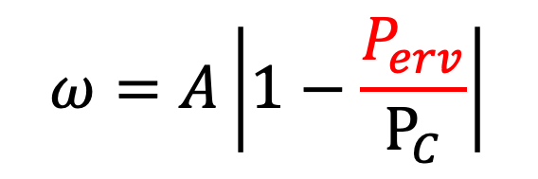
[Previous work] 2D Static beam model
6
◾️ Beam current
density
$$J_{ }= \frac{{4ε}_{0}}{9}\sqrt{\frac{2q}{m}}\frac{V_{ext}^{1.5}}{{\left(rα_{0}\right)}^{2}}$$
◾️ Axisymmetric 2D beam
extraction model
$$I= \frac{{8πε}_{0}}{9}\sqrt{\frac{2q}{m}}\frac{V_{ext}^{1.5}}{α_{0}^{2}} \left(1−cosθ\right)$$
◾️ Beam current
$$θ ≈\frac{5}{8}\frac{a}{d}\left(1−\frac{I/V_{ext}^{1.5}}{C}\right)$$
◾️ Beam Focusing
Angle
C : constant
◾️ Beam divergence
angle
$ω= \left|ψ−θ\right|$
$=\left|\frac{a}{3d}−\frac{5}{8}\frac{a}{d}\left(1−\frac{P_{erv}}{C}\right)\right|$
$$ω=A\left|1−\frac{P_{erv}}{P_{C}}\right|$$
J.R.Coupland et al. Rev. Sci. Instrum. 44, 9 (1973).
◾️ $ω$is a function of $P_{erv}=I/V_{ext}^{1.5}$
A, $P_{C}$: constant
Notes:
Multiplying the current density by the meniscus surface area gives the beam current, and rearranging gives the expression for the angle theta.
Using the geometric relation, the beam divergence angle omega is then written with an absolute value and the constants A and Pc.
The important point is that omega is a function of the perveance, the beam current I divided by the extraction voltage V_extract to the power 1.5.

Slide 8
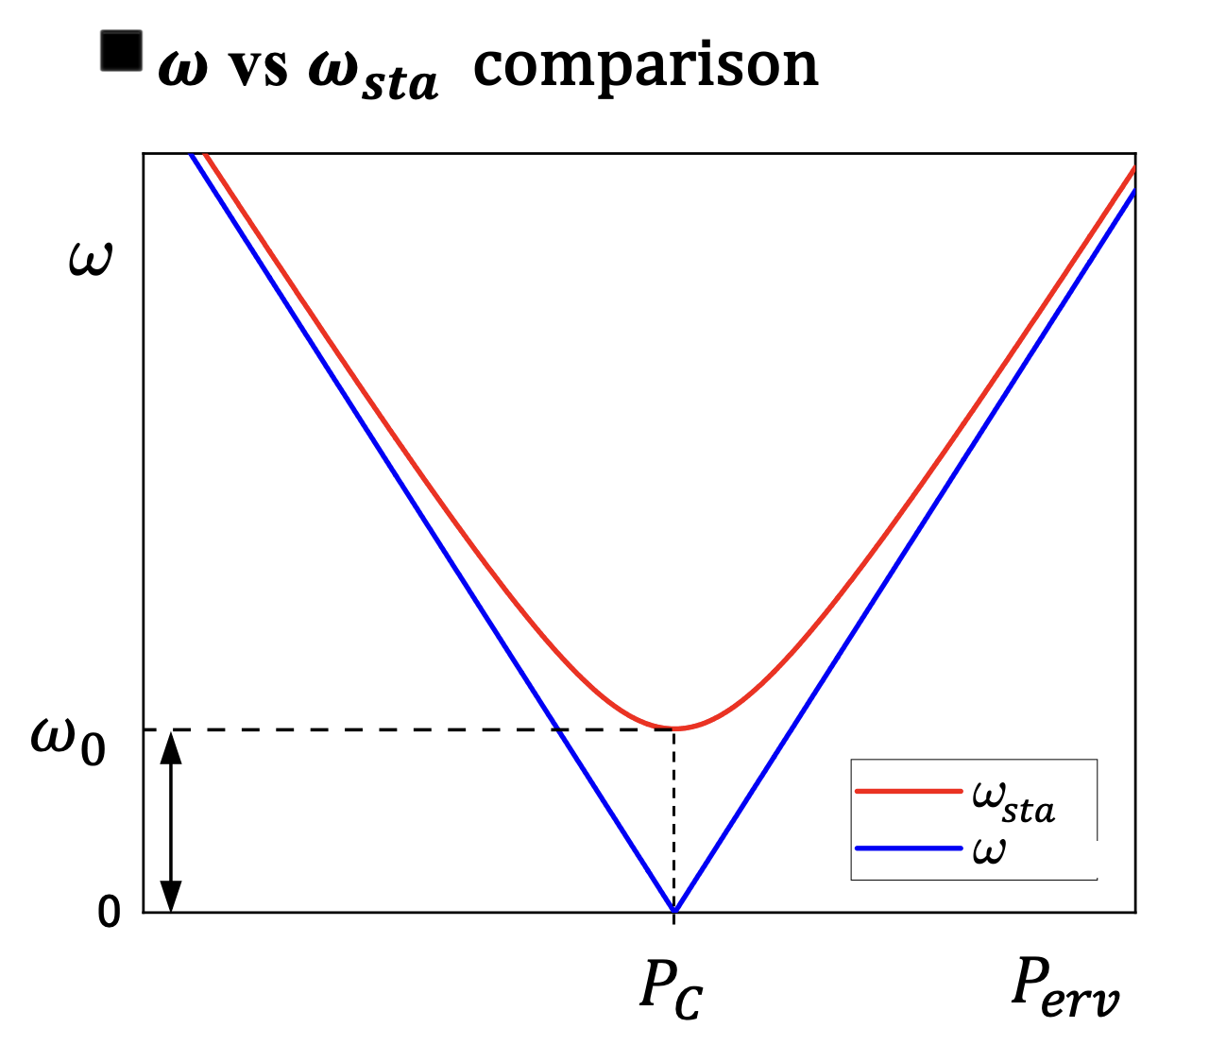

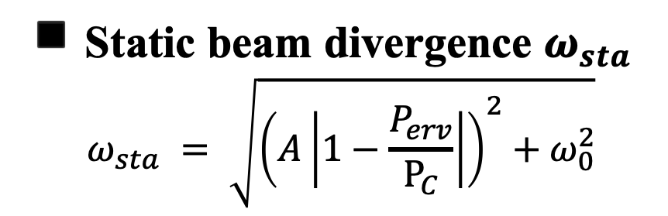
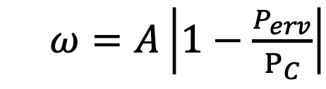

2D Static beam model with $ω_{0}$
4
7
[3] J.R.Coupland et al., Rev. Sci. Instrum. 44, 9 (1973).
$ω=A\left|1−\frac{P_{erv}}{P_{C}}\right|$
$ω_{0}$ minimum divergence angle
$$ω_{0}^{ }$$
◾️ Static beam divergence $ω_{sta}$
$$ω_{sta} = \sqrt{{\left(A\left|1−\frac{P_{erv}}{P_{C}}\right|\right)}^{2}+ω_{0}^{2}}$$
Notes:
Plotting the resulting expression with perveance on the horizontal axis and divergence angle on the vertical axis gives the blue curve, where the divergence angle falls to zero at perveance equal Pc.
However, In the experiment, the divergence doesn’t reach zero, as shown in red.
So,We introduce minimum divergence angle omega_0.
Taking this into account, the static beam divergence angle omega_static corresponding to the red curve is obtained as shown at the bottom right.

Slide 9
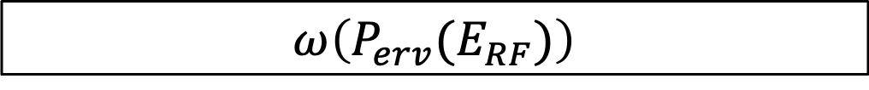
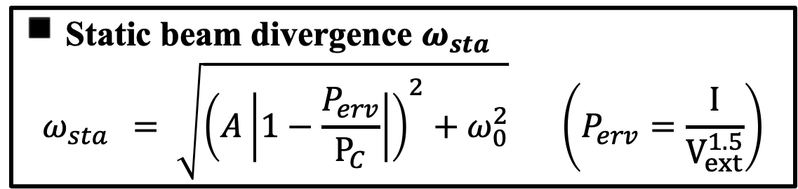
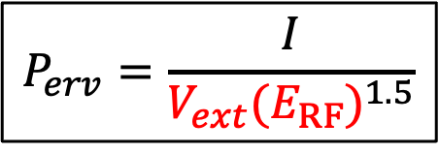
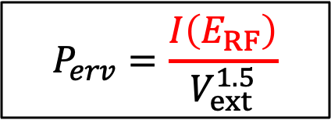
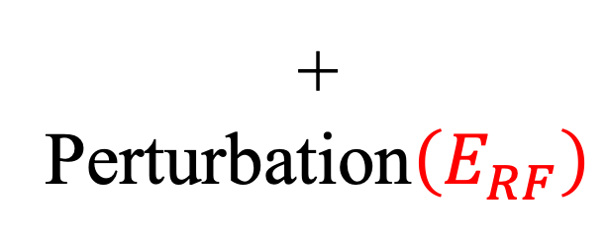
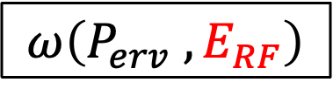

RF field perturbation: Three elementary processes
8
◾️ Static beam divergence $ω_{sta}$
$$ω_{sta } = \sqrt{{\left(A\left|1−\frac{P_{erv}}{P_{C}}\right|\right)}^{2}+ω_{0}^{2}} \left(P_{erv}=\frac{I}{V_{ext}^{1.5}}\right)$$
+
Perturbation$\left(E_{RF}\right)$
$$ω\left(P_{erv}(E_{RF})\right)$$
$$ω\left(P_{erv} , E_{RF}\right)$$
$$P_{erv}=\frac{I\left(E_{RF}\right)}{V_{ext}^{1.5}}$$
$$P_{erv}=\frac{I}{{V_{ext}(E_{RF})}^{1.5}}$$
$$P_{erv}=const.$$
Model 1
Model 2
Model 3
Notes:
In this study we introduce an RF electric field perturbation into this static beam divergence model to build the divergence response model.
We consider three elementary processes of the RF perturbation to be important and have built three corresponding models.
The three models are distinguished by the relation between the perveance and the RF electric field.
Model 1: the beam current oscillates with the RF field, so the perveance oscillates. As a result, omega oscillates.
Model 2: the extraction voltage oscillates with the RF field, so the perveance oscillates. As a result, omega oscillates.
Model 3: the perveance does not change, and the beam divergence angle oscillates directly with the RF field.

Slide 10
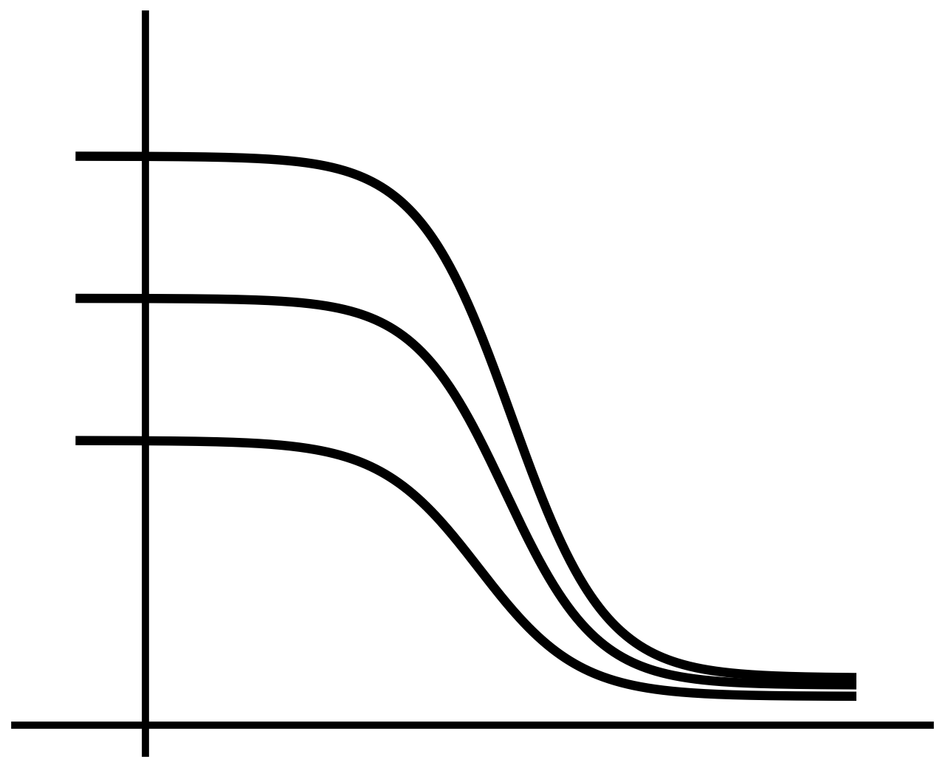
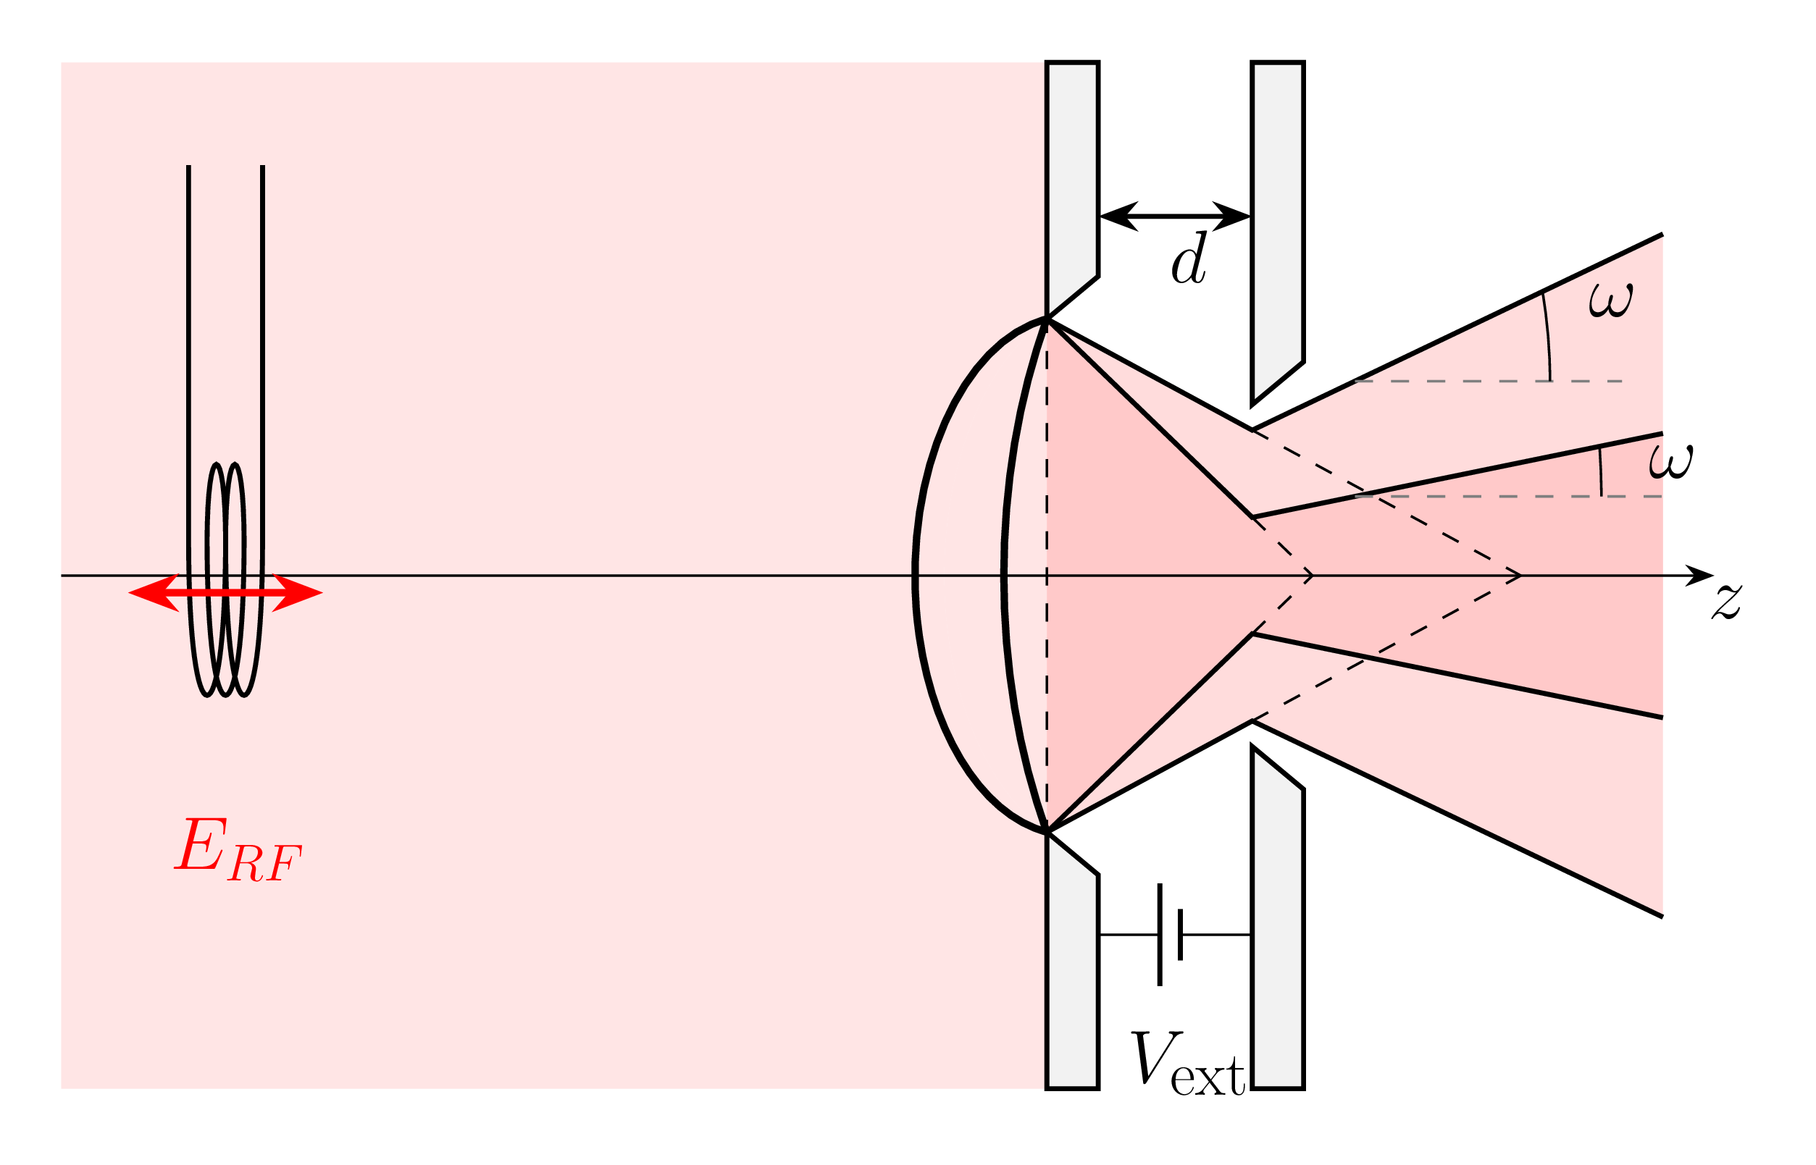
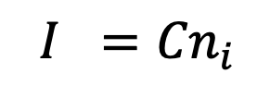
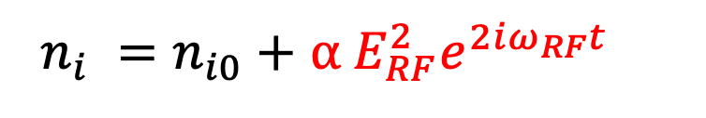
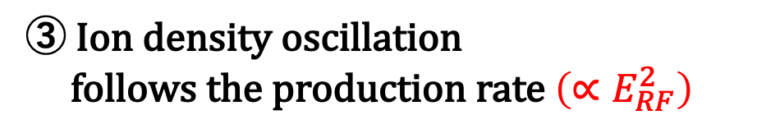

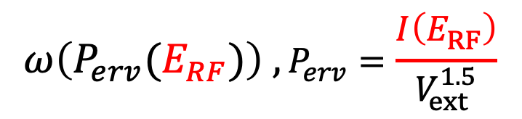

Model 1: Ion density oscillation model
9
▪ Hypotheses
▪ Model schematic
$$n_{i}$$
① Current oscillation is dominant.
$$ω\left(P_{erv}(E_{RF})\right) ,P_{erv}=\frac{I\left(E_{RF}\right)}{V_{ext}^{1.5}}$$
$$n_{i0}$$
② Current oscillation originates from ion density oscillation.
$$I ={Cn}_{i}$$
③ Ion density oscillation
follows the production rate ${\left(∝E_{RF}^{2}\right)}_{ }^{ }$
$n_{i} =n_{i0}+$ $α E_{RF}^{2}e^{2iω_{RF}t}$
indicating beam current does not oscillate at ω_{RF}
T.Shibata et al. AIP Conf. Proc. 2373, 050002 (2021)
Notes:
First, Model 1, the ion density oscillation model.
We make three hypotheses.
First, the current oscillation is dominant.
Second, the current oscillation originates from ion density oscillation.
Third, that ion density oscillation follows the production rate, which is proportional to the square of the RF electric field.
Now, we can write ion density like that.
It means ion density and beam current oscillates at twice the RF frequency, not at the RF frequency.
For reference, beam current oscillation has also been observed in the RF negative ion source used at J-PARC in Japan.
The elementary processes of this model are shown in the figure on the right.
The ion density oscillation drives an oscillation of the beam current, which oscillates the divergence angle through the perveance.

Slide 11
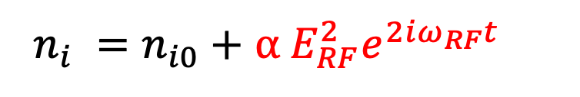
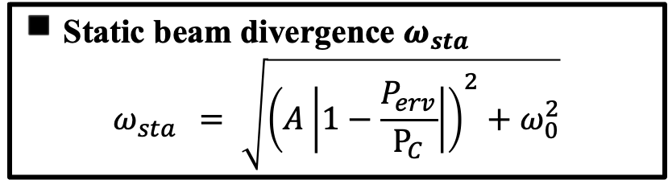
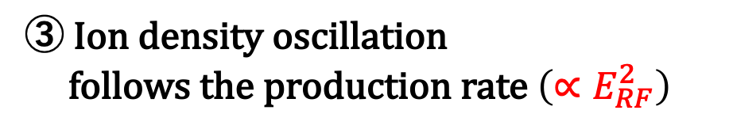
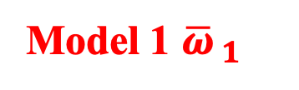




Model 1: Ion density oscillation model
10
▪ Hypotheses
◾️ Static beam divergence $ω_{sta}$
$$ω_{sta } = \sqrt{{\left(A\left|1−\frac{P_{erv}}{P_{C}}\right|\right)}^{2}+ω_{0}^{2}}$$
① Current oscillation is dominant.
$$ω\left(P_{erv}(E_{RF})\right) ,P_{erv}=\frac{I\left(E_{RF}\right)}{V_{ext}^{1.5}}$$
$$P_{erv}= \frac{C{(n}_{i0}+ α E_{RF}^{2}e^{2iω_{RF}t})}{V_{ext}^{1.5}}$$
$= P_{sta}(1+ \frac{α}{n_{i0}}E_{RF}^{2}e^{2iω_{RF}t})$
② Current oscillation originates from ion density oscillation
$$I ={Cn}_{i}$$
③ Ion density oscillation
follows the production rate ${\left(∝E_{RF}^{2}\right)}_{ }^{ }$
Model 1 ${\overline{ω}}_{ 1}$
$n_{i} =n_{i0}+$ $α E_{RF}^{2}e^{2iω_{RF}t}$
$${\overline{ω}}_{ 1}= \frac{1}{T}\int{\sqrt{{{\left(A\left|1−\frac{P_{sta}(1+\frac{α}{n_{i0}}E_{RF}^{2}e^{2iω_{RF}t})}{P_{C}}\right|\right)}^{2}}^{ }+ω_{0}^{2}}}dt$$
Notes:
From these hypotheses, the beam current is derived as shown.
Dividing by the voltage gives the perveance in this form.
P_static is the perveance in the static state.
When the RF field is applied, the perveance oscillates about P_static.
Using this perveance in the static beam divergence model and taking the time average gives the Model 1 expression for the divergence angle, in the red box.

Slide 12




Model 2: Extraction field oscillation model
11
▪ Hypotheses
▪ Model schematic
① Electric Field oscillation is dominant.
$$ω\left(P_{erv}(E_{RF})\right) ,P_{erv}=\frac{I}{{V_{ext}(E_{RF})}^{1.5}}$$
② The RF field is superimposed on the extraction field.
$$\frac{V_{ext}}{d}+E_{RF}e^{iω_{RF}t}$$
③ The RF field is much smaller than the static field
$$\left|E_{RF}e^{iω_{RF}t}\right|≪\frac{V_{ext}}{d}$$
Notes:
Next, Model 2, the meniscus field oscillation model.
We make three hypotheses.
First, the electric field oscillation is dominant.
Second, the RF field is superimposed on the extraction field.
The zeroth-order component of the extraction field is the electrostatic field from the extraction voltage V_extract and the first-order perturbation is the RF field, written as shown.
Third, the RF field strength is sufficiently small compared with the electrostatic field.
The elementary processes are shown in the figure on the right.
The oscillation of the extraction field can be regarded as a change in the extraction voltage.
As a result, perveance and divergence angle oscillate.

Slide 13



Model 2: Extraction field oscillation model
12
▪ Hypotheses
◾️ Static beam divergence $ω_{sta}$
$$ω_{sta } = \sqrt{{\left(A\left|1−\frac{P_{erv}}{P_{C}}\right|\right)}^{2}+ω_{0}^{2}}$$
① Electric Field oscillation is dominant.
$$ω\left(P_{erv}(E_{RF})\right) ,P_{erv}=\frac{I}{{V_{ext}(E_{RF})}^{1.5}}$$
② The RF field is superimposed on the extraction field.
$$P_{erv}= \frac{I}{{\left(V_{ext}+{dE}_{RF}e^{iω_{RF}t}\right)}_{ }^{1.5}}$$
$$= P_{sta}\left\{1−1.5\frac{d}{V_{ext}}E_{RF}e^{iω_{RF}t}+1.875{\left(\frac{d}{V_{ext}}\right)}^{2}E_{RF}^{2}e^{2iω_{RF}t}\right\}$$
$$\frac{V_{ext}}{d}+E_{RF}e^{iω_{RF}t}$$
③ The RF field is much smaller than the static field
$$\left|E_{RF}e^{iω_{RF}t}\right|≪\frac{V_{ext}}{d}$$
$${\overline{ω}}_{ 2}= \frac{1}{T}\int{\sqrt{{{\left(A\left|1−\frac{P_{sta}\left\{1−1.5\frac{d}{V_{ext}}E_{RF}e^{iω_{RF}t}+1.875{\left(\frac{d}{V_{ext}}\right)}^{2}E_{RF}^{2}e^{2iω_{RF}t}\right\}}{P_{C}}\right|\right)}^{2}}^{ }+ω_{0}^{2}}}dt$$
Model 2 ${\overline{ω}}_{ 2}$
Notes:
From these hypotheses, the voltage oscillation is written as shown.
Computing the perveance and using it in the static model gives the divergence angle expression, in the blue box.

Slide 14








Model 3: Direct meniscus response model
13
▪ Hypotheses
① Direct response of the meniscus structure to $E_{RF}$ is dominant.
▪ Model schematic
$$ω\left(P_{erv} , E_{RF}\right) ,P_{erv}=const.$$
② Meniscus position on the z axis $l$ varies in proportion to $E_{RF}$
$$l_{ }−l_{sta}= εE_{RF}e^{iω_{RF}t}$$
Geometrically: $l_{ }−l_{sta} \sim \frac{a}{2}\left(θ_{sta}−θ_{ }\right)$
$$θ_{ }=θ_{sta} −\frac{a}{2}εE_{RF}e^{iω_{RF}t}$$
$$ω=\sqrt{{{\left(\left|\frac{a}{3d}−θ_{ }\right|\right)}^{2}}^{ }+ω_{0}^{2}}$$
Notes:
The third is the direct meniscus oscillation model.
We make two hypotheses.
First, the direct response of the meniscus structure to the RF field is dominant.
Second, there is hypothesis on the shape of the meniscus.
Please look at the figure: the meniscus in the static state is drawn in black, and in red is the meniscus whose curvature has been changed by the RF field at a given instant.
Focusing on the meniscus position along the z axis L, we assume that L changes in proportion to the RF electric field.
Using the geometric relations of the model, oscillation of the divergence angle is derived as shown.

Slide 15









Model 3: Direct meniscus response model
14
◾️ Static beam divergence $ω_{sta}$
$$ω_{sta } = \sqrt{{\left(A\left|1−\frac{P_{erv}}{P_{C}}\right|\right)}^{2}+ω_{0}^{2}}$$
▪ Hypotheses
① Direct response of the meniscus structure to $E_{RF}$ is dominant.
Geometrically: $l_{ }−l_{sta} \sim \frac{a}{2}\left(θ_{sta}−θ_{ }\right)$
$$ω\left(P_{erv} , E_{RF}\right) ,P_{erv}=const.$$
$$θ_{ }=θ_{sta} −\frac{a}{2}εE_{RF}e^{iω_{RF}t}$$
② Meniscus position on the z axis $l$ varies in proportion to $E_{RF}$
$$ω=\sqrt{{{\left(\left|\frac{a}{3d}−θ_{ }\right|\right)}^{2}}^{ }+ω_{0}^{2}}$$
$$l_{ }−l_{sta}= εE_{RF}e^{iω_{RF}t}$$
Model 3 ${\overline{ω}}_{ 3}$
$${\overline{ω}}_{ 3}= \frac{1}{T}\int{\sqrt{{{\left(A\left|1−\frac{P_{sta}}{P_{C}}+\frac{2}{{Aa}^{ }}{ε E}_{RF}e^{iω_{RF}t}\right|\right)}^{2}}^{ }+ω_{0}^{2}}}dt$$
Notes:
Using this geometric relationship, the divergence angle expression for this model is derived as shown in the green box.
[60s]

Slide 16




Comparison with experiment ① $P_{erv}$ dependence
15
Model 1: Ion density oscillation model
◾️ Model vs. experimental data
$${\overline{ω}}_{ 1}= \frac{1}{T}\int{\sqrt{{{\left(A\left|1−\frac{P_{sta}(1+\frac{α}{n_{0}}E_{RF}^{2}e^{2iω_{RF}t})}{P_{C}}\right|\right)}^{2}}^{ }+ω_{0}^{2}}}dt$$
Model 2: Extraction field oscillation model
$${\overline{ω}}_{ 2}= \frac{1}{T}\int{\sqrt{{{\left(A\left|1−\frac{P_{sta}\left\{1−1.5{\frac{d}{V_{ext}}E_{RF}e^{iω_{RF}t}}^{ }+1.875{{ \left(\frac{d}{V_{ext}}E_{RF}\right)}^{2 }e^{2iω_{RF}t}}^{ }\right\}}{P_{C}}\right|\right)}^{2}}^{ }+ω_{0}^{2}}}dt$$
Model 3: Direct meniscus response model
$${\overline{ω}}_{ 3}= \frac{1}{T}\int{\sqrt{{{\left(A\left|1−\frac{P_{sta}}{P_{C}}+\frac{2}{{Aa}^{ }}{ε E}_{RF}e^{iω_{RF}t}\right|\right)}^{2}}^{ }+ω_{0}^{2}}}dt$$
All models reproduce the experimental result.
Notes:
Now I compare the models with the experimental data from earlier work.
First, the perveance dependence of the divergence angle.
The figure on the right plots the measured, time-averaged divergence angle against perveance.
Black circles are the static state, black triangles are with the RF applied.
The divergence angle increases when the RF is applied.
First, Fitting the existing static model to the static data fixes all constants except the perturbation coefficients.
Then, we vary only the perturbation coefficient of each RF model and try to reproduce the data with the RF applied.
The red, blue and green curves are the fits of each model.
The three curves lie almost on top of each other and the red line is completely hidden behind the others.
It shows every model reproduces the experimental result with the RF applied.

Slide 17







Comparison with experiment ② Divergence oscillation
16
Model 1: Ion density oscillation model
$${\overline{ω}}_{ 1}= \frac{1}{T}\int{\sqrt{{{\left(A\left|1−\frac{P_{sta}(1+\frac{α}{n_{0}}E_{RF}^{2}e^{2iω_{RF}t})}{P_{C}}\right|\right)}^{2}}^{ }+ω_{0}^{2}}}dt$$
Frequency spectrum of $ω$ (measured)
$$ω_{RF}$$
$${2ω}_{RF}$$
Model 2: Extraction field oscillation model
$${\overline{ω}}_{ 2}= \frac{1}{T}\int{\sqrt{{{\left(A\left|1−\frac{P_{sta}\left\{1−1.5{\frac{d}{V_{ext}}E_{RF}e^{iω_{RF}t}}^{ }+1.875{{ \left(\frac{d}{V_{ext}}E_{RF}\right)}^{2 }e^{2iω_{RF}t}}^{ }\right\}}{P_{C}}\right|\right)}^{2}}^{ }+ω_{0}^{2}}}dt$$
Model 3: Direct meniscus response model
$${\overline{ω}}_{ 3}= \frac{1}{T}\int{\sqrt{{{\left(A\left|1−\frac{P_{sta}}{P_{C}}+\frac{2}{{Aa}^{ }}{ε E}_{RF}e^{iω_{RF}t}\right|\right)}^{2}}^{ }+ω_{0}^{2}}}dt$$
Model 1 is inconsistent with
the experimental result.
Notes:
Next, the oscillation period of the divergence angle.
In the model expressions, the terms in red oscillate at the RF frequency and those in blue at twice the RF frequency.
The divergence angle oscillates in step with these terms.
The figure on the right is the frequency spectrum of the beam divergence angle obtained in the experiment.
The experiment shows an oscillation of the divergence angle at the RF frequency, but almost none at twice the RF frequency.
Model 1 oscillates the divergence angle only at twice the RF frequency, so it is inconsistent with the experimental result.

Slide 18

Summary and outlook
17
Summary
Based on the static beam focusing model, we developed three beam divergence models
with RF electric field perturbations corresponding to three elementary processes.
 | Elementary process | Consistency with experimental results
 |  | $P_{erv}$ dependence response | Divergence oscillation period
Model 1 | Ion density oscillation | ○ | ×
Model 2 | Extraction field oscillation | ○ | ○
Model 3 | Direct meniscus response | ○ | ○
The divergence oscillation may not originate from the ion density oscillation.
Outlook
Compare Model 2 and Model 3 through additional experiments.
Identify the focusing degradation mechanism of the ITER RF negative ion source with the model.
Notes:
Summary,
Based on the static beam focusing model, we developed three divergence angle models with RF electric field perturbations corresponding to three elementary processes.
Of these, Model 1, corresponding to oscillation of the ion density and the beam current, is inconsistent with the experimental result for the oscillation period of the divergence angle.
The other two models are consistent with the experimental data.
The inconsistency of Model 1 implies that the divergence oscillation does not originate from the current oscillation.
Outlook.
We plan to determine which of Model 2 and Model 3 is dominant through additional experiments,
and to apply these models to the ITER RF negative ion source to identify the dominant focusing degradation mechanism.
Thank you for your attention.
[60s]

Slide 19
Appendix
Appendix Page
Notes:
First, the static beam extraction model for positive ions.
The figure shows the one-dimensional beam extraction model.
The z axis is taken along the beam propagation direction.
A potential difference V_extract exists between the two electrodes, and ions at rest near the left electrode are accelerated, producing a beam of current density J.
Applying Poisson's equation, energy conservation and the definition of current density to this system gives the expression for the current density known as the Child-Langmuir law. [40s] (Note: it is a maximum current density because an infinite ion density is assumed near the meniscus here.)

Slide 20





Phase relationship at $ω_{RF}$
17
$$E_{RF}$$
$$I$$
$$ω_{x}$$
Sharp distribution
broad
distribution
The $ω_{x}$ oscillation at $ω_{RF }$ should not predominantly originate through $I$.
Notes:
We found that the current oscillation at twice the RF frequency is not dominant for the divergence oscillation.
We then used the experimental results to examine whether the current oscillation at the RF frequency is dominant for the divergence angle.
Look at this figures.
They shows causality between 2 physical quantity.
The left figure is a histogram of the phase difference between the RF field and the beam divergence angle over the RF cycle; the right is the phase difference between the beam current and the beam divergence angle.
The left distribution is sharp, showing strong phase locking, while the right one is broad.
If the current oscillation were dominant, the current and the beam divergence angle would have to be strongly locked.
But actually they are not.
This shows that the current oscillation at the RF frequency is also not dominant for the oscillation of the beam divergence angle.

Slide 21






Operating regimes of negative ion sources and Perv
◾️ Operating regimes of negative ion sources
C$hild−Langmuir law$
$$∝V_{ext}^{1.5}$$
Low $V_{ext}$ regime … $P_{erv}$ constant
(space-charge limit dominates → $I∝V_{ext}^{1.5}$)
=>Only model 3 is applicable.
Ion saturation current
Measured current
High $V_{ext}$ regime … $P_{erv}$ variable
(ion saturation current dominates → $I∝n_{i}^{ }$)
=>All models are applicable.
$P_{erv} is$constant
$P_{erv}$ is variable
Notes:
As you say, model2 and 3 is looks similar.
The difference of them is whether perveance is constant or variable.
Let me explain.
There are two operating regimes about Nbi.
When the Vext is low, perveance is constant.
In this situation, model3 can only be applicable. アプリかぶる
on the other hand, When the Vext is high, perveance is variable.
In this situation, model 2 and model 3 can be applicable.
That’s why we make 2 similar models.

Slide 22


Antenna

Slide 23

Relationship between $ω_{x}$ oscillation and value increasing

