Slide 1
Applications, Developments, and Recent Work with O⁻ Beams
Noel S Smith and Stephane Melanson
Oregon Physics LLC
n.smith@oregon-physics.com
OREGON PHYSICS LLC, 15236 NW Greenbrier Parkway, Beaverton, Oregon 97006, USA

Slide 2
Overview
What is Secondary Ion Mass Spectrometry (SIMS)
Why Focused O⁻ beams are used.
Ion Source requirements for Focused Ion Beams
Evolution from Duoplasmatrons to ICP ion sources.
Possible Future Developments

Slide 3
Secondary Ion Mass Spectrometry (SIMS)
Hit a surface with a focused keV ion beam, collect the few sputtered atoms that leave as ions, and mass-analyse them — the most sensitive surface analysis technique there is.
one m/z at a time reaches the detector
detector
Why use SIMS?
▪ ppm–ppb sensitivity; all elements incl. H, Li, B
▪ isotopes resolved → dating, tracers, meteorites
▪ depth profiles with ~1 nm resolution (dopants)
▪ imaging at 50 nm – 10 µm (NanoSIMS, ToF-SIMS)
magnetic sector
counts ions
(mass spectrometer)
ion
source
secondary ions M⁺ (or M⁻)
However!
▪ Only a tiny, chemistry-dependent fraction is ionised → primary ion: O for M⁺, Cs for M⁻
▪ resolution, speed, depth resolution follow from spot size & current → source brightness
10⁻⁴–10⁻¹ of what is sputtered;
accelerated to keV by the sample bias
secondary immersion /
extraction lens
primary
objective lens
Output:
primary beam:
Mass spectrum
Depth profile
Element map
O⁻, O₂⁺ or Cs⁺, 1–30 keV
focused and rastered
Sample being analyzed
sample at ±kV
Instrument families: Magnetic Sector SIMS (Cameca NanoSIMS/1300/IMS Series — magnetic sector, high mass resolution and transmission – nuclear, biology, geology, etc..)
ToF-SIMS (pulsed Bi⁺, Ar cluster — molecular surface info)
Quadrupole SIMS (mostly semiconductor applications)

Slide 4
Why Oxygen Primary Beams for SIMS?
Secondary ion yield of many electropositive species enhanced by implanted oxygen
Sputtering removes atoms efficiently; the problem is that almost all leave neutral
Oxygen in the surface raises the work function and forms M–O bonds; sputtered matrix atoms leave as M⁺ with 10–1000× higher probability
The beam itself implants oxygen, so the surface reaches a steady oxide state.
Complement: Cs⁺ lowers the work function → boosts negative secondaries (H, C, O, S, Si, halogens, As, P)
O⁻ / O₂⁺ primary
(implants O into the surface)
M⁺ secondary ion
(M–O bond breaks, e⁻ stays on O)
sample surface, oxygen-saturated
O
O
O
O
O
M
M
M
M
“Bond-breaking” picture of the oxygen matrix effect
Oxygen beams ⇒ positive secondaries ⇒ the electropositive elements
Dopants and metals in semiconductors: B, Al, W, Cu, Fe, Ti
Geoscience, cosmochemistry, nuclear forensics: Mg, Al, Si, Ca, Ti, Cr, Fe, rare earths, U, Th, Pb
Biology: Ca, Mg, Na, K and Lanthanides

Slide 5
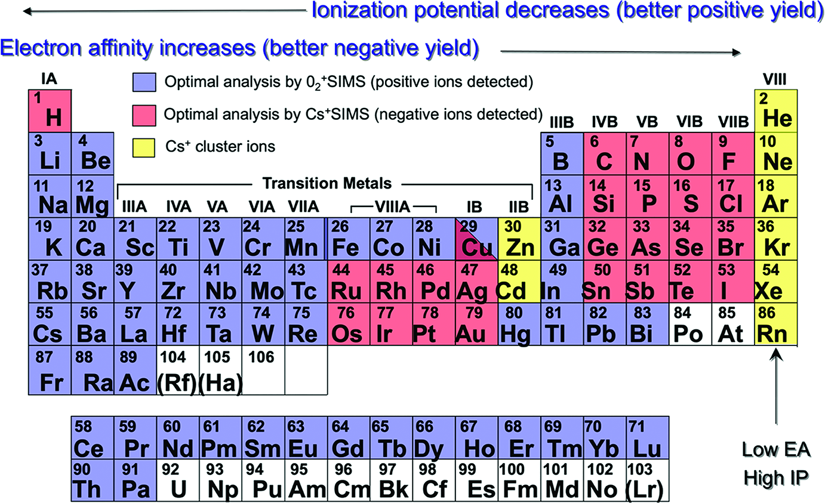
Secondary ion yield enhancement of electropositive ions with oxygenated surface
Alkali metals and alikali earth metals give highest ion yield
Lanthanides
Actinides
92
93
94
95
96
U
Np
Pu
Am
Cm
U–Cm shaded here (unshaded in the original only because no RSF data existed): the actinides have low ionisation potentials (U 6.2 eV, Pu 6.0 eV) and form very polar oxides, so O⁻ / O₂⁺ is the standard beam for U and Pu isotopics — measured as U⁺, UO⁺ and UO₂⁺.

Slide 6
SIMS for Trace Element Detection
Primary ion beam
O⁻, O₂⁺, Cs⁺
1–30 keV, pA–µA
50 nm–µm spot
Sputter
from top 1–2 nm of
the sample
Secondary ions
~0.01%–10%
of sputtered atoms
leave charged
Mass spectrometer
magnetic sector,
ToF or quadrupole
Result
isotope / element
map or depth profile

Slide 7
Why O⁻ for Insulating Samples?
Positive primary (O₂⁺)
Negative primary (O⁻)
extraction electrode 0 V
extraction electrode 0 V
O₂⁺
O⁻
M⁺ out
secondary e⁻ (few eV)
secondary e⁻ (few eV)
brings −
pulled straight back in
land nearby
+ + + + + + +
−
e⁻ e⁻ e⁻ e⁻ e⁻
insulating sample on a +5 kV holder
insulating sample on a +5 kV holder
→ surface potential rises without limit
net charge per ion: −1, balanced by ≈ 1 escaping electron
→ spot settles a few volts negative and stays there
▪ primary beam is deflected and defocused → image degrades
▪ O⁻ in and M⁺ out drive the surface slightly negative
which ejects secondary e⁻ into the surrounding area.
▪ secondary ions gain energy → shifted out of the spectrometer’s energy window
Secondary e- are only a few eV, so they stay close and re-land, but analysis region becomes stable.
A negative primary brings its own neutralisation.
No low energy electron flood gun needed.
Stable images and spectra.

Slide 8
O⁻ Primary Ions Can Share an Objective lens with Positive Secondary Ions
Conventional SIMS: two separate objective lenses
Coaxial (NanoSIMS): one objective for both beams
lens bodies nearly touch:
same working distance, but the
primary must arrive obliquely
immersion objective: primary in, secondaries out
sample at a few kV,
oblique primary impact
normal incidence.
sample and primary of opposite polarity (increased impact energy)
Actual Cameca NanoSIMS lens is more complicated and provides some independence of primary and secondary focusing.
High secondary ion collection efficiency
Approximately:
C_{c} ∝ f
C_{s} ∝ f³
Secondary ion beam extraction lens
primary ↓
↑ secondary
Lens working distance (WD)≈ 5-10 mm
Primary ion beam
objective lens
gap ≈ 0.4 mm
sample
sample
(both beams)
Primary probe size
aberrations grow with working distance:
C_{s}, C_{c} scale with WD → d_{min} ↑
WD = 5–10 mm vs 0.4 mm
Extraction field at the sample
E = V / gap: 5 kV / 5 mm ≈ 1 V/µm
5kV / 0.4 mm ≈ 12.5 V/µm
stronger field → increased secondary ion collection efficiency
Beam Polarity
The two beams must have opposite sign,
O⁻ required for positive secondaries

Slide 9
How a Primary Ion Column Works
Ion source
virtual source d_{v}
angular intensity I′
energy E, spread ΔE
B_{r} = I′ / (π d_{v}² E)
Primary ion optics
demagnification M · aberrations C_{s}, C_{c}
Focused spot
size d
current I
half-angle α
for M ≪ 1 only the objective lens matters
Three blurs, added in quadrature
The source fixes B_{r} and ΔE — nothing downstream can improve them
The column fixes C_{s}, C_{c} (design) and M (lens excitation — the one knob you turn)
Ask for more current → larger α → aberrations grow; demagnify harder → smaller image but larger α again
So for every current there is an optimum M
α = √( I / (π · I′ · M²) )
d_{g} = M · d_{v}
d_{c} = (ΔE / E) · C_{c} · α
d_{s} = ½ · C_{s} · α³
d = √( d_{g}² + d_{c}² + d_{s}² )
Half-Angle needed for current, I
Gaussian image
Chromatic blur
Spherical blur
Total spot
"Classical (quadrature) estimate; Barth & Kruit, Optik 101 (1996) give a more accurate FW50 addition rule."

Slide 10
Minimum Spot: Balancing the Three Blurs
Sweep M at a fixed current
Gaussian image ∝ M, chromatic ∝ 1/M, spherical ∝ 1/M³
The quadrature sum has a minimum → that M is the optimum lens excitation
Repeat for each current → the spot-size-vs-current curve shown later for Hyperion II
What the source buys you
At low I (chromatic-limited):
d_{min} ∝ (C_{c} ΔE/E)^{½} · (I / B_{r})^{¼}
d_{min} scales with the inverse 4th root of the brightness, such that 10x gain in brightness results a factor of 1.8 reduction on spot size.
Reducing the energy spread by a factor of 2 and you get a factor of 1.4 reduction in d_{min}.

Slide 11
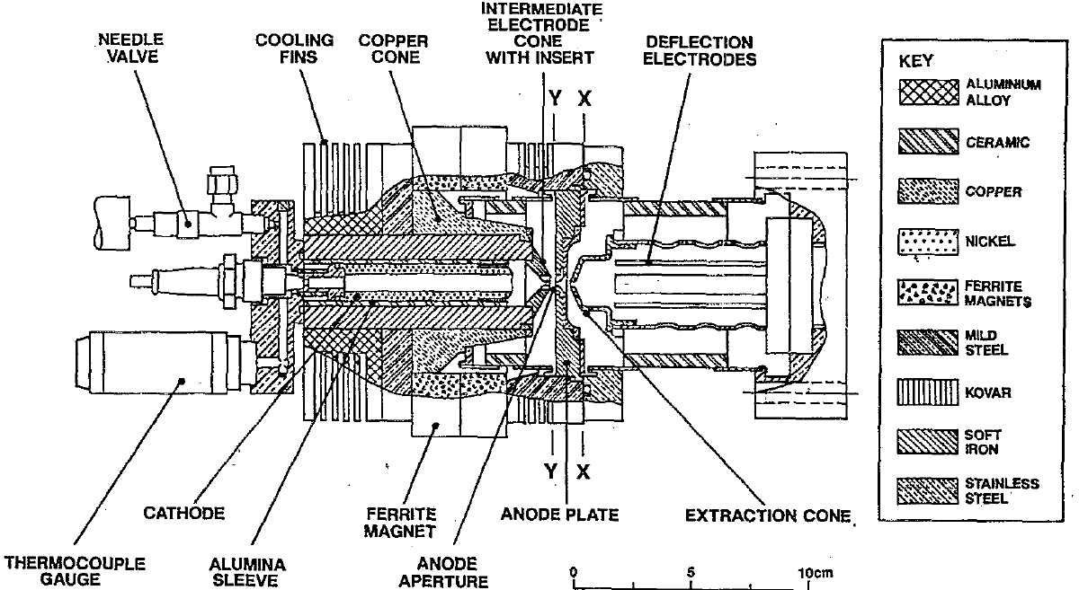
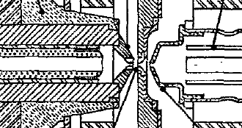
~1965-2015 - Only Duoplasmatrons for O₂⁺ and O⁻ Beams
Duoplasmatron
Highest brightness for O₂⁺ , O⁻ and inert gases.
For high brightness, you suffer with the short and unpredictable lifetimes.
Duoplasmatron
Brightness (Am⁻²sr⁻¹V⁻¹) | ~500 (O₂⁺) and ~5 (O⁻)
Energy Spread (eV) | 10-15eV
Lifetime | 1 week – 6 months
Beam Stability | ±1% over 30 minutes
Gases | oxygen, hydrogen, inert
~ -30V
~ -500V
+
e
e
e
e
e
e
+
+
+
+
+
e
e
+
e
e
e
Long, Coathe and Drummond – Cambridge Univ – 1995

Slide 12
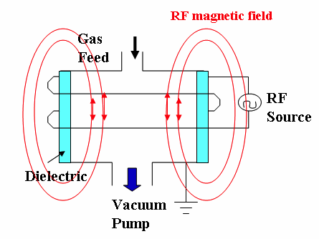
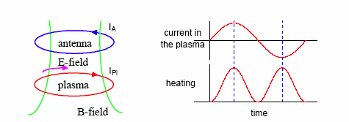
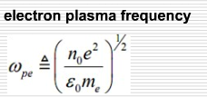
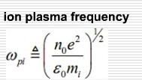
Cold Plasma Creation with Inductive Power Coupling
Time varying current in an external coil creates a time varying B field, which induces an azimuthal E field.
∇xE=-∂B/∂t
Induction E field accelerates electrons to ionize resident gas.
~9GHz
~18MHz
(when Xe plasma density, n_{o}=1x10¹²cm⁻³)
10

Slide 13
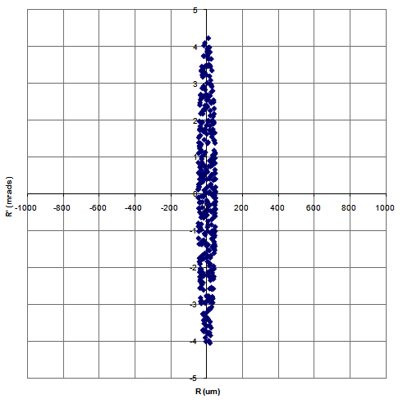
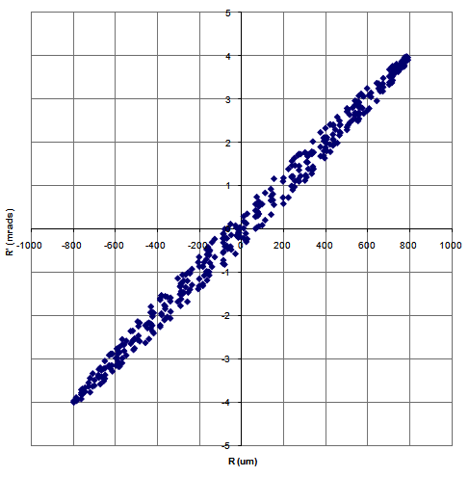
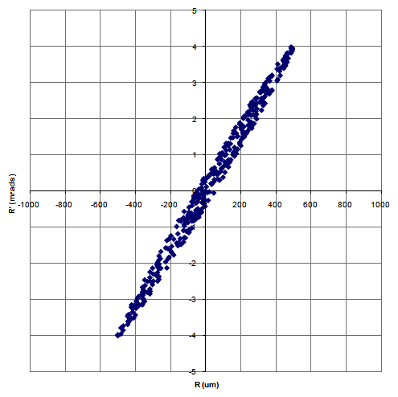
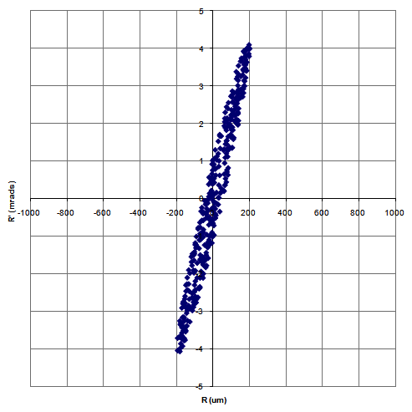

Ion Sources for Focused Ion Beams
Plasma
Source Electrode (250um aperture)
Extractor Electrode
+10kV
0kV
⊕
Virtual Source
d_{v}~5-50μm
⊕
⊕
Angle (mrads)
⊕
⊕
⊕
⊕
⊕
Radius (um)
>1x10¹²cm⁻³

Slide 14
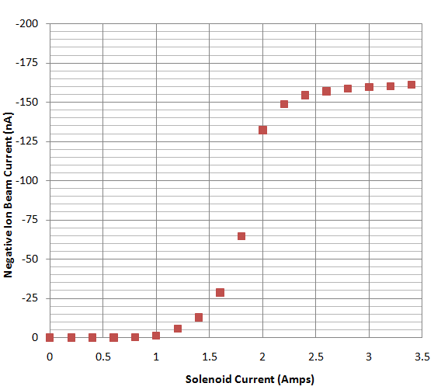
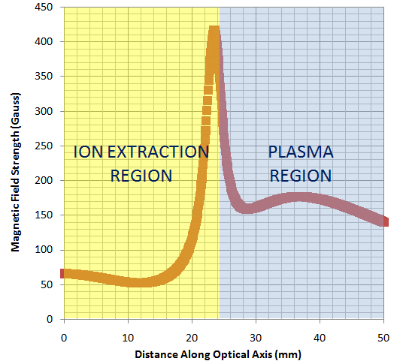
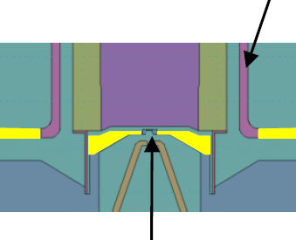
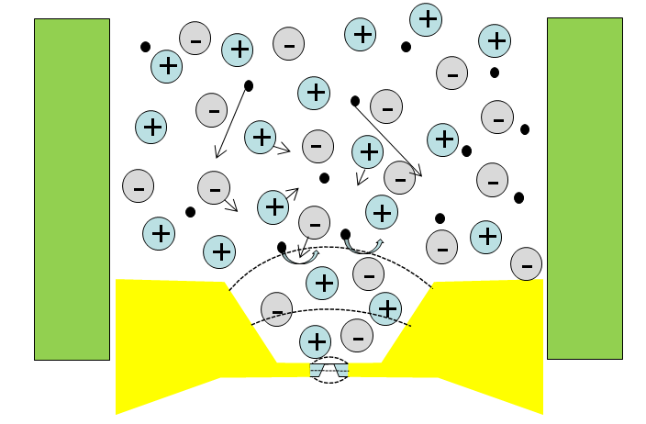
Extracting Negative Ions (High Res. SIMS Imaging)
O⁻ for SIMS imaging of geological, semiconductor and biological materials
Plasma Chamber
with low loss tangent
Faraday Shield
High Azimuthal Impedance
PLASMA
RF Antenna
Magnetic Poles
Transverse B
Extractor Electrode
Pole Gap
~600 Guass
Ion-Ion plasma
(depleted of hot electrons)

Slide 15
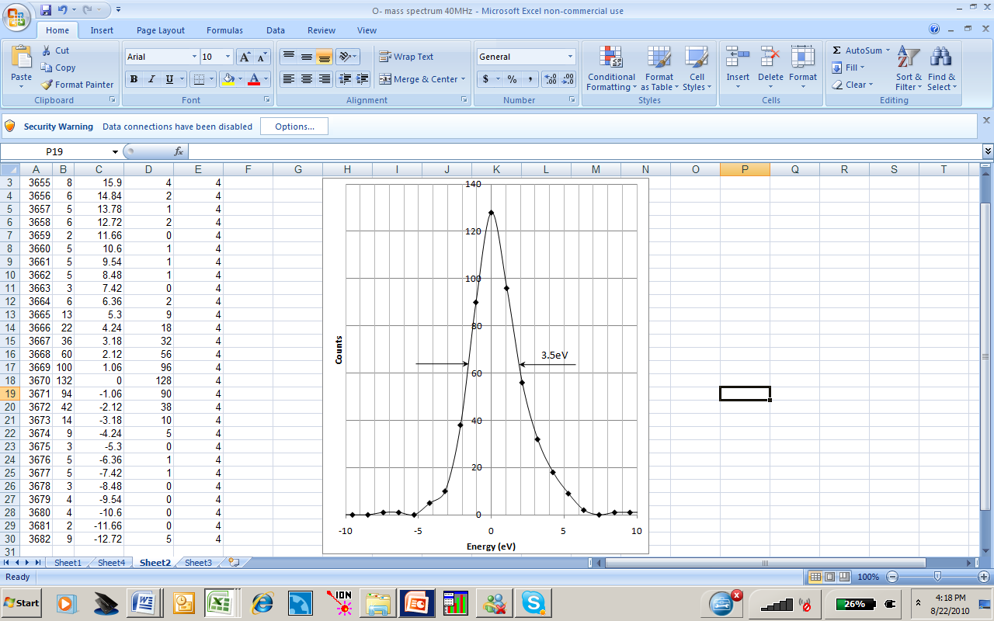
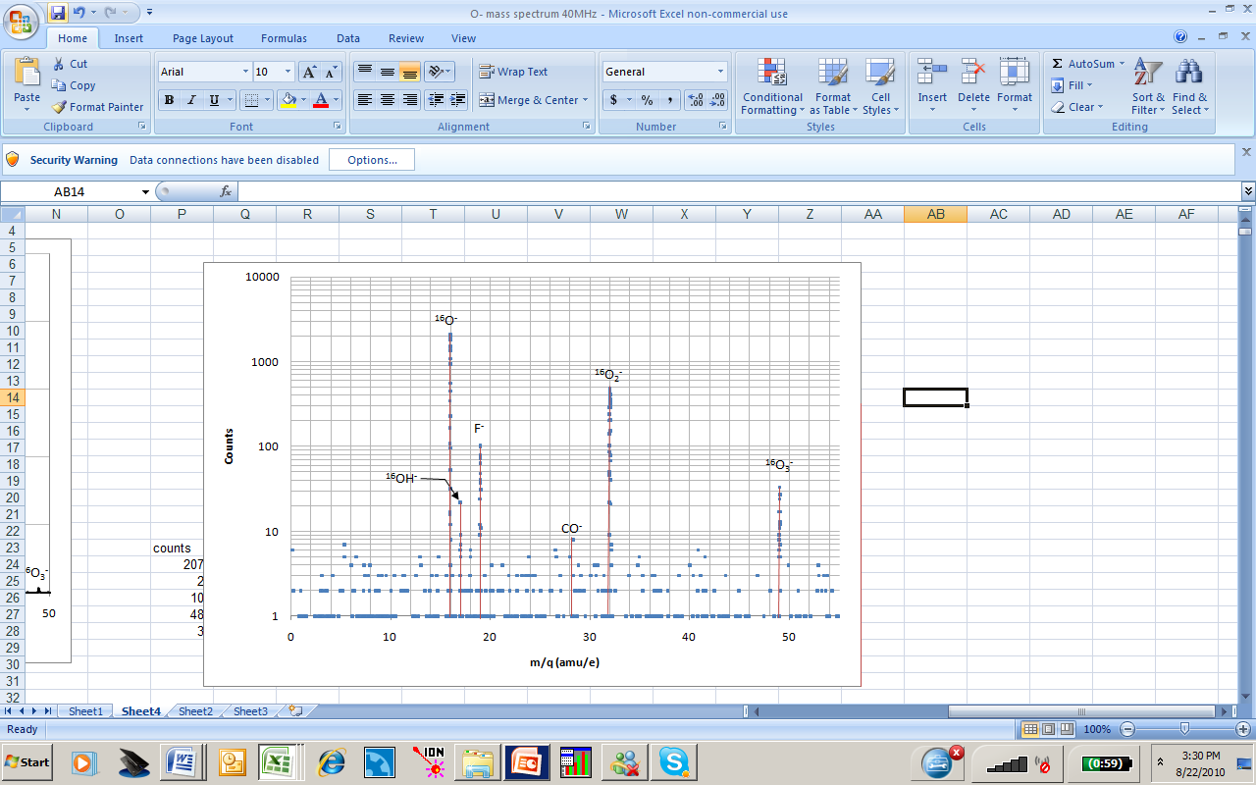
O⁻ Ion Source Parameters
Oxygen Plasma
O⁻ formed primarily by dissociative electron attachment.
O₂ + e− → O + O⁻
 | Duoplasmatron | ICP (Hyperion)
Energy Normalized Brightness (Am⁻²sr⁻¹V⁻¹) | 5 | 100
Axial Energy Spread (eV) | 10-15 | 3.5
Lifetime | 1 week – 6 months | >2 years

Slide 16
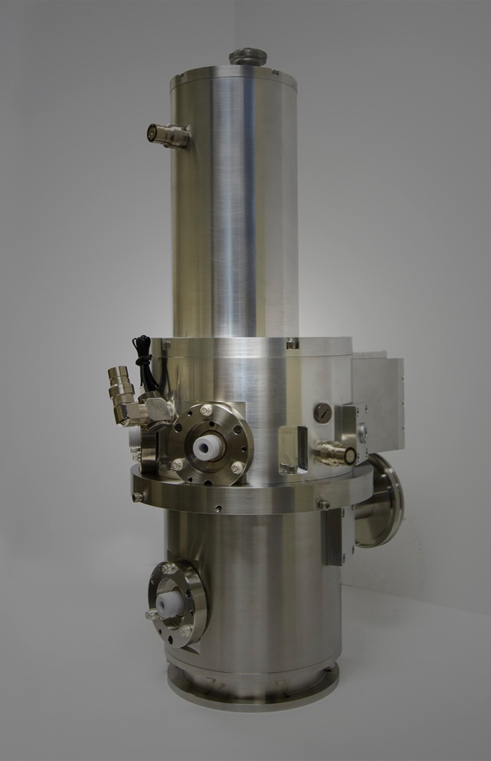
Hyperion II
Hyperion II - Parameters
  0 to ±30kV
  Typically operated with Xe, O₂, He or N₂
  Energy Normalized Brightness
    + ions Xe: 1x10⁴, O₂ : 4x10³, He: 6.5x10³ Am⁻²sr⁻¹V⁻¹
    - ions O :1x10² Am⁻²sr⁻¹V⁻¹
  Virtual source (dv)
    5um or 12um (+ ions)
    50-70um (- ions)
  Axial Energy Spread
    5eV (+ ions)
    3.5eV (- ions)
  Lifetime > 2 years
  Stability <1% drift/ hour, <5% drift/24 hours

Slide 17
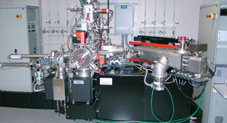
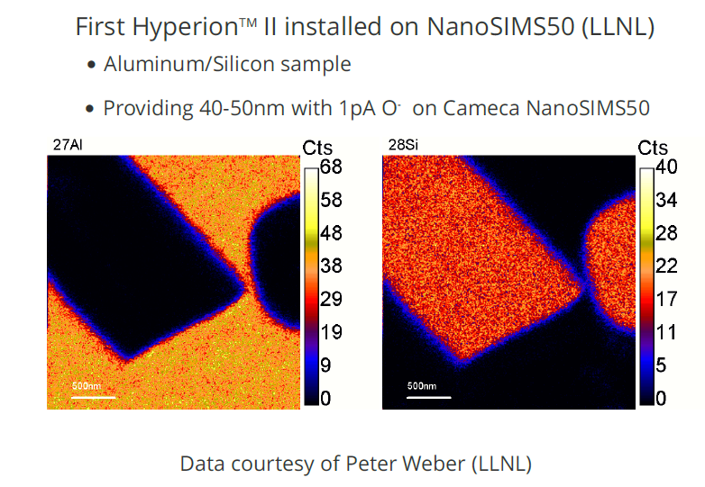
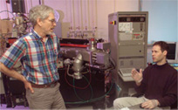
SIMS Imaging Performance at LLNL
Hyperion II + LLNL NanoSIMS
Supported by DoE and Glenn Seaborg Inst.
(P. Weber, M. Kristo and I.Hutcheon)
  High Imaging Resolution Trace Element SIMS
  Direct replacement for duoplasmatron on Cameca NanoSIMS.
  Image resolution, with O⁻ reduced from 200nm to 50nm.
  Lifetime increased from 1 week to >2 years.

Slide 18
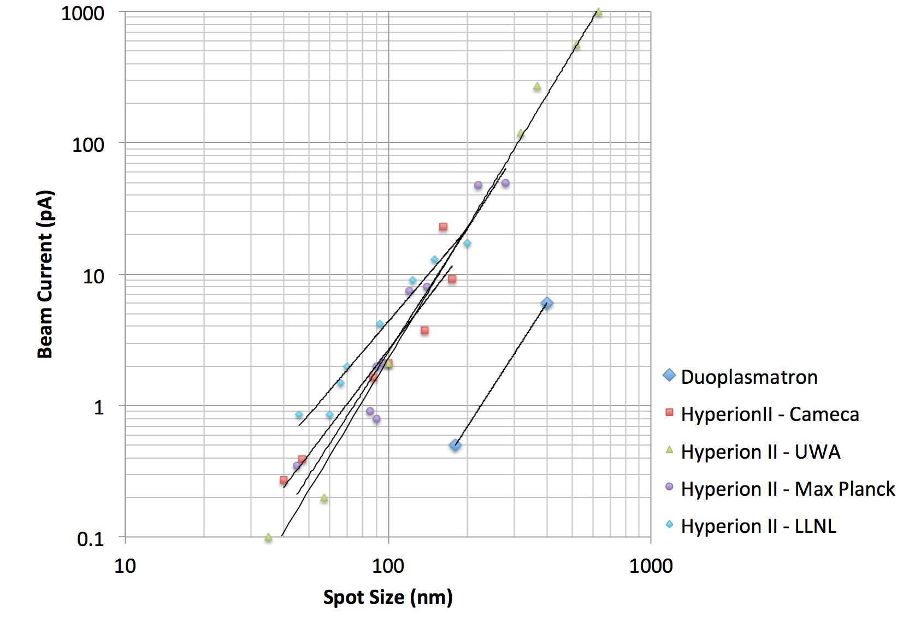
Hyperon II on Cameca NanoSIMS50
Data Courtesy of:
Cameca (F. Horreard)
Lawrence Livermore (P. Weber)
U.West. Aus. (M. Kilburn)
Max Planck (P. Hoppe)
~200pA
6pA

Slide 19
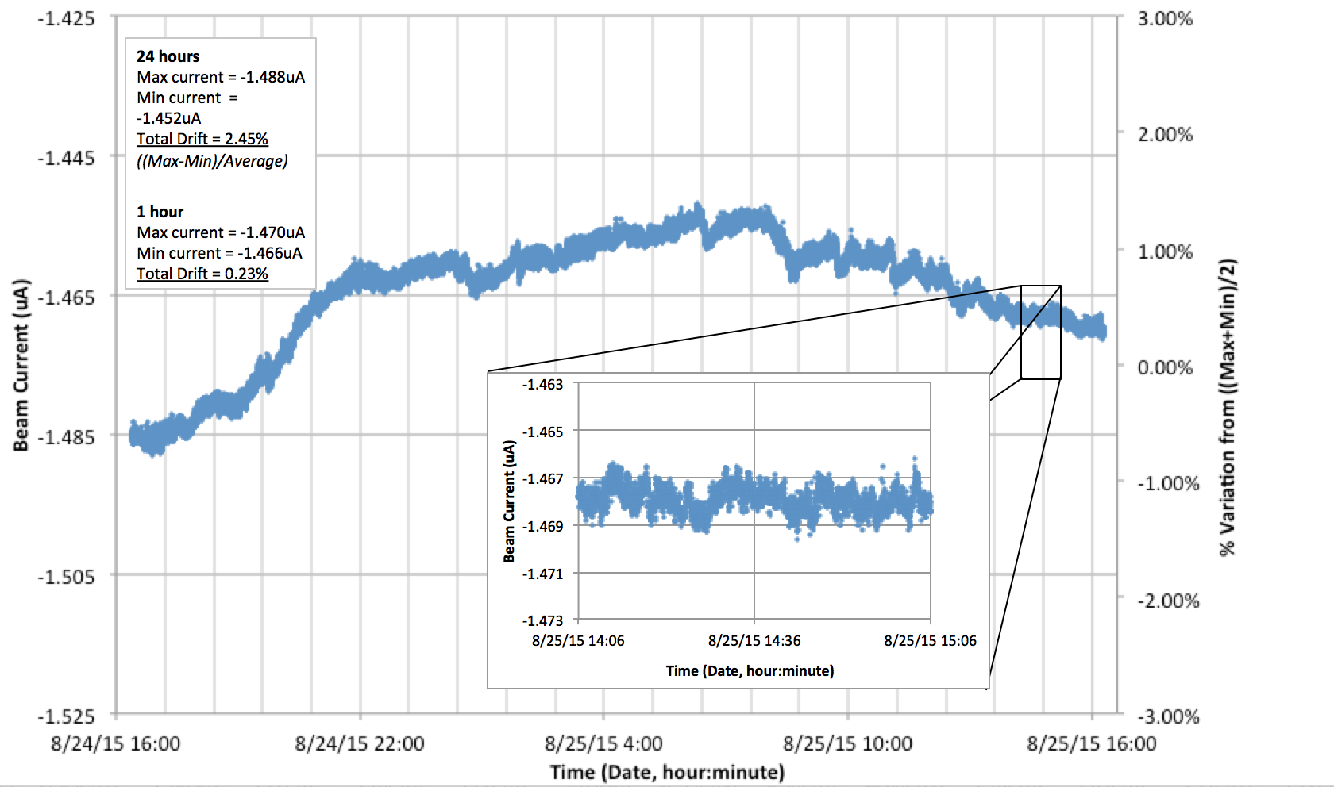
Beam Current Stability
No sputtering in plasma source
With steady gas flow and temperature regulation, beam current is very stable.
Residual drift is primarily due to lab. temperature drift (~0.5%/ ⁰C)
11

Slide 20
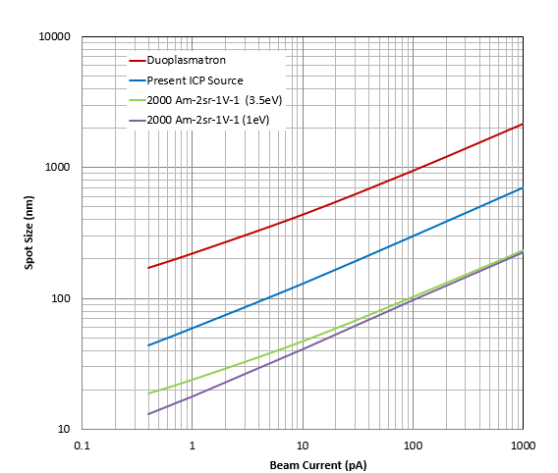
Possible Useful Developments
High Brightness
  Higher throughput
  Higher spatial resolution imaging
Molecular oxygen ions (O₂⁻ and O₃⁻)
  Higher Depth Resolution
  Increased Useful Ion Yield
O₃⁻ provides ~2x gain in useful ion yield for U isotope analysis*
 | O⁻ | O₂⁻ | O₃⁻
Typical | ~80% | ~19% | <1%
NIST | 67% | 20% | 13%
* ‘Improved Uranium Particle Analysis by SIMS using O₃⁻ Primary Ions’ E. Groopman et al,, NIST, J. Anal. At. Spectrom., 2022, 37(10)

Slide 21
THANKYOU!

