Slide 1

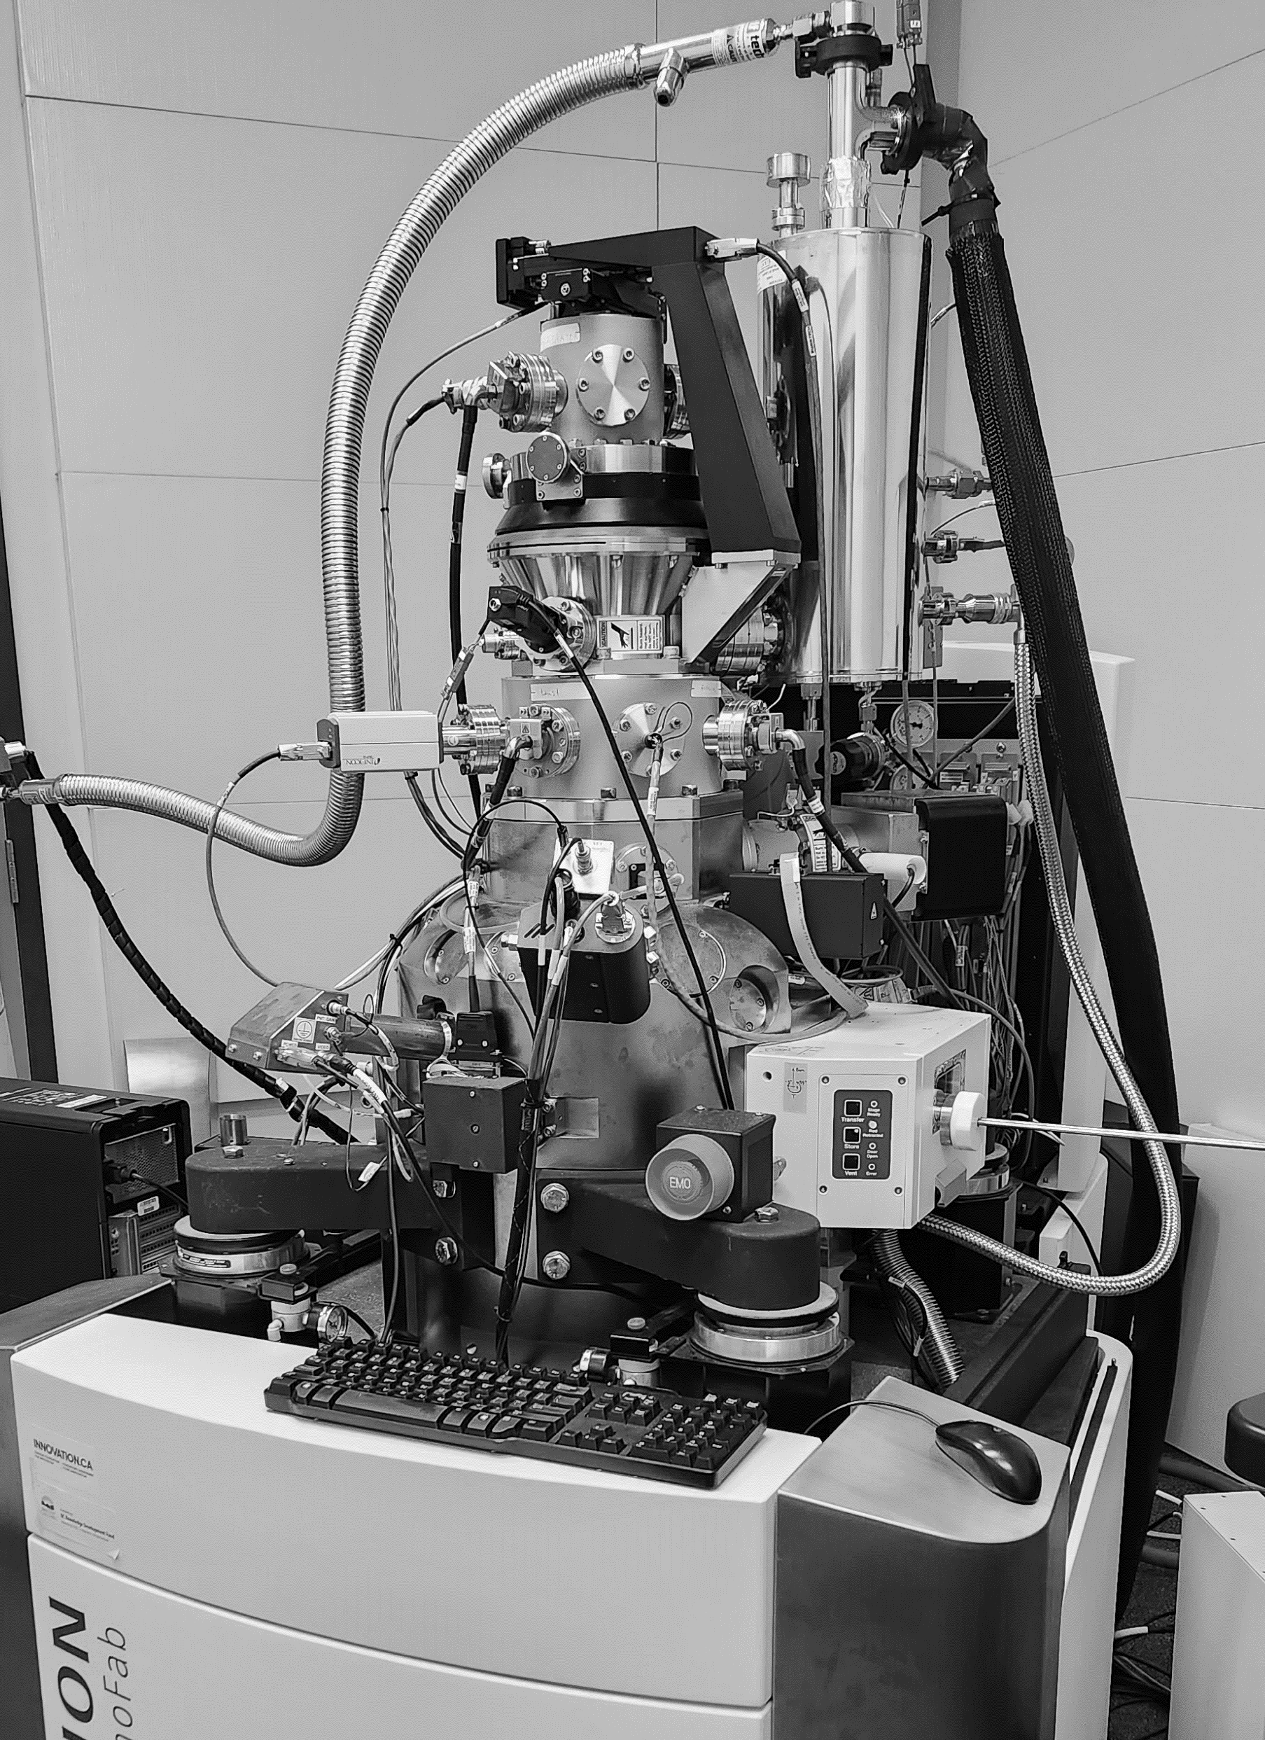
Negative Helium Ion Production Using
Nano-Foils
Primary Investigator: Philip Jackle
Academic Supervisor: Karen Kavanagh SFU
Industry Supervisors: Morgan Dehnel SIRC
Anand George D-Pace
Funding: SFU, D-Pace, & NSERC
PRESENTATION DATE: September 23, 2026

Slide 2
Motivation
He⁻ made with vapour metals (alkali’s mostly).
Alkali vapour:
  Handling and maintenance issues.
  Equipment to create & control vapours: ovens, pumps, baffles, etc.
  System contamination.
Explore charge exchange with foils.
  Easier handling → Safer
  Less vacuum equipment → Lower costs
  Less contamination → Reduced maintenance & risk

Slide 3
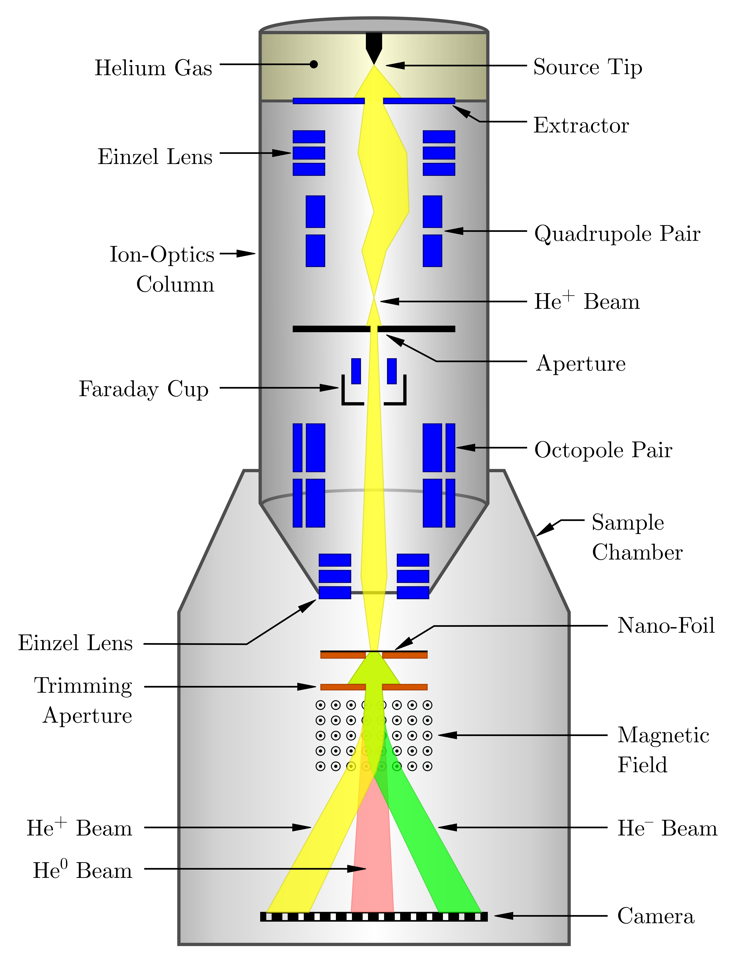
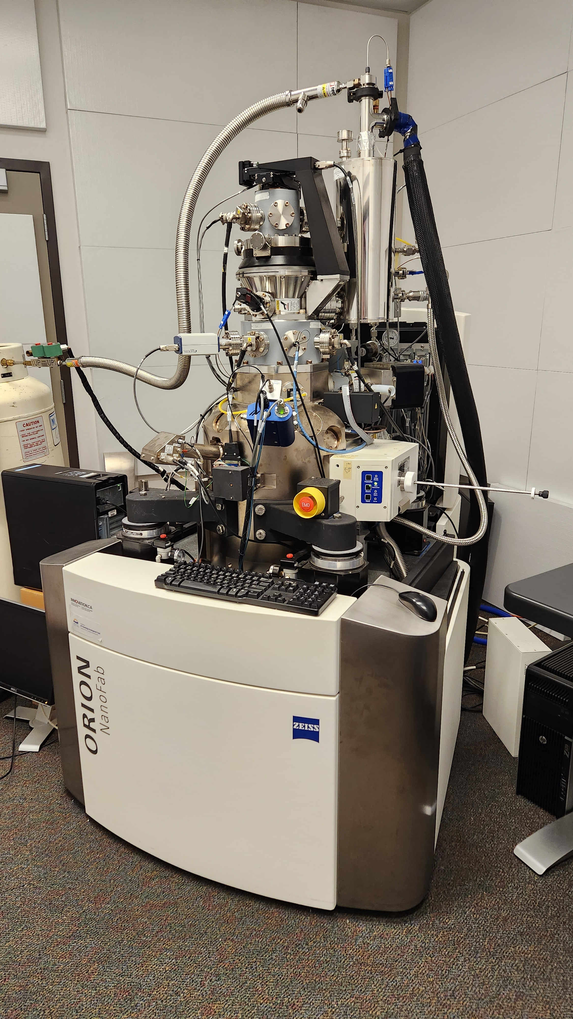
Helium Ion Microscope
Foil & Magnet
Camera

Slide 4
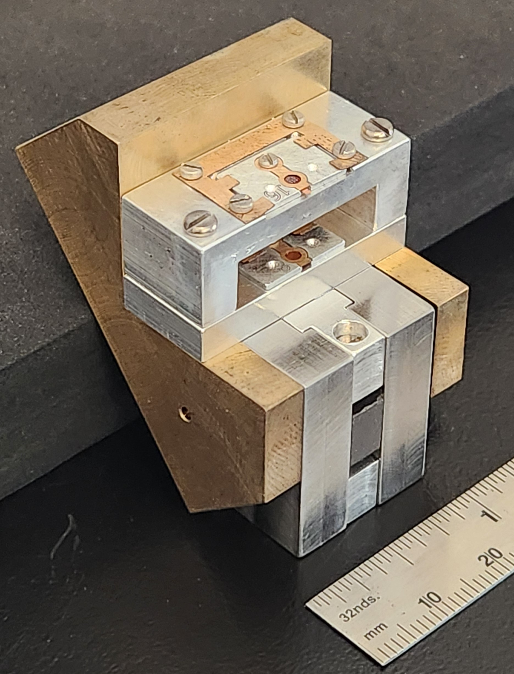
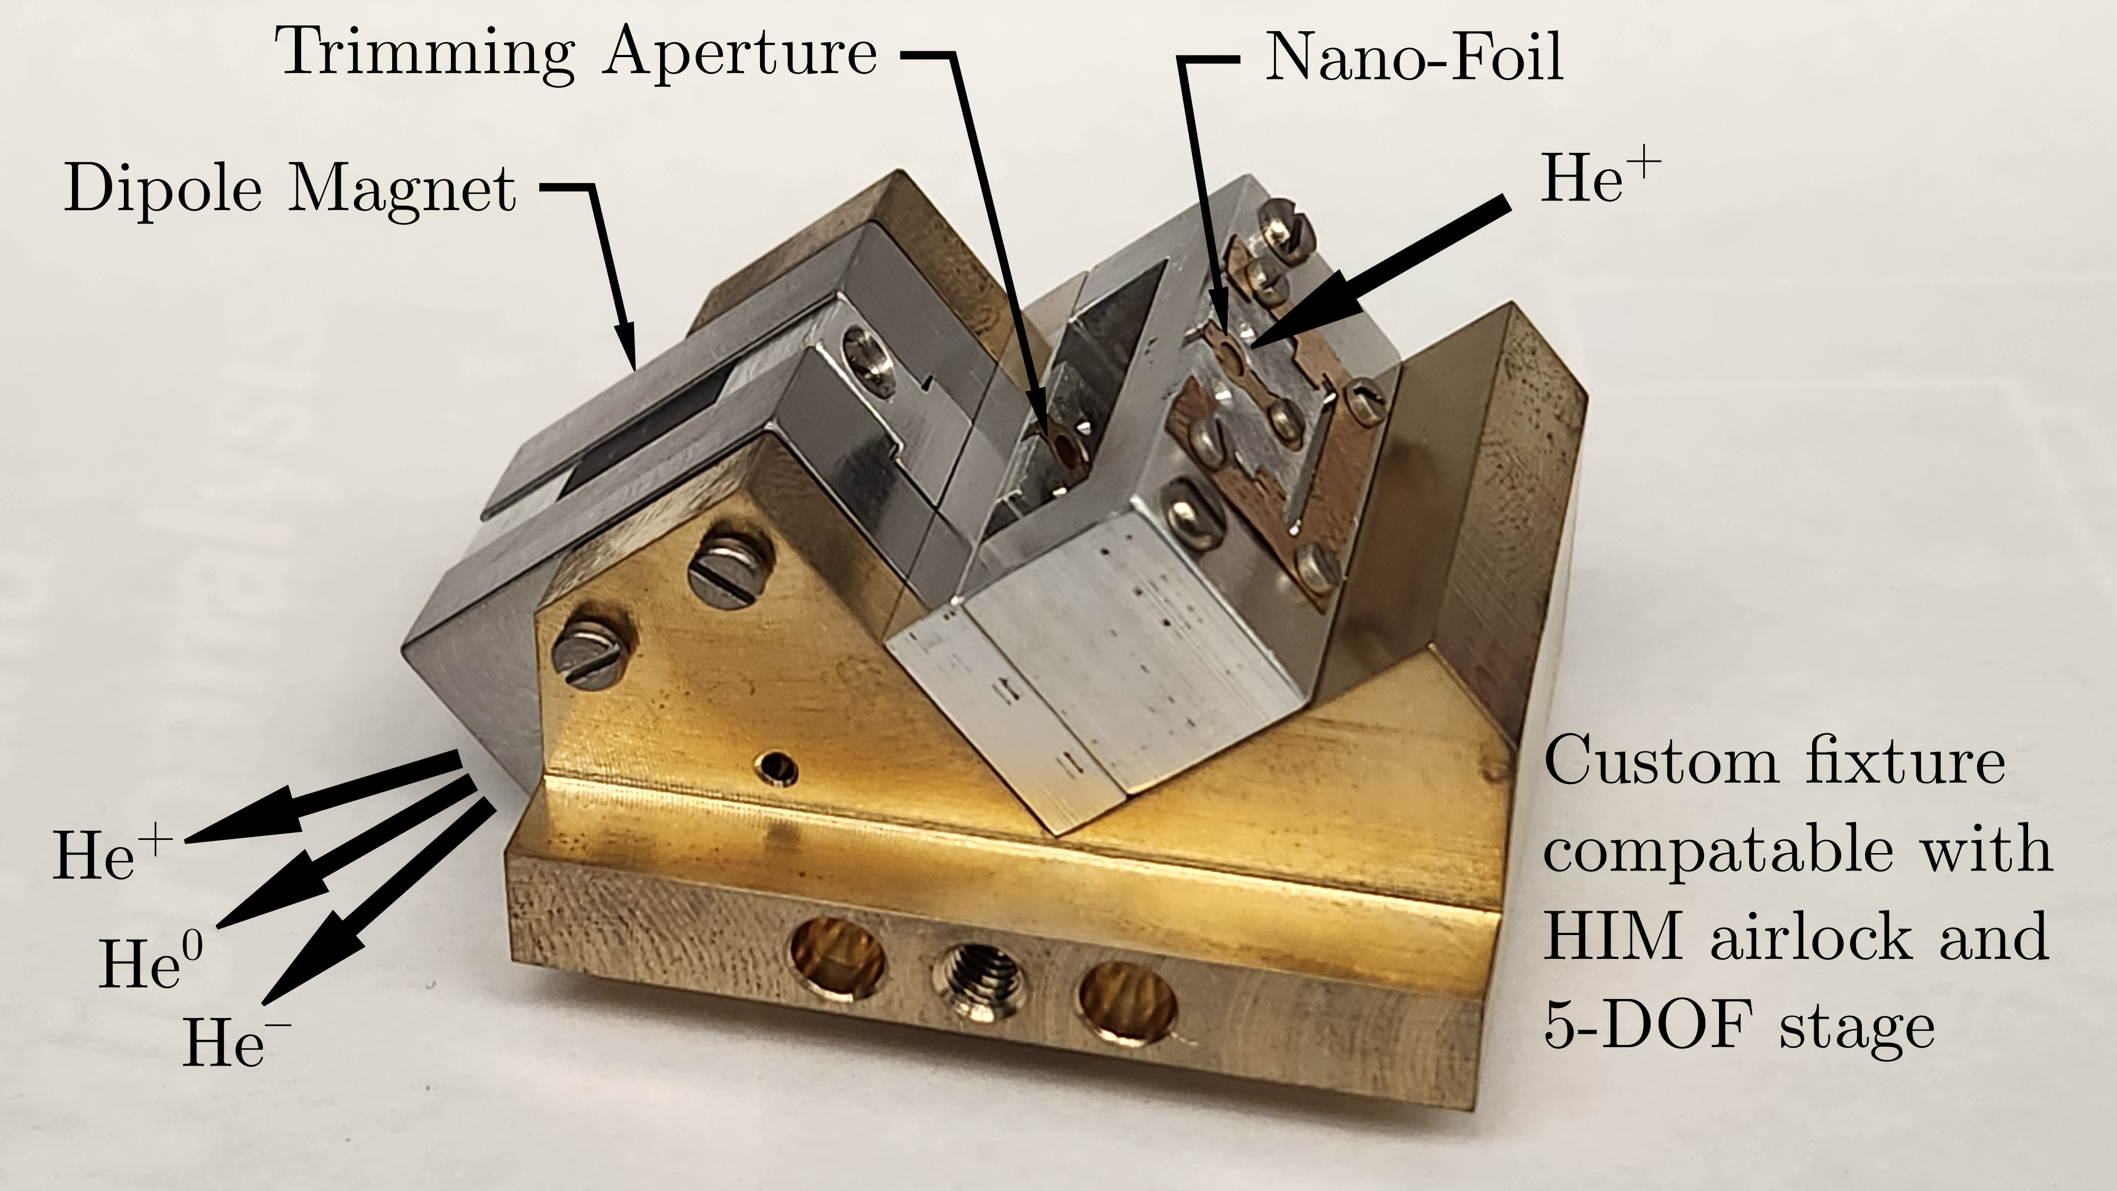
Experiment Holder
Holds standard Ø3 mm transmission electron microscopy (TEM) grids

Slide 5
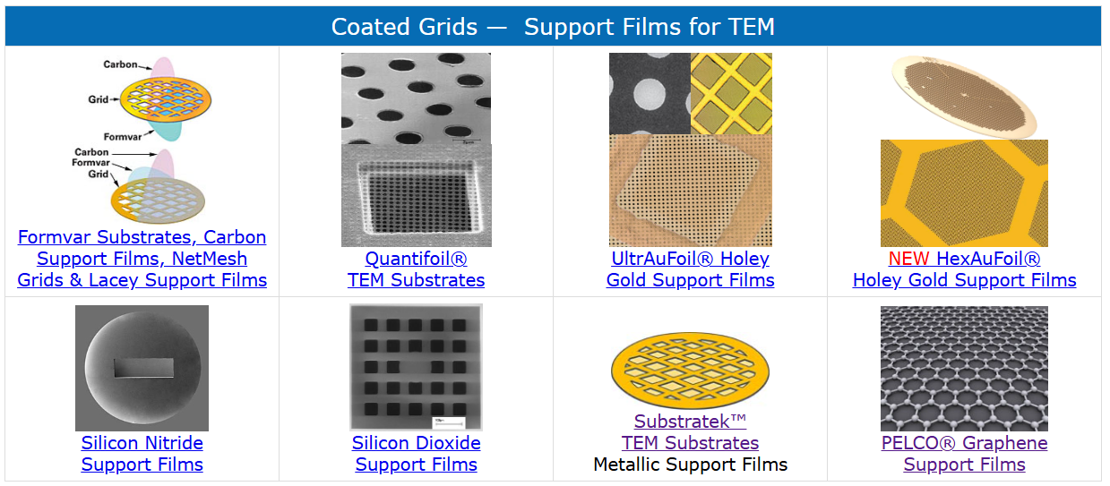
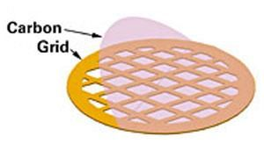
Coated TEM Grids
Commercially available thin foils on standard, Ø3 mm support grids.
Carbon: amorphous, graphene
Polymer: Formvar
Metals: Gold, Platinum, Palladium
Others: SiO₂, TiO_{X}, SiN_{X}
[1] www.tedpella.com/grids_html/grids.aspx (2026)

Slide 6
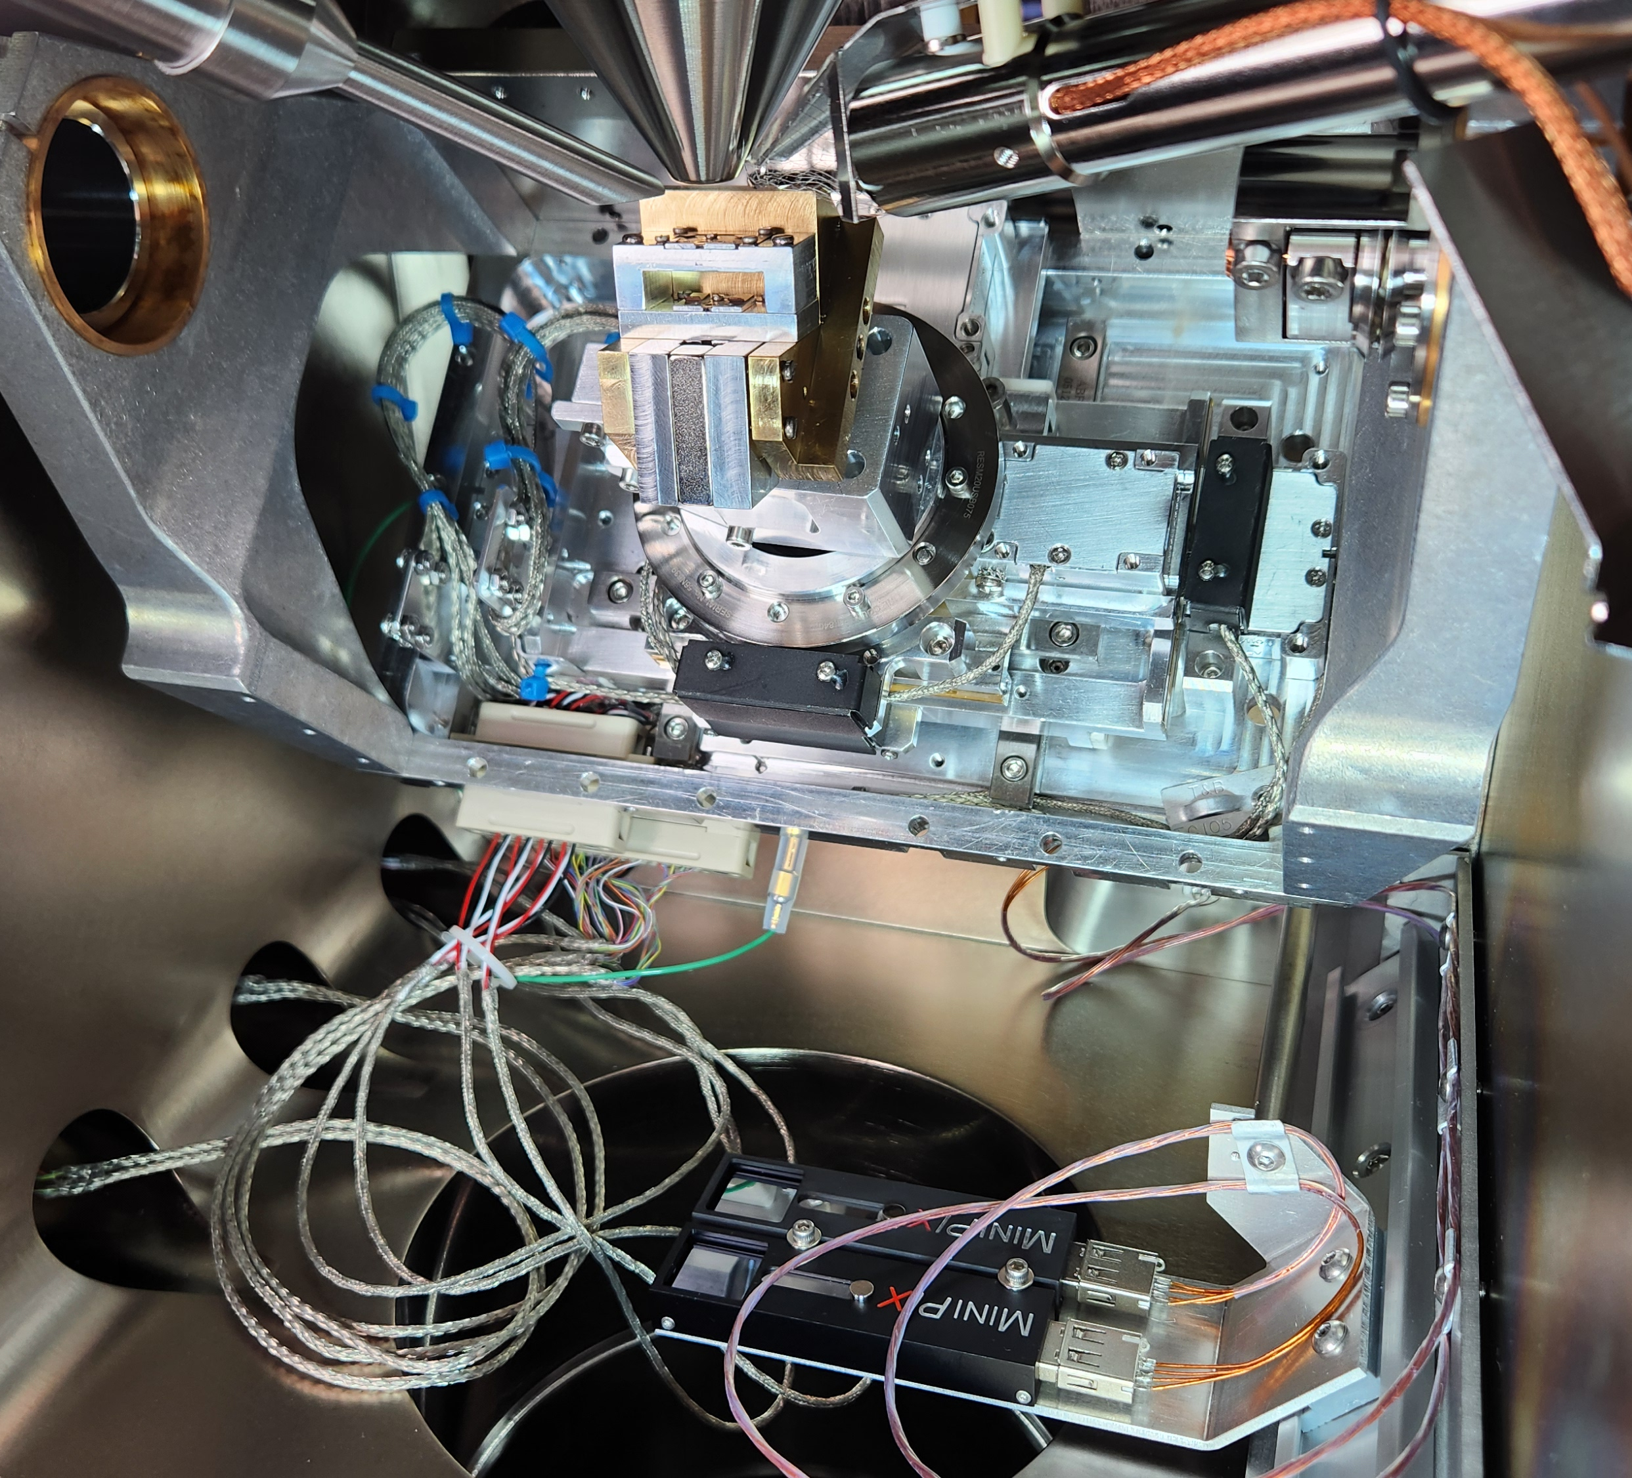
Experiment
He⁺ Beam
Foil
Aperture
Magnet
He²⁺
He⁺
He⁰
He⁻
Beams
Cameras

Slide 7
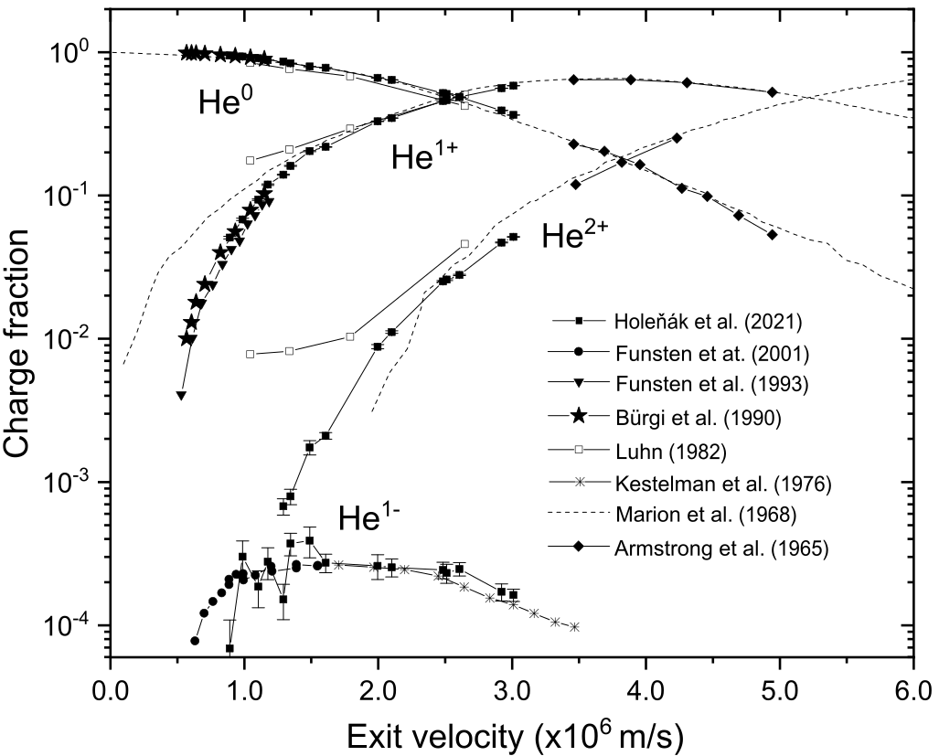
Previous Work
Charge state fractions of He after passing through 25 nm thick amorphous carbon foil
20 keV
30 keV
Previous works suggest, at 20 ~ 30 keV & 25 nm carbon:
  He⁻ = 0.02 to 0.03%
  He⁰ = 90 to 95%
  He⁺ = 5 to 10%
Also:
  He²⁺?
  Broad range of energy for best conversion efficiency.
15 keV
140 keV
2 to 3 × 10⁻⁴
[2] R. Holeňák et al., Vacuum 185 (2021)

Slide 8
Alkali Vapours
Charge state fractions of He after passing through 25 nm thick amorphous carbon foil
K: [3] R. M. Ennis, IEEE Trans. on Nucl.
Sci. 14 (1967)
K: [4] Pedersen et al., Phys. Rev. A 64
(2001)
Mg: [5] Chang et al., 20th Int. Conf. on Ion
Implant. Tech. (2014)
Cs: [6] Schlachter et al., Phys. Rev. 174
(1968)
He⁻: 0.15 ~ 1.5%
[2] R. Holeňák et al., Vacuum 185 (2021)

Slide 9
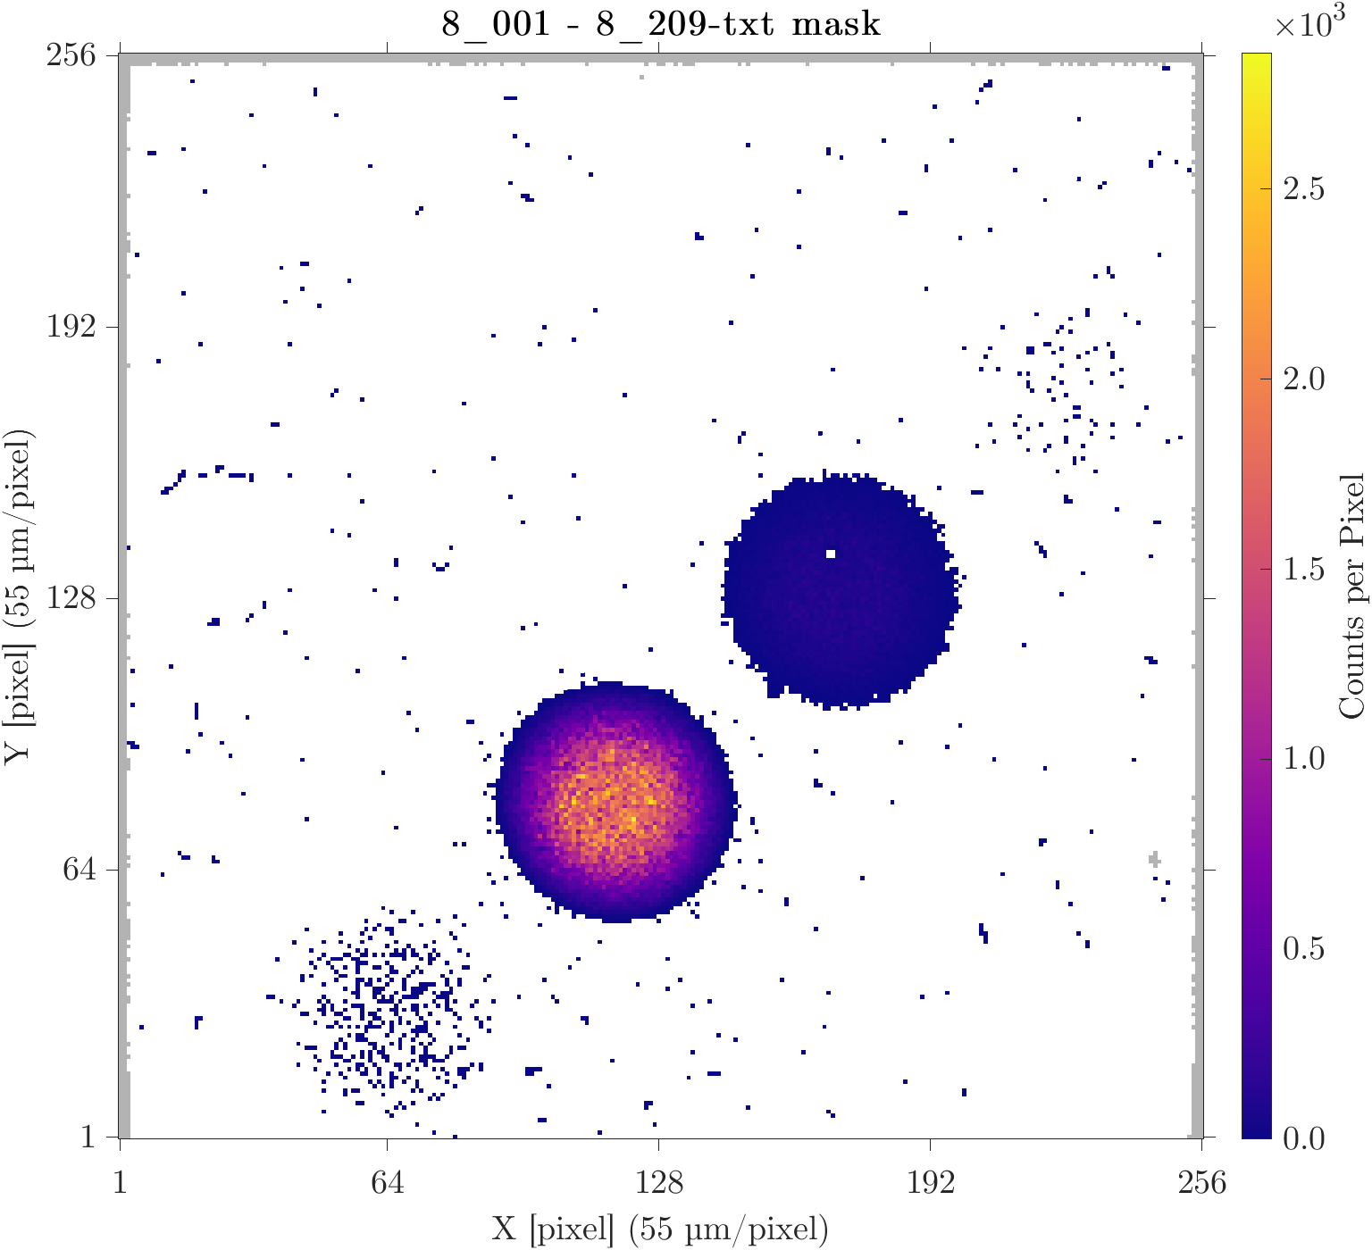
17 nm Carbon
He²⁺
25 keV He⁺
0.12 ± 0.02 pA
35 min exposure
Transmitted [%]:
  He⁺ / Total = 5.245 ± 0.017
  He⁰ / Total = 94.71 ± 0.10
  He⁻ / Total = 0.0232 ± 0.0011
  He²⁺/Total = 0.0043 ± 0.0005
  Re. / Total = 0.0185 ± 0.0010
He⁺
He⁰
Poisson statistics uncertainty = √N
He⁻

Slide 10
Material Choice
ELEMENT | FERMI VELOCITY [×10⁶ m/s]
Cesium (Cs) | 0.75
Rubidium (Rb) | 0.81
Potassium (K) | 0.86
Sodium (Na) | 1.07
Barium (Ba) | 1.13
Strontium (Sr) | 1.18
Calcium (Ca) | 1.28
Lithium (Li) | 1.29
Niobium (Nb) | 1.37
Silver (Ag) | 1.39
Palladium (Pd) | 1.39 (2.68)
Gold (Au) | 1.40
Platinum (Pt) | 1.42 (2.79)
Iridium (Ir) | 1.44 (3.00)
Copper (Cu) | 1.57
Aluminum (Al) | 2.00
Carbon (C) | 2.20
Ruthenium (Ru) | (2.60)
ELEMENT | FERMI VELOCITY [×10⁶ m/s]
Cesium (Cs) | 0.75
Rubidium (Rb) | 0.81
Potassium (K) | 0.86
Sodium (Na) | 1.07
Barium (Ba) | 1.13
Strontium (Sr) | 1.18
Calcium (Ca) | 1.28
Lithium (Li) | 1.29
Niobium (Nb) | 1.37
Silver (Ag) | 1.39
Palladium (Pd) | 1.39 (2.68)
Gold (Au) | 1.40
Platinum (Pt) | 1.42 (2.79)
Iridium (Ir) | 1.44 (3.00)
Copper (Cu) | 1.57
Aluminum (Al) | 2.00
Carbon (C) | 2.20
Ruthenium (Ru) | (2.60)
ELEMENT | FERMI VELOCITY [×10⁶ m/s]
Cesium (Cs) | 0.75
Rubidium (Rb) | 0.81
Potassium (K) | 0.86
Sodium (Na) | 1.07
Barium (Ba) | 1.13
Strontium (Sr) | 1.18
Calcium (Ca) | 1.28
Lithium (Li) | 1.29
Niobium (Nb) | 1.37
Silver (Ag) | 1.39
Palladium (Pd) | 1.39 (2.68)
Gold (Au) | 1.40
Platinum (Pt) | 1.42 (2.79)
Iridium (Ir) | 1.44 (3.00)
Copper (Cu) | 1.57
Aluminum (Al) | 2.00
Carbon (C) | 2.20
Ruthenium (Ru) | (2.60)
Element | Fermi Velocity [×10⁶ m/s]
Cesium (Cs) | 0.75
Rubidium (Rb) | 0.81
Potassium (K) | 0.86
Sodium (Na) | 1.07
Barium (Ba) | 1.13
Strontium (Sr) | 1.18
Calcium (Ca) | 1.28
Lithium (Li) | 1.29
Niobium (Nb) | 1.37
Silver (Ag) | 1.39
Palladium (Pd) | 1.39 (2.68)
Gold (Au) | 1.40
Platinum (Pt) | 1.42 (2.79)
Iridium (Ir) | 1.44 (3.00)
Copper (Cu) | 1.57
Aluminum (Al) | 2.00
Carbon (C) | 2.20
Ruthenium (Ru) | (2.60)
Match He⁺ velocity to the foil’s conduction band electron’s Fermi velocity.
v_{ion} ≈ v_{Fermi}
Minimize the momentum transfer when the He⁺ captures an electron.
20 keV He⁺: 0.98 × 10⁶ m/s
30 keV He⁺: 1.2 × 10⁶ m/s
Best match… but not practical
Try Gold
Most studied
[7] Ashcroft & Mermin, “Solid State Physics” (1976)

Slide 11
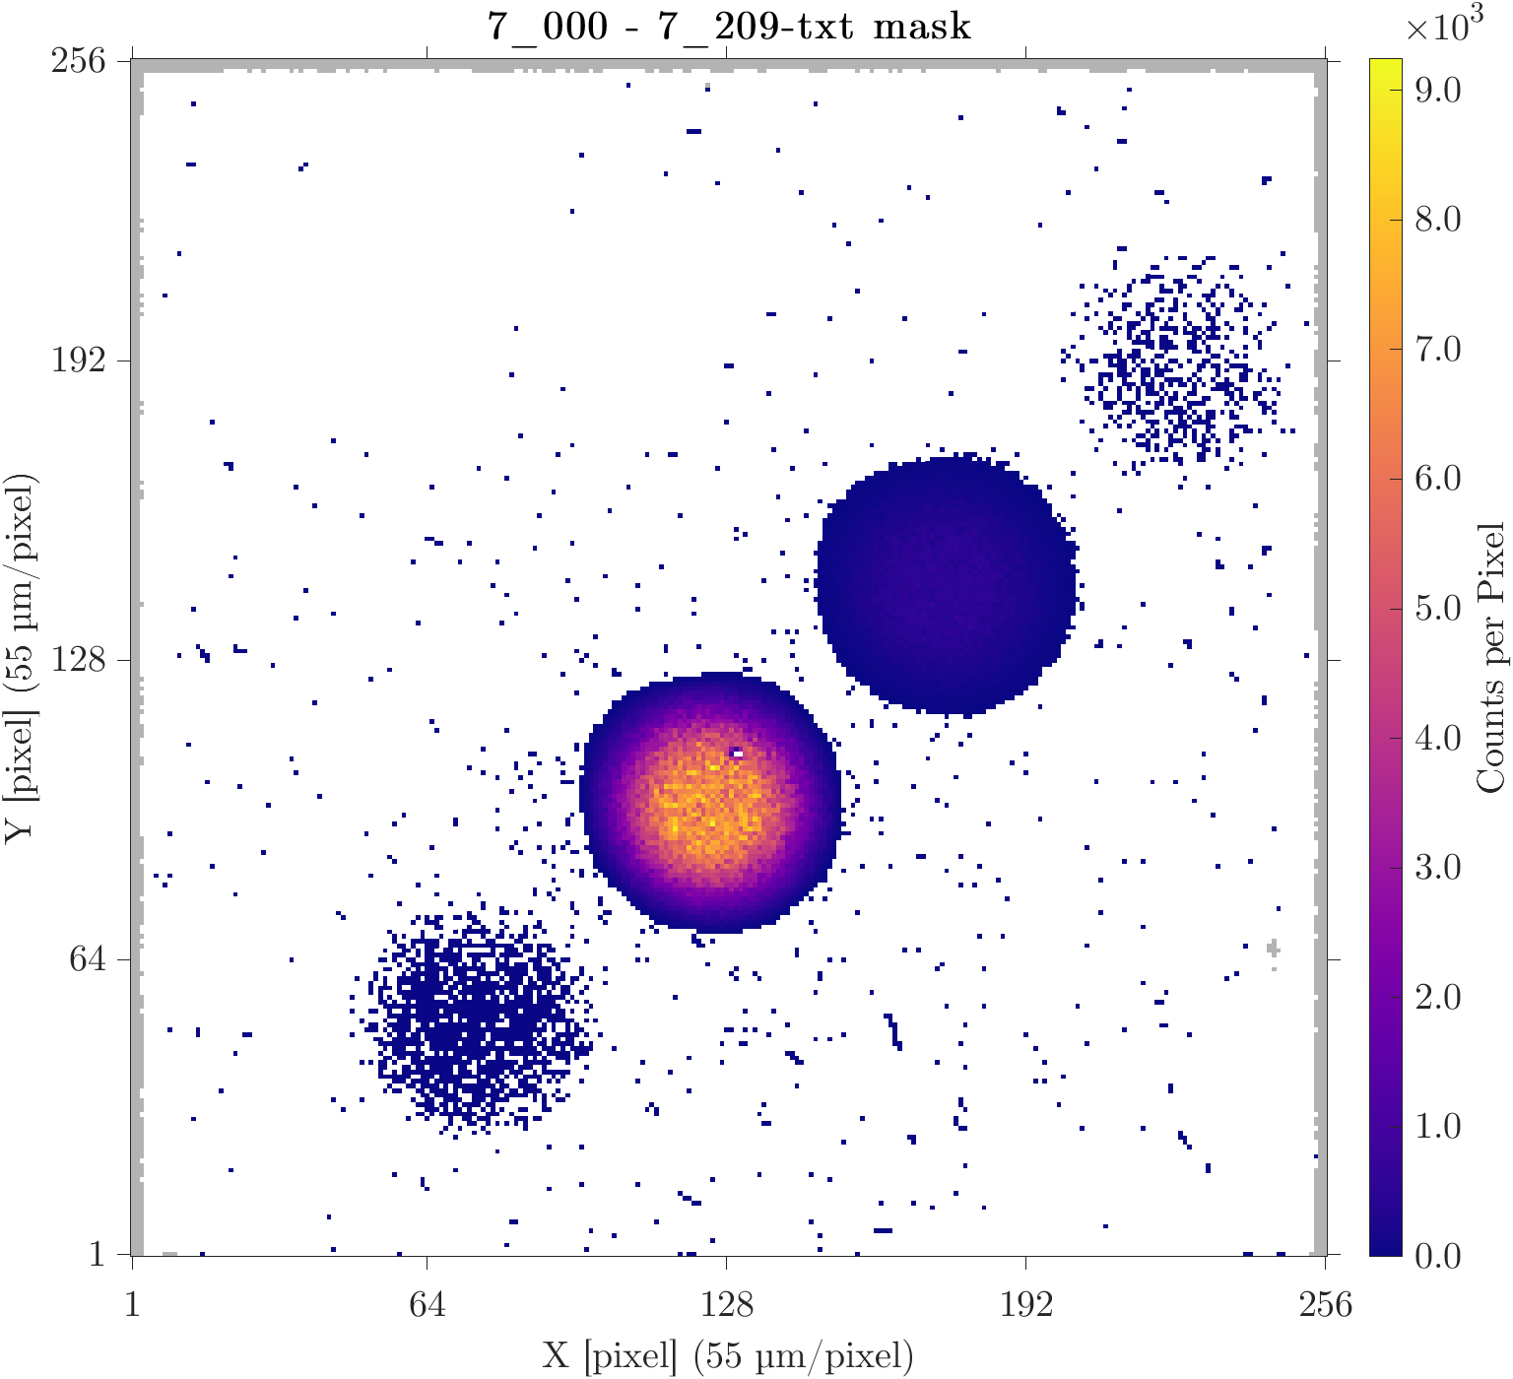
3 nm Gold
He²⁺
25 keV He⁺
0.12 ± 0.02 pA
35 min exposure
Transmitted [%]:
  He⁺ / Total = 7.07 ± 0.01
  He⁰ / Total = 92.89 ± 0.05
  He⁻ / Total = 0.0272 ± 0.0006
  He²⁺/Total = 0.0085 ± 0.0003
  Re. / Total = 0.0165 ± 0.0005
He⁺
He⁰
He⁻

Slide 12
Material Comparison
Foil Material | Thickness [nm] | Fermi Velocity [×10⁶ m/s] | Avg. He⁻ Created [%] ± 0.001
 |  |  | 30 keV | 25 keV | 20 keV
Graphene (1 Layer) | 0.34 | ~ 1.0 | - | 0.022 | 0.023
Silicon (amorphous) | 15 | - | - | 0.019 | -
Silicon Dioxide (SiO₂) | 20 | - | 0.005* | - | -
Silicon Nitride (SiN_{x}) | 10 | - | 0.020 | 0.020 | 0.023
Titanium Oxide (TiO_{X}) | 10 ~ 20 | - | 0.023 | - | 0.026
Palladium (Pd) | 2 ~ 3 | 1.39 (2.68) | 0.024 | 0.028 | 0.026
Gold (Au) | 2 ~ 3 | 1.40 | 0.022 | 0.027 | 0.022
Platinum (Pt) | 2 ~ 3 | 1.42 (2.79) | 0.024 | 0.028 | 0.022
Carbon (amorphous) | 3 ~ 4 | 2.2 | 0.024 | 0.024 | -
Carbon (amorphous) | 10 | 2.2 | 0.023 | 0.024 | 0.026
Carbon (amorphous) | 17 | 2.2 | - | 0.023 | -
Everything acts like carbon
*Dynamic behaviour witnessed.

Slide 13
Surface Contamination
Charge fractions reach equilibrium in angstroms.
[8] J. A. Phillips, Phys. Rev. 97 (1955), [9] Funsten et al., Opt. Eng. 32 (1993)
Exiting charge fractions are dependent on the exit atomic layers.
[10] Funsten et al., Phys. Rev. B 63 (2001)
If there is (carbon) contamination on the exit → carbon foil result.

Slide 14
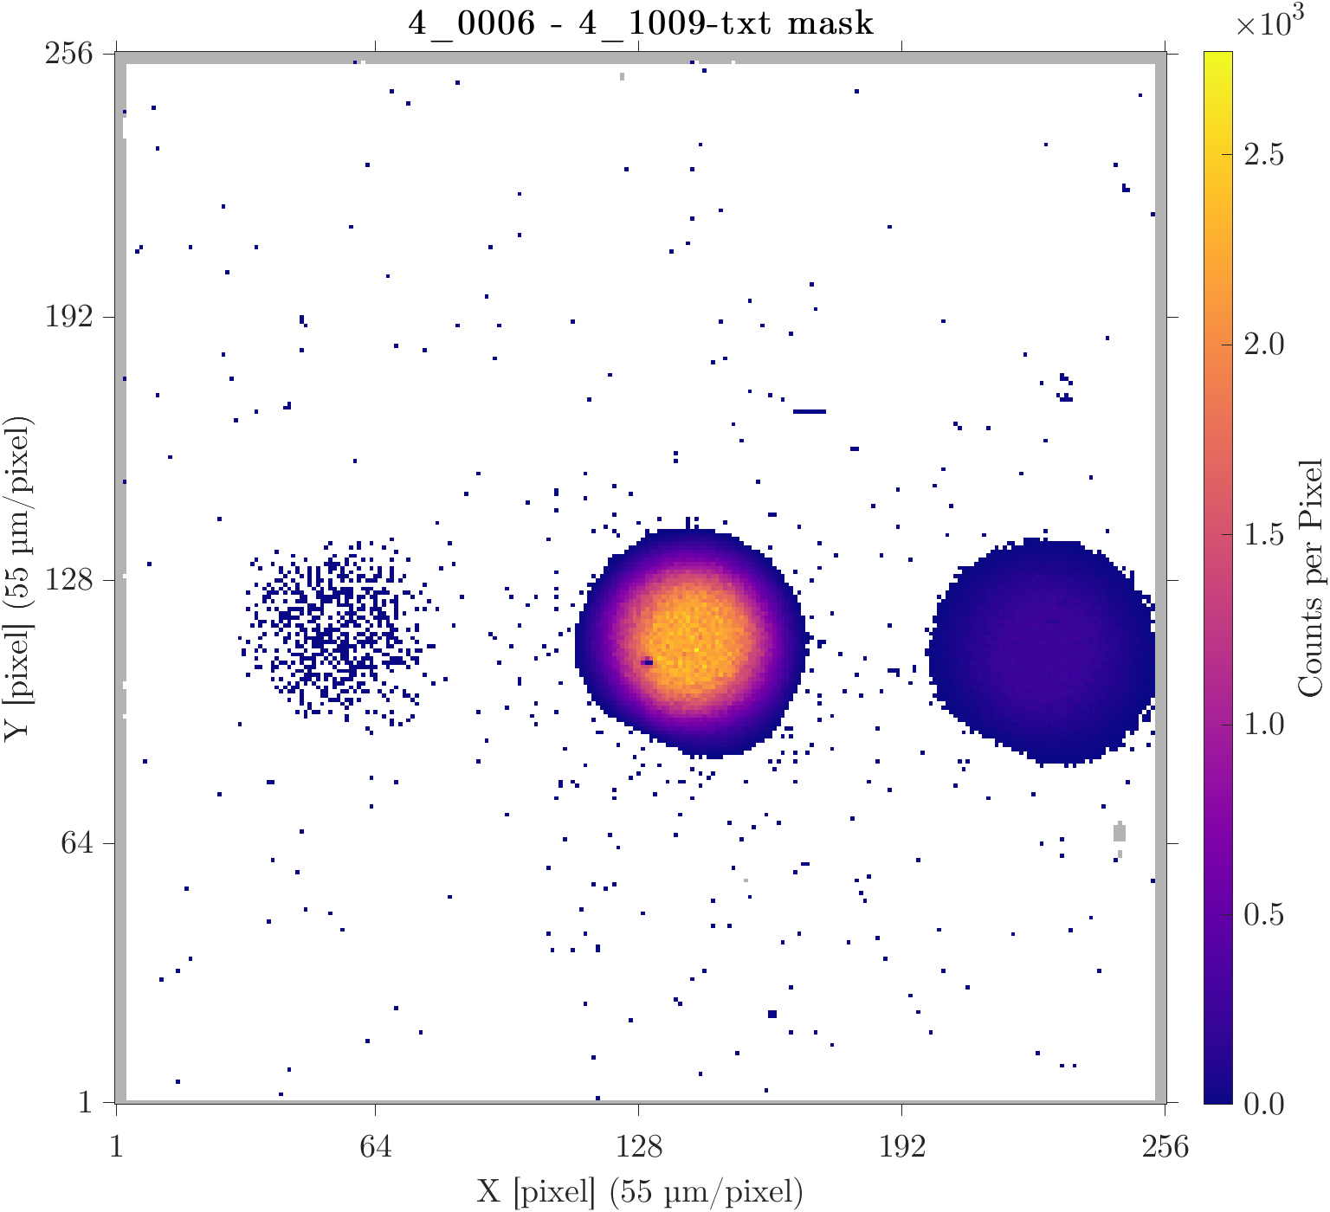
Before Cleaning
2~3 nm thick gold foil.
30 keV He⁺
0.12 ± 0.02 pA
8:21.5 exposure
Transmitted [%]:
  He⁺ / Total = 10.03 ± 0.02
  He⁰ / Total = 89.93 ± 0.08
  He⁻ / Total = 0.028 ± 0.001
  Re. / Total = 0.0154 ± 0.0008
He⁻
He⁰
He⁺

Slide 15
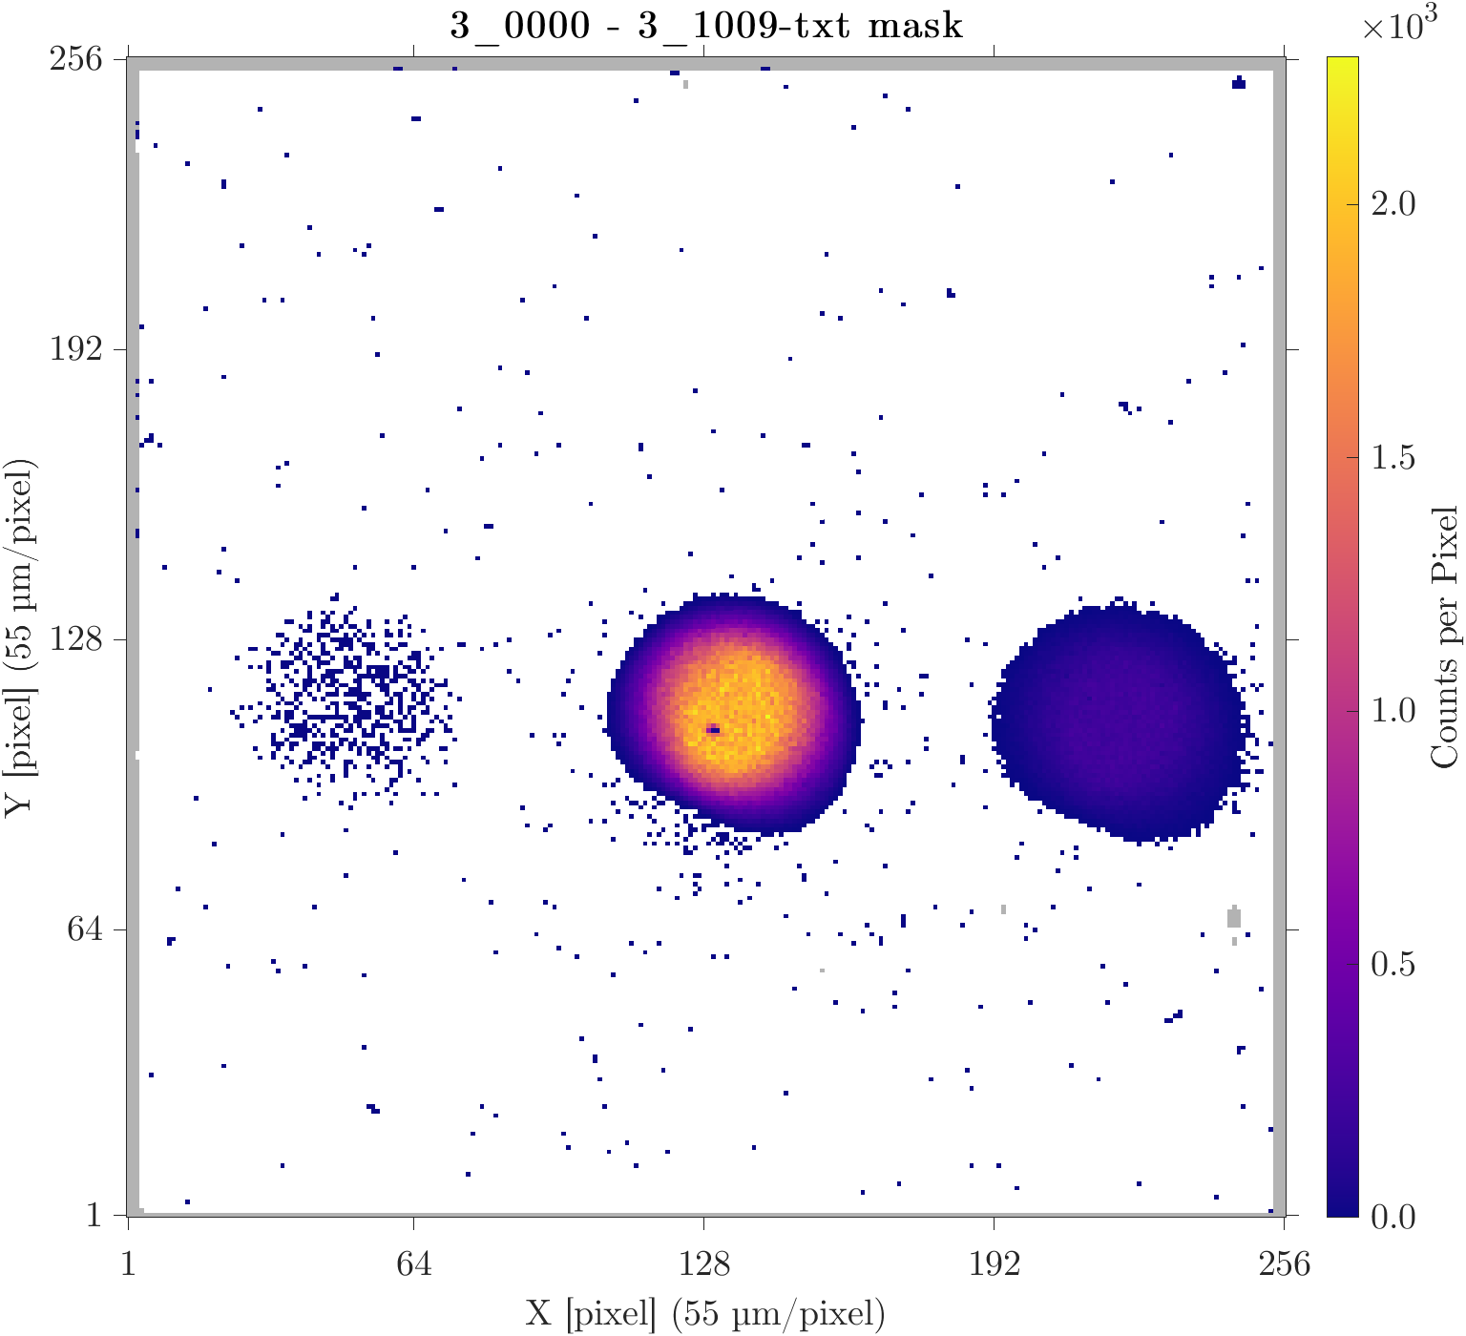
After Cleaning
> 2 hrs required for pumpdown
2~3 nm thick gold foil.
30 keV He⁺
0.14 ± 0.02 pA
8:22.5 exposure
Transmitted [%]:
  He⁺ / Total = 10.92 ± 0.02
  He⁰ / Total = 89.03 ± 0.09
  He⁻ / Total = 0.029 ± 0.001
  Re. / Total = 0.026 ± 0.001
He⁻
He⁰
He⁺
  Before:
  He⁺ / Total = 10.03 ± 0.02
  He⁰ / Total = 89.93 ± 0.08
  He⁻ / Total = 0.028 ± 0.001
  Re. / Total = 0.0154 ± 0.0008

Slide 16
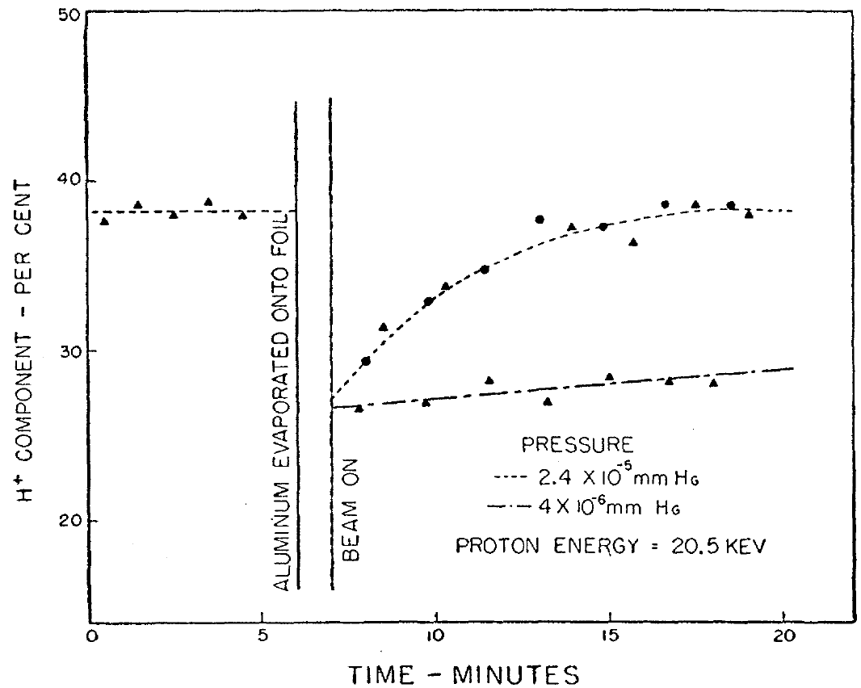
“Fresh” Exit Surface
He⁺ at 20.5 keV.
Al foil.
Deposited fresh Al
on the exit.
[8] J. A. Phillips, Phys. Rev. 97 (1955).

Slide 17
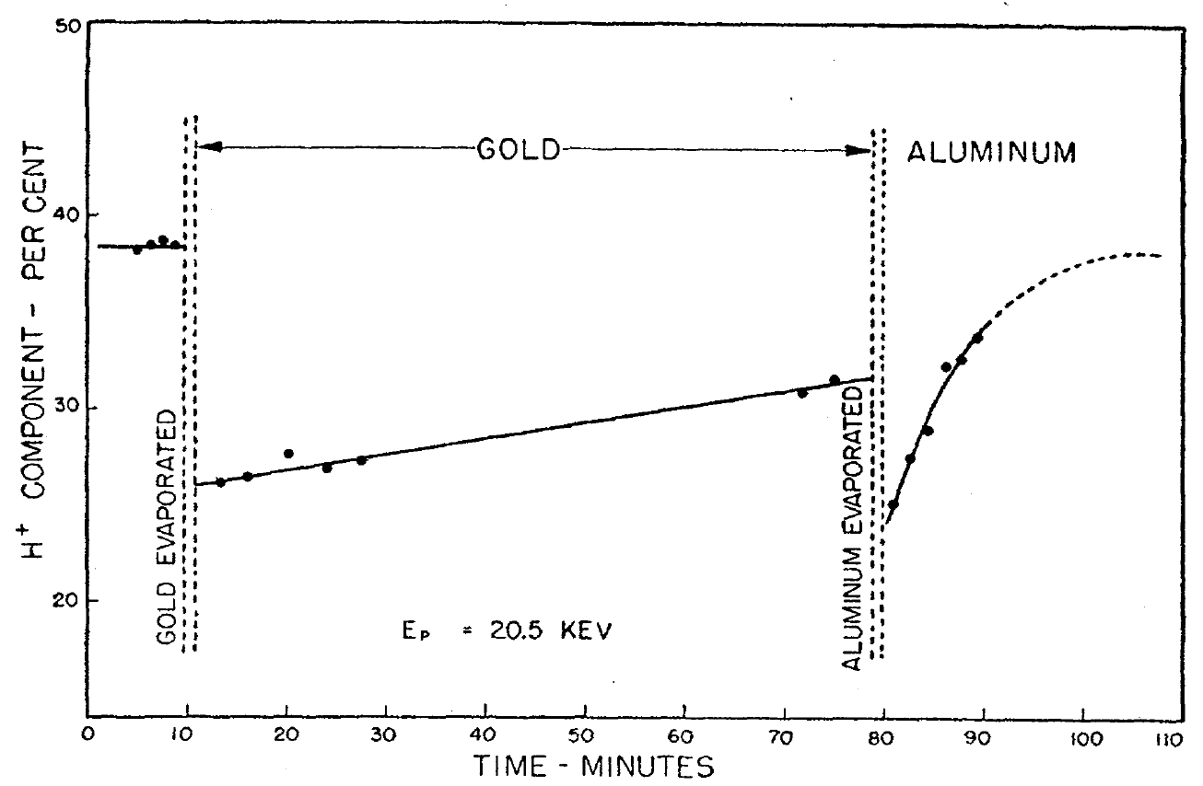
Contamination vs. Oxidation
He⁺ at 20.5 keV.
Al foil.
Deposited fresh Au
on the exit vs. Al.
Contamination
Oxidization
[8] J. A. Phillips, Phys. Rev. 97 (1955).

Slide 18
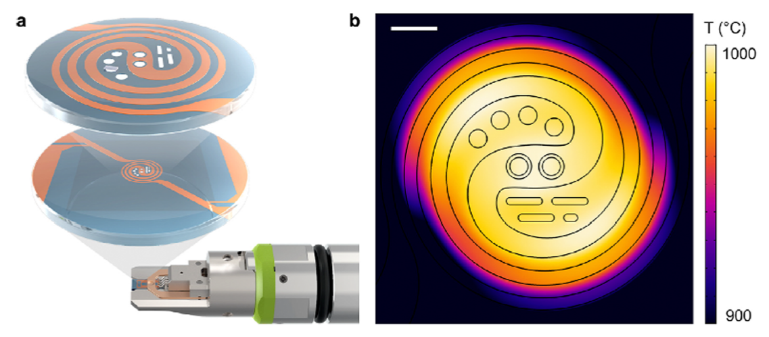
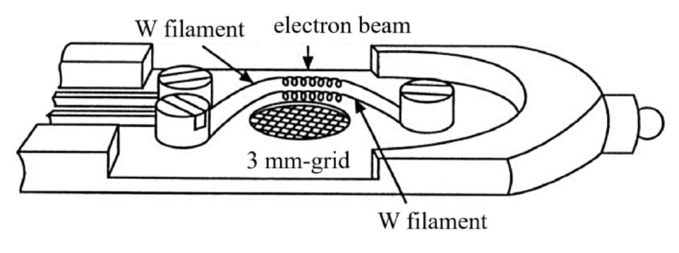
Future: Continuous Cleaning
Local heating approaches:
1. Foil mounted on a heater:
Designs exist for TEM.
[11] Yaguchi et al., Microscopy (2024)
2. Beam-heating:
Energy deposited by He⁺ into
the foil heats it.

Slide 19
References
[1] Ted Pella. (September 16, 2026). TEM Grids. https://www.tedpella.com/grids_html/grids.aspx
[2] R. Holeňák, S. Lohmann, F. Sekula, D. Primetzhofer, “Simultaneous assessment of energy, charge state and angular distribution for medium energy ions interacting with ultra-thin self-supporting targets: A time-of-flight approach”, Vacuum 185 (2021) 109988.
[3] R. M. Ennis Jr., D. E. Schechter, G. Thoeming, D. B. Schlafke, “Production of negative helium ions by nearly-resonant charge exchange in potassium”, IEEE Trans. on Nucl. Sci. 14 (1967) 75.
[4] U. V. Pedersen, M. Hyde, S. P. Møller and T. Andersen, “Lifetime measurement of He− utilizing an electrostatic ion storage ring”, Phys. Rev. A 64 (2001) 012503.
[5] S. Chang, B. Gori, C. Norris, J. Klein, K. Decker-Lucke, “High Energy Hydrogen and Helium Ion Implanter”, 20th International Conference on Ion Implantation Technology (IIT), Portland, OR, USA (2014).
[6] A. S. Schlachter, D. H. Loyd, P.J. Bjorkholm, L. W. Anderson, and W. Haeberli, “Charge-Exchange Collisions Between Helium Ions and Cesium Vapor in the Energy Range of 1.5-25 keV”, Phys. Rev. 174 (1968) 201.
[7] N. W. Ashcroft and N. D. Mermin, “Solid State Physics”, Philadelphia, USA, Saunders College (1976).
[8] J. A. Phillips, “Charge Equilibrium Ratios for Hydrogen Ions from Solids”, Phys. Rev. 97 (1955) 404.
[9] H. O. Funsten III, D. J. McComas and B. L. Barraclough, “Ultrathin foils used for low-energy neutral atom imaging of the terrestrial magnetosphere”, Optical Eng. 32 (1993) 3090.
[10] H. O. Funsten, S. M. Ritzau and R. W. Harper, “Negative helium ions exiting a carbon foil at keV energies”, Phys. Rev. B 63 (2001) 155416.
[11] T. Yaguchi, M. L. San Gabriel, A. Hashimoto and J. Y. Howe, ”In-situ TEM study from the perspective of holders”, Microscopy 73 (2024) 117.

Slide 20


Funding:
Thank you for your attention.
Notes:
HOW TO CHANGE IMAGE:
Click on image box.
Go to “Picture Format” tab
Click “Change Picture”

Slide 21
Supplemental

Slide 22
Foil Damage
Before
After

Slide 23
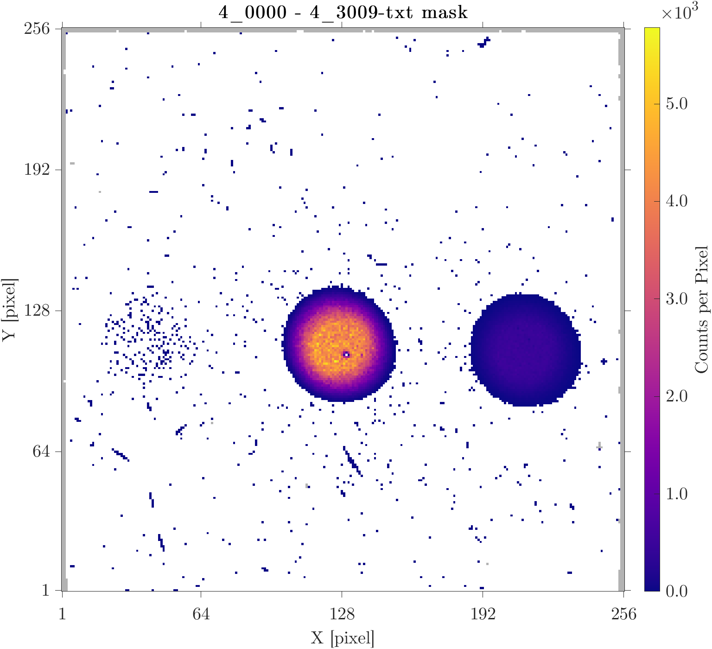
Charging
20 nm thick SiO₂.
30 keV He⁺
0.12 ± 0.02 pA
40:06.4 exposure
Transmitted [%]:
  He⁺ / Total = 10.42 ± 0.02
  He⁰ / Total = 89.56 ± 0.06
  He⁻ / Total = 0.0048 ± 0.0003
  Re. / Total = 0.0193 ± 0.0006
He⁻
He⁰
He⁺

Slide 24
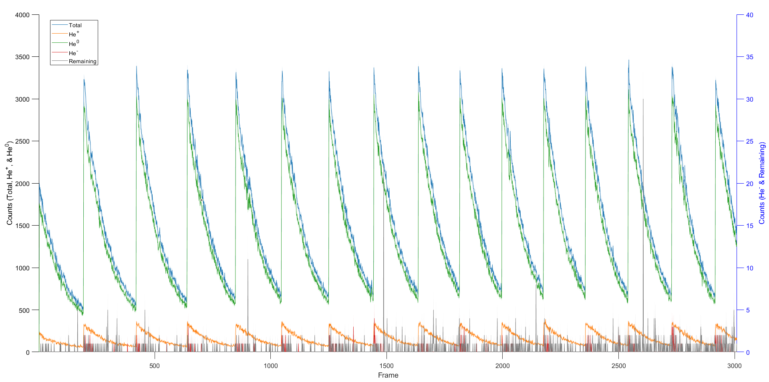
Charge/Discharge Per Frame
40 min
2:56 ~2.24 between peaks (0.8 sec / frame)

Slide 25
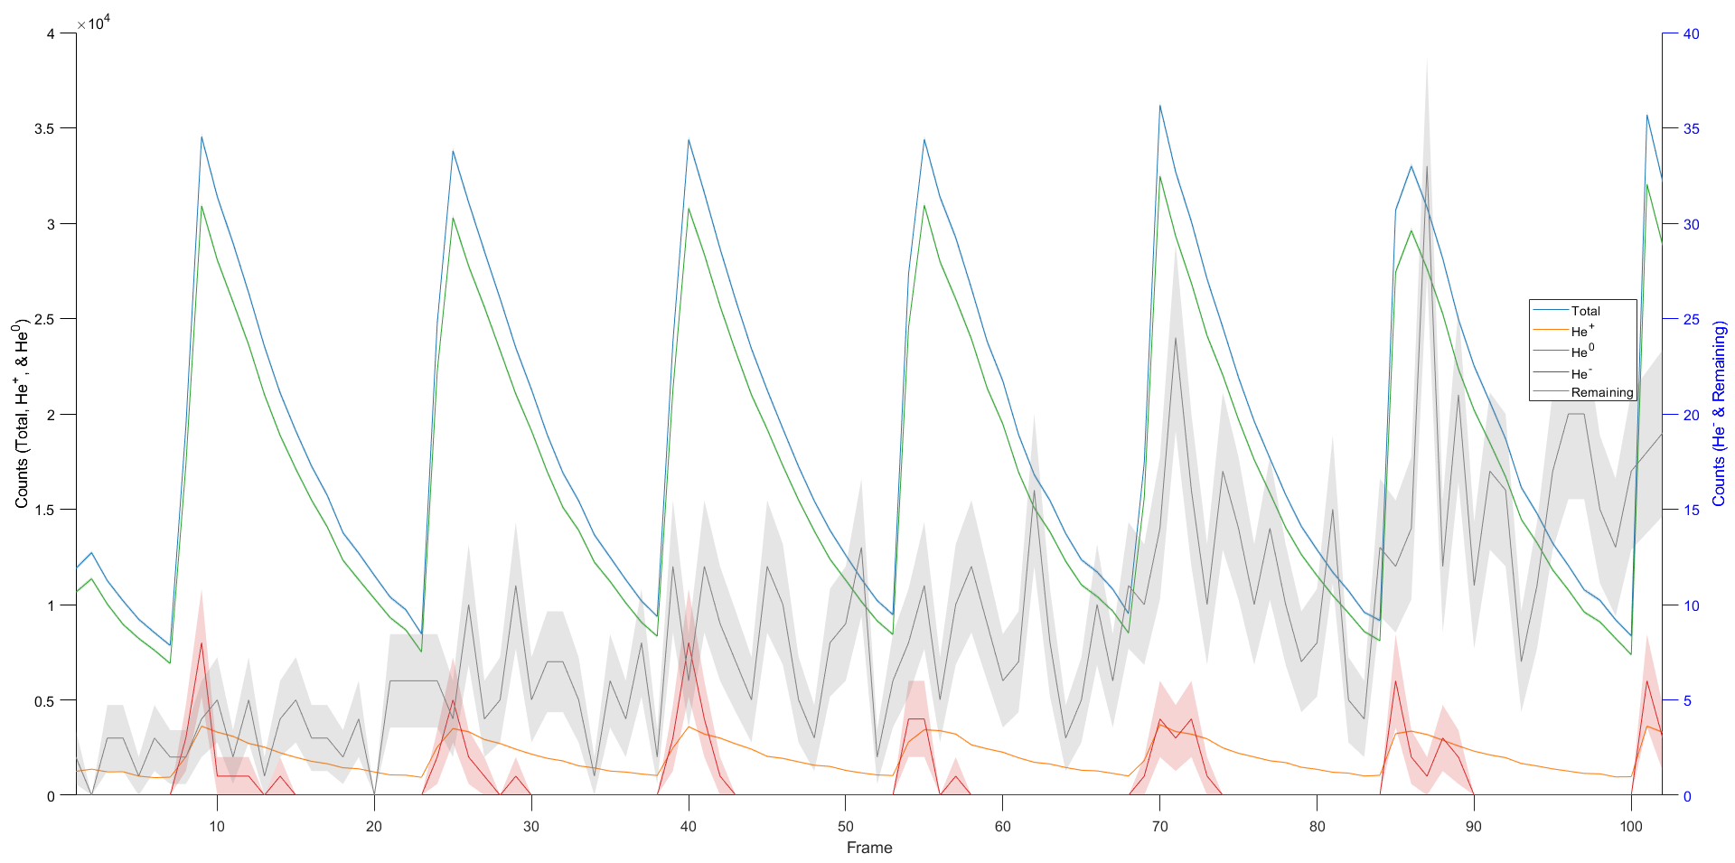
Charge/Discharge: Per Frame
17 min
~2:30 between peaks (10 sec / frame)

Slide 26
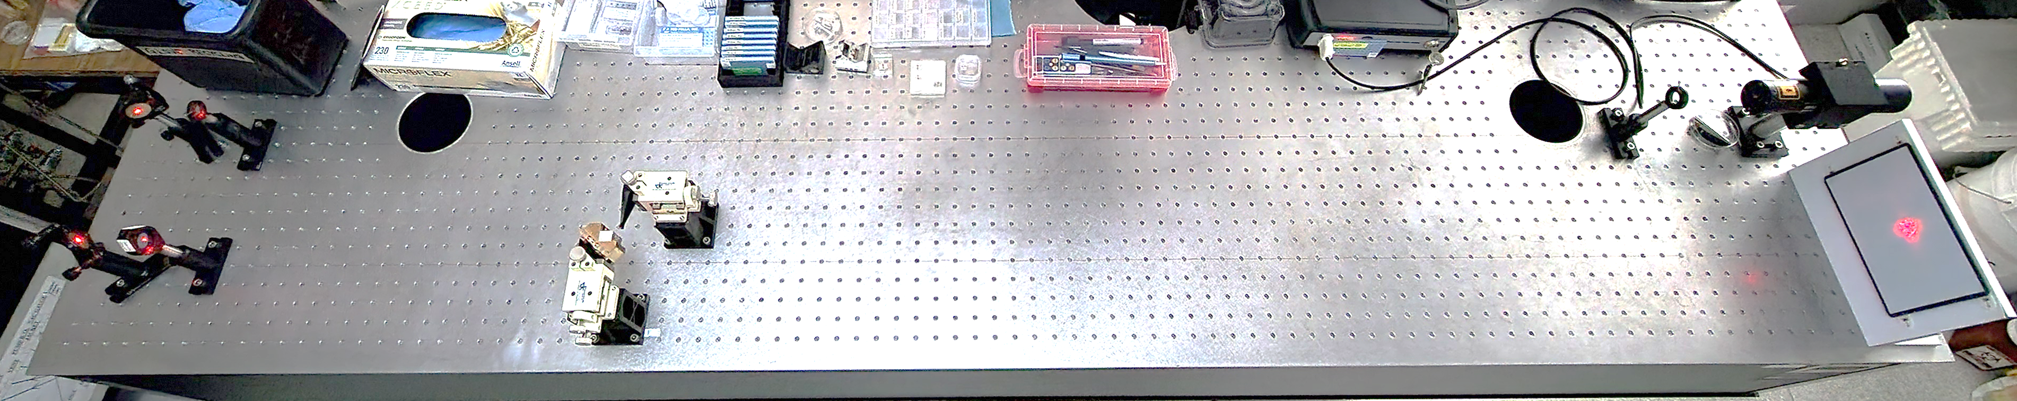
Laser Alignment
Mirror
Alignment
Aperture 2
Micro Adjuster
Alignment
Aperture 1
Laser
Mirror
Lens
Experiment Holder
Screen

Slide 27
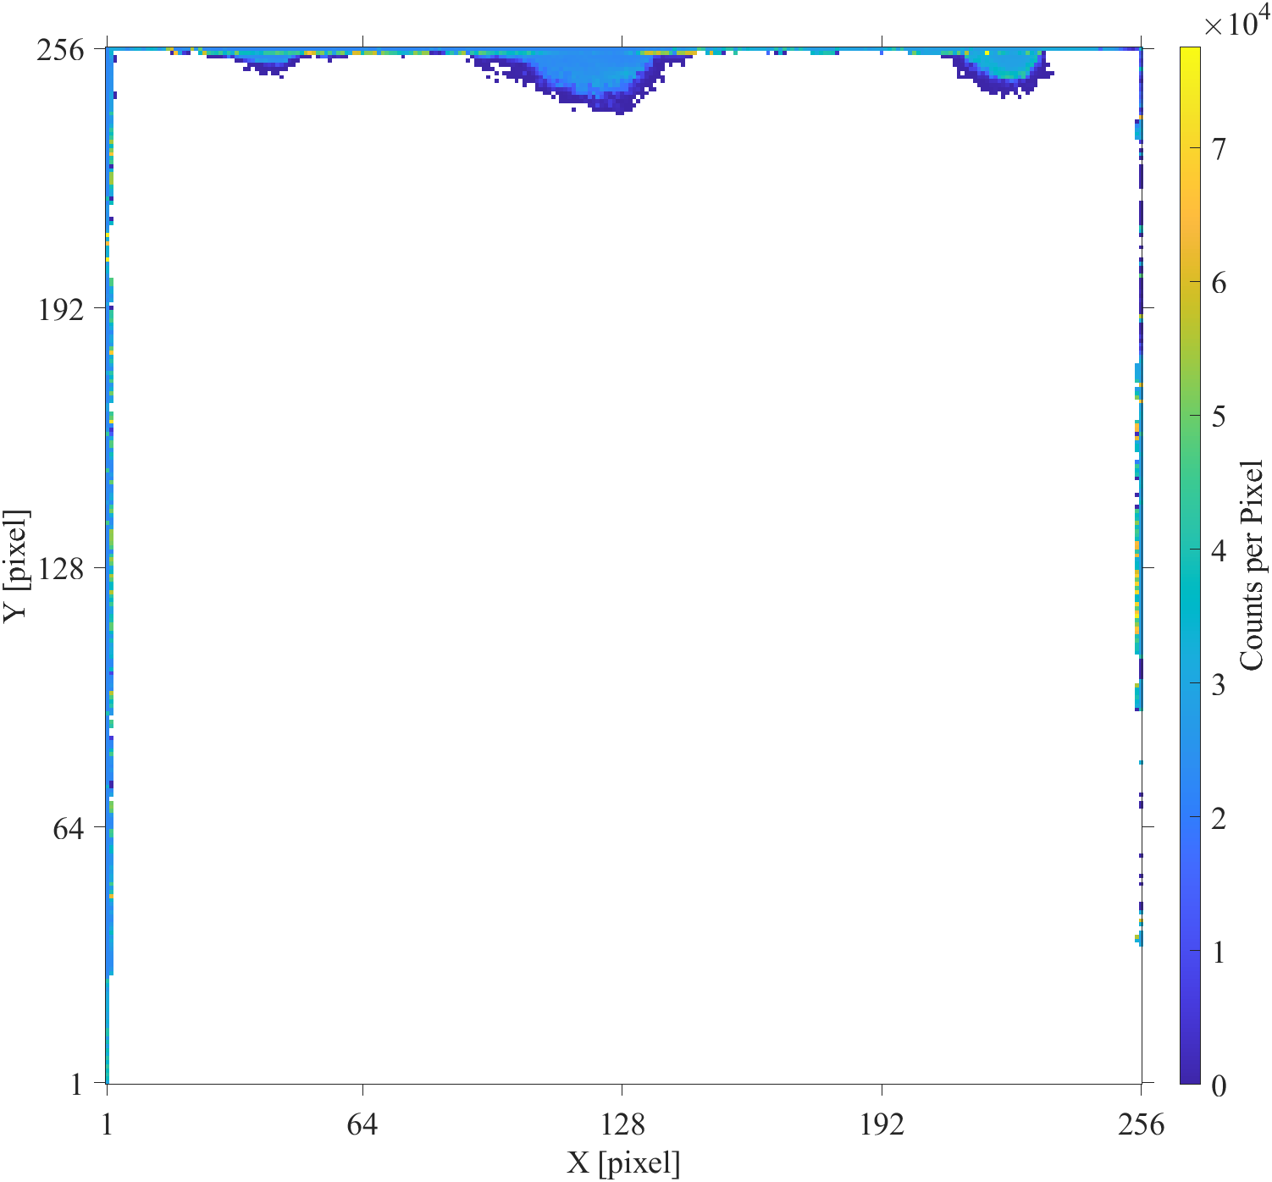
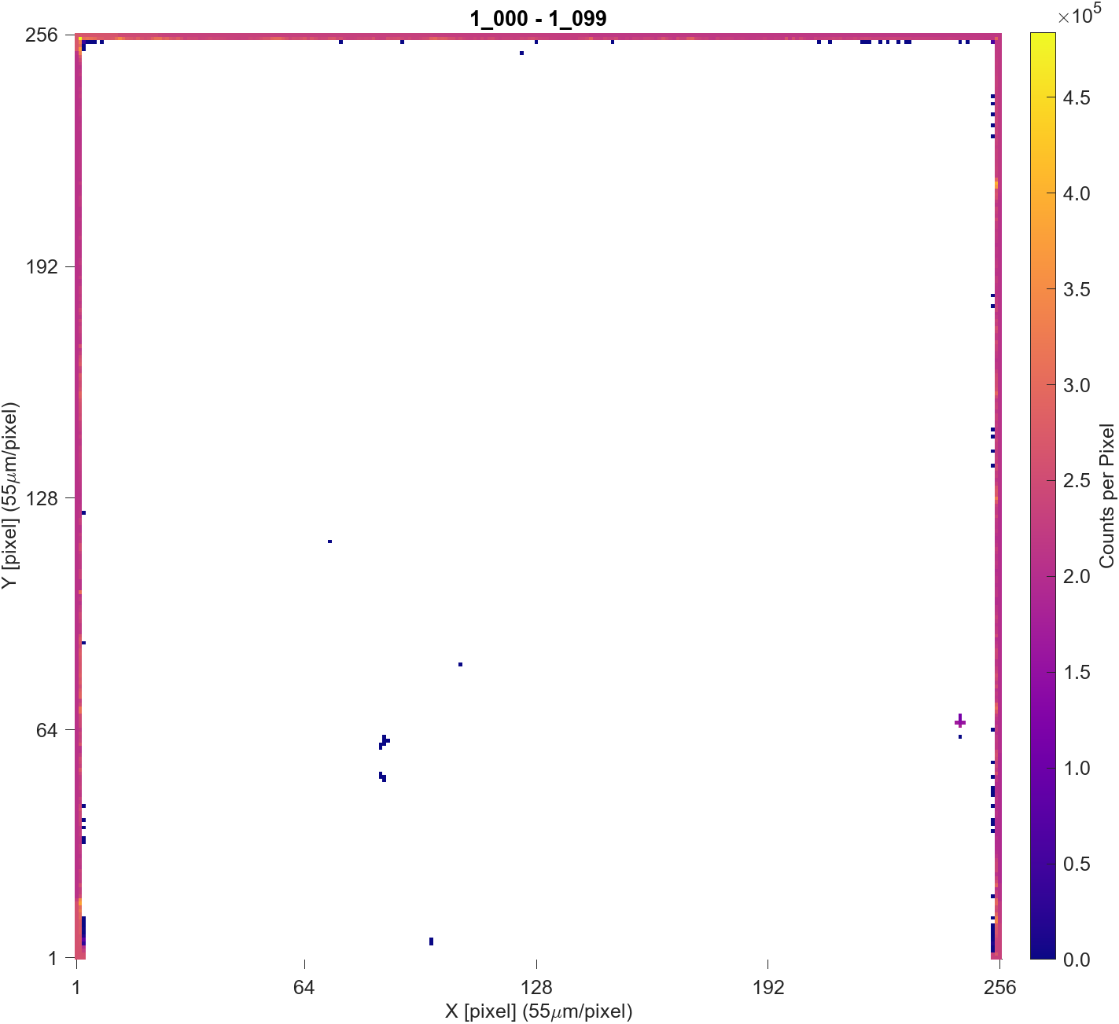
Darkfield Signal
Old Camera
New Camera

Slide 28
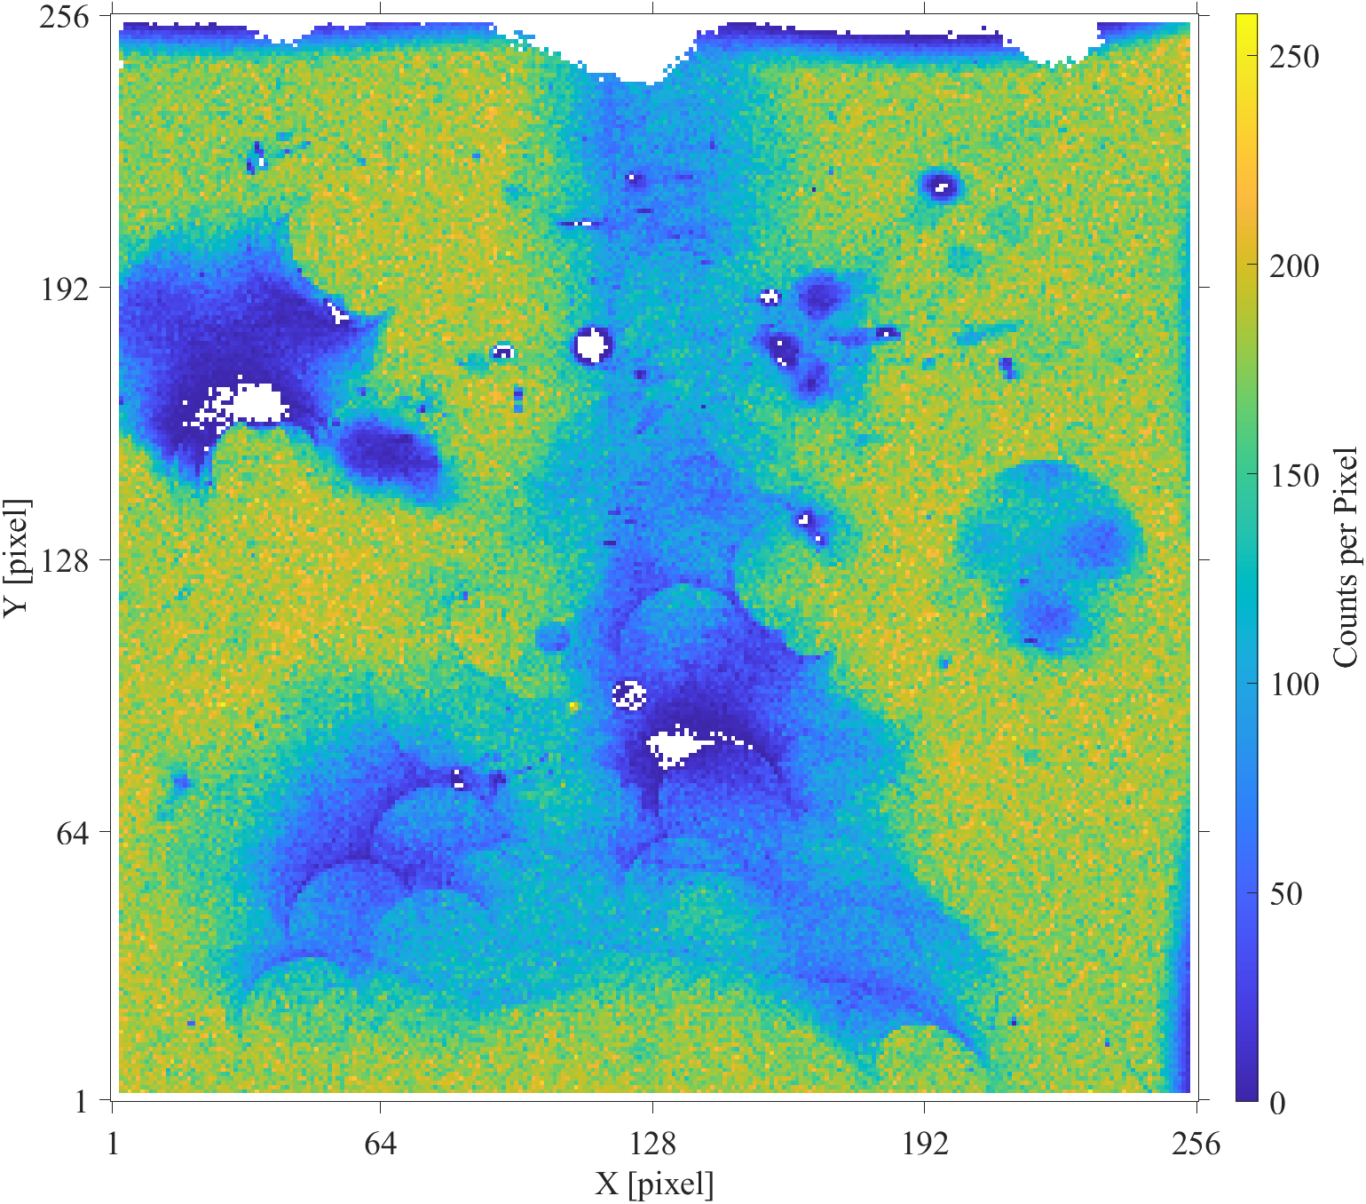
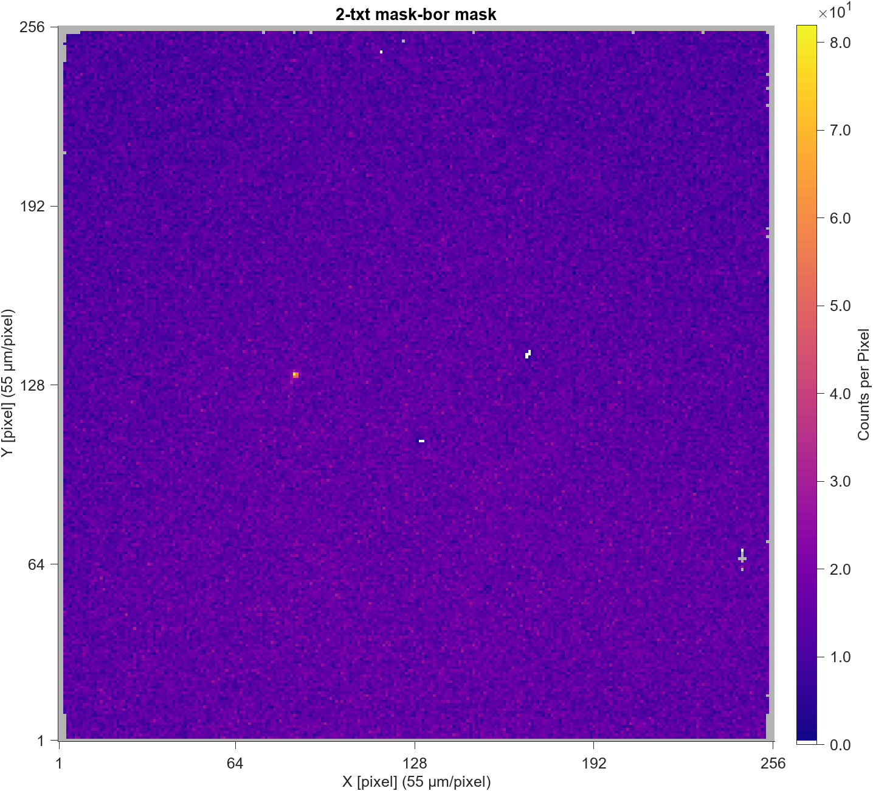
Exposure Damage
Old Camera
New Camera

Slide 29
Particle Flux
Ø50 µm at the foil →
0.10 pA: Particle flux = 3.2 × 10⁸ ions·cm⁻²·s⁻¹
0.15 pA: Particle flux = 4.8 × 10⁸ ions·cm⁻²·s⁻¹
Ø20 µm at the foil→
1.0 pA: Particle flux = 2.0 × 10¹⁴ ions·cm⁻²·s⁻¹
… for comparison, 1 mA onto Ø1 cm →
Particle flux = 7.9 × 10¹⁵ ions·cm⁻²·s⁻¹

Slide 30
He⁺ Tandem Accelerator
Tandem Accelerator
Charge-Mass Selector
(Bending Magnet)
~1 MeV He⁻
35 keV He⁻
~2 MeV He⁺
~3 MeV He²⁺
On to beamline…
~1 MeV He⁺
Charge Exchange Foil
Vapour Charge Exchange Cell
35 keV He⁺
0 V
1 MV
0 V
He⁺
He²⁺
He⁰
He⁻ (lifetime: ~280 μs @ 300 K)
Ion Source
[1] P. Reinhed, A. Orbán, J. Werner, S. Rosén, R.D. Thomas, I. Kashperka, H.A. Johansson, D. Misra, L. Brännholm, M. Björkhage, H. Cederquist, H.T. Schmidt, “Precision lifetime measurements of He⁻ in a cryogenic electrostatic ion-beam trap”, Phys Rev Lett. 103 (2009) 213002.
Notes:
Ok we have to dig in a bit more about what’s happening with these Tandem accelerators, and where negative helium fits in…
First, a positive helium source creates a positive ions with 10’s of keV, which then goes through a vapour charge exchange cell. This is where the negative helium ions are created, at basically the same energy. The negative helium is filtered out and fed into the Tandem.
Now a tandem accelerator is a clever way of getting a higher-energy beam with a lower-potential power supply. See normally to get a beam of say 2 MeV you would need a huge power supply that has a voltage up to 2 mega-volts… but here you only need one with 1 mega-volt. The electrodes inside step up to a high voltage, which accelerates the negative helium, but in the middle this is changed to positive helium, so now stepping the electrodes back down to zero will accelerate the positive helium out…
So the negative helium is sort of ‘drawn’ in, getting one kick of energy, and the positive helium is getting ‘pushed’ out, getting a second kick. So that’s a bit about the overall process,
(click)
but we’re interested in this charge exchange cell. This uses some metal vapours to change the helium,
(click)
and I’m looking at if this could be done with a foil instead.

Slide 31

Vapour Charge Exchange Cell
He²⁺
He⁰
He⁻
He⁺
35 keV 25 mA
He²⁺
He⁺
He⁺
He⁰
He⁻
38 µA
$$\frac{(He^{−}out)}{(He^{+}in)}=0.15\%$$
ALKALI METALS:
Potassium: 1~5%
Rubidium: ~1.3%
Cesium: ~2%
Gas / Vapour
(ex: Mg)
[3] – [6]
[5] Chang et al., 20th Int. Conf. on Ion Implant. Tech. (2014)
Pump
Notes:
OK, so what’s going on with this vapour charge exchange cell…
The positive helium beam comes in and could go straight through. (click)
Or it could hit one of these atomic-vapour atoms (here I’m showing Magnesium) (click)
Now it could loose an electron and become an alpha, and pass through (click) or gain an electron and become neutral… and pass through. (click)
Some of the neutrals could also hit a Magnesium and pick up an electron, becoming negative helium. (click)
And of course these others could hit things and become others things too… (click)
And at the end you get a mix of helium ions coming out.
As I mentioned, there is currently a method used to make negative helium… which is to use a gas or vapour-filled charge exchange cell.
How this works is a beam of positive helium is created by an ion source upstream of this device, and as the positive helium passes through, there is region inside that contains a gas or atomic vapour... Here I’m showing a magnesium vapour, as that is one type used in the semiconductor industry. (click)
As the positive helium passes though, some fraction picks up an electron from the vapour and neutralizes (click), and in turn some fraction of this picks up another electron to become a negative helium (click).
All three types of helium exit the cell (click), and downstream are separated before the negative helium is accelerator.
As an example, if 25 milli-amps of positive helium at 35 keV enter the cell, only about 38 micro-amps of negative helium would be produced; which is a conversion of only .15 percent.
Now, this vapour doesn’t stay within just this region of the vacuum system (click); it will diffuse to other areas. And to control this, extra pumping equipment is needed (click).
So, some problems with this method are: low negative helium production, the vapour can migrate and contaminate other systems, and to deal with that extra pumping equipment is needed. And as I’ll show later, alkali metals are the best so far at producing negative helium, but they are particularly bad to have floating about an implanter in those applications.

Slide 32
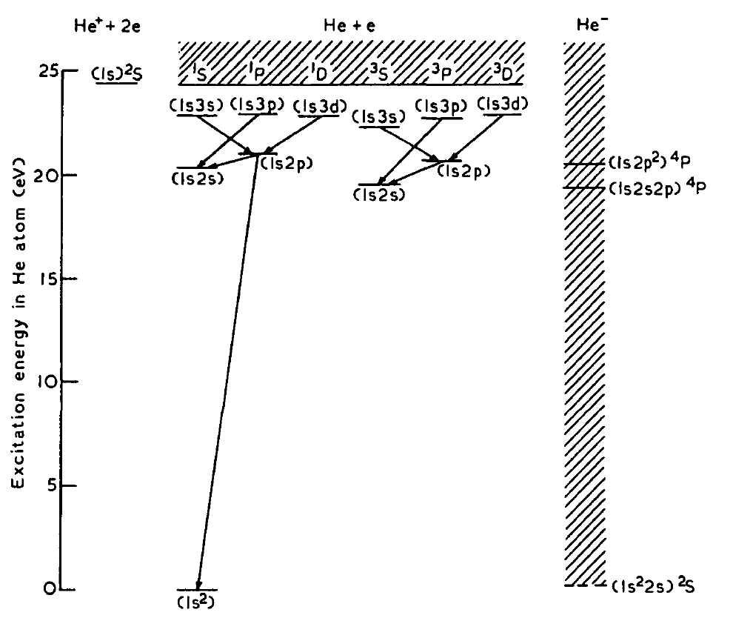
Two Steps
+ e
He⁺
He⁺ to He⁻ is a 2-step process:
He⁺ + X → He* + X⁺
He* + X → He⁻ + X⁺
Material selection:
Find a material with an
ionization energy ≈ 4.8 eV.
4.8 eV
+ e
He*
He⁻
0.0775 eV
He
[4] I.G. Main, “Negative helium ions for tandem accelerators”, Phys. Bull. 20 (1969) 419.
Notes:
So, as I showed, to get negative helium is a two-step process. (click)
First the positive helium is neutralized (click), and there is a difference in energy of 4.8 eV for this step…
Then the neutral helium picks up another electron to become negative, and there is a slight reduction in energy here: 77 milli electron volts.
So, initially the method for picking a target material is to find one with an ionization energy close to 4.8 eV.
The excited neutral helium state we need has a long lifetime, over 2 hours in high vacuum. [19]

Slide 33
Want He⁻
[21] P.T. Brunt, G.C. King, F.H. Read, "A study of resonance structure in n=2 excitation
of helium by electron impact" Journal of Physics B: Atomic and Molecular Physics,
10(7) (1977) 1289.
Ground state of He⁻ is unstable! 1s²2s ²S_{1/2} (auto-detaches in 10⁻¹⁵ s)
1st excited state of He⁻ is meta-stable: 1s2s2p ⁴P … three J values
Electronic Config. | 1s2s2p
Term Symbol | ⁴P_{1/2} | ⁴P_{3/2} | ⁴P_{5/2}
Lifetime | 7.8 ± 1.0 µs | 12.3 ± 0.5 µs | 359.0 ± 0.7 µs
Angular Momentum | J = 1/2 | J = 3/2 | J = 5/2
Population | 16.6% | 33.3% | 50%
J = 1/2
1s2s2p ⁴P
J = 3/2
32.34 µeV
J = 5/2
3.41 µeV
[6] P. Reinhed et al, “Precision Lifetime Measurements of He⁻ in a Cryogenic Electrostatic Ion-Beam Trap”, Phys. Rev. Let. 103 (2009) 213002.
At cryogenic temp… At 300 K: ~280 µs

Slide 34
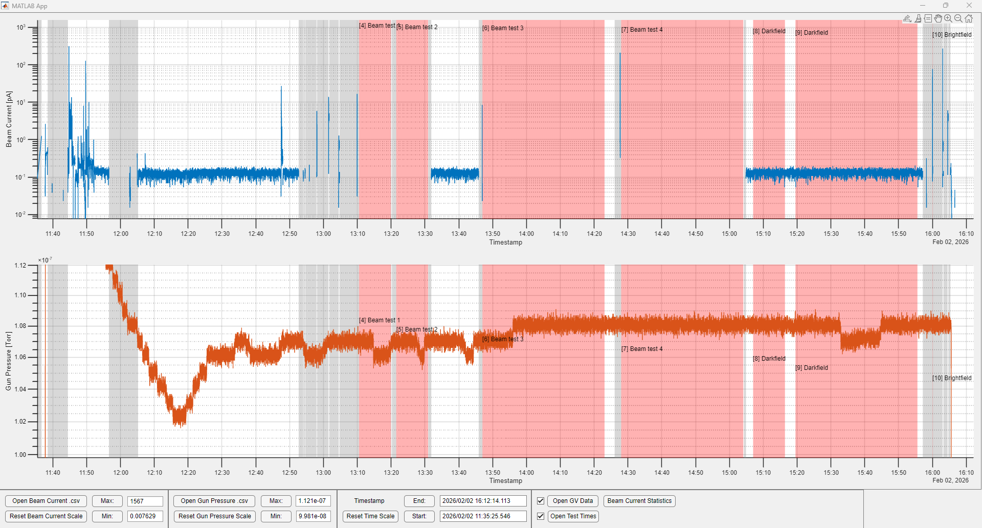

Slide 35
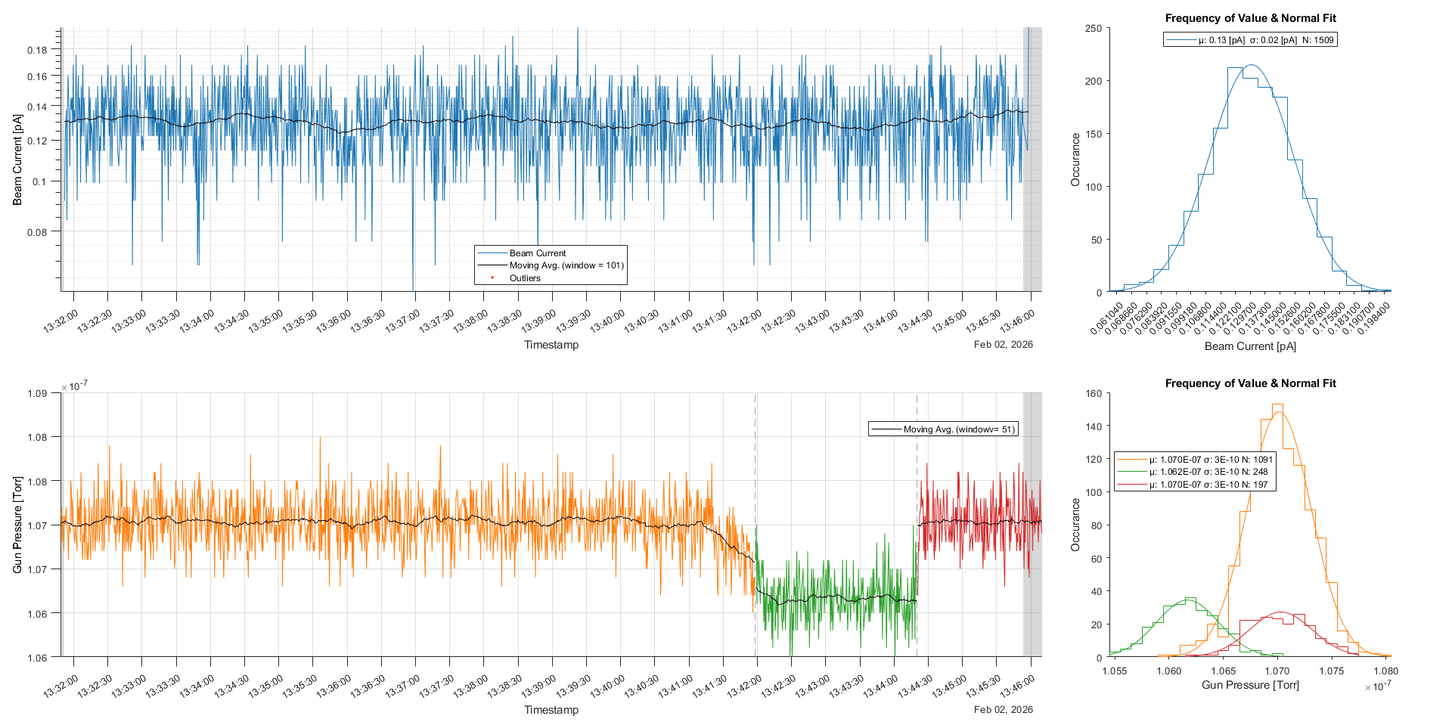

Slide 36
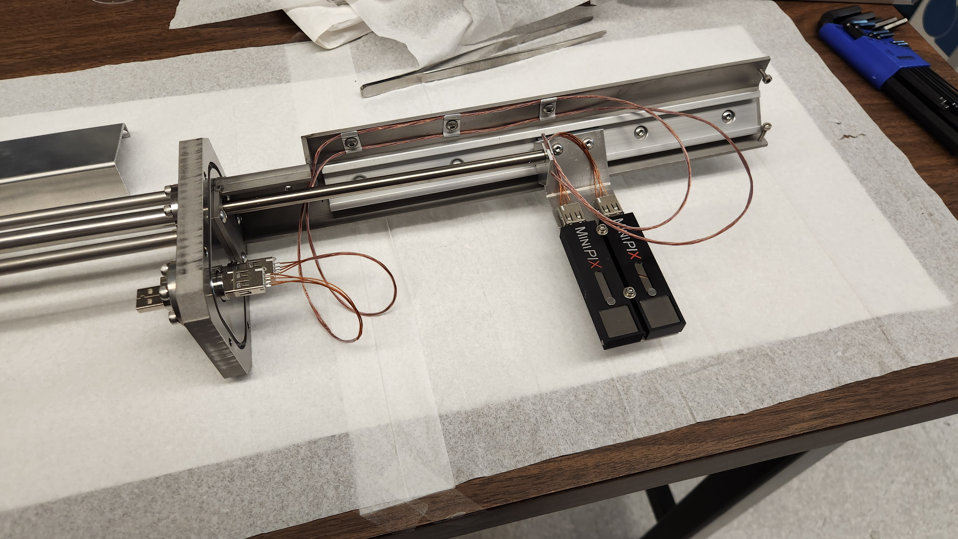
Two Camera Upgrade
Notes:
This device has already been designed, built, and installed. The 3D model is shown here.
This is an image of the completed device before installation.

Slide 37
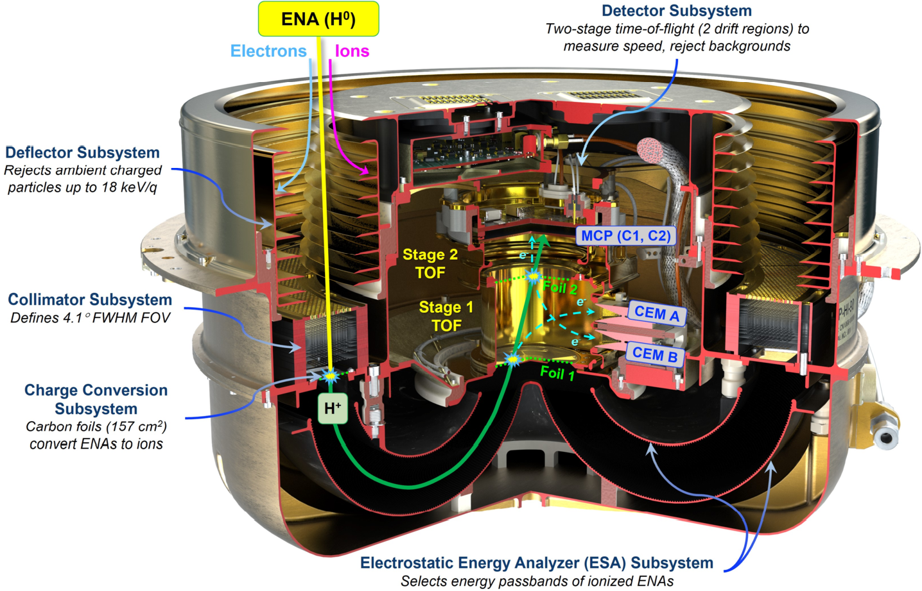
Neutral Atom Imaging Space Plasmas

