Slide 1


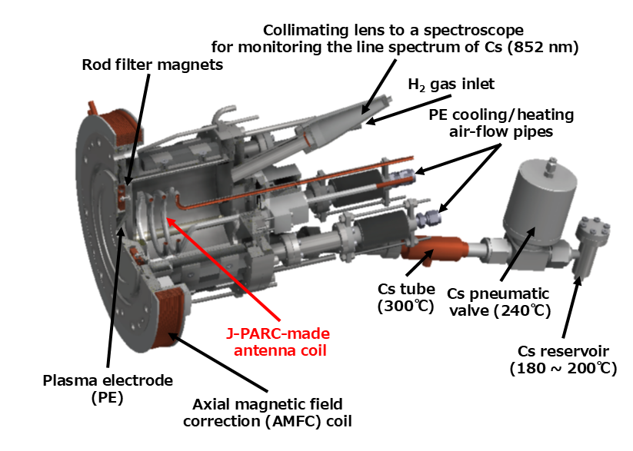
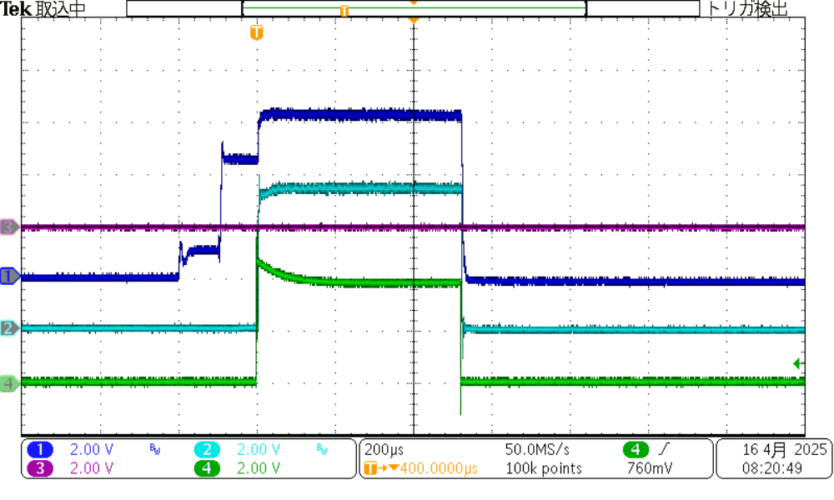
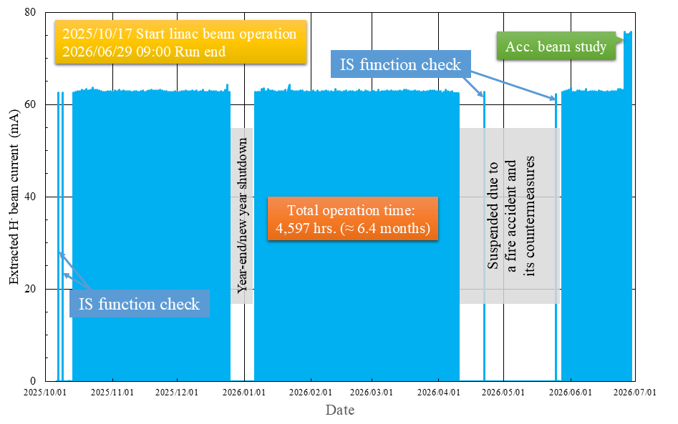
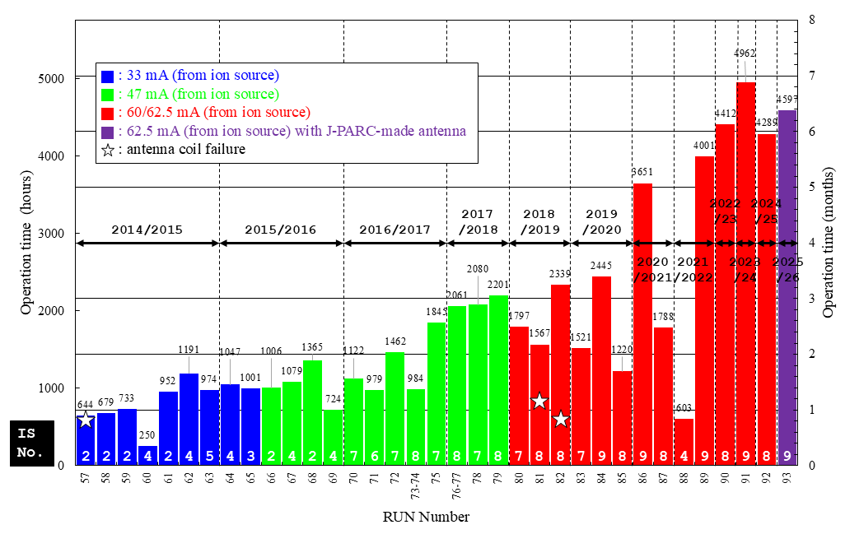
ID:76
10th International symposium on Negative, Ions,
Beams and Sources (NIBS2026)
held in Nelson, BC, Canada on 20th -25th September 2026
High-intensity RF-driven cesiated negative hydrogen ion source equipped with J-PARC-made antenna coil for J-PARC user operation
K. Shinto^{A)}, K. Ohkoshi^{A)}, T. Shibata^{B)}, K. Nanmo^{B)},
K. Tobita^{C)}, T. Sagawa^{D)}, K. Ikegami^{B)} and A. Ueno^{A)}
^{A)}J-PARC/JAEA, ^{B)}J-PARC/KEK, ^{C)}NECO Ltd., ^{D)}NAT Corp.
Abstract
It has been over a decade since J-PARC initiated negative hydrogen ion beam (H⁻ beam) supply from its high-intensity radiofrequency-driven (RF-driven) H⁻ ion source in the autumn of 2014. It is noteworthy that there have been virtually no major incidents to date, with only three instances of operational shutdowns and replacement work due to damage to the antenna coils. The operation of the ion source equipped with the J-PARC-made antenna coil was initiated for J-PARC users in the autumn of 2025. The ion source extracts the H⁻ beams with a beam current of 62.5 mA in order to fulfil the requirement of 50-mA H⁻ beam current at the end of the linac and a beam energy of 52.5 keV for appropriate injection into the RFQ. The ion source exhibited a noteworthy operational longevity, sustaining continuous operation for a cumulative duration of 4,597 hours from the autumn of 2025 to the summer of 2026, with no occurrences of substantial issues.
J-PARC high-intensity RF-driven cesiated H⁻ ion source
Table 1: Specifications and parameters of the H⁻ ion source
Specifications and parameters |  |  | For J-PARC user operation | For Accelerator beam study
Input RF power |  |  | 28 kW | 31 kW
H₂ gas flow rate |  |  | 21.0 sccm | 21.0 sccm
Applied voltage | PE-EE (V_{ext}) | PE-EE | 10.3 kV | 11.2 kV
 | EE-GE (V_{acc_dc}+V_{acc_m}) | EE-GE (V_{acc}) | 42.2 kV | 41.3 kV
 | Total | Total | 52.5 kV | 52.5 kV
H⁻ beam current at LEBT |  |  | 62.5 mA | 75.0 mA
Emittance (95% rms) |  | Vertical | 0.24π mm・mrad | 0.28π mm・mrad
 |  | Horizontal | 0.26π mm・mrad | 0.28π mm・mrad
V_{ext} +V_{acc_dc}
V_{ext} +V_{acc_dc} +V_{acc_m}
V_{acc_dc} Only
62.5 mA
@LEBT
58 mA
@MEBT1
Beam pulse width:0.5 ms
Figure 1:A 3-dimensional drawing of the J-PARC
high-intensity RF-driven cesiated H⁻ ion source.
PE: Plasma Electrode, EE: Extraction Electrode, GE: Ground Electrode, V_{ext}: Extraction Voltage, V_{acc_dc}: DC Acceleration Voltage, V_{acc_m}: Modulated (Pulsed) Acceleration Voltage
Figure 2: Typical waveforms of the H⁻ beam current at LEBT between H⁻ ion source and RFQ, and MEBT1 downstream of RFQ
The ion source, which is equipped with the J-PARC-made antenna coil, was operated for the first time in order to deliver the experimental facilities for J-PARC users.
The ion source extracts the 75-mA H⁻ beam with the 2-MHz pulsed RF input power of approximately 31 kW.
The transmission rate of H⁻ beam extracted from the ion source was maintained at approximately 92.8% in the J-PARC RFQ during the campaign.
Status of the beam operation of the J-PARC H⁻ ion source during the 2025/2026 campaign (Run#93),
as well as operating history of the H⁻ ion source since the initiation of the RF-driven type
Figure 3: H⁻ beam current extracted from the ion source during 2025/2026 campaign (Run#93).
Figure 4: Operating history of the J-PARC RF-driven cesiated H⁻ ion source since the autumn of 2014.
The ion source, equipped with the J-PARC-made antenna coil, exhibited a noteworthy operational longevity, sustaining continuous operation for a total of 4,597 hours from the autumn of 2025 to the summer of 2026, with no recorded occurrences of significant issues.
With the exception of three runs (#57, #81 and #82), the J-PARC RF-driven cesiated H⁻ ion source has completed all scheduled run times without encountering any significant issues to date. Furthermore, since the 2022/2023 campaign (Run#90), operations have been completed with a single ion source per campaign.
Summary and prospects
In the course of the 2025/2026 campaign (Run#93), the high-intensity RF-driven cesiated H⁻ ion source, equipped with the J-PARC-made antenna coil, was successfully completed for the first time. The J-PARC user operation was examined by a single ion source with the continuous operating time of 4,597 hours without any significant issues.
It has been determined that the internal antenna coil exhibited no serious deterioration following its deployment. We have therefore begun investigations into the operation of an ion source utilizing an internal antenna coil over a period of several years, and we plan to carry out various tests on an offline ion source test stand in the future.

