Slide 1
Fulcher-α Spectra and
Laser Photo-Detachment Measurements, and Models at SNU H⁻ Source
10th International symposium on Negative Ions, Beams and Sources - NIBS'26
Jeong-Jeung Dang¹, Jaeyoung Choi², Kihyun Lee³, June Young Kim⁴, Kyoung-Jae Chung⁵, and Yong-Seok Hwang⁵
¹ Department of Energy Engineering, Korea Institute of Energy Technology (KENTECH)
² Display Research Center, Samsung Display,
³ Korea Atomic Energy Research Institute (KAERI),
⁴ Department of Semiconductor Engineering, Myongji University,
⁵ Department of Energy Systems Engineering, Seoul National University

Slide 2
Outline
Introduction to the SNU H⁻ Source
Optical and Laser Diagnostics for the SNU H- Source
Self-Consistent 1-D Modeling & Analysis
Recent Work on Novel H⁻ Source Concepts
Summary

Slide 3
Development Experience of SNU RF-TCP H⁻ Source
Introduction to the SNU H⁻ Source
Stage 1: Establishing R&D Foundation (2000–2006)
  Concept and Set-up of Cs-Free Volume-Production H⁻ Source
  Introduced RF-TCP antenna outside dielectric window to prevent erosion & contamination [1]
  Extracted H⁻ beam for tandem accelerator injector [2]
  Controlled T_{e} near extraction hole via dipole magnets in extractor: reduced e/H⁻ ratio to 8 [3]
Stage 2: Performance Enhancement via Hardware Modifications (2006–2014)
  Modifications of Potential Structures, Surface Materials,
  and Chamber Geometry
  Controlled local potential structure to be favorable for H⁻ extraction and introduced tantalum secondary electrode to boost surface production [4]
  Modified length and shape of source chamber to elevate driver T_{e} and power density for increased H₂(υ*) precursor generation [5, 6]
Stage 3: Diagnostic Systems & Physical Modeling
(2015–Present)
  Strengthening Physical Analysis via H ⁻ Source Diagnostic & Coupled Modeling
  Established comprehensive diagnostic systems: OES (VDF measurement), laser photo-detachment (H⁻ density), and Langmuir probes (plasma parameters) [7, 8]
  Developed numerical models to figure out physical relationships between measured parameters and source performance [7]
[1] Y. S. Hwang and G. H. Lee, RSI 71 (2000), 943-945.
[2] I. S. Hong, et al., AIP Conf. Proc. 639 (2003), 61-66.
[3] H. S. Jeong, et al., RSI 77 (2006), 03A536.
[4] Y. An, B. Jung, Y. Hwang, RSI 81 (2010), 02A702.
[5] K. J. Chung, et al., RSI 85 (2014), 02B112.
[6] B. K. Jung, et al., RSI 85 (2014), 02B114.
[7] K. J. Chung, et al., New J. Phys. 18 (2016), 105006
[8] J. J. Dang, et al., RSI 87 (2016), 053503 (2016)

Slide 4
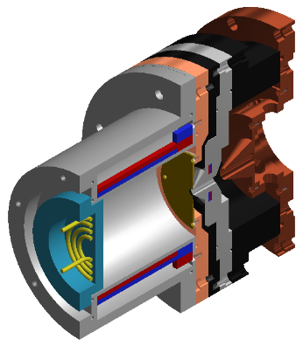
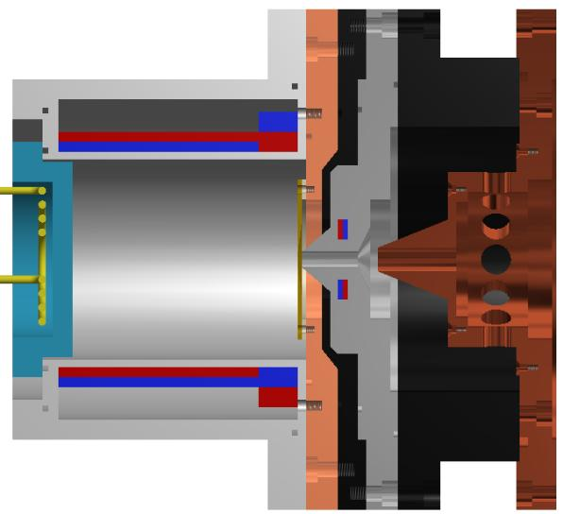
Negative Ion Source (NIS) in SNU
Introduction to the SNU H⁻ Source
Bias
electrode
Plasma
electrode
Extraction
electrode
Acceleration
electrode
Quartz
window
13.56 MHz
RF Power
Operation Conditions
  Pressure : 0.4 - 4 Pa (H₂)
  RF power : 0.5 - 1 kW
  T_{e} : 5 - 10 eV (driver)
  1 - 3 eV (extr.)
  n_{e} : ~ 10¹⁸ m⁻³ (driver)
  ~ 10¹⁷ m⁻³ (extr.)
  n⁻ : 10¹⁵ - 10¹⁶ m⁻³
3½ turns
planar
antenna
Cusp
magnet
Virtual
filter
magnet
Dipole
filter
magnet

Slide 5
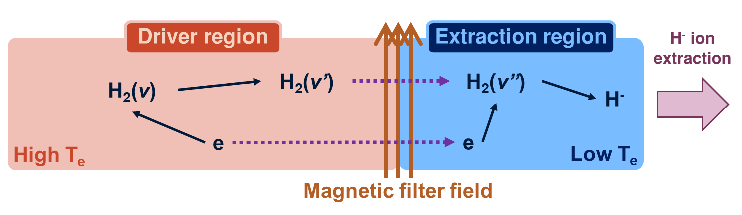
Configuration of Volume-Production NIS
Introduction to the SNU H⁻ Source
Simultaneous Requirement of High and Low T_{e} Regions
Part | Driver region | Extraction region
Role | Populating vibrationally excited hydrogen molecules | Producing H⁻ ions & Preventing destruction

Slide 6
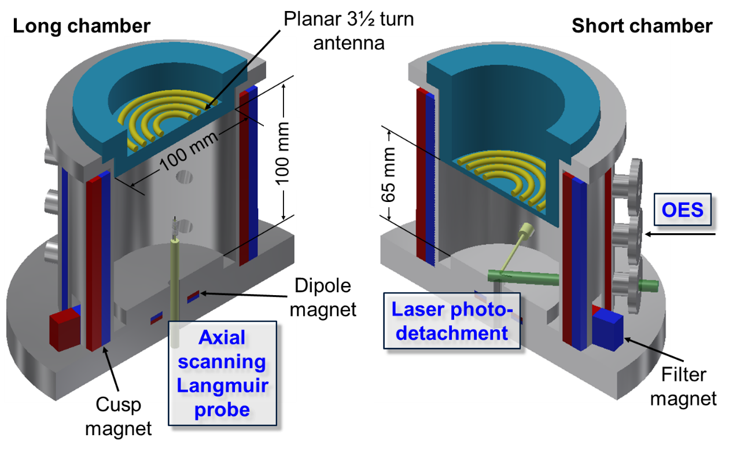
Diagnostics for NIS in SNU
Optical and Laser Diagnostics for the SNU H- Source
Diagnostics
  Plasma parameters : Langmuir probe, Optical Emission Spectroscopy (OES)
  Vibrational states H₂(υ*) : OES (Fulcher-α)
  Negative ion density (n⁻) :
  Laser photo-detachment

Slide 7
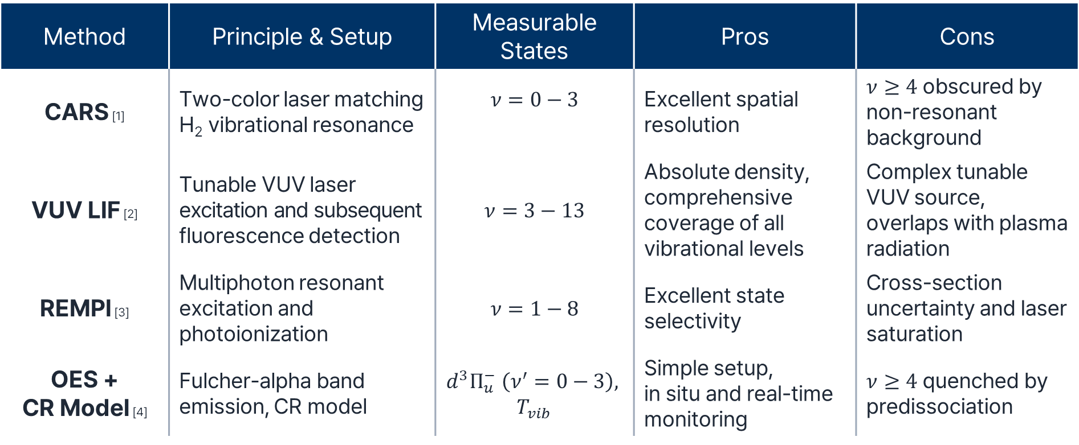
Diagnostics for Vibrational State Distribution
Optical and Laser Diagnostics for the SNU H- Source
Method | Principle & Setup | Measurable States | Pros | Cons
CARS [1] | Two-color laser matching H₂ vibrational resonance | $$ν=0−3$$ | Excellent spatial resolution | $ν≥4$ obscured by non-resonant background
VUV LIF [2] | Tunable VUV laser excitation and subsequent fluorescence detection | $$ν=3−13$$ | Absolute density, comprehensive coverage of all vibrational levels | Complex tunable VUV source, overlaps with plasma radiation
REMPI [3] | Multiphoton resonant excitation and photoionization | $$ν=1−8$$ | Excellent state selectivity | Cross-section uncertainty and laser saturation
OES + CR Model [4] | Fulcher-alpha band emission, CR model | $$d^{3}Π_{u}^{−} \left(ν^{′}=0−3\right),$$ $$T_{vib}$$ | Simple setup, in situ and real-time monitoring | $ν≥4$ quenched by predissociation
[1] M. Péalat, et al., J. Chem. Phys. 82 (1985), 4943-4953 [2] T. Mosbach, et al., PRL 85 (2000), 3420-3423 [3] P. J. Eenshuistra, et al., EPL 8 (1989), 423-427 [4] U. Fantz and B. Heger, PPCF 40 (1998) 2023-2032

Slide 8
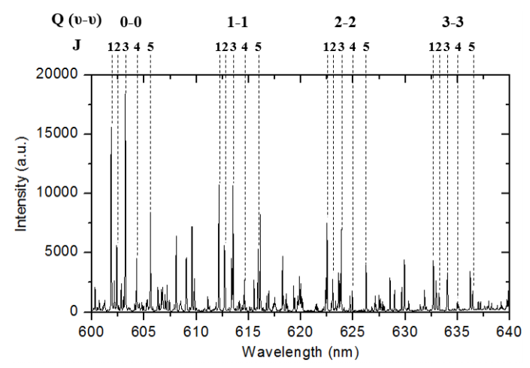
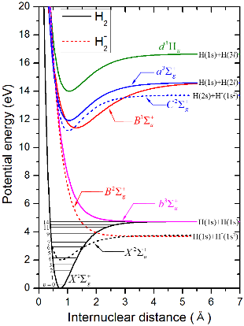
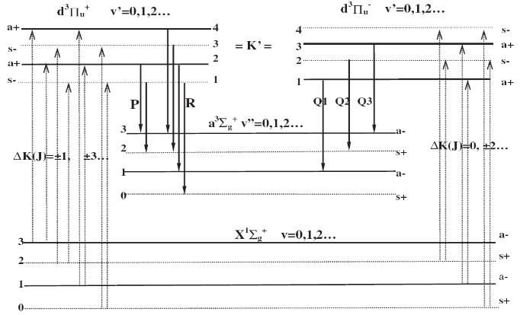
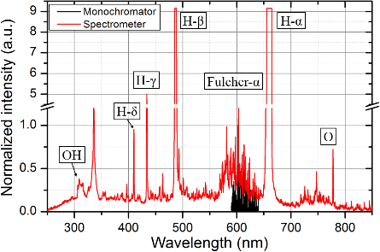
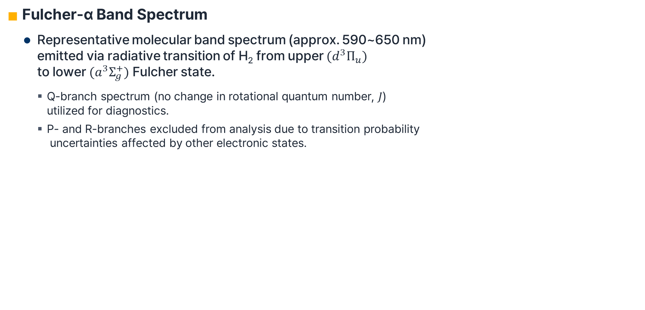
Vibrational States Diagnostics
Optical and Laser Diagnostics for the SNU H- Source
Fulcher-α Band Spectrum
  Representative molecular band spectrum (approx. 590~650 nm)
  emitted via radiative transition of H₂ from upper $(d^{3}Π_{u})$
  to lower $(a^{3}Σ_{g}^{+})$ Fulcher state.
    Q-branch spectrum (no change in rotational quantum number, 𝐽)
    utilized for diagnostics.
    P- and R-branches excluded from analysis due to transition probability
    uncertainties affected by other electronic states.
Q2
Q3
Q1

Slide 9
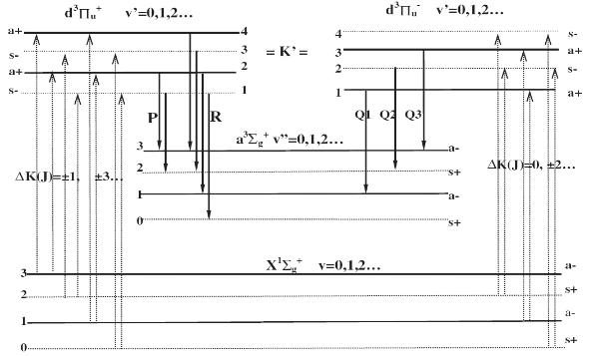

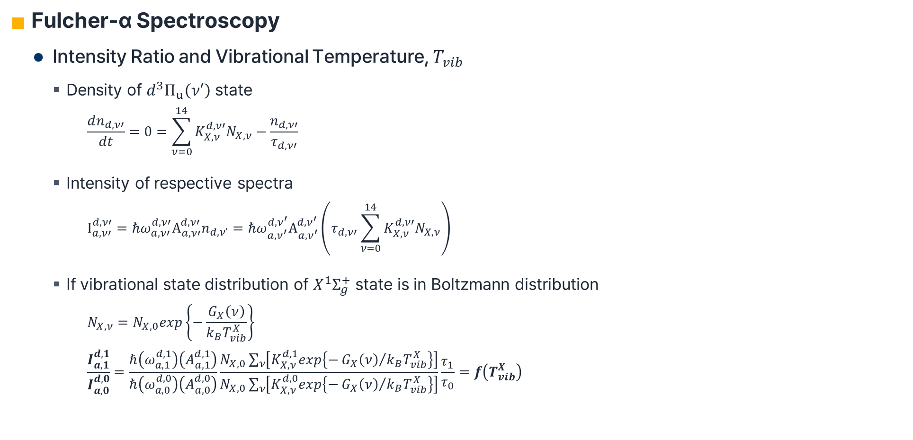
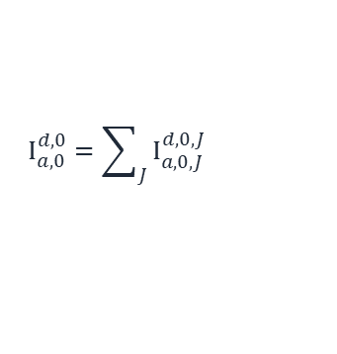
Vibrational States Diagnostics
Optical and Laser Diagnostics for the SNU H- Source
Fulcher-α Spectroscopy
  Intensity Ratio and Vibrational Temperature, $T_{vib}$
    Density of $d^{3}Π_{u}\left(ν′\right)$ state
      $$\frac{dn_{d,ν′}}{dt}=0=\sum_{ν=0}^{14}{K_{X,ν}^{d,ν′}N_{X,ν}}−\frac{n_{d,ν′}}{τ_{d,ν′}}$$
    Intensity of respective spectra
    $$I_{a,ν′}^{d,ν′}={ℏω}_{a,ν′}^{d,ν′}A_{a,ν′}^{d,ν′}n_{d,ν’}={ℏω}_{a,ν^{′}}^{d,ν^{′}}A_{a,ν^{′}}^{d,ν^{′}}\left(τ_{d,ν′}\sum_{ν=0}^{14}{K_{X,ν}^{d,ν′}N_{X,ν}}\right)$$
    If vibrational state distribution of $X^{1}Σ_{g}^{+}$ state is in Boltzmann distribution
    $$N_{X,ν}=N_{X,0}exp\left\{−\frac{G_{X}\left(ν\right)}{k_{B}T_{vib}^{X}}\right\}$$
    $$\frac{I_{a,1}^{d,1}}{I_{a,0}^{d,0}}=\frac{ℏ\left(ω_{a,1}^{d,1}\right)\left(A_{a,1}^{d,1}\right)}{ℏ\left(ω_{a,0}^{d,0}\right)\left(A_{a,0}^{d,0}\right)}\frac{N_{X,0}\sum_{ν}{\left[K_{X,ν}^{d,1}exp\left\{−{G_{X}\left(ν\right)}/{k_{B}T_{vib}^{X}}\right\}\right]}}{N_{X,0}\sum_{ν}{\left[K_{X,ν}^{d,0}exp\left\{−{G_{X}\left(ν\right)}/{k_{B}T_{vib}^{X}}\right\}\right]}}\frac{τ_{1}}{τ_{0}}=f\left(T_{vib}^{X}\right)$$
Q2
Q3
Q1
$$I_{a,0}^{d,0}=\sum_{J}{I_{a,0,J}^{d,0,J}}$$

Slide 10
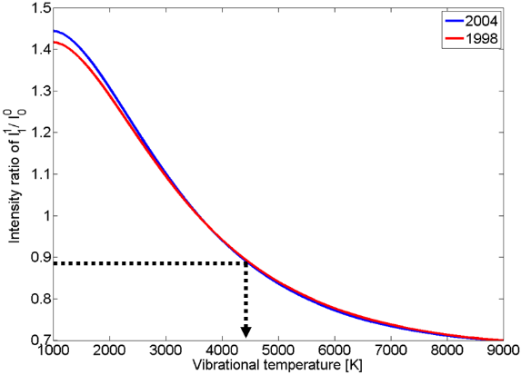
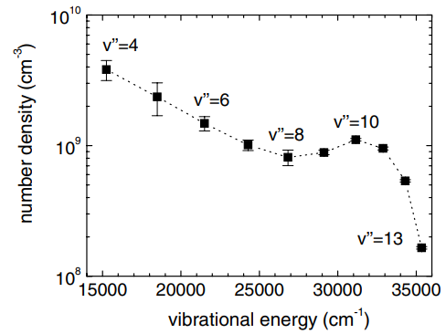
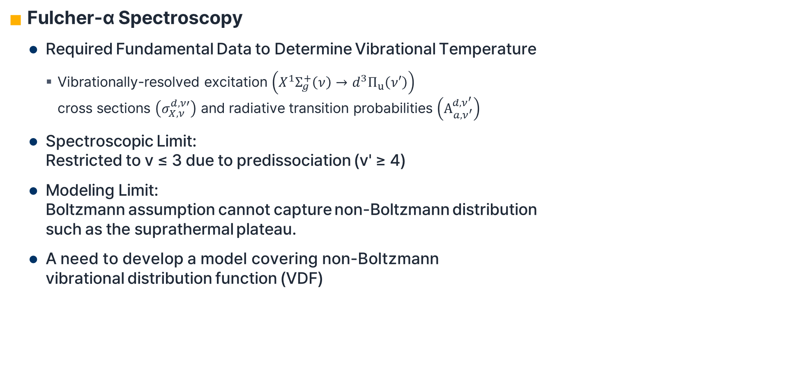
Vibrational States Diagnostics
Optical and Laser Diagnostics for the SNU H- Source
Fulcher-α Spectroscopy
  Required Fundamental Data to Determine Vibrational Temperature
    Vibrationally-resolved excitation $\left(X^{1}Σ_{g}^{+}\left(ν\right)→d^{3}Π_{u}\left(ν′\right)\right)$
    cross sections $\left(σ_{X,ν}^{d,ν′}\right)$ and radiative transition probabilities $\left(A_{a,ν^{′}}^{d,ν^{′}}\right)$
  Spectroscopic Limit:
  Restricted to v ≤ 3 due to predissociation (v' ≥ 4)
  Modeling Limit:
  Boltzmann assumption cannot capture non-Boltzmann distribution
  such as the suprathermal plateau.
  A need to develop a model covering non-Boltzmann
  vibrational distribution function (VDF)
2006
1998
U. Fantz and B. Heger, PPCF 40 (1998) 2023-2032.
U. Fantz and D. Wünderlich, At. Data Nucl. Data Tables 92 (2006), 853-973.
T. Mosbach, et al., PRL 85 (2000), 3420-3423

Slide 11
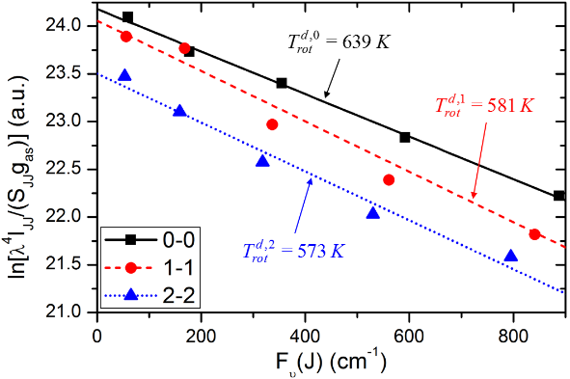
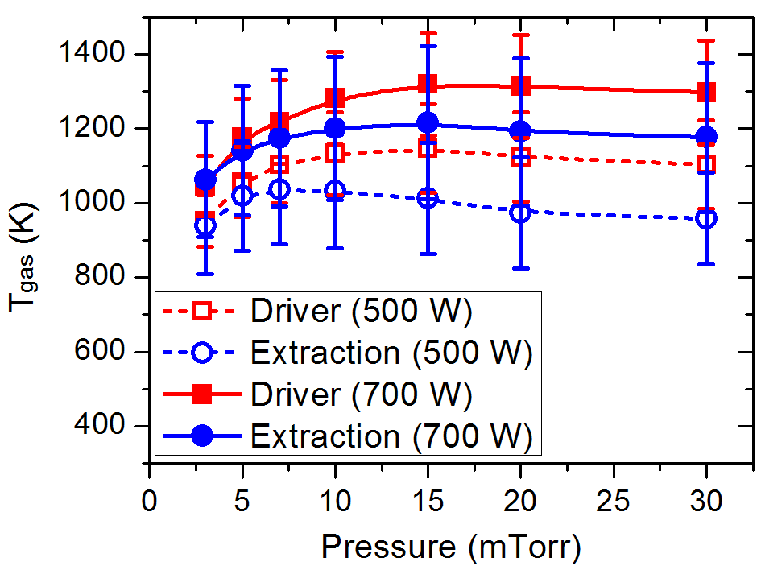
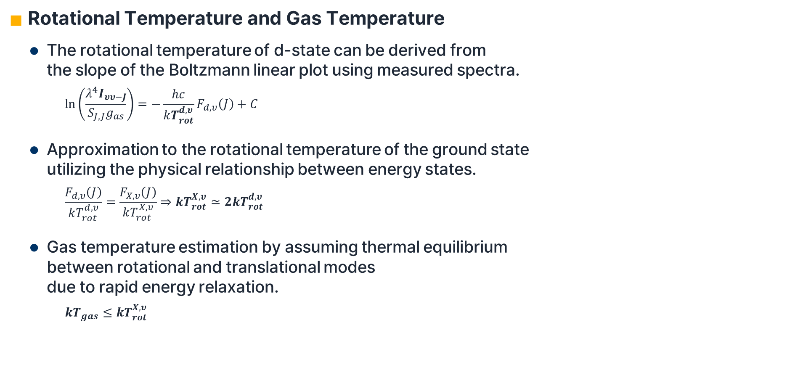
Other Parameters from Fulcher-α
Optical and Laser Diagnostics for the SNU H- Source
Rotational Temperature and Gas Temperature
  The rotational temperature of d-state can be derived from
  the slope of the Boltzmann linear plot using measured spectra.
      $$\ln\left(\frac{λ^{4}I_{υυ−J}}{S_{J,J}g_{as}}\right)=−\frac{hc}{kT_{rot}^{d,υ}}F_{d,υ}\left(J\right)+C$$
  Approximation to the rotational temperature of the ground state
  utilizing the physical relationship between energy states.
      $$\frac{F_{d,υ}\left(J\right)}{kT_{rot}^{d,υ}}=\frac{F_{X,υ}\left(J\right)}{kT_{rot}^{X,υ}}⇒kT_{rot}^{X,υ}≃2kT_{rot}^{d,υ}$$
  Gas temperature estimation by assuming thermal equilibrium
  between rotational and translational modes
  due to rapid energy relaxation.
      $$kT_{gas}≤kT_{rot}^{X,υ}$$

Slide 12
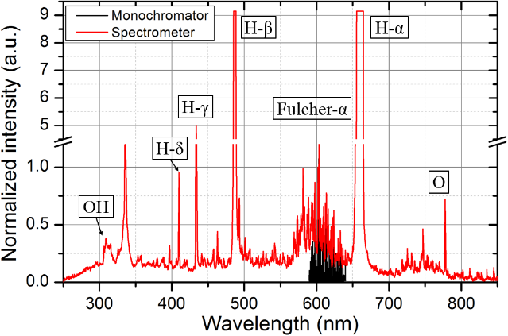
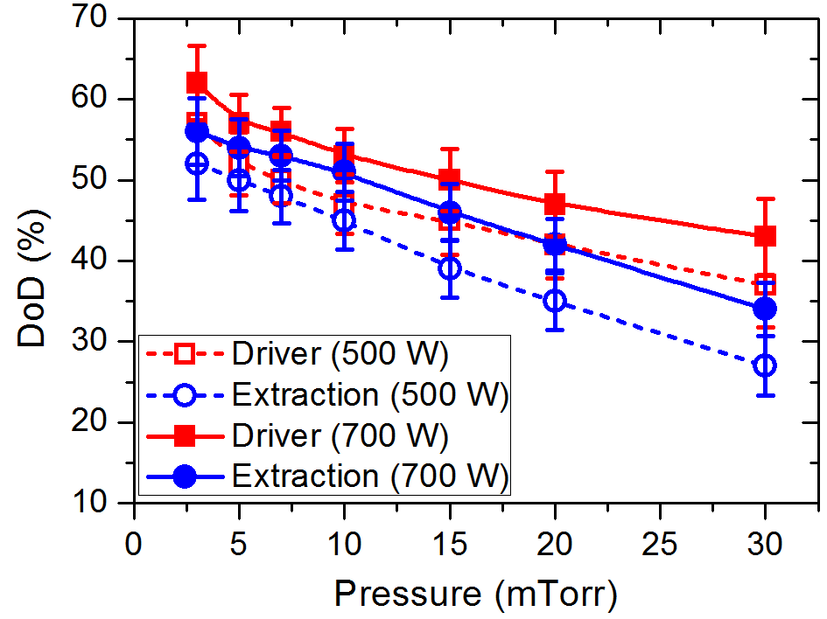
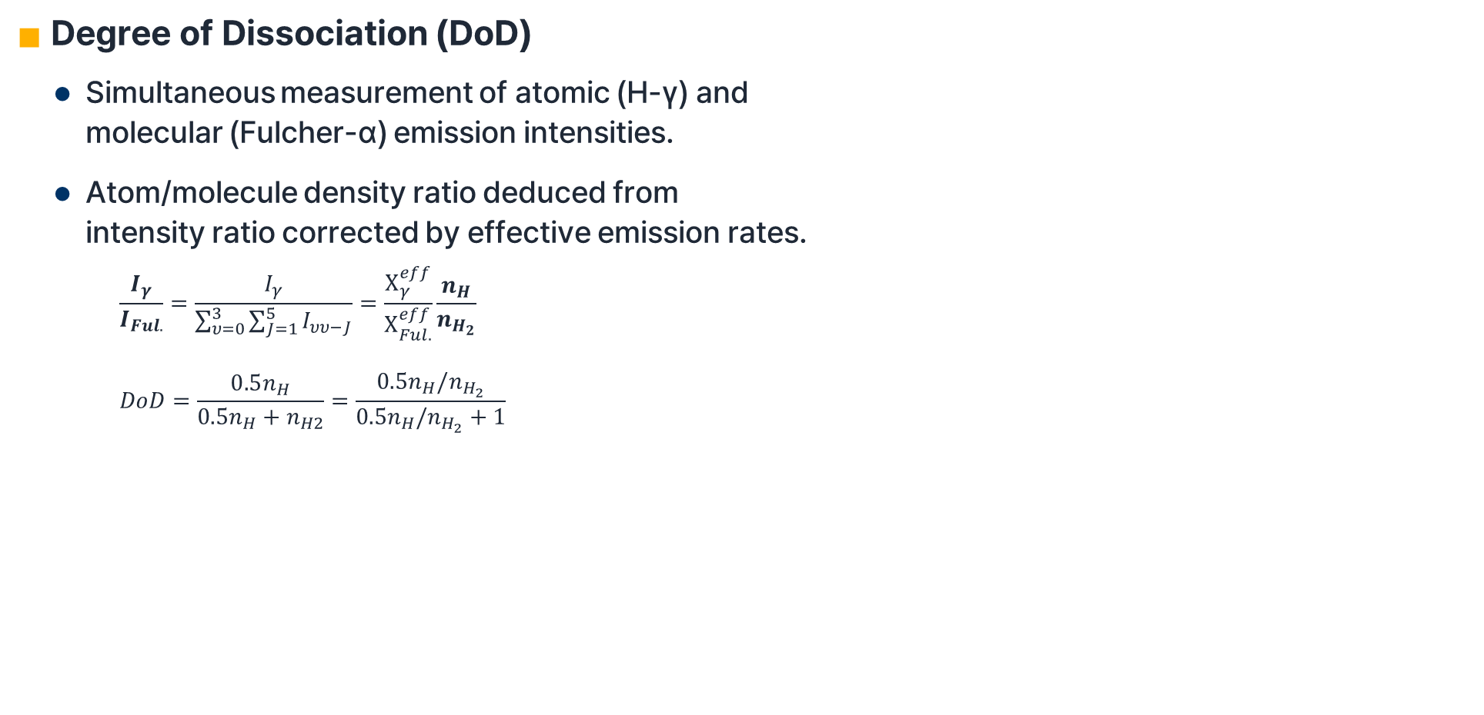
Other Parameters from Fulcher-α
Optical and Laser Diagnostics for the SNU H- Source
Degree of Dissociation (DoD)
  Simultaneous measurement of atomic (H-γ) and
  molecular (Fulcher-α) emission intensities.
  Atom/molecule density ratio deduced from
  intensity ratio corrected by effective emission rates.
      $$\frac{I_{γ}}{I_{Ful.}}=\frac{I_{γ}}{\sum_{υ=0}^{3}{\sum_{J=1}^{5}{I_{υυ−J}}}}=\frac{Χ_{γ}^{eff}}{Χ_{Ful.}^{eff}}\frac{n_{H}}{n_{H_{2}}}$$
      $$DoD=\frac{0.5n_{H}}{0.5n_{H}+n_{H2}}=\frac{0.5n_{H}/n_{H_{2}}}{0.5n_{H}/n_{H_{2}}+1}$$
U. Fantz et al., Nucl. Fusion 46 (2006), S297

Slide 13
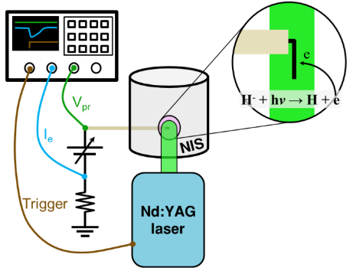
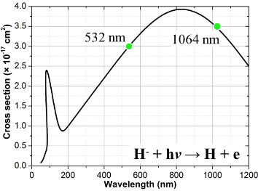
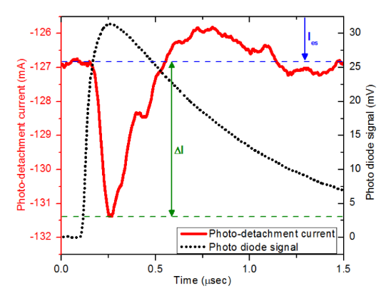
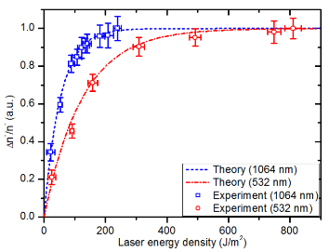
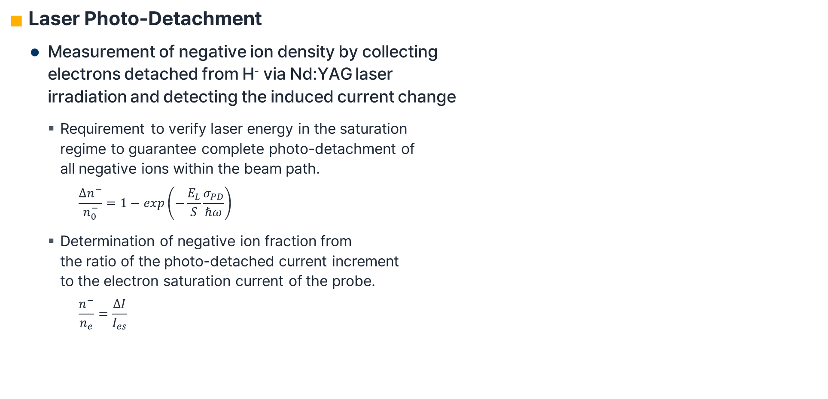
Negative Ion Density Measurement
Optical and Laser Diagnostics for the SNU H- Source
Laser Photo-Detachment
  Measurement of negative ion density by collecting
  electrons detached from H⁻ via Nd:YAG laser
  irradiation and detecting the induced current change
    Requirement to verify laser energy in the saturation
    regime to guarantee complete photo-detachment of
    all negative ions within the beam path.
      $$\frac{Δn^{−}}{n_{0}^{−}}=1−exp\left(−\frac{E_{L}}{S}\frac{σ_{PD}}{ℏω}\right)$$
    Determination of negative ion fraction from
    the ratio of the photo-detached current increment
    to the electron saturation current of the probe.
      $$\frac{n^{−}}{n_{e}}=\frac{ΔI}{I_{es}}$$

Slide 14
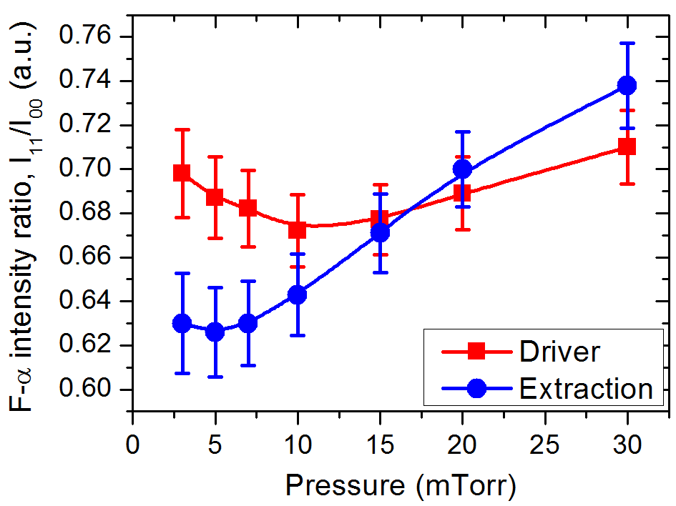
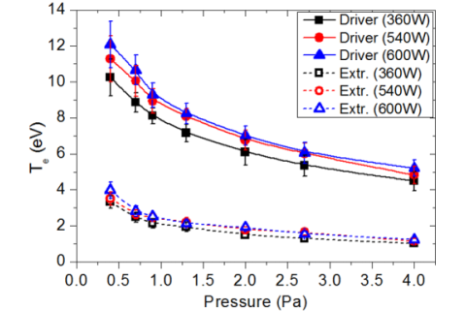
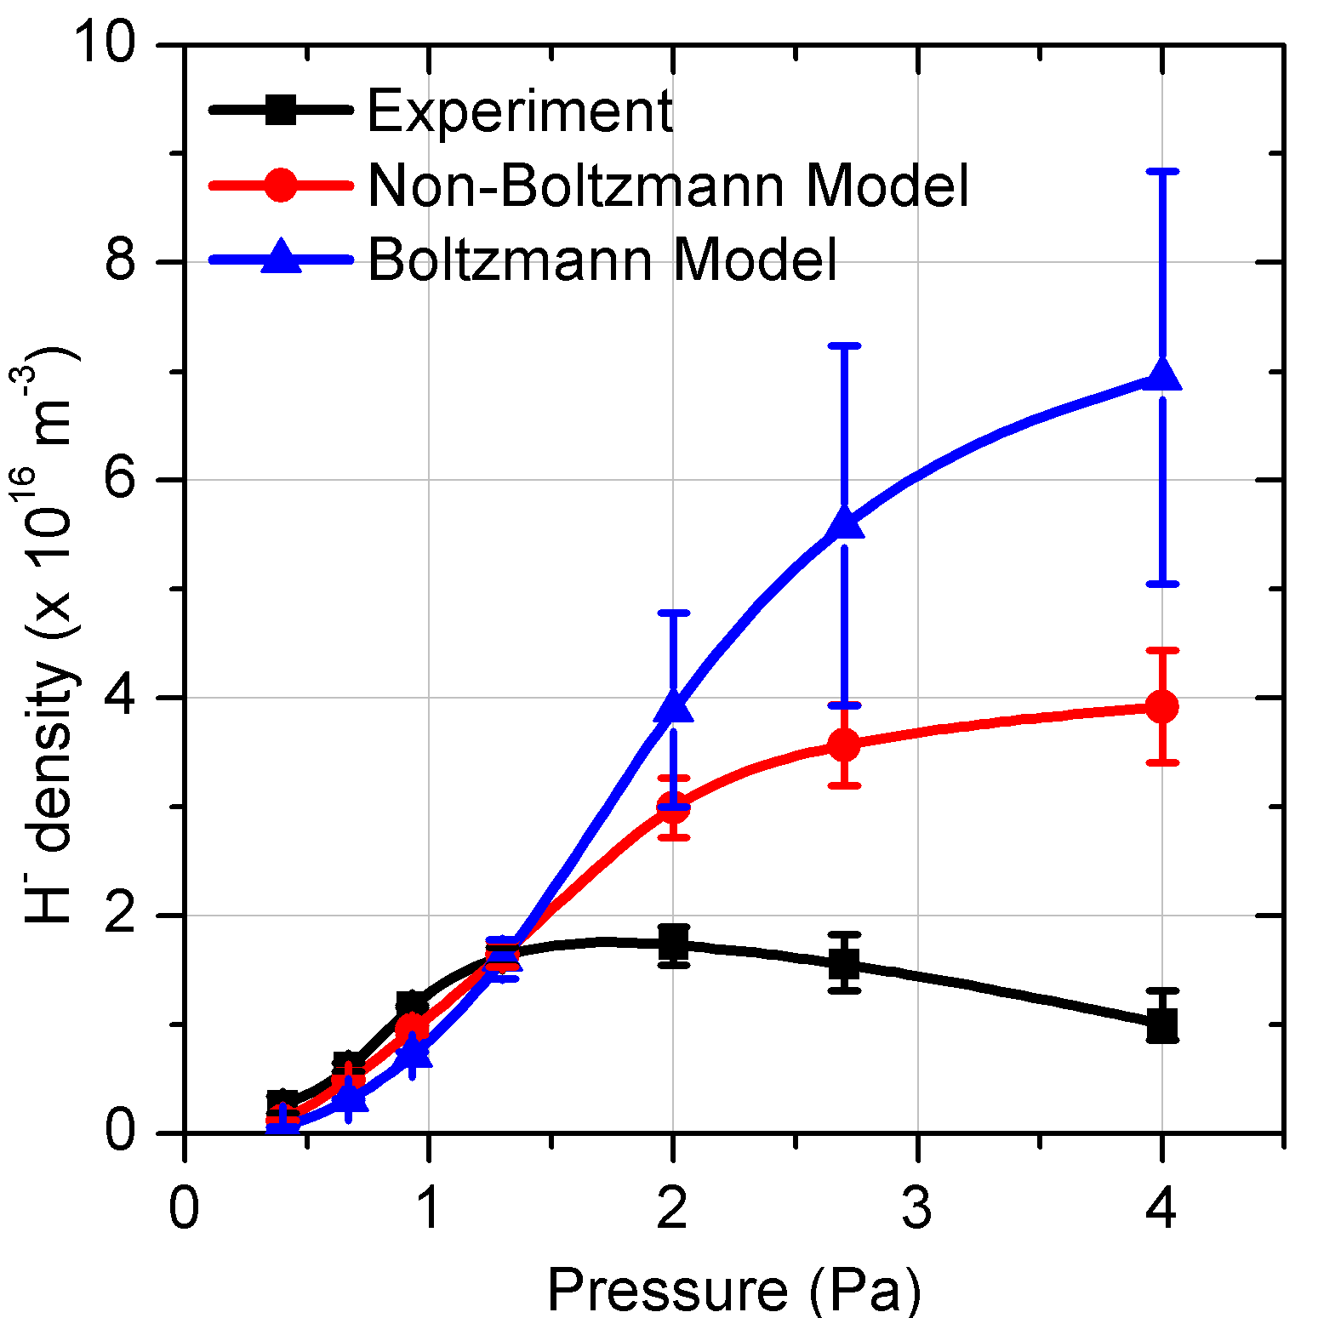
Motivation for Simulation Study
Recent Work on Novel H⁻ Source Concepts
Contradiction of Diagnostic Results and Limitation of 0-D Model for VDF
  Contradictions in Fulcher-α diagnostics assuming a Boltzmann distribution (e.g., higher vibrational
  temperature in the low-T_{e} extraction region), requiring a non-Boltzmann VDF treatment.
  Inability of the zero-dimensional (0-D) model to accurately reproduce the exact
  negative ion density peak at specific pressures, resulting in overestimation at high pressure regimes.
  Requirement for an integrated 1-D transport model coupling the generation of
  vibrationally excited molecules in the driver region with their collisional relaxation
  during transport to accurately evaluate the local VDF and negative ion density.
T_{vib}

Slide 15
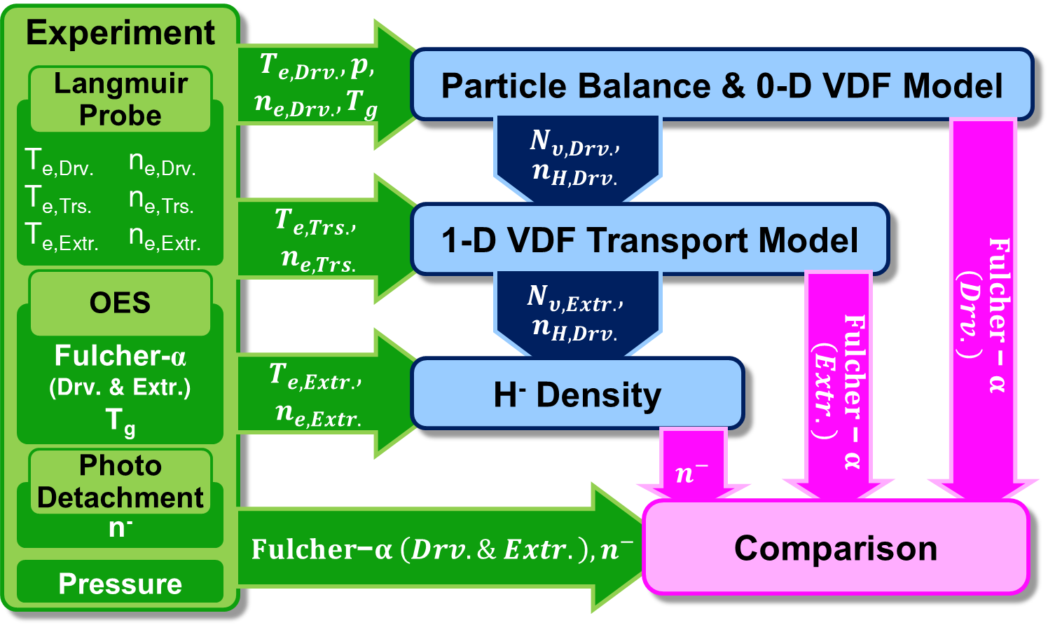
Self-Consistent 1-D Model for NIS

Slide 16























List of Processes in Model
Recent Work on Novel H⁻ Source Concepts
$$H+e→H^{+}+2e$$
$$H_{2}\left(υ\right)+e→H_{2}^{−}→e+H_{2}\left(υ^{′}\right)$$
$$H^{+}+e→H+hν$$
$$H_{2}\left(υ\right)+e→H_{2}\left(B^{1}Σ_{u}^{+},C^{1}Π_{u}\right)+e→H_{2}\left(υ^{′}\right)+e+hν$$
$$H^{+}+2e→H+e$$
$$H_{2}\left(υ\right)+e→H_{2}^{−}→H+H^{−}$$
$$H_{2}^{+}+e→H+H^{+}+e$$
$$H_{2}\left(υ\right)+e→2H+e$$
$$H_{2}^{+}+e→2H$$
$$H_{2}\left(υ\right)+e→H_{2}^{+}+2e$$
$$H_{2}^{+}+e→2H^{+}+2e$$
$$H_{2}\left(υ\right)+e→H+H^{+}+2e$$
$$H_{3}^{+}+e→H_{2}+H or 3H$$
$$H_{2}\left(υ\right)+e→H_{2}\left(B,B^{′},B^{″},C,D,D^{′}\right)+e$$
$$H_{3}^{+}+e→2H+H^{+}+e$$
$$H_{2}\left(υ\right)+H^{+}→H_{2}\left(υ^{′}\right)+H^{+}$$
$$H_{2}+H_{2}^{+}→H+H_{3}^{+}$$
$$H_{2}\left(υ\right)+H^{+}→H+H_{2}^{+}$$
$$H+wall→\frac{1}{2}H_{2}$$
$$H+H_{2}^{+}→H_{2}\left(υ\right)+H^{+}$$
$$H_{2}\left(υ\right)+H→H_{2}\left(υ−1\right)+H$$
$$H^{+}+wall→H$$
$$H_{2}\left(υ\right)+H_{2}\left(ω\right)→H_{2}\left(υ−1\right)+H_{2}\left(ω\right)$$
$$H_{2}^{+}+wall→H_{2}$$
$$H_{2}\left(υ\right)+H_{2}\left(ω\right)→H_{2}\left(υ+1\right)+H_{2}\left(ω−1\right)$$
$$H_{3}^{+}+wall→H_{2}+H$$
$$H_{2}\left(υ\right)+wall→H_{2}\left(υ^{′}\right)$$

Slide 17
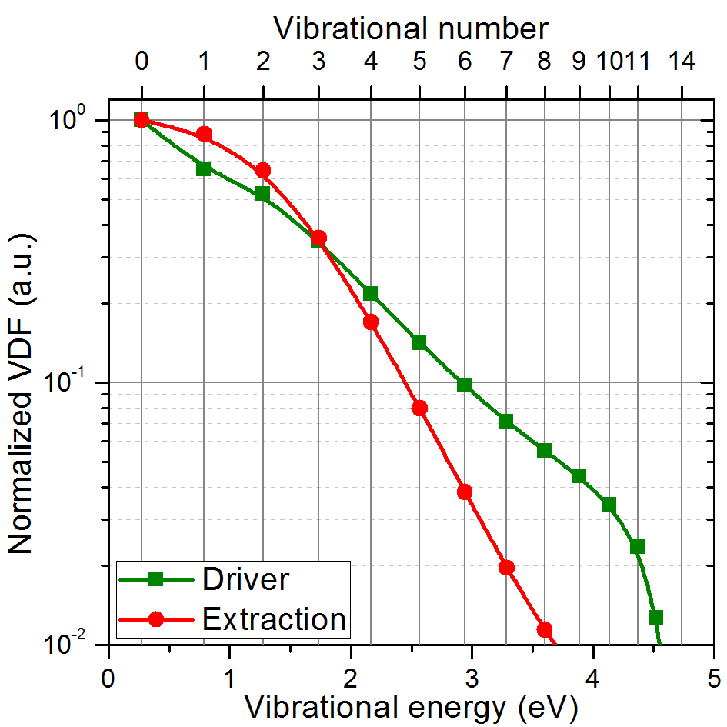
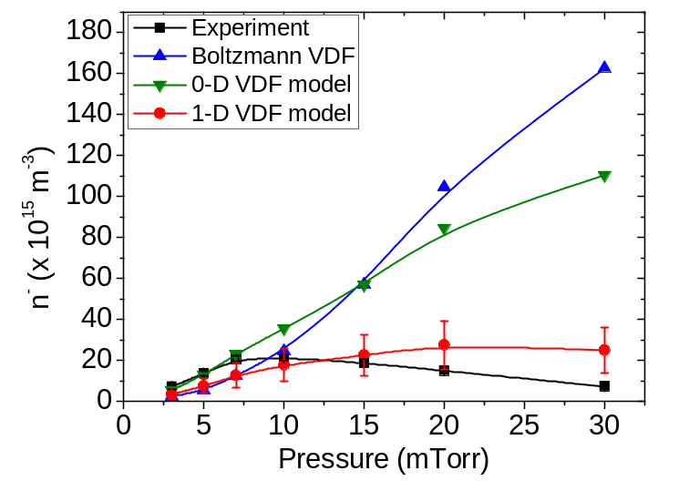
Key Results of Simulation
Recent Work on Novel H⁻ Source Concepts
Key Results of Simulation for Volume-Production NIS
  VDF Relaxation during Transport:
  Decay of highly vibrationally-excited molecules to lower states
  during transport from the driver to the extraction region.
  Dominant Collisional Quenching:
  Intensified VDF relaxation at high-pressure regimes driven by
  frequent vibrational-translational (V-T) energy transfer
  collisions with neutral particles.
  Correction of Overestimation:
  Successful correction of the negative ion density
  overestimation observed in 0-D model at high pressures.

Slide 18
Summary of Volume-Production NIS Study
Recent Work on Novel H⁻ Source Concepts
Mechanism of Optimum Pressure for H⁻ Production
  Low-Pressure Limitations:
  High electron temperature is favorable for generating vibrationally excited molecules in the driver region. However, the absolute H⁻ yield in the extraction region is restricted by lower plasma density and degraded dissociative attachment (DA) due to relatively high T_{e} at extraction region.
  High-Pressure Limitations:
  Higher operating pressure increases plasma density and lowers T_{e}, theoretically favoring the DA process. However, excessive pressure severely depletes the critical highly-excited precursor states during transport due to frequent V-T collisional quenching.
  Conclusion (Optimum Condition): The existence of an optimal pressure maximizing the absolute H⁻ density is determined by a physical trade-off balancing the availability of H₂ precursors and the mitigation of collisional VDF quenching, comprehensively validated by both experimental measurements and self-consistent 1-D modeling.

Slide 19
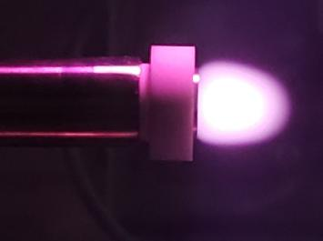
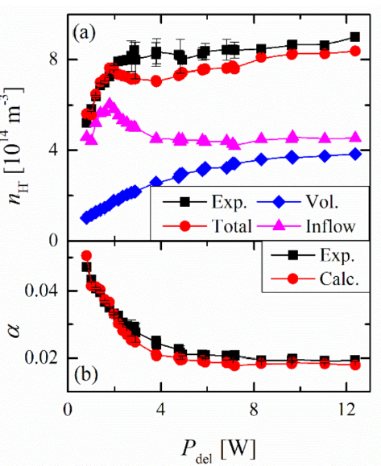
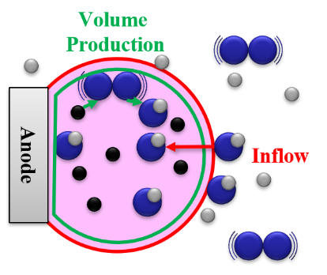
Confinement-Driven H⁻ Enhancement via Anode Spot
Recent Work on Novel H⁻ Source Concepts
High Density H⁻ Generation Mechanism
  Anode spot plasma: Generation of localized high n_{e} and T_{e} region via a positively biased electrode at low power.
  Volume-Production: Accelerated H₂(𝜐*) generation via elevated T_{e} , boosting internal H⁻ yield.
  Potential-Driven Inflow: A steep potential structure actively pulls in and traps surrounding H⁻ ions, dramatically boosting local density.
  Future Work: Optimization of operating conditions (e.g., pressure) and extraction geometries to harness as a practical ion source.
Jaeyoung Choi, et al., Plasma Sources Sci. Technol. 34 (2025) 025013

Slide 20
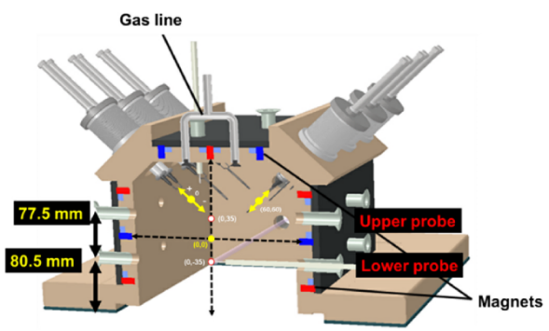
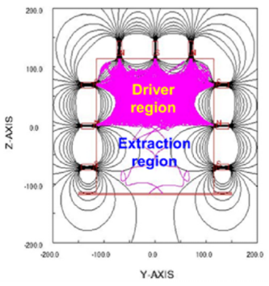
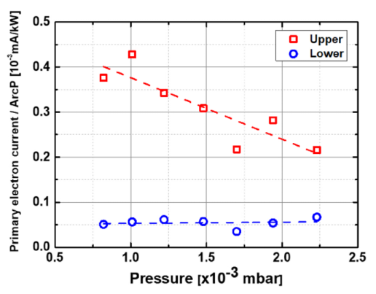
Two-Region Arc Plasma (TRAP) Ion Source
Recent Work on Novel H⁻ Source Concepts
Filter-Free Two-Region Separation
  TRAP Ion Source: DC arc-driven H⁻source developed by KAERI for NBI systems.
  Primary Electron Confinement: Shapes the magnetic field and adjusts movable filaments to strictly confine high-energy primary electrons within the upper chamber.
  Filter-Free Spatial Division: Achieves a hot driver and cold extraction region without a conventional transverse filter field, as only collisionally-cooled slow electrons flow downward.
  Future Work: Reinforcing negative ion diagnostics and developing comprehensive numerical models to understand primary electron behavior and the H⁻ production mechanisms.
Kihyun Lee, et al., Nucl. Eng. Technol. 56 (2024) 3961–3968

Slide 21
Summary
Summary
Summary of SNU H⁻ Source Research & Recent Novel Concepts
  RF-TCP SNU H- Source: External antenna setup for contamination-free, long-lifetime CW operation based on a volume-production design.
  Diagnostics System: Langmuir Probe, Fulcher-α OES (VDF, T_{gas}, DoD), and Laser Photo-Detachment (H⁻ density)
  1-D VDF Transport Model
    Developed to overcome the 0-D model's overestimation of H⁻ density at high pressures.
    Incorporates the collisional relaxation of VDF during transport from the driver to the extraction region, showing high agreement with H⁻ density measurements.
  Recent Novel Concepts
    Anode Spot (SNU): Utilizes local double-layer potential to induce inflow and maximize H⁻ density.
    TRAP Ion Source (KAERI): A novel arc ion source that physically separates regions using
    optimized magnetic field structures and movable filament placement.

Slide 22
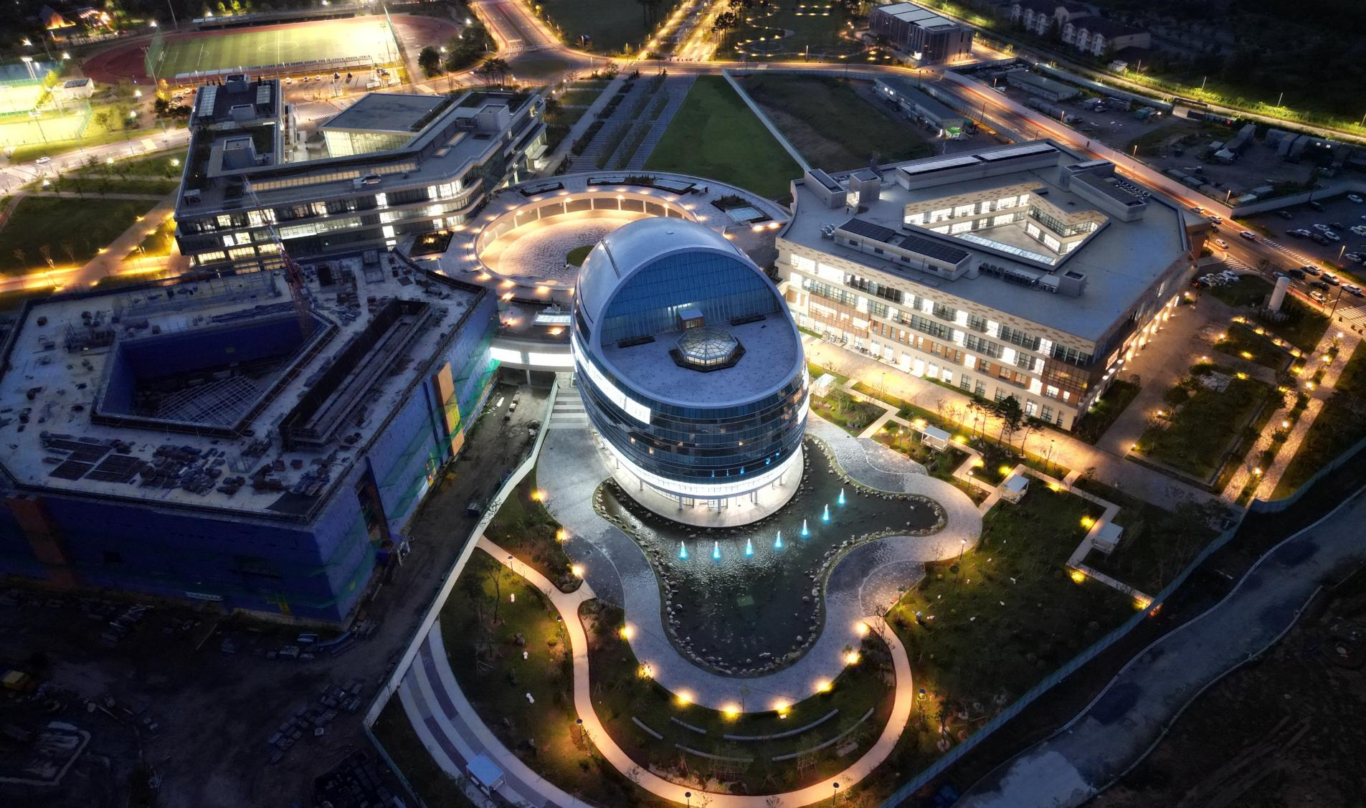

10th International symposium on Negative Ions, Beams and Sources - NIBS'26
Thank You for Your Attention
Jeong-Jeung Dang
Department of Energy Engineering, KENTECH
Fusion pLASma Heating lab. (FLASH)
jjdang@kentech.ac.kr

